Slide 1
Morphological Operations
IF221126 Digital Image Processing
Zulhaj Aliansyah
2025-12-03

Slide 2
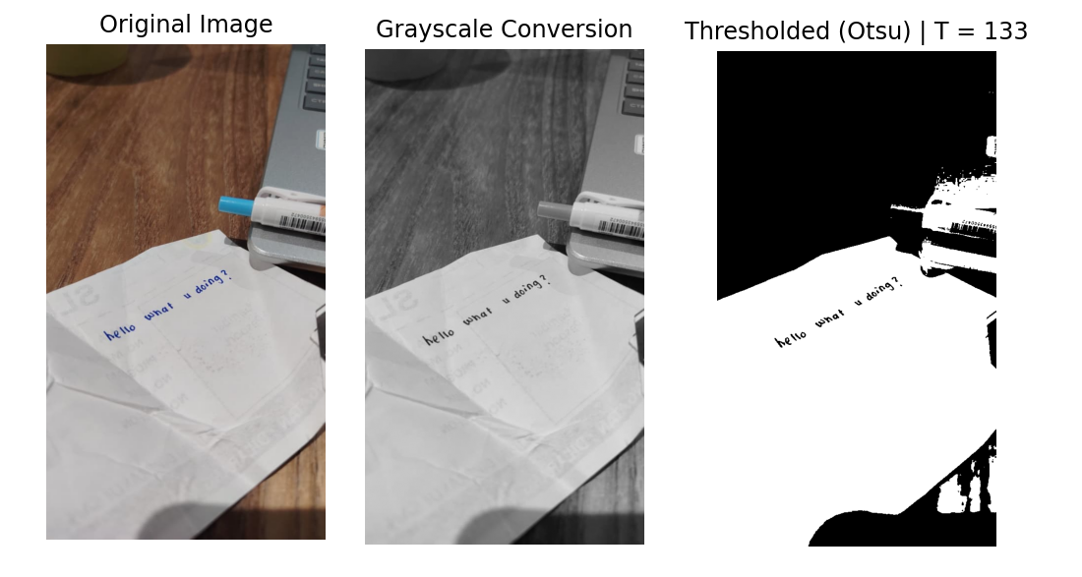
Recap: acquired information
works well when the information is clear (the handwriting),
but complex scene is hard to make out the details from (is it pen? laptop?)

Slide 3
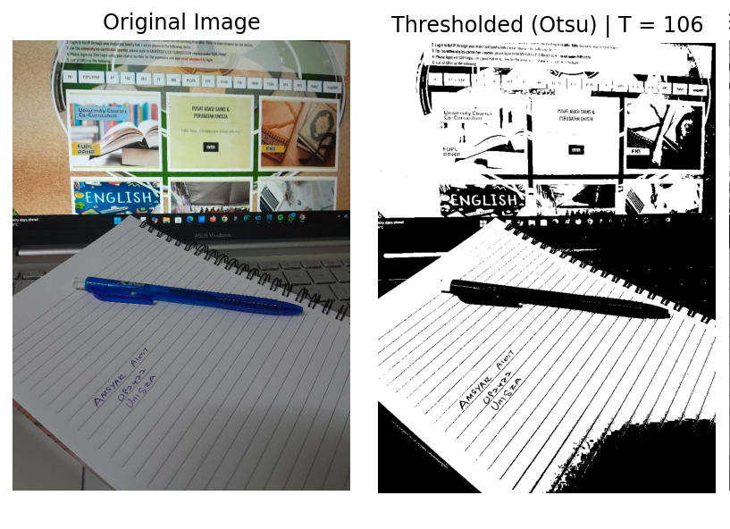
Recap: the lines
unwanted feature (the lines) is extracted along the intended information (handwriting)

Slide 4

Attendance List
Attendance List "Digital Image Processing" 2025-12-10
Link: https://forms.gle/88JrpTiLDJZxtg9e7
I am sorry for the asynchronous setting of the class
Please fill in the attendance 2025-12-16 Noon Malaysia time.

Slide 5
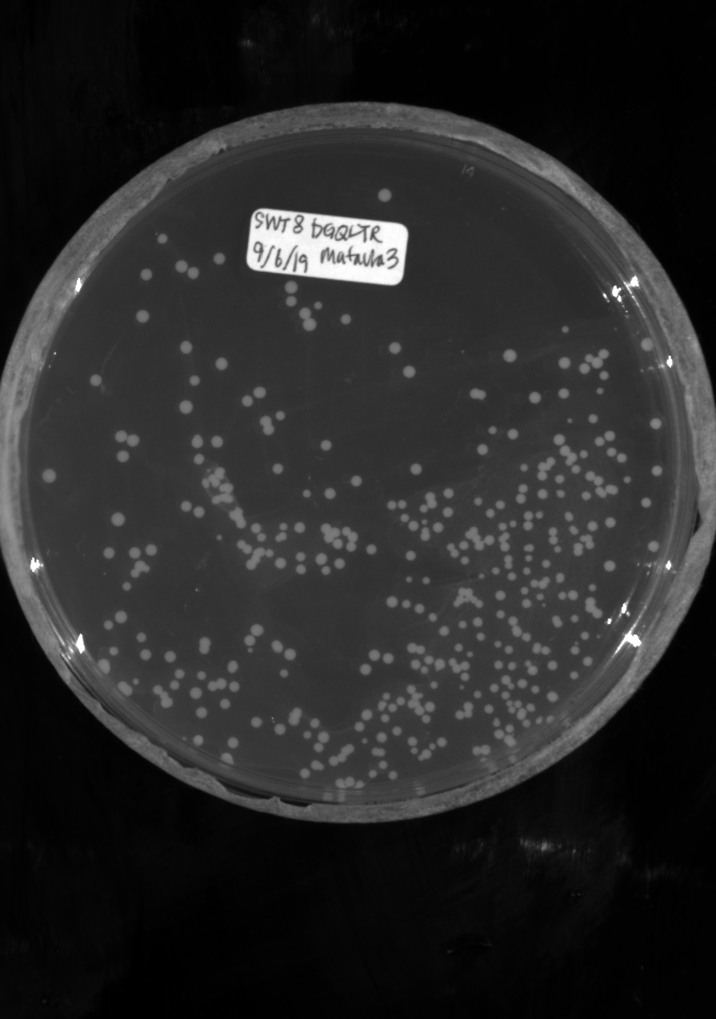
Use case: count many cells?
Bacteria Colony Counting Based on Machine Learning Algorithms
Jihyun Park, Edward Bateh, Jackson Harmon, Yang Zhang, Weiyao Tang
https://tang111111.github.io/ColonyCountingML/images/generated_images.jpg
Machine learning can be too fancy at times.
Exact count may not be necessary, ballpark guess is not quite satisfactory.
We need educated-based estimate.

Slide 6
Considerations
Observations:
The [bacterial] cell colonies are round, white
Slight brighter whitish background around the colonies (allelopathic network)
Sizes can be a bit varying (slightly smaller/bigger)
any else?
Concerns:
The bacteria can be densely populated at times; resulting in possible overlapping, touching, merged cell colonies
We won’t need the area of the petri dish rim, but the rim is quite as white at the cells; thus needs to be masked out

Slide 7
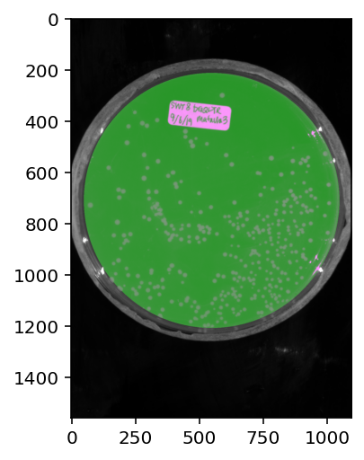
Apply circular mask
cx, cy = w // 2, h // 2-70
radius = min(cx, cy) - 50 # adjust offset here
mask = Image.new("L", (w, h), 0)
draw = ImageDraw.Draw(mask)
draw.ellipse(
(cx - radius, cy - radius, cx + radius, cy + radius),
fill=255
)

Slide 8
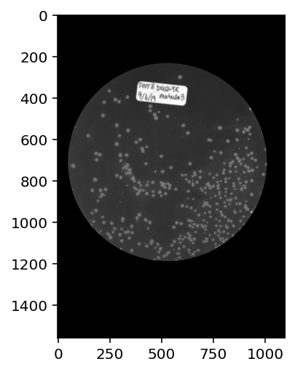

Obtain the object table
img_np = np.array(img)
mask_np = np.array(mask) > 0 # boolean mask
masked_img = img_np * mask_np[..., None]
Then we are going to mask out the label, too.

Slide 9
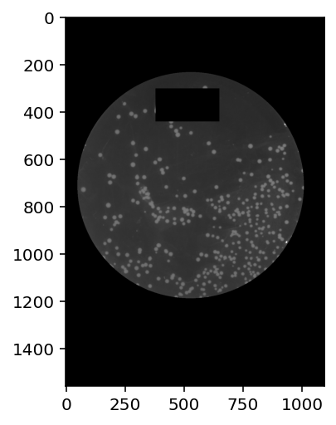
Obtain the object table
label_x0, label_y0 = 380, 300 # top-left
label_x1, label_y1 = 650, 440 # bottom-right
mask_label = np.ones((h, w), dtype=np.uint8)
mask_label[label_y0:label_y1, label_x0:label_x1] = 0
masked_img = masked_img * mask_label[..., None]

Slide 10
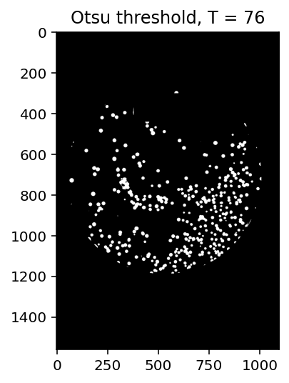
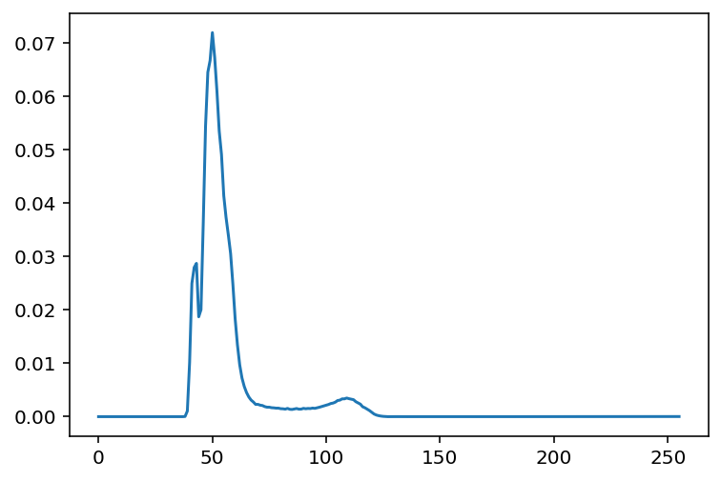
hist, _ = np.histogram(
gray, bins=256, range=(1, 255) # 0 bears no information
)
hist = hist.astype(float)
hist /= hist.sum()
omega = np.cumsum(hist)
mu = np.cumsum(hist * np.arange(256))
mu_t = mu[-1]
sigma_b2 = (mu_t * omega - mu)**2 / (omega * (1 - omega) + 1e-12)
otsu_thresh = np.argmax(sigma_b2)
otsu = np.zeros_like(gray, dtype=np.uint8)
otsu [(gray >= otsu_thresh)] = 1

Slide 11
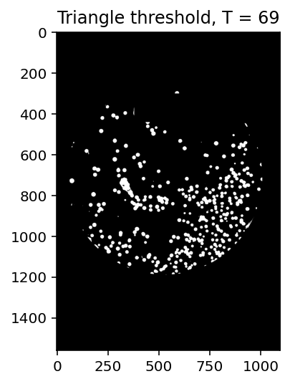
peak = np.argmax(hist)
end = np.max(np.nonzero(hist)) # last non-zero bin (end of tail)
# Construct line between peak and end
x = np.arange(peak, end + 1)
y = hist[peak:end + 1]
line = np.linspace(hist[peak], hist[end], len(x))
# Maximum distance from line
triangle_thresh = x[np.argmax(np.abs(y - line))]
tri = np.zeros_like(gray, dtype=np.uint8)
tri [(gray >= triangle_thresh)] = 1
plt.imshow(tri, cmap='gray')
plt.title(f"Triangle threshold, T = {triangle_thresh}")

Slide 12
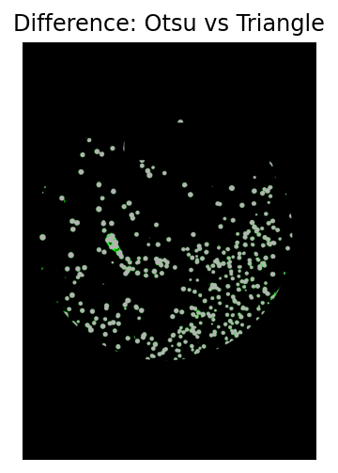
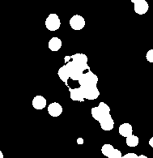

Both methods performs similarly.
Triangle threshold is more permissive.
Problematic areas persists.
Many blobs are conjoined.
We can either increase the threshold, often result in only marginally better detection.
Or apply morphological modification.

Slide 13


Morphological operator: erosion, dilation
Erosion: A pixel stays 1 only if all neighbors are 1
Dilation: A pixel becomes 1 if any neighbor is 1
Erosion>Dilation to ‘split objects/blobs’
def binary_erosion(img):
padded = pad_binary(img)
h, w = img.shape
neighbors = []
for dy in (-1, 0, 1):
for dx in (-1, 0, 1):
neighbors.append(
padded[1+dy : 1+dy+h, 1+dx : 1+dx+w]
)
# AND over all neighbors → min
eroded = np.logical_and.reduce(neighbors)
return eroded.astype(np.uint8)
def binary_dilation(img):
padded = pad_binary(img)
h, w = img.shape
neighbors = []
for dy in (-1, 0, 1):
for dx in (-1, 0, 1):
neighbors.append(
padded[1+dy : 1+dy+h, 1+dx : 1+dx+w]
)
# OR over neighbors → max
dilated = np.logical_or.reduce(neighbors)
return dilated.astype(np.uint8)

Slide 14
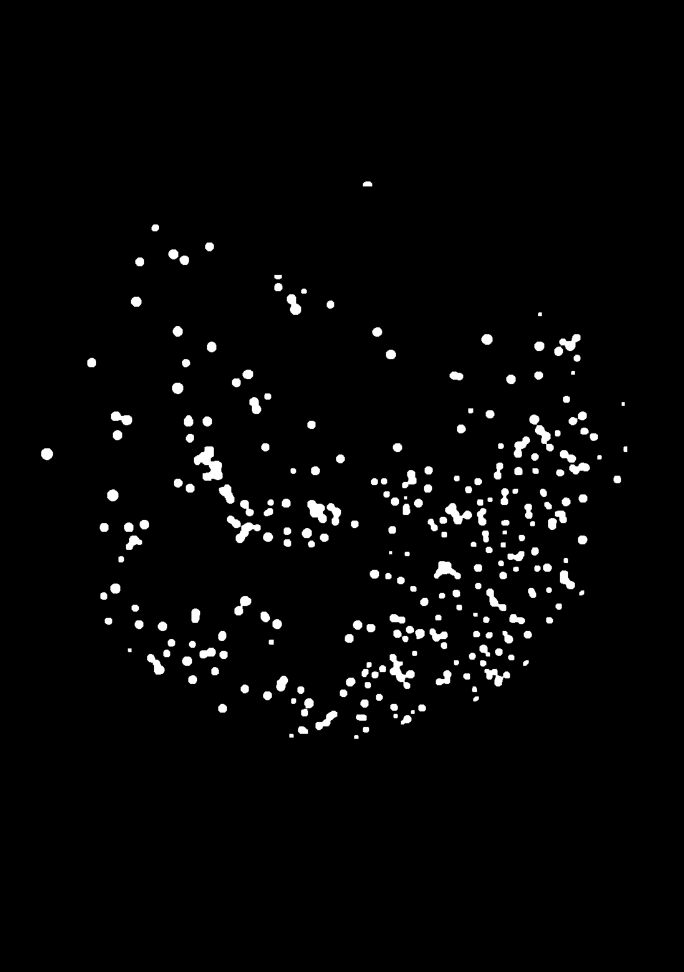
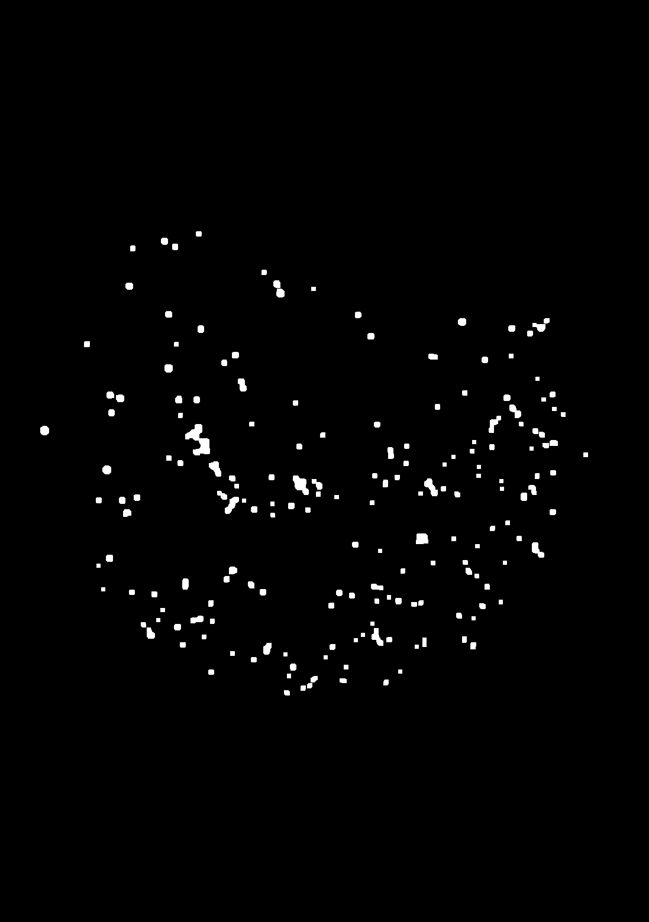
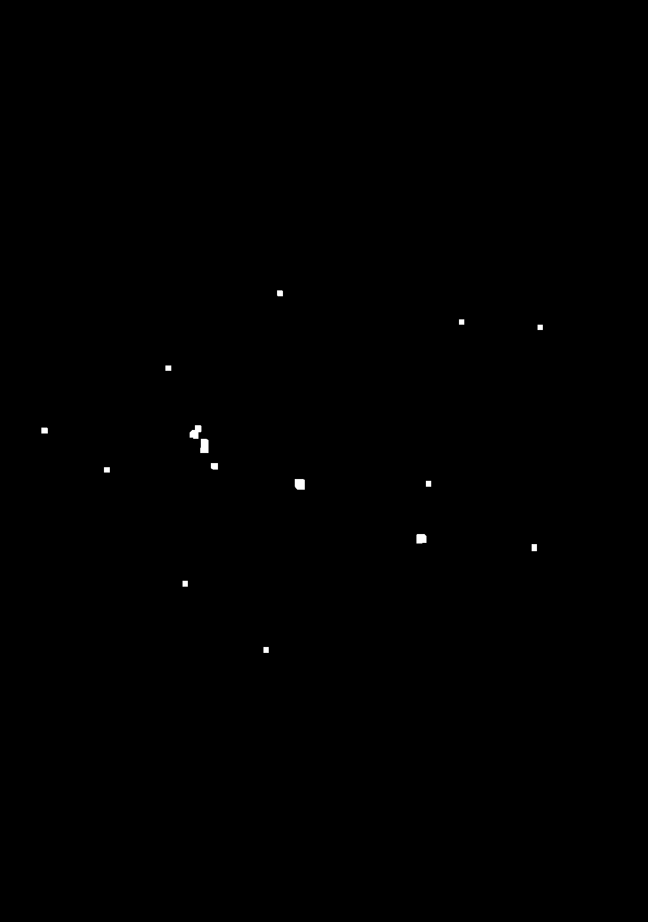
3E, 2D
5E, 2D
7E, 6D
Need to obtain proper amount of erosion and dilation to obtain meaningful improvement.
Too much erosion will lose data, too much dilation will result in blocky cell colonies.

Slide 15

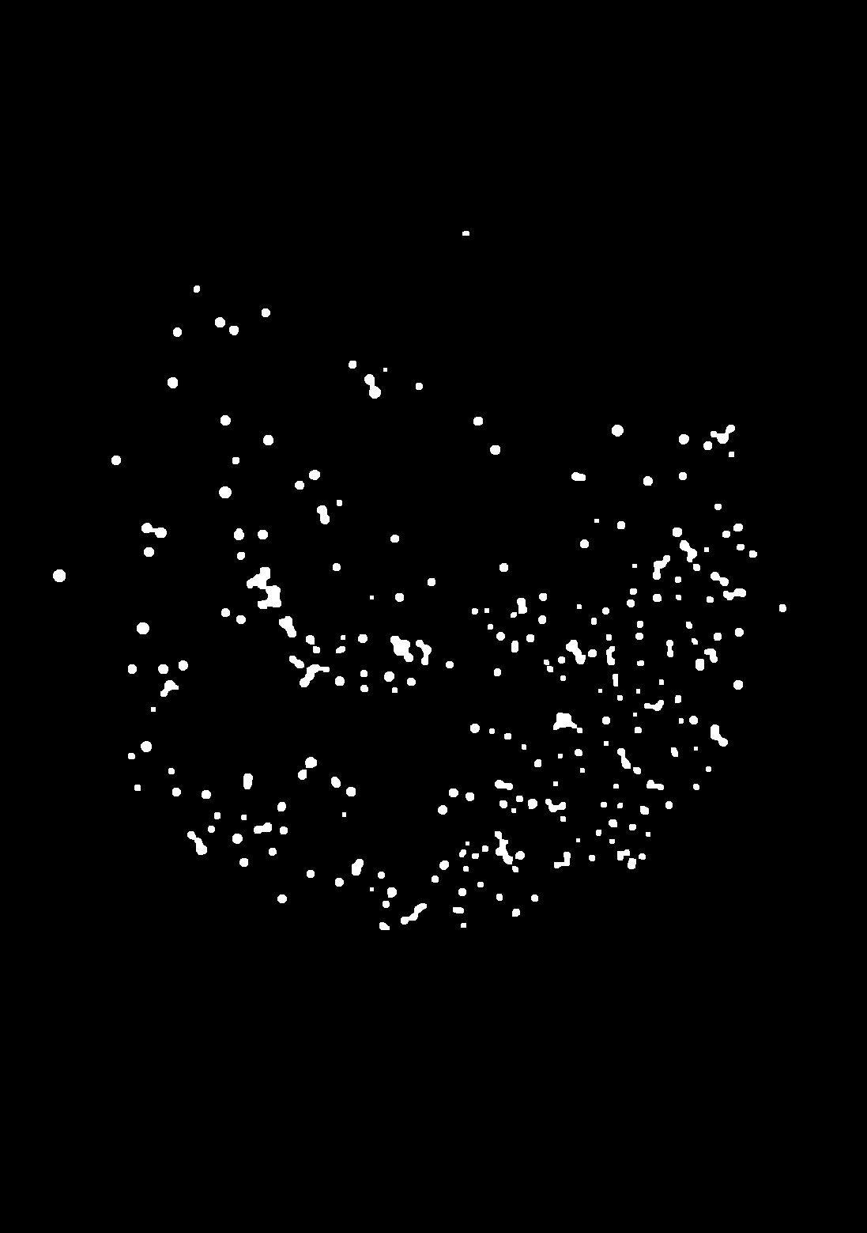
Counting the blob, connected component/flood fill
Otsu only
4E, 2D
Blob count: 259
Mean area: 246.14671814671814
Median area: 193.0
Blob count: 230
Mean area: 117.56521739130434
Median area: 89.0

Slide 16
What we did:
Proper thresholding give good starting point
Erosion/dilation to obtain slight improvement
Flood fill to count connected component

Slide 17
Assignment
Take a photo of densely packed small objects (coins, beans, grains, rice) using your phone with ample/good lighting (daylight is good, just be careful about the shadows and overexposure brightness).
Pre-process the image: convert to grayscale, apply suitable thresholding.
Segment the objects using morphological operations (erosion/dilation), watershed, iterative clustering, etc.
Count objects via connected-component labeling or contour detection.
Report your results, give brief explanation
Deadline: 2025-12-19 (Friday), 6 PM Malaysia time.

