Slide 1
Operations in Colorspace
Zulhaj Aliansyah
IF221126 Digital Image Processing

Slide 2
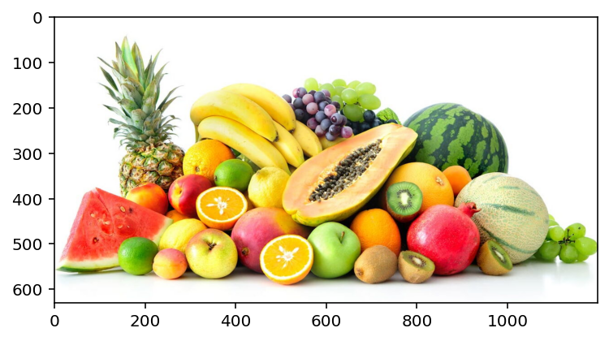
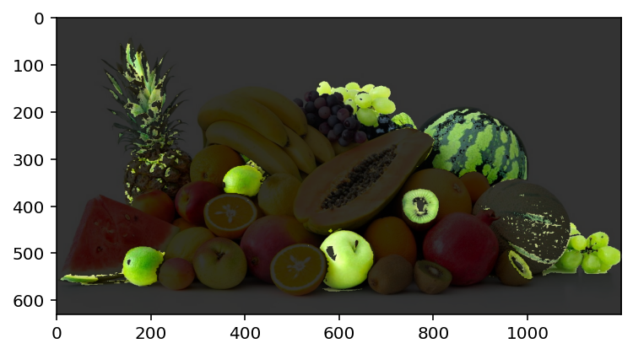
What to learn today
Loading images using matplotlib
Color space and the associated data structure
Brightness and contrast adjustment
Color segmentation (HSV)

Slide 3
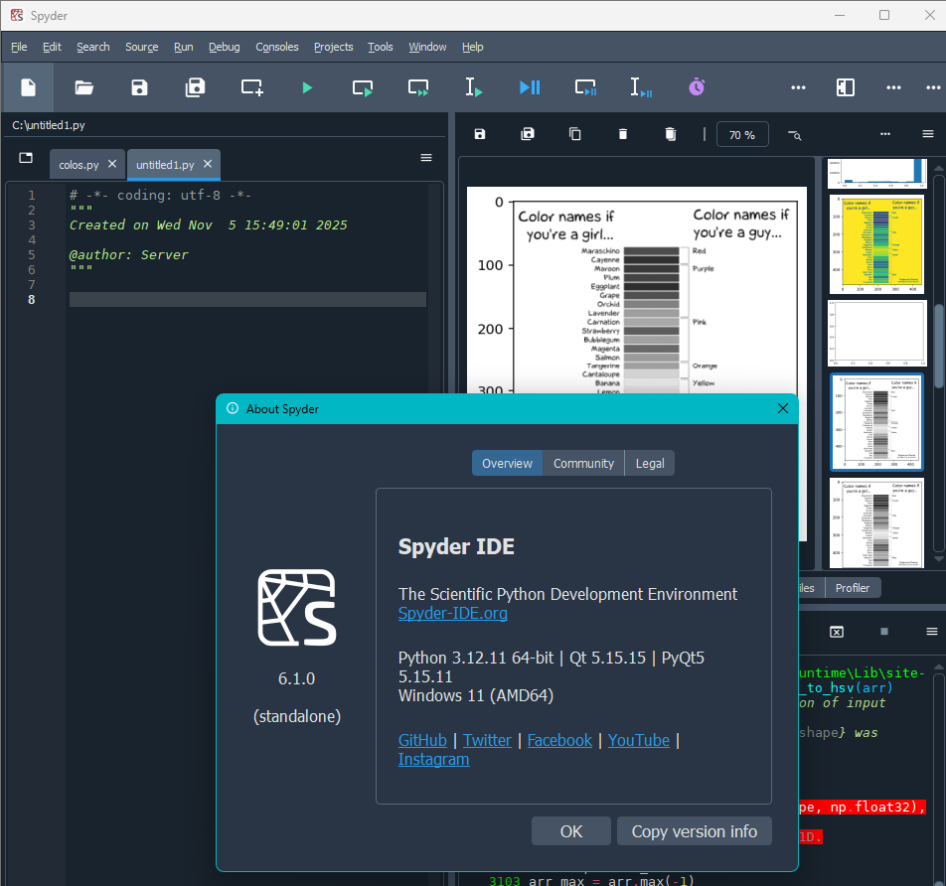
What to do today
Install Spyder IDE (6.1.0)
Learn some python basics on the fly
Code
Ask ChatGPT for suggestions 😀
Code (again)

Slide 4
Assignment
Find an image of your interest from the internet
Write a program to isolate object(s) of particular color
Highlight the object(s)
Send the python code (*.py) along with the images:
Recv: muhammad_zulhaj.sada@upnjatim.ac.id
Subject: UniSZA <your name> ASSIGN1 Highlight
Due 2025-11-12, 10:00 AM Malaysia time

Slide 5

Attendance List
Attendance List Digital Image Processing
05-11-2025
https://forms.gle/gHwmfbGH8iwMh81w5

