Slide 1
Pipelines of Functions
IF221126 Digital Image Processing
Zulhaj Aliansyah

Slide 2
Important Dates
Dec 24: project assignment announced, submission should be on github
Dec 31: project update, class will be held for consultative discussion session
Jan 3: project due: submit your python code (*.py *.ipynb) and input/output images and data. (late submission subject to significant deduction)
Jan 5: marks submitted to UPNVJT
Jan 7, 14, 21: presentations: each presentation will be peer evaluated
Jan 24: marks submitted to UNISZA (additional marks from presentation)

Slide 3

Github
Microsoft-hosted code sharing platform.
the very backend git is written by Linus Torvalds.

Slide 4
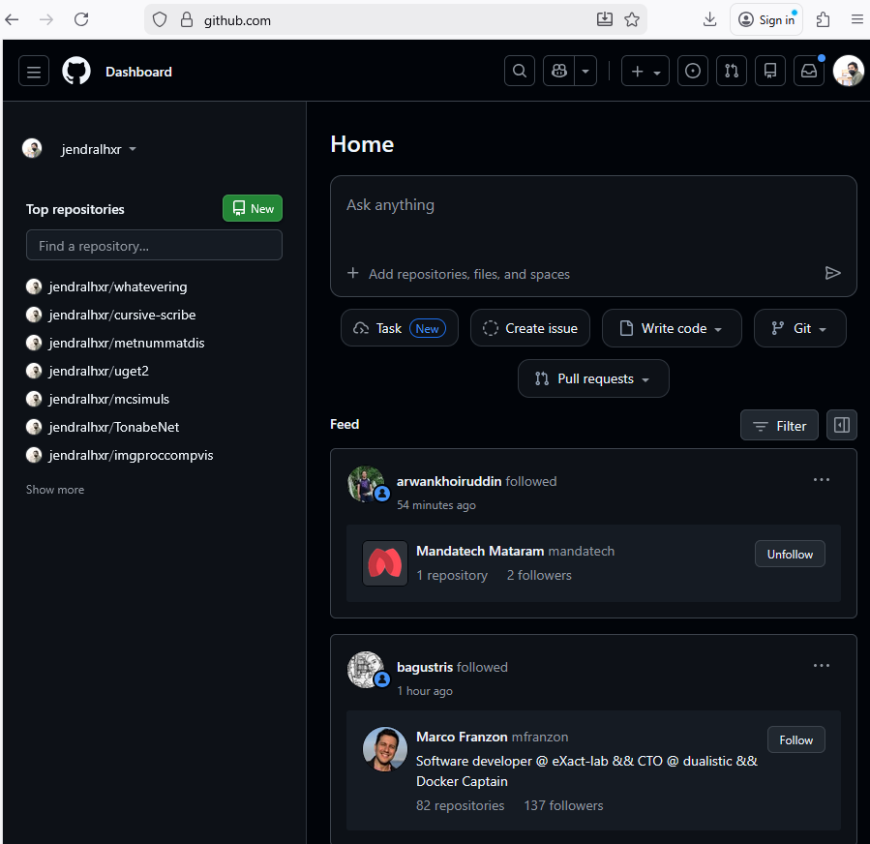
Github: facebook for code developers

Slide 5
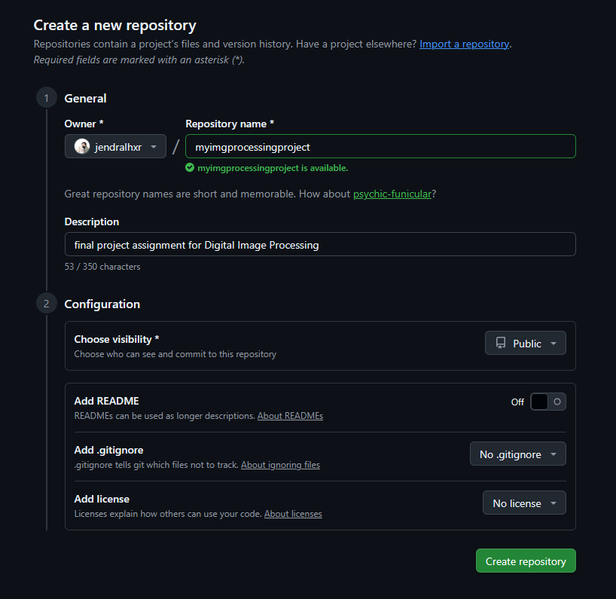
Github: code repository

Slide 6
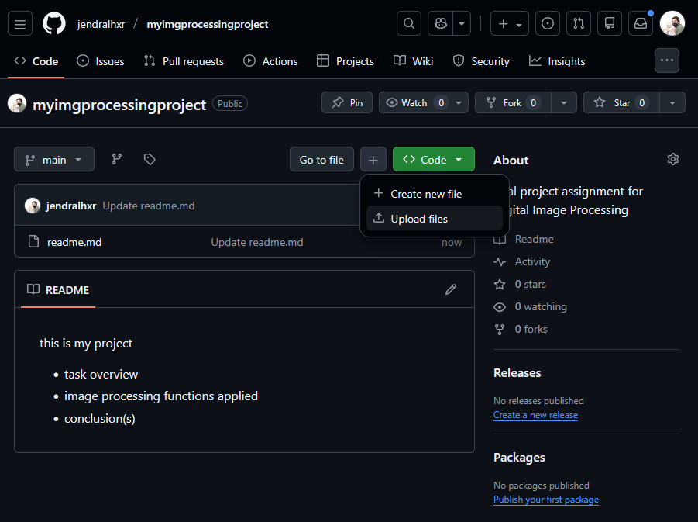
Github: upload/update files

Slide 7

Attendance List
Attendance List "Digital Image Processing" 24-12-2025
URL: https://forms.gle/Jz58dNnjixdtZTgV7

Slide 8
Work improvement

Slide 9
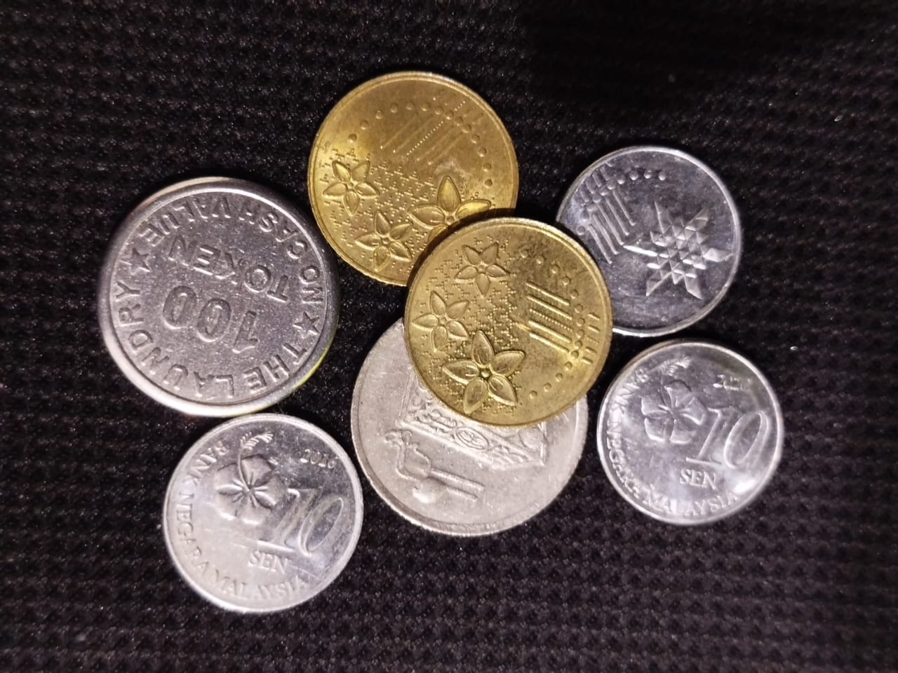
Original image

Slide 10
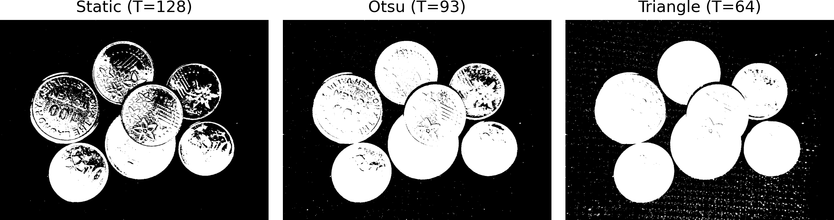

Slide 11
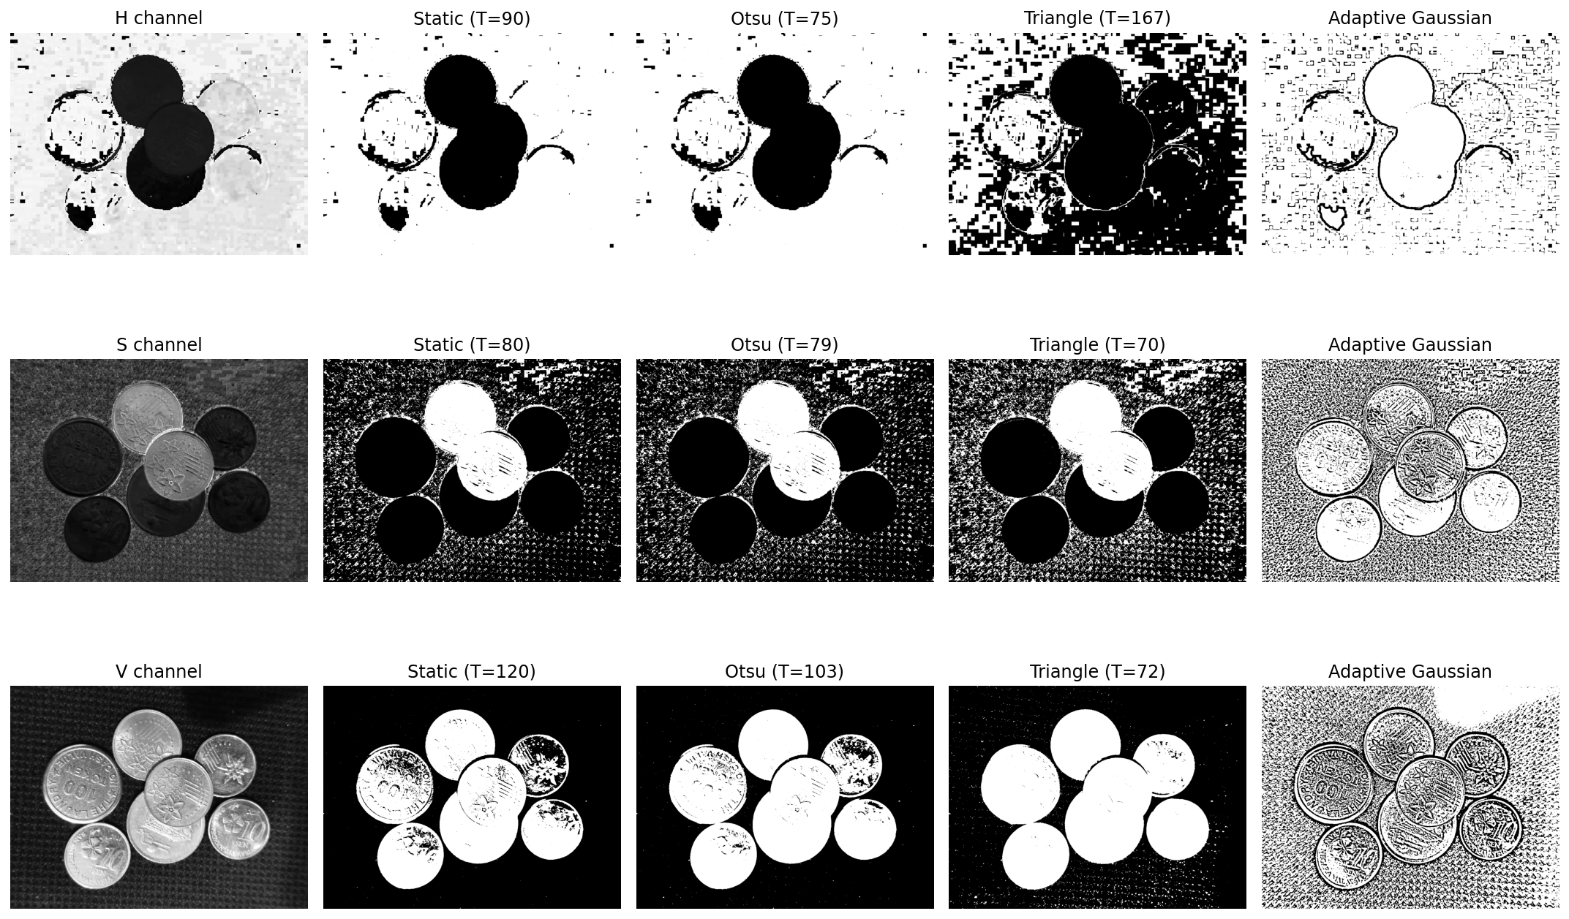

Slide 12
Our Plan
Triangle thresholding to obtain the face of the coins (white part)
may need to implement custom erosion (black speckles should be replaced with white if surrounded by white, else replaced with black if surrounded with more black pixels, i.e. majority rule erosion-dilation)
Edge detection to define the boundary of each coins
Distance transform to obtain the centroid of each coins (since the size is rather regular)
Notes:
Coin rims are visible
✖ Interiors are hollow / noisy
✖ Touching coins are not separated
✖ Edges cannot be filled reliably without topology
So:
Do NOT threshold edges
Do NOT try to fill by casual morphological operations

Slide 13
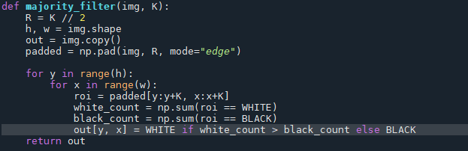
Majority Erosion-Dilation

Slide 14
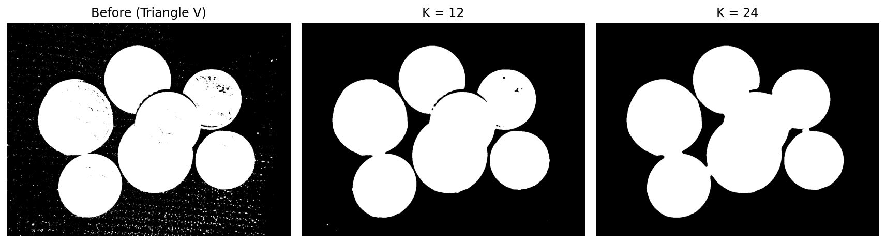
Majority Erosion-Dilation

Slide 15
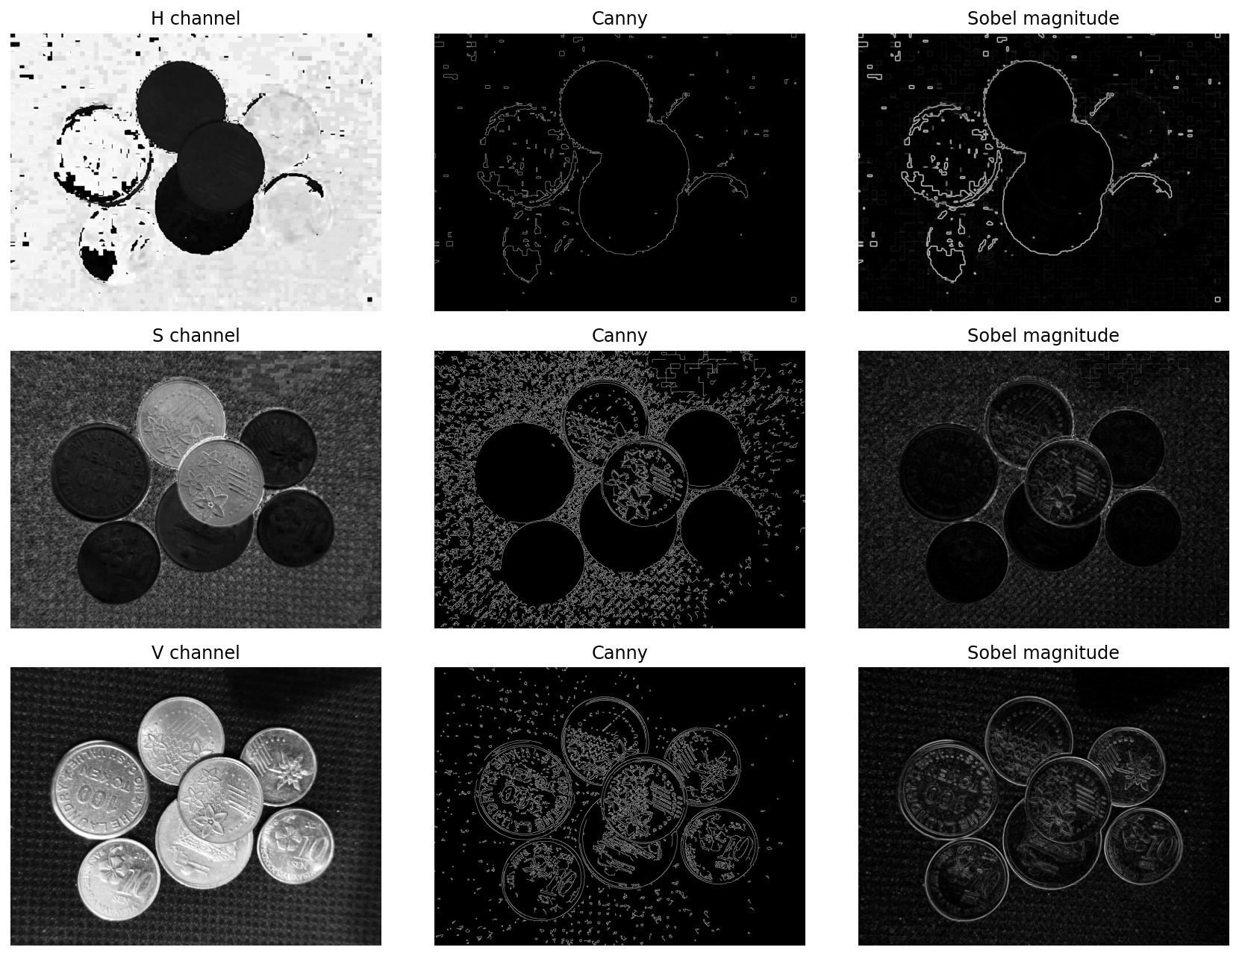
The Edges

Slide 16
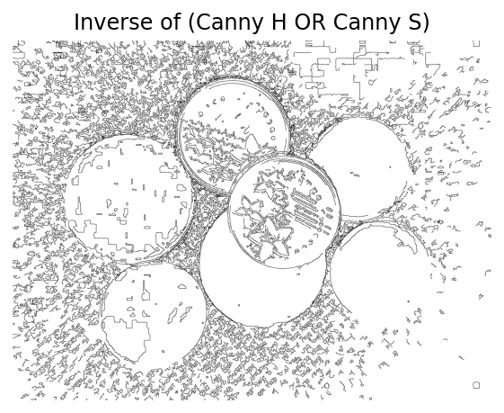
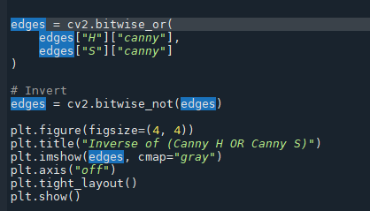

Slide 17
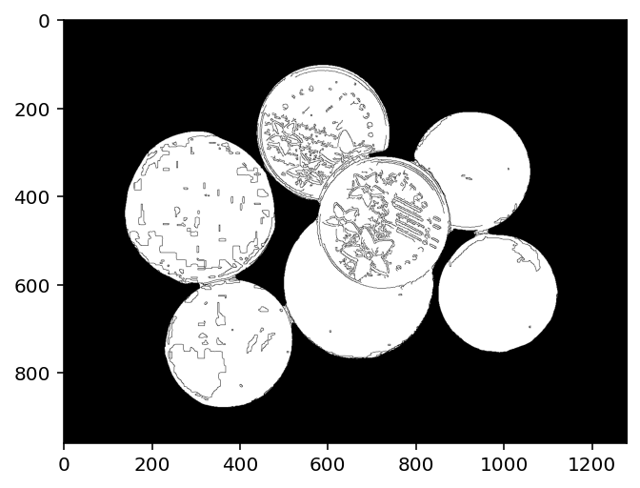


Slide 18
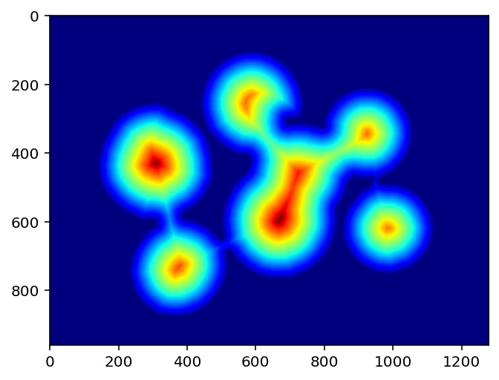
Distance Transform

Slide 19
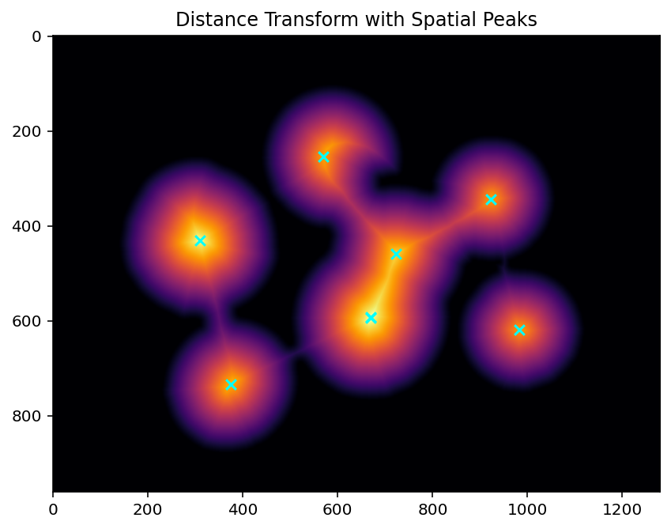


Slide 20
The assignment (due 2025-01-03)
Use image processing technique to do some task:
counting objects
segmenting object(s) from the background
highlighting object of particular interest
checking the regularity of shape/surface of some object
animation/art (but please keep it civil and relatable)
etc.
(even improving from previous assignment is totally okay)
Emphasis on the context of the problem.
Learn free (read: ask chatGPT and explore!)

