Slide 1
Image Data Structure
Zulhaj Aliansyah
IF221126 Digital Image Processing

Slide 2
Self-introduction
Muhammad Zulhaj Aliansyah
https://github.com/jendralhxr
Undergrad: major in Electrical Engineering major, minor Computer Engineering (parallel computer architecture)
Masters: Reconstruction of digitally-projected image with noise compensation
Doctoral: Infrastructure (bridge) structural movement/deformation measurement using digital image correlation
Post-doc: Structural health monitoring, Digitizing ancient/historic Jawi manuscript handwriting

Slide 3
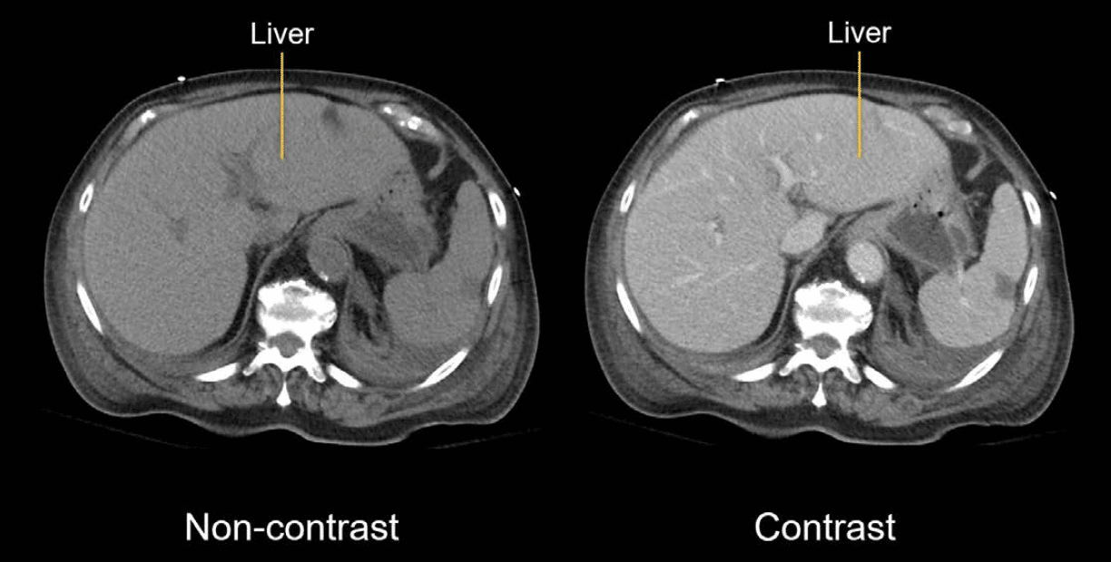
What is Digital Image Processing?
using computer algorithms and data structure to perform operations in order to retrieve, enhance, analyze, transform, or present digital images
Hartung and Brown. Jul 1, 2024. Abdominal CT: Basics https://litfl.com/abdominal-ct-basics/

Slide 4
What Digital Image Processing essentially is?
Converting image (either from light wavelength phenomena or other inherent data structure) into numerical form
Applying mathematical functions, often layered and convoluted to manipulate the image
(later) inferring candidate information from the image
Then, what image is?
2D function that represents intensity/value: f(x,y)
3D (e.g. time or z-axis depth) is just series of said 2D function

Slide 5
Image data structure: placement
Array of pixels (picture elements) within coordinate system
System | Y-Axis Direction | Origin (0,0) | Used In
Mathematical (Cartesian) Coordinate System | Upward ↑ | Bottom-left | Graphs, geometry, physics
Image Coordinate System (Raster/Grid) | Downward ↓ | Top-left | Digital images, computer graphics, screen displays

Slide 6
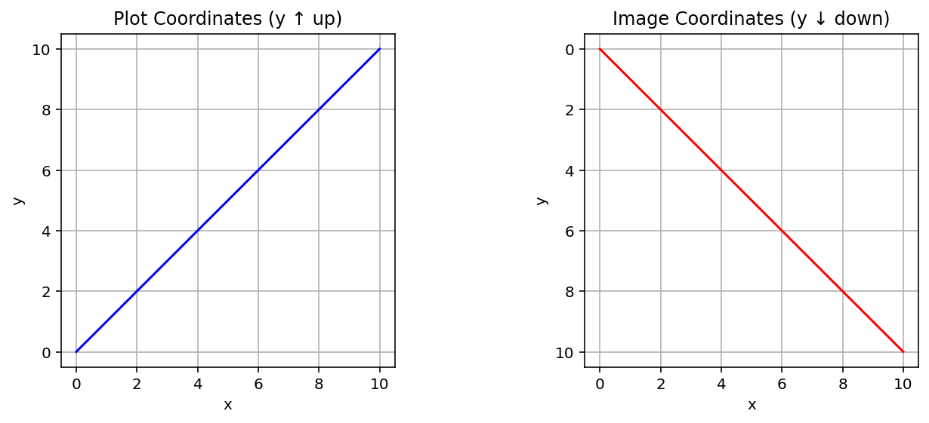
Image data structure: placement
y=x
y=x

Slide 7
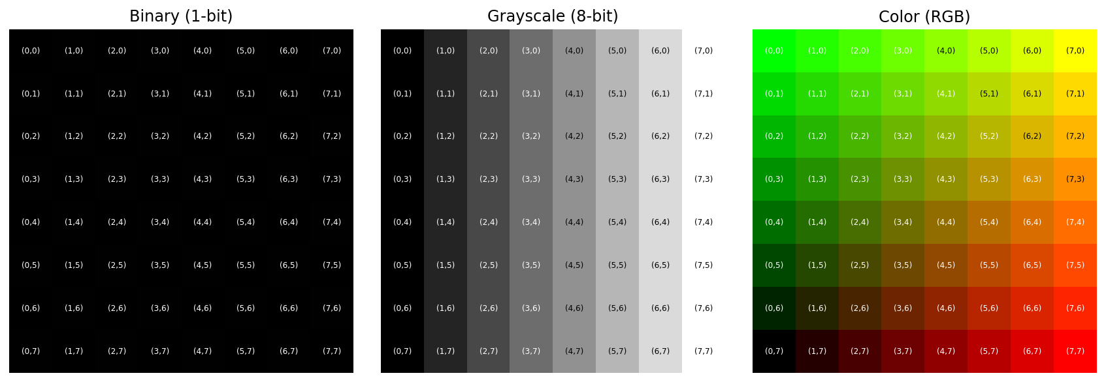
Pixel composition: denoting type of images
Binary (0 to 1)
Grayscale (0 to 255, typically 8-bit; higher resolution are also present)
Colors (RedGreenBue, HueSaturationValue, CyanMagentaYellowKroma, Bayer)

Slide 8
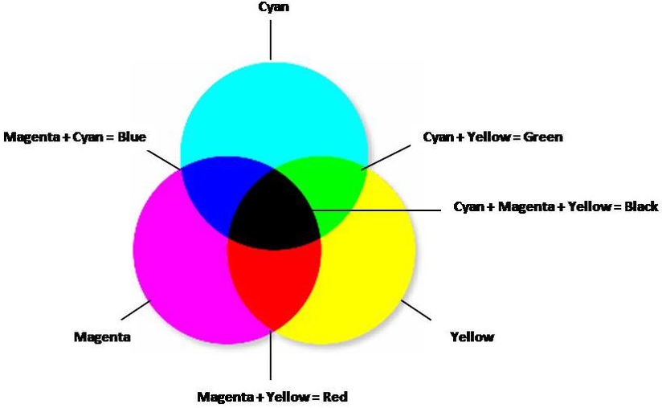
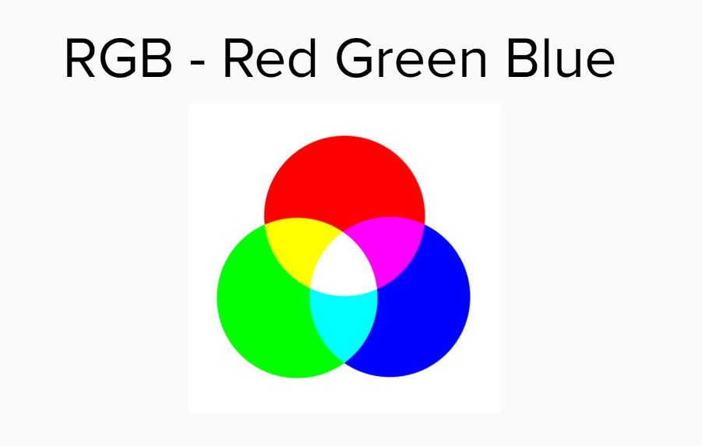
Color models
The most ubiquitous RGB
CMYK for printing
https://www.geeksforgeeks.org/computer-graphics/difference-between-rgb-cmyk-hsv-and-yiq-color-models/

Slide 9
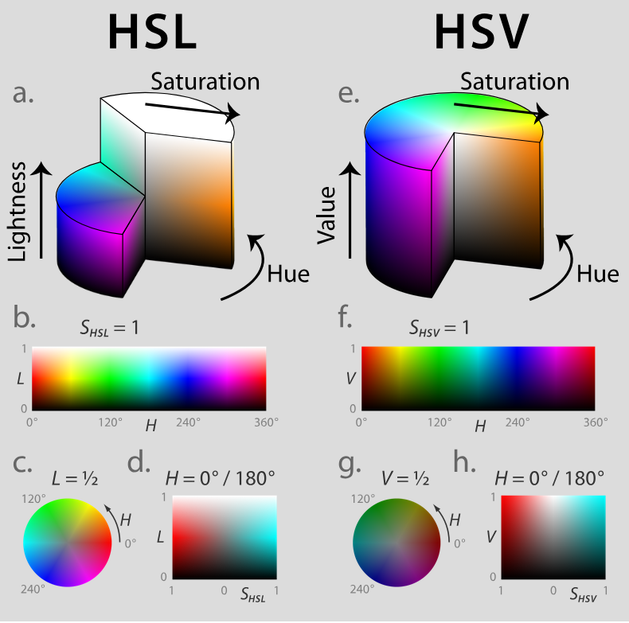
Color models: spectral continuity

Slide 10
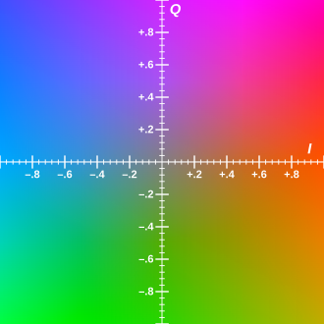
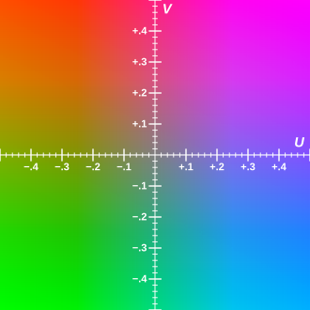
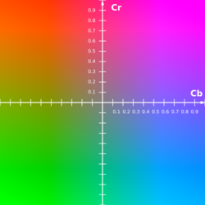
Color models: broadcasting transmission
Y=0.5
YIQ
YUV
Y’CbCr
Y is lightness (in monochrome television), as in grayscale

Slide 11
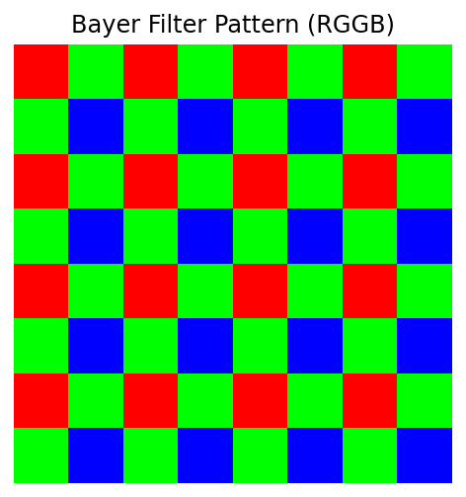
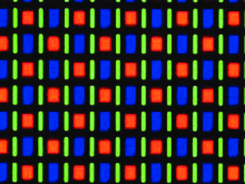
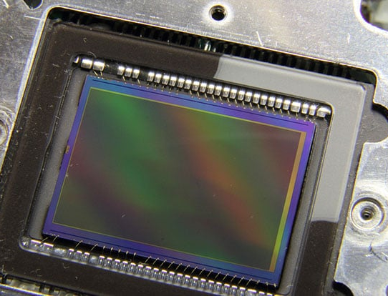
Color models: physical
AMOLED RGBG
https://ieeexplore.ieee.org/document/6799052/
Bayer
https://petapixel.com/2013/08/04/scratching-the-color-filter-array-layer-off-a-dslr-sensor-for-sharper-bw-photos/

Slide 12
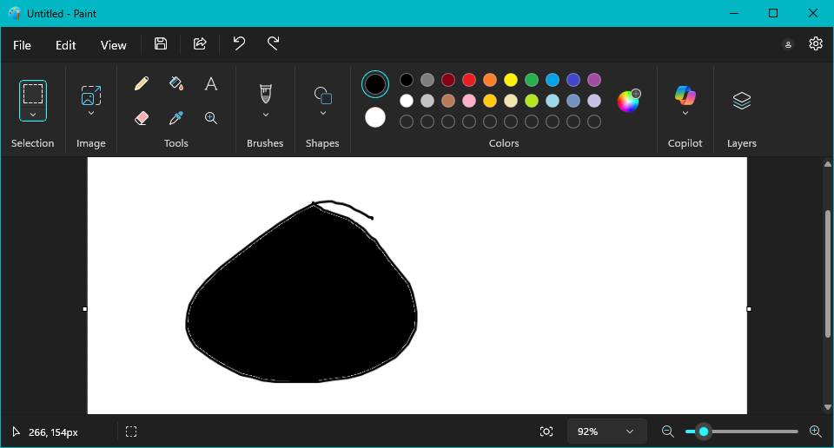

Derivatives data structure
During processing, image data structure may be altered:
Linked list (i.e. boundary contour of an object is recorded as a list)
Stack/queue (neighbor flood fill)
Tree/graph (e.g. layered compression i.e. additional depth adds resolution; segmented object i.e. pixel as node, similarity to neighbor as edge)

Slide 13
As a file
Lossless: TIFF, PNG, BMP (palette), GIF (palette), RAW (DNG, CR2, SR2, NEF, ORF...)
Lossy: JPG/JPEG, AVIF, HEVC
Hybird: WEBP

Slide 14
Questions?

Slide 15

Attendance List
https://forms.gle/QJwtK9PCHozWcuJH7

