Slide 1
ENSEMBLE LEARNING
Combining multiple models to make stronger, more reliable predictions
MACHINE LEARNING • MODEL STRATEGY

Slide 2
DEFINITION
What Is Ensemble Learning?
A technique that trains multiple models (“base learners”) on the same problem and combines their predictions — by voting, averaging, or a learned combiner — into a single, stronger final prediction.
Model A
Σ
Model B
No single model is asked to be perfect — each one only needs to be decent, and different from the others.
Model C
Final Prediction
Three ways to combine predictions
Voting: Each model casts a class label; the majority wins (classification).
Averaging: Predictions are averaged, often weighted by each model's accuracy (regression).
Learned combiner: A meta-model studies the base predictions and learns how to blend them (stacking).
02

Slide 3
MOTIVATION
Why Ensemble Is Required
Any single model sits somewhere on the bias–variance trade-off. Ensembles let you address both sides at once.
1
2
3
4
Small variance, high bias (Underfitting)
High variance within class (Overfitting)
Uncorrelated errors
Wisdom of the crowd
A simple model can be too rigid to capture real patterns in the data.
A complex model unintentionally memorizes training noise and fails on new data.
Different models tend to make different mistakes; combined, those errors partly cancel out.
A diverse group of decent predictors, combined well, consistently beats any one expert model.
03

Slide 4
BEFORE YOU COMMIT
Factors to Weigh Before Using an Ensemble
Computational cost
Marginal accuracy gain vs. effort
Training and serving N models takes N× the time, memory, and infrastructure of a single model.
Netflix famously shipped 2 of the 107 models in its Prize-winning ensemble — the rest weren't worth the engineering cost.
Interpretability needs
Risk of noisy/mislabeled data
A 500-tree forest or stacked model is far harder to explain than one decision tree — a problem in regulated domains like finance or healthcare.
Boosting in particular keeps re-weighting hard examples, so it can overfit to label noise if left untuned.
Model diversity available
Latency & deployment constraints
Ensembling only helps if the base models actually make different errors; near-identical models add cost without benefit.
Real-time systems may not tolerate the extra inference time multiple models add.
05

Slide 5
METHOD
How to Ensemble: Three Core Strategies
Bagging
Boosting
Stacking
Bootstrap Aggregating — parallel
Sequential correction
Heterogeneous, meta-learned
01
02
03
Train models independently on random bootstrap samples of the data, then average (regression) or vote (classification). Reduces variance.
Train models one after another; each new model focuses on the errors of the previous ones, then combine with weighted votes. Reduces bias.
Train several different model types, then feed their predictions as input features into a meta-learner that learns the best way to combine them.
Best for: unstable, high-variance models
Best for: weak learners, structured data
Best for: squeezing out final accuracy
06

Slide 6
BAGGING
Bagging: Bootstrap Aggregating
1
2
3
4
Bootstrap Sampling
Train in Parallel
Aggregate Results
Random Forest Twist
Draw random samples with replacement from the training data — each sample keeps ~63% unique rows.
Fit one base learner per sample, independently and at the same time — no learner depends on another.
Average the predictions for regression, or take a majority vote for classification.
Also randomize which features are considered at each split, decorrelating the trees even further.
REDUCES
BEST FOR
Variance / overfitting
Unstable, high-variance learners (deep decision trees)
07

Slide 7
BAGGING
Bagging: scikit
from sklearn.ensemble import BaggingClassifier, RandomForestClassifier
from sklearn.tree import DecisionTreeClassifier
from sklearn.datasets import load_breast_cancer
from sklearn.model_selection import train_test_split
X, y = load_breast_cancer(return_X_y=True)
X_train, X_test, y_train, y_test = train_test_split(X, y, test_size=0.2)
# Generic bagging: many decision trees on bootstrap samples
bagging = BaggingClassifier(
estimator=DecisionTreeClassifier(),
n_estimators=100,
max_samples=0.8, # fraction of training data per bootstrap sample
bootstrap=True, # sample with replacement
n_jobs=-1,
random_state=42
)
bagging.fit(X_train, y_train)
print("Bagging accuracy:", bagging.score(X_test, y_test))
# Random Forest = bagging + random feature subsets at each split
rf = RandomForestClassifier(n_estimators=200, max_features="sqrt", n_jobs=-1)
rf.fit(X_train, y_train)
print("Random Forest accuracy:", rf.score(X_test, y_test))
07

Slide 8

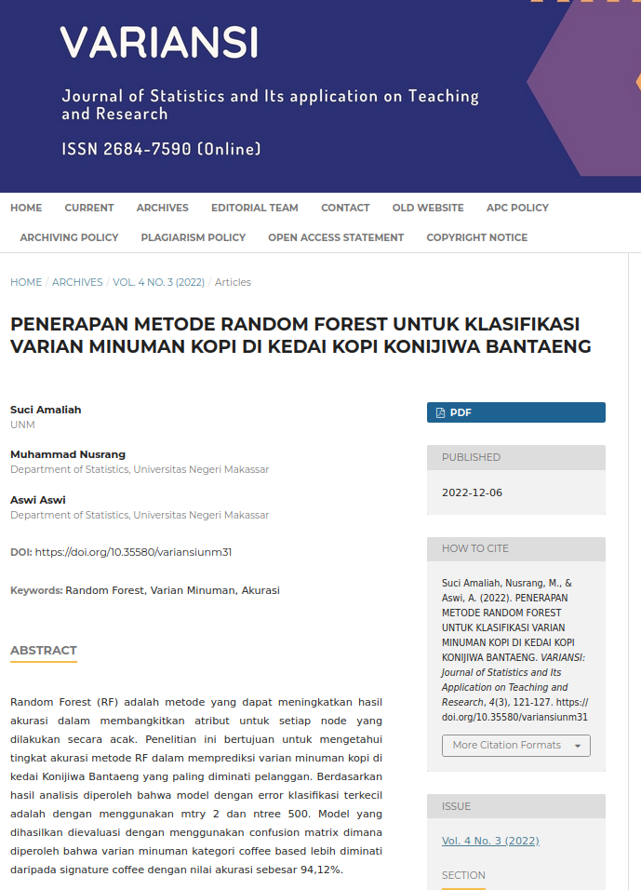
BAGGING
07

Slide 9
BOOSTING
Boosting: Constrained Sequential Error Correction
1
2
3
4
Train First Learner
Reweight the Errors
Train the Next Learner
Combine with Weights
Fit a simple, typically weak model on the original training data.
Increase the weight on misclassified points (AdaBoost) or target the residual error (Gradient Boosting).
Fit a new model that focuses specifically on the examples the previous ones got wrong.
Repeat for n rounds, then blend every learner into one weighted final prediction.
REDUCES
KEY ALGORITHMS
CAUTION
Bias / underfitting
AdaBoost, Gradient Boosting, XGBoost, LightGBM
Sensitive to noisy or mislabeled data
08

Slide 10
BOOSTING
Boosting: scikit
from sklearn.ensemble import AdaBoostClassifier, GradientBoostingClassifier
from sklearn.tree import DecisionTreeClassifier
# AdaBoost: reweights misclassified samples each round
ada = AdaBoostClassifier(
estimator=DecisionTreeClassifier(max_depth=1), # weak learner ("stump")
n_estimators=200,
learning_rate=0.5,
random_state=42
)
ada.fit(X_train, y_train)
print("AdaBoost accuracy:", ada.score(X_test, y_test))
# Gradient Boosting: fits each new tree to the residual error
gb = GradientBoostingClassifier(
n_estimators=200,
learning_rate=0.05,
max_depth=3,
random_state=42
)
gb.fit(X_train, y_train)
print("Gradient Boosting accuracy:", gb.score(X_test, y_test))
# XGBoost (optimized gradient boosting; pip install xgboost)
from xgboost import XGBClassifier
xgb = XGBClassifier(n_estimators=200, learning_rate=0.05, max_depth=3, eval_metric="logloss")
xgb.fit(X_train, y_train)
print("XGBoost accuracy:", xgb.score(X_test, y_test))

Slide 11


BOOSTING

Slide 12
STACKING
Stacking: Feature extraction for subsequent model
1
2
3
4
Train Base Learners
Out-of-Fold Predictions
Build Meta-Features
Train the Meta-Learner
Fit several different model types — e.g. SVM, k-NN, and a decision tree — on the same data.
Use cross-validation so each prediction comes from data the model didn't train on.
Treat each base learner's predictions as new input features for a second-stage model.
Fit a final model that learns the best way to weigh and combine the base predictions.
REDUCES
KEY IDEA
Both bias and variance, via a learned blend
Meta-learning over heterogeneous models

Slide 13
STACKING
Stacking: Feature extraction for subsequent model
from sklearn.ensemble import StackingClassifier
from sklearn.linear_model import LogisticRegression
from sklearn.svm import SVC
from sklearn.neighbors import KNeighborsClassifier
# Level-0: heterogeneous base learners
base_learners = [
("svm", SVC(probability=True, random_state=42)),
("knn", KNeighborsClassifier(n_neighbors=5)),
("tree", DecisionTreeClassifier(max_depth=5, random_state=42)),
]
# Level-1: meta-learner that combines their out-of-fold predictions
stack = StackingClassifier(
estimators=base_learners,
final_estimator=LogisticRegression(),
cv=5, # generates out-of-fold predictions to avoid leakage
n_jobs=-1
)
stack.fit(X_train, y_train)
print("Stacking accuracy:", stack.score(X_test, y_test))

Slide 14
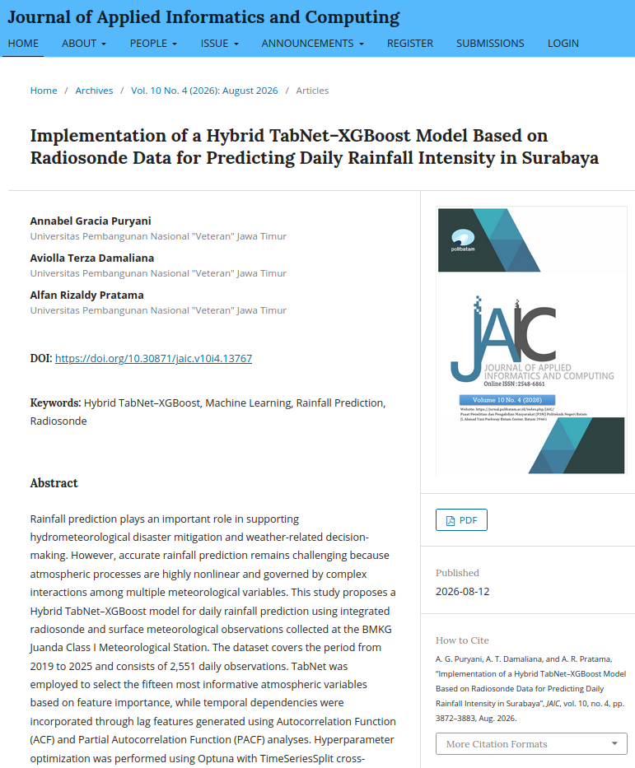

STACKING

Slide 15
THE DIVERSITY PRINCIPLE
Ensembles Only Win When Models Disagree
Combining predictions only helps if the base models make different mistakes. If they always fail on the same examples, averaging changes nothing.
A WORKED EXAMPLE
GOOD
5 classifiers, each 70% accurate, errors independent
Independent Errors
Each model stumbles on different examples. Combining them cancels out most of the individual mistakes — this is where ensembling pays off.
70%
83.7%
single model
majority vote
WEAK
Correlated Errors
A majority vote is correct whenever at least 3 of the 5 models are correct — the binomial distribution puts that probability at 83.7%, a ~14-point gain from models that are individually just decent.
Models trained the same way on the same data tend to fail on the same hard cases. If all members miss together, the vote stays stuck at their solo accuracy.
Diversity comes from different training samples (bagging) and feature subsets (random forests), different model families (stacking), or reweighted training rounds (boosting).

Slide 16
SUMMARY
Key Takeaways
1
Diversity is the real engine. Ensembling only helps when base models genuinely disagree — identical models add cost, not accuracy.
2
Bagging, boosting, and stacking solve different problems. Bagging tames variance, boosting tames bias, and stacking learns the best blend of both.
3
The gains aren't free. More compute, more memory, and less interpretability come with every model you add to the mix.
4
Always benchmark against a single well-tuned model first. If the ensemble's edge doesn't clear that bar, the added complexity usually isn't worth shipping.

