Slide 1
Machine Learning II
From Pathfinding to Reinforcement Learning
Unifying traditional ML loss functions, greedy heuristics

Slide 2



CORE FRAMEWORKS
Three Paradigms of Machine Learning
Supervised
Unsupervised
Reinforcement
Direct Instruction
Pattern Discovery
Trial & Feedback
Explicit ground truth labels provided for every input example.
Uncovering inherent structure in unlabeled data collections.
Sequential decision making guided by dynamic reward signals.

Slide 3

SUPERVISED MECHANICS
Loss Functions in Traditional ML
Static Error Measurement
Calculates instantaneous distance between prediction and fixed targets.
// Mean Squared Error Loss
Gradient Descent Optimization
Adjusts model parameters along steepest directional error gradient.
// Parameter Update Rule
Key Limitation
Requires instantaneous ground truth; cannot evaluate sequential actions.

Slide 4
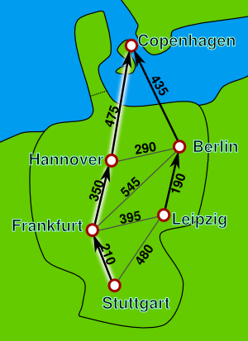
EXACT GRAPH SEARCH
Deterministic Pathfinding: Dijkstra
Full Model Assumption
Requires a fully known graph with static edge weights given upfront.
Guaranteed Optimality
Computes exact shortest path without sampling or trial-and-error.
Core Update Rule
Dynamic programming relaxation: d(v) = min(d(v), d(u) + w(u,v)).

Slide 5
UNCERTAIN ENVIRONMENTS
When Traversal Costs Are Unknown
PURE GREEDY
TRAP RISK
STOCHASTIC SEARCH
Immediate Myopic Choices
Local Optima Lock-In
Probabilistic Action Selection
Always picks the local lowest-cost edge visible right now.
Refuses to explore higher-cost steps that lead to global shortcuts.
Samples actions based on estimated probability distributions.
The Missing Link
Unknown costs force agents to sample the world to estimate real edge weights.

Slide 6
STATELESS EXPLORATION
Multi-Armed Bandits & Monte Carlo
The Fundamental Dilemma
Monte Carlo Value Estimation
Exploit known slot machines with good payouts, or explore unknown machines to discover higher payouts?
Estimates expected payout Q(a) by averaging cumulative rewards across repeated random trials.
ε-Greedy Strategy:
Random Action with prob ε
Best Known Action with prob 1 - ε

Slide 7

REINFORCEMENT LEARNING: MATHEMATICAL CORE
Bellman Optimality Equation
Immediate Reward
Discount Factor (γ)
Expected Future Value
R(s, a) gained instantly.
Weights immediate vs future gains.
Sum of next state optimal values.

Slide 8
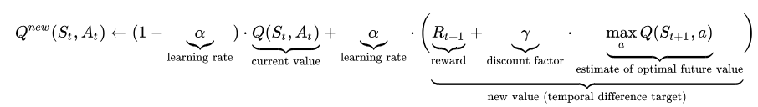
MODEL-FREE CONTROL
Q-Learning & Temporal Difference
Model-Free Learning
Learns optimal action values without knowing transition dynamics P(s'|s,a).
TD Error Signal
Updates estimates based on single-step experience observations.

Slide 9
SUMMARY & DISCUSSION
Optimization Under Uncertainty
Reinforcement Learning is dynamic programming extended to worlds with unknown transitions and reward functions.

