Slide 1
Exploratory analysis for ancestry-specific interrogation of splicing in pediatric AML
Jenea I. Adams
Xing Lab Roundtable
Friday, April 29th, 2022

Slide 2
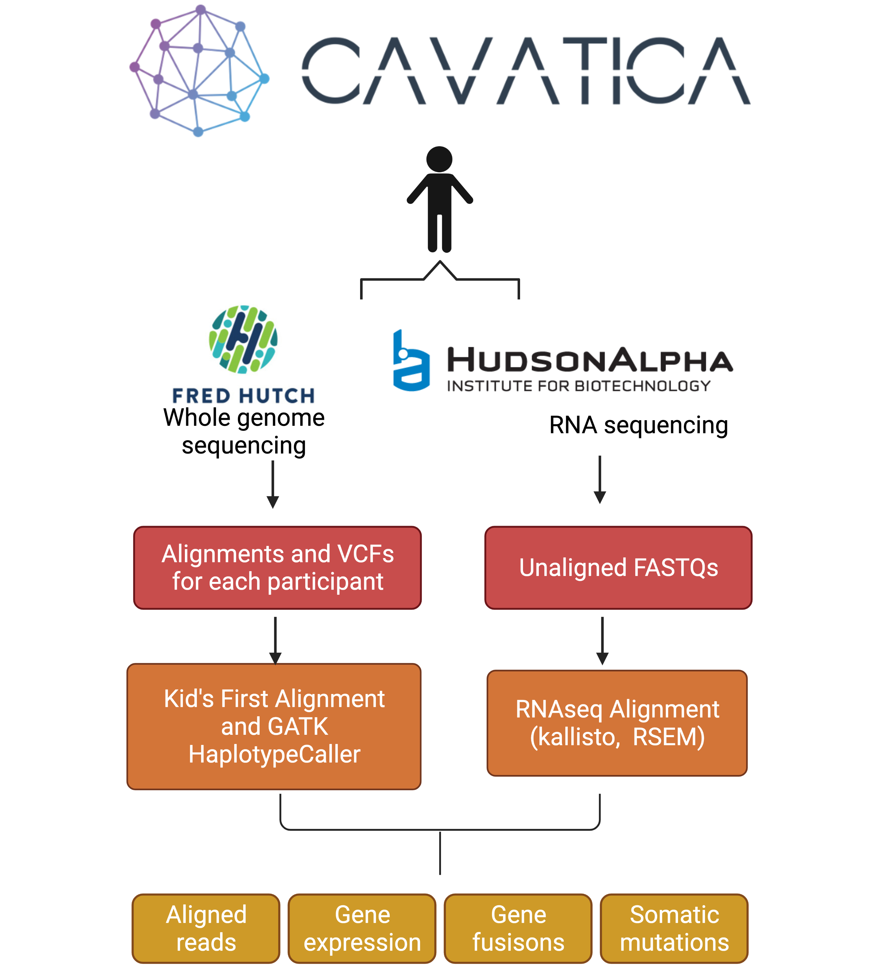
CAVATICA: CHOP data-analysis platform of raw and harmonized multiomic data
Overview of data used for this analysis
De-novo AML, DS-AML, APL-AML
Data from Children’s Oncology Group Clinical Trial (No. AAML1031)
1,113 RNA-seq files (aligned and quantified)
Both kallisto and RSEM were used
Gene fusions also quantified
408 whole-genome sequencing (WGS) files
Notes:
Looking for FLT3 (FMS-like tyrosine kinase 3)-ITD (internal tandem duplication) . FLT3 mutated in more than 30 % of AML cases and the -ITD variation is associated with higher disease burden
DS-AML = down-syndrome AML
APL-AML = acute promyelotic leakemia
Researchers want to know if the addition of a drug called bortezomib to the standard chemotherapy, can improve the cure rate for AML. Bortezomib has been studied in adults with AML in combination with standard chemotherapy drugs. It has also been studied in small groups of pediatric patients.
FLT3 is a gene that plays an important role in the normal process of making blood cells. The FLT3 gene is called wild-type FLT3 when there is no abnormal change (mutation) in the structure of the gene. The FLT3 gene is called mutant FLT3 when there is an abnormal change (mutation) in the structure of the gene. This abnormal change allows cancer cells to grow. Patients with more mutant FLT3 than wild-type FLT3 in their cancer cells (i.e. high amounts of FLT3 gene mutation) don't respond as well to standard chemotherapy treatment. Sorafenib is a drug that has been shown to block the abnormal function of the FLT3 gene that makes cancer cells grow. AAML1031 will study if the addition of Sorafenib to chemotherapy is effective treatment for patients with high-risk AML due to the FLT3 gene mutation in their leukemia cells.

Slide 3
Breakdown of COG data in CAVATICA by data type
Methodology
Using case_ID (a patient identification marker), we matched data in CAVATICA with Richard’s metadata file
Data Highlights
WGS (tumor) data were not available for any individual
Only 480 of the 1,097 individuals in the metadata set could be intersected with CAVATICA data based on case_ID
Individuals (n) | Data Type
Individuals (n) | WGS (normal) | WGS (tumor) | RNA-seq (normal) | RNA-seq (tumor) | Patient metadata
259 | √ | x | x | √ | √
211 | x | x | x | √ | √
131 | √ | x | x | √ | x
10 | √ | x | x | x | √
8 | √ | x | x | x | x
62 | x | x | √ | x | x
450 | x | x | x | √ | x
Total number of individuals with each data type available in CAVATICA
1,131 | 408 | 0 | 62 | 1,051 | 480
√ Data type available
x Data type not available

Slide 4
Exploratory analysis of patients with sequencing data
N = 480

Slide 5
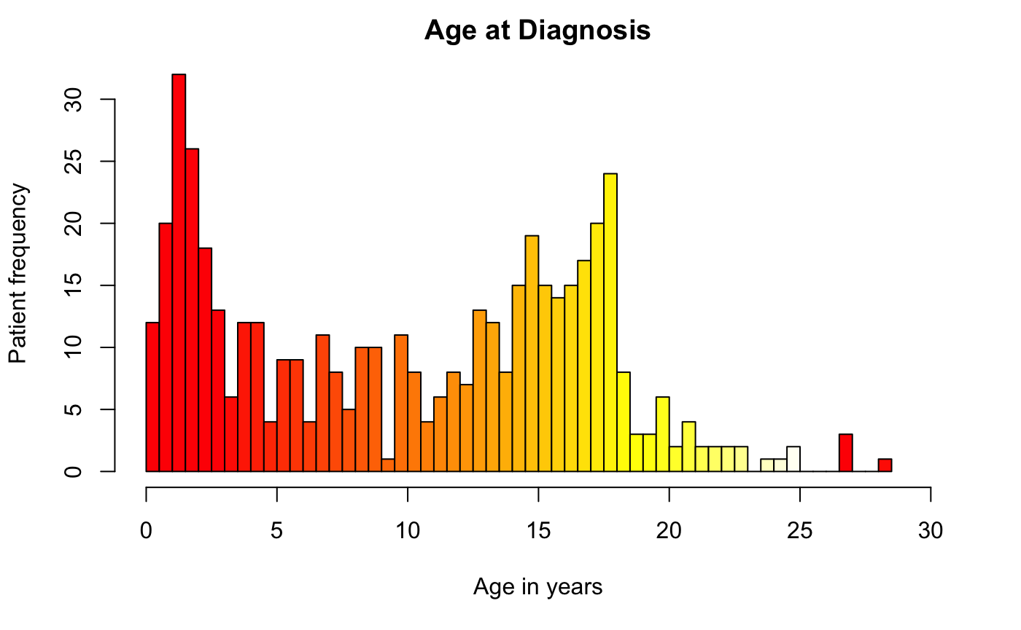
Distribution of age at diagnosis of COG patients

Slide 6
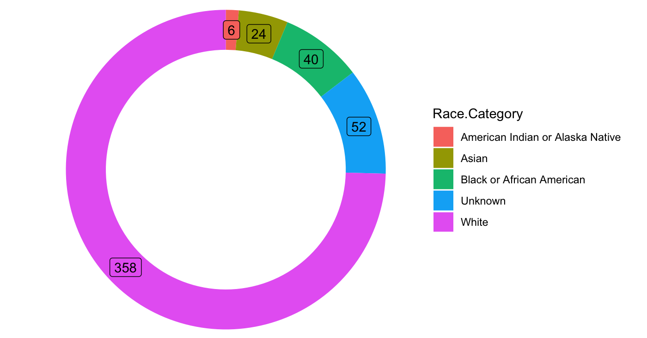
Race categories of COG patients

Slide 7
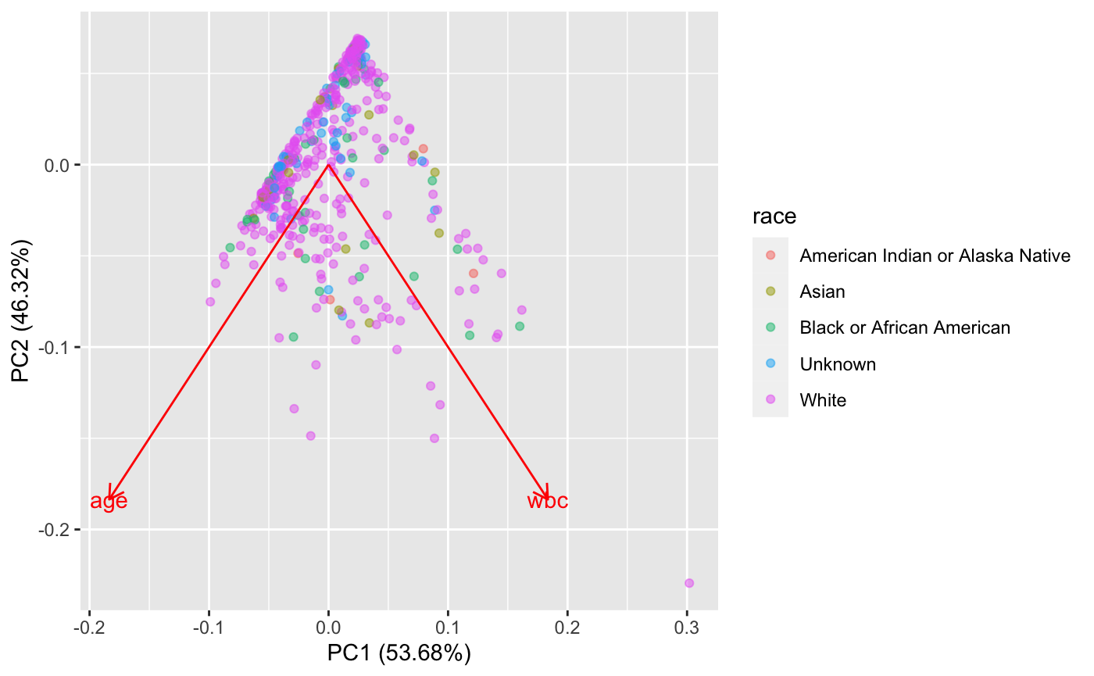
2D projection of race categories onto WBC and age features

Slide 8
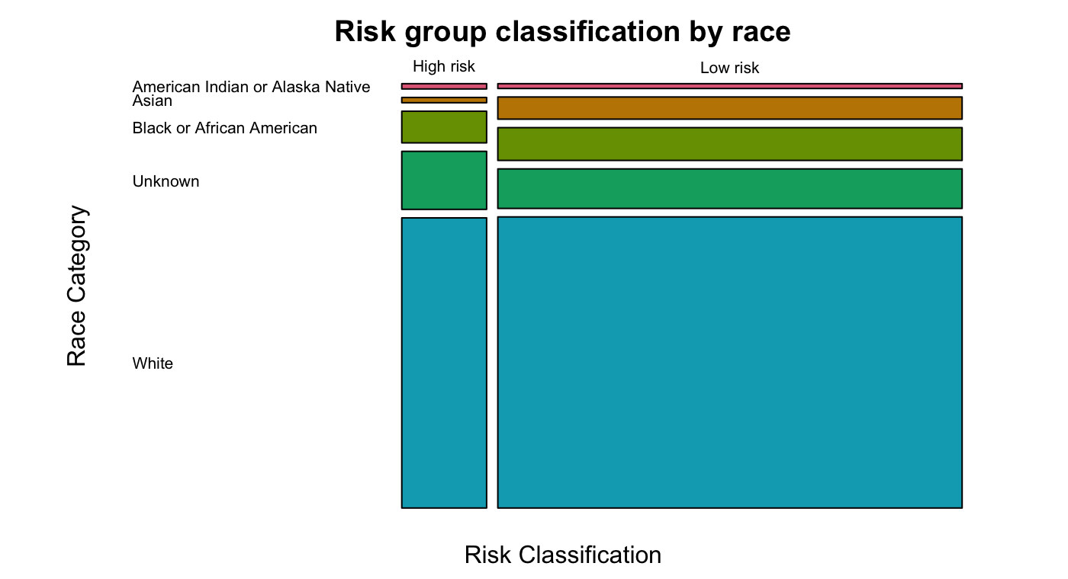
Risk group classification by race

