Slide 1
Secure Data Hiding In Images Using Steganography
CAPSTONE PROJECT
Presented By:
Student Name : JENEFA JOY A B
College Name & Department : ST.JOSEPH’S COLLEGE OF ENGINEERING/ ELECTRONICS AND COMMUNICATION

Slide 2
OUTLINE
Problem Statement
Technology used
Wow factor
End users
Result
Conclusion
Git-hub Link
Future scope

Slide 3
Problem Statement
Traditional encryption techniques are prone to detection and interception.
There is a need for a method that ensures data confidentiality without raising suspicion.
Steganography, by embedding messages within images, solves this problem by providing a covert communication channel that is undetectable by traditional methods.

Slide 4
Technology used
Programming Language: Python
Libraries: OpenCV (cv2), OS
Platform: Cross-platform (Windows/Linux)
Tools: Python IDLE

Slide 5
Wow factors
Invisible Security: The secret message, encoded using LSB steganography, remains perfectly hidden within the image. The changes are so subtle that the image's appearance remains unaltered to the human eye.
Dual-layer Protection: The passcode and message length act as additional layers of encryption, making unauthorized decryption virtually impossible.
User-Friendly Interface: No technical expertise is required—users simply select an image, input a message and passcode, and click "Encrypt." For decryption, just upload the encrypted image, enter the passcode, and retrieve the hidden message effortlessly.

Slide 6
End users
Security Professionals and Cybersecurity Enthusiasts:
Ideal for those in the cybersecurity field looking for innovative ways to protect and secure sensitive data. This project provides an additional layer of stealth encryption for professionals working on secure communication protocols.
Journalists, Activists, and Government Agencies:
Those in high-risk sectors who require discreet and secure communication to protect sensitive information from external threats. The system ensures that confidential data remains hidden even in the event of surveillance or interception.
Students and Researchers in Data Privacy and Steganography:
A valuable tool for academics and researchers studying steganography and data privacy, providing hands-on experience with practical encryption techniques.
General Users Seeking Enhanced Digital Security:
For everyday users who wish to protect their personal information, this system provides an easy-to-use solution for hiding sensitive data within ordinary images, offering both security and privacy without the complexity of traditional encryption methods.

Slide 7
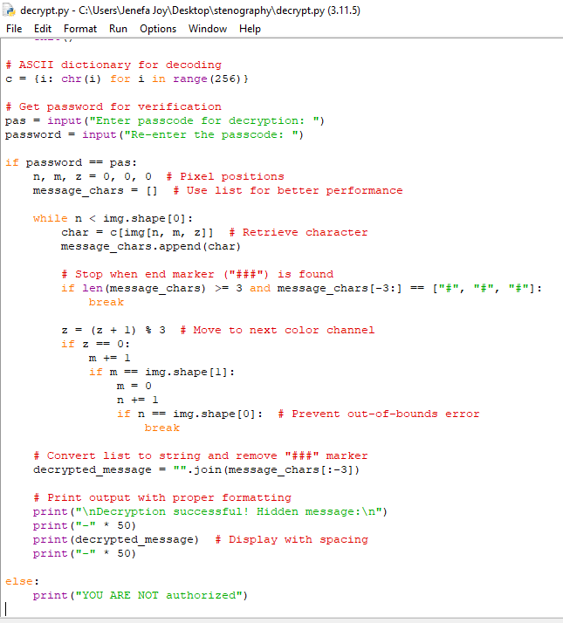
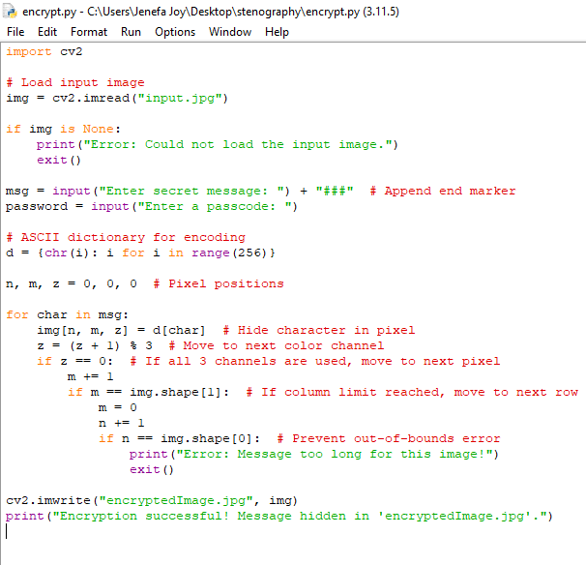
Results

Slide 8


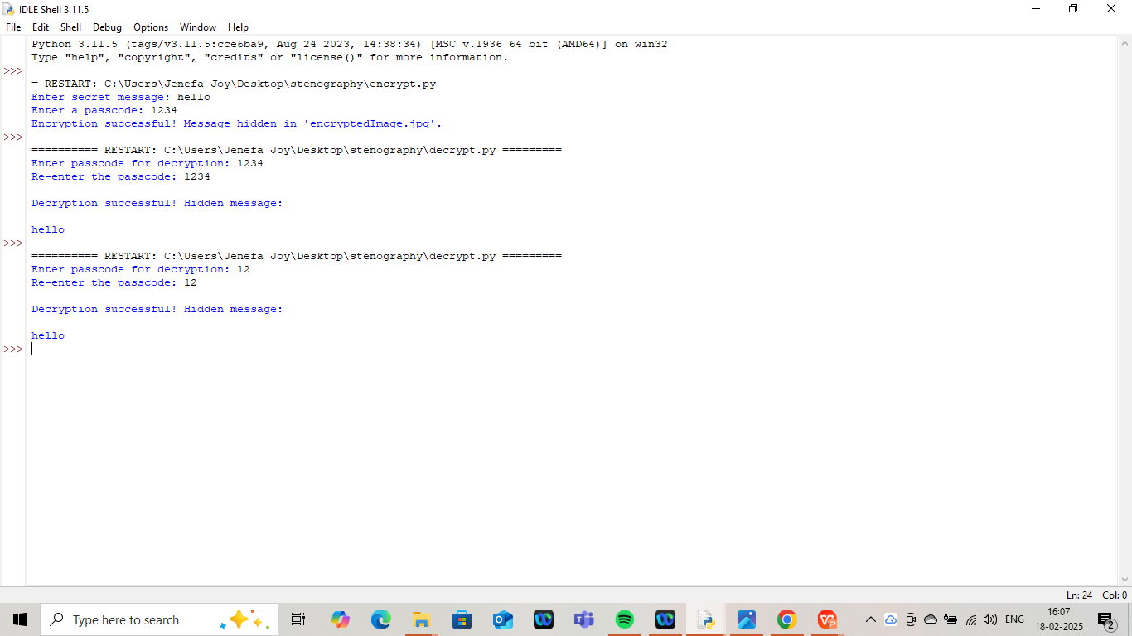
RESULTS
Encrypted image
Input image

Slide 9
Conclusion
The project successfully implements LSB steganography to hide secret messages within image files, providing a covert communication channel.
It embeds both the passcode and message length in the image header to ensure secure and accurate decryption.
The system uses the lossless PNG format, preserving the integrity of hidden data during image compression or transfer.
Advanced image processing techniques are applied to efficiently encode and decode messages, ensuring that hidden data remains undetectable by conventional methods.
The tool provides a high level of confidentiality, as the secret message is embedded within the least significant bits of image pixels, without altering the image’s visual appearance.
Password protection ensures that only authorized users can retrieve the hidden message, adding an extra layer of security.
The system is designed to be easily accessible for security professionals, journalists, activists, and general users seeking enhanced data privacy and secure communication.
This project demonstrates a robust, invisible, and highly secure method for message encryption, redefining digital communication security in today’s connected world.

Slide 10
GitHub Link
https://github.com/jenefajoyab/AICTE-CS-STEGANOGRAPHY.git

Slide 11
Future scope
Implement multi-layer steganography to hide multiple messages in one image.
Develop a real-time communication platform for secure messaging.
Add error detection and correction features to verify data integrity.
Create mobile apps for Android/iOS for easy message hiding/extraction.
Implement image tampering detection to ensure message integrity.
Integrate with cloud storage services for secure image sharing and storage.

Slide 12
THANK YOU

