Slide 1






Quasi Free Scattering with S444 Data (2020)
Tobias Jenegger
Analysis WG Meeting
22.07.2021
12C(p,2p)11B reaction
12C(p,ppn/pd)10B reaction
SRC Analysis
Supported by BMBF 05P15WOFNA and 05P19WOFN1.
The results presented here are based on the experiment s444/s473, which was performed at the beam line/infrastructure Cave C at the GSI Helmholtzzentrum für Schwerionenforschung, Darmstadt (Germany) in the frame of FAIR Phase-0.
Physics with R³B
CALIFA – Design

Slide 2
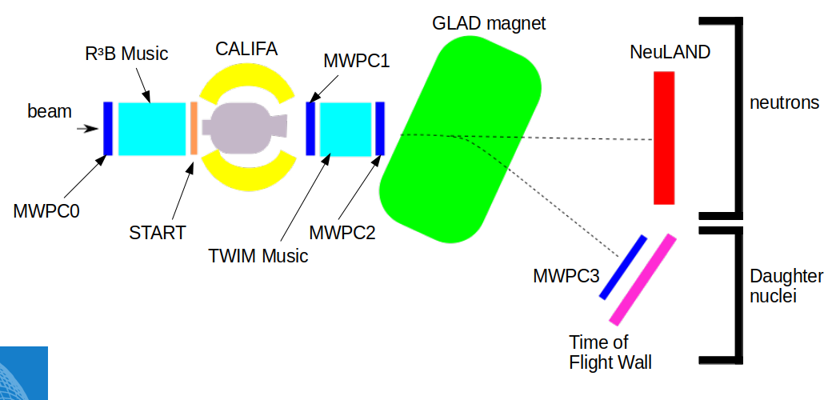

Quasi Free Scattering Analysis with Experiment S444/467 (2020)
12C(p,2p)11B reaction:
SETUP:
2 protons
¹¹B fragment
(spectator)
Beam energy: 400 AMeV
Beamtype: ¹²C
Target: CH₂
¹²C beam
proton like target
proton
¹¹B
proton

Slide 3

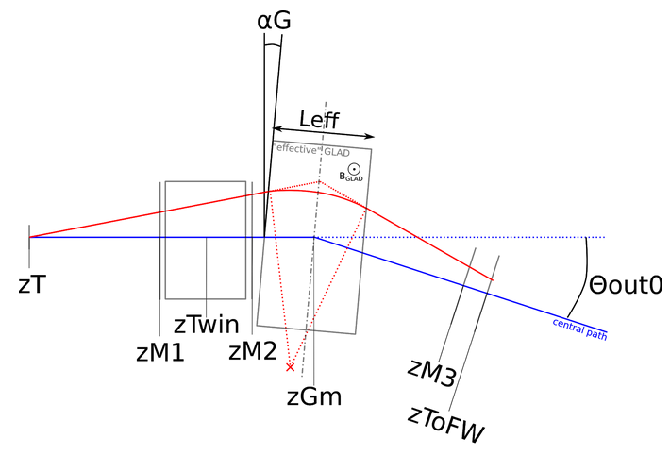
Fragment Particle Identification
Flightpath reconstruction:
¹²C
¹¹C
Radius reconstruction:
¹⁰B
¹¹B

Slide 4

12C(p,2p)11B reaction
Two Proton Identification:
→ two hits with E_{hit} > 30 MeV
proton
proton

Slide 5
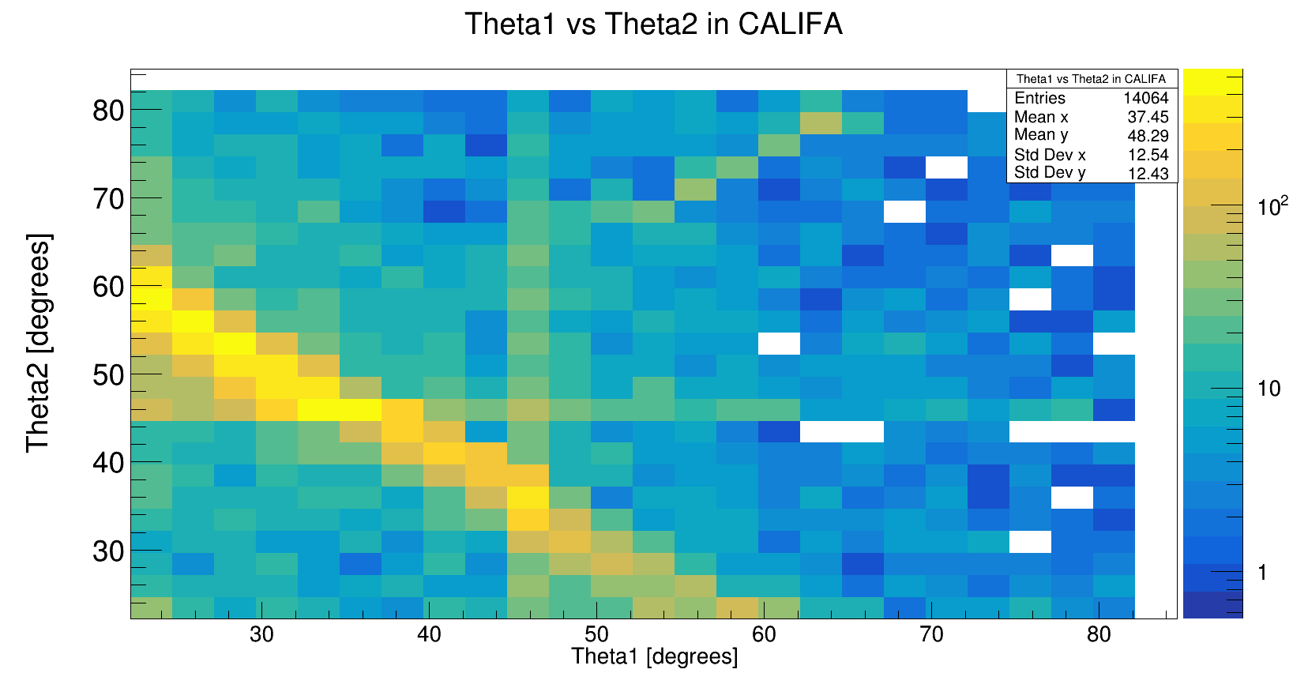

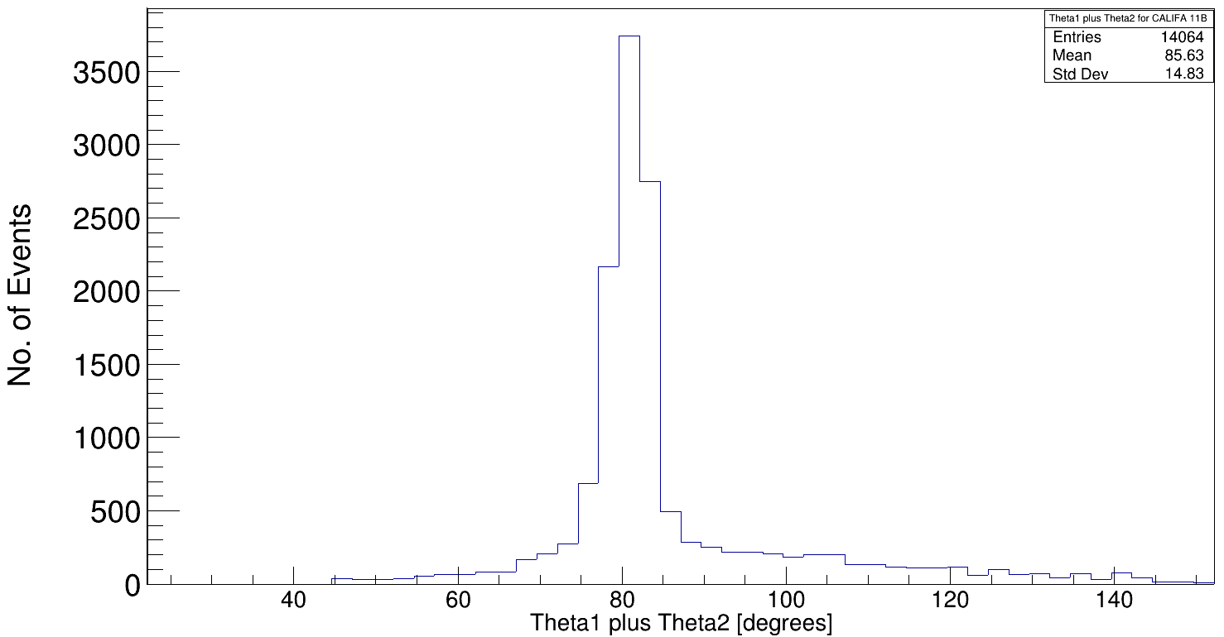
Polar Angular Distribution of protons for 12C(p,2p)11B
12C beam
Barrel region with high acceptance
iPhos region
11B Analysis with S455 Setup

Slide 6

Arzimuthal Distribution of protons for 12C(p,2p)11B
φ₂[degrees]
y
φ
x
φ₁[degrees]
Tobias Jenegger

Slide 7
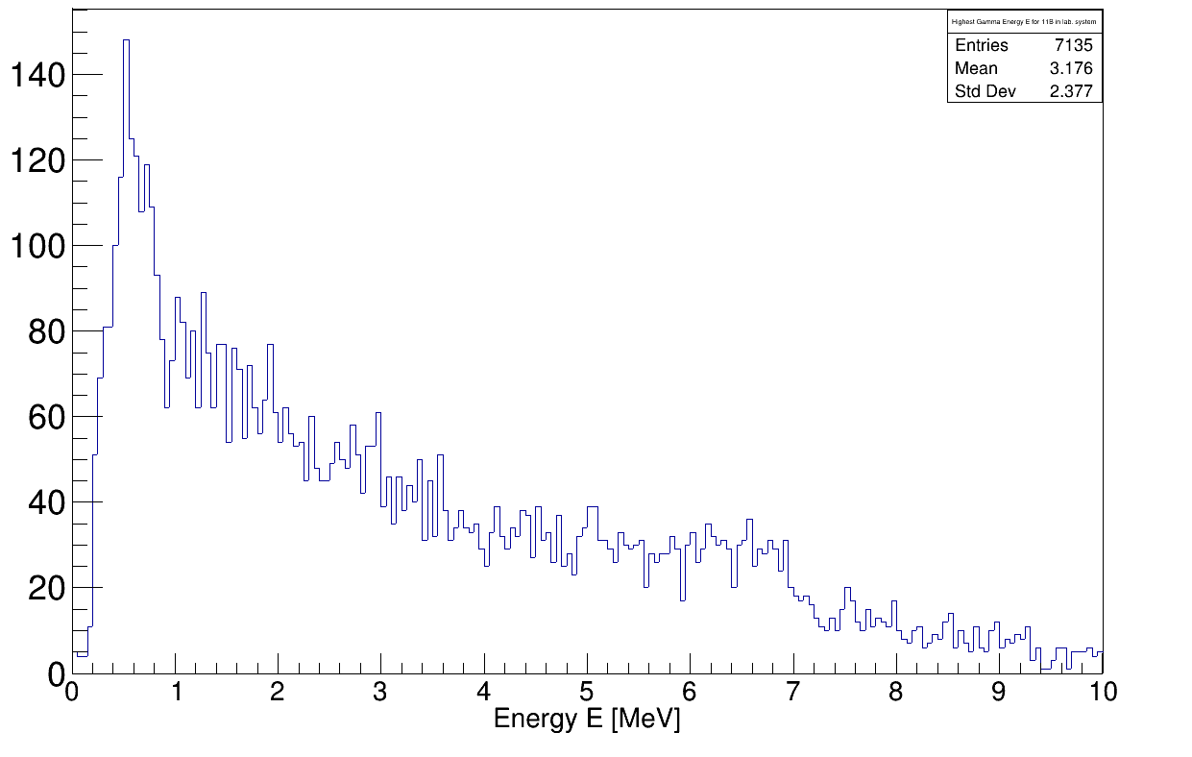
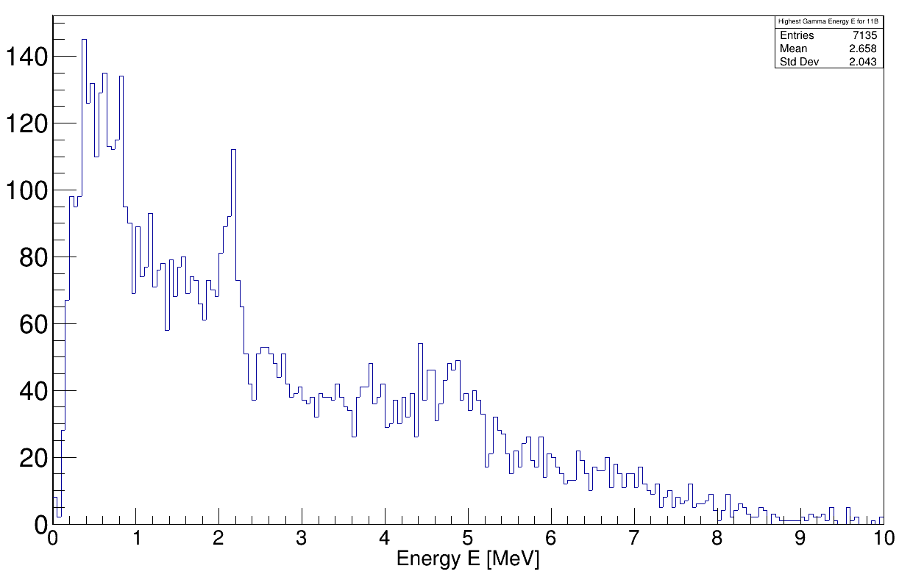
Gamma Spectrum of 11B
laboratory system
Doppler Correction:
¹¹B rest frame
2.1 MeV (1/2-) p-hole state
5.0 MeV (3/2-) p-hole state
+ single/double escape

Slide 8
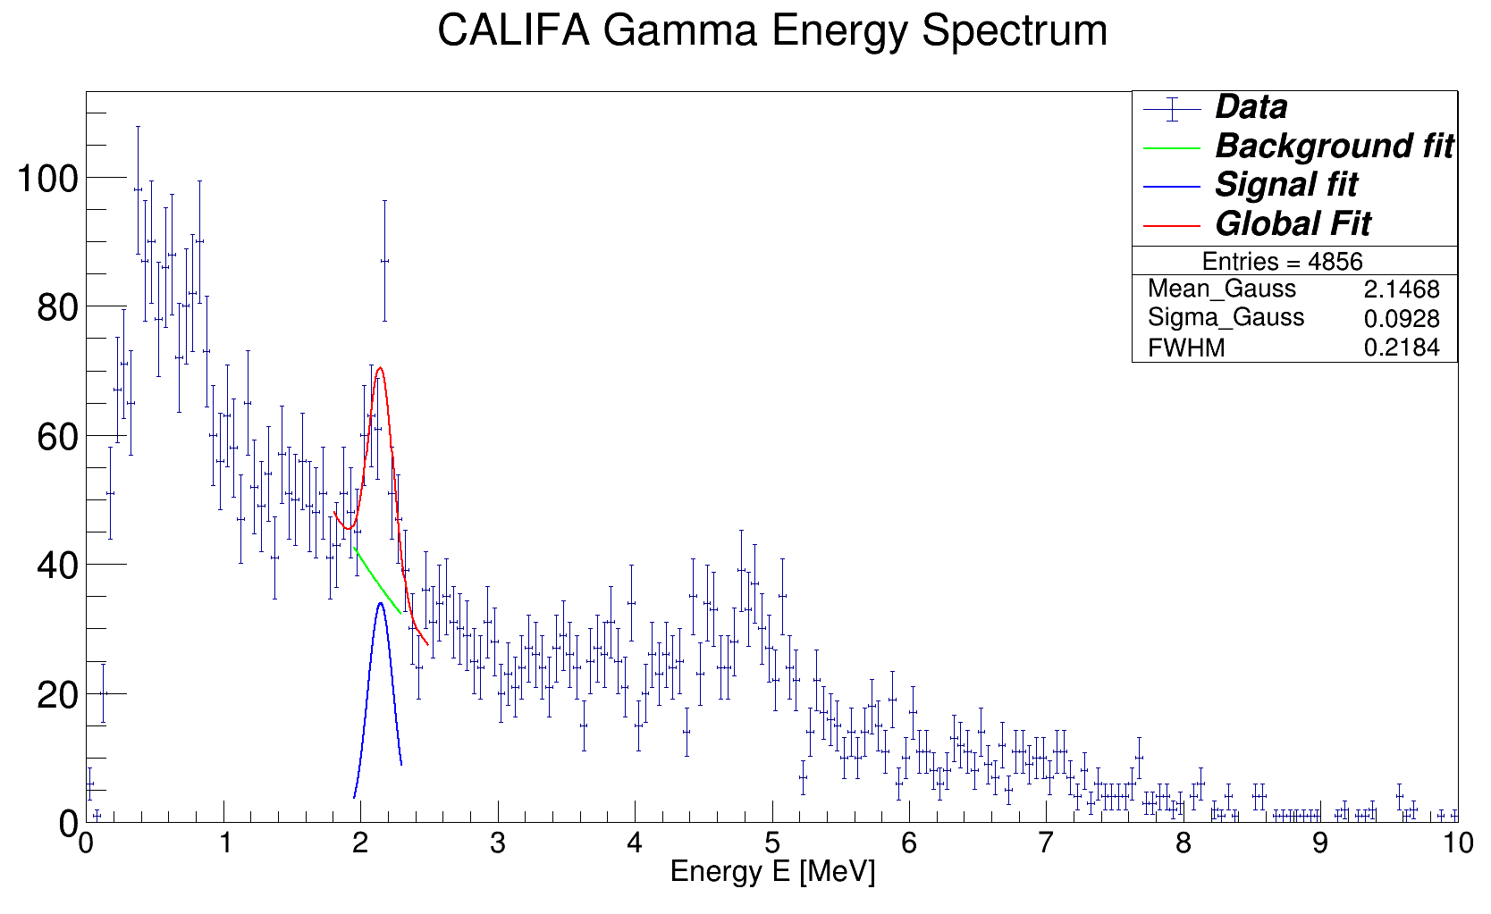
Gamma Spectrum with Angular Cuts
Event selection criteria for CALIFA:
→ 11B fragment identification
→ two hits (protons) with E_{hit} > 30 MeV
→ θ1 + θ2 < 90°
→ Δφ = 180° +- 40°

Slide 9
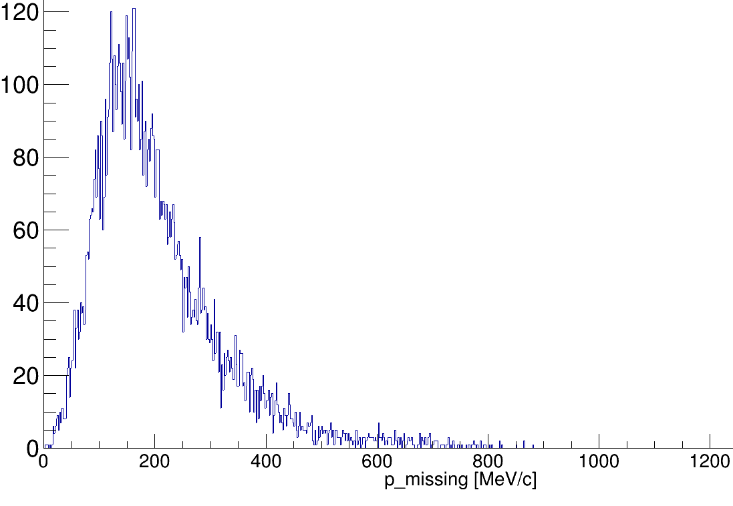
Reconstruction of Inner Momenta
Before Scattering:
After Scattering:
p₁
p_{i}
p_{tg}
(Four-)Momentum conservation relation:
p_{11B}
assuming QE scattering in mean field potential:
p₂
nucleon momentum inside 12C

Slide 10
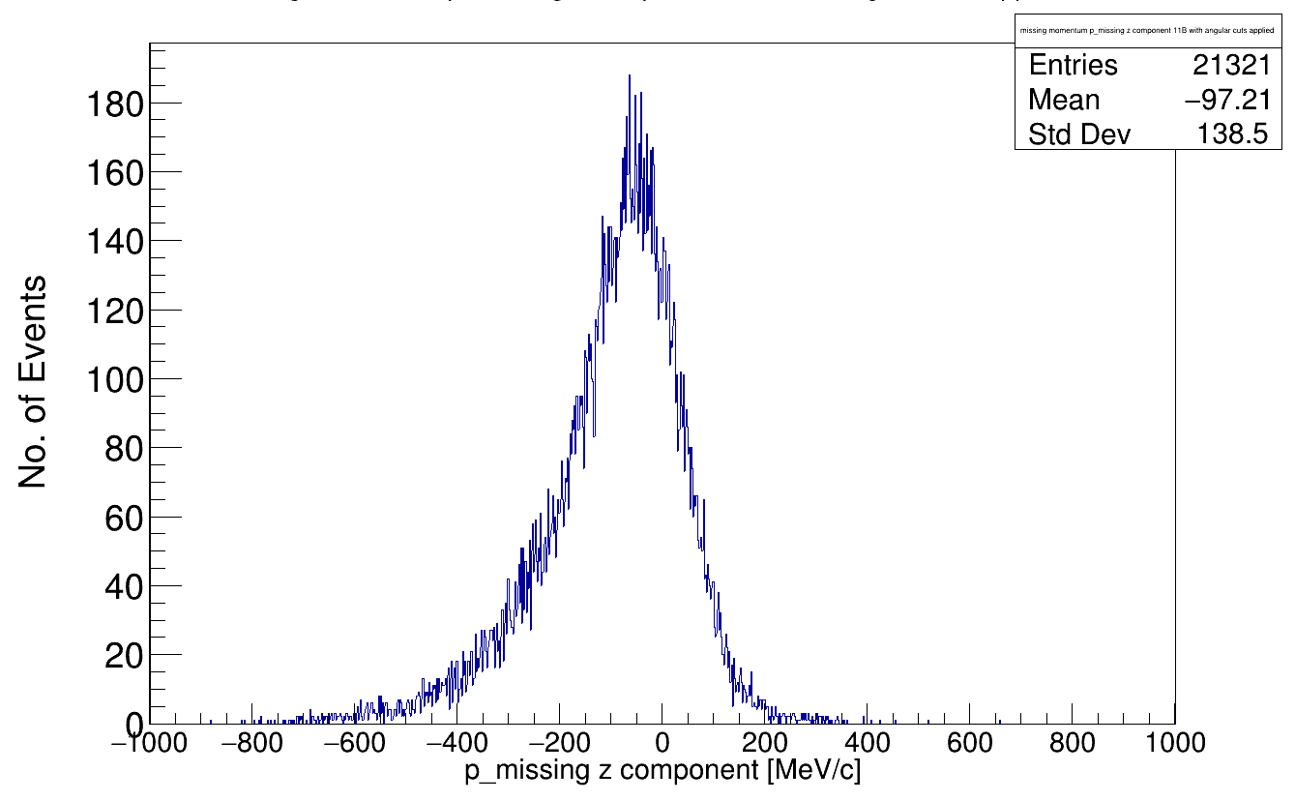
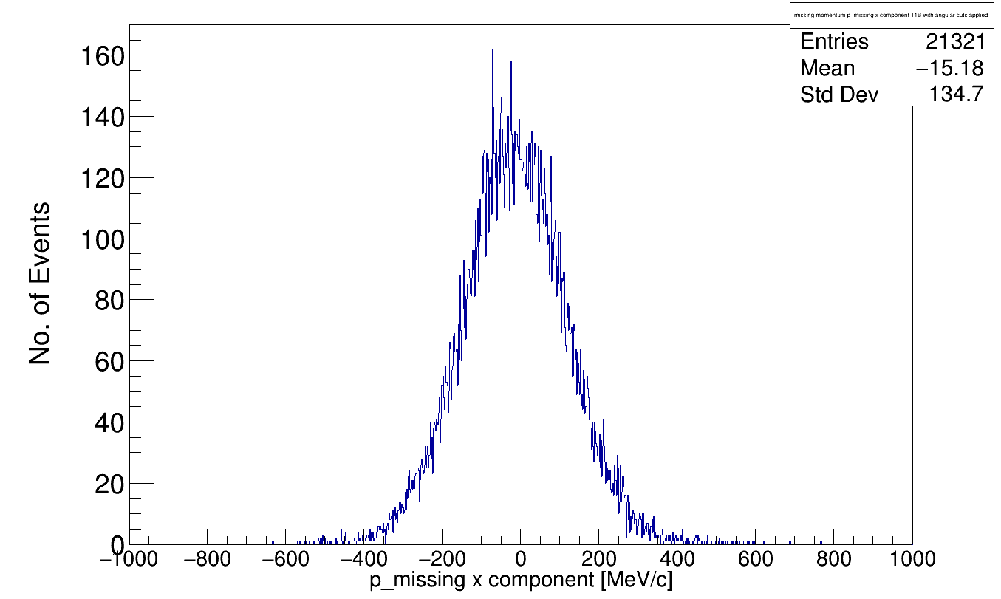
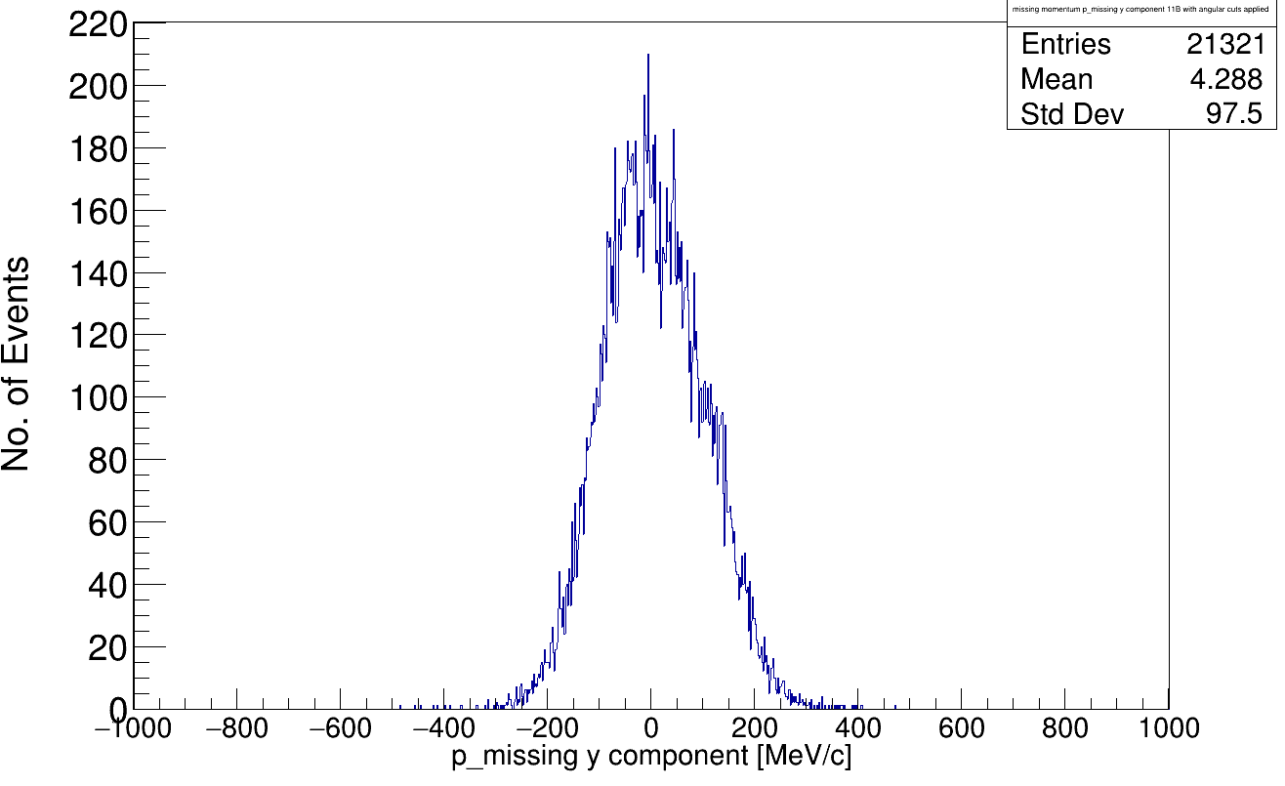
Momentum components of p_i
Before Scattering:
After Scattering:
p₁
p_{i}
p_{tg}
p_{11B}
p₂
p_{i} Momentum-Components (with angular cuts applied)
z-comp.
y-comp.
x-comp.

Slide 11
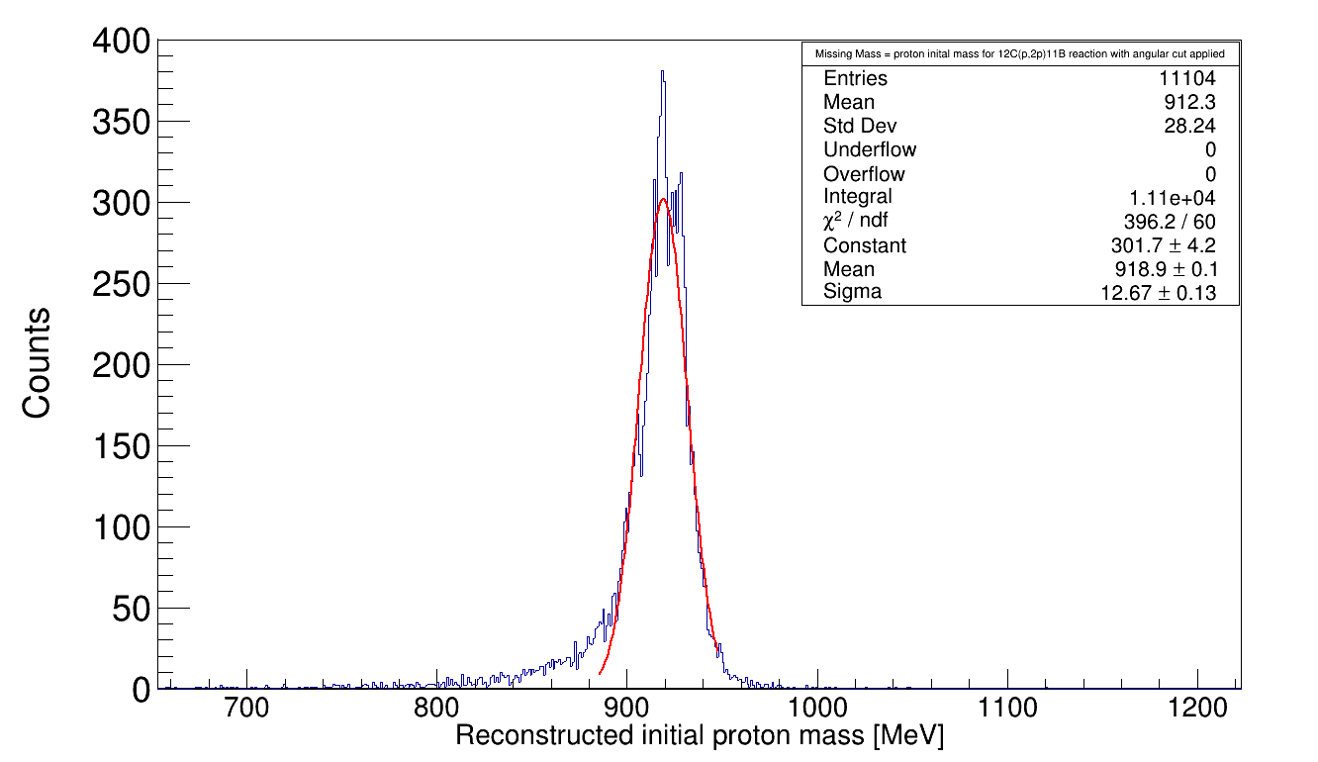
Mass reconstuction of p_i
Before Scattering:
After Scattering:
p₁
p_{i}
p_{tg}
p_{11B}
p₂
Looks ok, mean of 918 MeV is lower than expected….

Slide 12
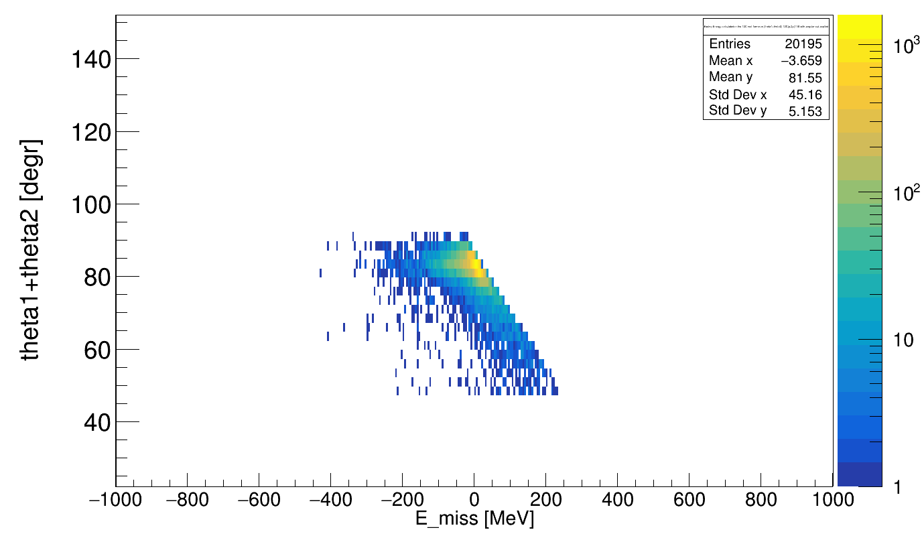
Missing Energy Distribution
Definition of Missing Energy *:
(where e_miss is the energy component of p_{missing})
E_{miss} = E_{initial} – E_{final}
( in 12C cms )
Cuts: θ₁ + θ₂ < 90° and Δφ = 180° +- 40°
But how can this prominent edge be explained?
E_{miss} = E_{Sep} + E_{Exc}
*From: https://www.nature.com/articles/s41567-021-01193-4.pdf

Slide 13
Analysis Missing Energy Distribution
Explicit calculation of the Missing Energy (in the 12C frame):
E_{miss} = E_{tgkin} - E_{p1kin} – E_{p2kin}
E’_{p1}
E_pot_{p1}
E_pot_{p2}
E’_{p2}
E_{tgkin}
E_{kin1}
E_{kin2}

Slide 14
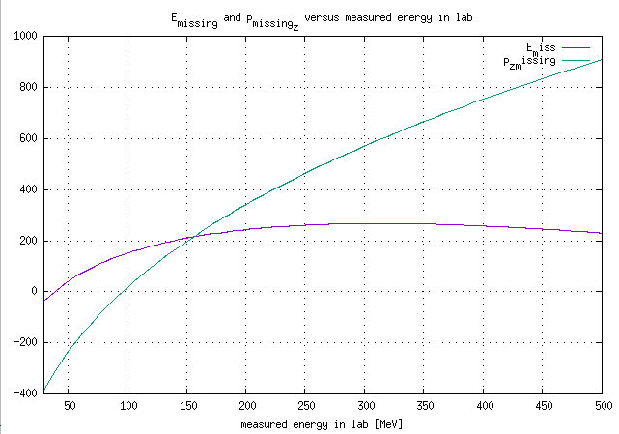
E_missing and p_z_missing for different opening angles
For simplicity let’s say θ₁ = θ₂ and E_{kin1} = E_{kin2}. That means for theta_sum = 44 ° → θ₁ = θ₂ = 22°
Maximum ≈ 270 MeV

Slide 15
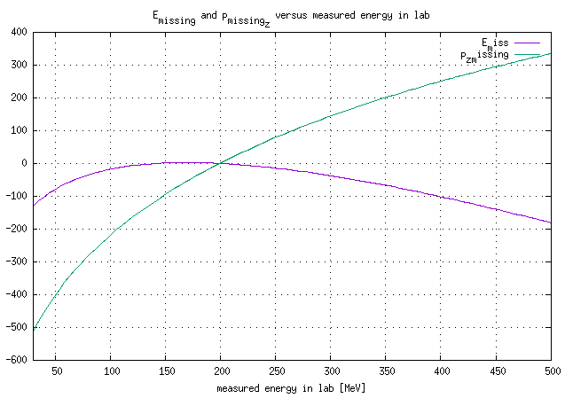
E_missing and p_z_missing for θ₁ = θ₂ = 42°
Quasi-Free Scattering reaction
≈ 84°

Slide 16
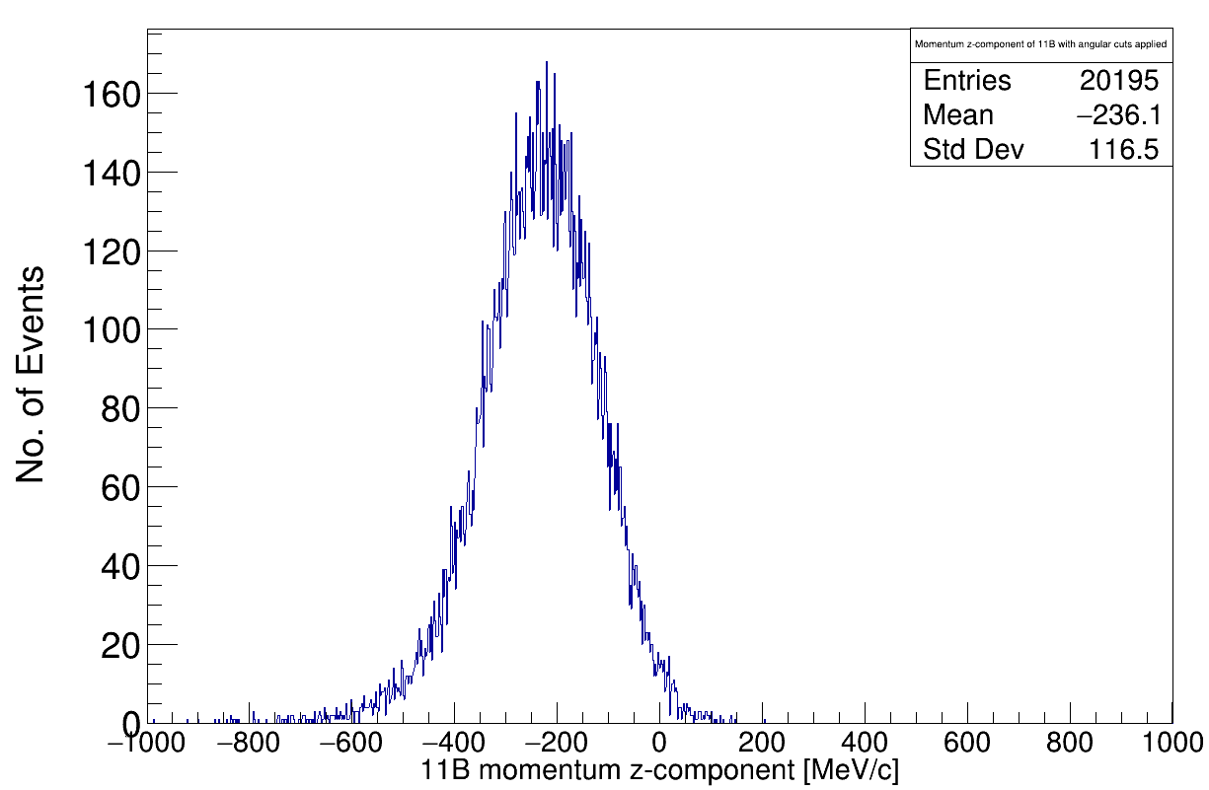
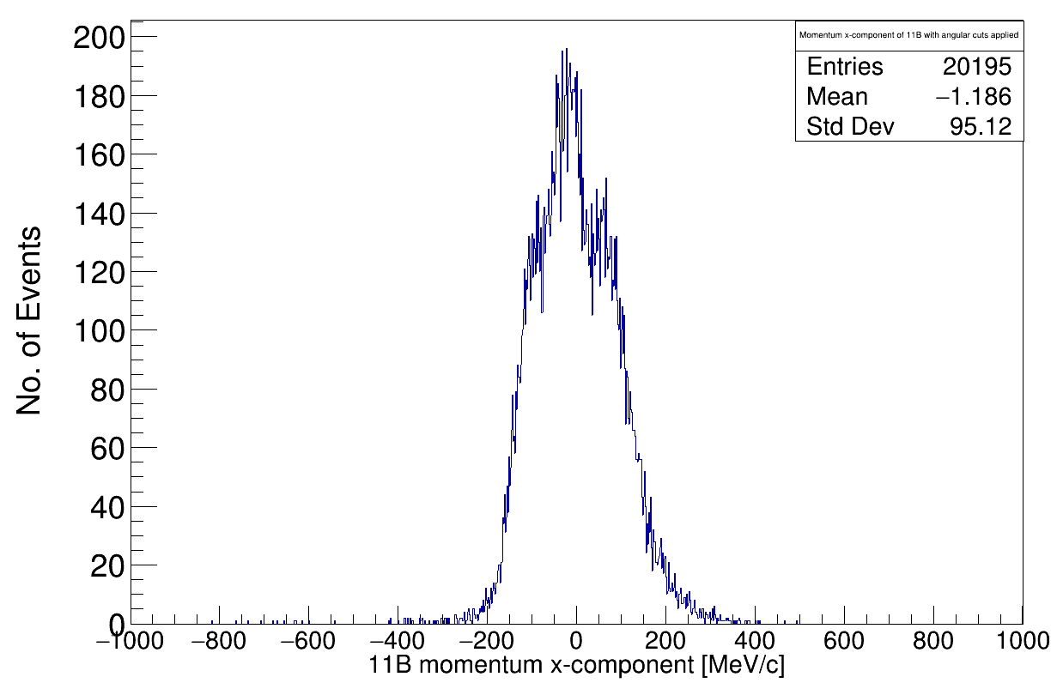
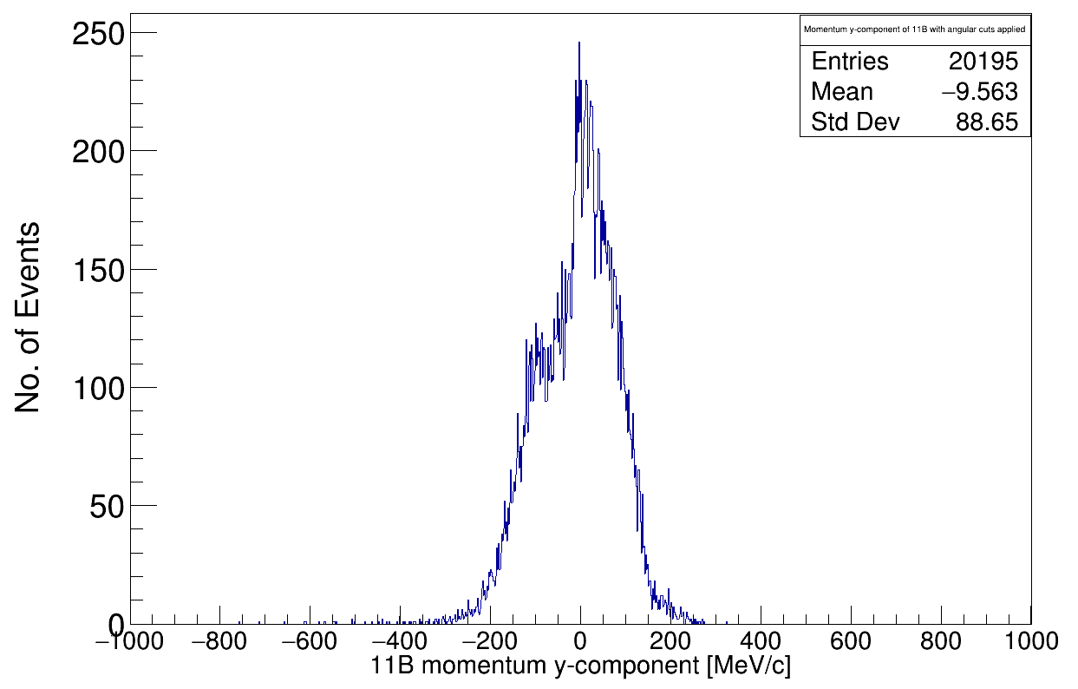
Momentum components of p_{11B}
Before Scattering:
After Scattering:
p₁
p_{i}
p_{tg}
Spectator!
p_{11B}
p₂
p_{11B} Momentum-Components (with angular cuts applied)
x-comp.
y-comp.
z-comp.

Slide 17
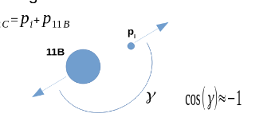
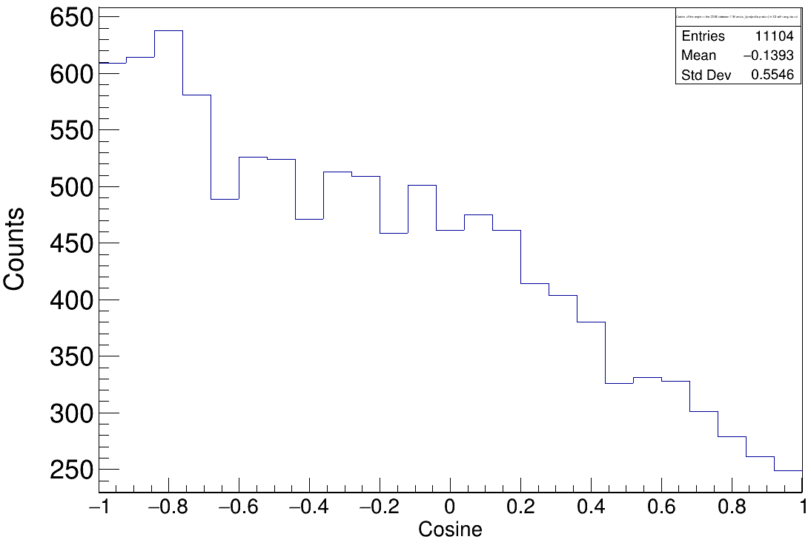
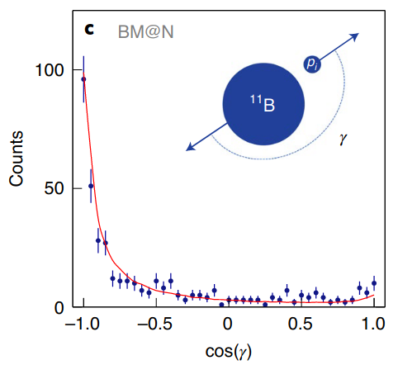
Inner angular distributions
p_{i} determined by angle and energy deposition of p1 and p2
p_{11B} determined by ToF and tracking detectors (MWPCs)
(p11B_y was calculated by y-position in MW1 and MW2)
Not satisfactory….
See: https://www.nature.com/articles/s41567-021-01193-4.pdf
Here I plotted the angle between the 3D vectors p_{i} and p_{11B}
This is the angle in the x-y plane

Slide 18
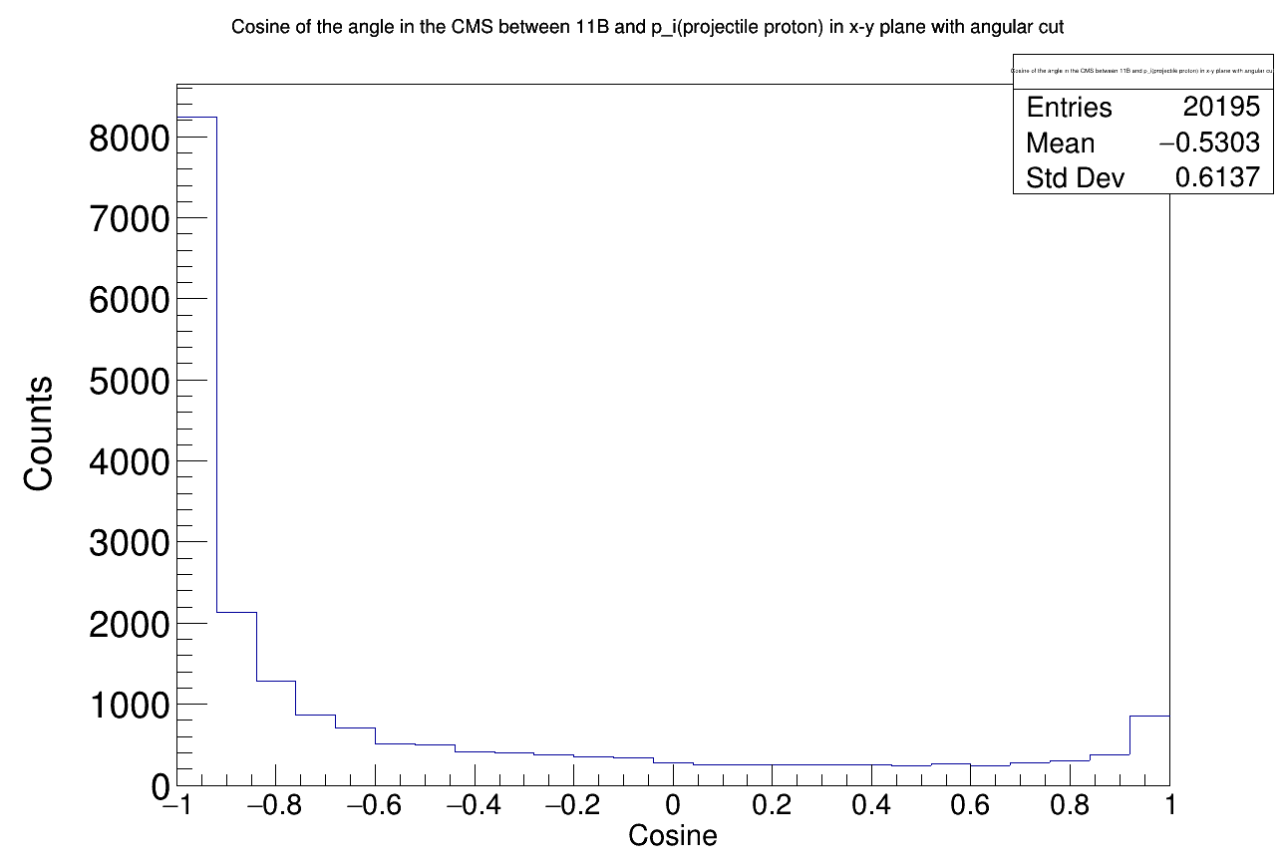
Angular Distribution in x-y plane
Therefore the y position was determined using MWPC3
(larger lever arm)
The y-position of MWPC3 has been reversed (+y→-y and -y→+y)
Moreover:
* MW0X inverted
* MW1Y and MW2Y swapped

Slide 19
Spatial Correlation of the Reaction Products
Assuming no inner momenta of the 12C constituents p_{i} and p_{11B}:
→ scattering would take place in reaction plane
Reaction plane
p₁
p_{tg}
p₂
p_{i}
p_{11B}
p_{11B}

Slide 20
Spatial Correlation of the Reaction Products
Assuming no inner momenta of the 12C constituents p_{i} and p_{11B}:
→ scattering would take place in reaction plane
BUT:
→ there are components perpendicular to the reaction plane!
Reaction plane
p₁
p_{tg}
p₂
p_{i}
p_{11B}
p_{11B}

Slide 21
Spatial Correlation of the Reaction Products
As measure of the overall perpendicular fraction to the reaction plane*:
or
Due to momentum conservation:
*Further details: https://www.sciencedirect.com/science/article/abs/pii/S0375947405008523

Slide 22
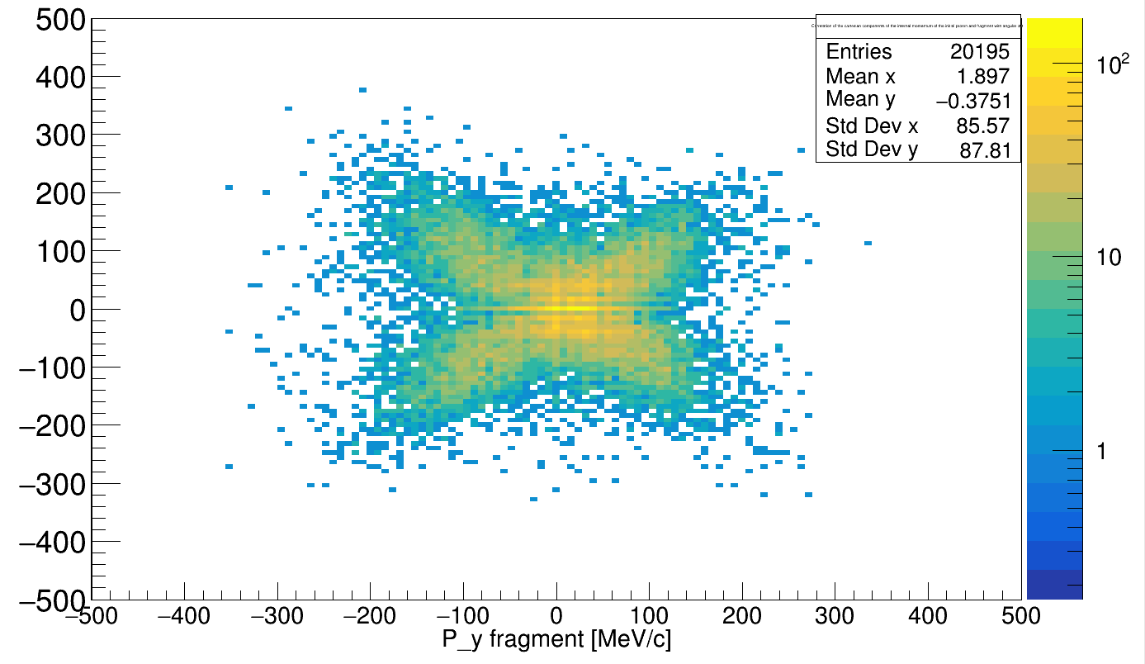
Q_{tr12} vs. |p_y_{11B}|
Q_{tr12} / Q_{tr21}

Slide 23
Q_{tr12} vs. |p_y_{11B}|
Q_{tr12}
Q_{tr12} / Q_{tr21}
Q_{tr21}

Slide 24
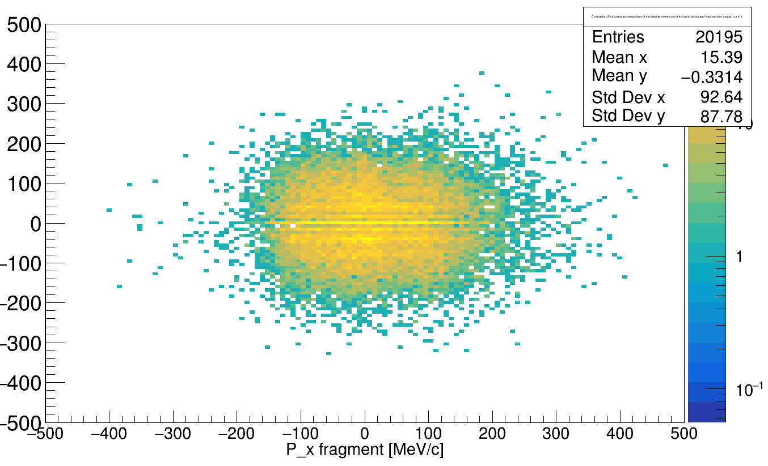
Q_{tr12} vs. |p_x_{11B}|
due to restricted geom. acceptance in iPhos region
Q_{tr12} / Q_{tr21}

Slide 25
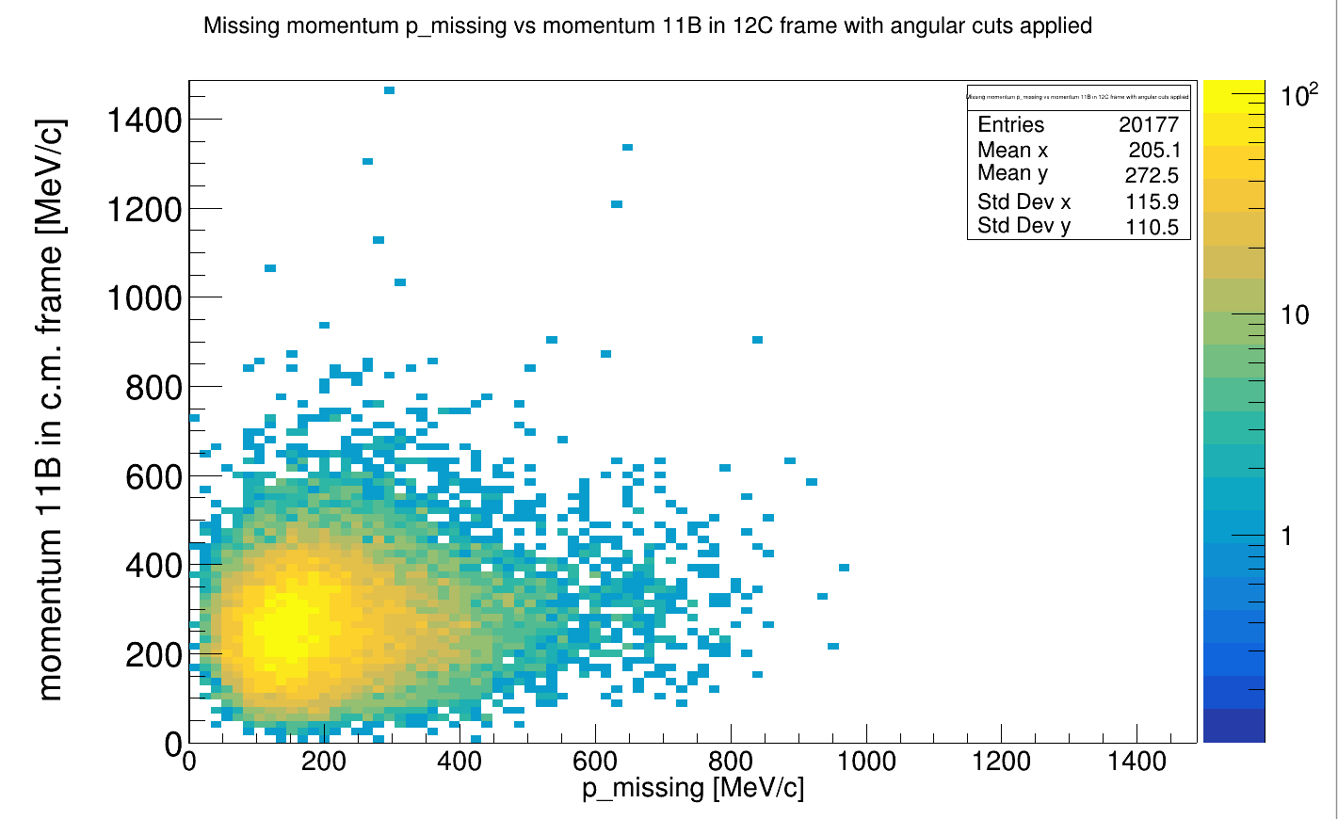
Momentum p_i vs p_11B in 12C
in 12C frame

Slide 26
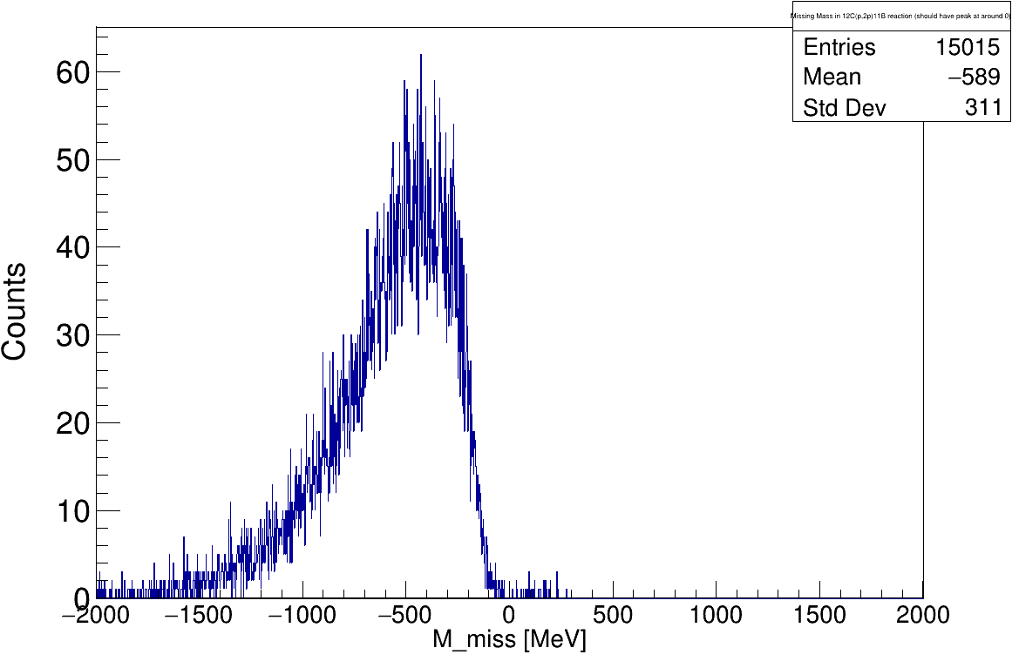
Missing Mass Reconstruction
( should be ≈ 0 )
before scattering
after scattering
???
p₁
p_{tg}
p_{11B}
p_{12C}
p₂

Slide 27
12C(p,ppn/pd)10B Reaction
Neutron Evaporation:
12C(p,pd)10B:
Short-Range-Correlated (SRC) Pair:
- possible explanation for the EMC – effect
- nucleon pairs with high relative and low c.m. momentum (compared to Fermi momentum k_{F})

Slide 28
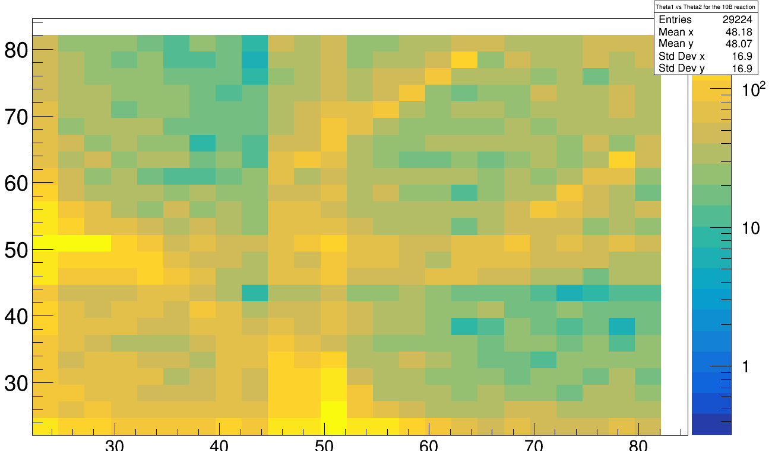
First (Polar) Angular Plots ...
θ₁(proton 1) vs. θ₂ (proton2) without any angular restrictions:
Constraints:
E_{1lab} and E_{2lab} > 30MeV
Identification of 10B
θ₂[°]
θ₁[°]

Slide 29
First (Polar) Angular Plots ...
θ₁(proton 1) vs θ₂ (proton2) without any angular restrictions:
θ₂[°]
Full Acceptance in Barrel Region
θ₁[°]

Slide 30
First (Polar) Angular Plots ...
θ₁(proton 1) vs θ₂ (proton2) without any angular restrictions:
???
θ₂[°]
Full Acceptance in Barrel Region
θ₁[°]

Slide 31
First (Polar) Angular Plots ...
θ₁(proton 1) vs θ₂ (proton2) without any angular restrictions:
Cluster algoritm:
CalifaCal2Hit->SetConeAlg(0.25)
θ₂[°]
θ₁[°]

Slide 32
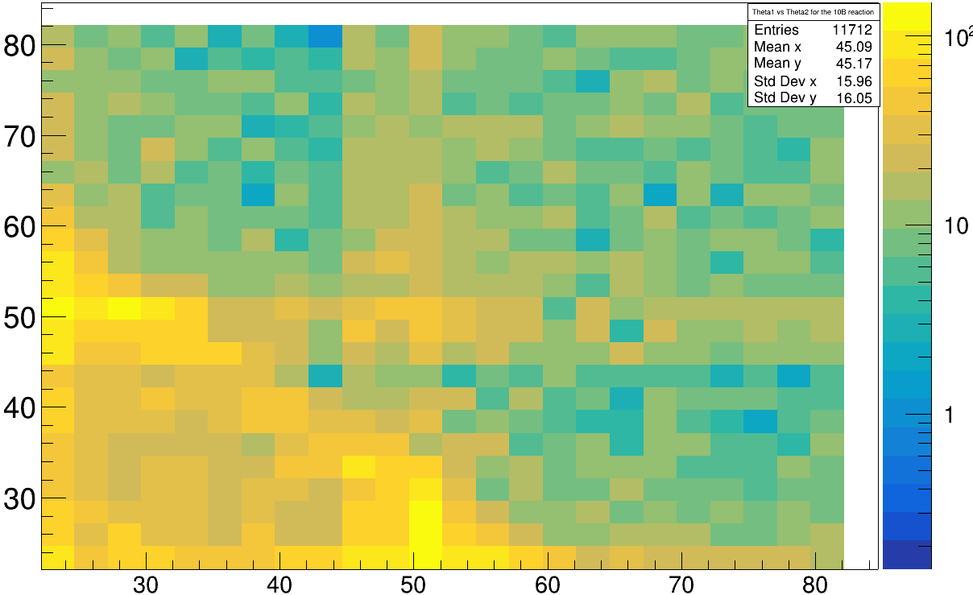
First (Polar) Angular Plots ...
θ₁(proton 1) vs θ₂ (proton2) with angular cut: Δφ > 100°
θ₂[°]
θ₁[°]

Slide 33
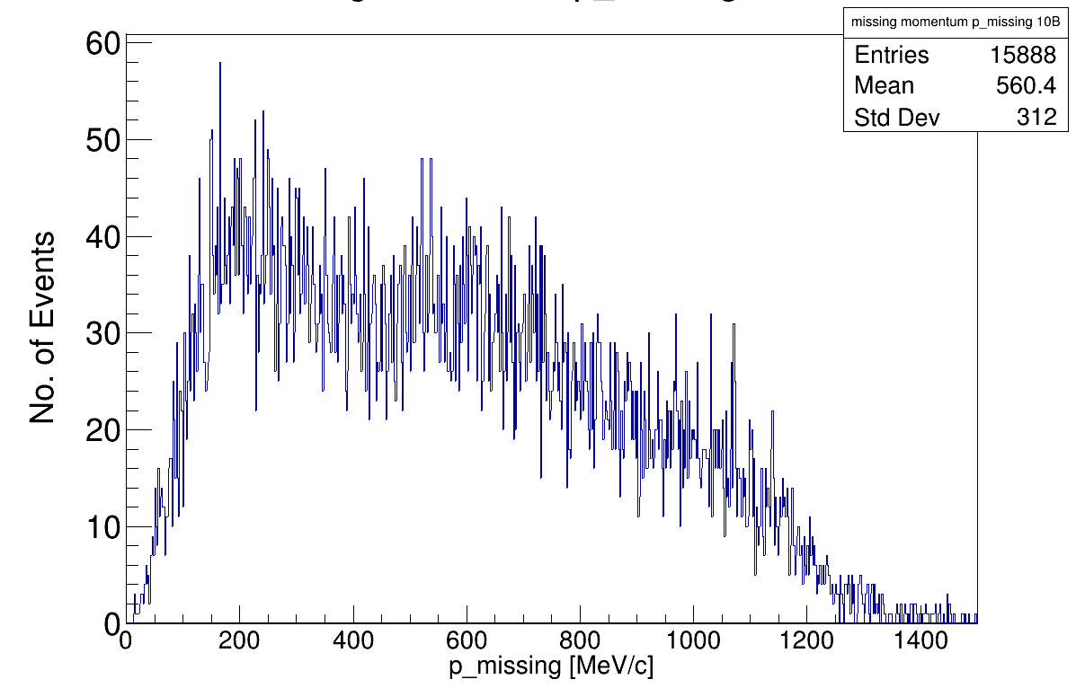
Reconstruction of inner momentum p_i

Slide 34
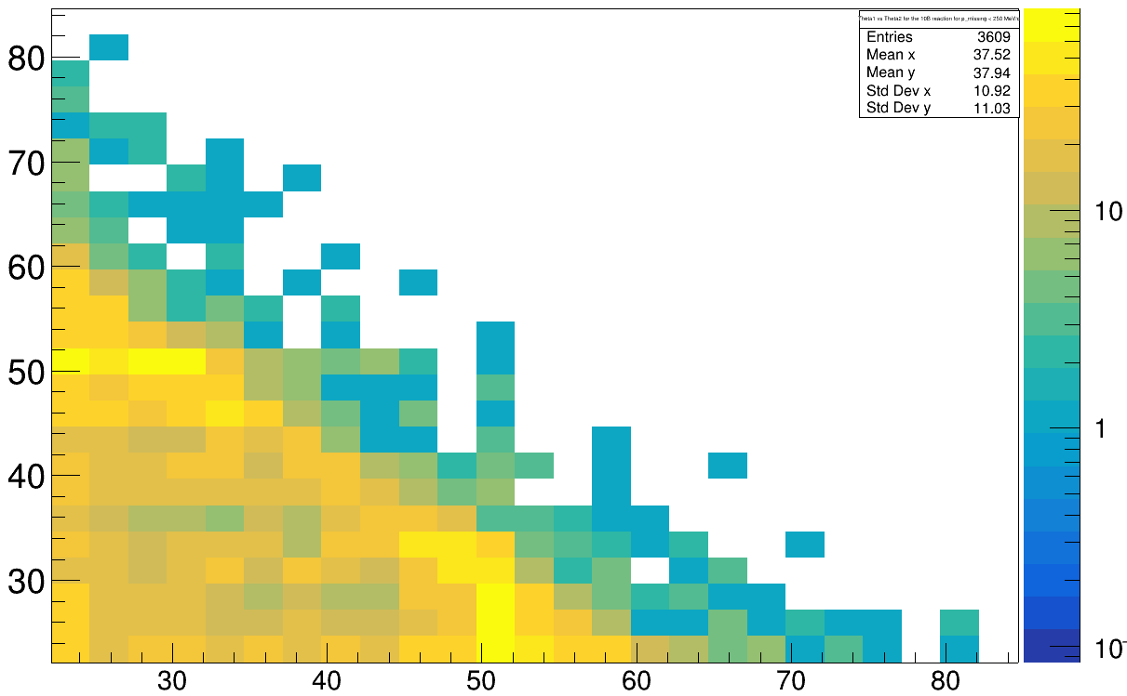
Angular Distribution for |p_i| < 250
θ₂[°]
θ₁[°]

Slide 35
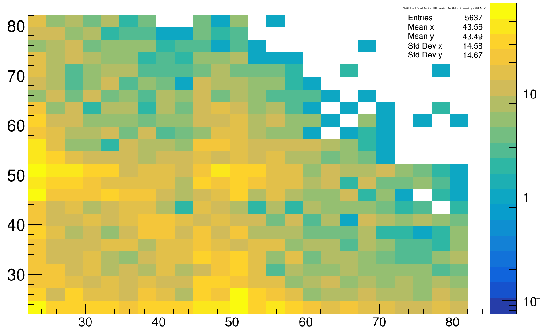
Angular Distribution for 250 MeV/c < |p_i| < 650 MeV/c
θ₂[°]
θ₁[°]

Slide 36
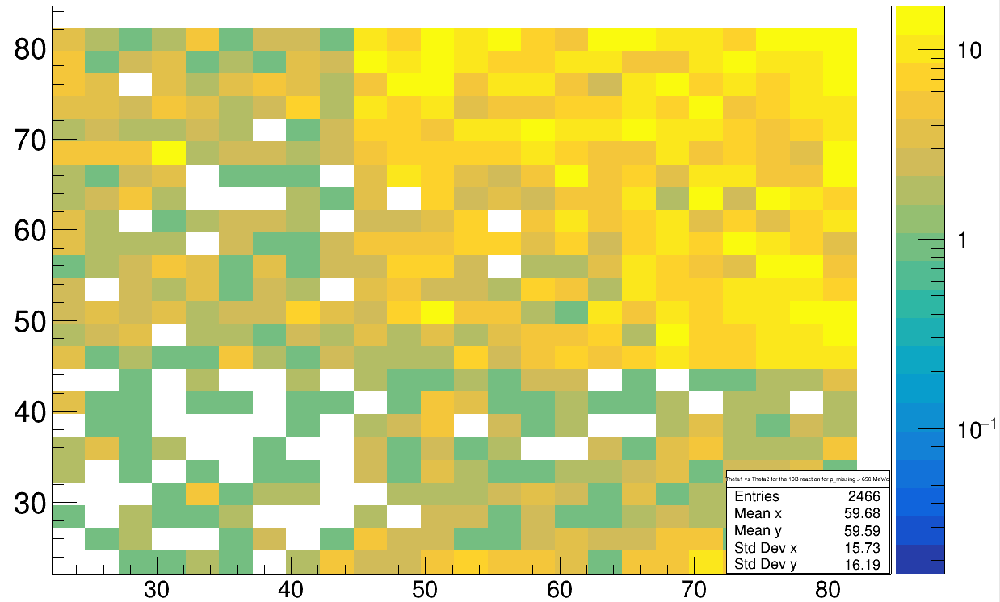
Angular Distribution for |p_i| > 650 MeV/c
θ₂[°]
θ₁[°]

Slide 37
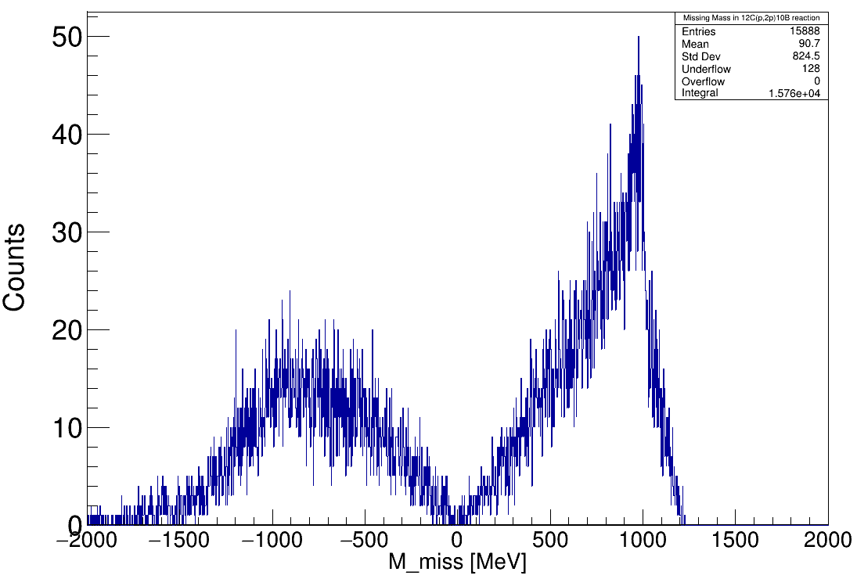
Neutron Mass Reconstruction
before reaction
after reaction
???
Possible Explanations:
→ boosting effects / z-shift
→ further checks needed

Slide 38
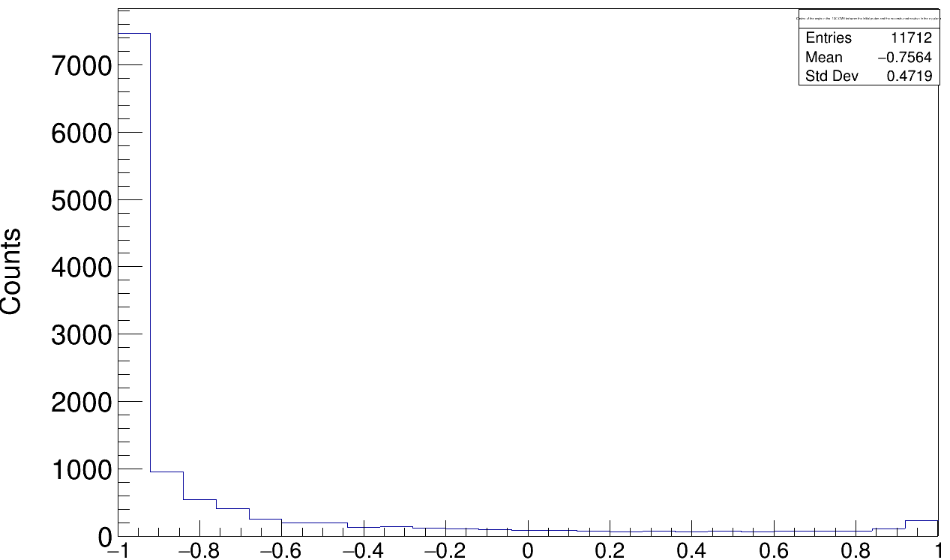
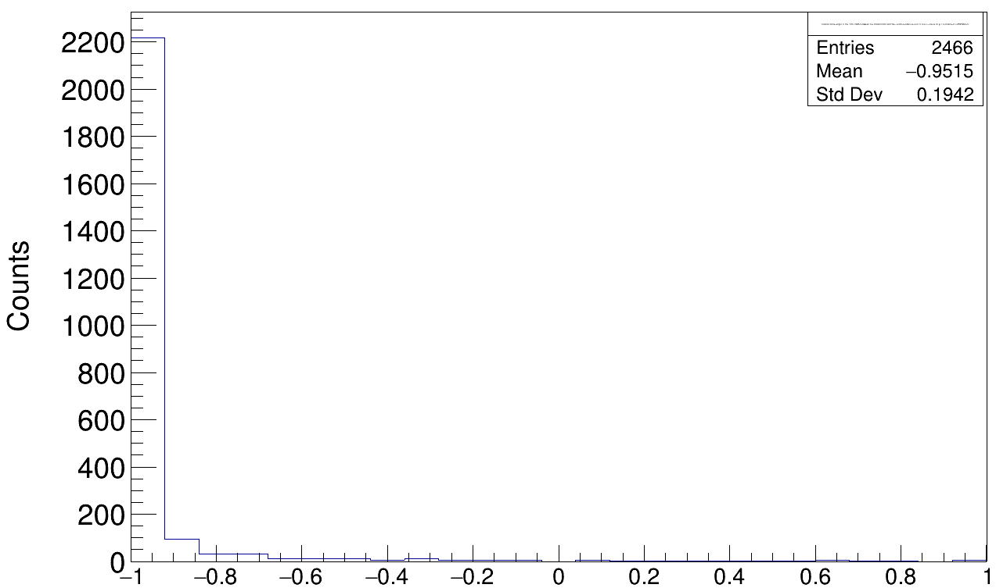
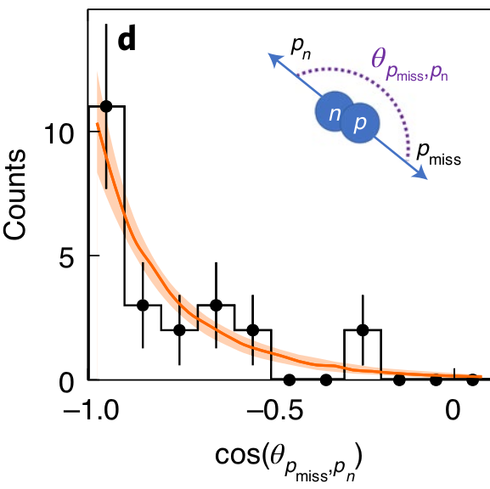
Angular Correlations for 12C(p,ppn/pd)10B in the x-y plane
Cut: |p_{i}| > 650 MeV/c
n
p
in 12C frame
in 12C frame
Compare to:
https://www.nature.com/articles/s41567-021-01193-4.pdf
Tobias Jenegger

Slide 39
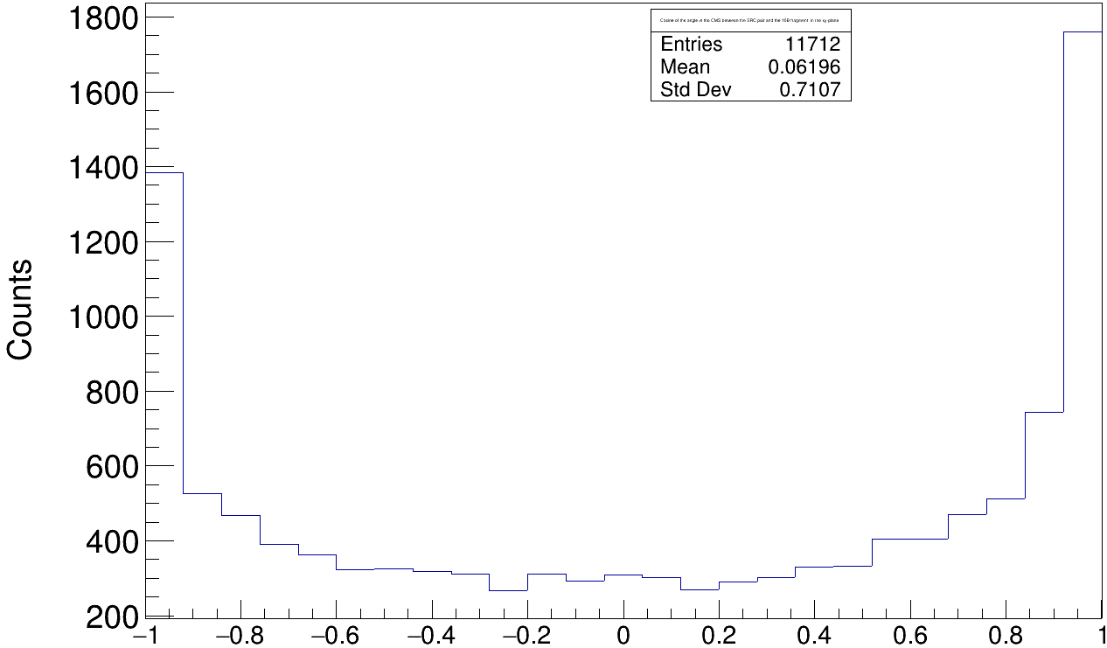
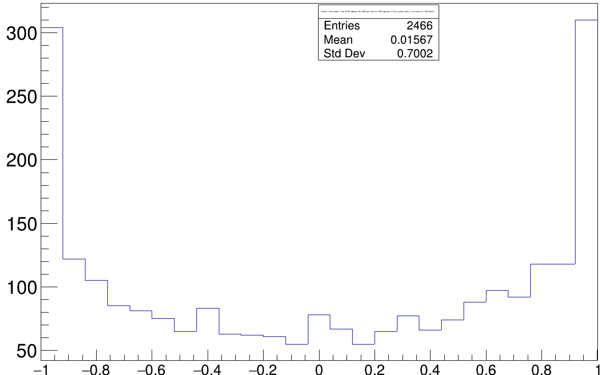
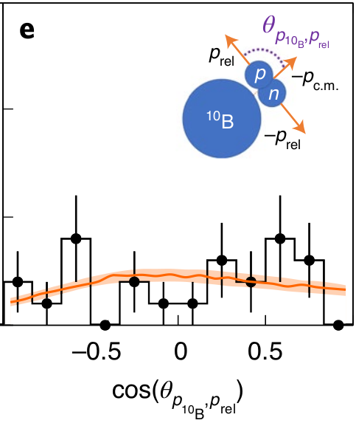
Angular Correlations for 12C(p,ppn/pd)10B in the x-y plane
p
Cut: |p_{i}| > 650 MeV/c
n
¹⁰B
with:
Compare to:
https://www.nature.com/articles/s41567-021-01193-4.pdf
Tobias Jenegger

Slide 40
Summary & Outlook
12C(p,2p)11B Quasi Free Scattering looks promising
But: Momentum shift in z-direction has to be further analyzed
For 12C(p,ppn/pd)10B already first results
How to distinguish between the three reaction types? (Deuteron detection with N_{f}-N_{s} information from CALIFA? Reasonable cuts?)
SRC - pair
Deuteron Knockout
Neutron Evaporation

Slide 41
Thank you!

Slide 42
Backup

Slide 43
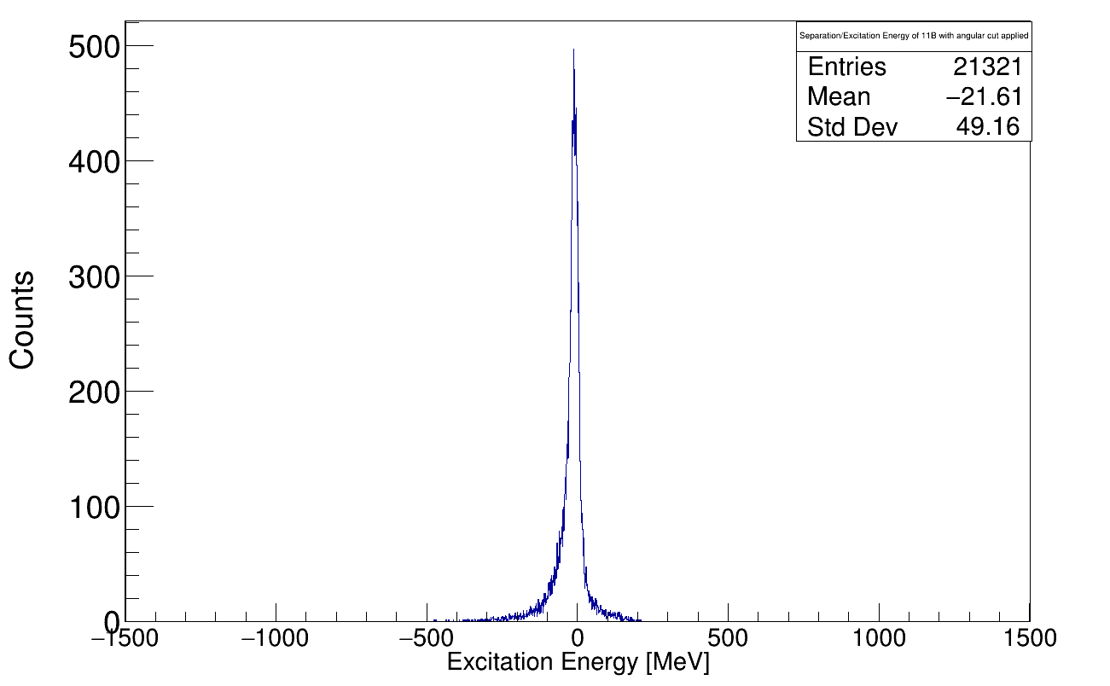
Excitation Energy of 11B
-p_{i}
Is this formula valid?

Slide 44
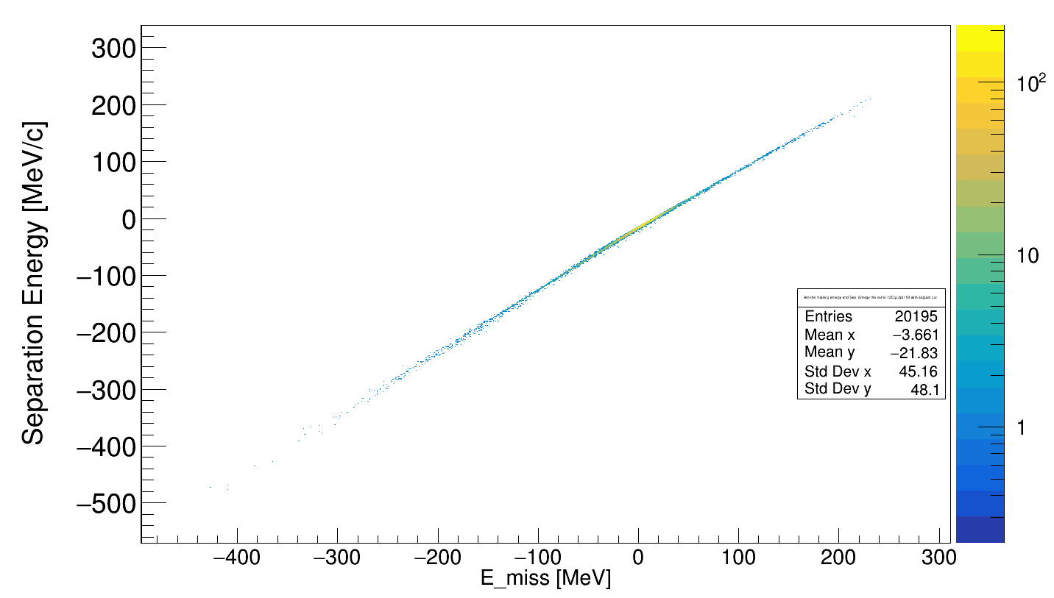
Excitation Energy vs. E_miss
Excitation Energy [MeV]

