Slide 1

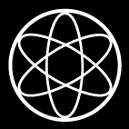
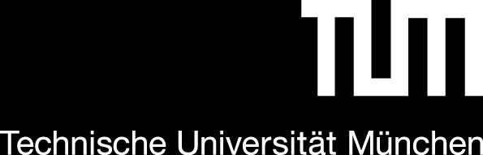




Energy Clustering in CALIFA
Status Update
Overview Clustering Models
Agglomerative Clustering + Linear Model
SR model ….
Tobias Jenegger
Funded by the Deutsche Forschungsgemeinschaft (DFG, German Research Foundation)
under Germany’s Excellence Strategy – EXC-2094 – 390783311,
BMBF 05P19WOFN1, 05P21WOFN1
and the FAIR Phase-0 program
Physics with R³B
CALIFA – Design
TUM Members:
Roman Gernhäuser,Lukas Ponnath,Philipp Klenze,Tobias Jenegger

Slide 2
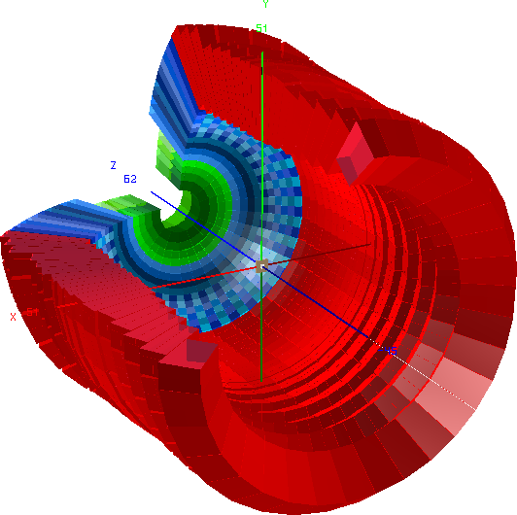

CALIFA Detector @ R³B
CALorimeter for the In Flight detection of γ-rays and light charged pArticles
Endcap:
iPhos:
512 CsI(Tl) crystals
CEPA:
96 LaBr3 &
LaCl3 crystals
What do we measure?
-Energy (100 keV γ-rays – 700 AMeV charged particles)
-Position
-Time
Barrel:
1952 CsI(Tl) scintillator crystals
BEAM
Over 2500 crystal channels!

Slide 3
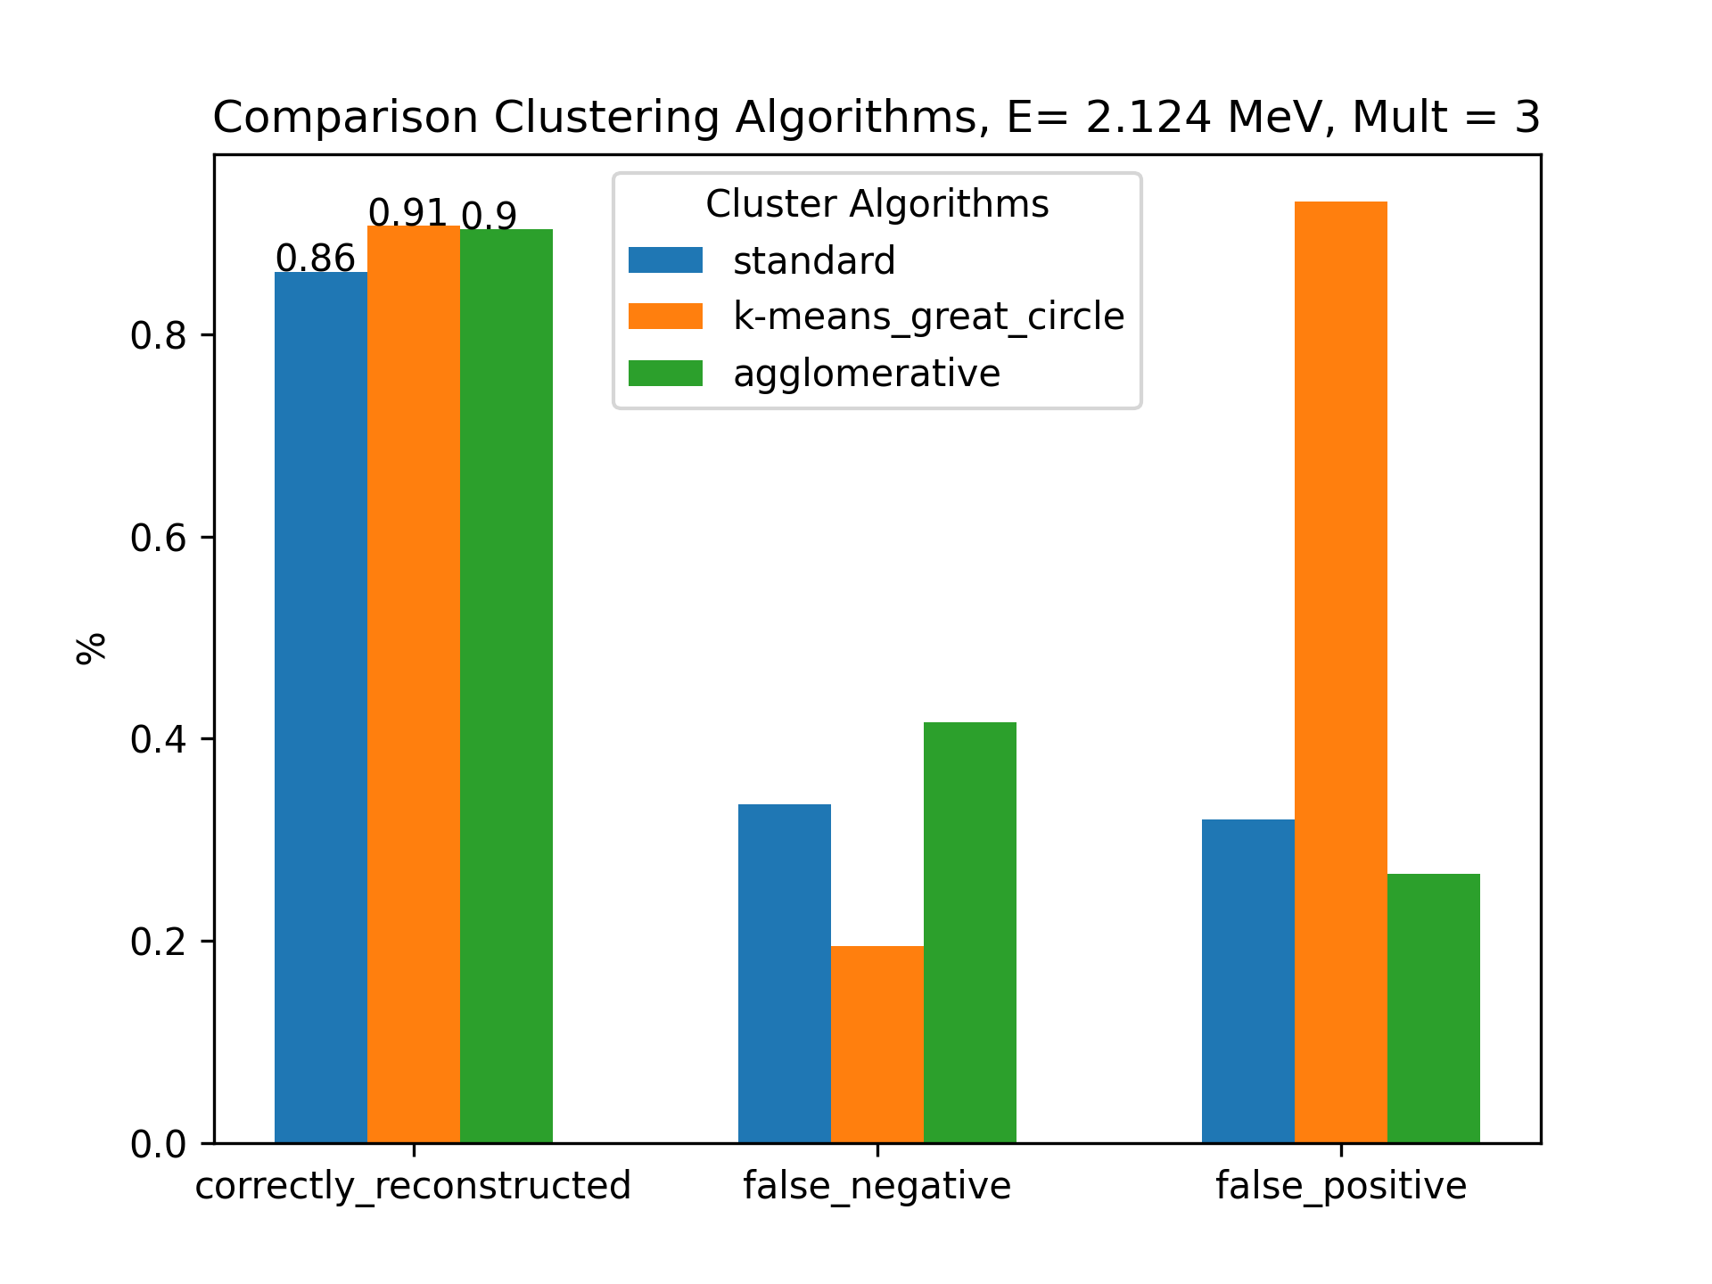
Summary Clustering Methods

Slide 4
Agglomerative Clustering + Linear Model
The Idea behind:
case A
→ First clusterize the data with agglomerative method
→ Select two types of events:
A) events with two subevents and two correctly reconstructed clusters
B) events with only one event but wrongly reconstructed two clusters
case B

Slide 5
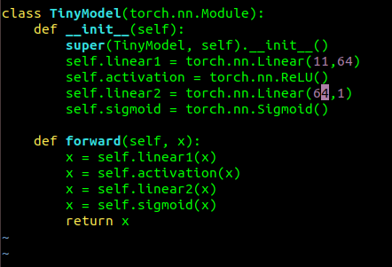
Feeding the Linear Model
Input:
Case A :
Case B:
E₁,θ₁,φ₁,t₁,E₂,θ₂,φ₂,t₂,abs(Δθ),abs(Δφ),abs(Δt),0
Values φ,θ,t(ime) are the center of mass values
E₁,θ₁,φ₁,t₁,E₂,θ₂,φ₂,t₂,abs(Δθ),abs(Δφ),abs(Δt),1
Input dim: 11
Output dim: 1
See: https://github.com/jenegger/agglo_linear_model

Slide 6
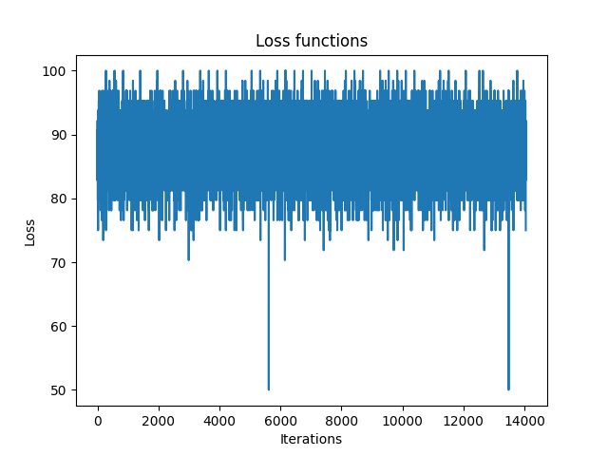
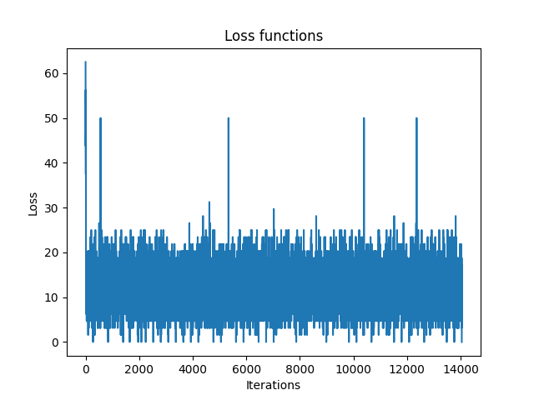
Model Parameters:
Input features: 11
nn.Linear- features: 64/32/16/8/4
Output features: 1
Batch-size: 64/32/16
Learning-rate: 3e-4
Optimizer: SGD/Adam
num_epochs: 50/500
Loss Function- BCELoss
Loss does not seem to decrease
Changing different parameters , eg. nn.Linear features, lr, batchsize does not change behaviour
Is the data size to small?
Since there is no tendency of decreasing loss, this does not seem to be the bottleneck
Data Input:
sample size: 17924 from which
→ 2127 case B (bad reco)
→15797 case A (well reco)

Slide 7
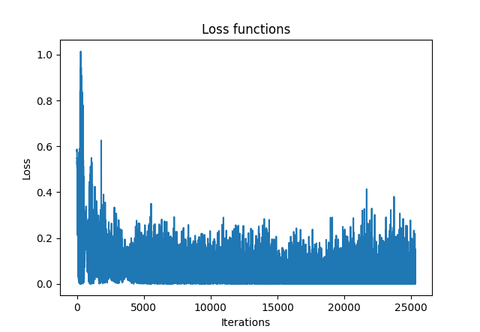
Now with time normalization
Best hyper-parameters
Learning rate: 8e-5
nn.Linear features : 64
Batchsize: 64
Optimizer: SGD
Num. Epochs: 100

Slide 8
Other Idea:
Compute all different combinations of the hits & appropriate mask
Input data:
Events, with 3 true clusters and e.g. 9 hits
511 combinations for 9 hits
Feed the combinations to a Model
Mask:
hit_i & hit_j do not belong to same true cluster → 0
hit_i & hit_j belong together and are the complete cluster → 1
hit_i & hit_j belong together and are part of bigger cluster → E_i+E_j /E_true
Issue: multi-dimensional model,
CNN is needed

Slide 9
Appendum - MLSegmenter Model

Slide 10
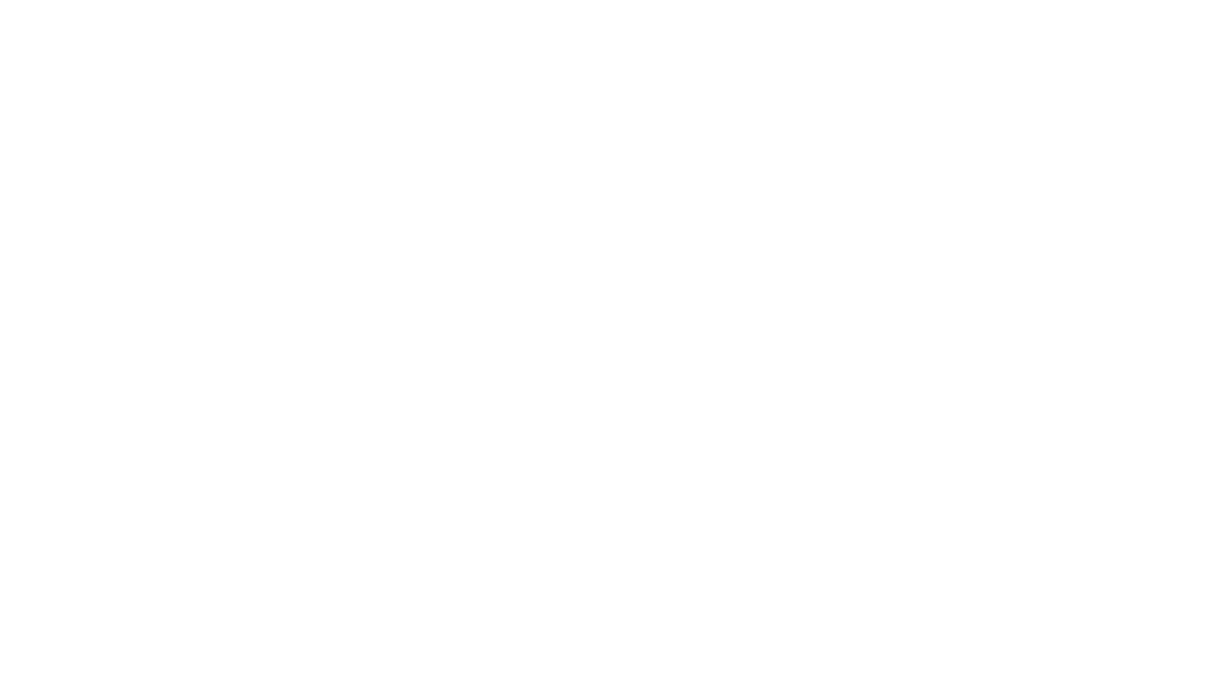
Clustering of CALIFA Data with MLSegmenterTorch Model
Adapt input shape, clusternr. Etc.
mlsegmenter = MLSegmenterTorch(image_shape=(1,27,112), nslots_max=3,
encoder_output_shape=(256,1,7), nlatent=16, encoder_class=Encoder_ae,
decoder_class=DecoderCNN_Resnet5, slotmaker_class=Slotmaker_ae)
Q: Should I use nslots_max= 3 or should I use a higher number so that the
algorithm tries to find the best cluster number?

Slide 11
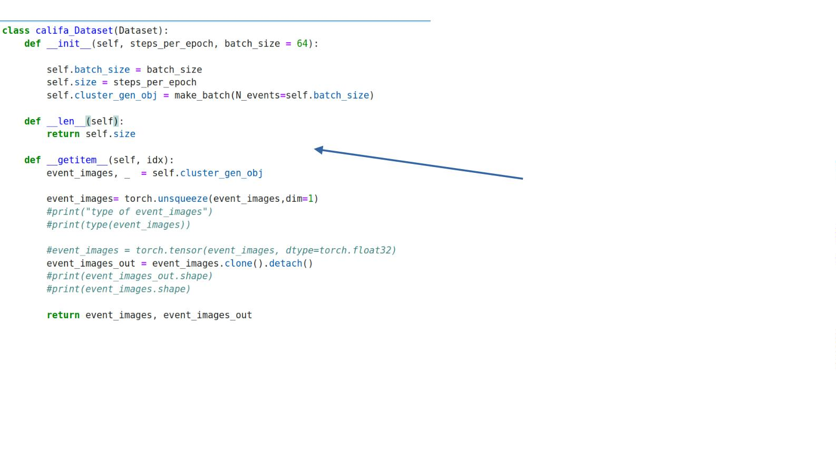
Califa DataSet Class
This function selects
randomly three clusters from
my simulated data and
merges them to one event

Slide 12
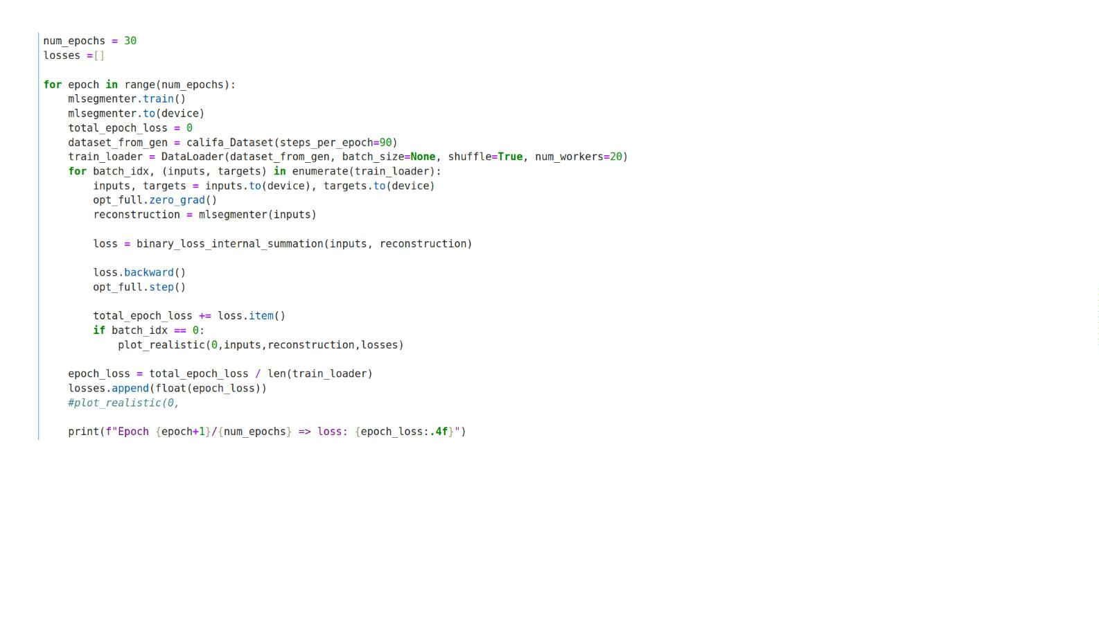
The final training steps:

Slide 13
How well does the Model train/perform?
Looking at the loss function progress it
seems to converge:
Epoch 1/30 => loss: 2.0170
Epoch 2/30 => loss: 1.3786
Epoch 3/30 => loss: 0.2274
Epoch 4/30 => loss: 0.0186
Epoch 5/30 => loss: 0.0057
Epoch 6/30 => loss: 0.0028
Epoch 7/30 => loss: 0.0017
Epoch 8/30 => loss: 0.0011
Epoch 9/30 => loss: 0.0008
Epoch 10/30 => loss: 0.0006
Epoch 11/30 => loss: 0.0005
Epoch 12/30 => loss: 0.0004
….
Seems good….
Epoch 30/30 => loss: 0.0001

Slide 14
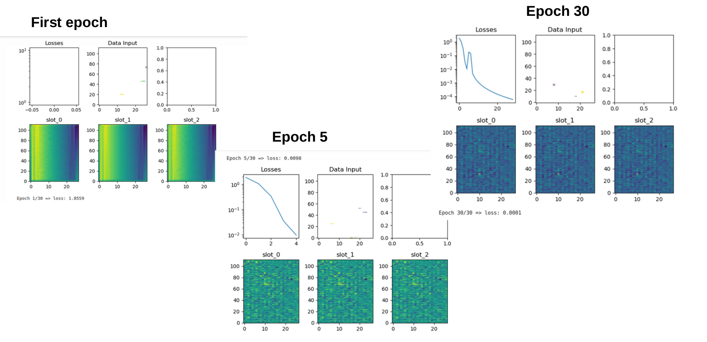
But when plotting the input data vs the reconstructed slots:

Slide 15
Short Summary
I tried to implement the MLSegmenter Model (only spatial info and energy info, time
info not yet)
→ the losses seem to converge
→ however clustering doesn’t seem to work. It seems so that the algorithm
converges to a state where all pixels in the slots go to 0
If you have any advices, spotted bugs in my code or ideas for
improvements please let me know!

Slide 16

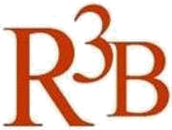

CALIFA @ Technical University of Munich (TUM)
Roman Gernhäuser, Lukas Ponnath, Philipp Klenze, Tobias Jenegger
Thank you!

