Slide 1





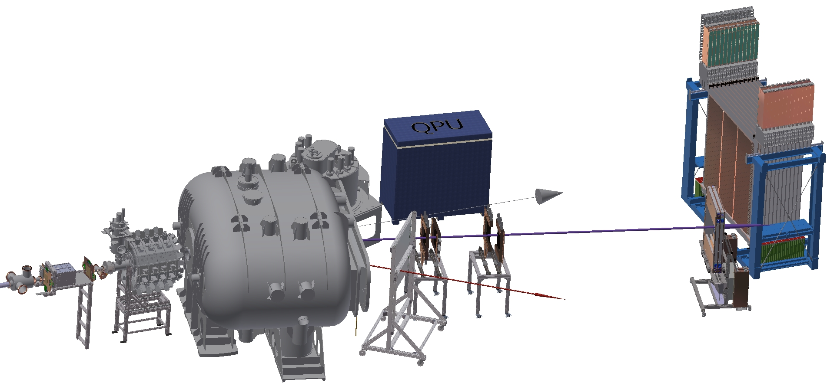

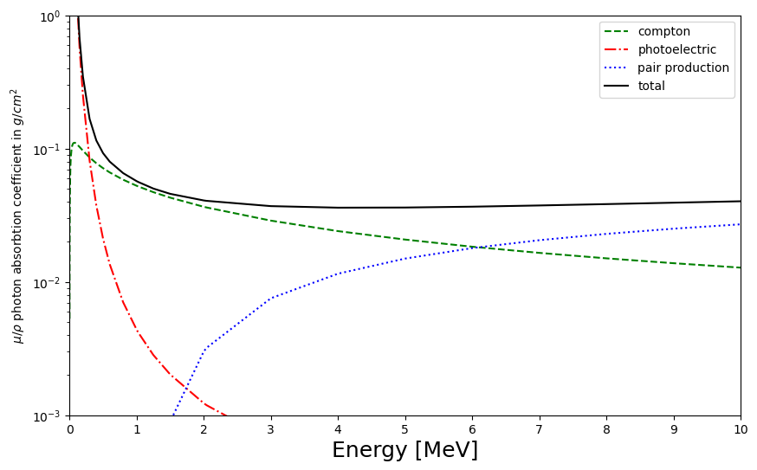
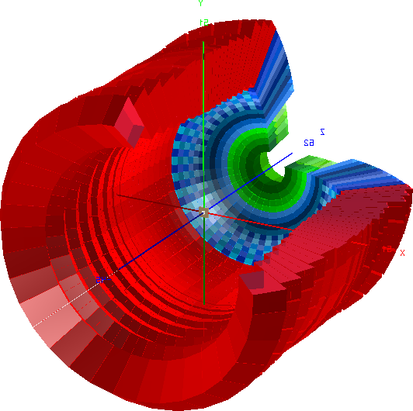
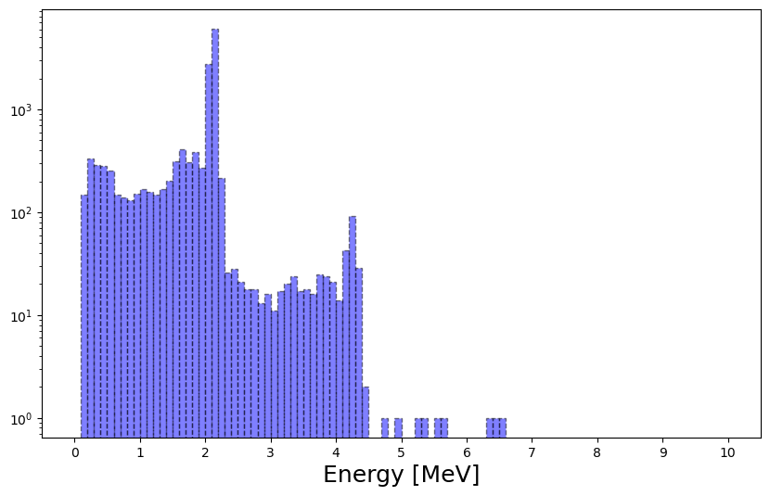
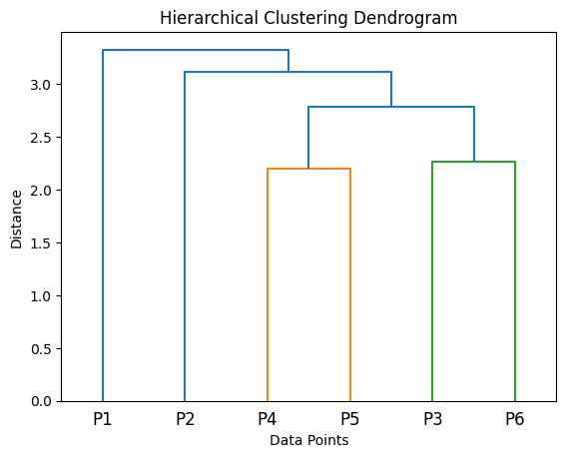
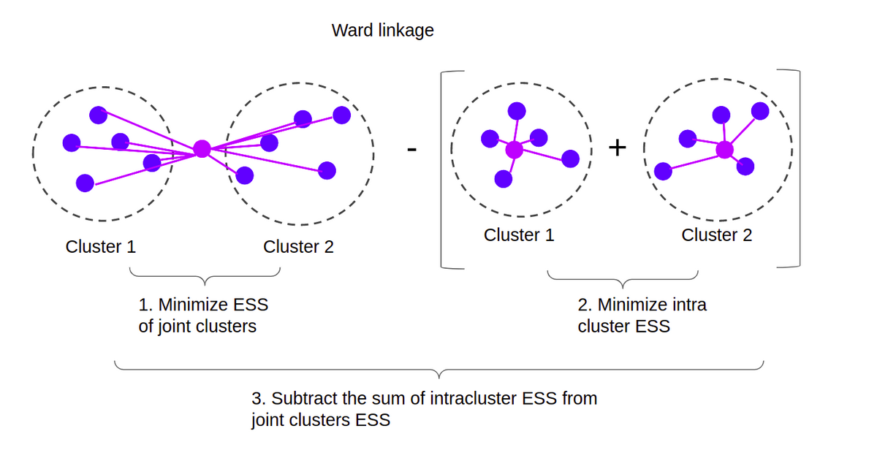
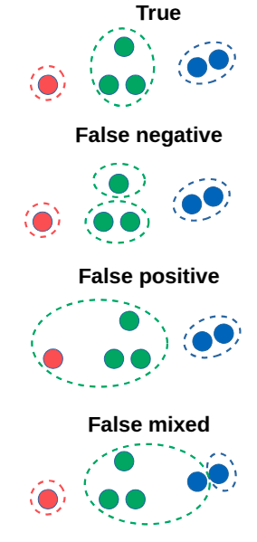
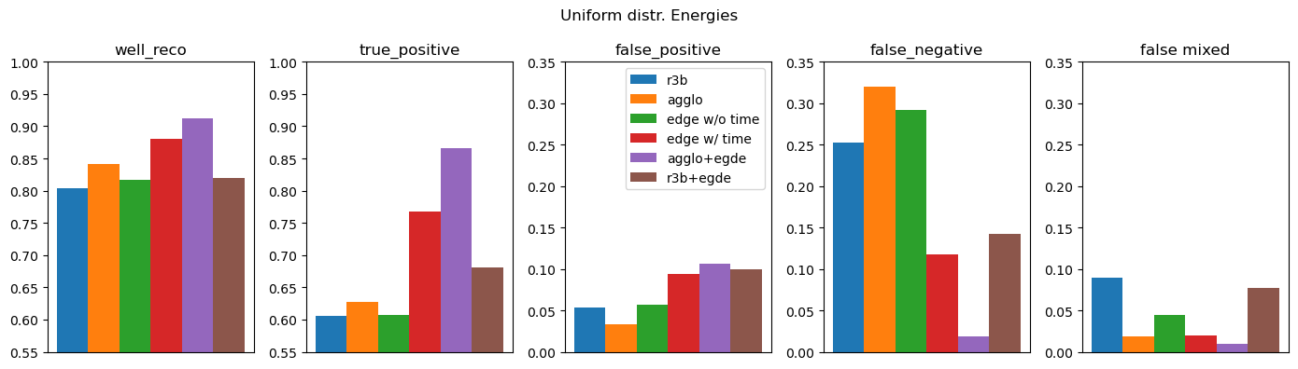
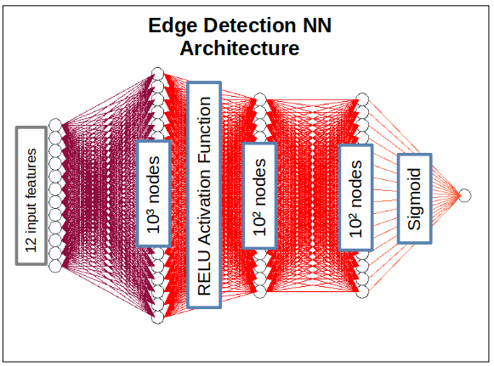


7th IML Workshop 2025
Machine Learning for the Cluster Reconstruction in the CALIFA Calorimeter at R³B
T. Jenegger, R. Gernhäuser for the R³B Collaboration
TUM School of Natural Sciences, Physics Department, E62, Technical University of Munich, Garching, Germany
CALIFA – Detection of gammas and light charged particles @ R³B
nucleus of interest
CALIFA
Interaction process photons – scintillator material
kinematically complete measurements
Endcap:
iPhos:
480 CsI(Tl) crystals
CEPA:
96 CsI(TI)
crystals
Photon absorbtion in CsI
neutrons
heavy fragment branch
Barrel:
1952 CsI(Tl) scintillator crystals
light fragment branch
BEAM
Cluster reconstruction from 2.1 MeV simulated gammas
1
1
Photopeak
Hit observables:
Energy deposit E
Polar angle θ
Azimuthal angle φ
Hit-time t
3
2
1
Single escape peak
Physics Program:
Highly segmented detector with 2544 CsI(Tl) crystals in total
2
Experiment to study the structure of atomic nuclei and its astrophysical implications
4
3
511keV from escape peak
TODO: write out more...
4
Two merged photopeaks
Standard R3B Clustering
Agglomerative Clustering
CALIFA Standard Method for Cluster Recognition
Example plot….
Example plot….
User defines shape and size of cluster:
(and set energy threshold for single crystals)
Sort the hit list according to their energy
30. MeV
1. create cluster centered around first hit
2. loop over all hits in list
→ if hit inside cluster add it and remove it from the list
3. Do this procedure until list is empty
22. MeV
10. MeV
5. MeV
3. MeV
2.5 MeV
Hit – time is integrated as radius - > 3D hit: θ,φ,r(=time)
0.7 MeV
Edge Detection Neural Network
Pairwise hit comparison (i,j)
Metrics
RESULTS
12 input features:
E_{i,j}, θ_{i,j}, φ_{i,j}, t_{i,j}, ΔE_{ij}, Δθ_{ij}, Δφ_{ij}, Δt_{ij}
Various Edge Detection NN models analyzed:
Edge model with/without time information
R3B + Edge (without time)
Agglo + Edge (with time)
Pre-Clustered data is fed to the Edge model
Contact: Tobias Jenegger
tobias.jenegger@tum.de
Supported by
BMBF: 05P24WO2,
Excellence Cluster ORIGINS from the DFG
(Excellence Strategy EXC-2094-390783311)

