Slide 1
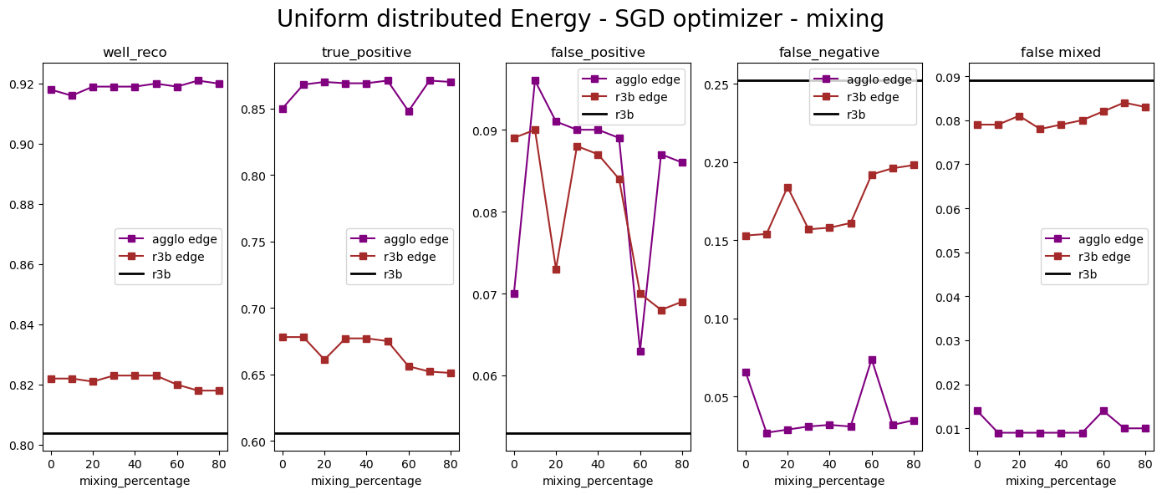
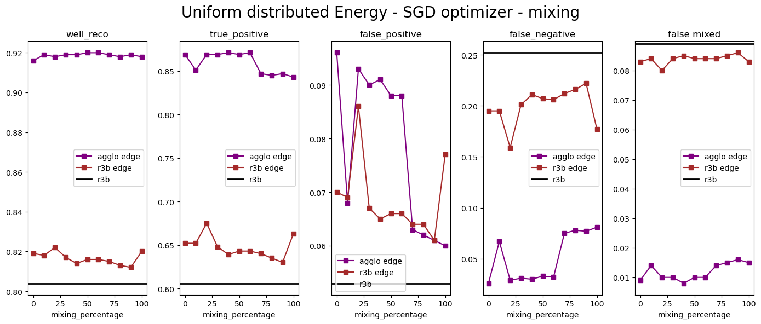
now check effect of mixing fn and true_pos for agglo + edge and r3b + edge
Lr= 9e-3, epochs = 80k
Lr= 5e-3, epochs = 80k
e.g. mixing percentage = 40 means that 40% true positive events is added to the number of the total fn_events

Slide 2
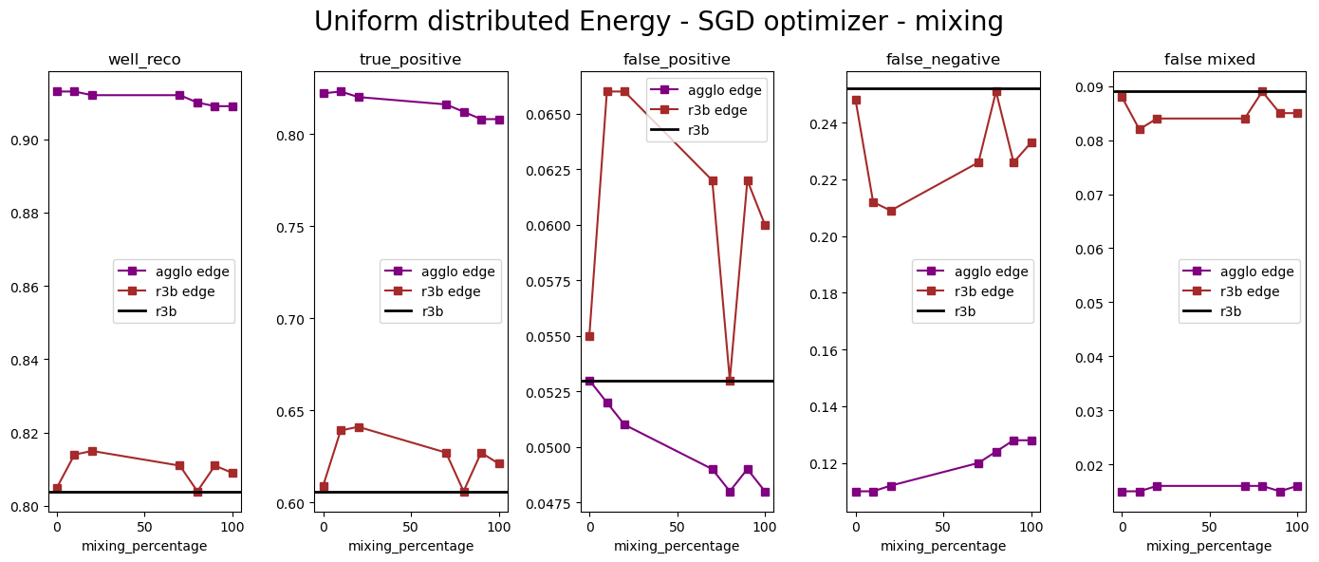
Ok, now tuning also prediction cut: 0.75 → 0.85
Lr= 5e-3, epochs = 80k
This is good!

Slide 3
Next TODOs:
Plot loss function
Apply Agglo+Edge and R3B+Edge to 2.4 MeV peak data, make nice plot

