Slide 1
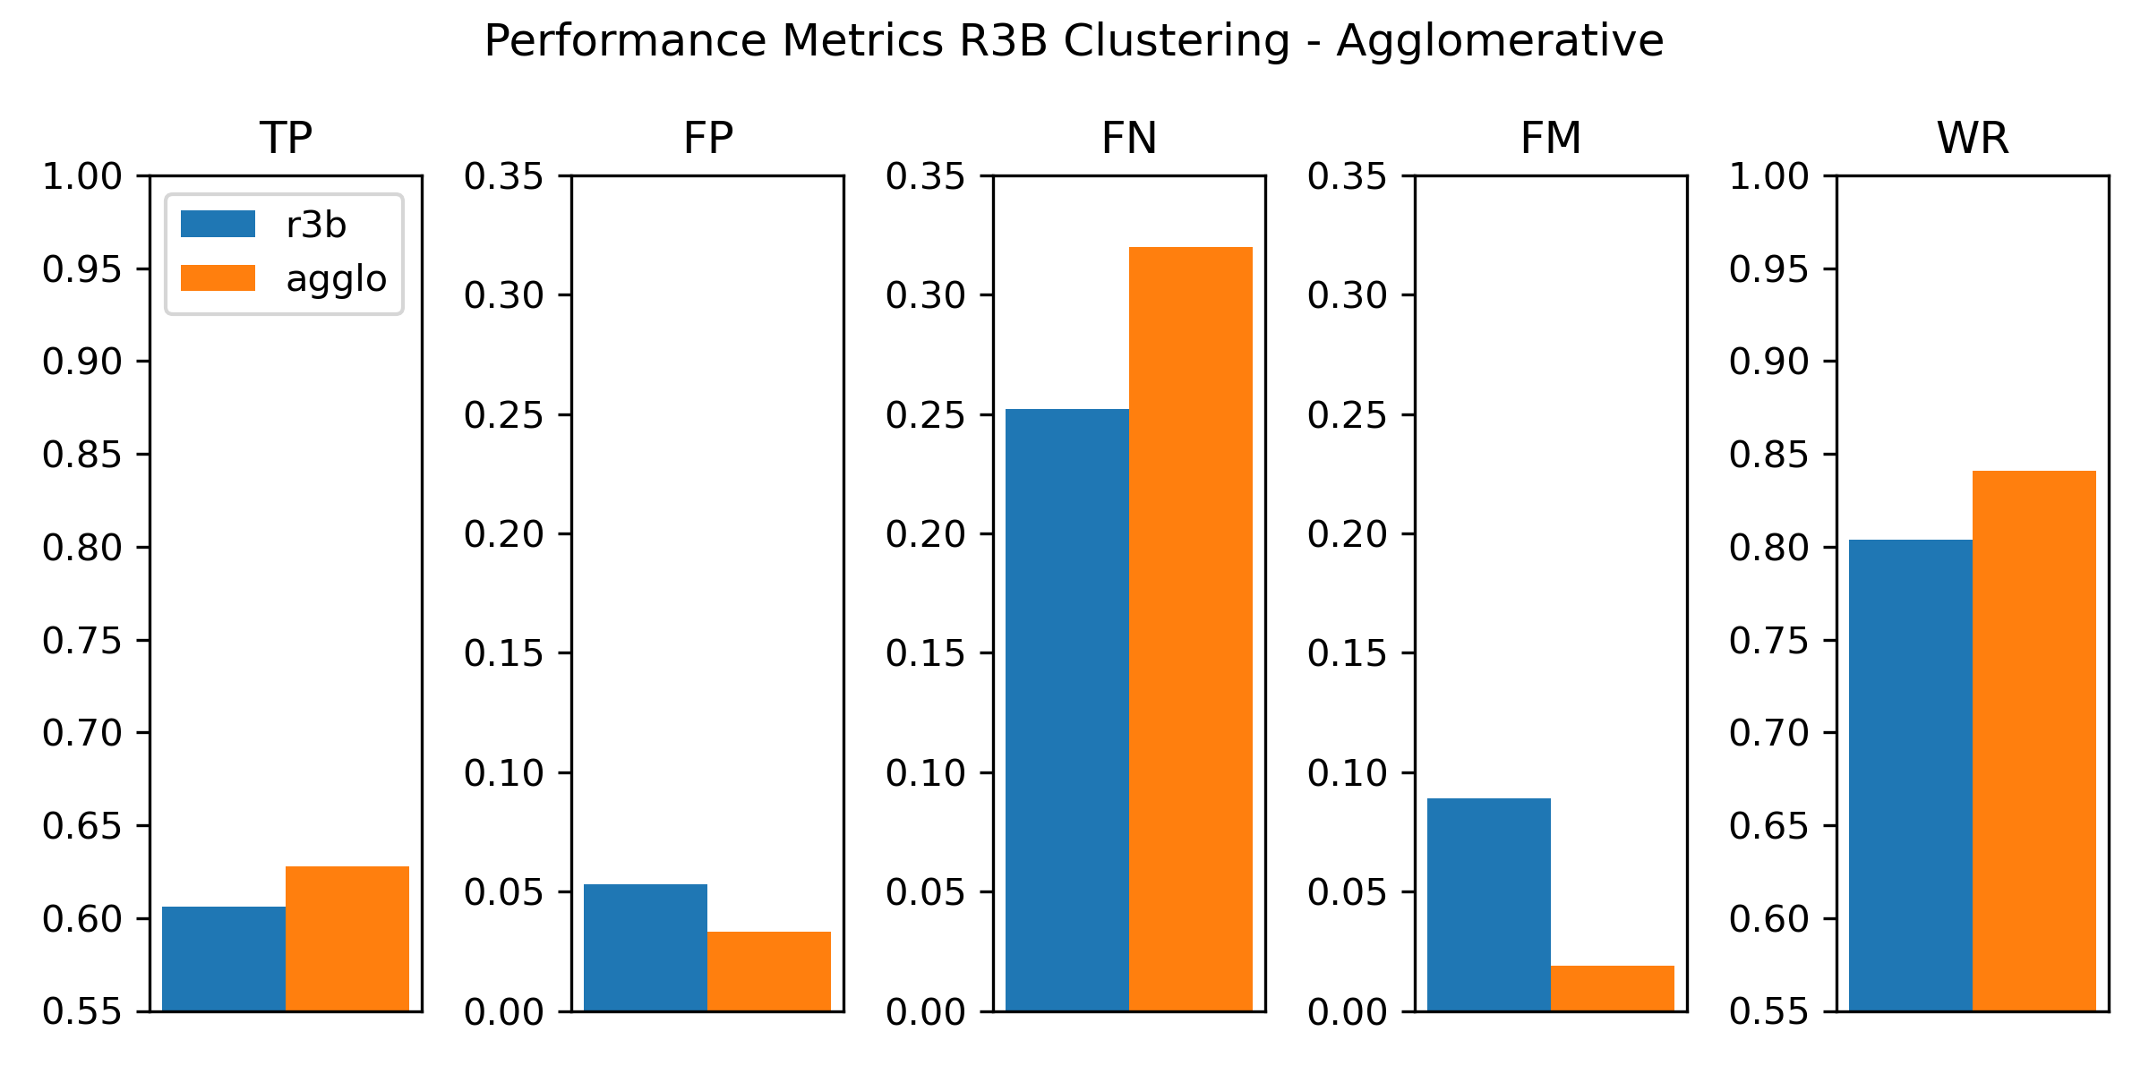
better
better
better
better
better

