Slide 1
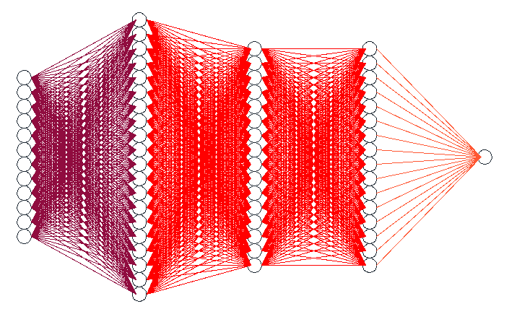
Edge Detection NN
Architecture
10³ nodes
RELU Activation Function
RELU Activation Function
12 input features
10² nodes
10² nodes
Sigmoid

