Slide 1
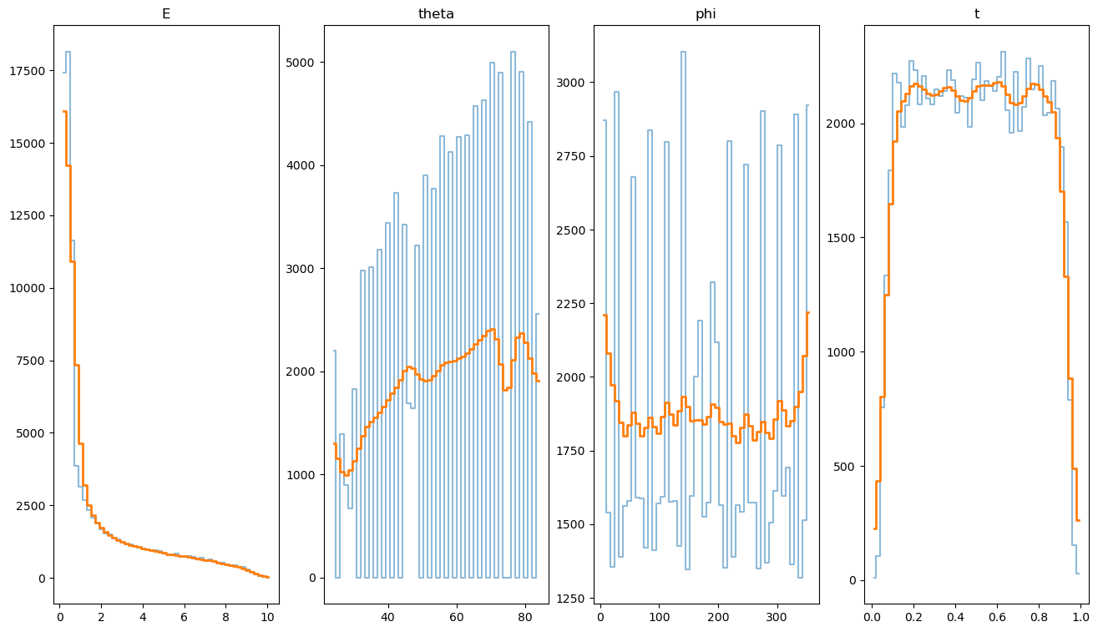
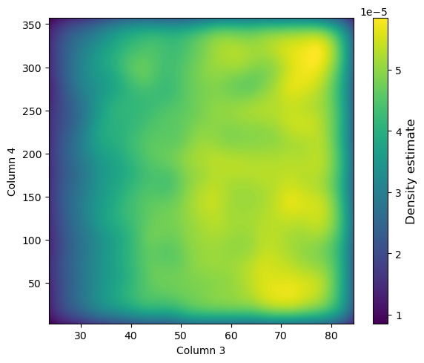
TO DO List:
Should I really use these plots?
Any idea for better visualization?
Or something like this for
Theta- phi

