Slide 1
S444 Isotope Correction - Fits

Slide 2
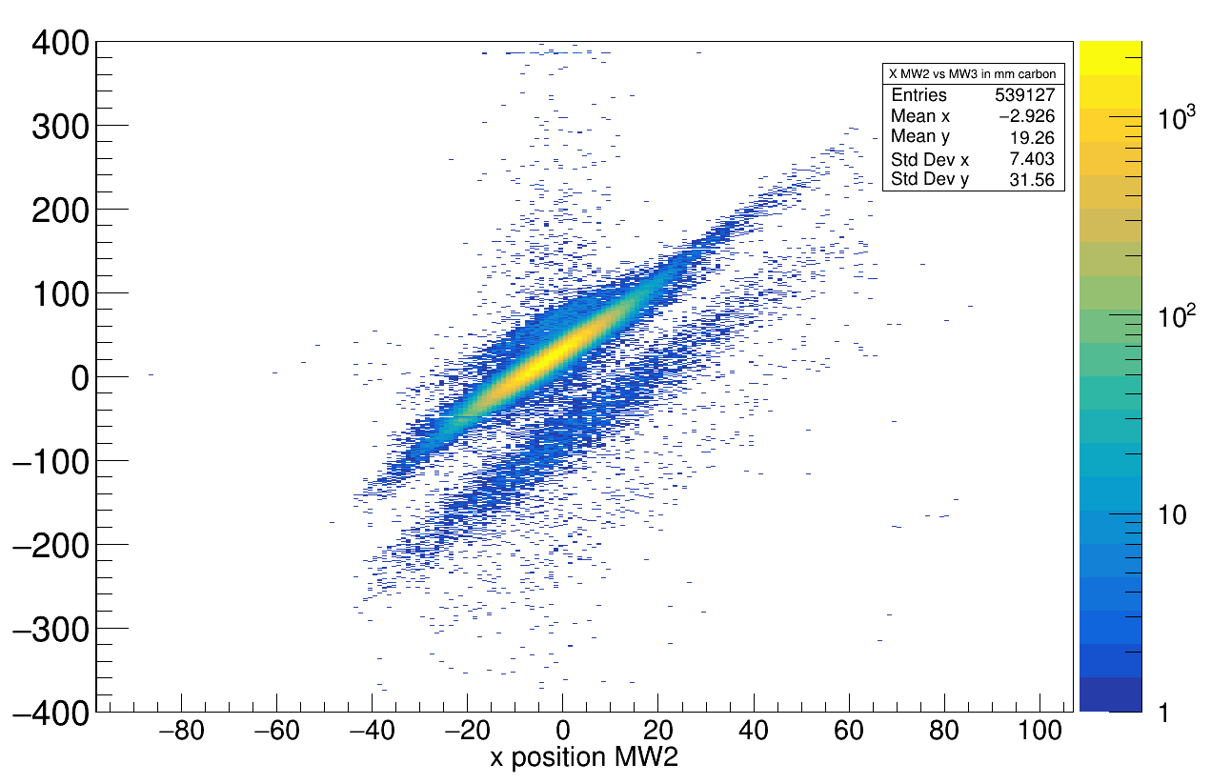
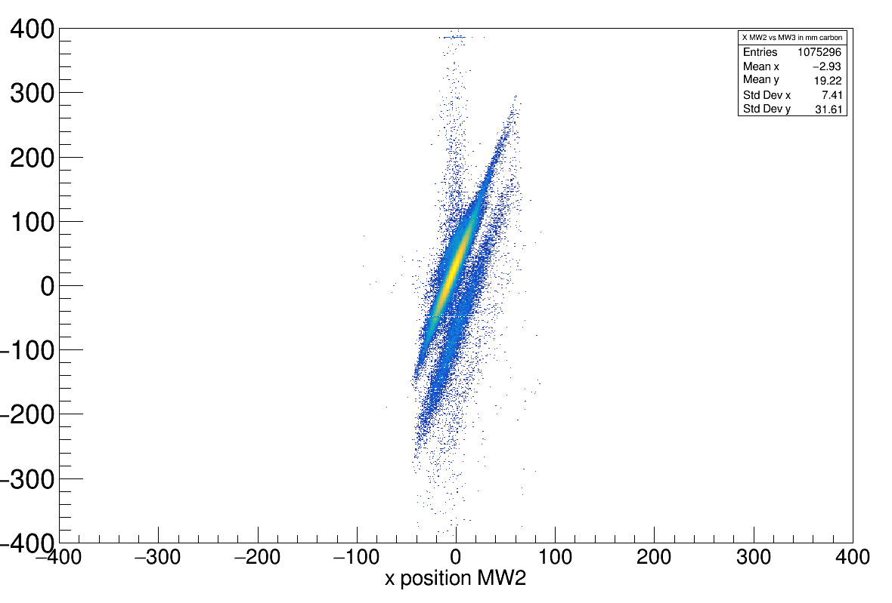
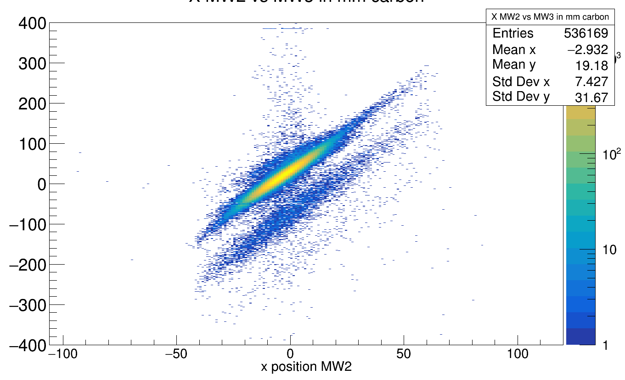
1st half
Were settings changed during Run ?
2nd half
NO, same strange line..

Slide 3
Bug found in code for histogram rotation...
rot_histo→ SetBinContent(rot_binX,rot_binY,vec_content[binX-1][binY-1]);
→ this code overwrites bin content if there is already something in bin!
Fix:
double prev = rot_histo->GetBinContent(rot_binX, rot_binY);
rot_histo->SetBinContent(rot_binX, rot_binY, prev + vec_content[binX-1][binY-1]);

Slide 4
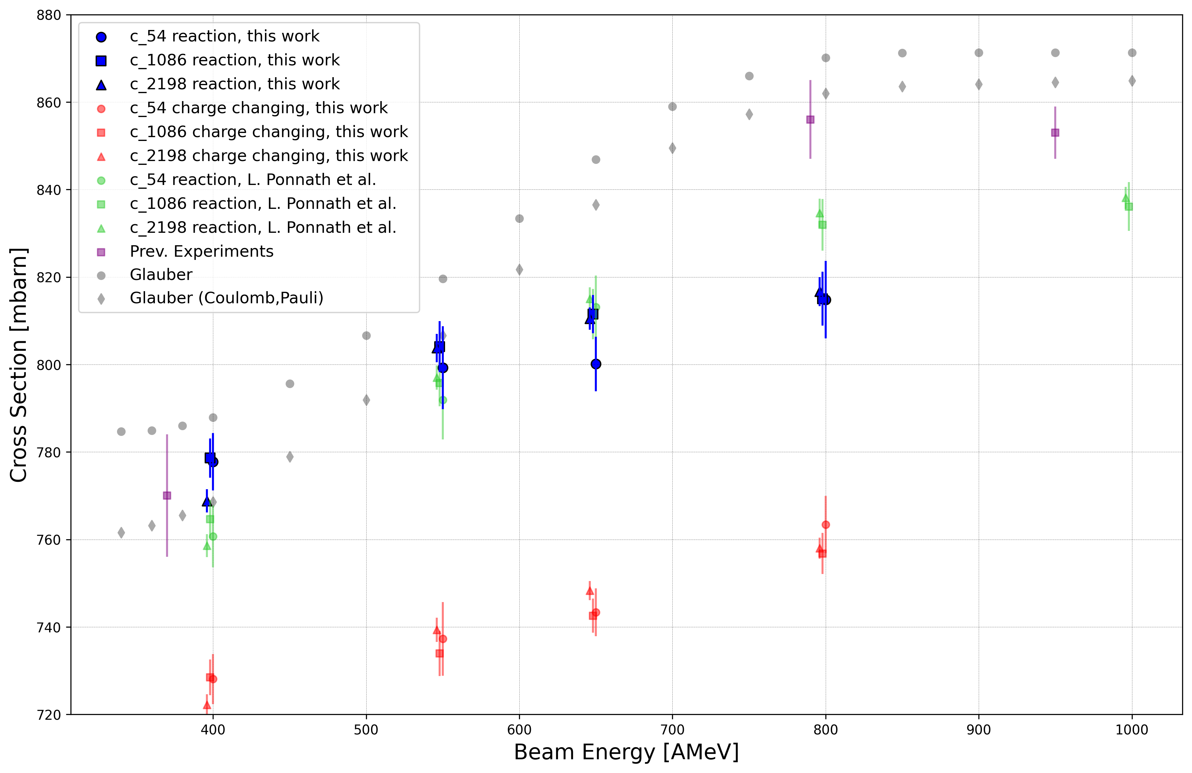
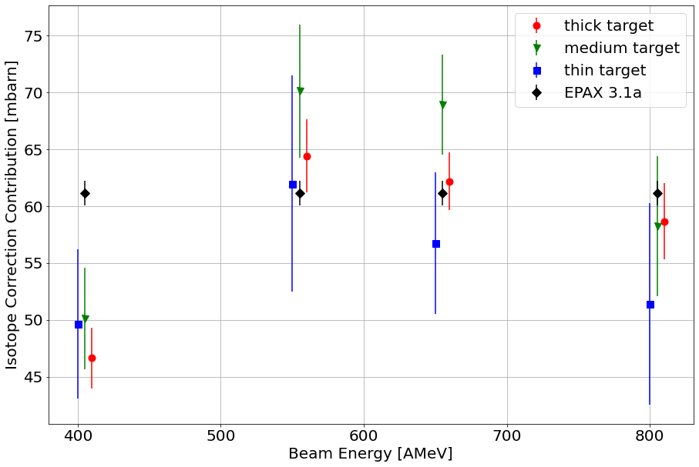
Method1: voigt fitting revised
Isotope correction:

Slide 5
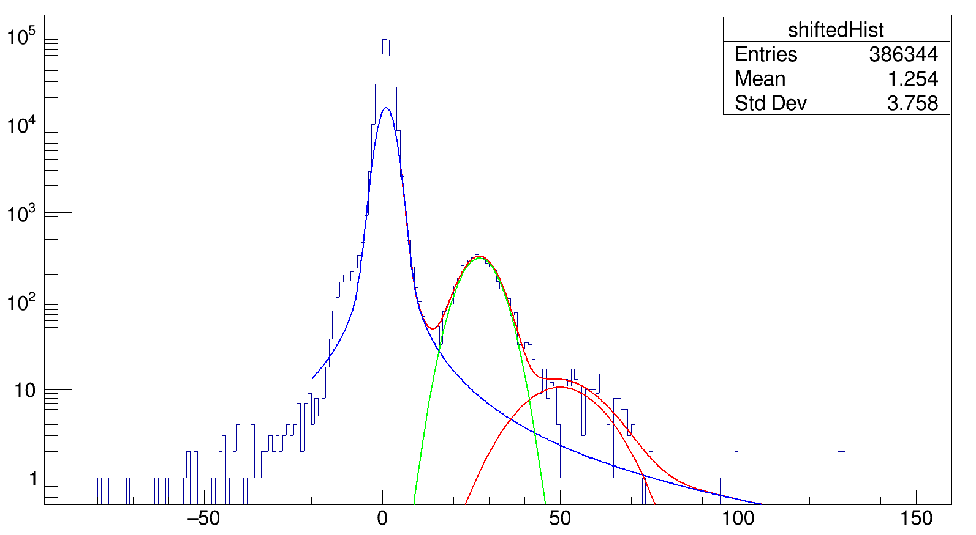
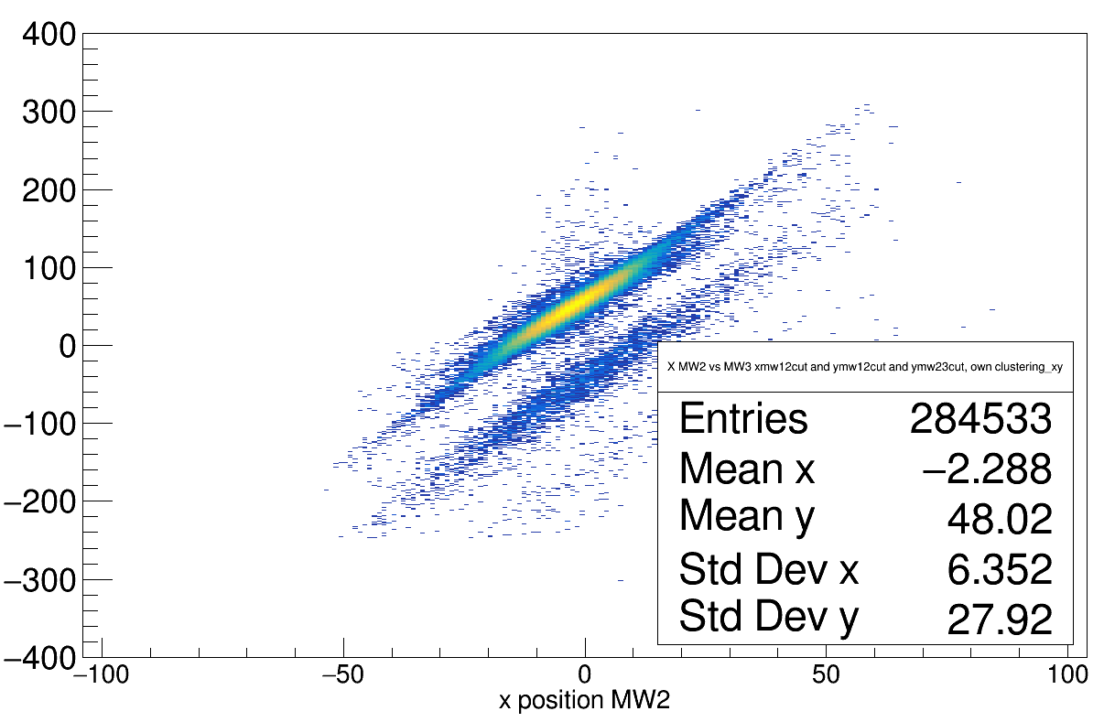
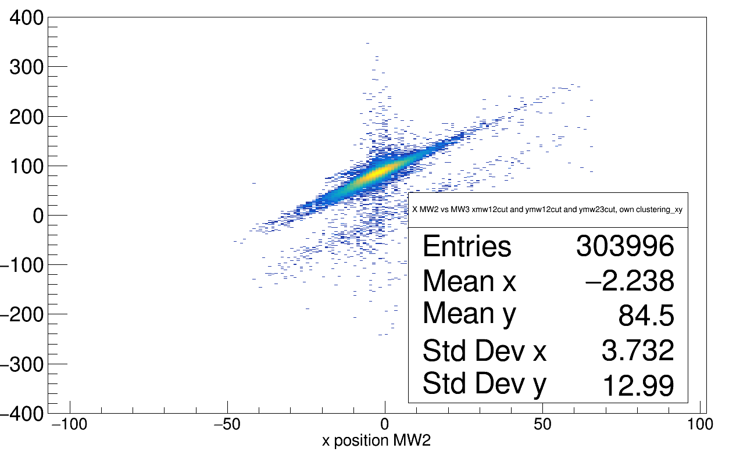
Drawbacks of method:
Correction factor (for both emtpy and target run) is calculated by:
1-(N_{11C} + N_{10C})/N_{histo}
This here is counted as ¹²C !!
→ if I do not consider left side: no eff. Correction between target/empty!
→ however, there is anyway no real correction between target empty; histogram represents something like angular deflection, not position!
Empty, 550 AMeV
Target thick, 550 AMeV

Slide 6
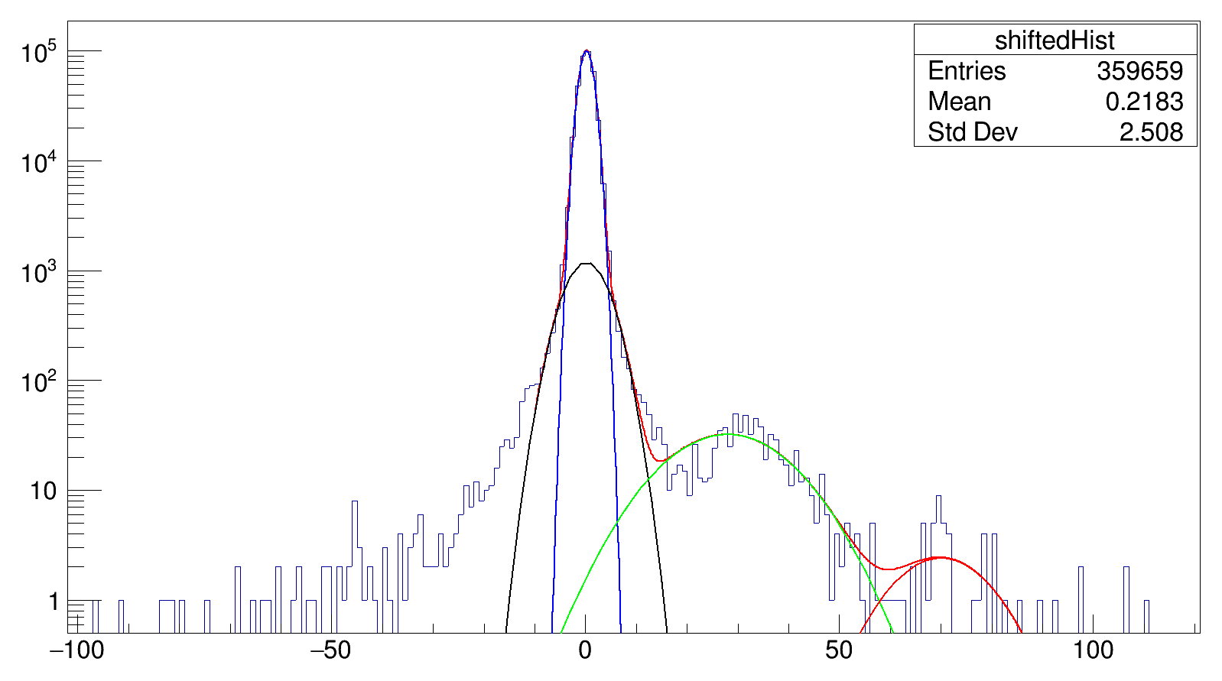
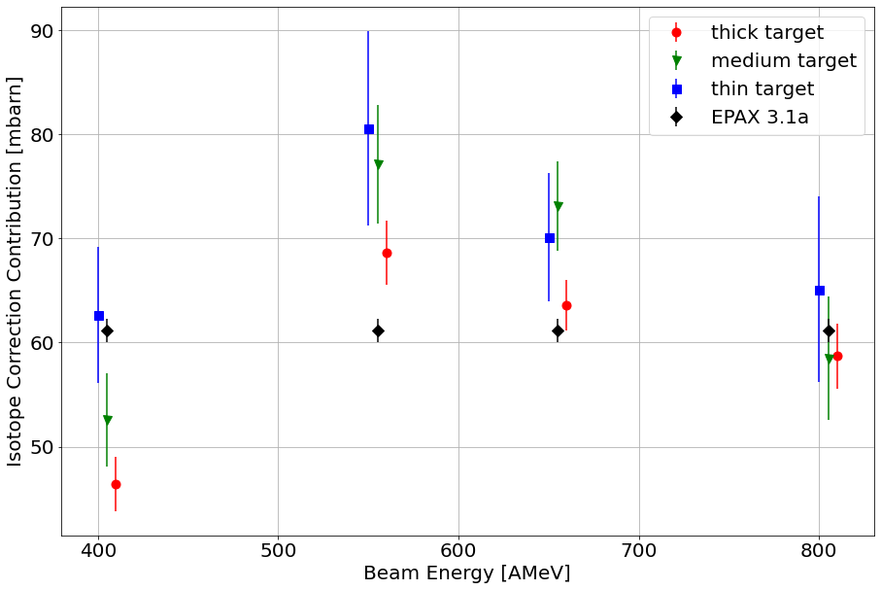
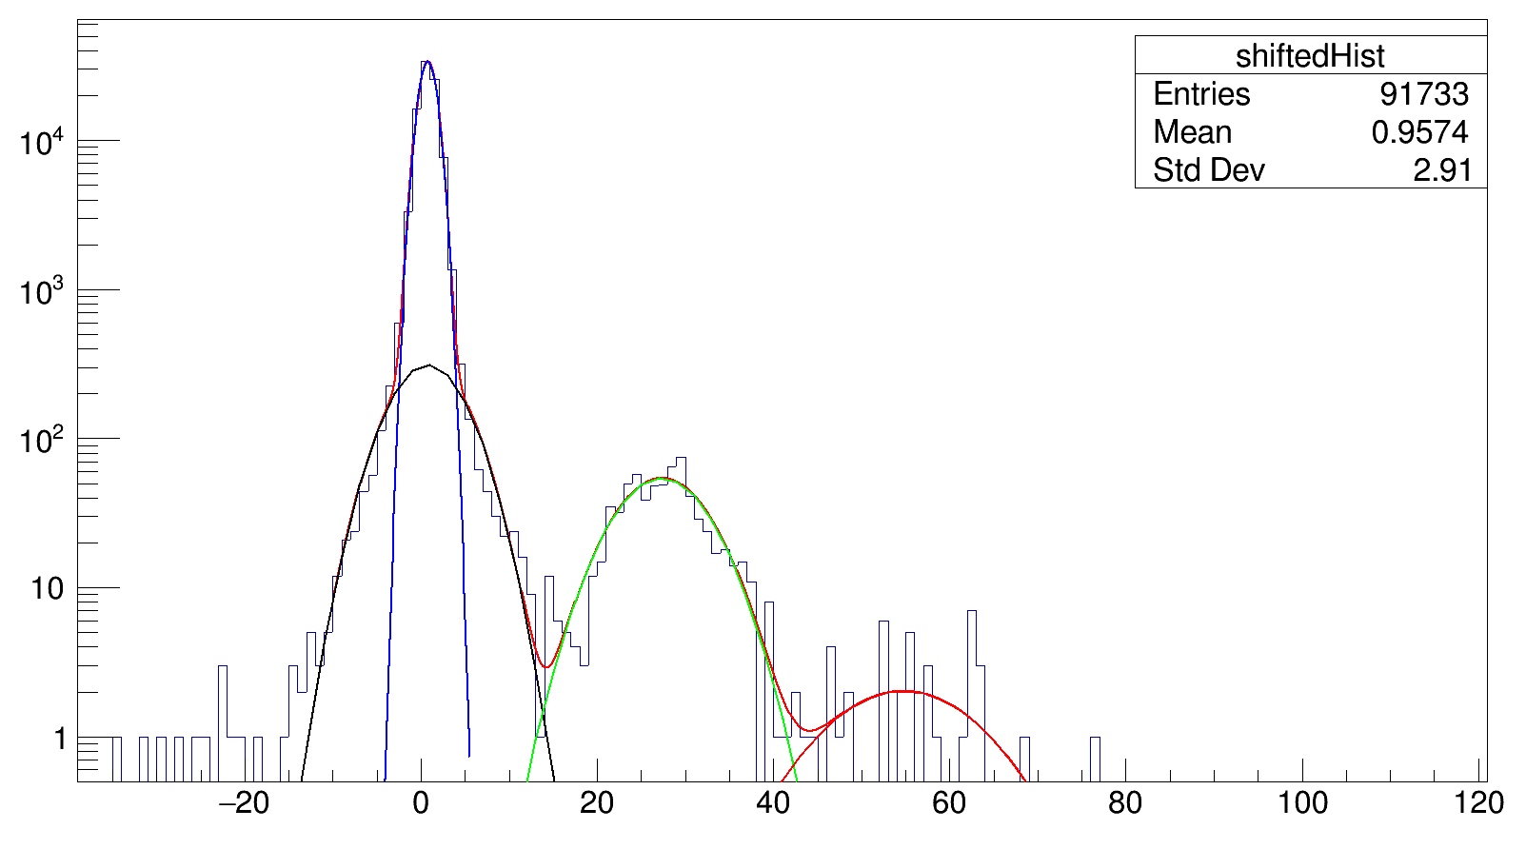
Gaussians do not well fit the data…, e.g.:
Method2: Fit with gaussians only
Correction factor (for both emtpy and target run) is calculated by:
1-(N_{11C} + N_{10C})/N_{full_fit}

Slide 7
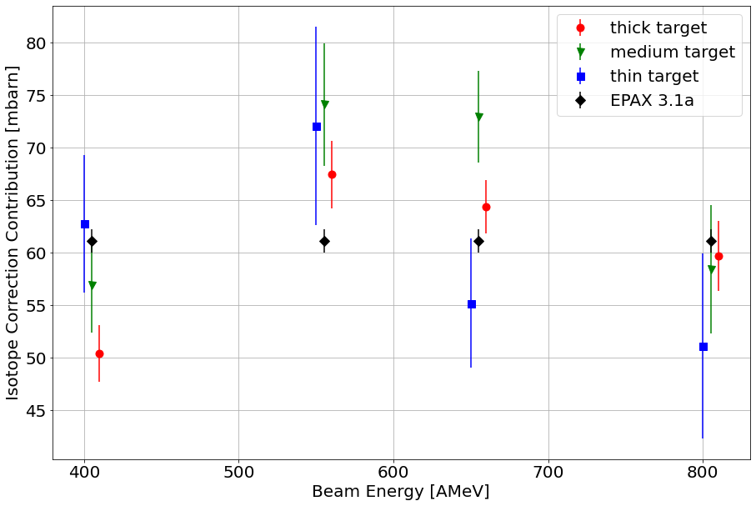
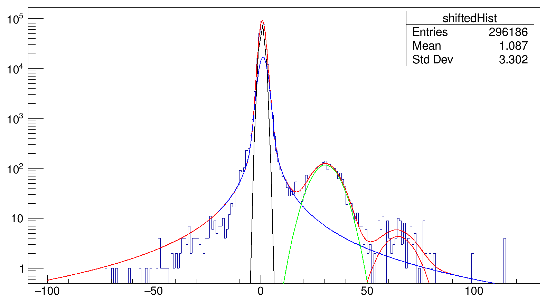
Method3: Fit over full range with voigt +gauss
gauss
voigt
Correction factor (for both emtpy and target run) is calculated by:
1-(N_{11C} + N_{10C})/N_{full_fit}

Slide 8
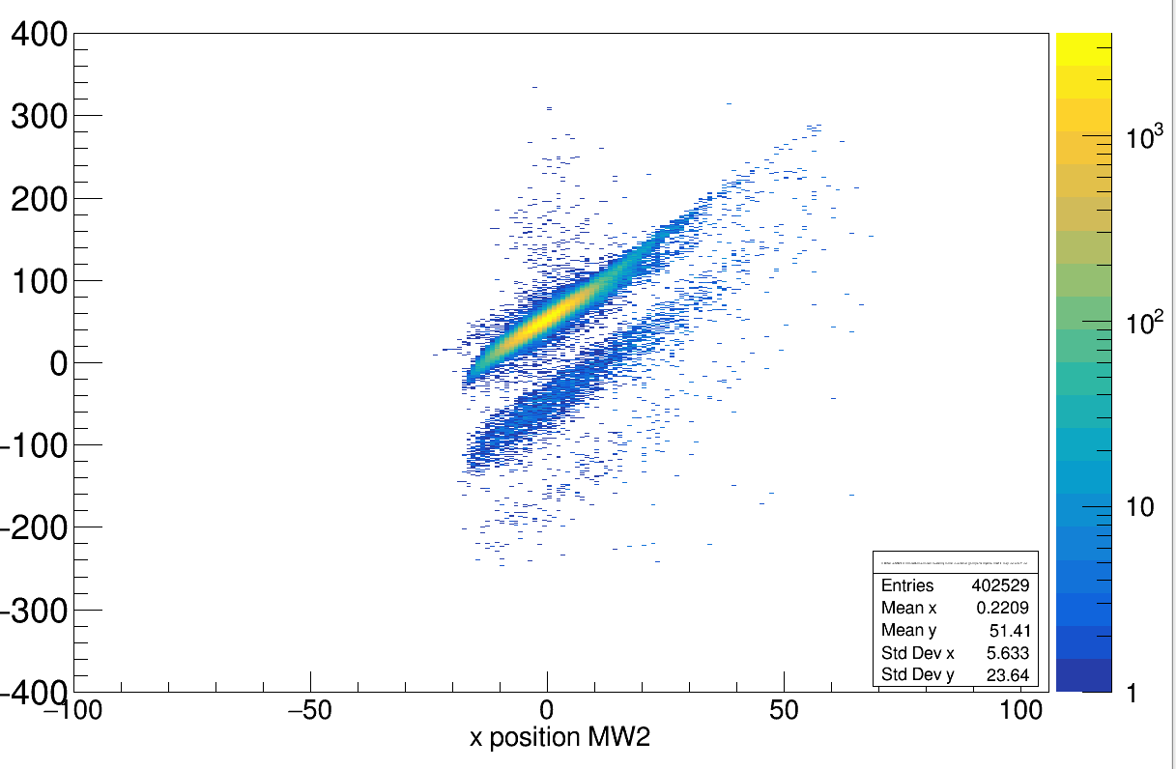
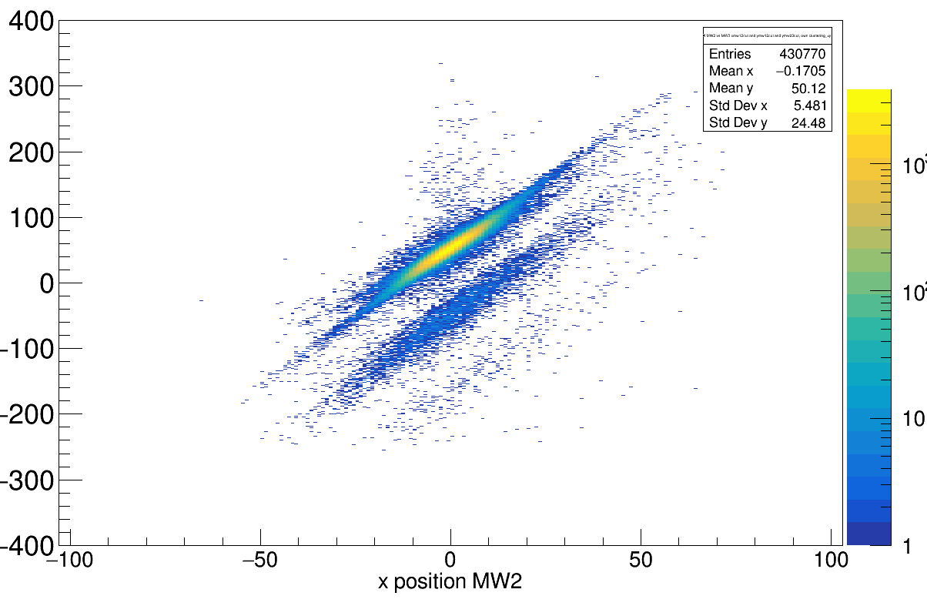
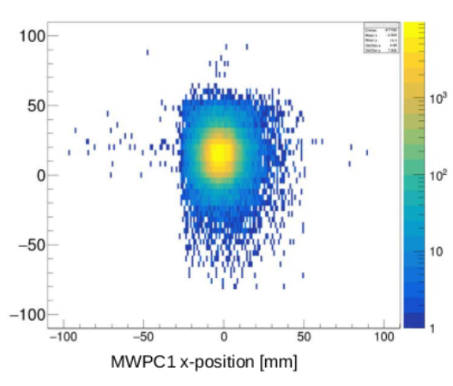
More sources of error:
But:
I do actually not rotate and project:
Weights:
a) 1x
b)2x
c)2x
d)4x
This can create asymmetries in the rotated and projected plots too...
a
b
c
d

