Slide 1
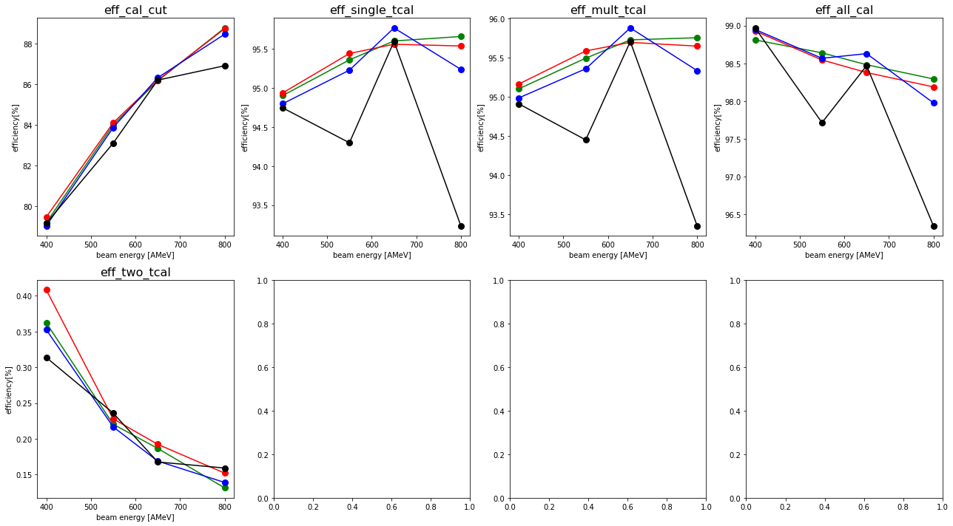
Sofia ToFWall condition:
Sofia ToFWall condition:
→ at least one up or down PMT has signal
→ hits in multiple bars are allowed, if they are neighbours (e.g. detID 14 & 15
→ at least one up or down PMT has signal
Allowed:
Allowed:

Slide 2
Sofia ToFWall condition:
Sofia ToFWall condition:
→ One or two neighbouring bars with up AND down PMT signal
→ Exact one bar with up AND down PMT signal
Allowed:
Allowed:

Slide 3
Sofia ToFWall condition:
→ two bars with up AND down PMT signal
Allowed:

Slide 4
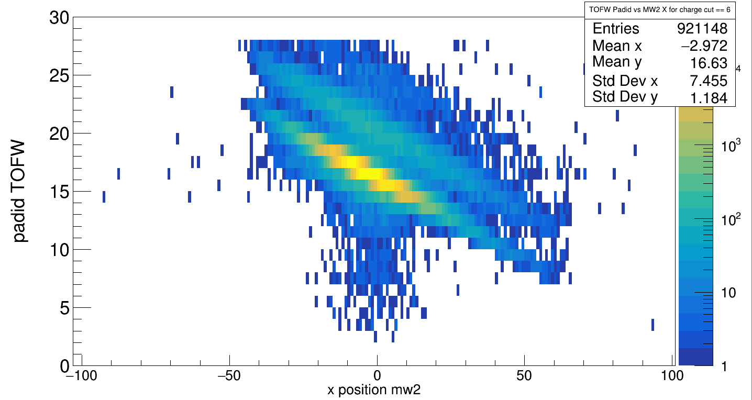
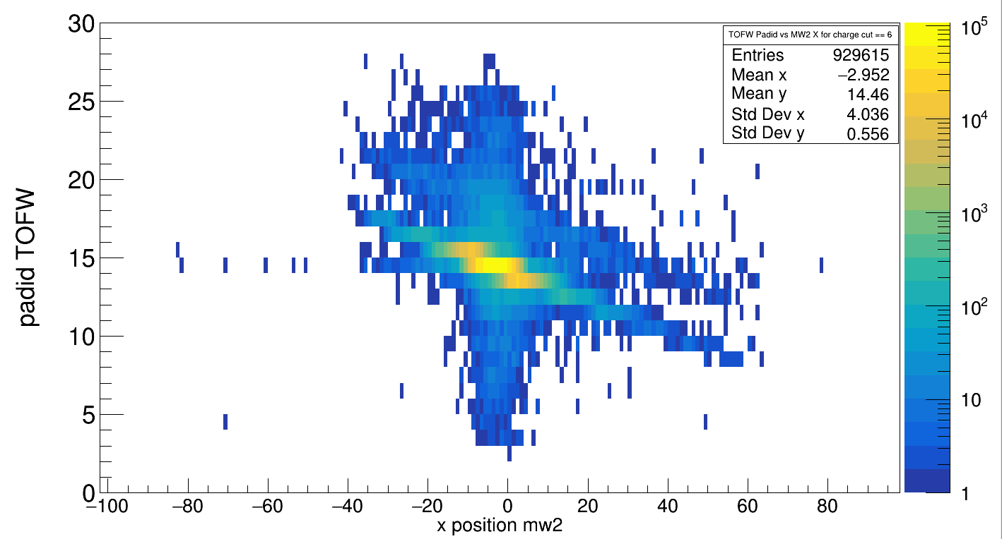
Sofia TOF DetID vs xMW2
Carbon target, 2cm, 400 AMeV
Empty target, 400 AMeV

Slide 5
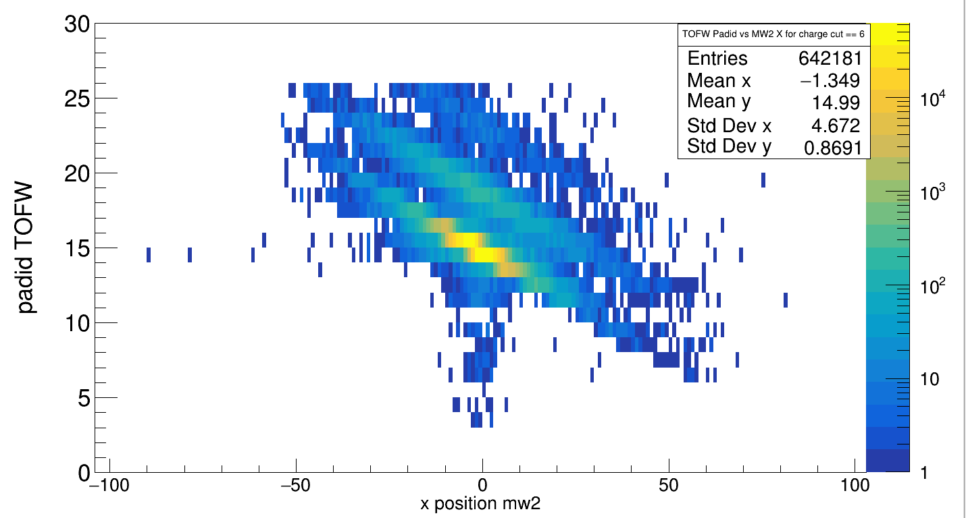
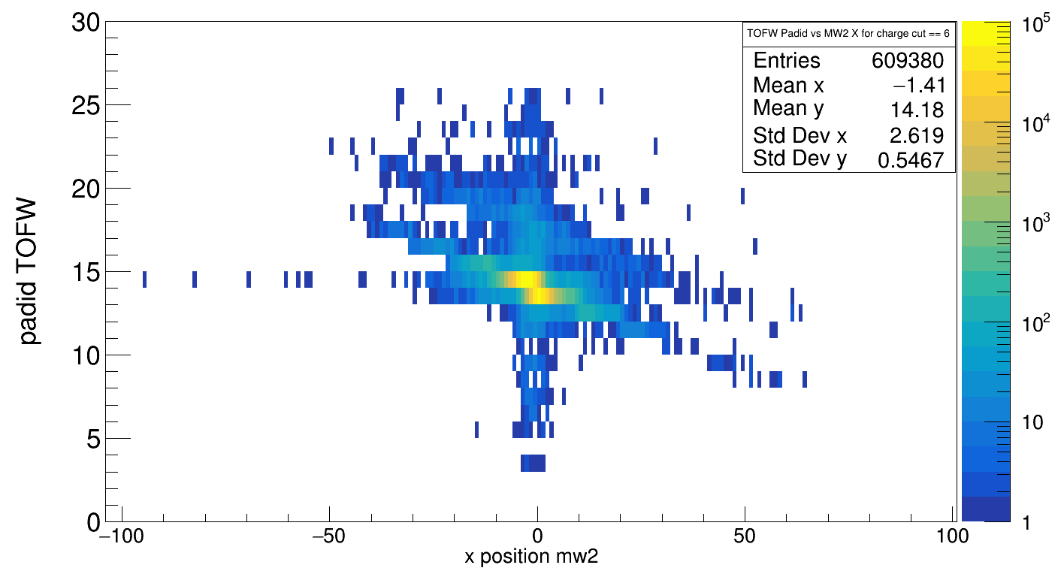
Sofia TOF DetID vs xMW2
Carbon target, 2cm, 800 AMeV
Empty target, 800 AMeV

Slide 6
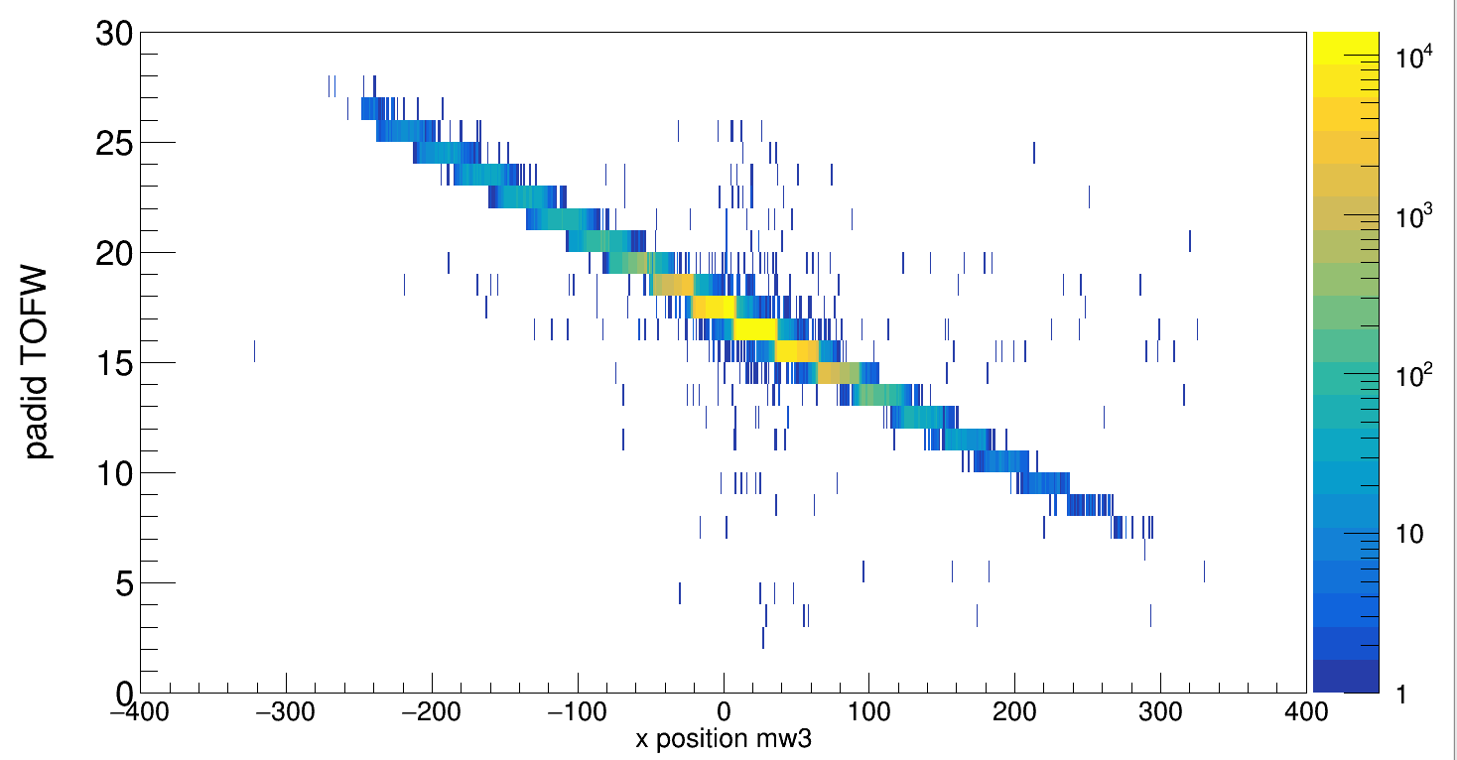
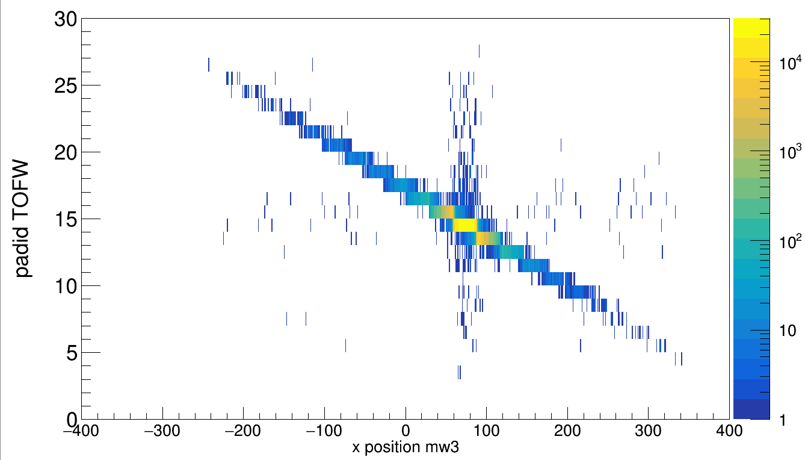
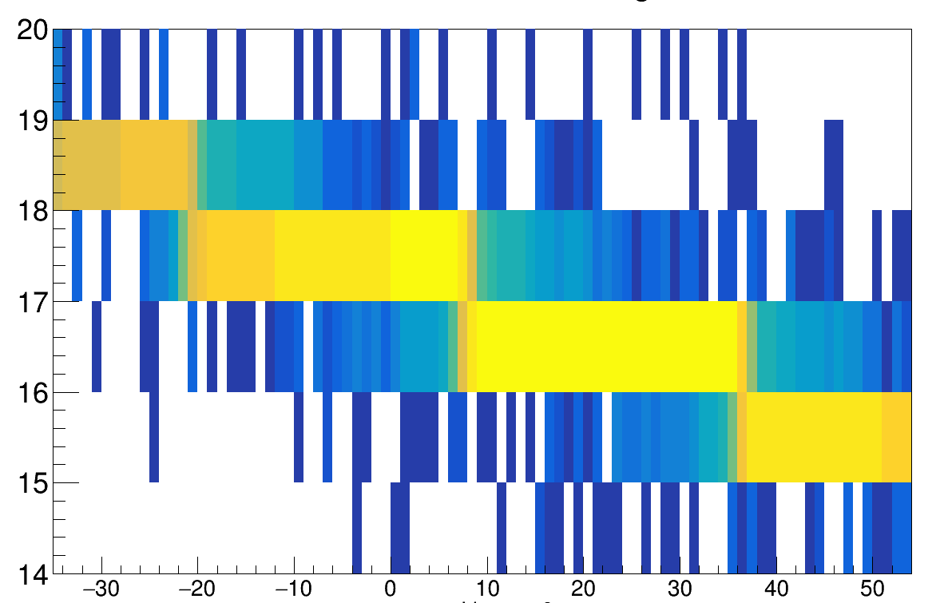
Sofia TOF DetID vs xMW3
Carbon target, 2cm, 400 AMeV
Empty target, 400 AMeV
Sofia ToFWall Pad size readable = 30mm

Slide 7
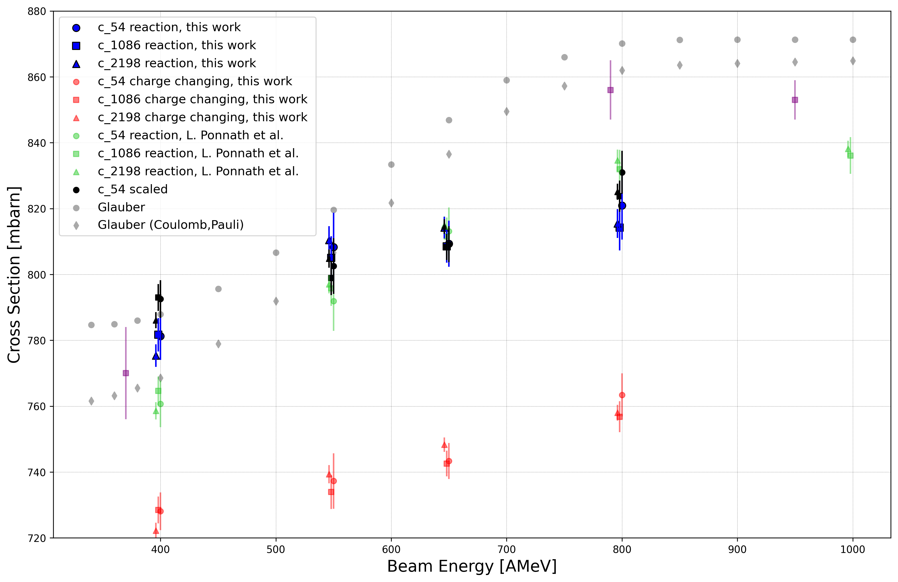
Scale isotope correction according to Charge Changing Cross Section
Scaling factor: 1.089

