Slide 1







Nuclear Structure Investigations of Light Nuclei with the R3B Experiment
Tobias Jenegger
R³B Experiment @FAIR
Total Interaction Cross Section 12C +12C
Quasi-Free Scattering 12C(p,2p)11B
Fission Experiments @ R3B
ML for Cluster Reconstruction in CALIFA
Funded by the Deutsche Forschungsgemeinschaft (DFG, German Research Foundation)
under Germany’s Excellence Strategy – EXC-2094 – 390783311,
BMBF 05P19WOFN1, 05P21WOFN1 / BMBF 05P24WO2
and the FAIR Phase-0 program
Mentor: Dr. Roman Gernhäuser
Supervisor: Prof. Dr. Laura Fabbietti

Slide 2
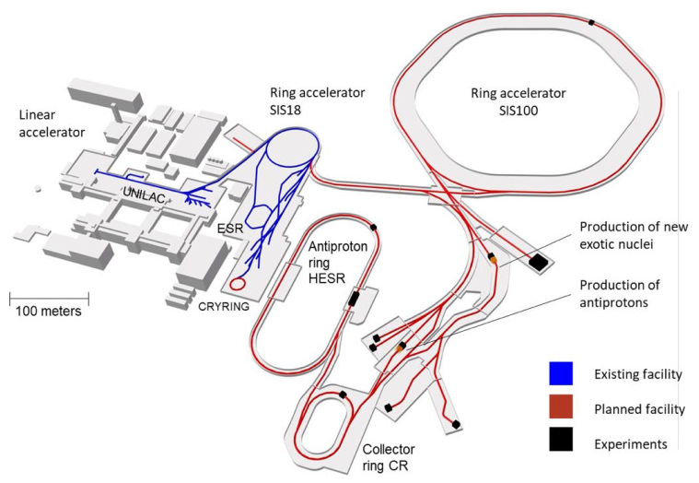
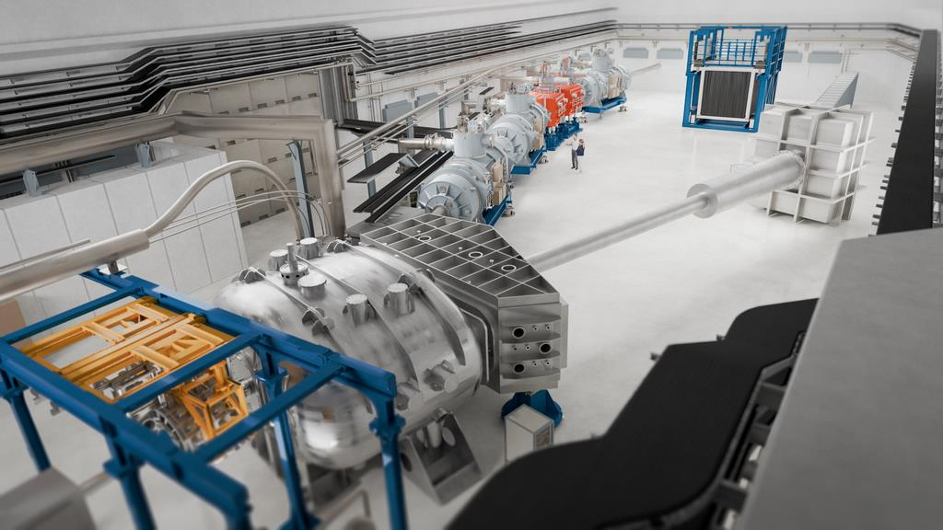
R³B Experiment
Reactions with Relativistic Radioactive Beams
GSI-FAIR Facility
NeuLAND
ToF chamber
GLAD
CALIFA
2019 - 2026
2027 - 2035
© GSI/FAIR
Haik Simon – FAIR & Super-FRS – EPS 20190930
Scientific goals:
• Study the structure of exotic, unstable nuclei
• Investigate nuclear fission dynamics and fission product properties
• Examine short-range correlations between nucleons
Experimental Approach:
• Inverse kinematics
• Kinematically complete measurements

Slide 3
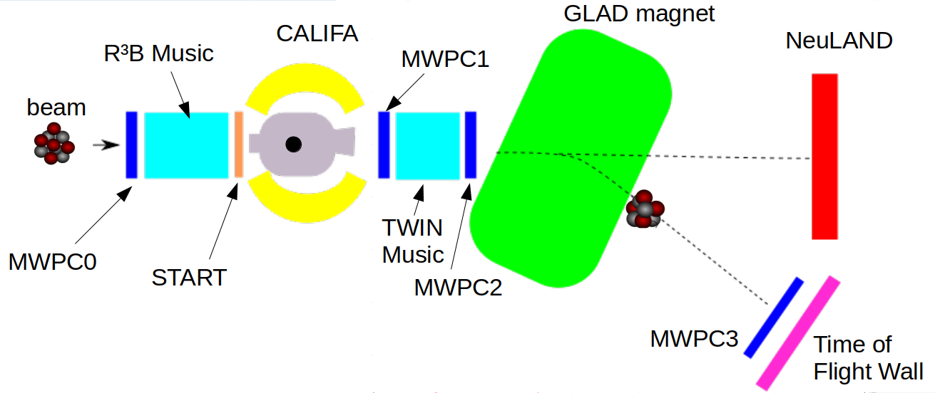
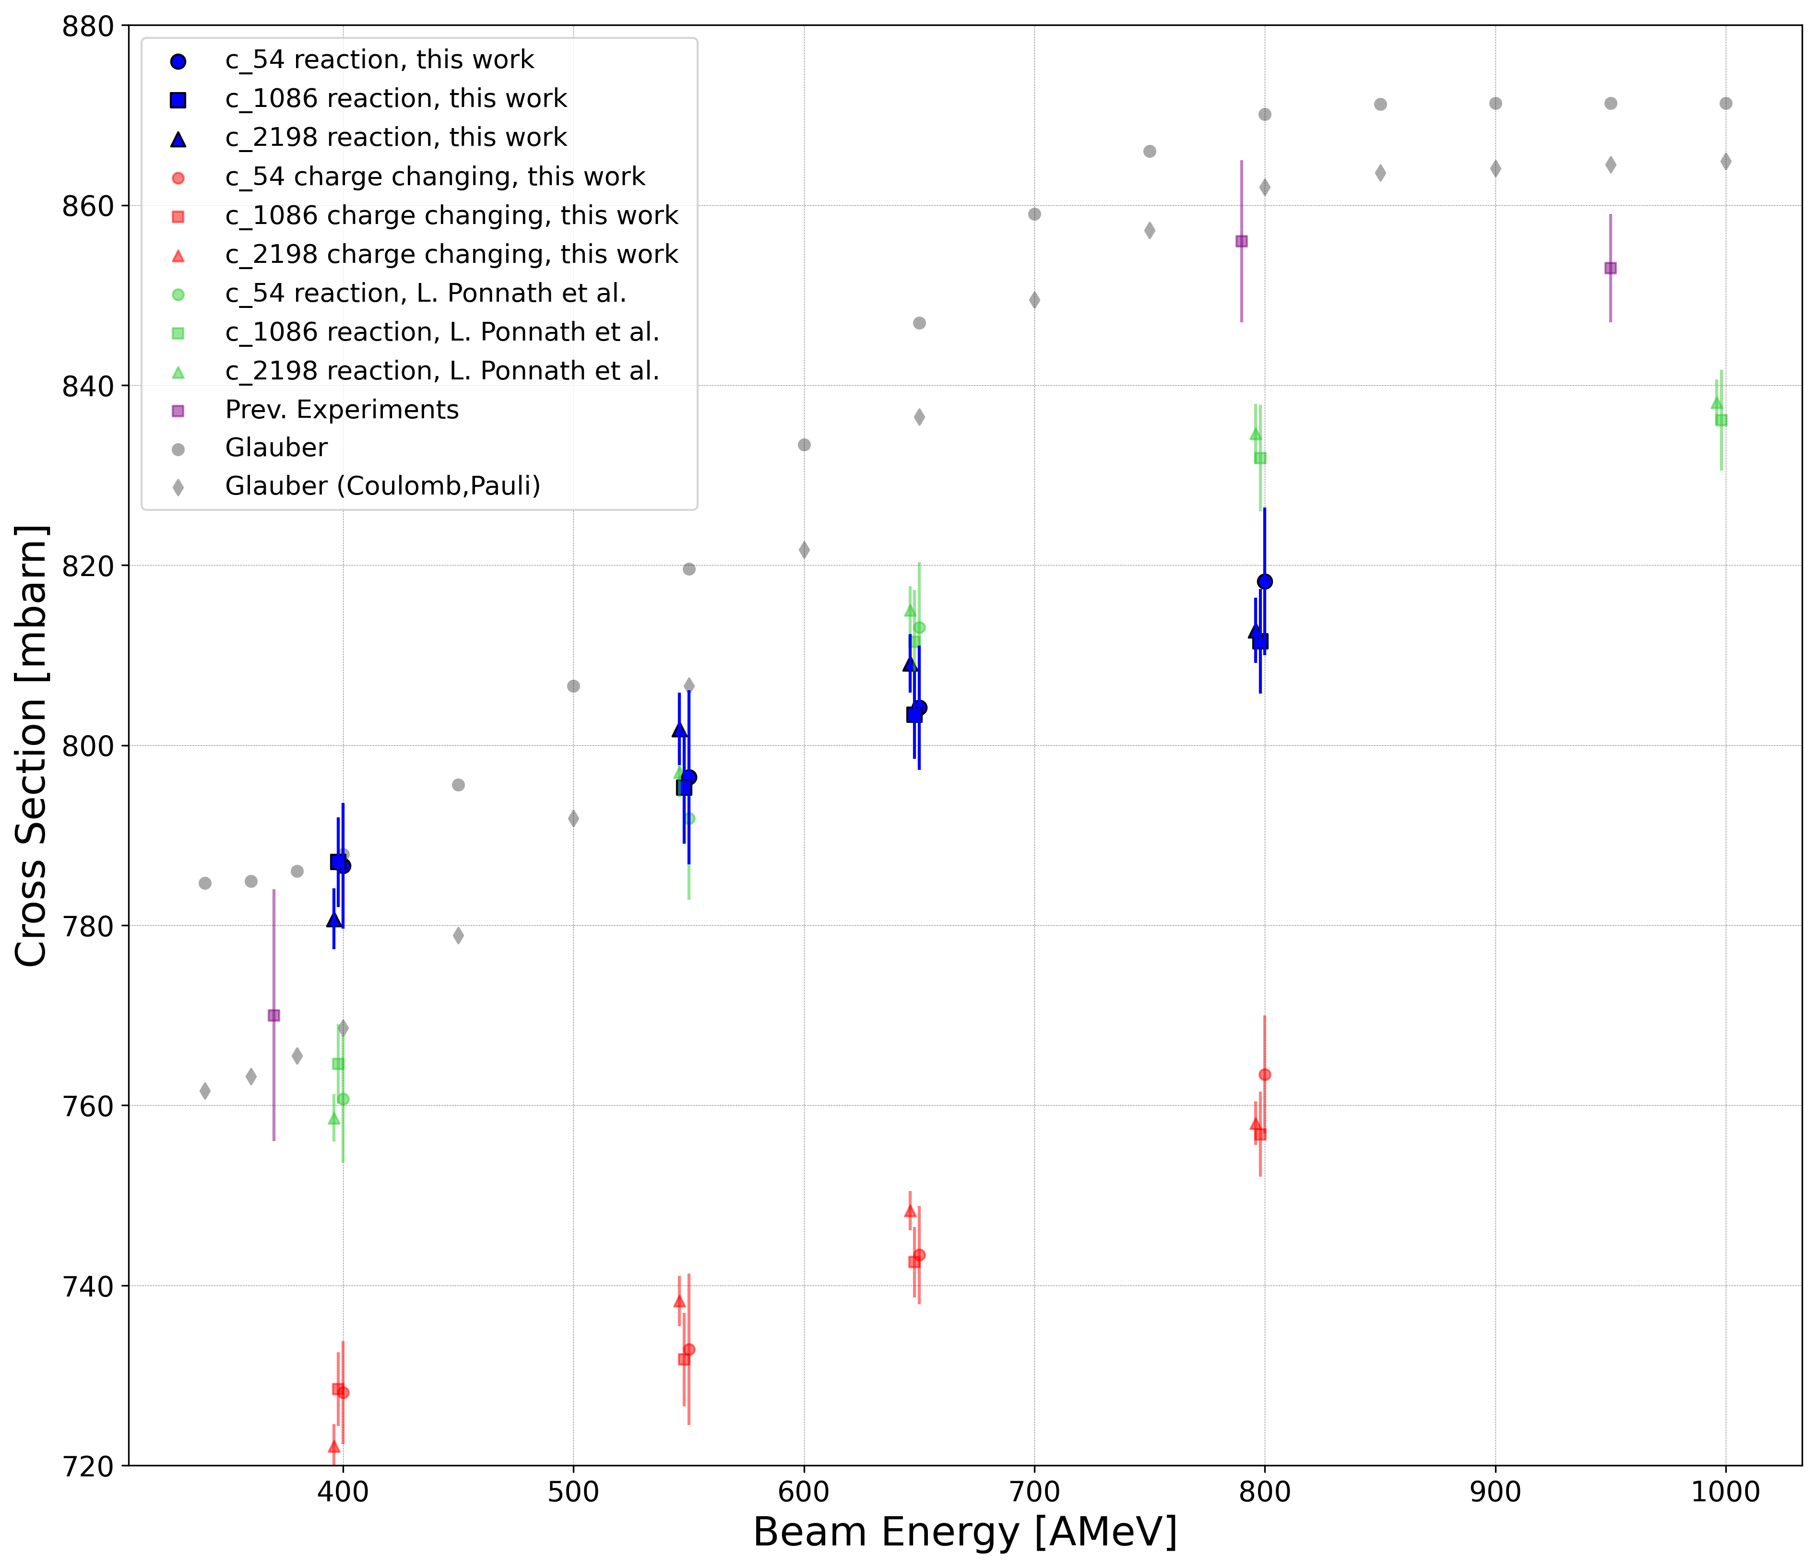
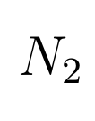
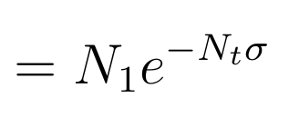
S444 Experiment – Total interaction cross section ¹²C + ¹²C
¹²C
High precision experiments @R3B
Motivation:
Quantify the uncertainty of the reaction model
Scientific goal:
Constrain slope parameter L of the symmetry energy of the EoS via precise σ_{ΔN} measurements
this work
Measurement via transmission method:

Slide 4
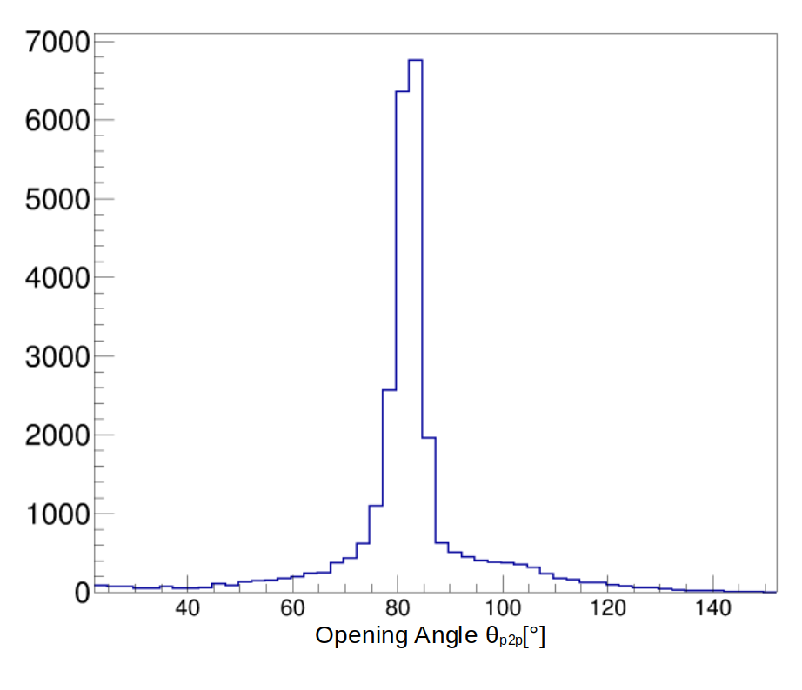
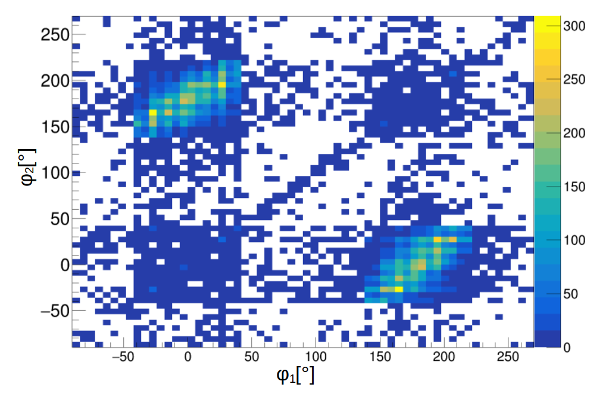

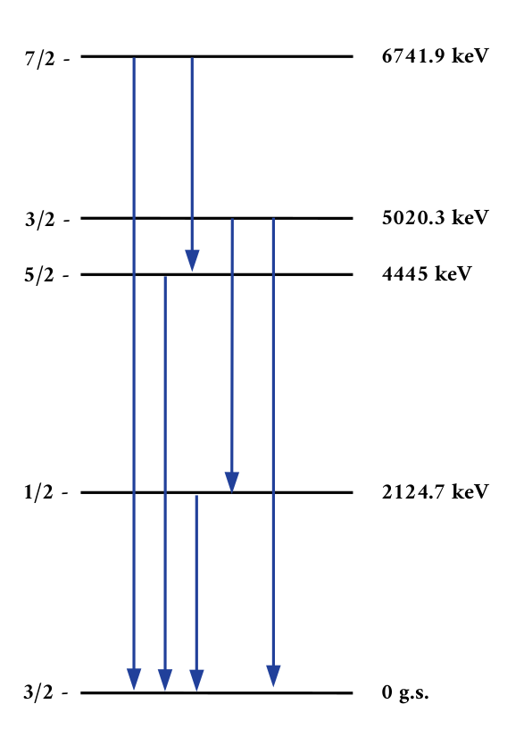
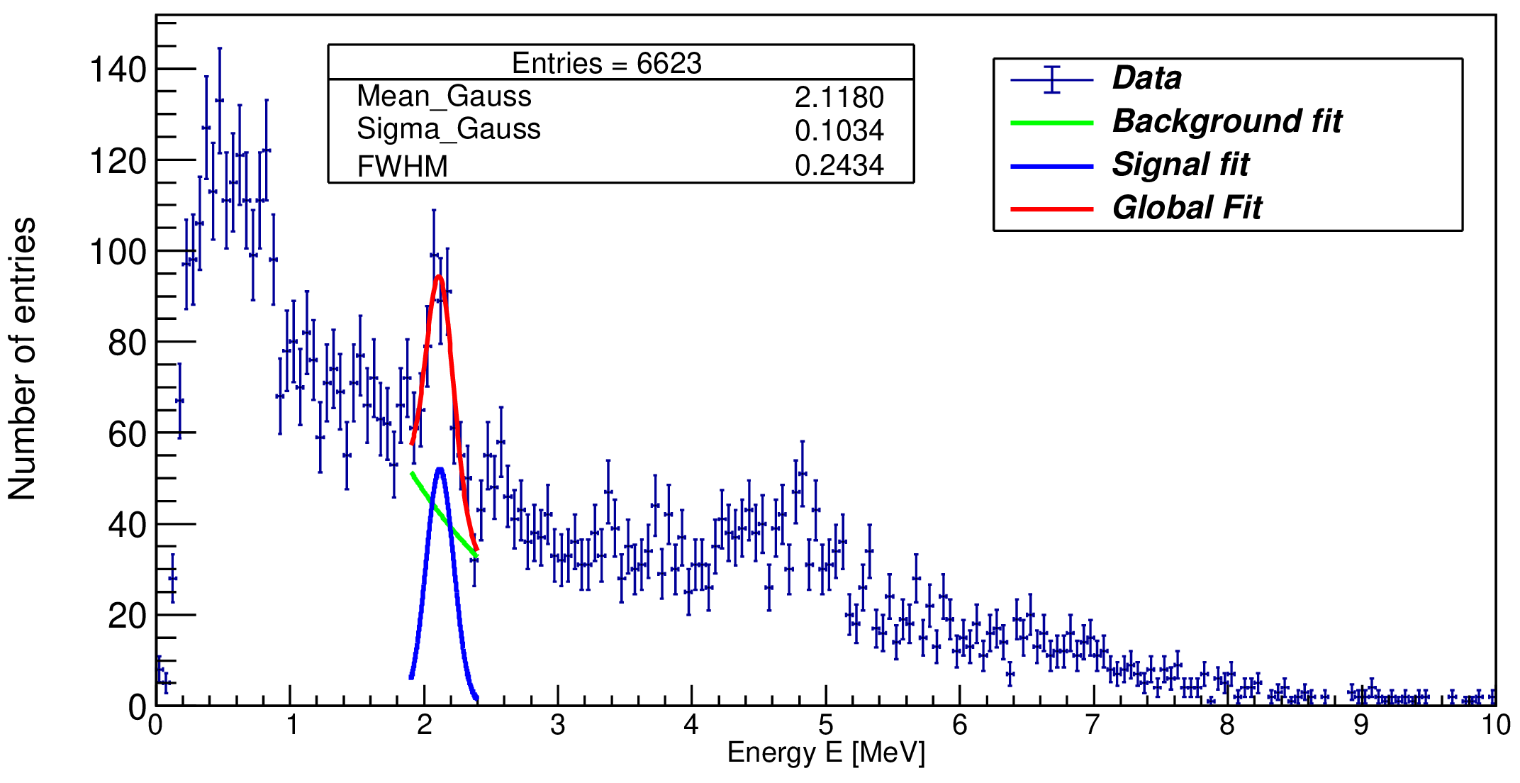
Quasi-Free Scattering ¹²C(p,2p)¹¹B
2 protons
¹¹B fragment
(spectator)
two-proton correlations
¹²C beam
proton like target
proton
¹¹B level scheme
Doppler-corrected
gamma spectrum
Direct access to single-particle properties
Detailed study of shell structure far from stability
proton

Slide 5
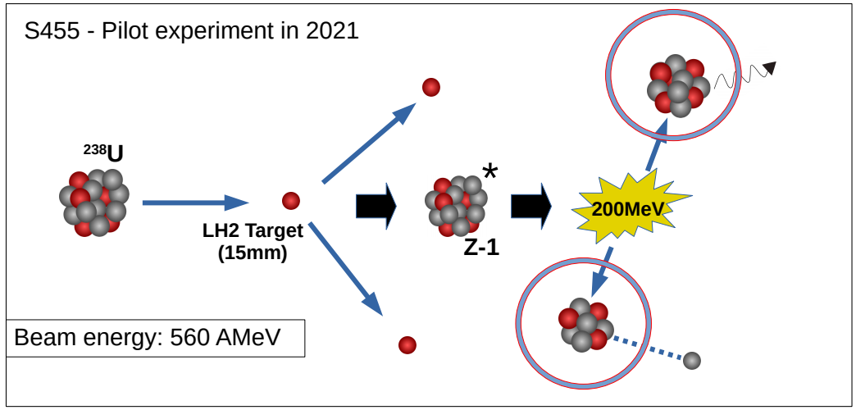
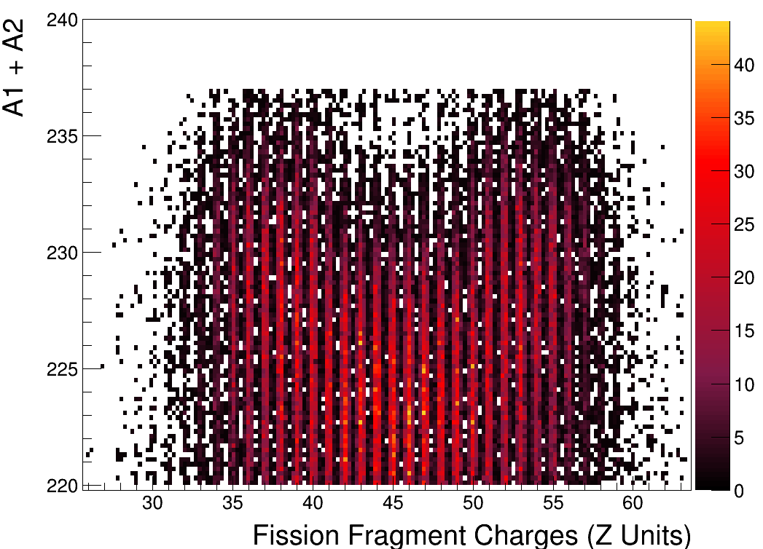
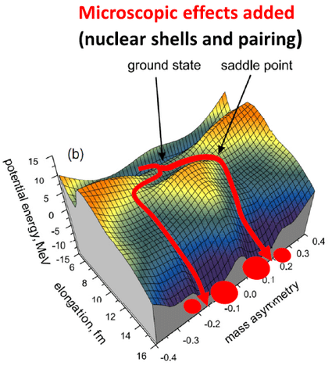
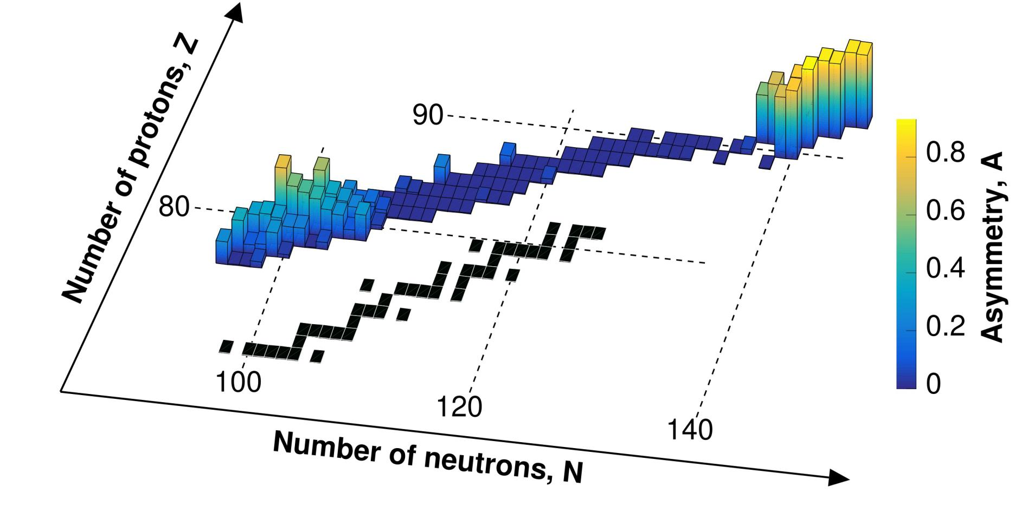
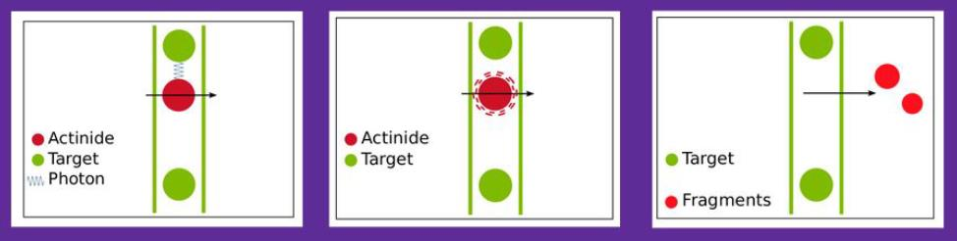
Fission Experiments @ R3B
Fission via QFS: ²³⁸U(p,2pf)
First results:
Missing mass spectroscopy
Complementary method via coulomb excitation
“An asymmetric fission island driven by shell effects in light fragments”, Nature (2025)

Slide 6
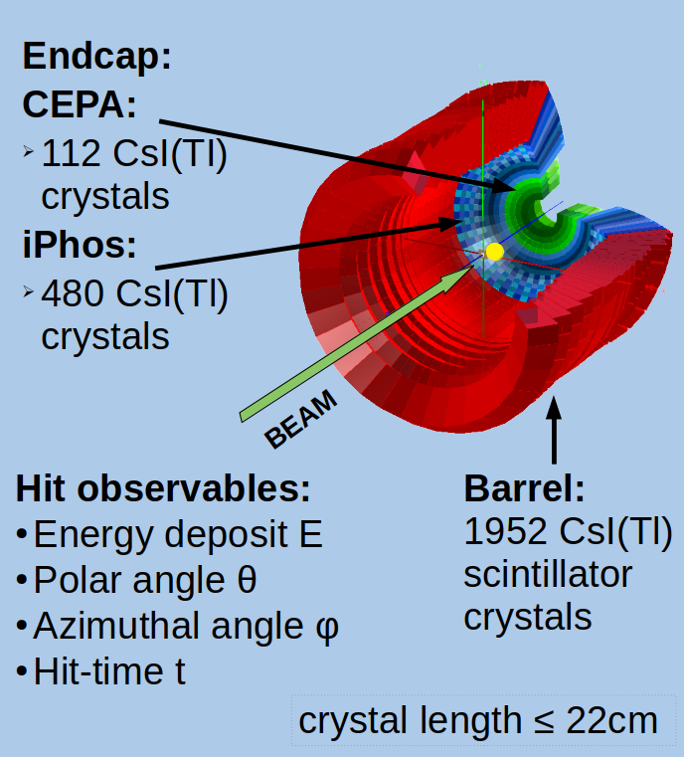
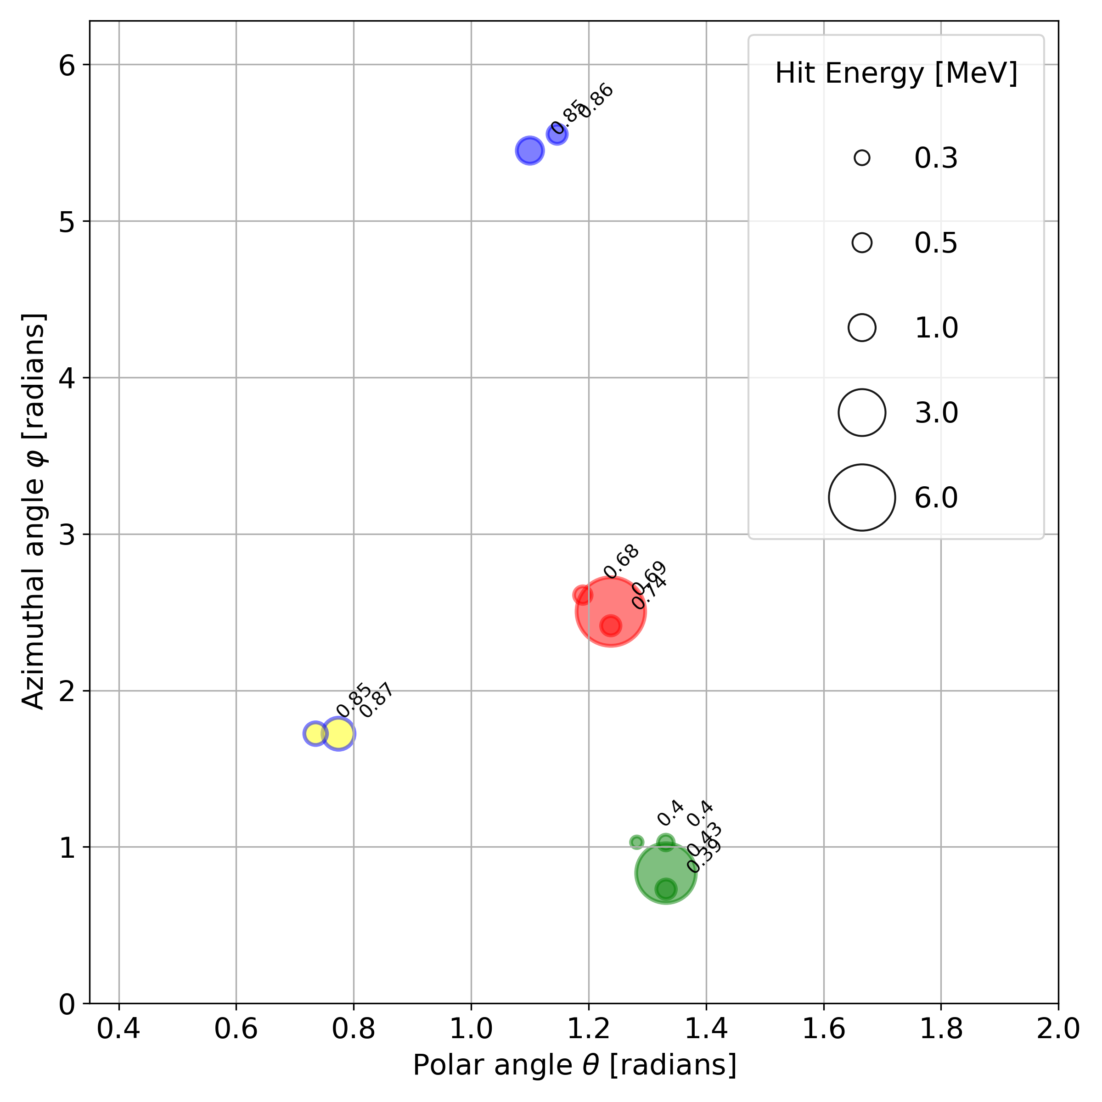
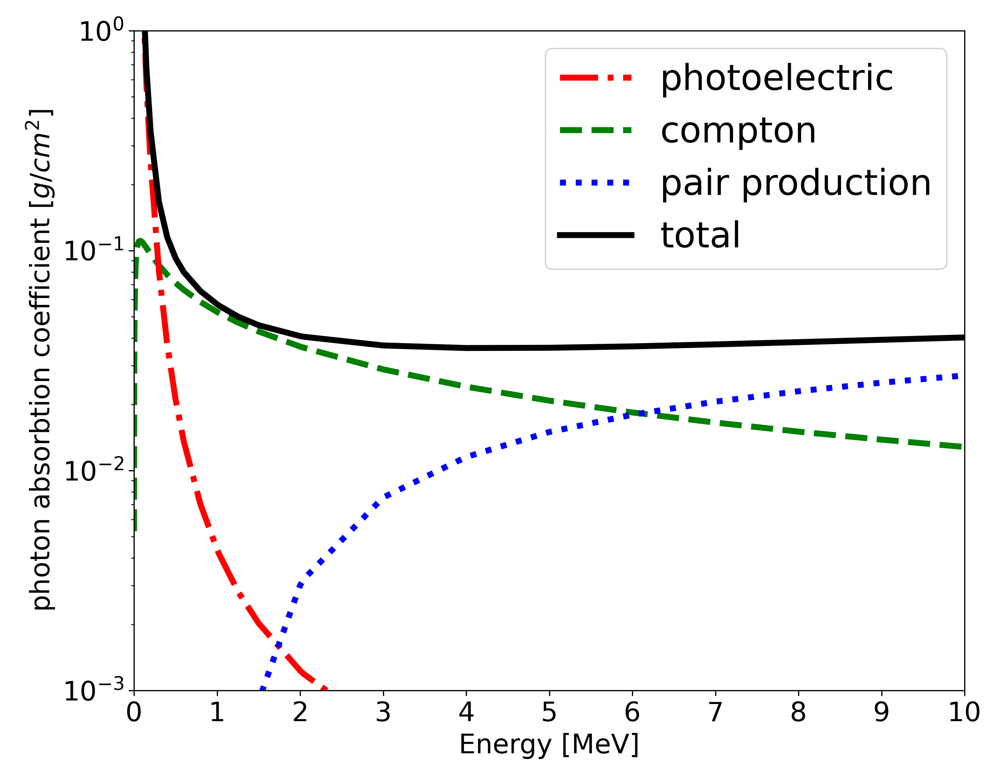
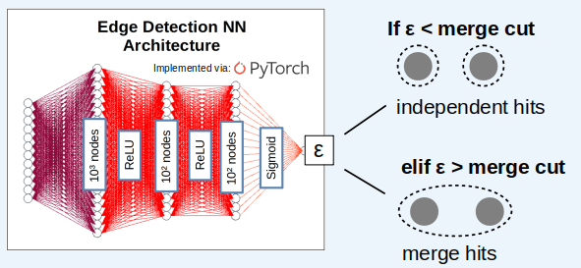
Machine Learning for the Cluster Reconstruction in the CALIFA Calorimeter at R3B
CALIFA
Edge Detection Neural Network
2. Pairwise hit comparison (i,j)
1. Pre- clustering

