Slide 1
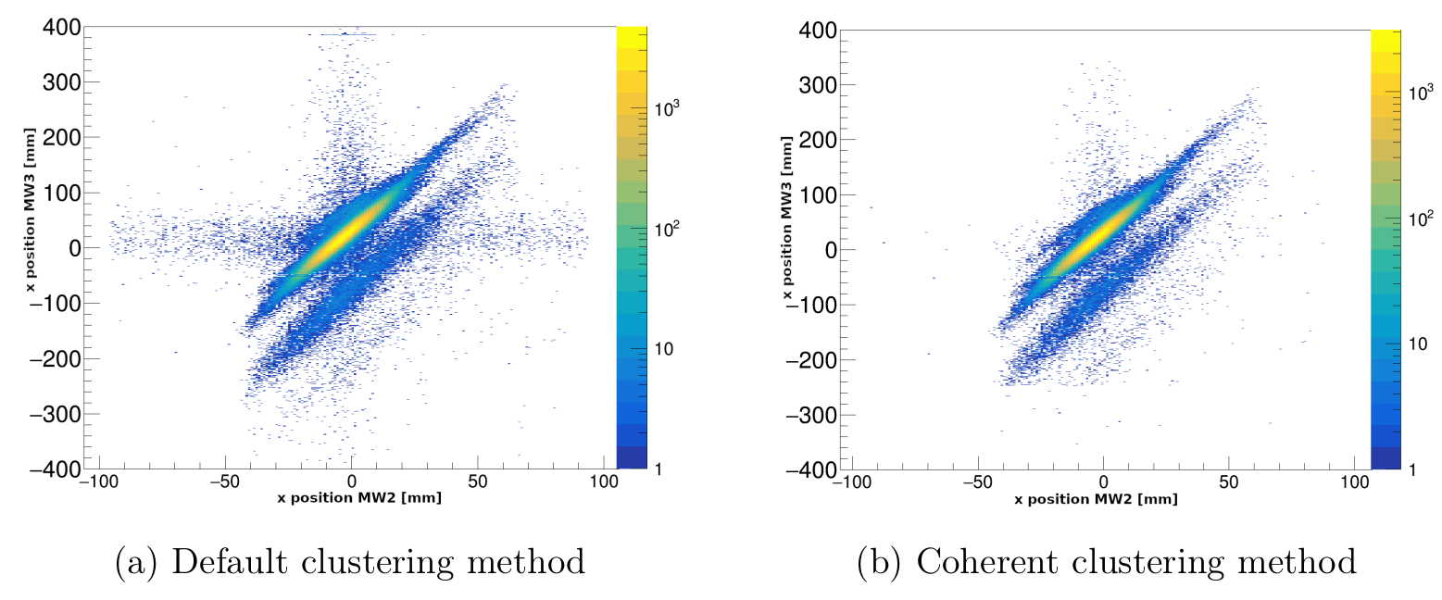
Is there an acceptance issue in xMW3?
Do we need to correct the ¹⁰C ?

Slide 2
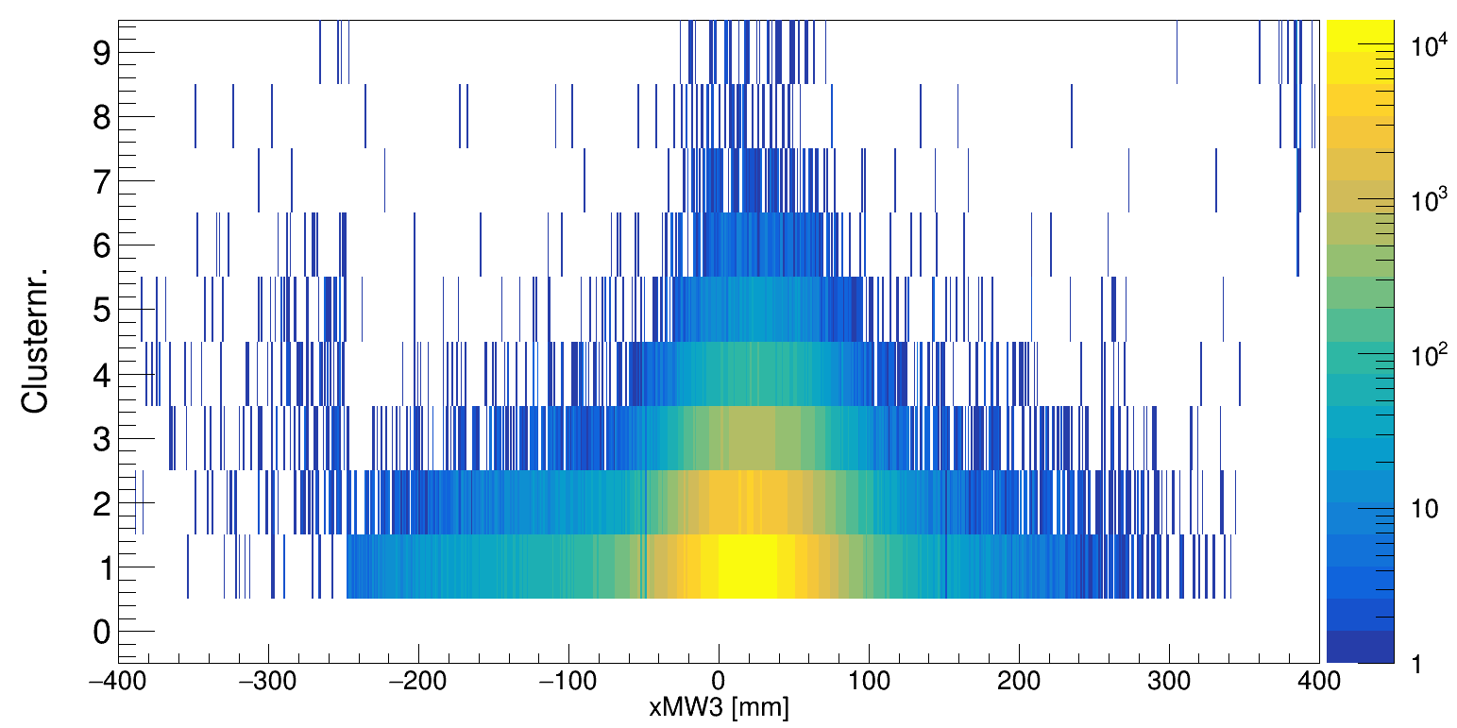
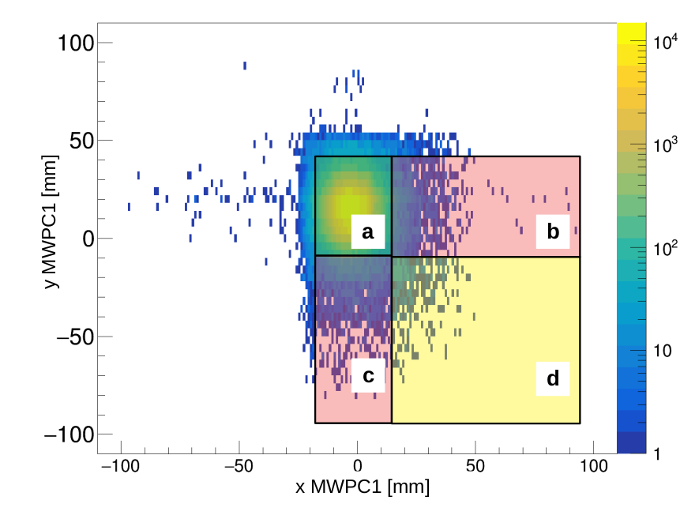
MWPC 3 Dimensions:
Geometry
- dimension: 900×600 mm2
- input and exit windows are 12 um thick Mylar foil - one plane of 288 vertical pads
- one plane of horizontal wires
- one plane of 120 horizontal pads
→ this cannot be an issue of geom. Acceptance
→ it only appears when I use the “coherent clustering”
Coherent clustering only selects events with clusternr =1
Note: for the final isotope correction we do not use the left site, due to xMW1 acceptance….

