Slide 1
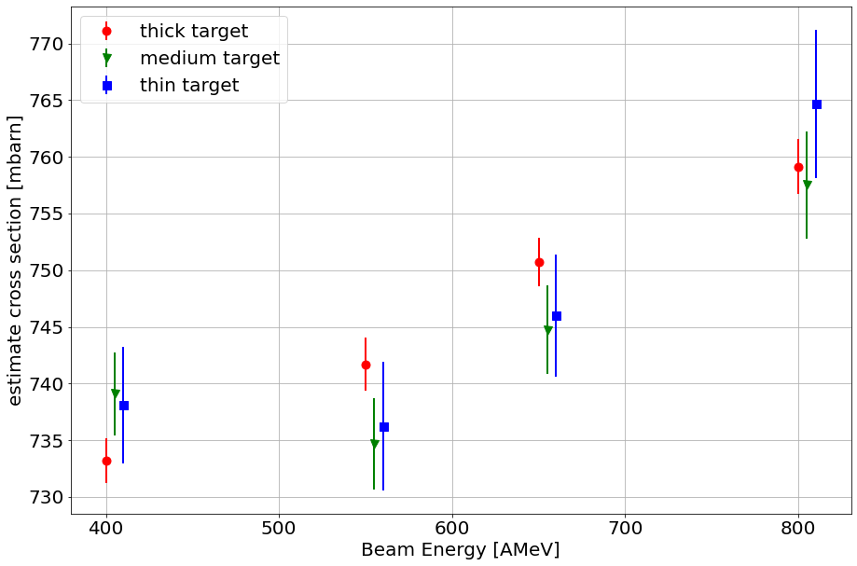
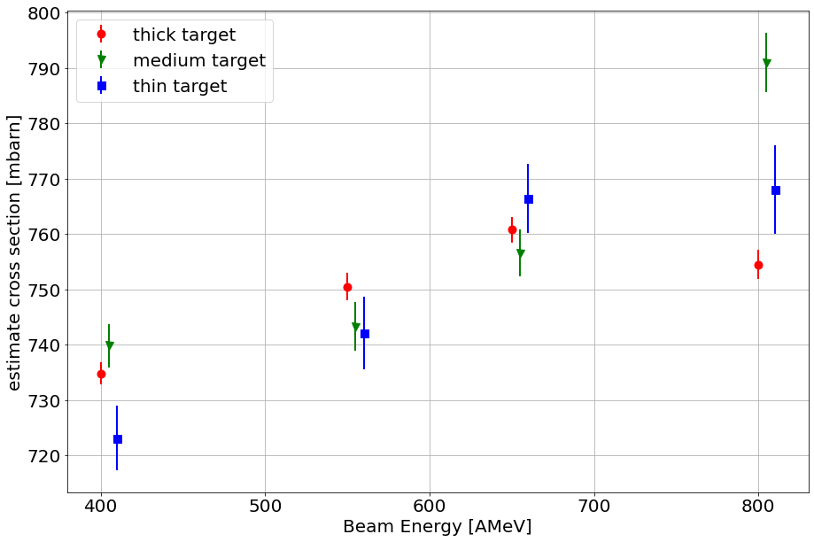
Integrating events within the ellipsoid
Using the fitted 2D gauss integral

