Slide 1
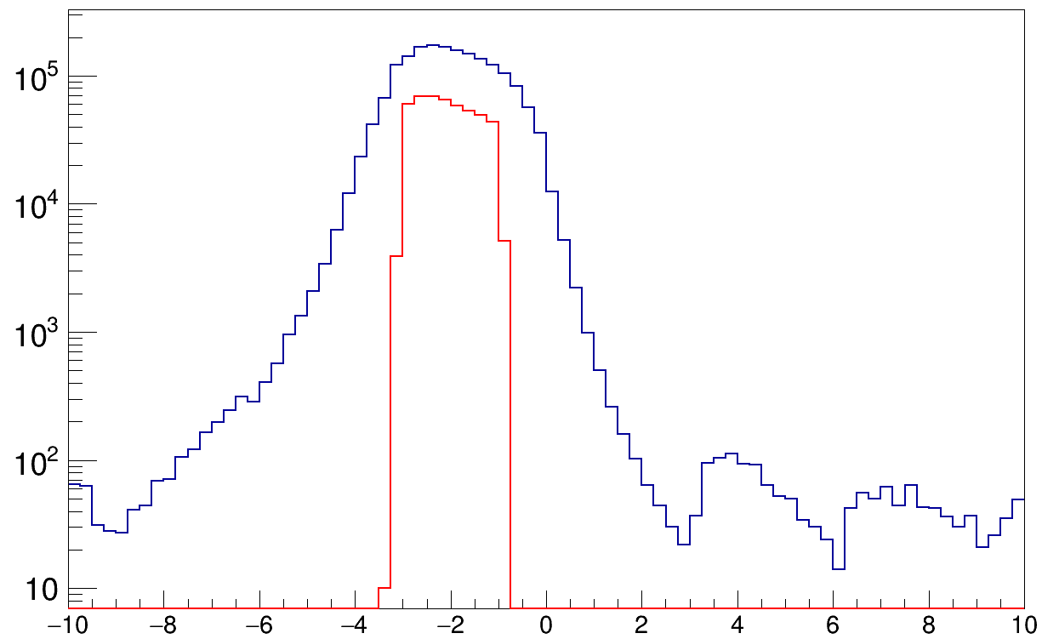
extrapolated x position at target point [mm]

