Slide 1
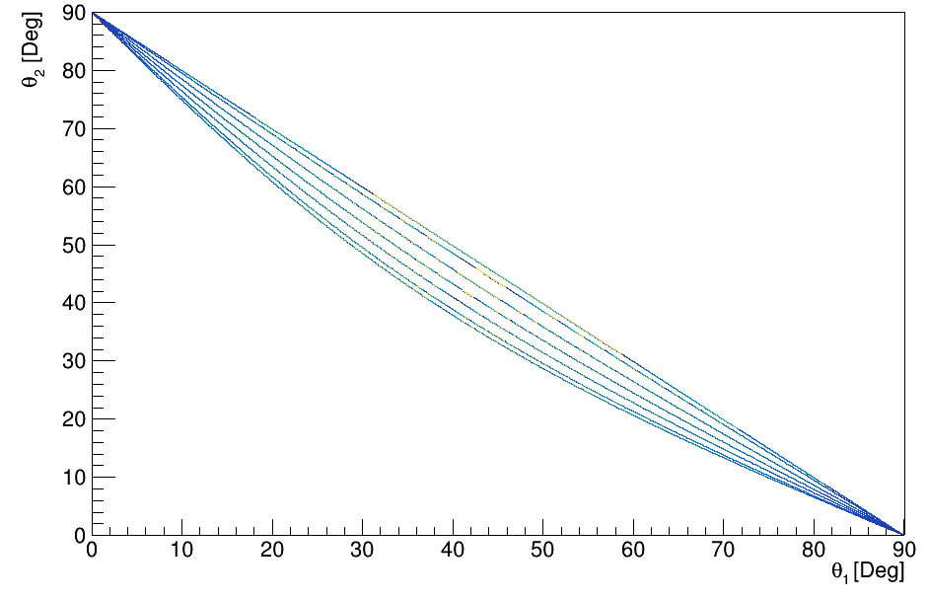
Polar angle correlations proton-proton free scattering
θ₂[ ° ]
θ₁[ ° ]

