Slide 1
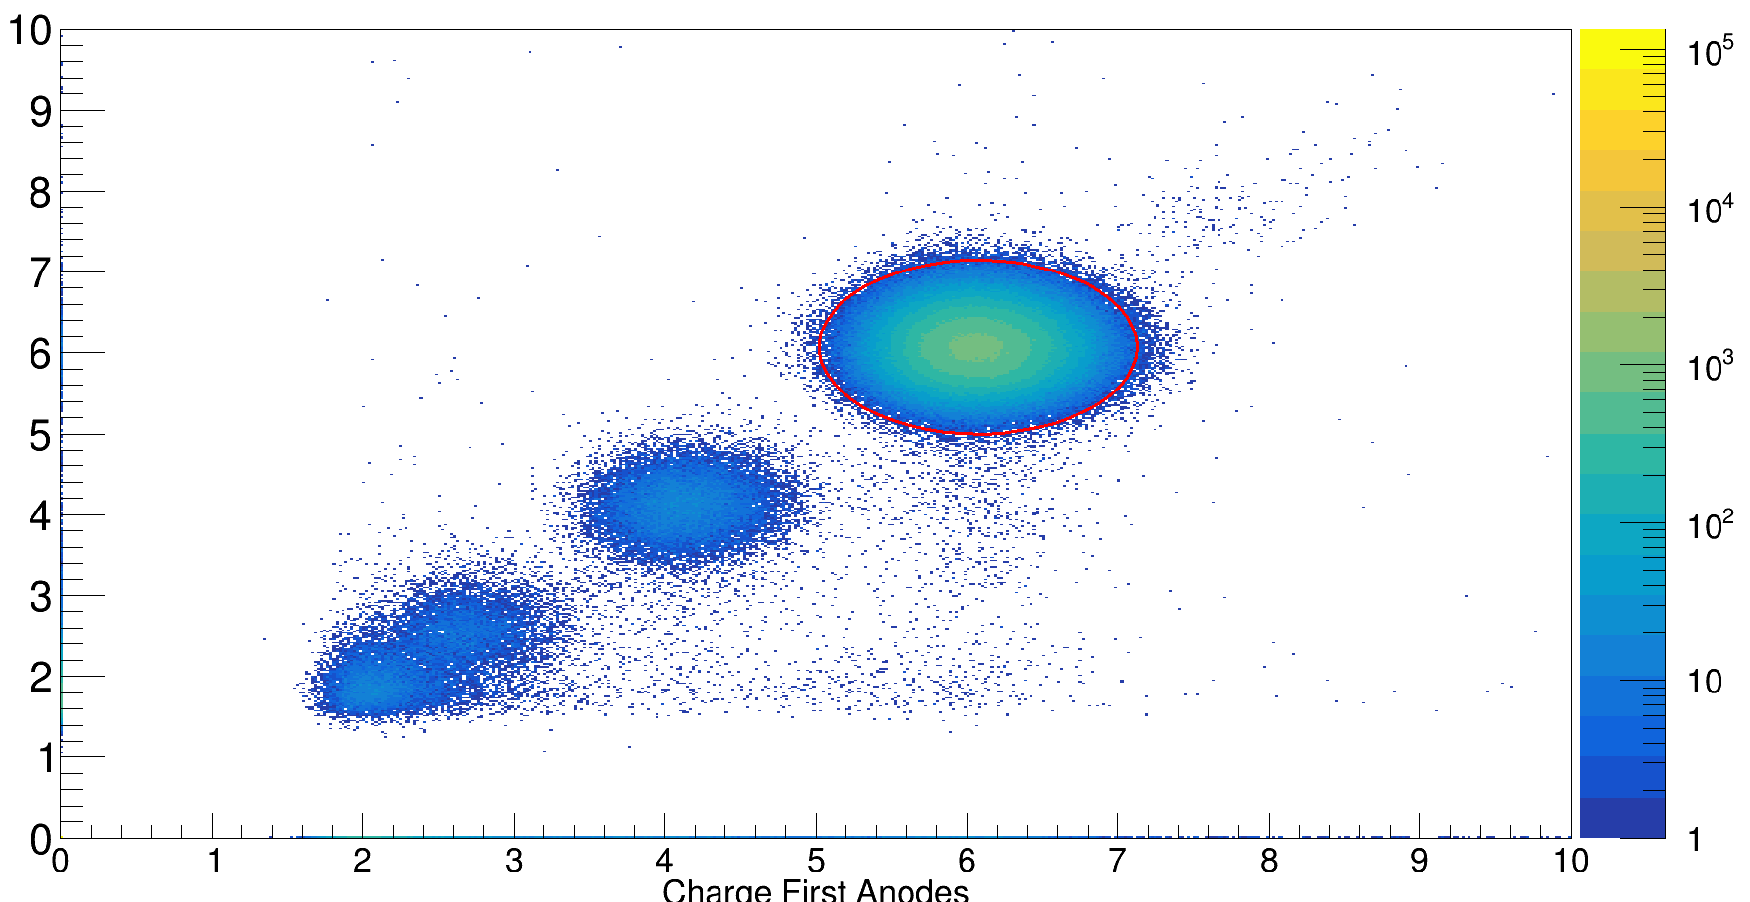
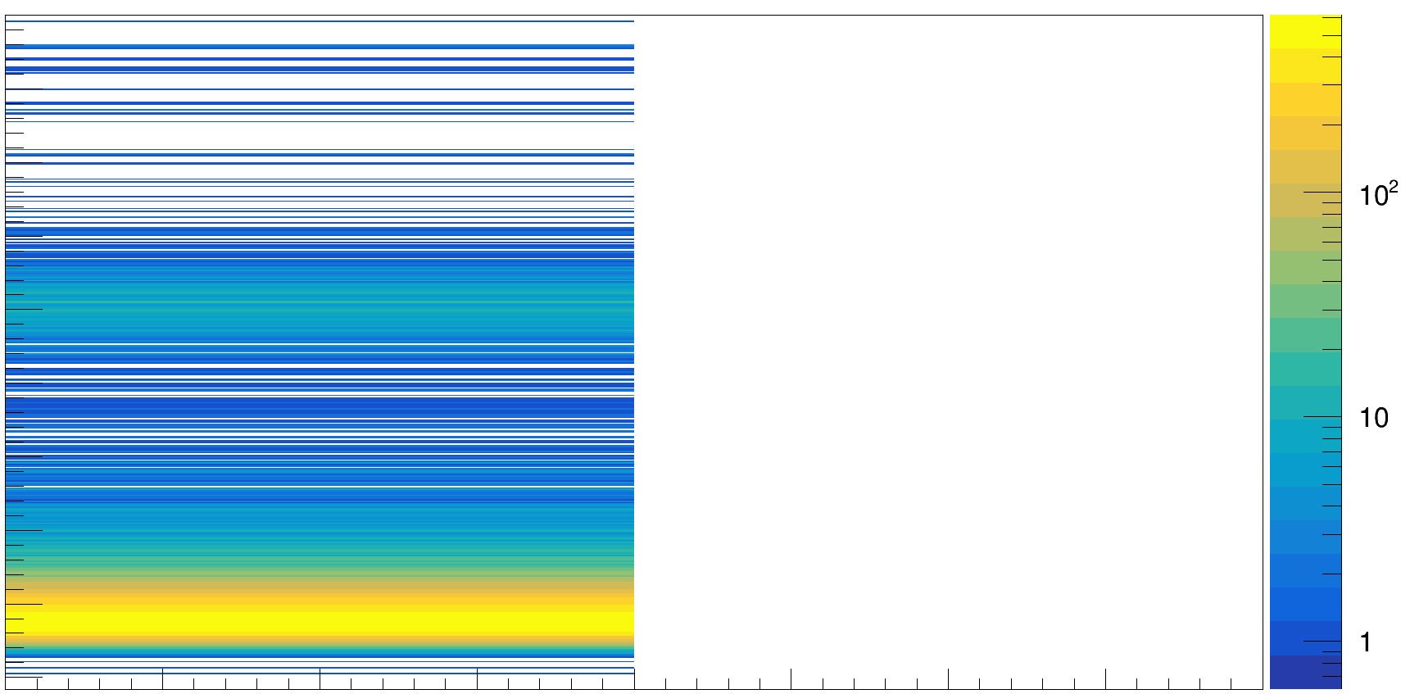
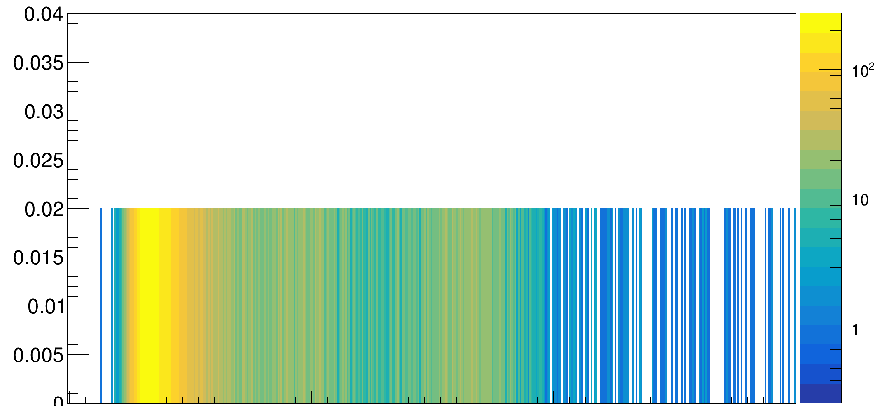
0.03%
15.59 %
calibrated energy loss ΔE a. u. - downstream anodes
0.10%
calibrated energy loss ΔE a. u. - upstream anodes

