Slide 1
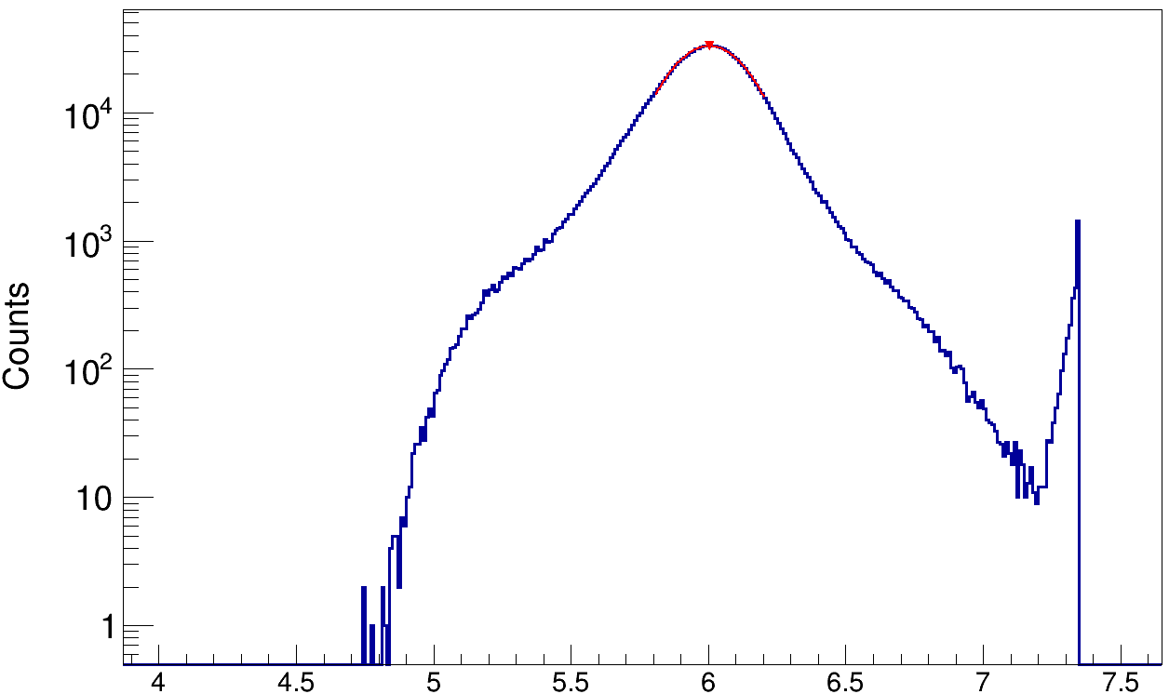
ΔZ ≈ 0.35 (FWHM)
charge value

