Slide 1
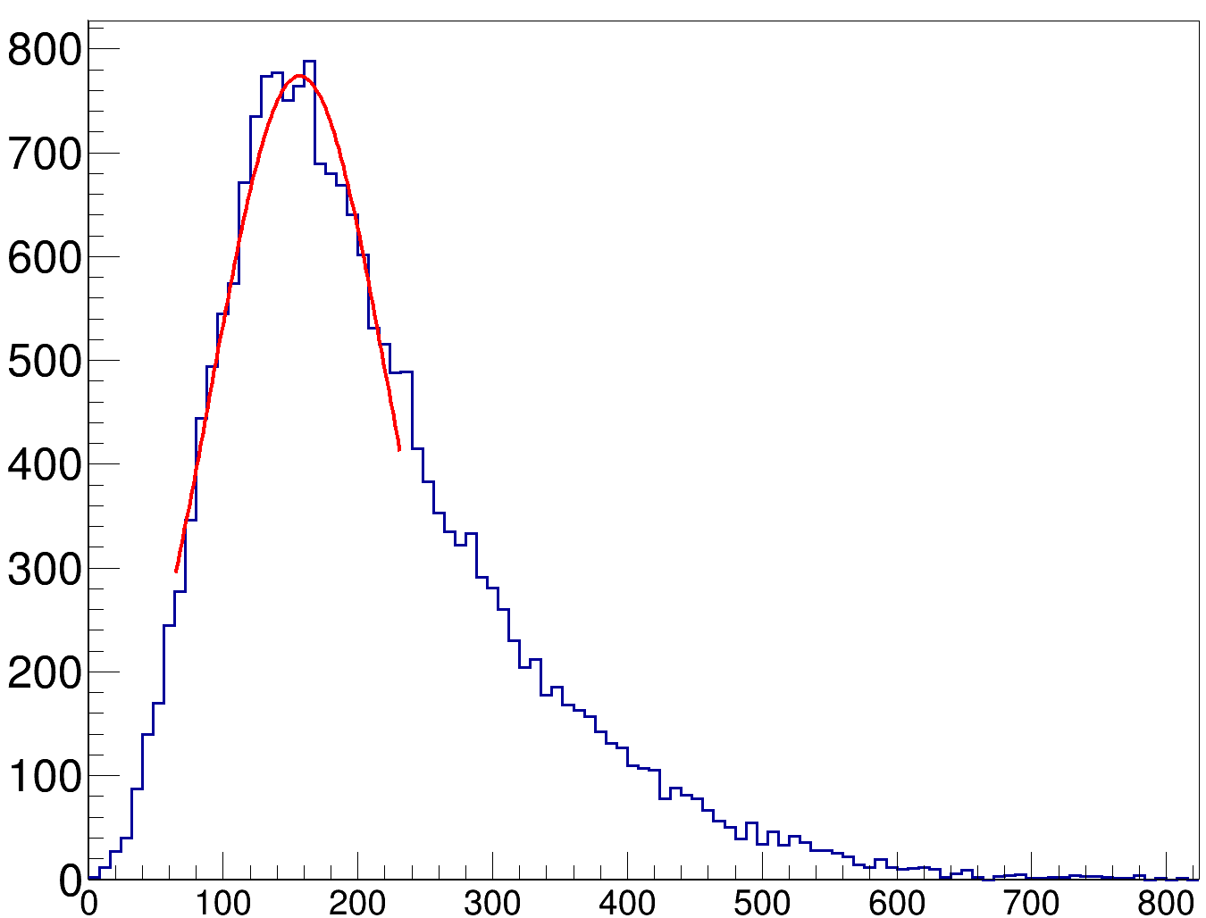
μ = 156 MeV/c
σ = 66 MeV/c
pmiss [MeV/c]

Slide 2
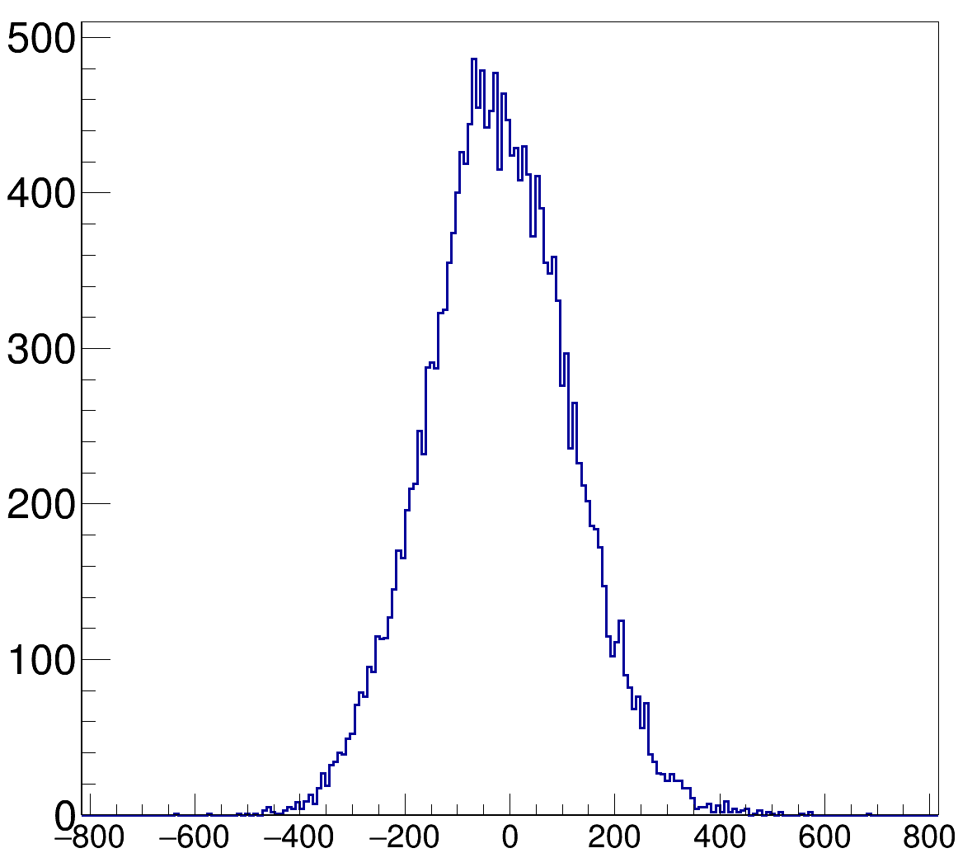
pxmiss [MeV/c]

Slide 3
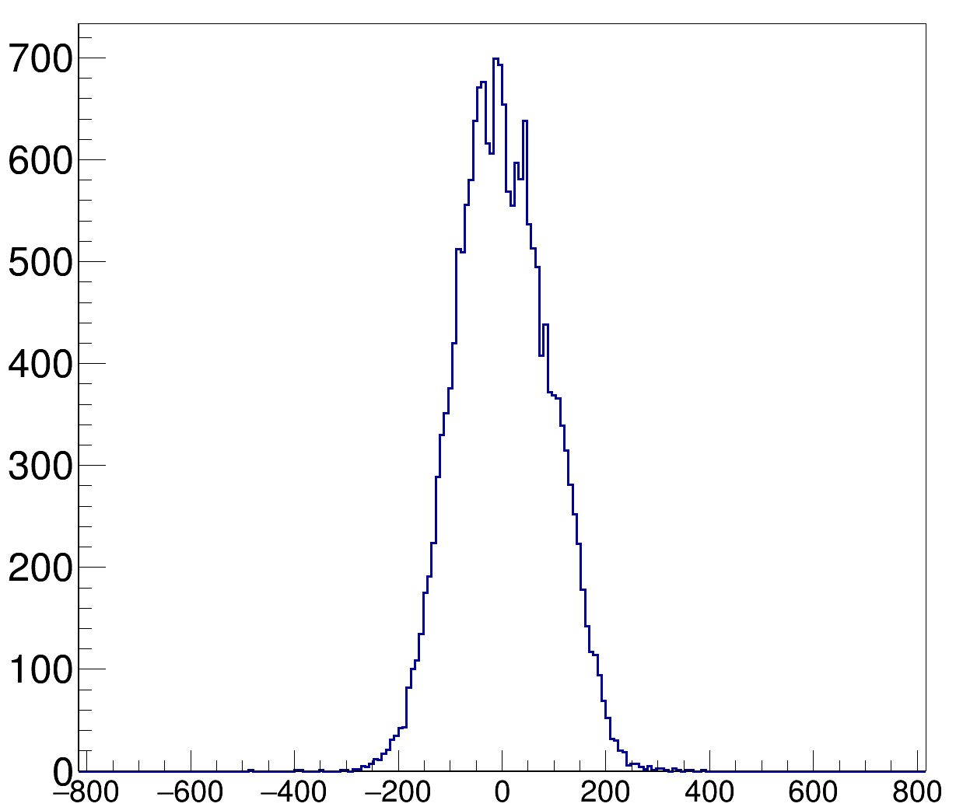
pymiss [MeV/c]

Slide 4
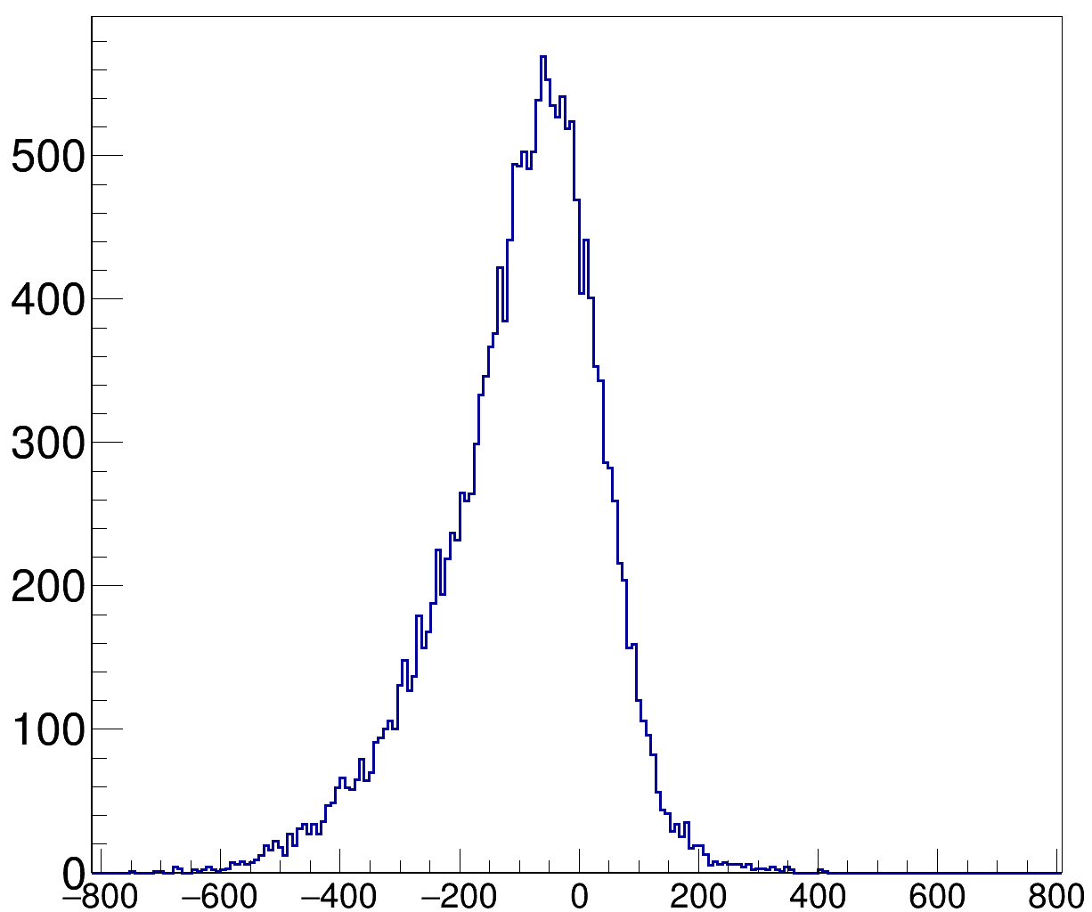
pzmiss [MeV/c]

