Slide 1
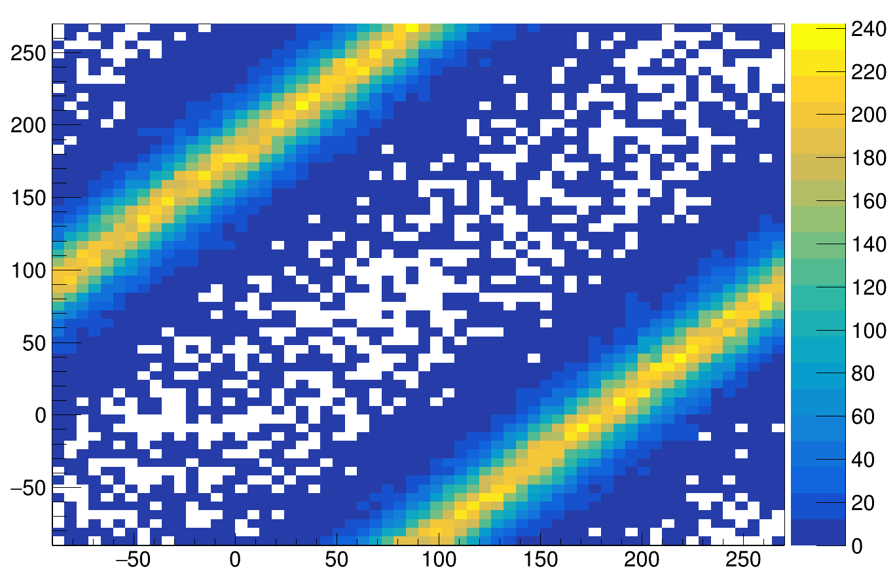
φ2 [°]
φ1[°]

