Slide 1
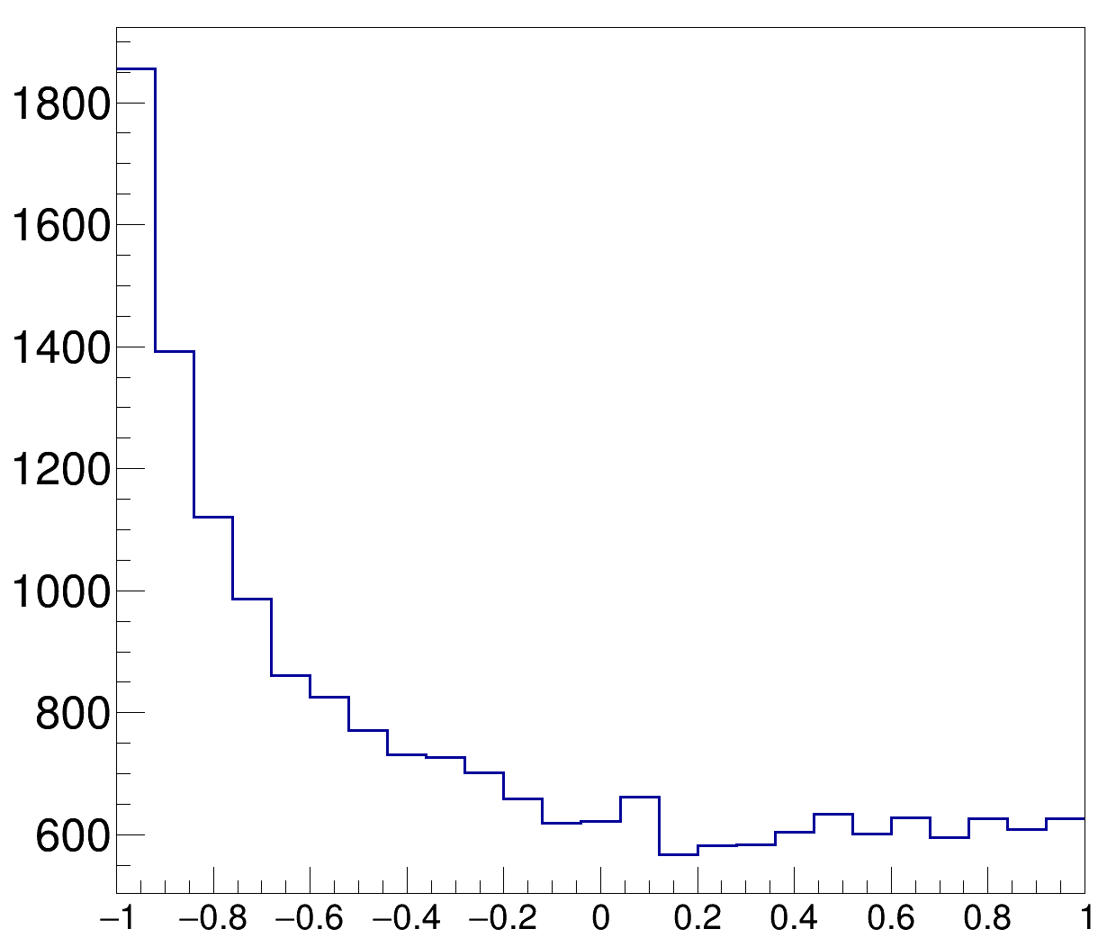
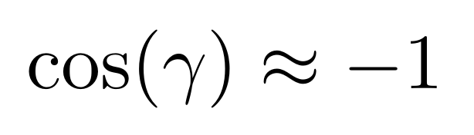

Slide 2
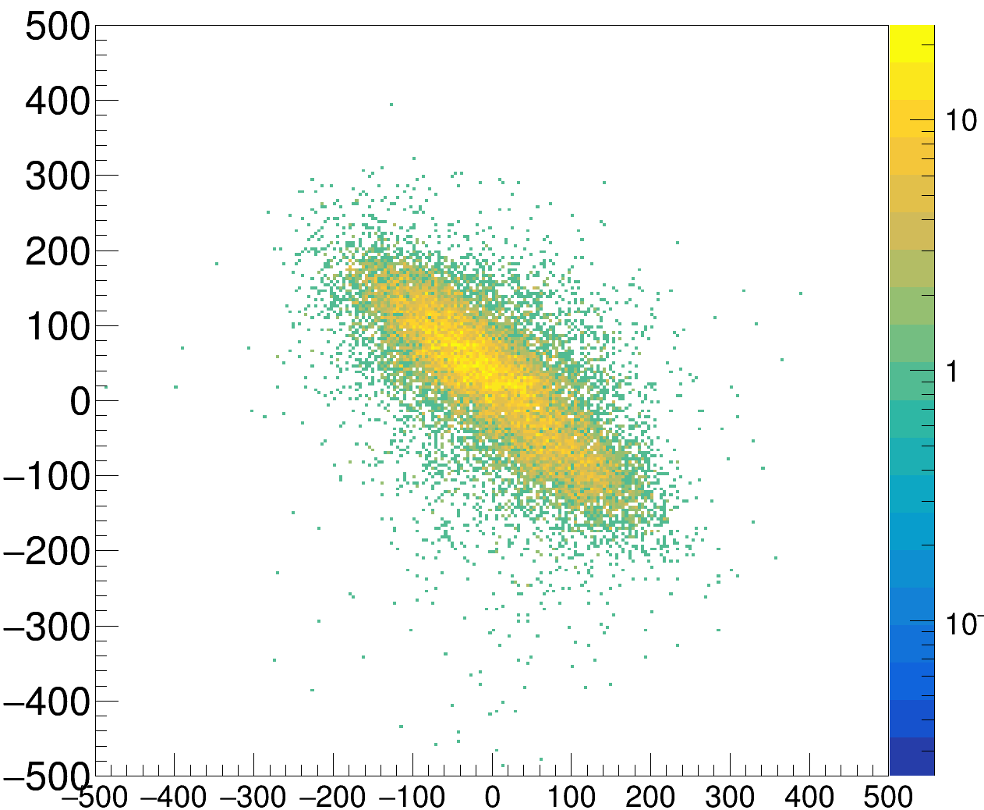
py11B [MeV/c]
pymiss [MeV/c]

Slide 3
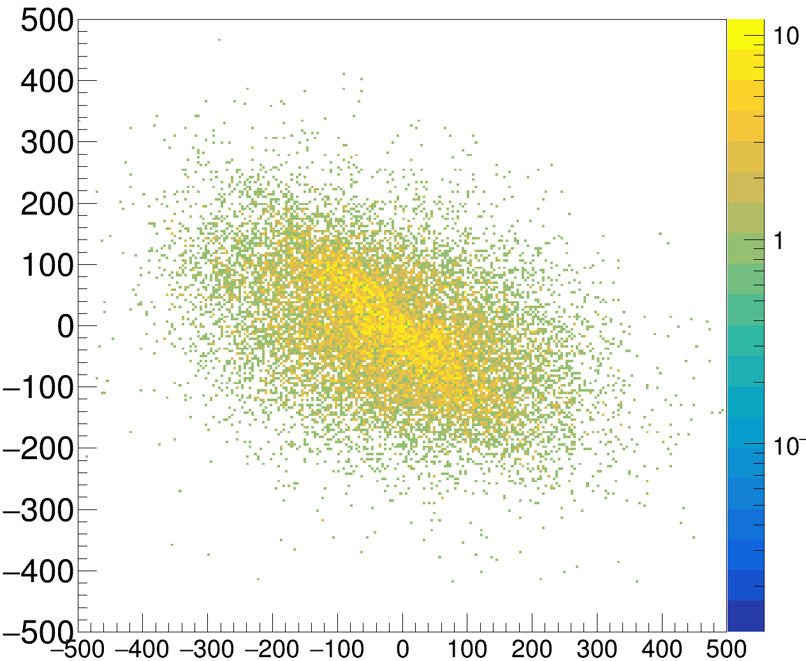
px11B [MeV/c]
pxmiss [MeV/c]

