Slide 1
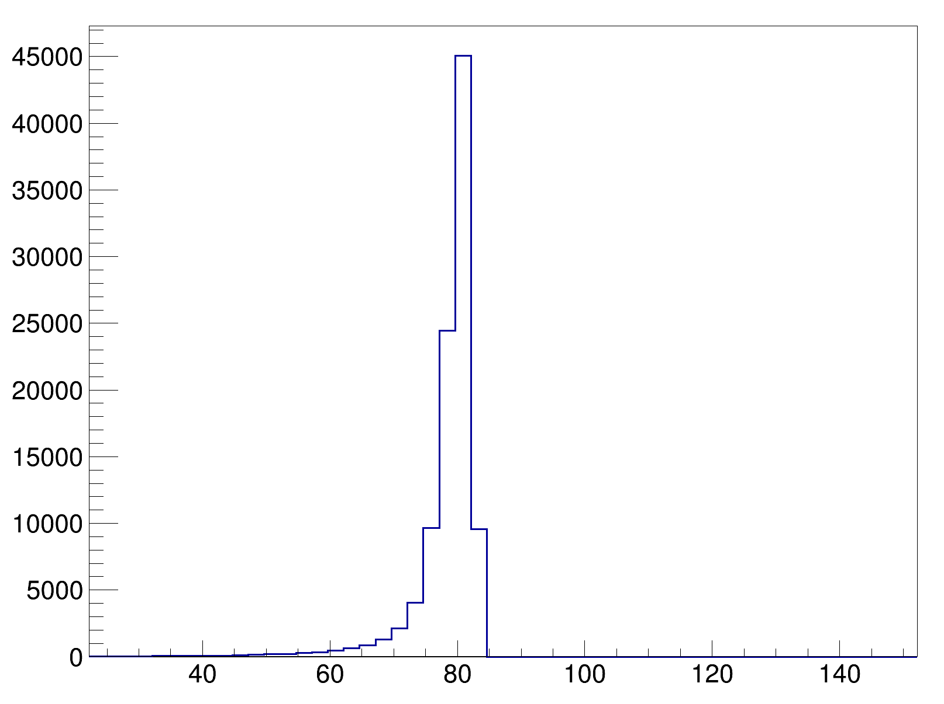
Opening Angle θp2p[°]

