Slide 1
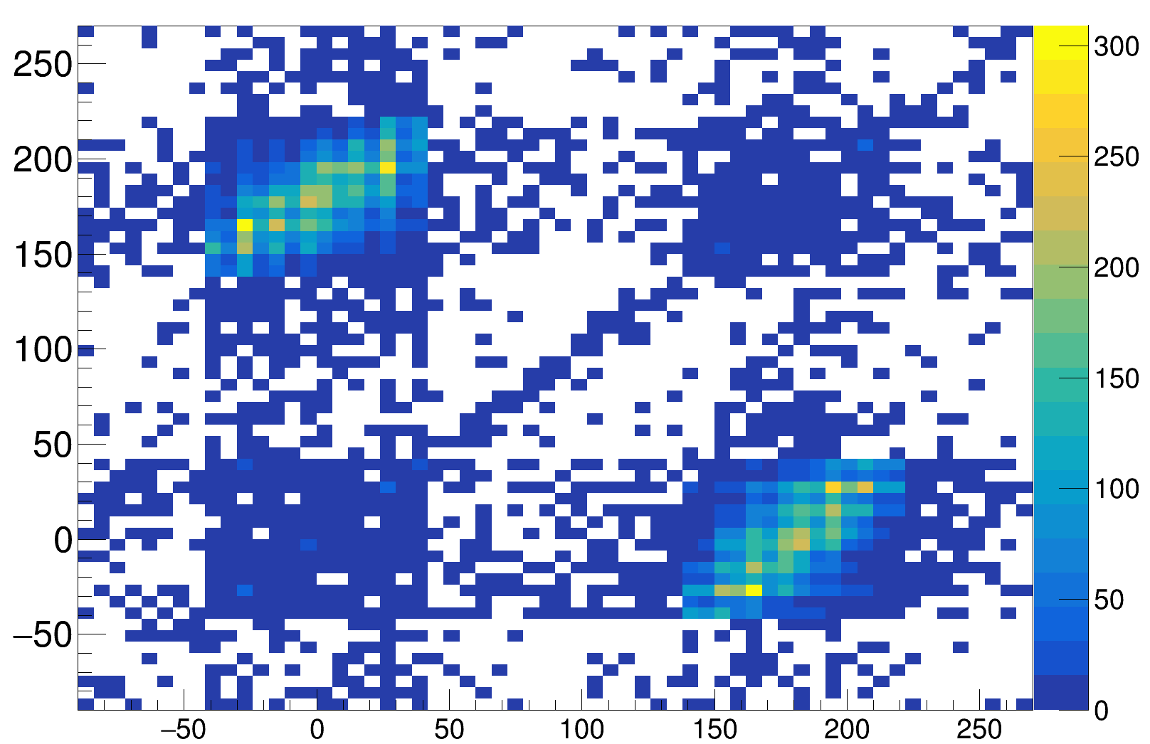
φ2[°]
φ1[°]

