Slide 1
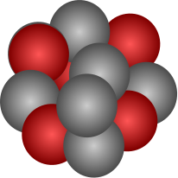


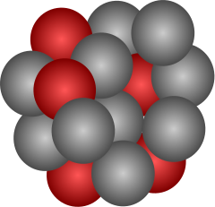
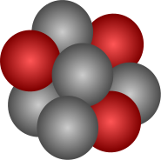

S455 - Pilot experiment in 2021
²³⁸U
*
200MeV
LH2 Target (15mm)
Z-1
Beam energy: 637 AMeV

