Slide 1
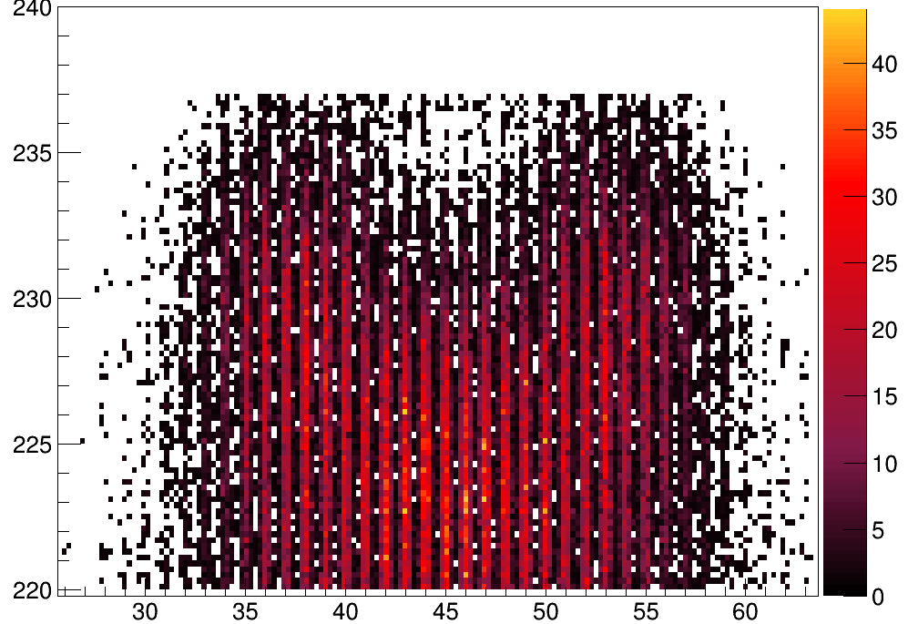
Z₁ + Z₂ = 91
Total Mass FF1 + FF2
Fission Fragment Charges

