Slide 1
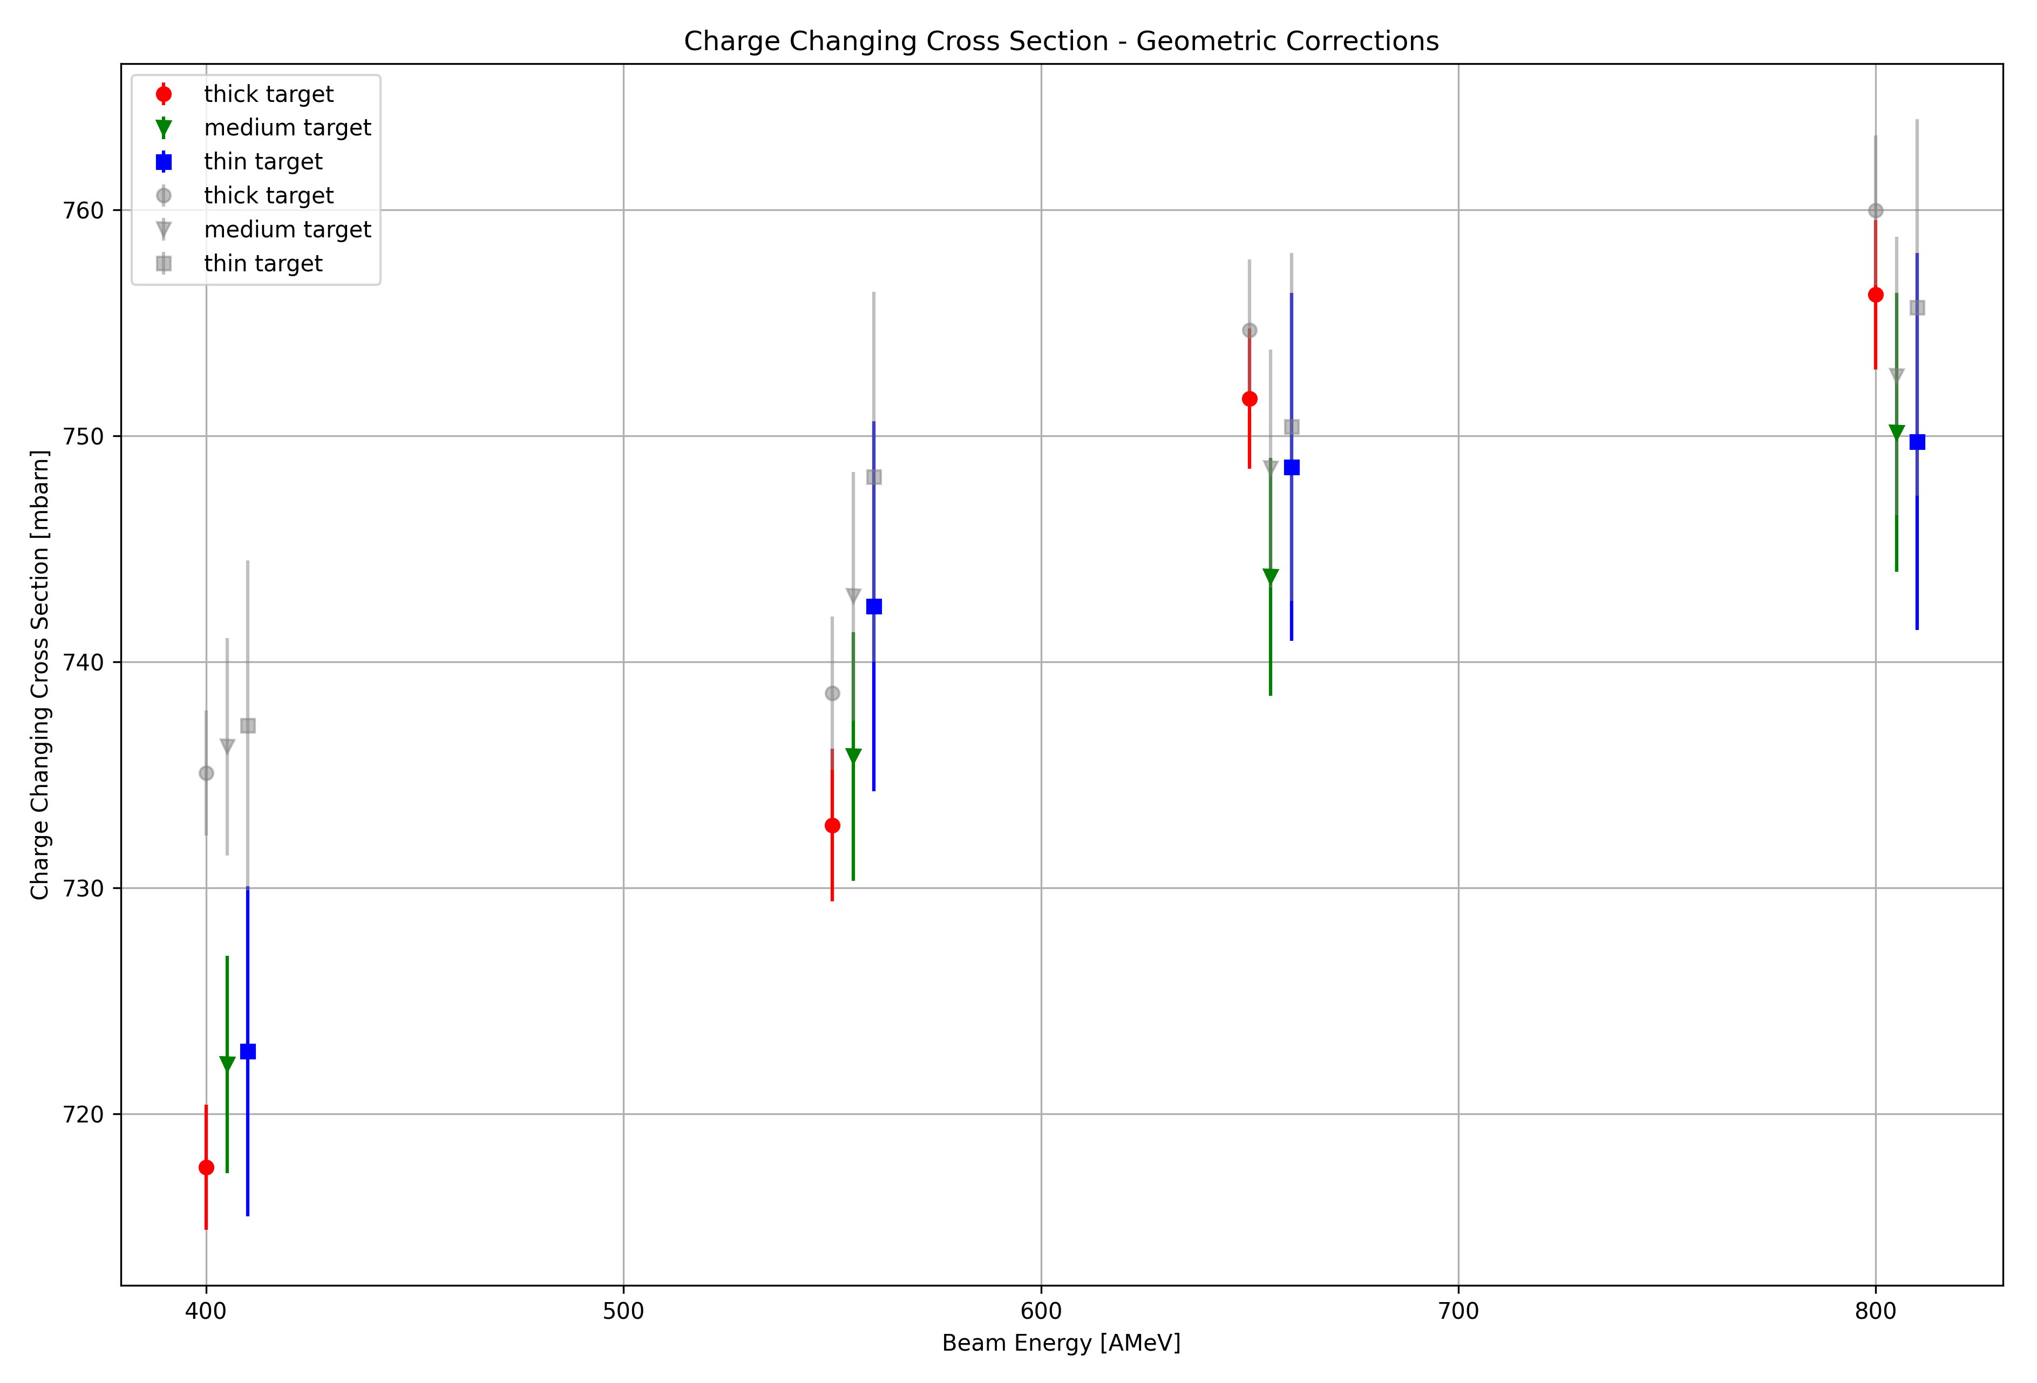
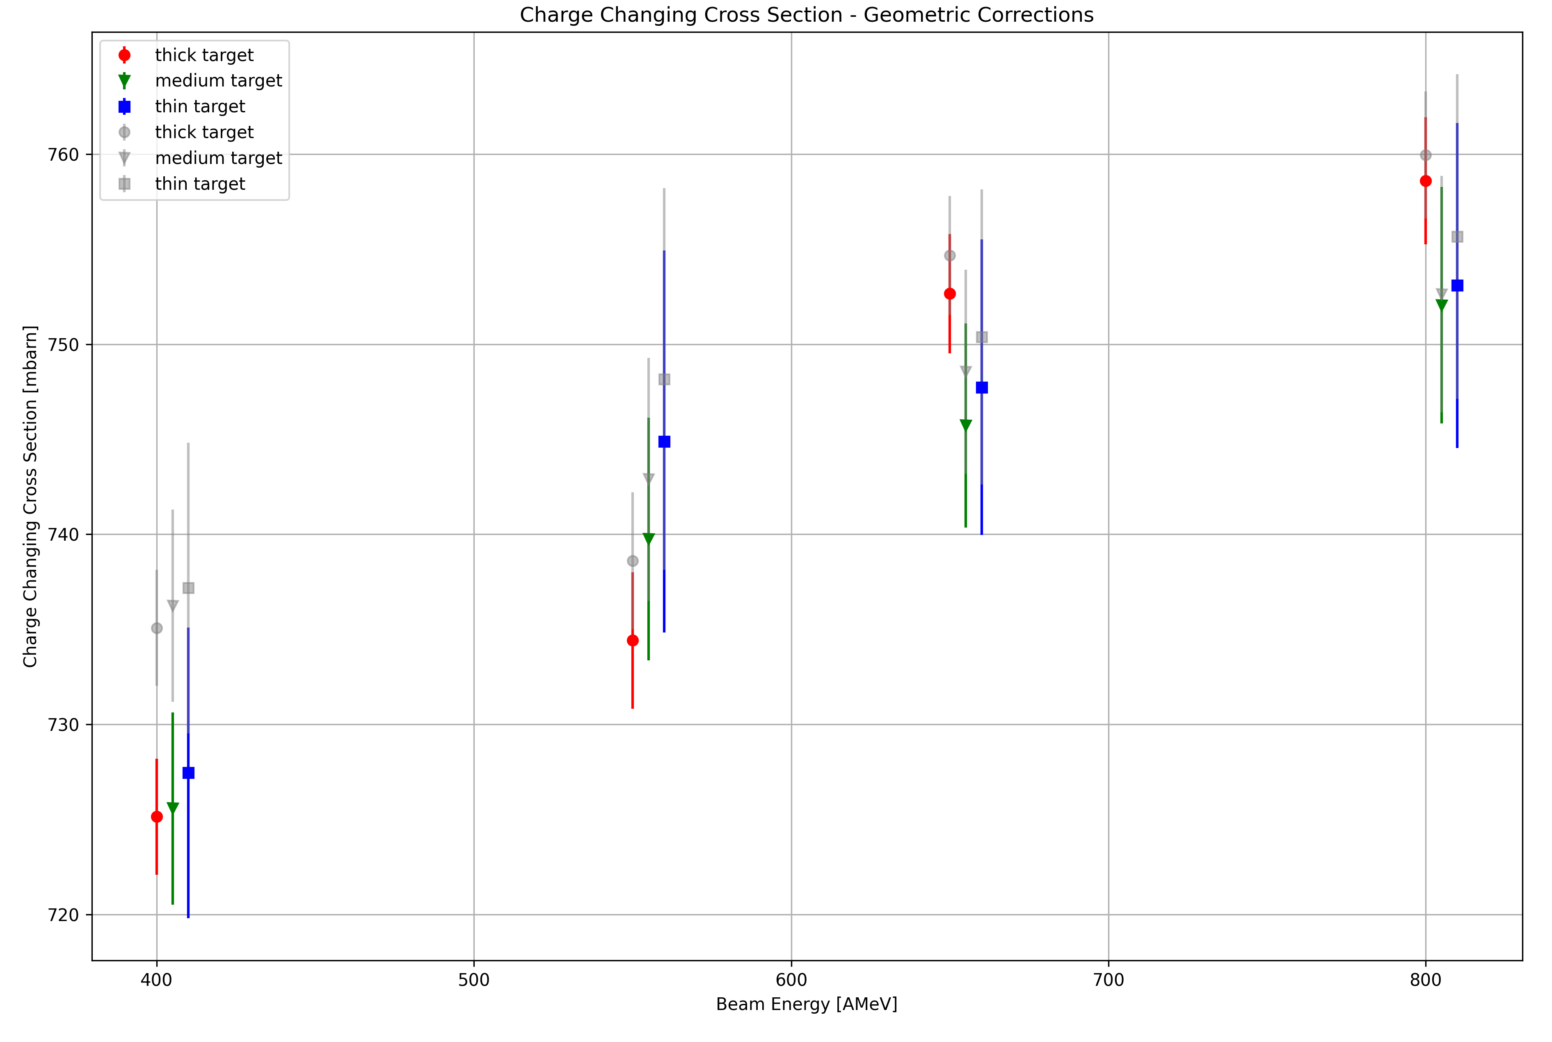
+-1 sigma cut in MW0 X-Y
Multi-fit method (old)
Flipping method

Slide 2
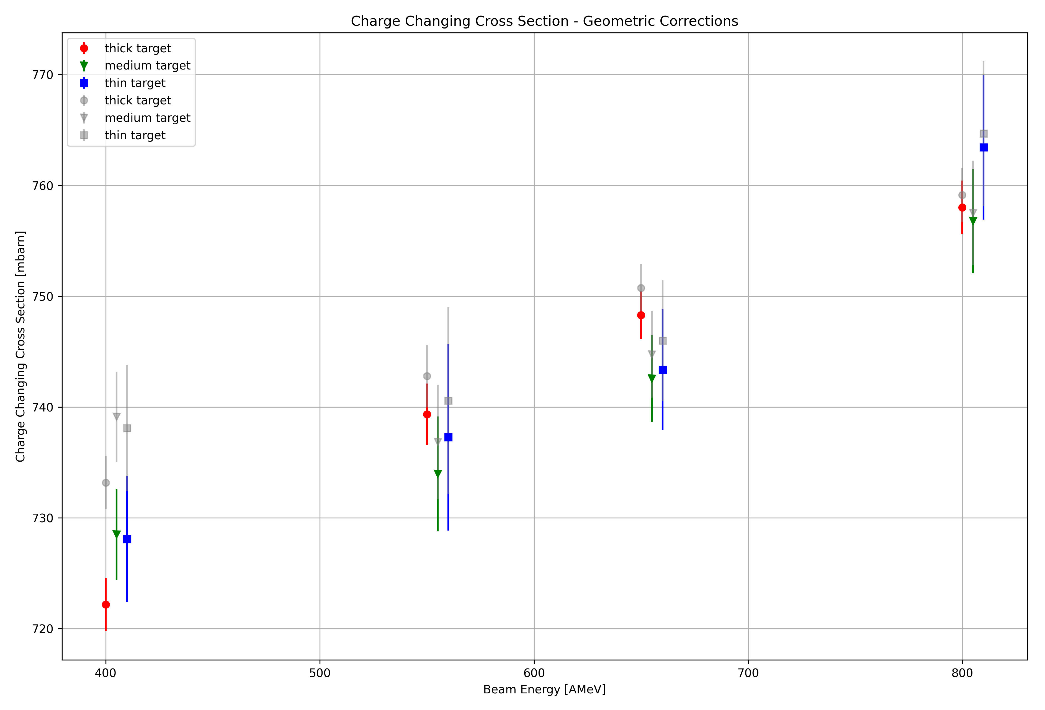
+-2 sigma cut in MW0 X-Y

