Slide 1
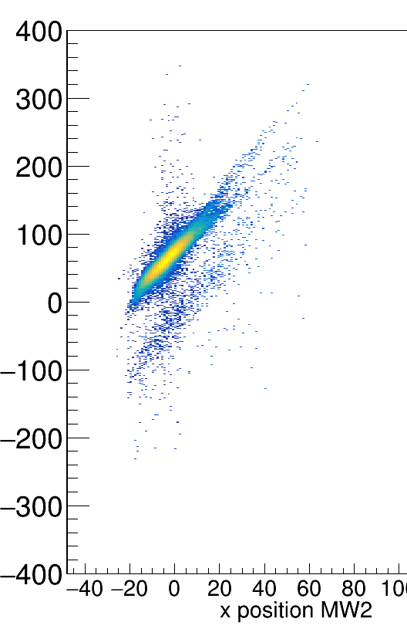
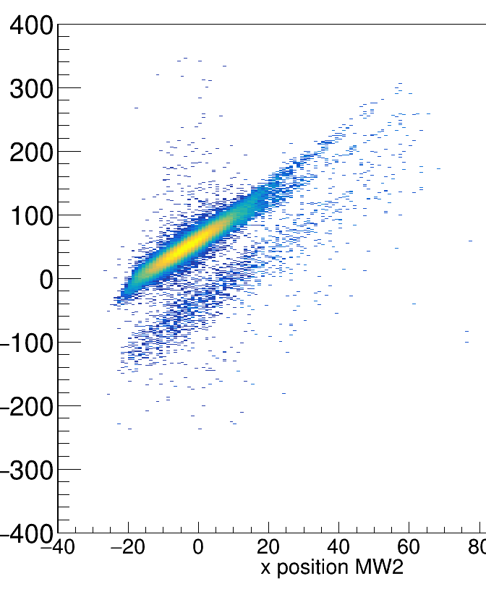
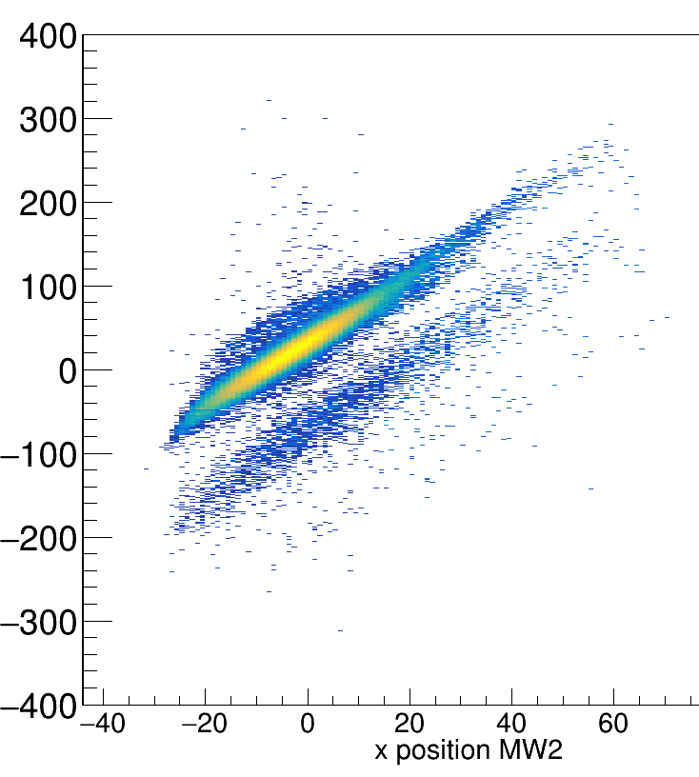
Thin target, 400 AMeV
Medium target, 400 AMeV
Thick target, 400 AMeV

Slide 2
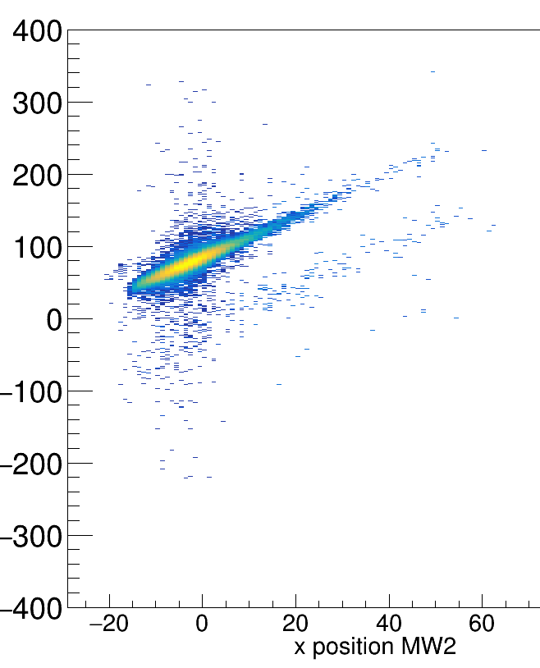
Empty target, 400 AMeV

Slide 3
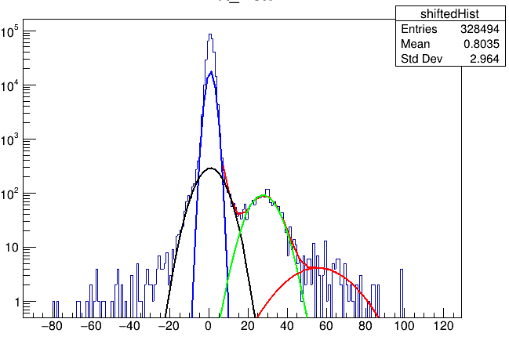
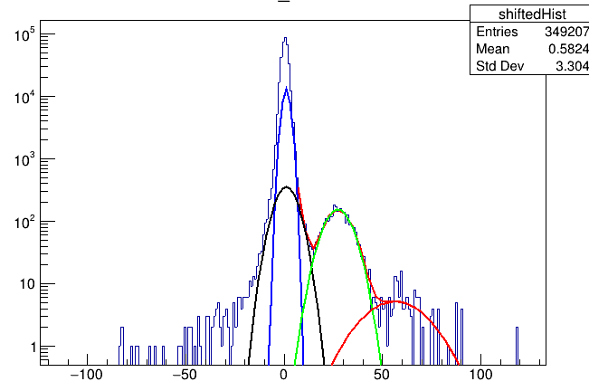
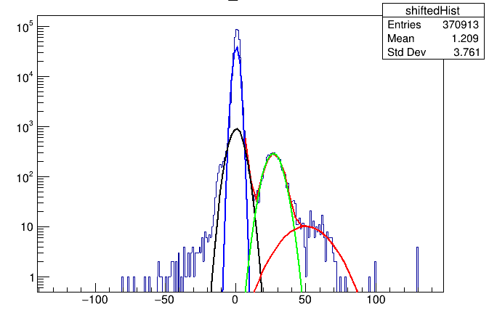
Thin target, 400 AMeV
Medium target, 400 AMeV
Thick target, 400 AMeV

Slide 4
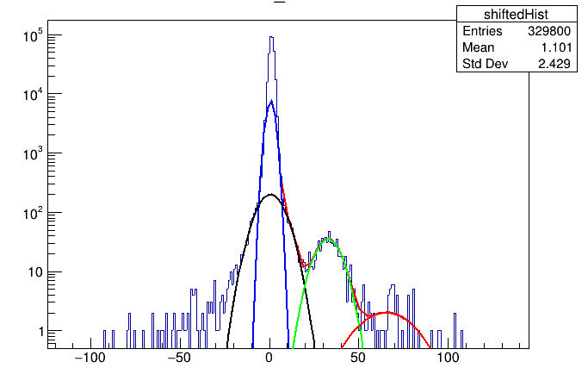
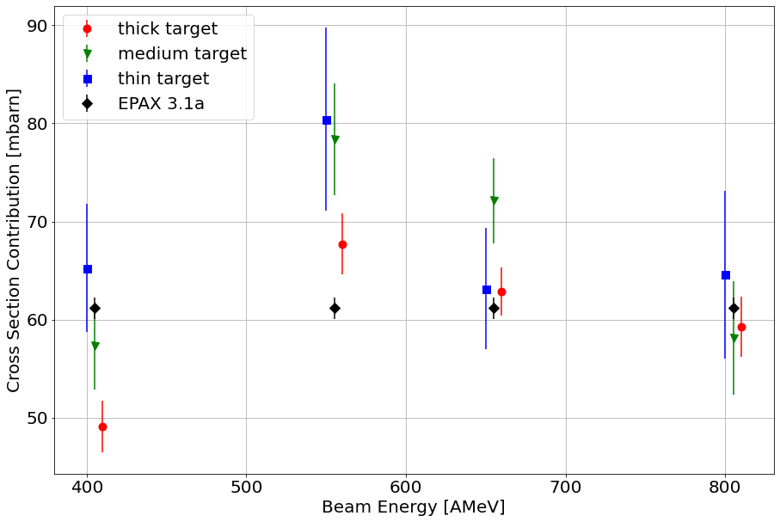
Empty target, 400 AMeV

Slide 5
numbers
exp c_1086 0181_0001 400 0.00773705 349207
exp c_1086 0101_0001 550 0.0111725 262345
exp c_1086 0127_0001 650 0.00975791 383411
exp c_1086 0168_0001 800 0.00772367 86117
exp c_2198 0183_0001 400 0.0119463 370913
exp c_2198 0103_0001 550 0.0170144 261291
exp c_2198 0130_0001 650 0.0152537 381199
exp c_2198 0170_0001 800 0.0138969 111033
exp c_54 0179_0001 400 0.00531327 328494
exp c_54 0099_0001 550 0.00742456 273765
exp c_54 0126_0001 650 0.00576197 400388
exp c_54 0166_0001 800 0.00518173 97572
exp empty 0187_0001 400 0.0020235 329800
exp empty 0096_0001 550 0.00337838 256404
exp empty 0124_0001 650 0.00258017 399946
exp empty 0173_0001 800 0.00192523 85564

