Slide 1
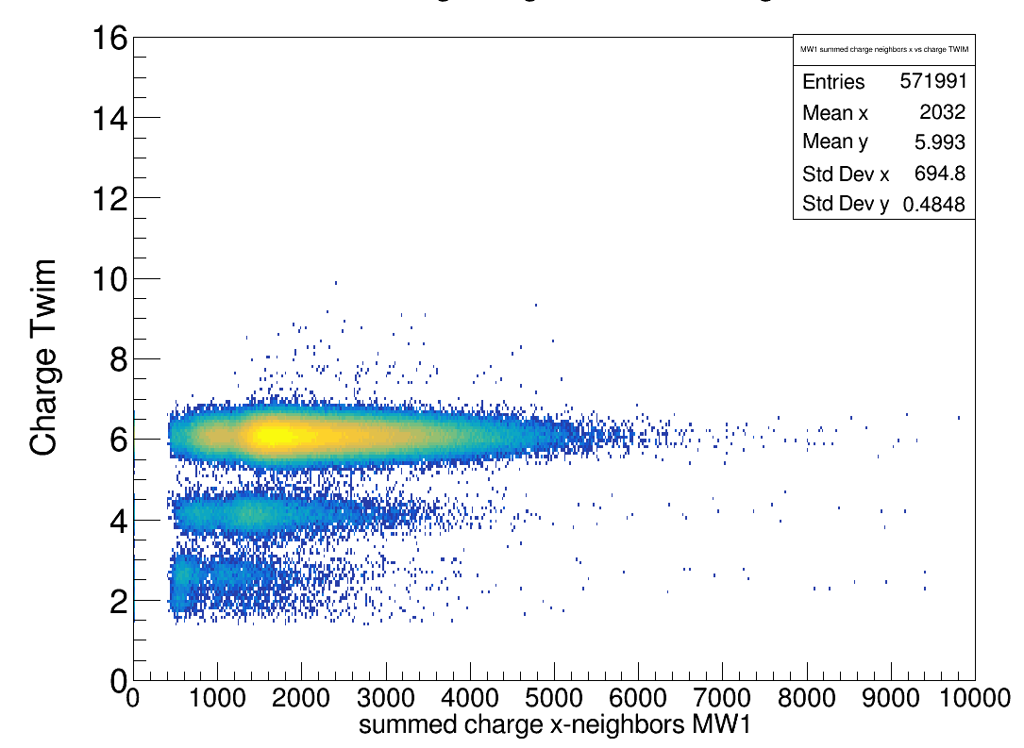
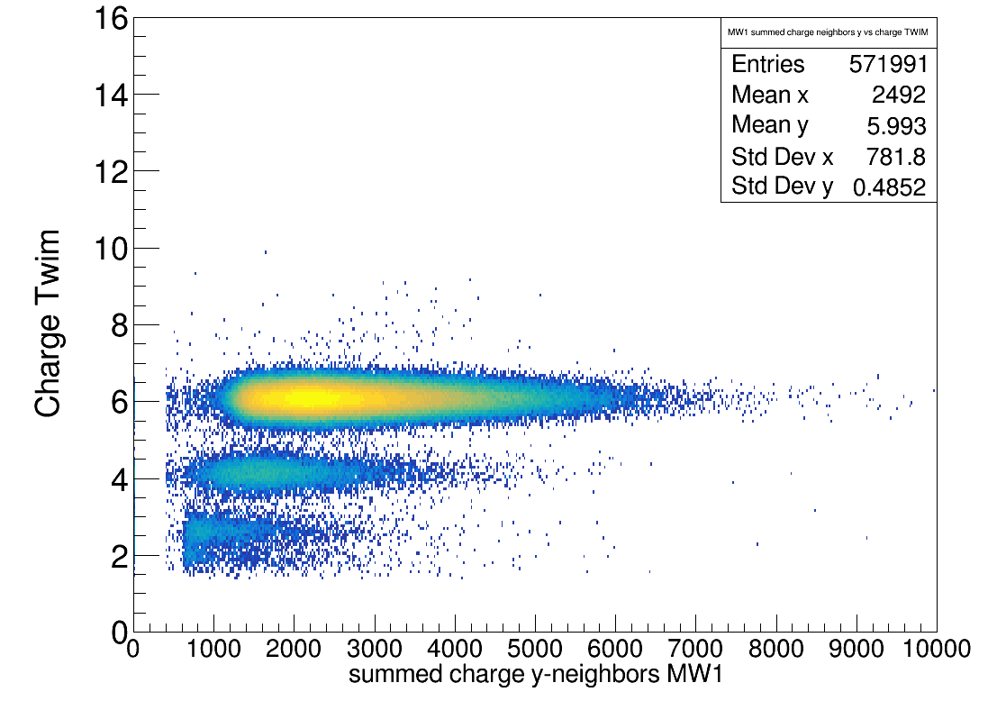
Charge MW1 x
Charge MW1 y

Slide 2
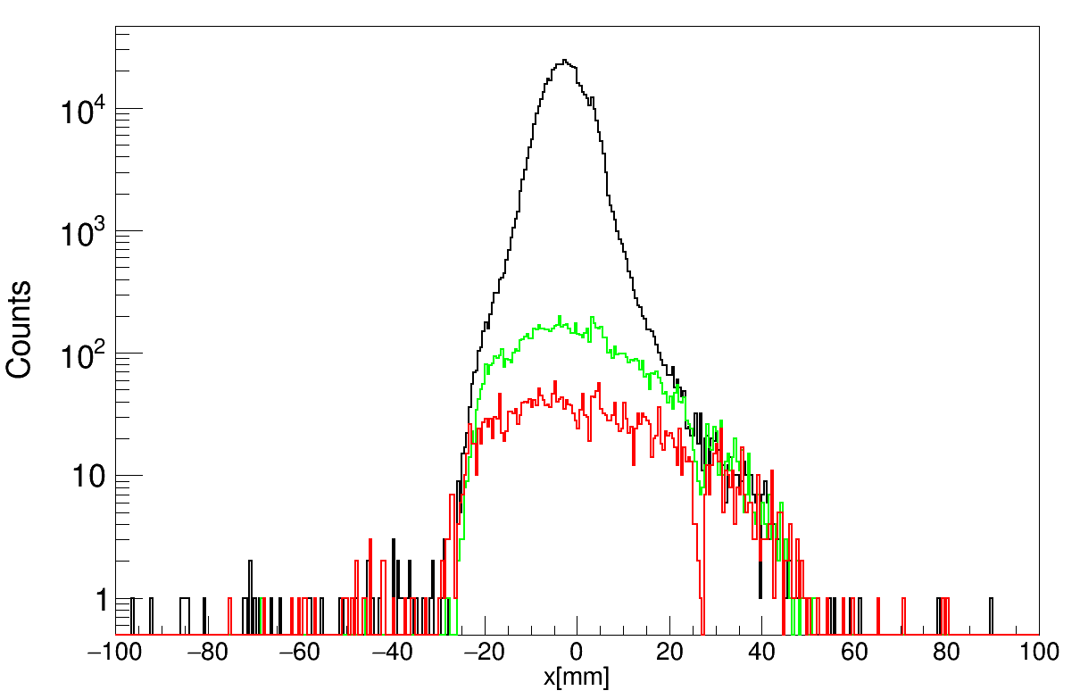
Z = 6
Z = 5
Z < 5
MW1

