Slide 1
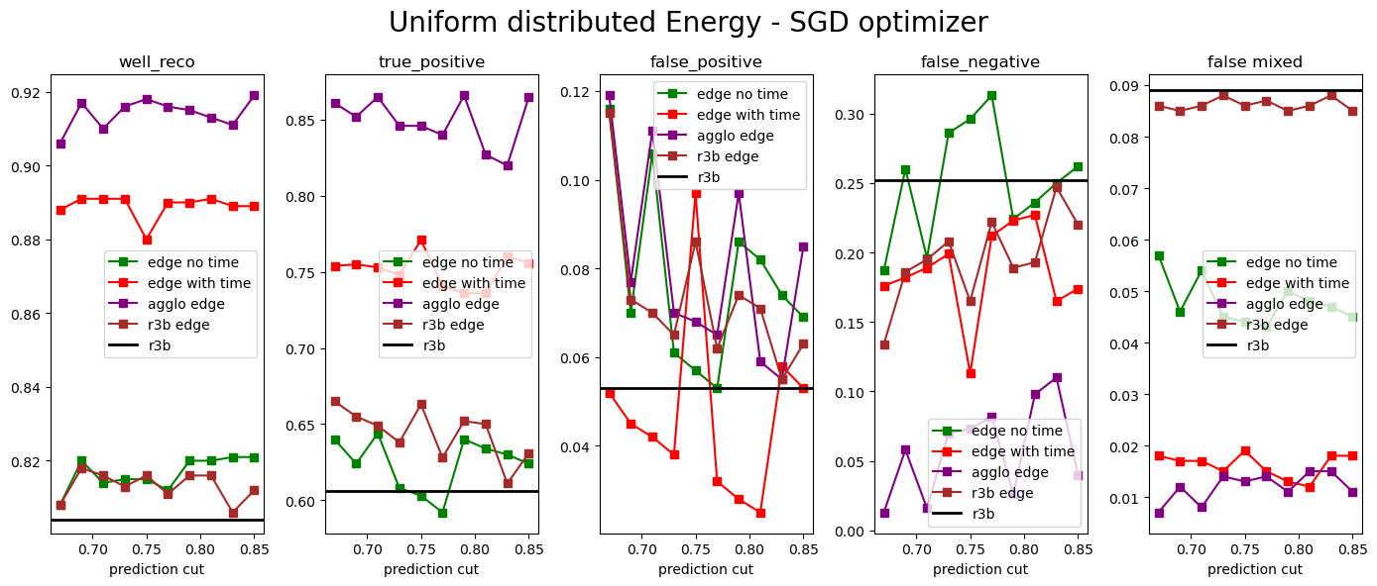
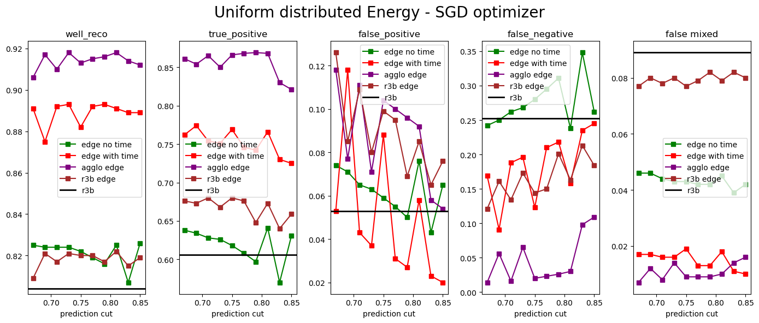
nr_epochs = 50k
Lr = 5e-3
nr_epochs = 80k
Lr = 9e-3

Slide 2
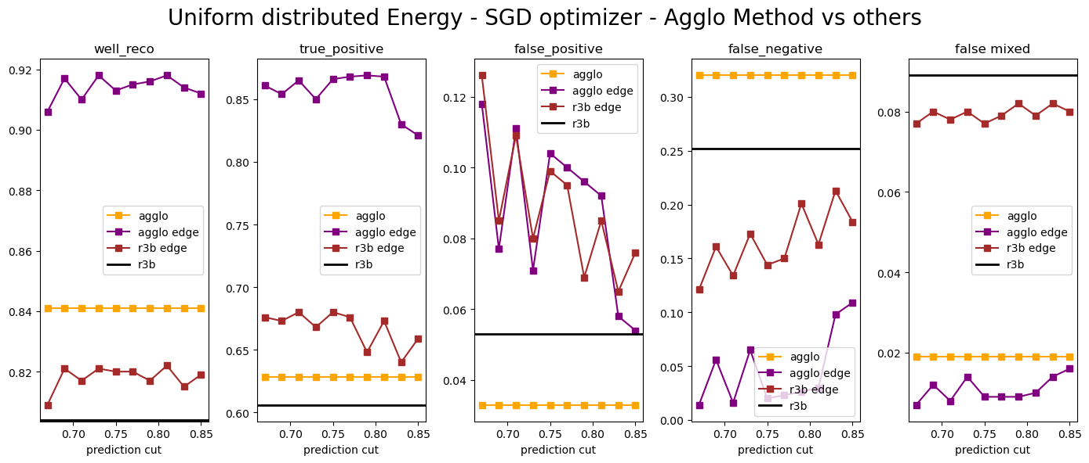
nr_epochs = 80k
Lr = 9e-3

