Slide 1
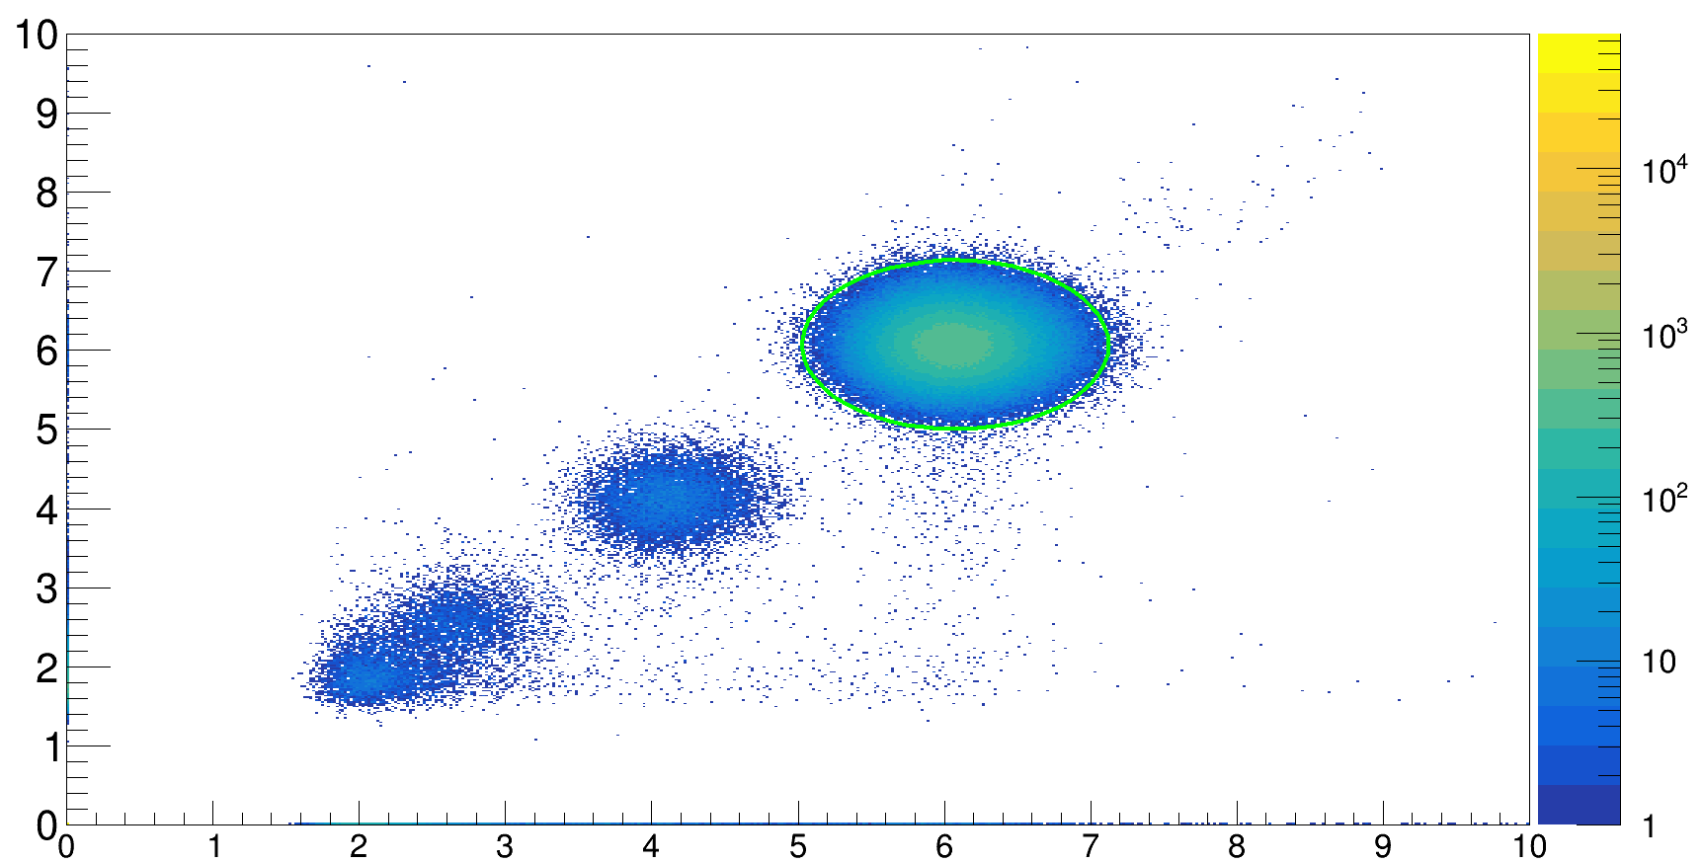
calibrated energy loss ΔE a.u. - downstream anodes
calibrated energy loss ΔE a.u. - upstream anodes

