Slide 1
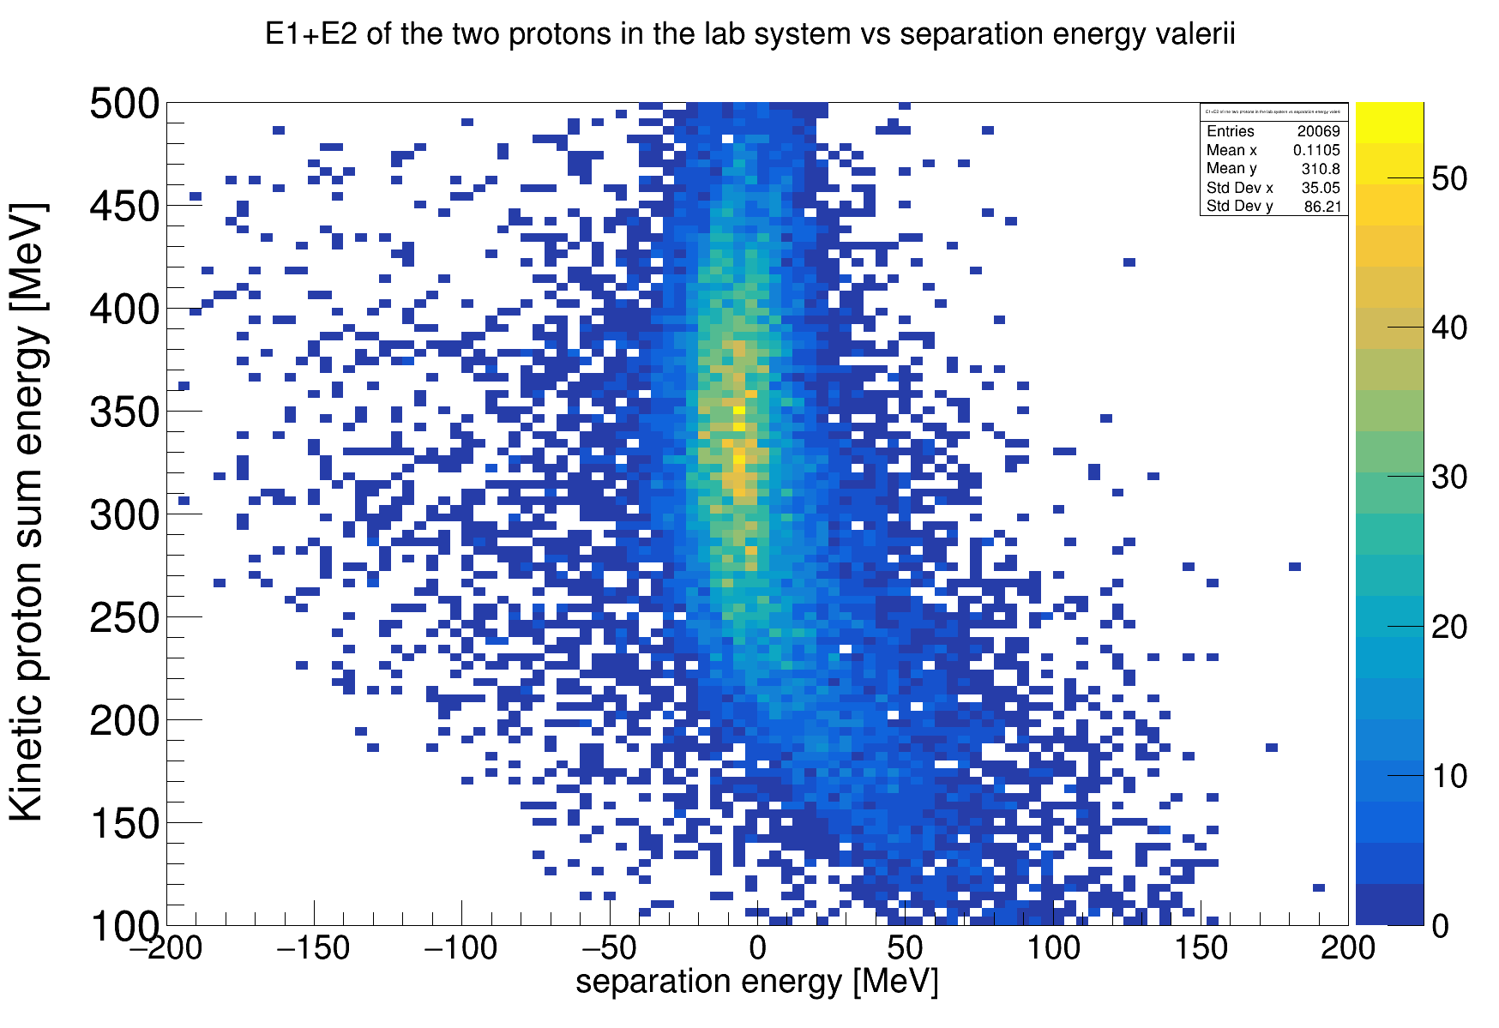
CH₂ target
T₁ + T₂ [MeV]

Slide 2
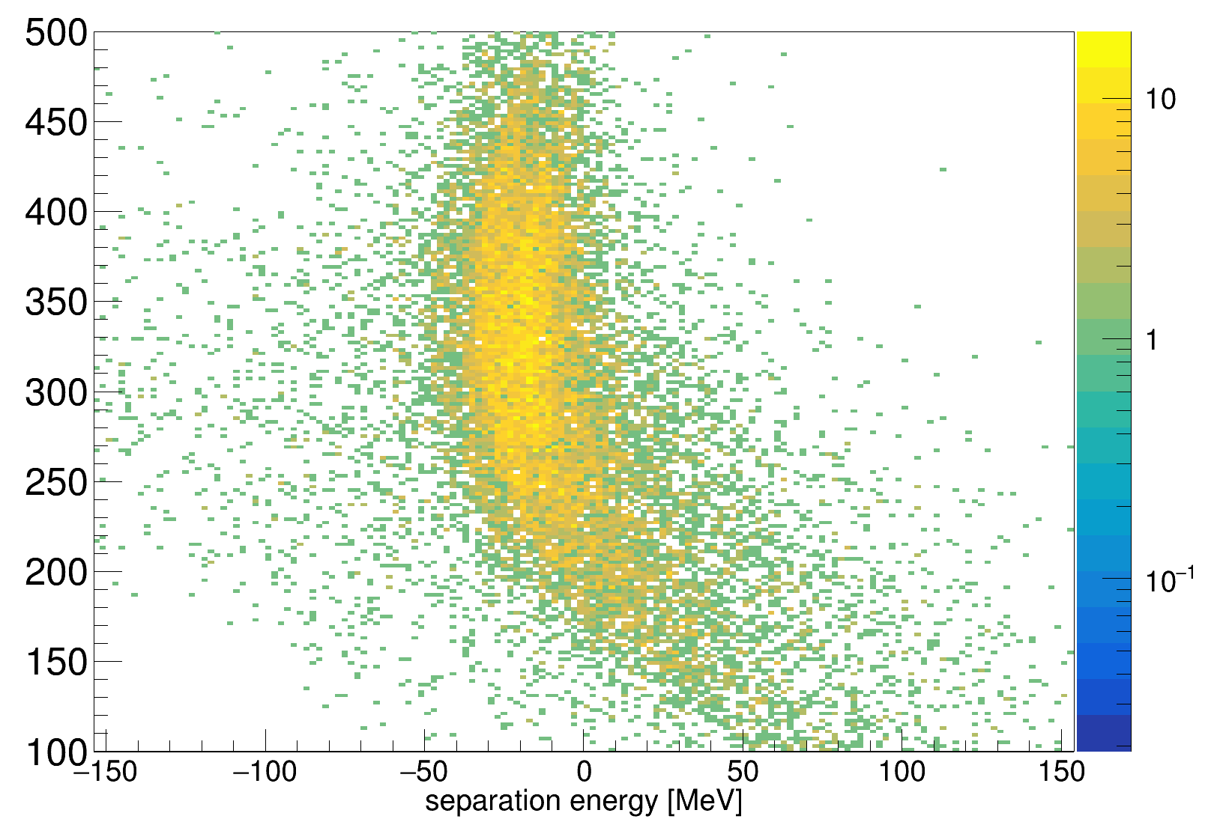
CH₂ target
T1 + T2 [MeV]
-32 MeV
-16 MeV
separation energy [MeV]

