Slide 1
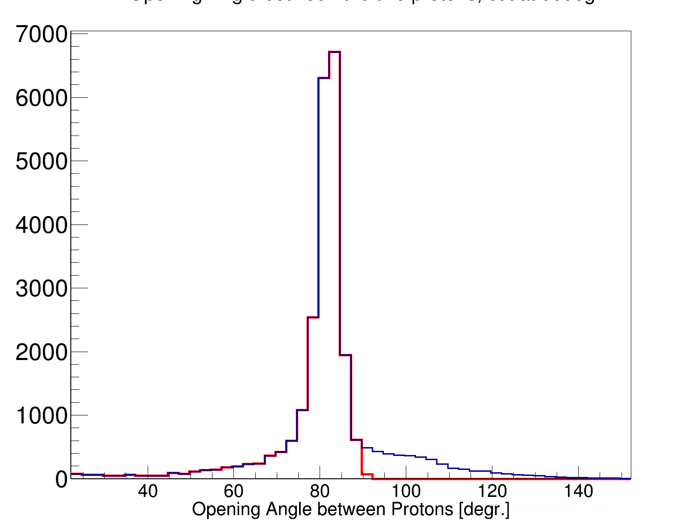
Opening Angle θp2p [°]

