Slide 1
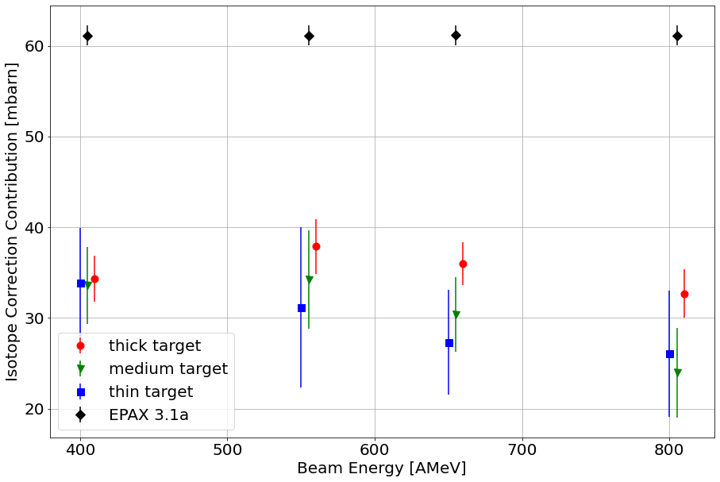
Just central part on MW1 X-Y selection:

Slide 2
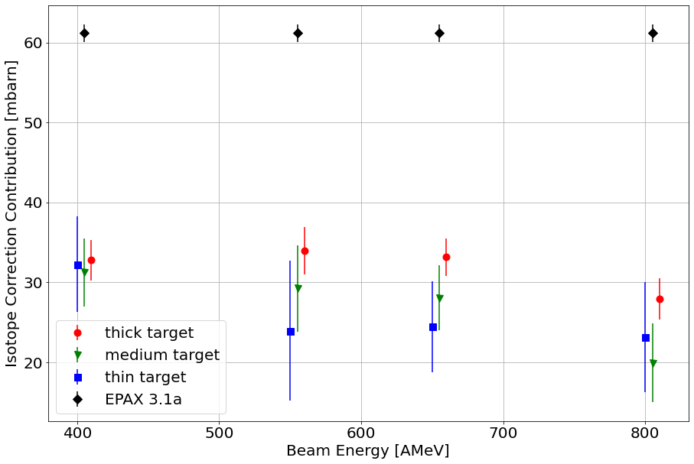
Just central part on MW1 X-Y selection:
But now best threshold adjustment ( MW2 Y: Q > 150)

