Slide 1
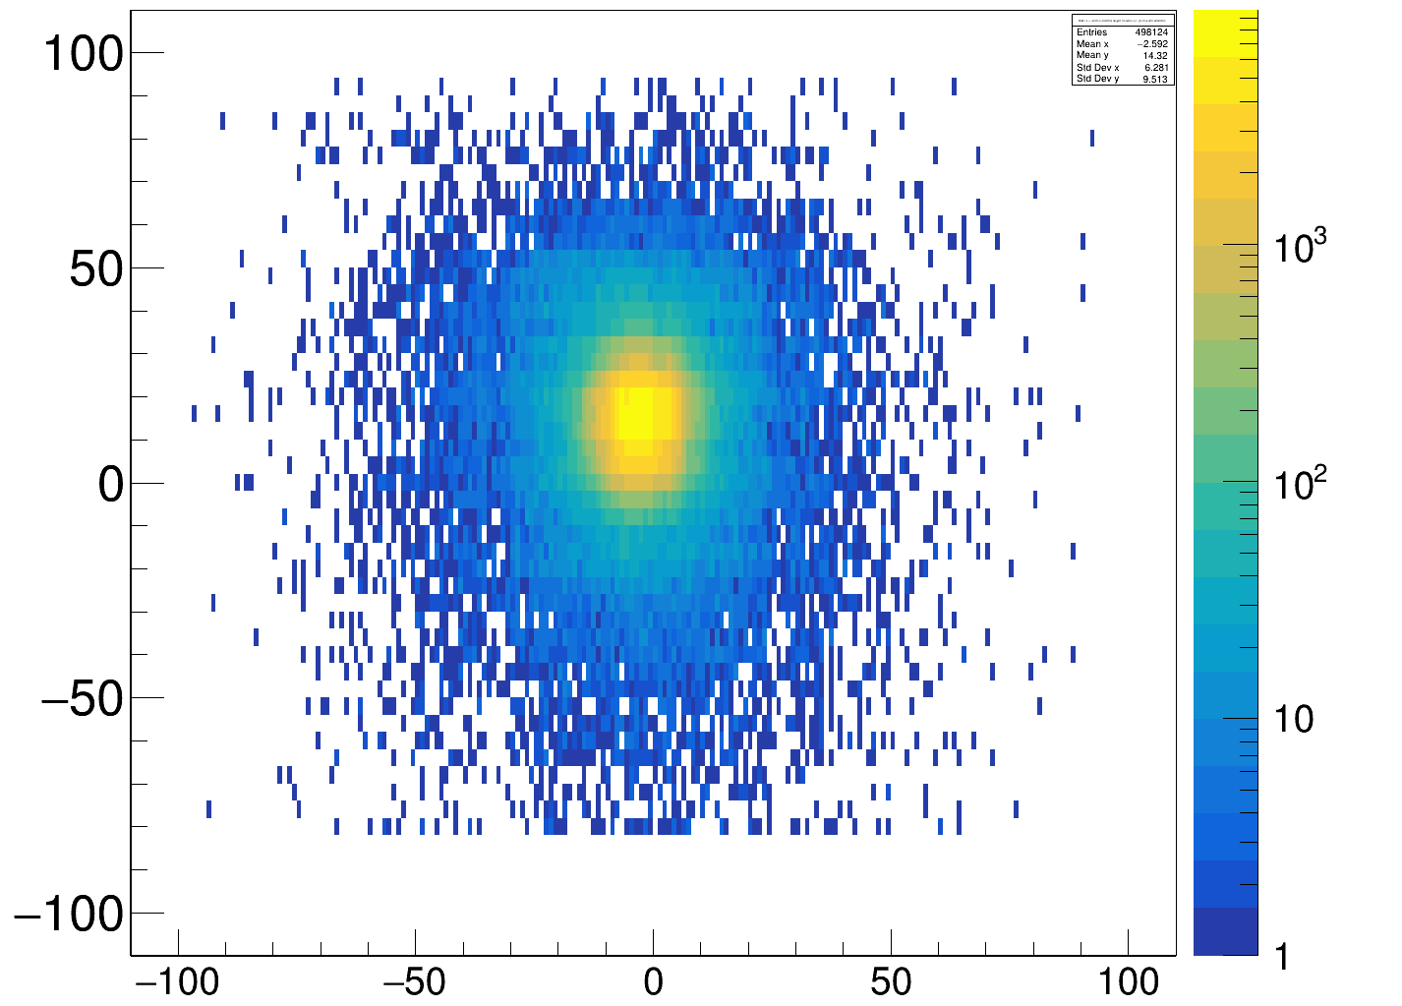
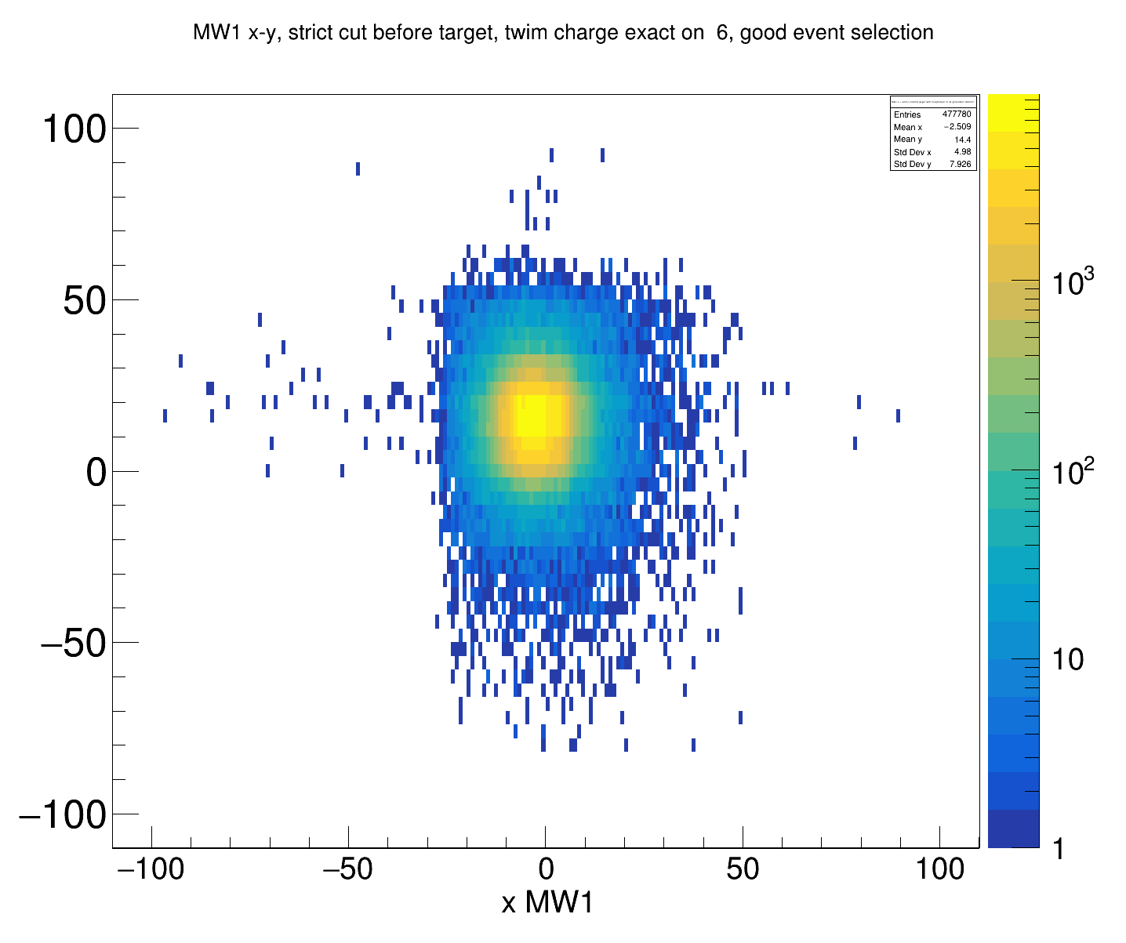
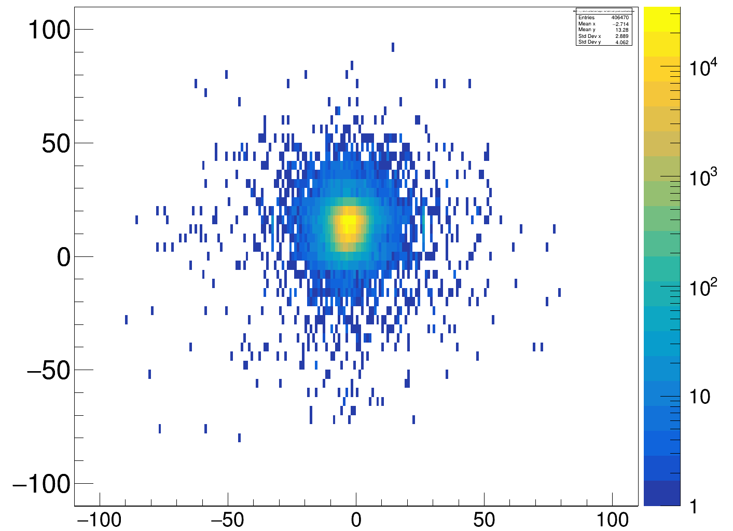
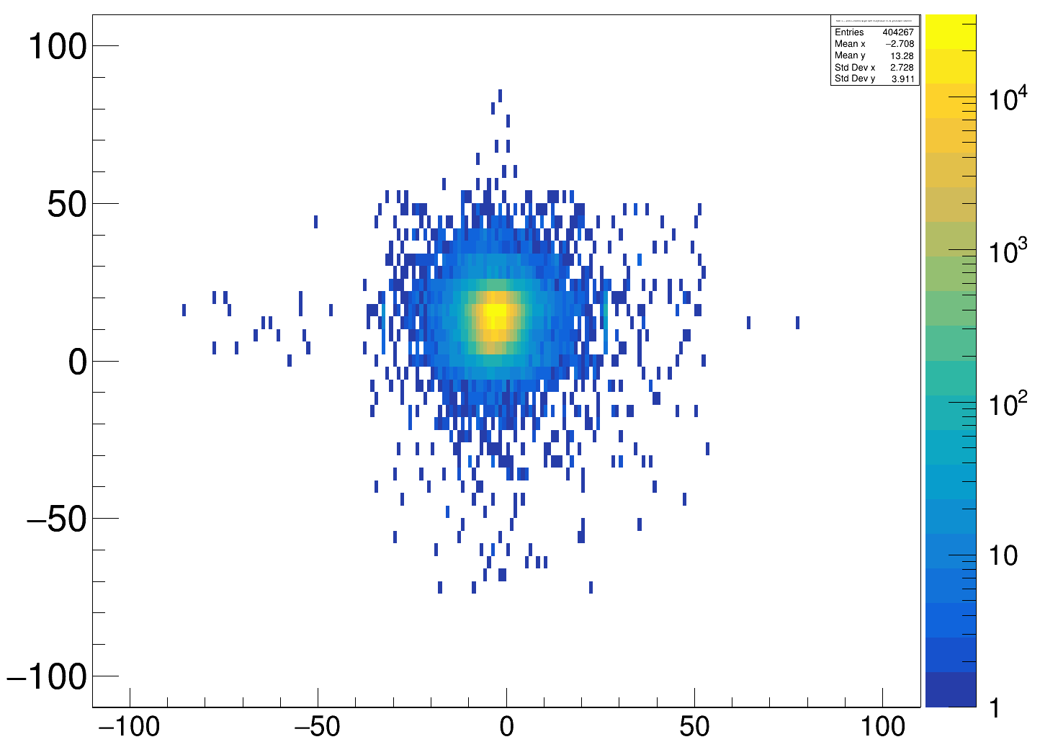
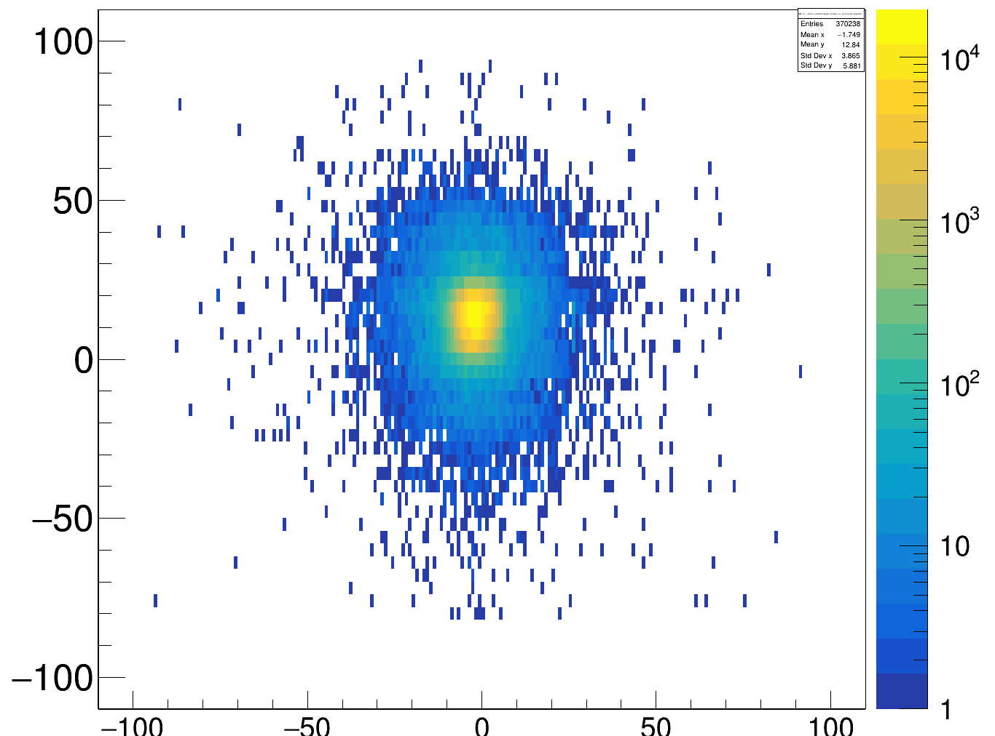
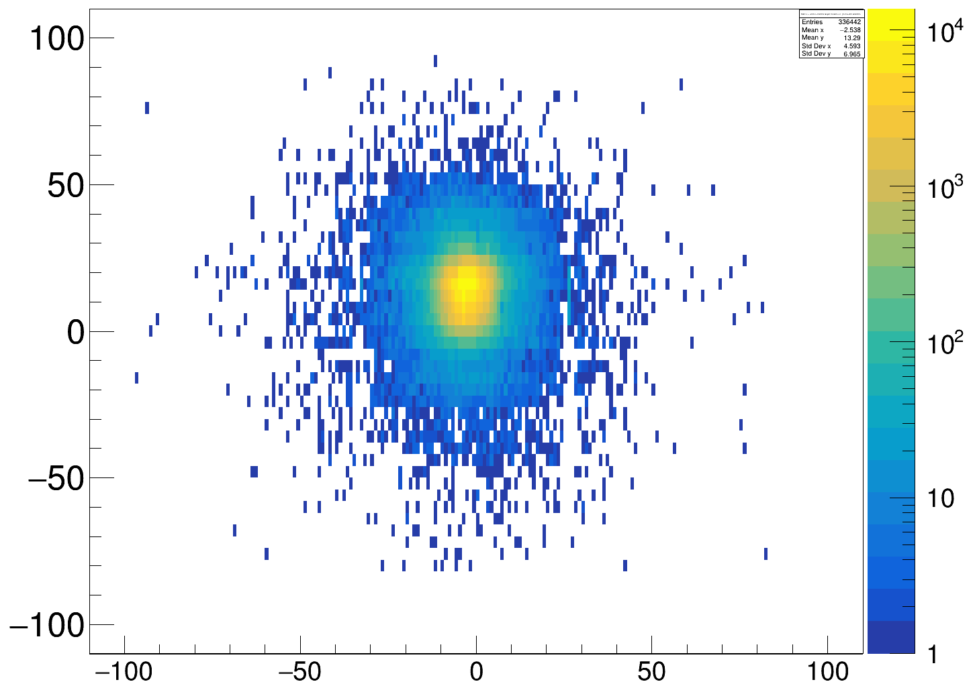
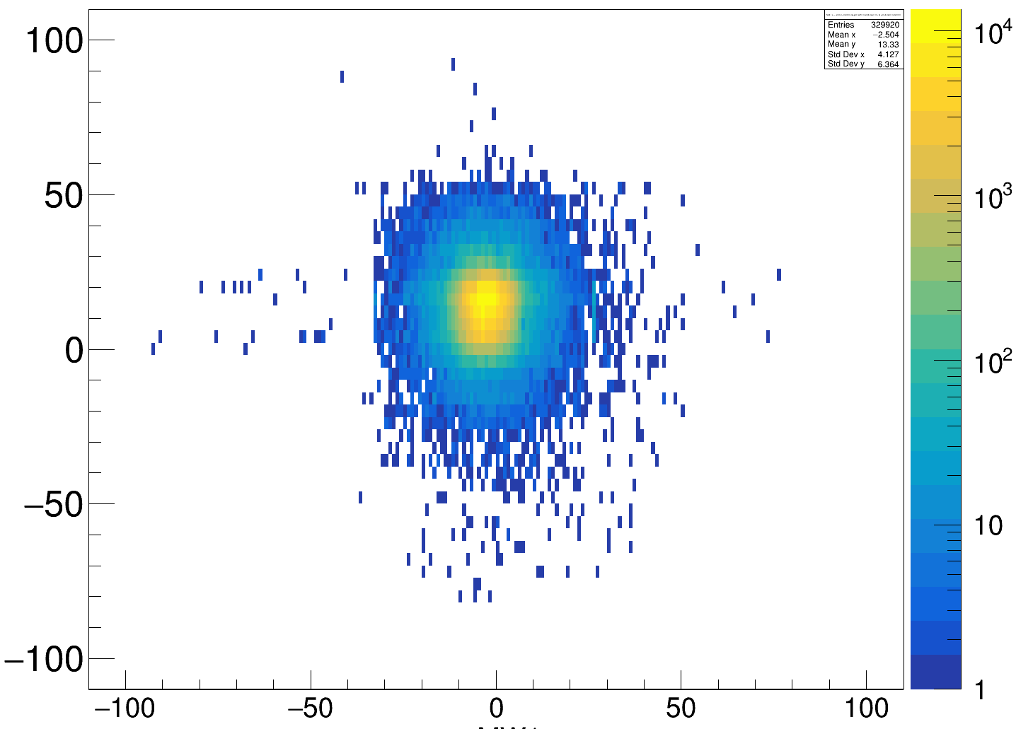
a) 400 AMeV, thick target. Left, no TWIN conditions; right, charge cut Z = 6
c) 550 AMeV, empty target. Left, no TWIN conditions; right, charge cut Z = 6
MWPC1 y-position [mm]
MWPC1 y-position [mm]
MWPC1 x-position [mm]
MWPC1 x-position [mm]
MWPC1 x-position [mm]
MWPC1 x-position [mm]
b) 400 AMeV, empty target. Left, no TWIN conditions; right, charge cut Z = 6
d) 550 AMeV, thick target. Left, no TWIN conditions; right, charge cut Z = 6
MWPC1 y-position [mm]
MWPC1 y-position [mm]
MWPC1 x-position [mm]
MWPC1 x-position [mm]
MWPC1 x-position [mm]
MWPC1 x-position [mm]

