Slide 1
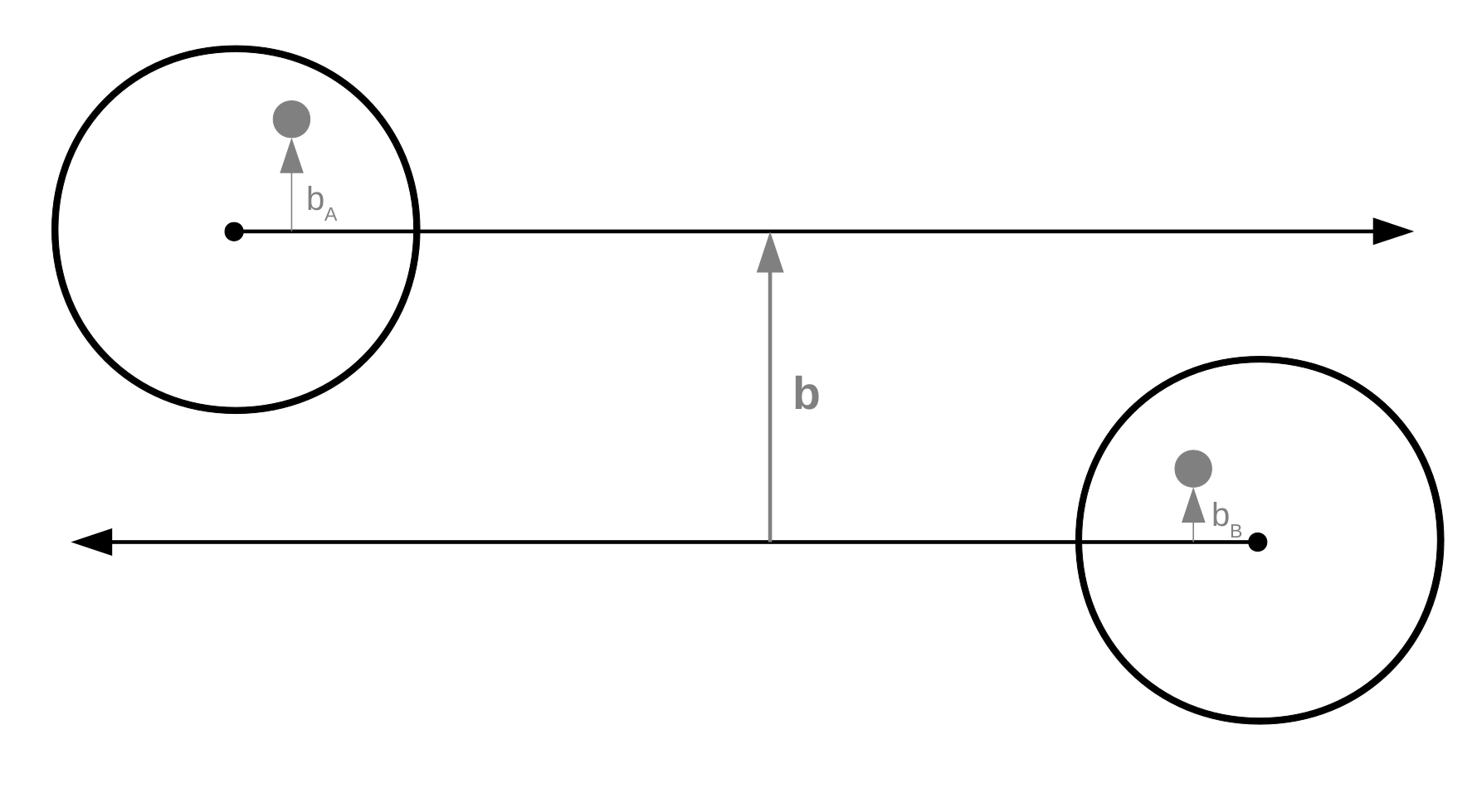
nucleus A
nucleus B

