Slide 1
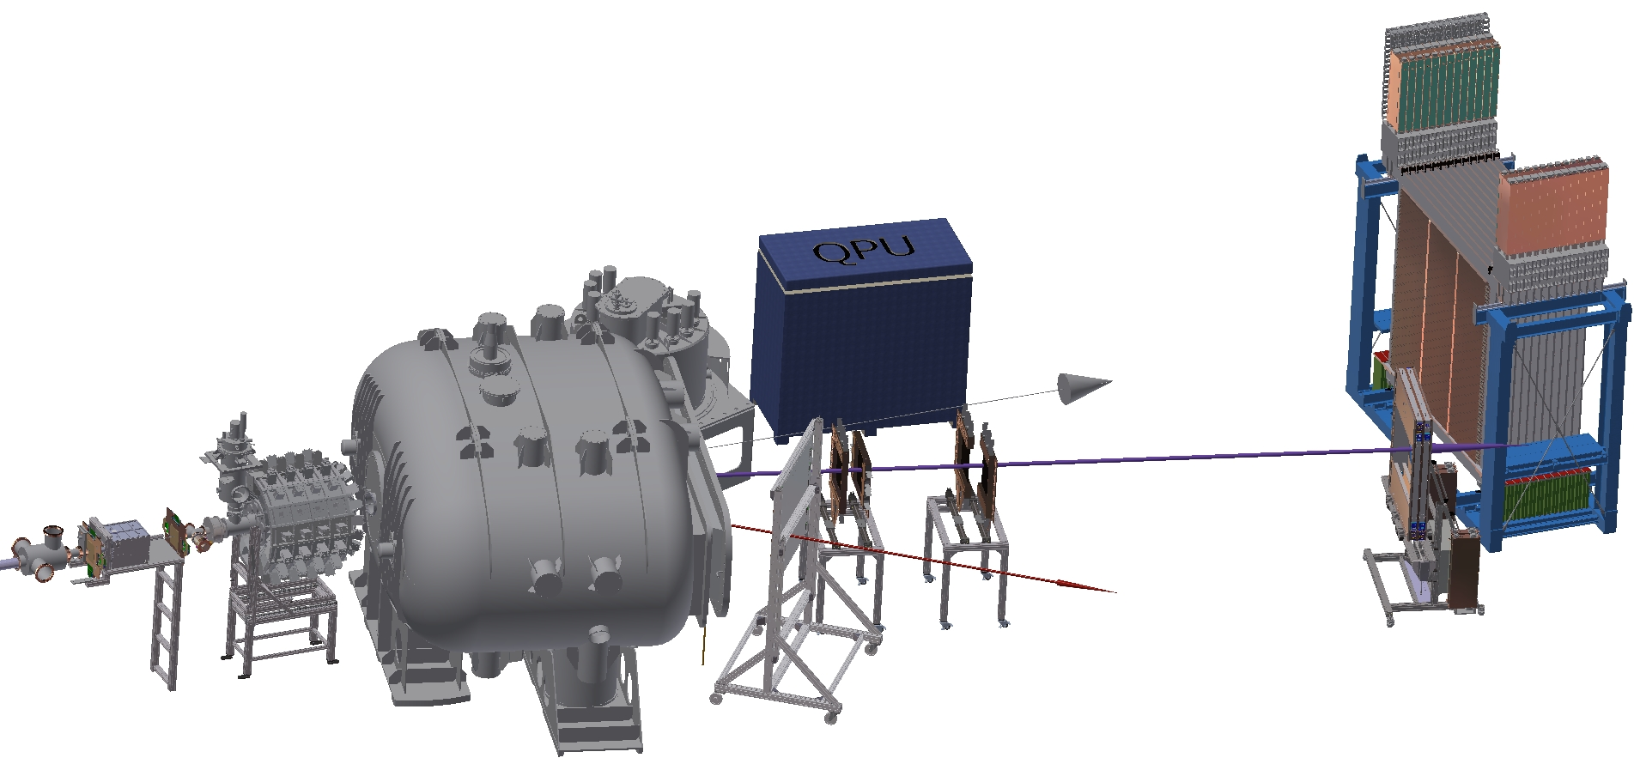
R3B Setup
neutrons
ion beam
heavy fragment branch
light fragment branch

