Slide 1







Recent Advancements in Analysis & Instrumentation @ R3B
R³B Experiment @FAIR
Scientific Objectives
12C +12C Exp.
Quasi-Free scattering + Fission
CALIFA development: hardware and software
Tobias Jenegger
10.12.2025
Funded by the Deutsche Forschungsgemeinschaft (DFG, German Research Foundation)
under Germany’s Excellence Strategy – EXC-2094 – 390783311,
BMBF 05P19WOFN1, 05P21WOFN1 / BMBF 05P24WO2
and the FAIR Phase-0 program
Tobias Jenegger, Mrunmoy Jena and Roman Gernhäuser

Slide 2
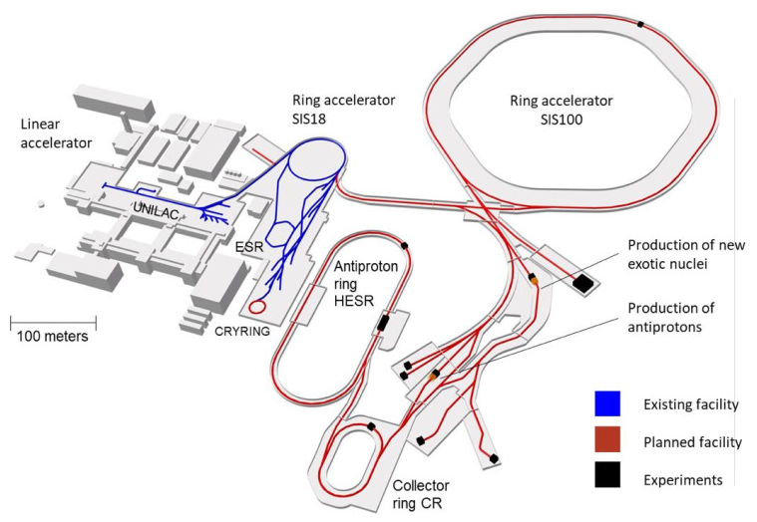
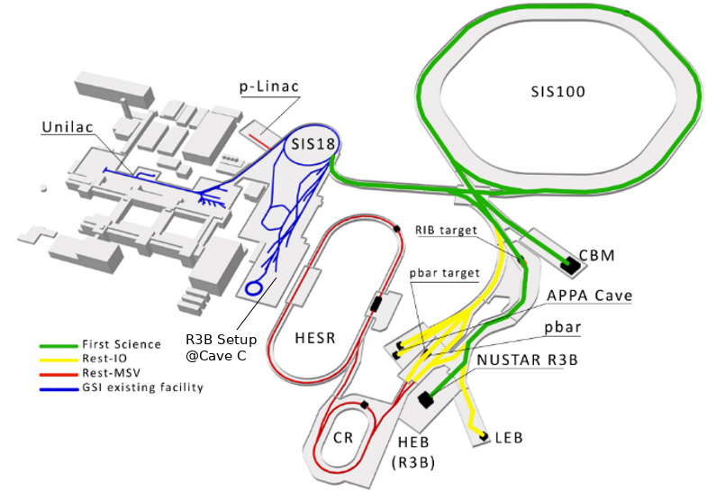
R³B Experiment at FAIR
R³B as part of the
Facility of Antiproton and Ion Research (FAIR) in Darmstadt
Haik Simon – FAIR & Super-FRS – EPS 20190930
@ D. Fehrenz, GSI/FAIR Sep. 2024

Slide 3
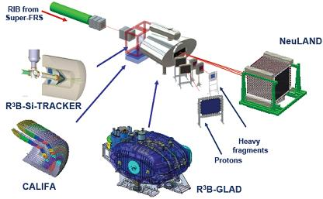
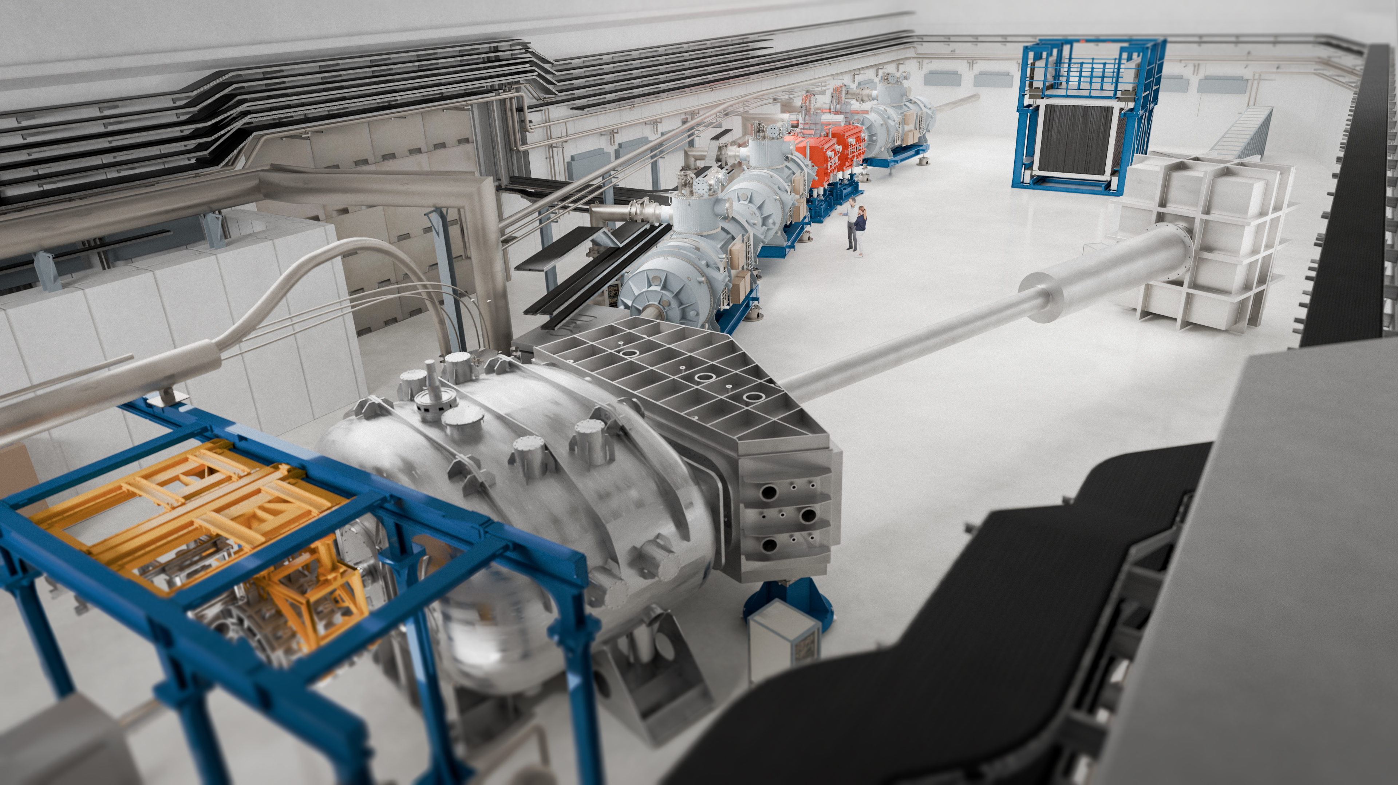
R³B Experiment at FAIR
Reactions with Radioactive Relativistic Beams
High Energy Cave
Haik Simon – FAIR & Super-FRS – EPS 20190930
© GSI, FAIR, Zeitrausch

Slide 4

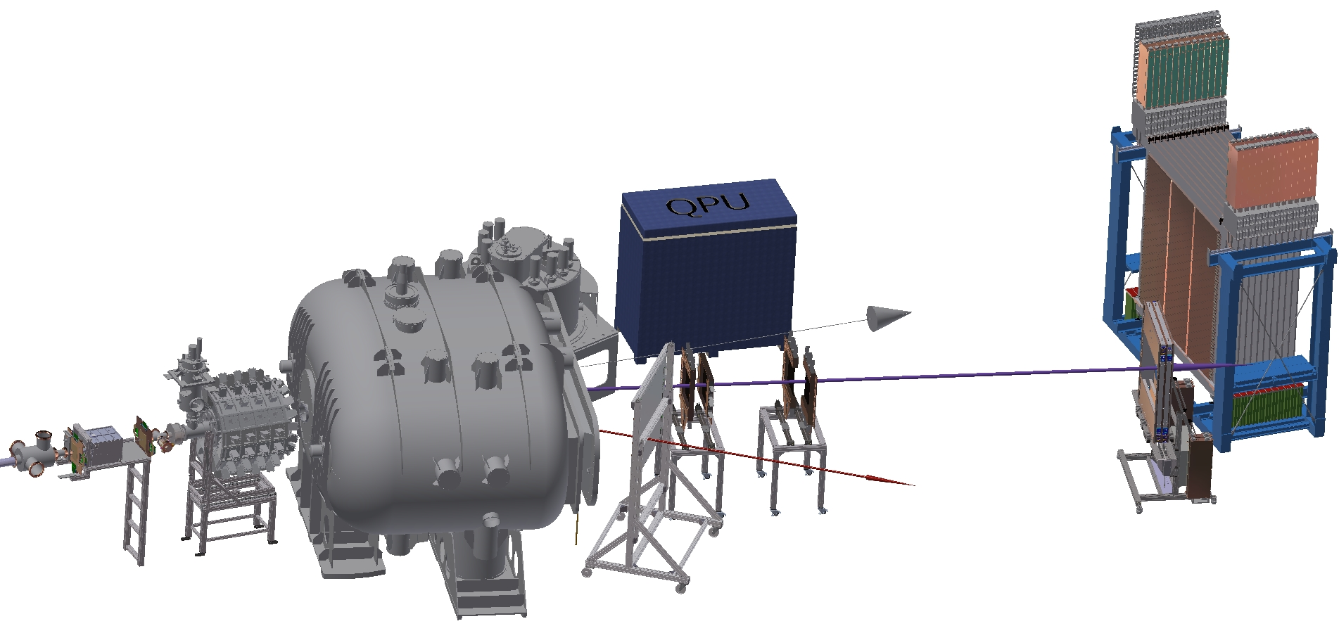
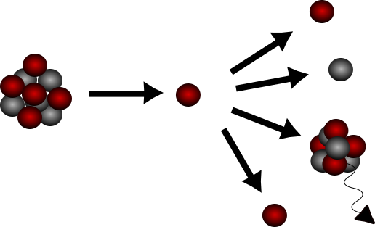
R3B - NUSTAR
R3B is part of NUSTAR →NUclear STructure, Astrophysics and Reactions
Focus: structure of atomic nuclei and its astrophysical implications
Experimental Approach:
Inverse kinematics → incoming exotic ion is nucleus of interest
Kinematically complete measurements
Dedicated detector setup needed
R3B Setup
neutrons
heavy fragment branch
nucleus of interest
light fragment branch
kinematically complete measurements
High Resolution Particle Spectroscopy

Slide 5
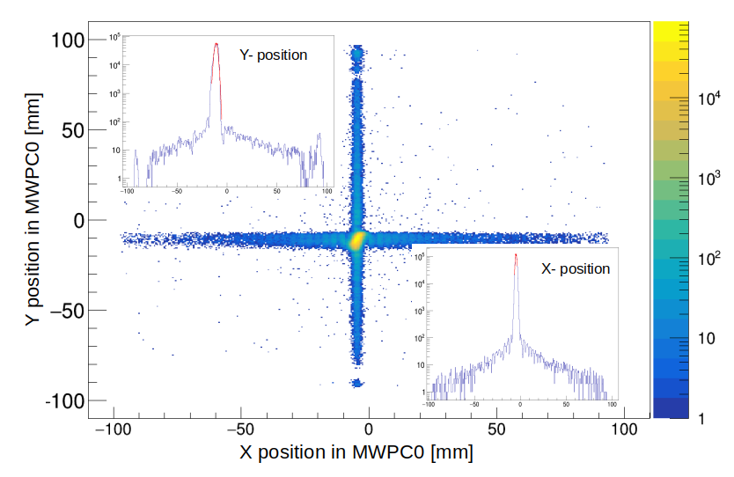
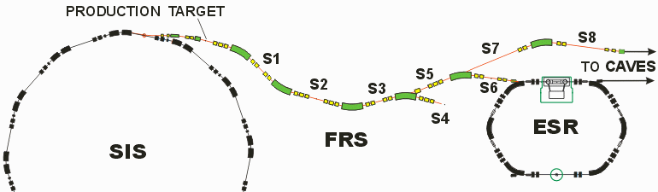
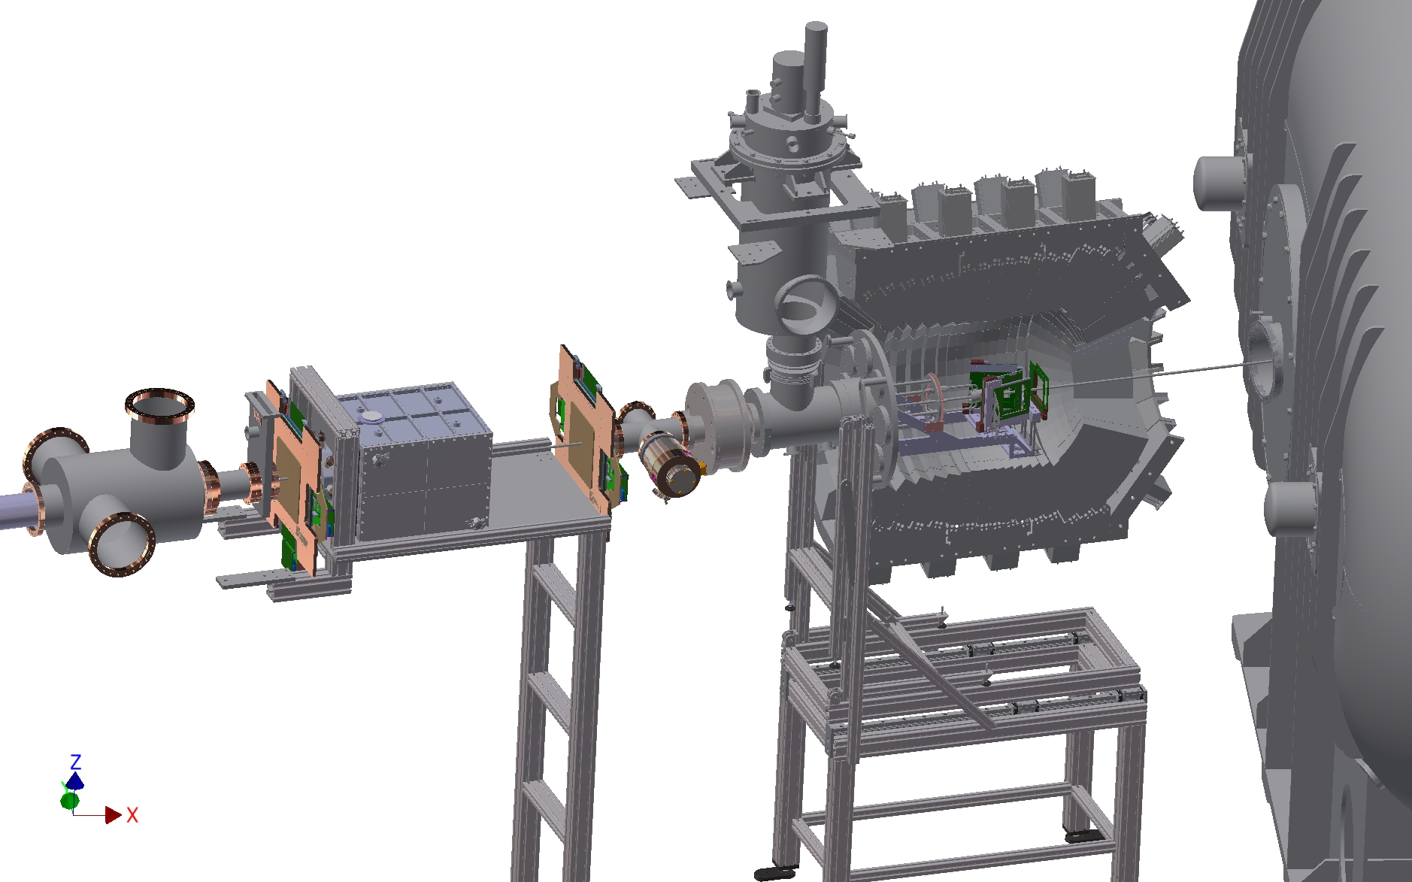
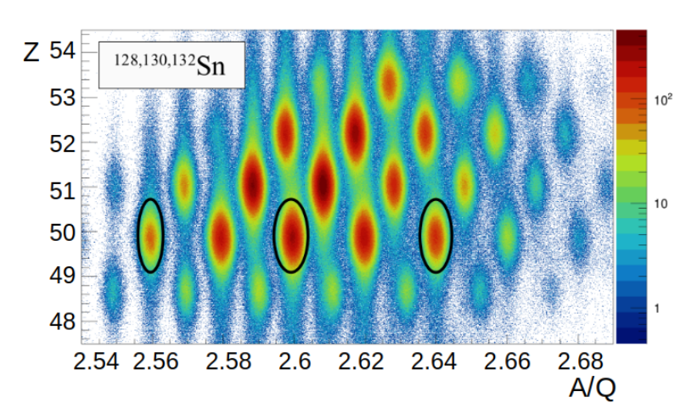
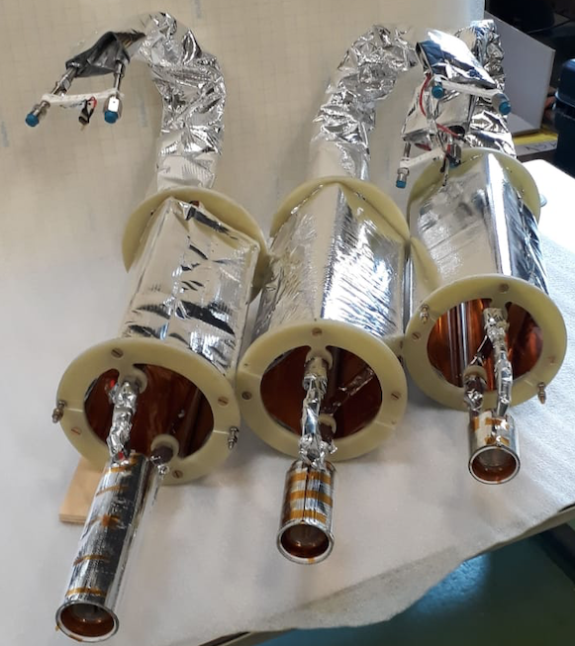
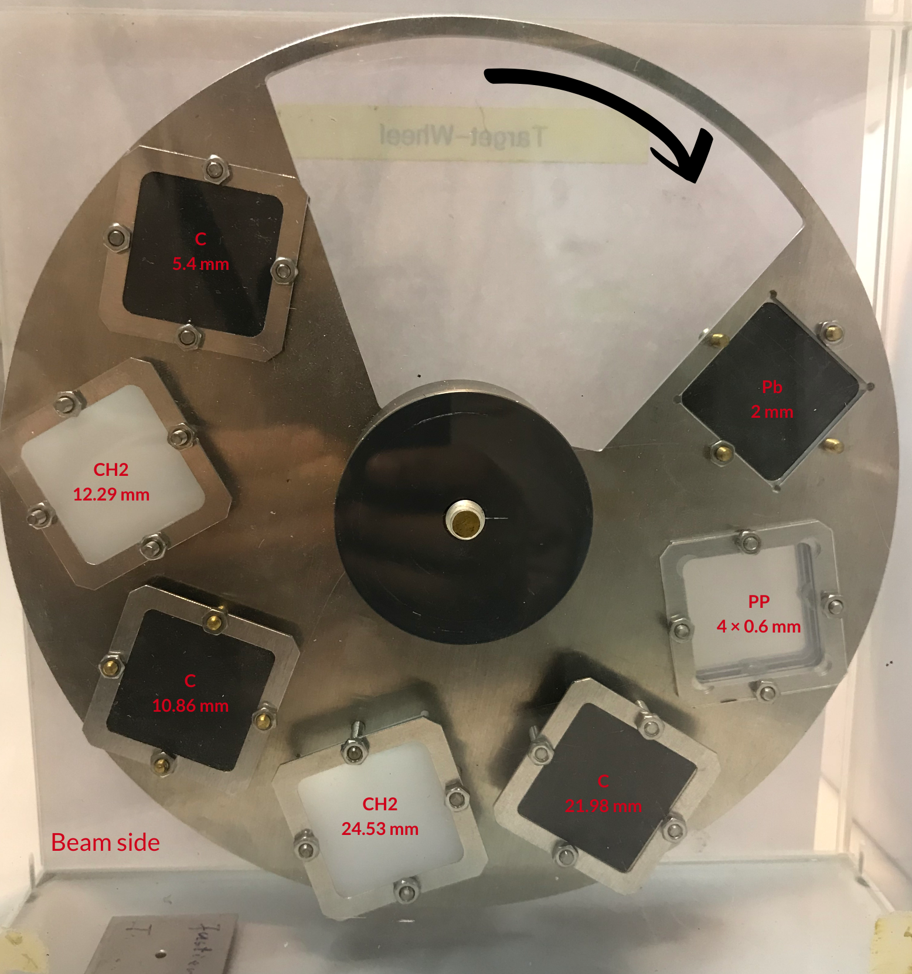
x – y Position
Identification of Incoming Ions
beam
≈ 3mm
MWPC0 xy plot
99% efficiency
Cave C
Mass & Charge Identification
via Bρ − ∆E − ToF method
LH2 Target – Target Wheel
LH2 Targets:
15 / 50 / 150 mm
courtesy: Ivana Lihtar
See also Super-FRS Talks:
HK 33.4 Justus Eder et al. (Wed.,18:30)
HK 55.1 Nicolas Hubbard et al. (Thu.,17:30)
MS 7.3 Makar Simonov et al. (Thu., 15:15)
21 K (+/- 1,2 K)

Slide 6
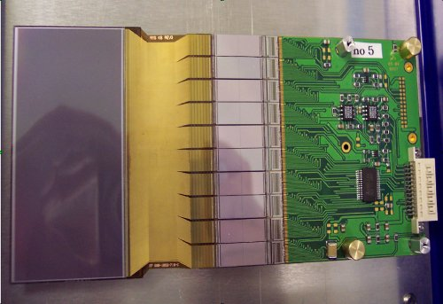
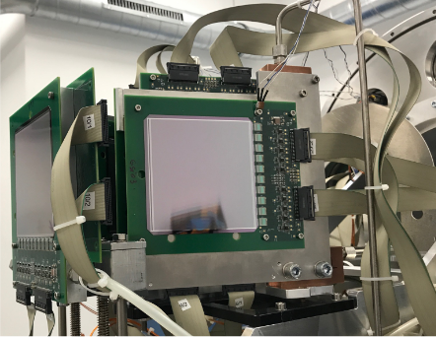
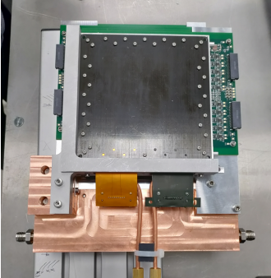
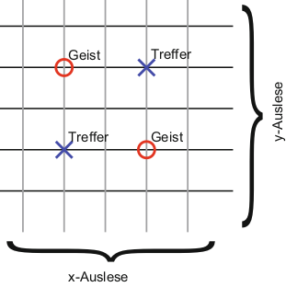
Tracking Detectors in Target Area
Si Strip Detectors
Si Pixel Detectors
AMS Detector - 300μm
FOOT – 150μm
ALPIDE - 50μm
FragmentatiOn Of Target
72 x 40 x 0.3 mm
Double sided Si microstrip detectors (μDSSD)
Used until 2021
100 x 100 x 0.15 mm
Single sided strip detector, x-y planes
Used since 2022 exp. Campaigns
New readout system
Chip based on Monolithic active pixel sensors (MAPS)
Designed for the ITS of ALICE at LHC
POVH, Bogdan, et al. Teilchen und Kerne
Combinatorial background for strip detectors with mult. > 1 !
See MAPS Talks:
HK 36.5 Berkin Ulukutlu et al (Wed., 18:45)
HK 51.1 Laszlo Varga et al (Thu., 15:45)
relevant for δ- electrons

Slide 7
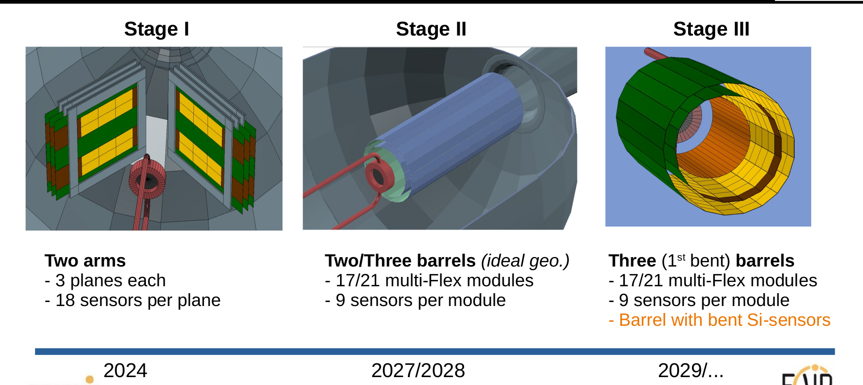
Towards R3B Target Recoil Tracker (TRT)
15% solid angle coverage
90% solid angle coverage
2025
Courtesy: J.L. Rodrígues Sánchez

Slide 8
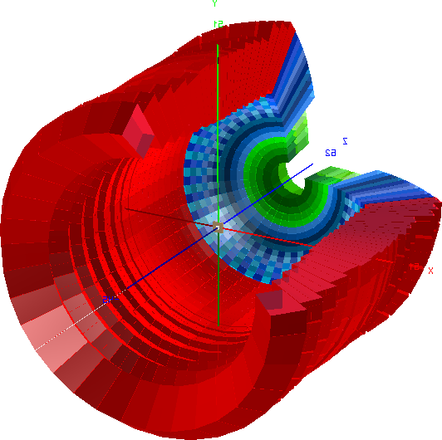
CALIFA – Detection of gammas and light charged particles
Endcap:
iPhos:
480 CsI(Tl) crystals
CEPA:
96 CsI(TI)
crystals
R3B Setup
neutrons
heavy fragment branch
Barrel:
1952 CsI(Tl) scintillator crystals
light fragment branch
BEAM
Target Tracker + CALIFA
Four momentum reconstruction of light particles
Angular range:
7° < θ < 140°
Energy range:
100 keV < Eγ
up to 700 MeV charged particles
Particle identification:
via Nf and Ns components of CsI(Tl) light emission
Flexible running mode:
self/external triggering
multiple d.o.f. in configuration
nucleus of interest

Slide 9
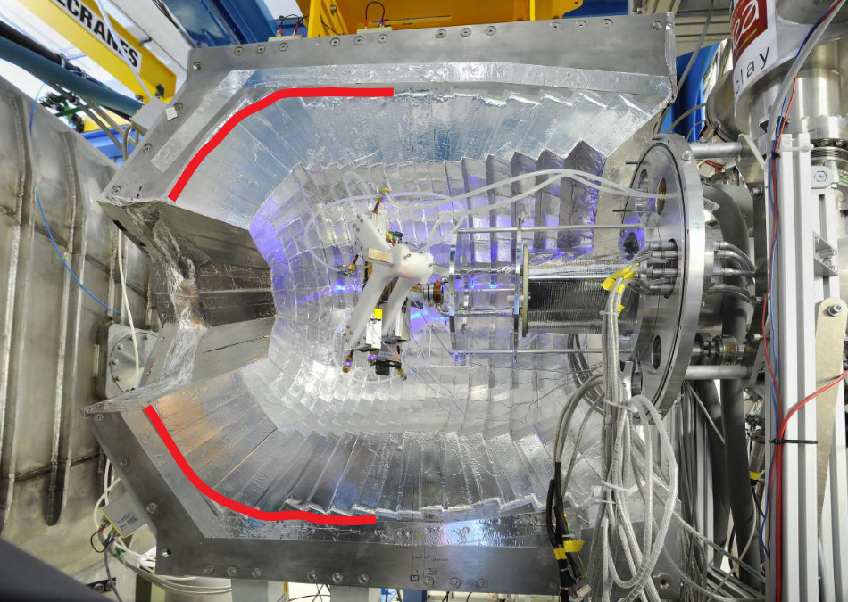
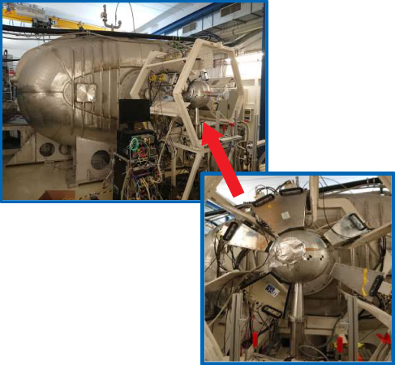
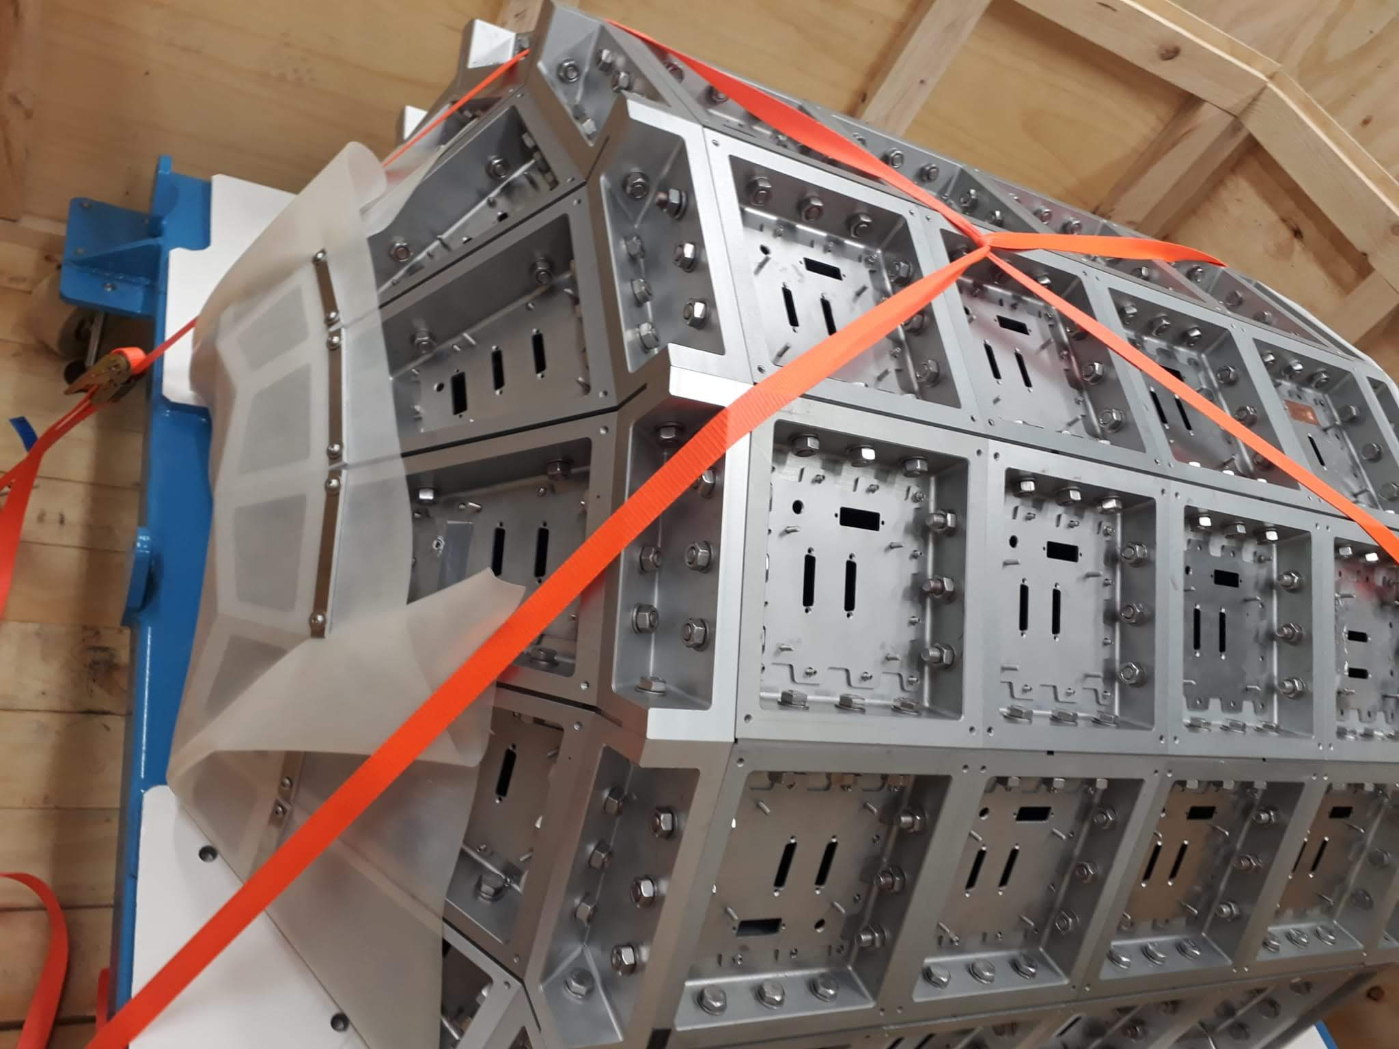
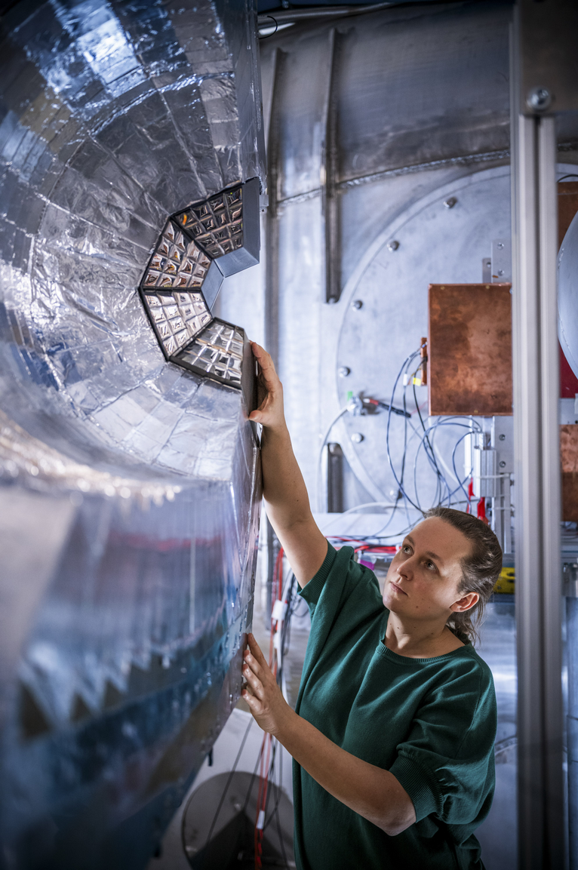
CALIFA - From Prototype to final Frame
Fully filled forward half!
+ 832 crystals
Barrel region 50% filled
iPhos region 35% filled
7° ≤ θ ≤ 19°
2026 – Backward
Barrel
2019 – Demonstrator
2020 – Final Frame
2021 – iPhos upgrade
2024 CEPA
See CALIFA Talks: HK 55.2 Mrunmoy Jena et al (Thu., 18:00)

Slide 10
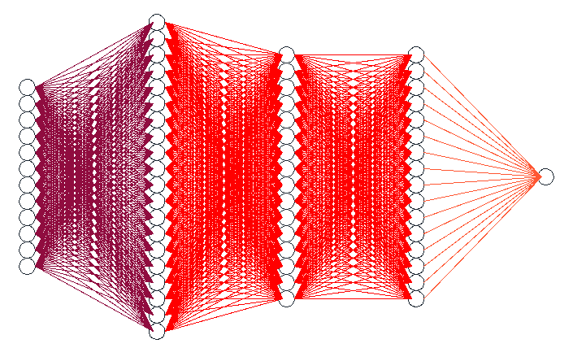
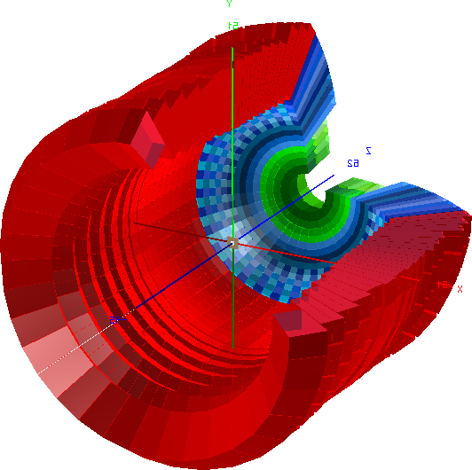
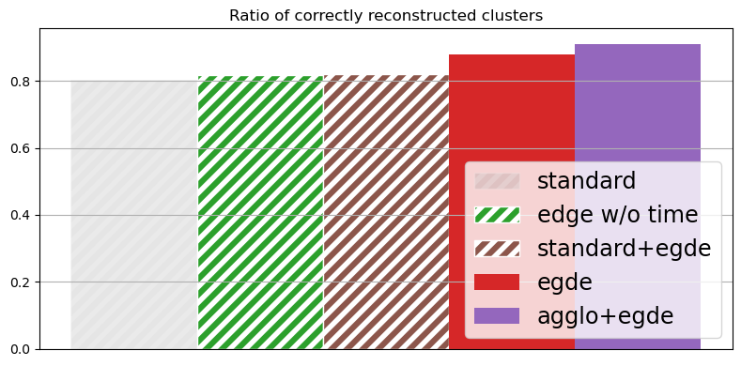
Machine Learning in CALIFA Hit Clustering for Gammas
“Edge Model” - Architecture
Sparse hits for gamma clusters:
E.g. pair production & annihilation
→ single & double escape peaks
pairwise comparison of hits
RELU Activation Function
10³ nodes
10² nodes
10² nodes
Sigmoid
preliminary
Input features:
Energy
Polar Angle θ
Azimuthal Angle φ
Time (not used in Standard Algorithm)
How to correctly assign this hit ?
*with three “true” clusters per simulated event

Slide 11
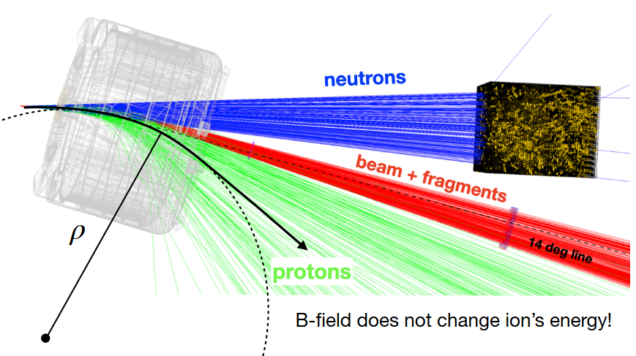
Fragment Identification with GLAD
neutrons
heavy fragment branch
+beam
light fragment branch
Superconducting Dipole Magnet GLAD
Angular Accepance: +- 80 mrad
High Bending Angle up to 40°
High (5 Tm) and homogeneous B-field

Slide 12
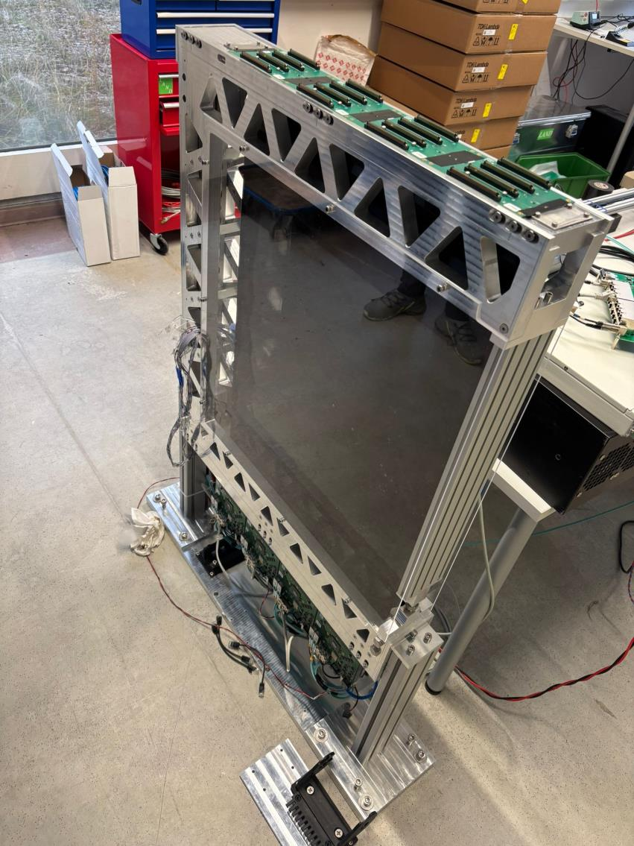
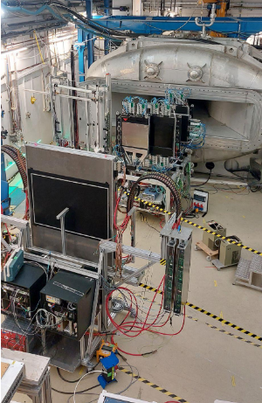
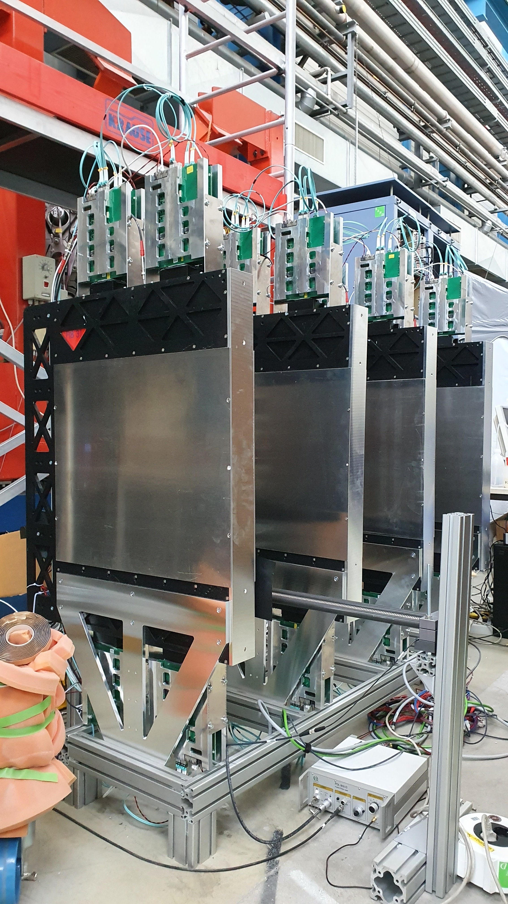
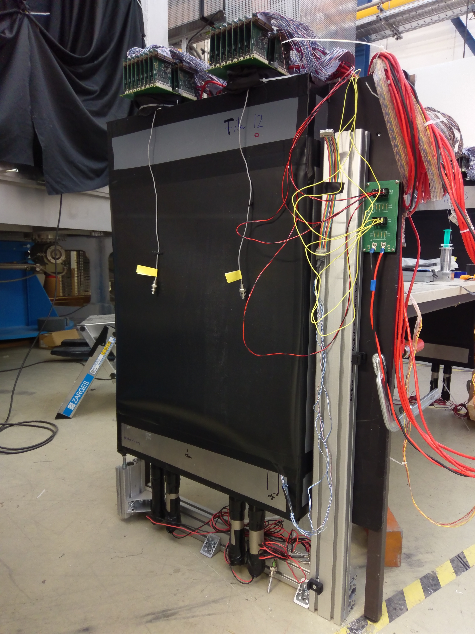
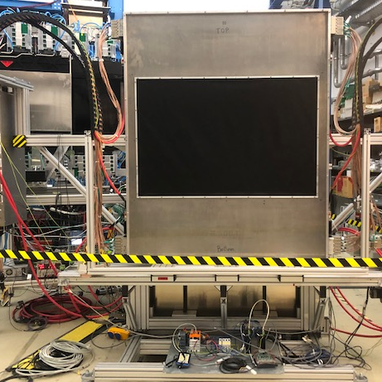
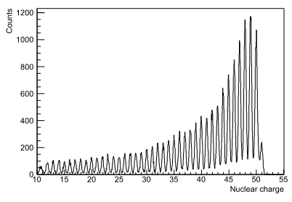
Tracking Detectors - Heavy Fragment Branch
Tracking – Fibers:
θ_{in} and θ_{out}
heavy fragment branch
+beam
Time-of-Flight Detector ToFD:
four planes of scintillators
Requirements:
Time: σ ≤ 14 ps
σΔE /ΔE of up to 1%
Large area fiber detectors build and commissioned
PMT Fibers:
Sensitive to magnetic field
SiPM Fibers:
Almost immune to magnetic fields
→ closer to GLAD
1m
¹²⁰Sn + ¹²C @ 800 AMeV
1.2m
Heil, M., Kelić-Heil, A., Bott, L. et al. A new Time-of-flight detector for the RB setup. Eur. Phys. J. A 58, 248 (2022). https://doi.org/10.1140/epja/s10050-022-00875-8
Merits: C.Caesar, D. Savran et al.
Merits: M. Heil et al.

Slide 13
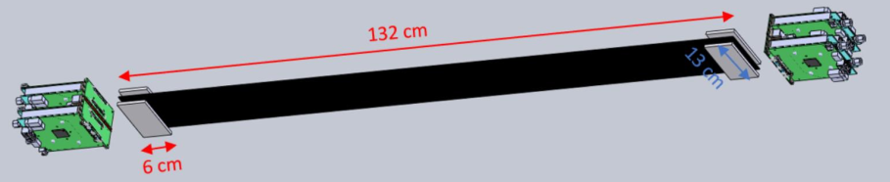
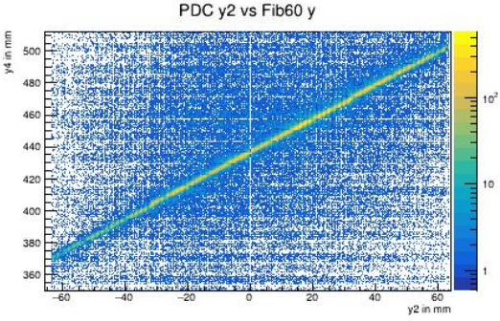
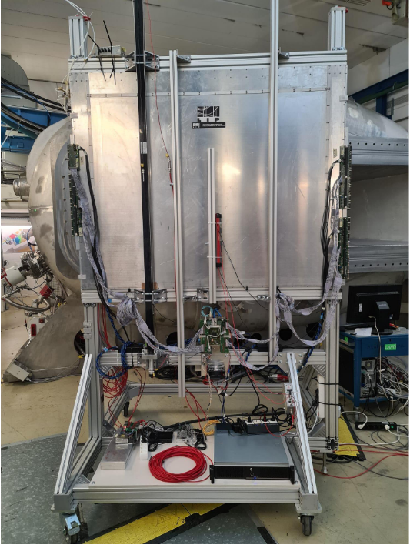
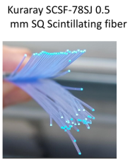
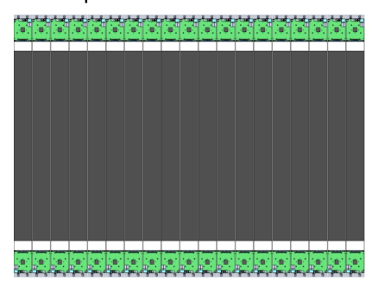
Tracking Detectors - Light Fragment Branch
Proton Arm Spectrometer (PAS) – Design Goals
Δp/p < 10⁻³
σ_{x}< 150 μm
Δθ_{x} < 1 mrad
+
Large area TOF Wall
PASTOF
light fragment branch
SiPM Fibers
Resistive Plate Chamber RPC:
Size: 1.5 x 1.2 m
Efficiency > 98%
σ_{t} ≤ 50ps
Cannot be operated in vacuum!
basic building block
Merits: M. Xarepe,
D. Galaviz Redondo et al.
R&D expertise in fiber detectors at R3B

Slide 14
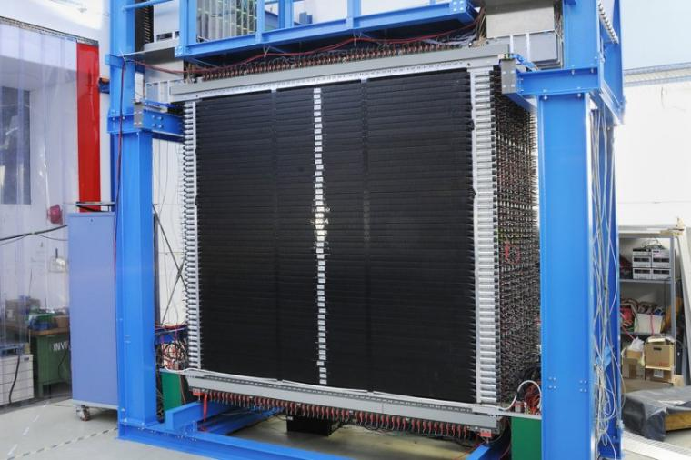
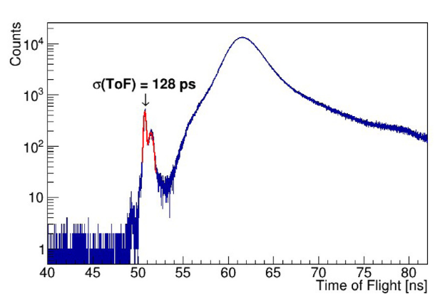
Neutron Branch - NeuLAND
Geometry:
2.5x2.5x3m - 3000 scintillator bars
Time Resolution:
σ < 150 ps
Spatial Resolution:
σ ≈ 1.5cm → high granularity
1n efficiency:
≈ 95% @ 400 AMeV
Multi-Neutron Recognition:
4n efficiency ≈ 50-70%
Merits: I. Gasparic et al.
Angular acceptance @15m ~ ± 80 mrad
Neutron detection via hadronic shower
neutrons
2.5m
2.5m
BORETZKY, Konstanze, et al. NeuLAND: The high-resolution neutron time-of-flight spectrometer for R3B at FAIR (2021)
See NeuLAND Talks:
HK 44.4 Yanzhao Wang et al. (Thu., 14:45)
2019: first double planes commissioned
2027: Move to HEC with significant more double planes
2024: 13 double planes

Slide 15
Experimental Campaigns @ R3B

Slide 16
Timeline @ R³B
2020
2024
2025
2026
2027
2028
Phase 0
Early Science
First Science
Moving
Commissioning
2020 – 2023:
2 Commissioning Runs
6 Experimental Runs
Tests, mounting -de mounting
every year new setup
SIS 18 beams
Partial FAIR/R3B equipment
SuperFRS
(large fragment acceptance)
SIS 100
(intensity x 10)
complete FAIR/R3B equipment
SuperFRS
(large fragment acceptance)
Commissioning Runs
1 Experimental Run
2 Experimental Runs
Experiments during Phase 0 were successfully performed

Slide 17
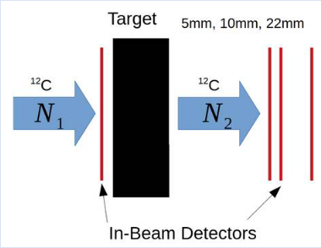
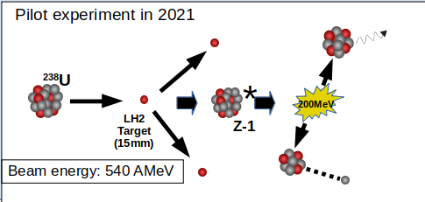

R3B Physics Program during FAIR Phase-0
2019
2020
2021
2022
2024
2025
2026
S509: Study of multi-neutron correlations
S522: Short-Range Correlations
HYDRA Test
S118: Commissioning & QFS of ³H
S091: Probing NN correlation via QFS
G249: Unveiling structure of ²⁵F
S122: Probing nuclear symmetry energy, EoS
S444: Commissioning
S473: Charge- and Neutron-removal Cross-Section of Sn
S454: Coulomb Dissociation of ¹⁶O
S444: Commissioning QFS ¹²C(p,2p)¹¹B
S467: Shell evolution along Z=20
S455: Investigation of fission via (p,p2f)
S494: Coulomb Dissociation of ¹⁶O
S515: Charge- and Neutron-removal Cross-Section of Sn
HYDRA:Measurement of matter radius of hypertriton
Λ
p
n

Slide 18

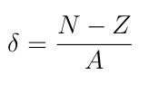


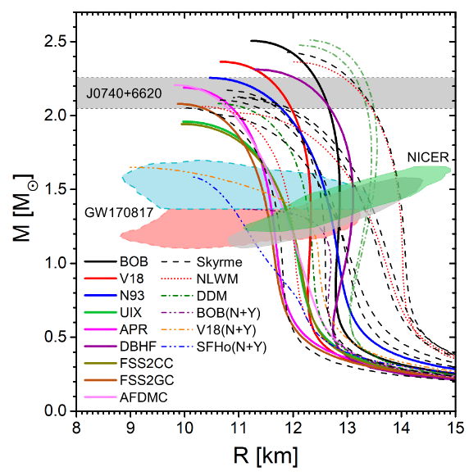
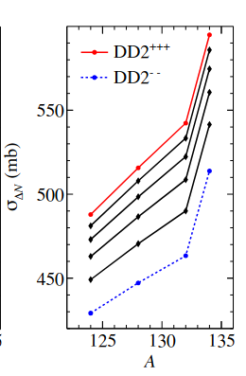
¹²C + ¹²C - S444 Experiment 2019
R. Gernhäuser et al.
Motivation:
Precise measurement of total interaction cross section of ¹²C + ¹²C → quantify the uncertainty of the reaction model
Constrain slope parameter L of the symmetry energy of the EoS
Mass-Radius Relation of Neutron Stars
increasing slope parameter L
The path to go:
stiff EoS
Precise prediction of neutron removal cross section σ_{ΔN ,} since:
σ_{ΔN} slope parameter L
soft EoS
L = 100 MeV
T. Aumann, C.A. Bertulani, F. Schindler, S. Typel, Phys. Rev. Lett. 119, 262501 (2017)
Reaction model is key ingredient for
σ_{ΔN} prediction !
See Previous Talk:
HK 8.1,Lukas Ponnath et. al. (Mon., 16:45)
L = 25 MeV
G.F. Burgio et al. Progress in Particle and Nuclear Physics 120(12):103879(2021)

Slide 19
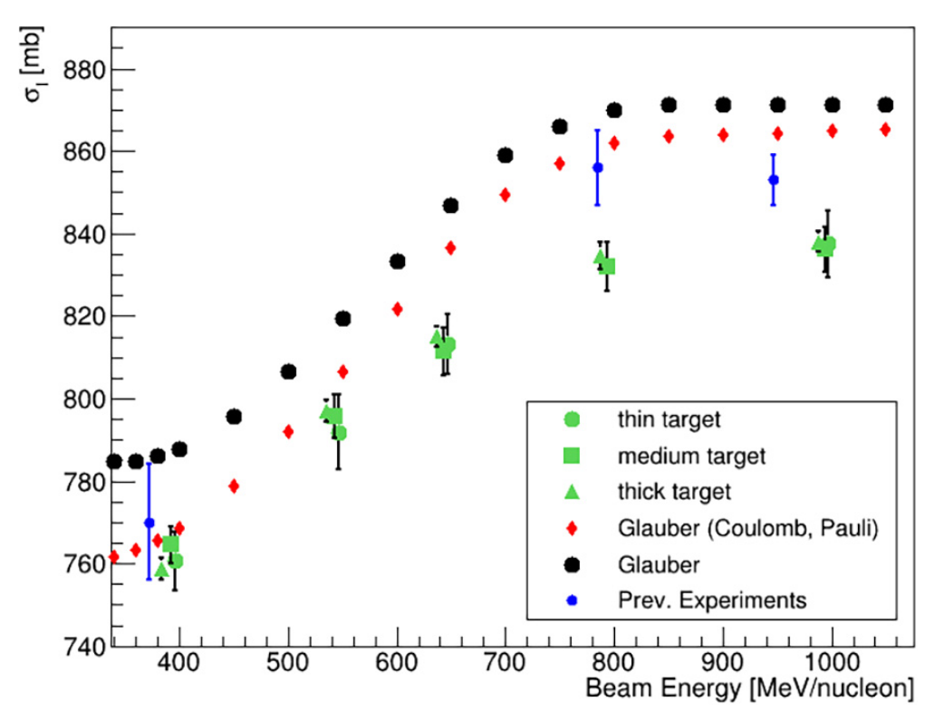
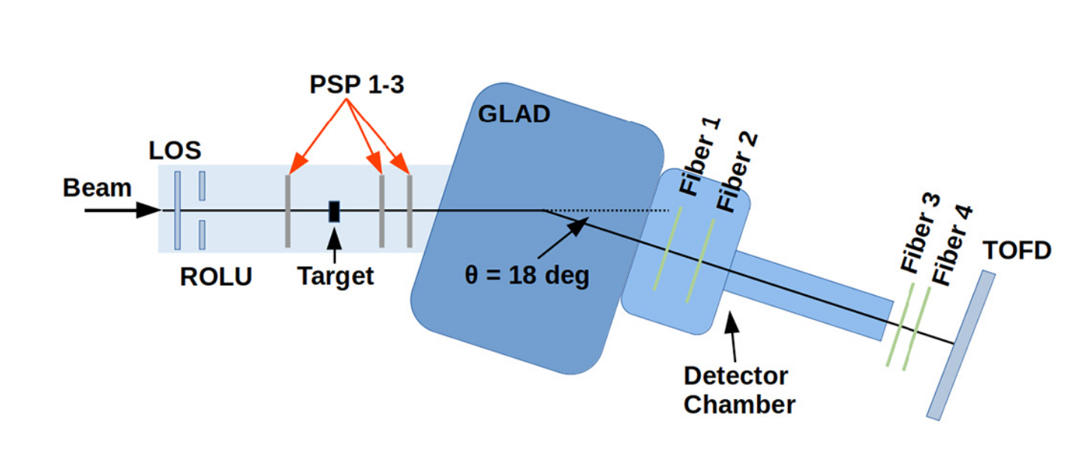
¹²C + ¹²C - S444 Experiment 2019
Courtesy: Lukas Ponnath
Δσ = 0.4% !
We can do really high precision measurements at R³B !
PONNATH, L., et al. Measurement of nuclear interaction cross sections towards neutron-skin thickness determination. Physics Letters B, 2024, S. 138780.
We are able to do high-precision measurements (σI @ 400 AmeV = 758 +- 1.84 (stat) +-1.87(syst) mb)
Experimental results are in agreement with previous experiments at low energies ( ~ 400 AMeV)
Significant discrepancy experimental data - theory
Δσ = 2% !

Slide 20
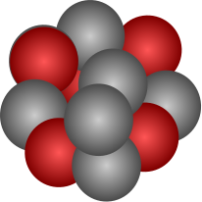


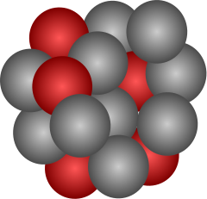
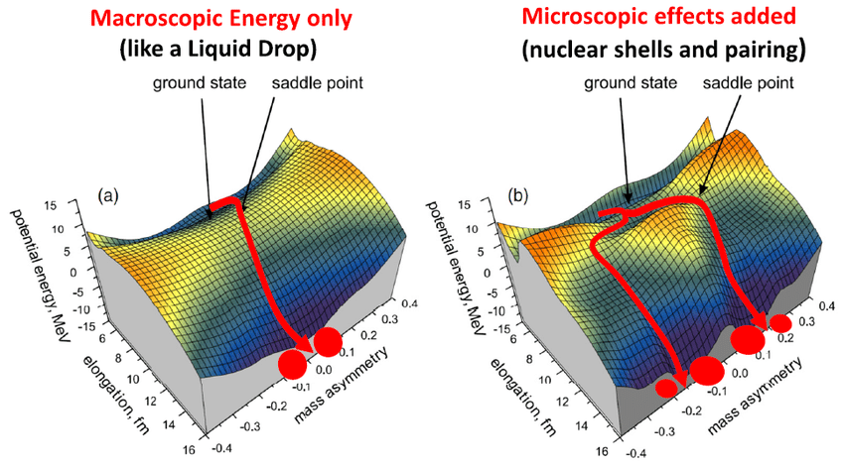
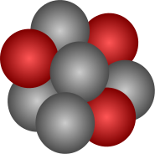

S455 Fission Experiments
Fission via Coulomb Excitation → Submitted paper to Nature, P. Morfouace, J. Taieb et al.
”An asymmetric fission island driven by shell effects in light fragments”
stay tuned !
Induced Fission via QFS – Pilot Experiment
J. Benlliure et al.
Why induced fission via QFS?
Measurement excitation energy on an event-by-event basis
Precise measurement of fission barriers
Pin down microscopic shell effects and explain asymmetric mass/charge distributions
²³⁸U
*
200MeV
LH2 Target (15mm)
Z-1
Beam energy: 540 AMeV
Complete kinematics studies of fission reaction!
Popescu, Vlad. (2021). Fission modes of exotic nuclei.

Slide 21


Identification ²³⁸U(p,2p)²³⁷Pa + Fission – A Unique Setup
Multi-neutron recognition in NeuLAND
Double ionization chamber TWIN MUSIC:
Simultaneous measurement of the two fragments
Target Tracker + CALIFA
Four momentum reconstruction of light particles
Fragment tracking via several MWPCs

Slide 22

Induced Fission via QFS – First Results
quasi free (p,2p) fission reactions
Polar angle correlation of outgoing protons
Excitation energy
Multi-nucleon knockout
GARCÍA-JIMÉNEZ, G., et al. Study of (p, 2p) fission reactions in inverse kinematics using the R3B set-up. In: EPJ Web of Conferences. EDP Sciences, 2023. S. 02009.
Popescu, Vlad. (2021). Fission modes of exotic nuclei.
Popescu, Vlad. (2021). Fission modes of exotic nuclei.

Slide 23

Outlook 2026 - HYDRA Experiment
A. Obertelli et al.
HYpernuclei Decay at R3B Apparatus
Hypertriton: large spatial extension predicted (unmeasured!) Hypernuclear halo?
d
s
u
Universality of halos: loosely bound (hyper)nuclei are candidates
Λ
(e.g. ¹¹Li, S_{2n} ~380 keV)
Binding energy of hypertriton:
Predictions: ~150keV
Exp. Values: range from 70 – 400 keV
p
n
Experimental Goal:
Measurement of the cross section of hypertriton with ¹²C target
→ deduce its matter radius
Would give more insights into the hyperon-nucleon interaction.
Implications in EoS, since in astrophysics hyperons are expected to emerge in neutron stars
Bertulani, C. A. (2023). Probing the size and binding energy of the hypertriton in heavy ion collisions. Physics Letters B, 837, 137639.

Slide 24



HYDRA – Experimental Approach
Two-Target Metod:
Production cross section: σ_{Λ}
¹²C + ¹²C → X + ³_{Λ}H
Interaction cross section of ³_{Λ}H: σ_{ΛR}
³_{Λ}H → ³He + π⁻
Two independent measurements to separate σ_{Λ} / σ_{ΛR} :
¹²C beam, 1cm ¹²C target
¹²C beam, 6cm ¹²C target
(5cm)
generic hypernucleus
τ = 200ps
σ_{Λ} = 1.8 μb
Velardita, S., Alvarez-Pol, H., Aumann, T. et al. Method to evidence hypernuclear halos from a two-target interaction cross section measurement. Eur. Phys. J. A 59, 139 (2023).
Beam: ¹²C; 1.9 GeV; intensity 10⁶ pps
Velardita, S., Alvarez-Pol, H., Aumann, T. et al. Method to evidence hypernuclear halos from a two-target interaction cross section measurement. Eur. Phys. J. A 59, 139 (2023).

Slide 25
R³B towards Early Science in HEC
Tight Schedule…..
2028
First Science
NeuLAND: with significant more double planes
SIS 100
(intensity x 10)
complete FAIR/R3B equipment
SuperFRS
(large fragment acceptance)
Early Science
SIS 18 beams
Partial FAIR/R3B equipment
SuperFRS
(large fragment acceptance)
GLAD: new cooling scheme
TOFD: in vaccum chamber
PASTOF: from prototype to final design
CALIFA: + 832 crystals
© GSI, FAIR, Zeitrausch

Slide 26



CALIFA @ Technical University of Munich (TUM)
Tobias Jenegger, Mrunmoy Jena and Roman Gernhäuser
Thank you!

Slide 27
BACKUP

Slide 28


Quasi Free Scattering (QFS) Reaction
initial state
reaction
final state
Applications of QFS in inverse kinematics:
Shell structure and deformation via gamma spectroscopy of exotic nuclei
SRC and physics beyond the mean field
Fission via QFS
…...
⁵³K(p,2p)⁵²Ar
Panin, V., T. Aumann, and C. A. Bertulani. "Quasi-free scattering in inverse kinematics as a tool to unveil the structure of nuclei: A tribute to Mahir S. Hussein." The European Physical Journal A 57 (2021): 1-13.
Impulse Approximation:
Instantaneous two body interaction of single particle (inside nucleus) with proton target
Rest nucleus is treated as “spectator” - no influence on the interaction
H.N. Liu et al., Phys. Rev. Lett. 122, 072502 (2019)
QFS gives access to the single-particle nuclear states

Slide 29

¹²C + ¹²C - S444 Experiment 2019
See Previous Talk:
HK 8.1,Lukas Ponnath et. al. (Mon., 16:45)
Motivation:
Precise measurement of total interaction cross section of ¹²C + ¹²C → quantify the uncertainty of the reaction model
Reaction model is key ingredient to predict neutron removal cross section σ_{ΔN} neutron skin thickness Δr_{np}
Constrain slope parameter L of the symmetry energy of the EoS
increasing slope parameter L
stiff EoS
soft EoS
L = 100 MeV
T. Aumann, C.A. Bertulani, F. Schindler, S. Typel, Phys. Rev. Lett. 119, 262501 (2017)
L = 25 MeV
X. Roca-Maza et al., Phys. Rev. C 92
G.F. Burgio et al. Progress in Particle and Nuclear Physics 120(12):103879(2021)
Final Goal:
Precise pred. Of neutron removal cross section-

Slide 30
Identification of Daughter Nuclei
TWIN MUSIC:
Double Ionisation Chamber
e⁻ drift
e⁻ drift
1
2
+ θin measurement
0
3
Z
anode planes

Slide 31
S455 Experiment – Induced Fission via QFS
Pilot experiment in 2021
Pilot experiment
Goal:
Constrain the models & parameters for the r-process
²³⁸U
*
QFS allows to measure the excitation energy on an event-by-event basis
200MeV
LH2 Target (15mm)
Z-1
mass/charge distributions
(+probabilities)
Beam energy: 540 AMeV
excitation energy
²³⁸U
Popescu, Vlad. (2021). Fission modes of exotic nuclei.

Slide 32


¹²C + ¹²C - S444 Experiment 2019
Courtesy: Lukas Ponnath
Transmission Measurement:
Has the incoming particle undergone a nuclear reaction?
PONNATH, L., et al. Measurement of nuclear interaction cross sections towards neutron-skin thickness determination. Physics Letters B, 2024, S. 138780.
We are able to do high-precision measurements (σR @ 400 AmeV = 762 +- 1.86 (stat) +-1.69(syst) mb)
Experimental results are in agreement with previous experiments at low energies ( ~ 400 AMeV)
Significant discrepancy experimental data - theory
Total Interaction Cross Section:
See Previous Talk:
HK 8.1,Lukas Ponnath et. al. (Mon., 16:45)

