Slide 1







R³B Experiments with Final CALIFA Setup
Tobias Jenegger
PSI Seminar 07.06.2023
R³B @ FAIR
CALIFA Status & Final Configuration
Analysis S444 Experiment
Funded by the Deutsche Forschungsgemeinschaft (DFG, German Research Foundation)
under Germany’s Excellence Strategy – EXC-2094 – 390783311,
BMBF 05P19WOFN1, 05P21WOFN1
and the FAIR Phase-0 program
Physics with R³B
CALIFA – Design
TUM Members:
Roman Gernhäuser,Lukas Ponnath,Philipp Klenze, Stefan Eder,Tobias Jenegger

Slide 2
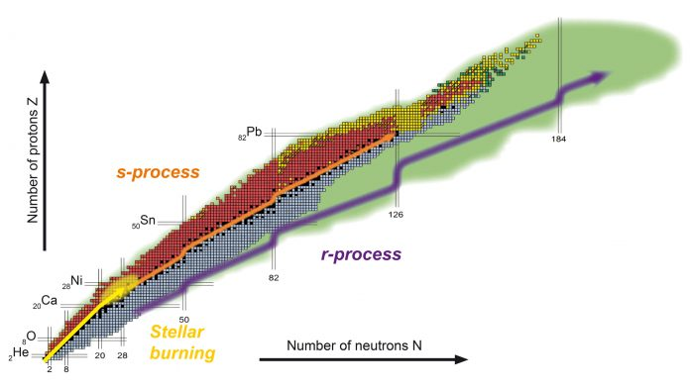
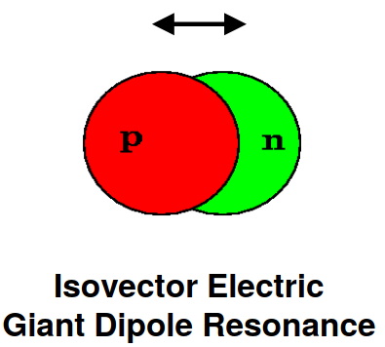
Physics Program @ R³B
Reactions with Radioactive Relativistic Beams
Formation of Elements – Nucleosynthesis
abundances - r-Process - fission feeding
fission feeding
Collective Excitations
→ EOS - Giant Dipole Reonances
→ Pygmy Resonances - neutron skin thickness

Slide 3
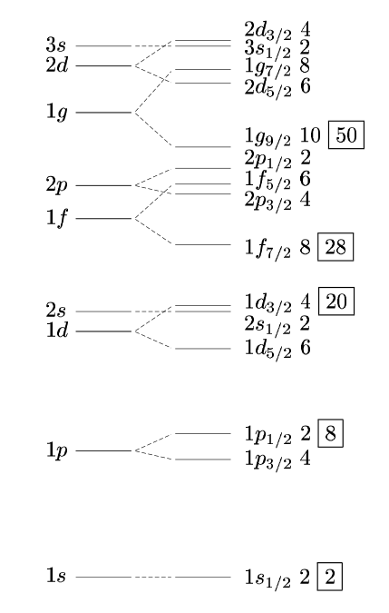
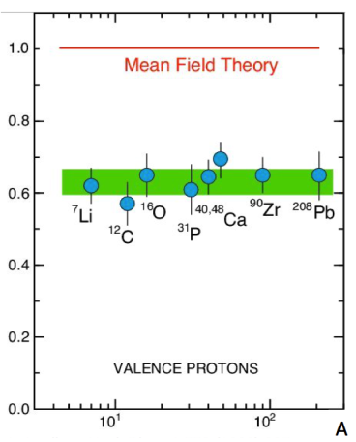
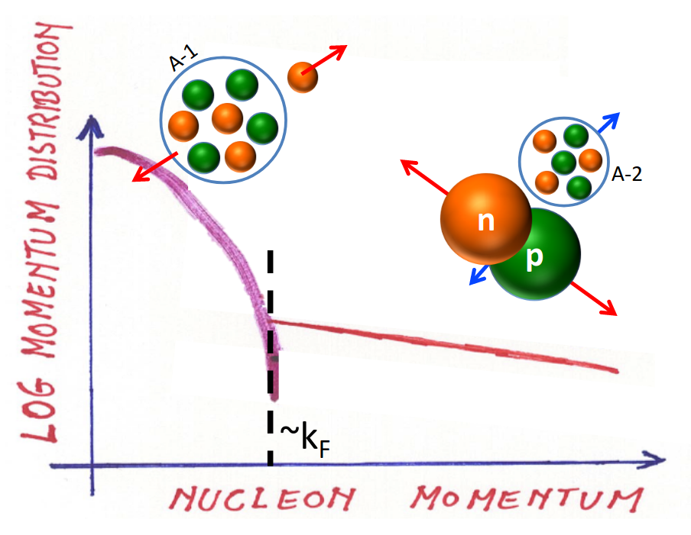
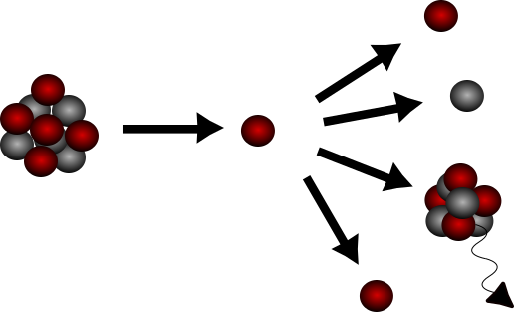
Physics Program @ R3B
Single Particle Properties inside atomic nucleus
→ Nuclear Structure far off stability
→ Short Range Correlated (SRC) nucleons
Nuclear Shell Model
Experimental Setup Requirements:
FAIR accelerator facility
R3B Setup
max
+
kinematically complete measurements

Slide 4
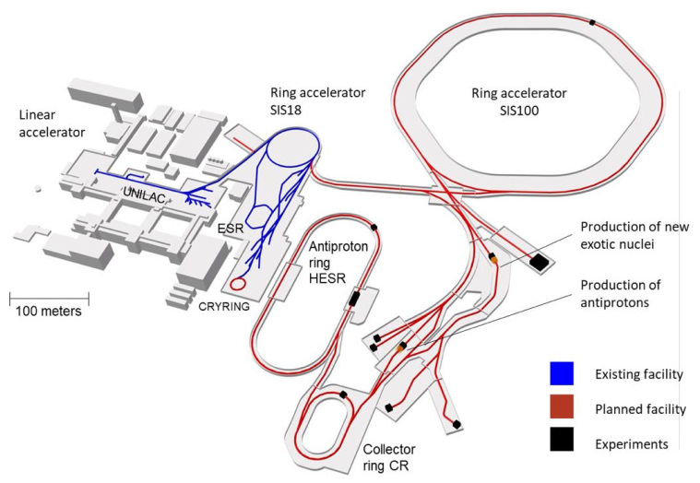
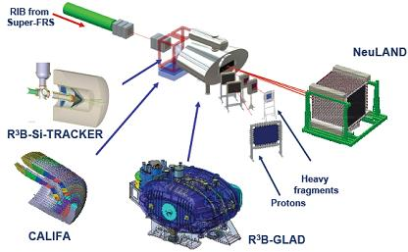
R³B @ FAIR
R³B as part of the
Facility for Antiproton and Ion Research (FAIR)
in Darmstadt:
Reactions with Radioactive Relativistic Beams
Haik Simon – FAIR & Super-FRS – EPS 20190930
in 2027
kinematically complete measurements
<Foliennummer>

Slide 5
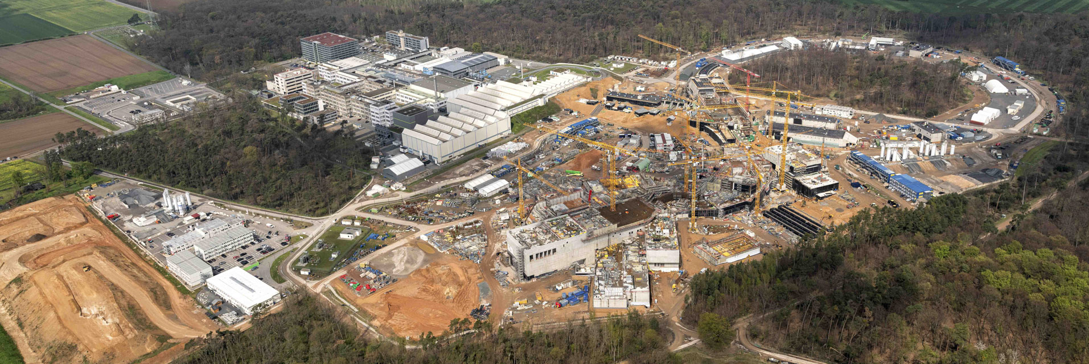
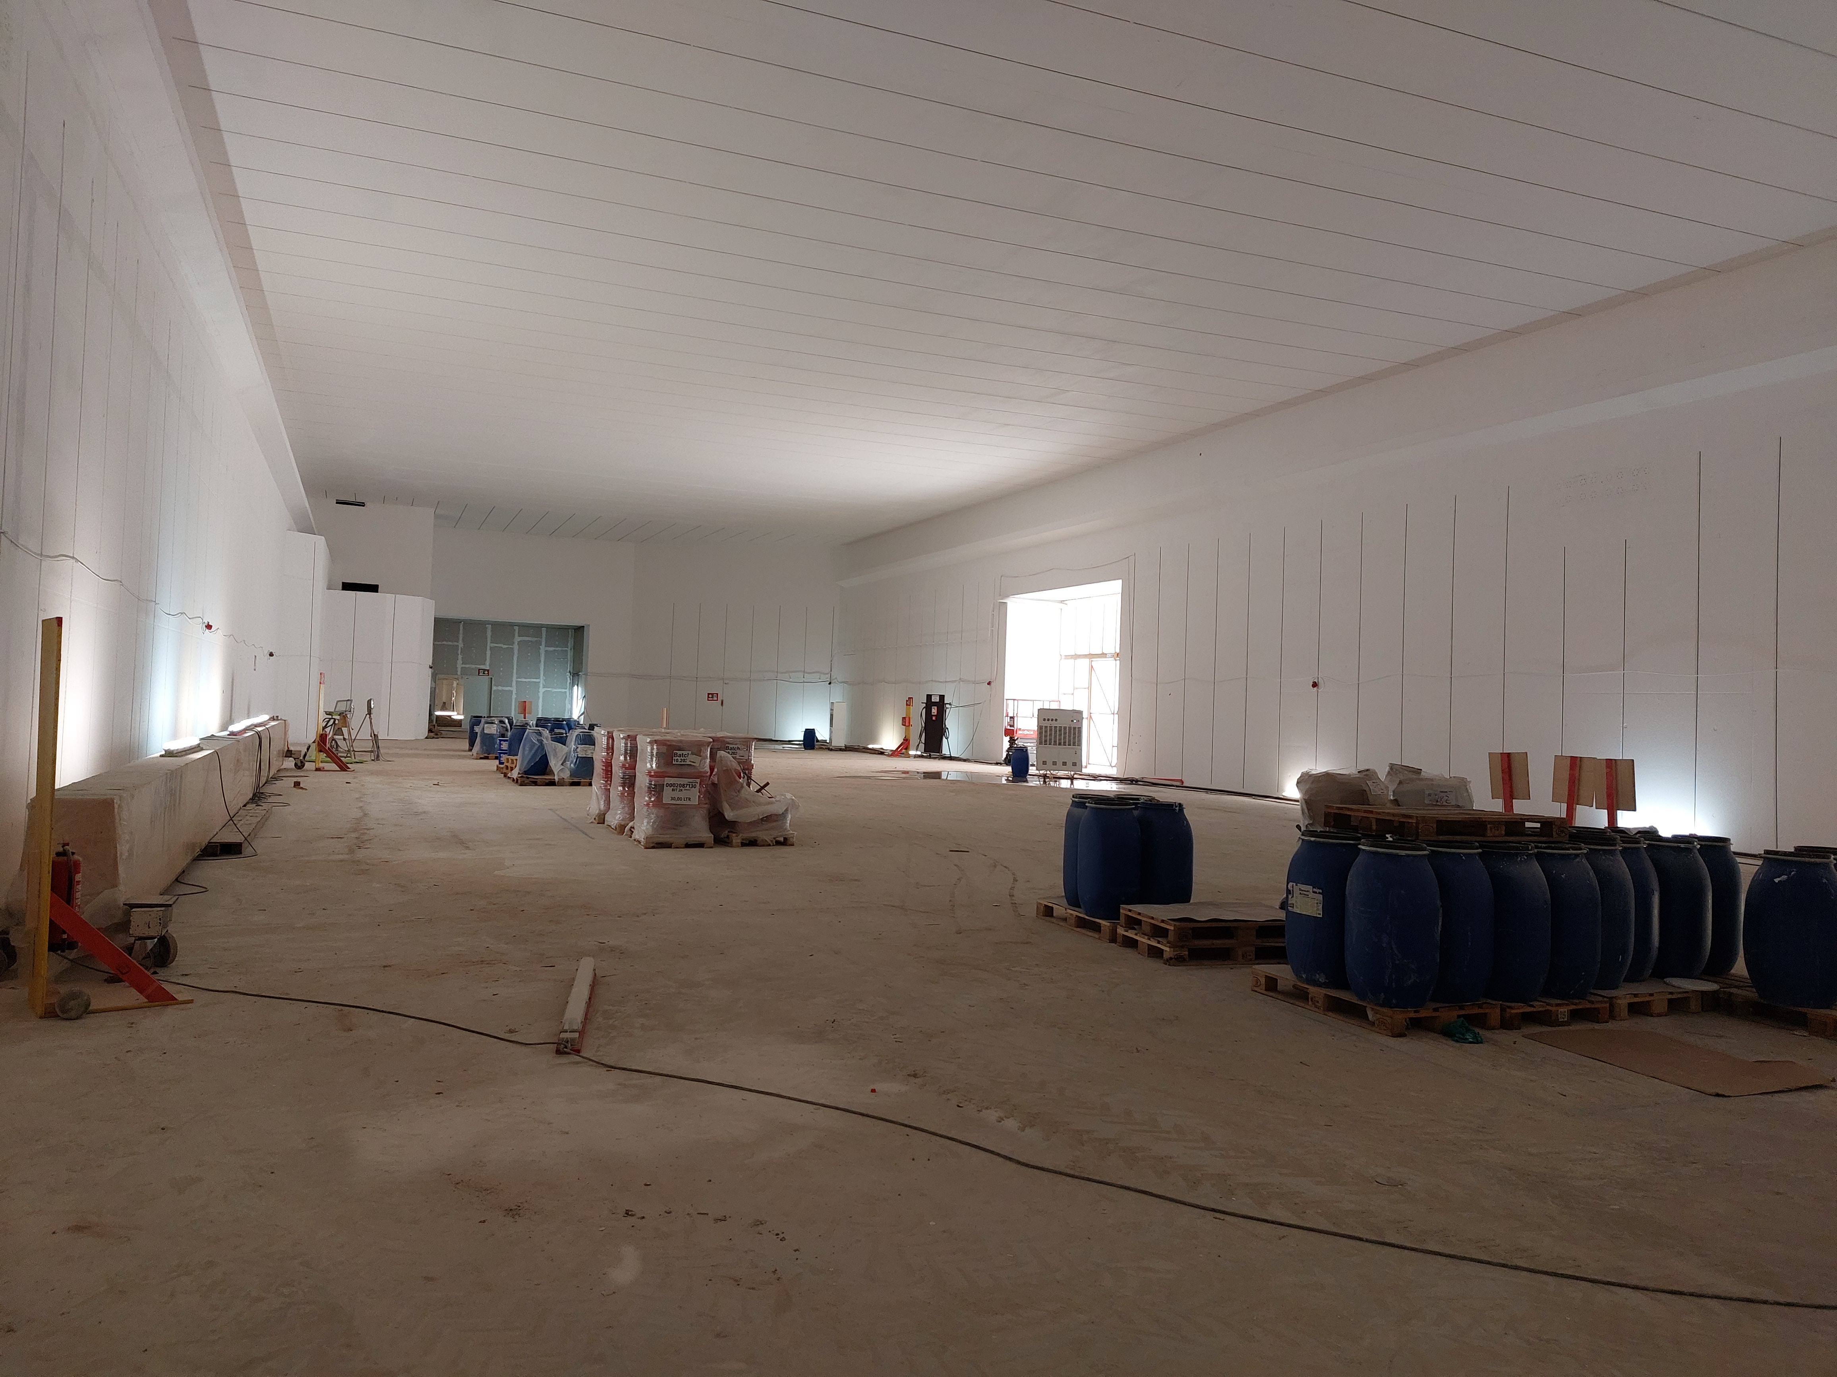
FAIR Construction Site
High Energy Cave
© D. Fehrenz, GSI/FAIR, May 2023
Dimensions: 60 x 20 x 7 m
<Foliennummer>

Slide 6
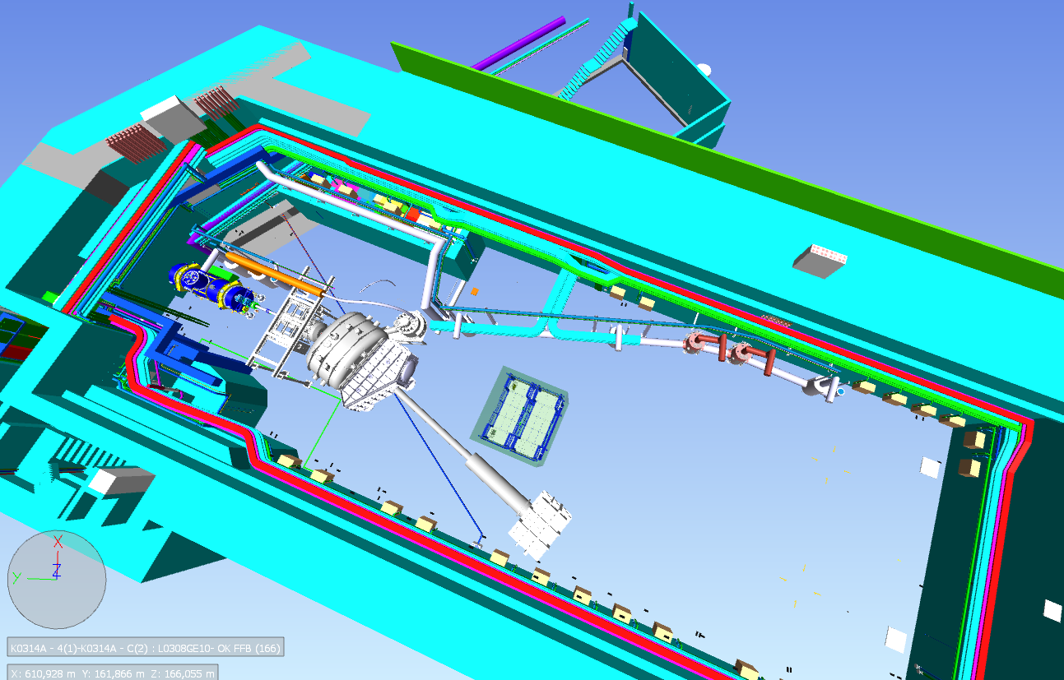
Final R³B Setup
nishe for racks
FHF1 multiplet
Satellite Box
Cryo system for HRS
Fragmentrohr
CALIFA with its frame
NEULAND
GLAD magnet
GLAD vacuum chamber
TOF Detector ?

Slide 7
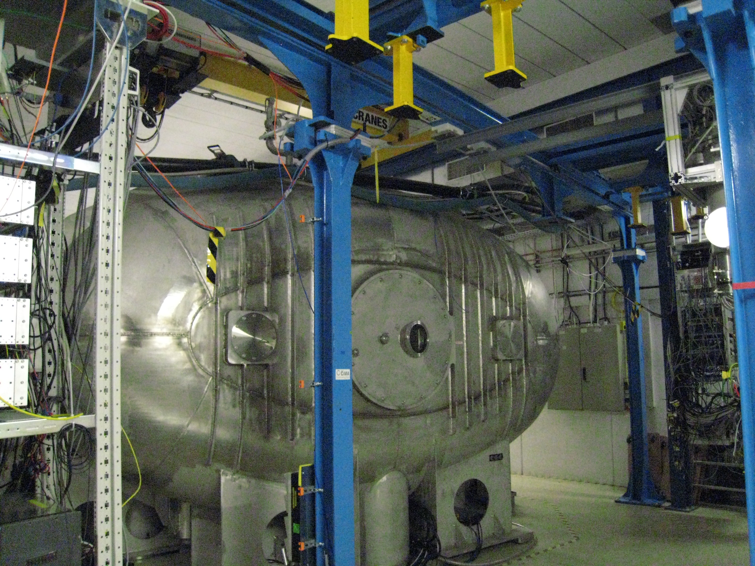
But space in Cave C is limited...

Slide 8
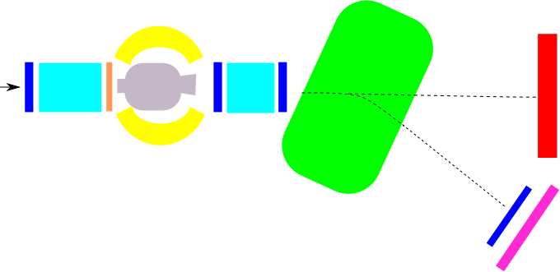
R3B Setup*
GLAD magnet
CALIFA
NeuLAND
R³B Music
MWPC1
beam
TWIM Music
MWPC0
START
MWPC2
MWPC3
Time of Flight Wall
Identification of incoming beam
Complete kinematic measurement of reaction channels
Measurement of γ/target-like particles
* S444 Experiment, 2020
<Foliennummer>

Slide 9
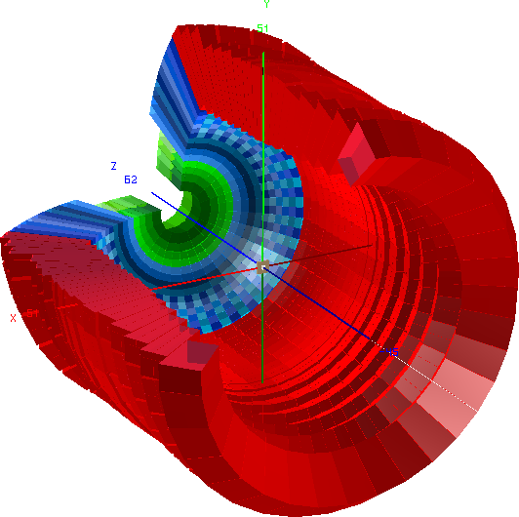
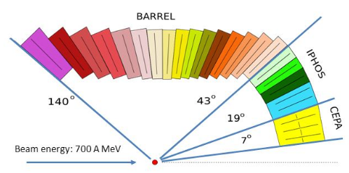
CALIFA Detector @ R³B
CALorimeter for the In Flight detection of γ-rays and light charged pArticles
Endcap:
iPhos:
480 CsI(Tl) crystals
CEPA:
112 CsI (Tl)
crystals
Highly segmented detector:
good angular reconstruction/
doppler correction
Broad calorimetric energy measurements:
From 100 keV γ-rays up to high energetic charged particles
Flexible running mode:
self/external triggering mode
Barrel:
1952 CsI(Tl) scintillator crystals
BEAM
beam

Slide 10
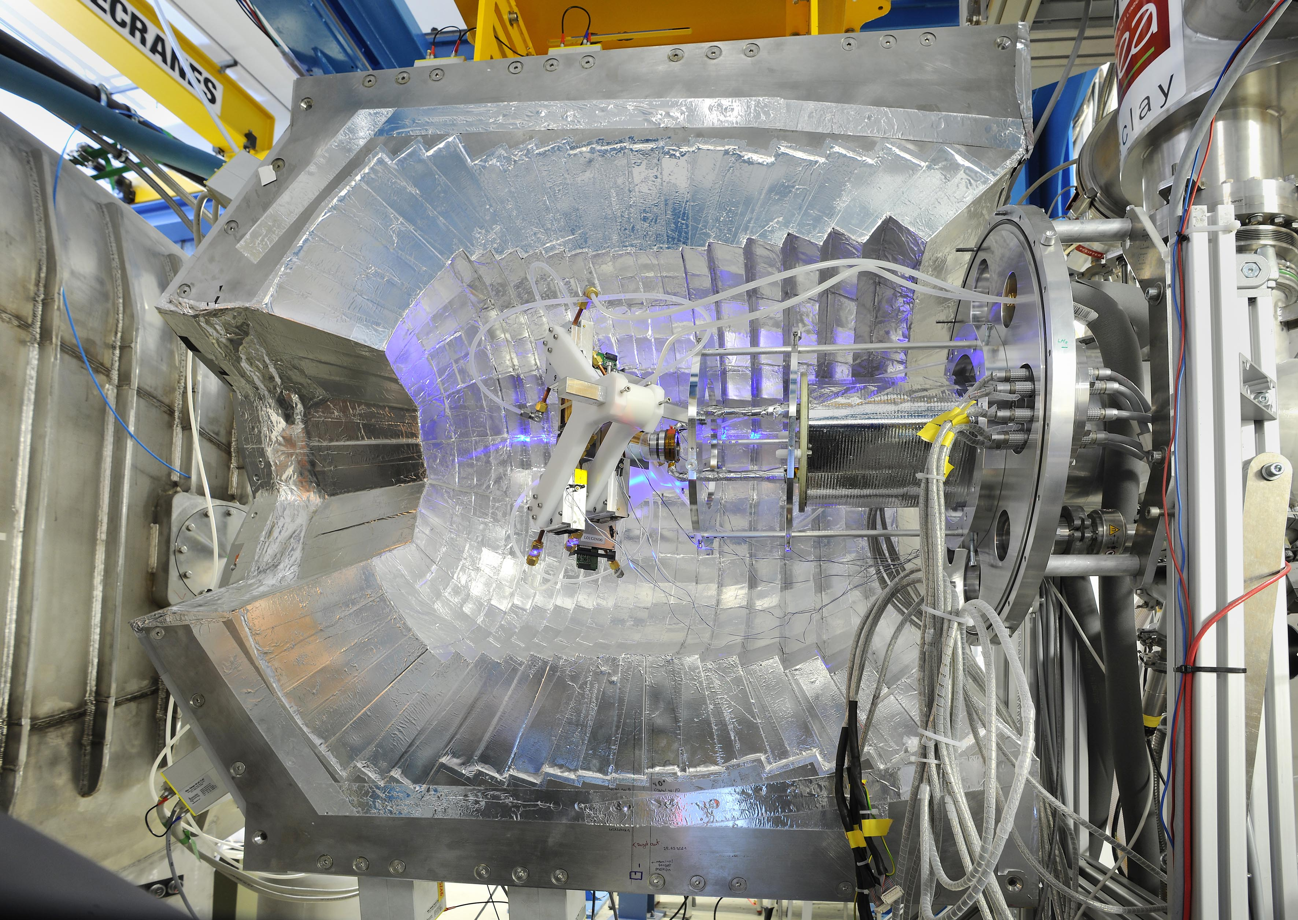
CALIFA Configuration (S522, 2022)
IPhos: 480 crystals
completely filled
readout with Dual Range Preamps
DR
300/30 MeV
Barrel: 1024 crystals
half filled
readout with Single Range (300/30 MeV) Preamps
DR
82°
19°
beam

Slide 11
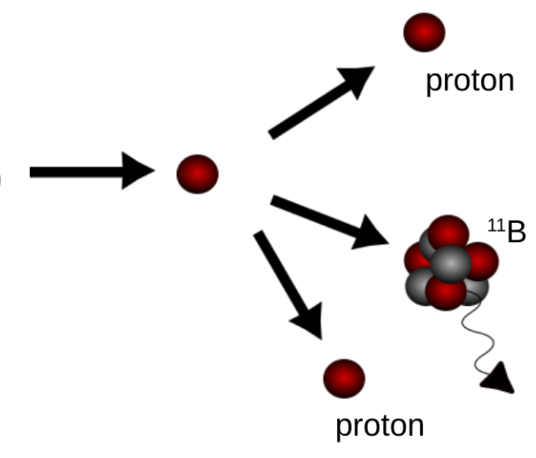
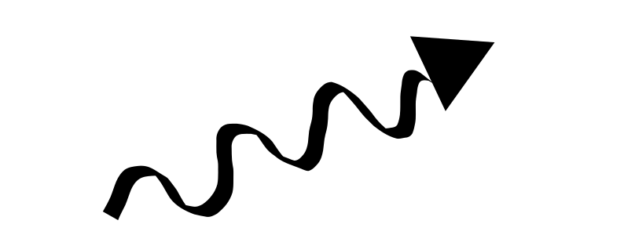

CALIFA Configuration (S522, 2022)
Possible Electronic Configurations
Comparison
SingleRange Preamplifier
Dual Range Preamplifier
low gain range
4π Config.
4π Config.
Workload:
Minimum DAQ effort
Find missing 18 x FEBEX
Find 2 missing EXPLODERS
Gamma threshold:
500 keV
IPhos: 480 crystals
completely filled
readout with Dual Range Preamps
DR
30/300
SR
30/300
SR
10/100
DR 30/300
DR 30/300
SR 30/300
SR 30/300
SR
30/300
SR
10/100
DR 30/300
SR
30/300
SR 30/300
SR 30/300
DR
30/300
SR
30/300
SR
10/100
DR 30/300
SR
30/300
SR 30/300
DR 30/300
SR 30/300
SR
30/300
SR
10/100
DR 30/300
SR 30/300
DR 30/300
DR 30/300
SR 30/300
DR
30/300
SR
30/300
SR
10/100
DR
DR 48 30/300
DR 30/300
SR 30/300
SR 30/300
SR
30/300
SR
10/100
DR 48 30/300
SR
30/300
SR 30/300
SR 30/300
DR
30/300
SR
30/300
SR
10/100
DR 48 30/300
DR 30/300
SR 30/300
SR 30/300
SR
30/300
SR
10/100
DR 48 30/300
SR
30/300
SR 30/300
SR 30/300
DR
30/300
SR
30/300
SR
10/100
Orders:
8 x DR 48 30/300 (60 k€)
8 x SR32 30/300 10/100 (40 k€)
11 x SR32 10/100 (55 k€)
+ 3 spares (15 k€)
Modify 4 FEBEX CRATES (8 k€)
54 new FEBEX Cards (60 k€)
Low voltage extension (20 k€)
DR 48 30/300
SR
30/300
DR 48 30/300
SR
30/300
DR 48 30/300
SR 30/300
SR 30/300
DR 48 30/300
DR 30/300
SR 30/300
SR 30/300
SR
10/100
DR
30/300
SR
30/300
SR
10/100
DR 48 30/300
DR 30/300
SR 30/300
SR 30/300
SR
30/300
SR
10/100
DR 48 30/300
SR
30/300
SR 30/300
SR 30/300
DR
30/300
SR
30/300
SR
10/100
DR 30/300
DR 30/300
SR 30/300
SR 30/300
SR
30/300
SR
10/100
DR 30/300
SR
30/300
SR 30/300
SR 30/300
OR
DR
30/300
SR
30/300
SR
10/100
DR 30/300
SR 30/300
SR 30/300
SR
30/300
SR
10/100
SR
30/300
DR 30/300
DR 30/300
DR 30/300
DR 30/300
SR 30/300
SR 30/300
300/30 MeV
DR 30/300
+
high gain range
Barrel: 1024 crystals
half filled
readout with Single Range (300/30 MeV) Preamps
SIMULTANEOUS
high energetic paricle measurement
&
gamma spectroscopy
DR
Gamma threshold:
100 keV
Sum: 248k€
As planned
As planned
All features in - 4π save
All features in - 4π save
Issues with punch through at 42-60°
Issues with punch through at 42-60°
More data, less spares
More data, less spares
2 x channelnr.
Eproton via tot-method
Two more racks needed

Slide 12
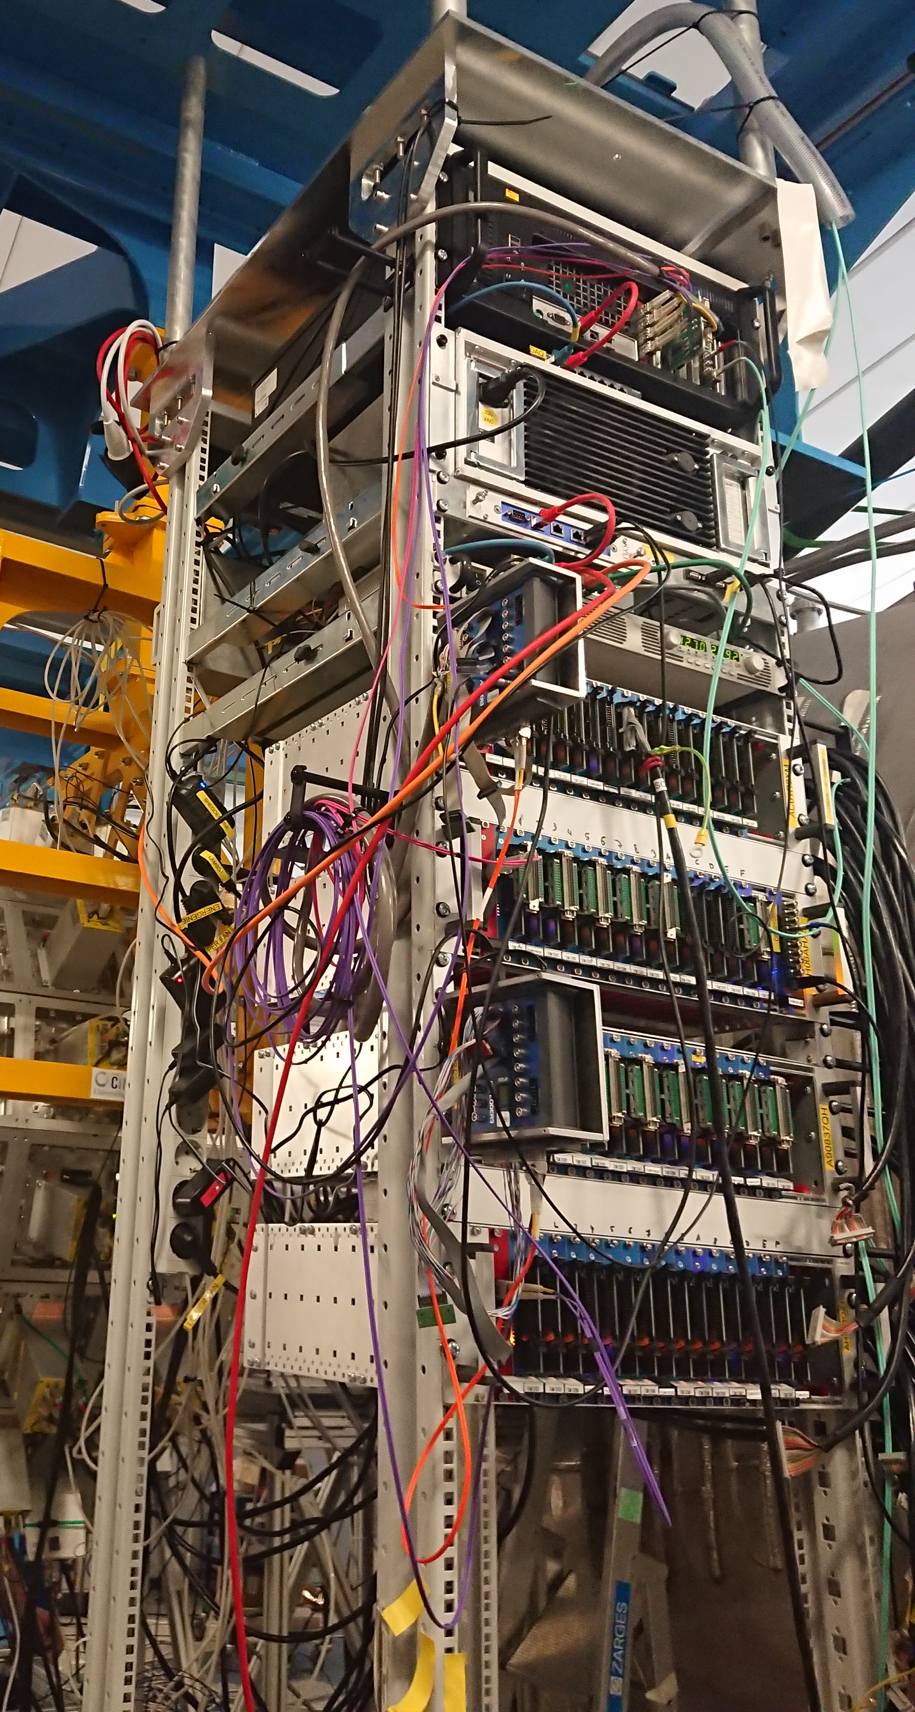
CALIFA DAQ Status (S522, 2022)
Pexor
Trixor
CALIFA DAQ-PC
Pexaria
LV - WIENER
Power Distributer
Electronic Rack
Exploder
8 Crates (each with 18 x FEBEX + Addon)
2 PCs (with Knipex+TRIXOR)
2 TDK Lambda
4 Exploder
1 “Overlord” Exploder
2 Slow Control PCs
Exploder
TDK Lambda
NIM Crate

Slide 13
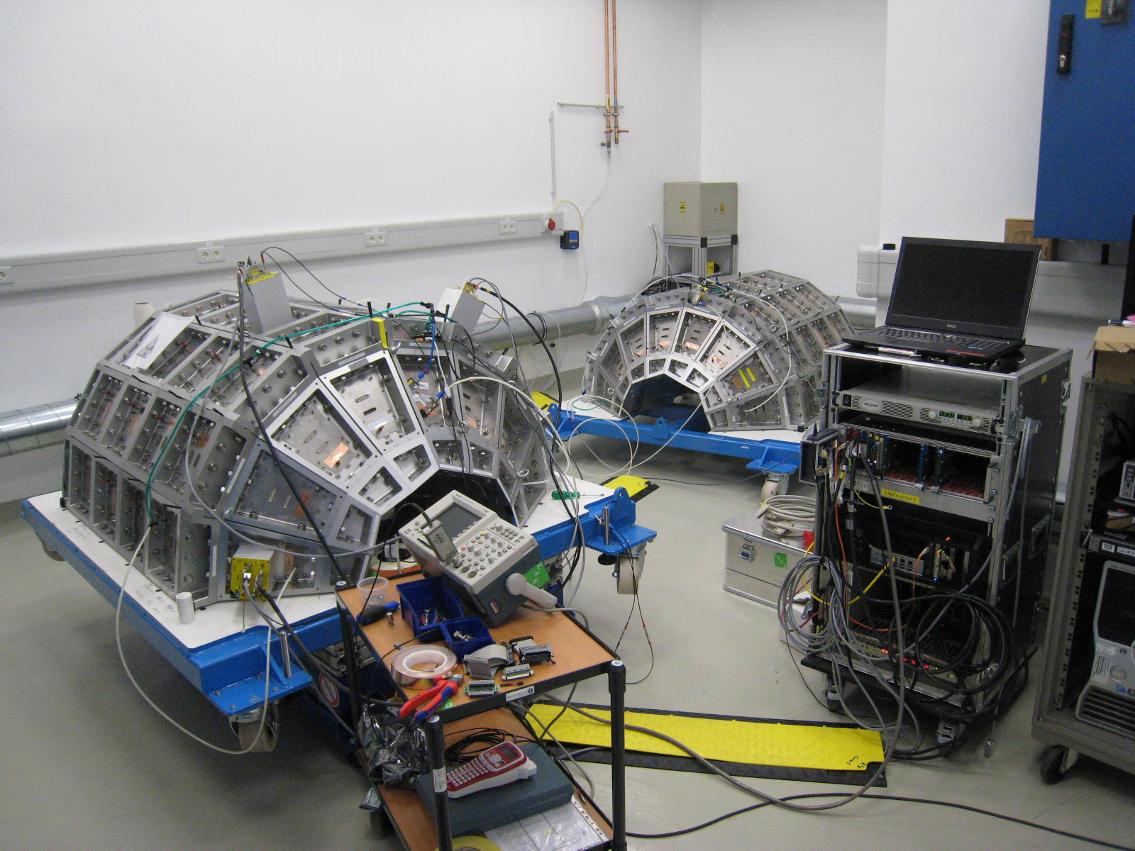
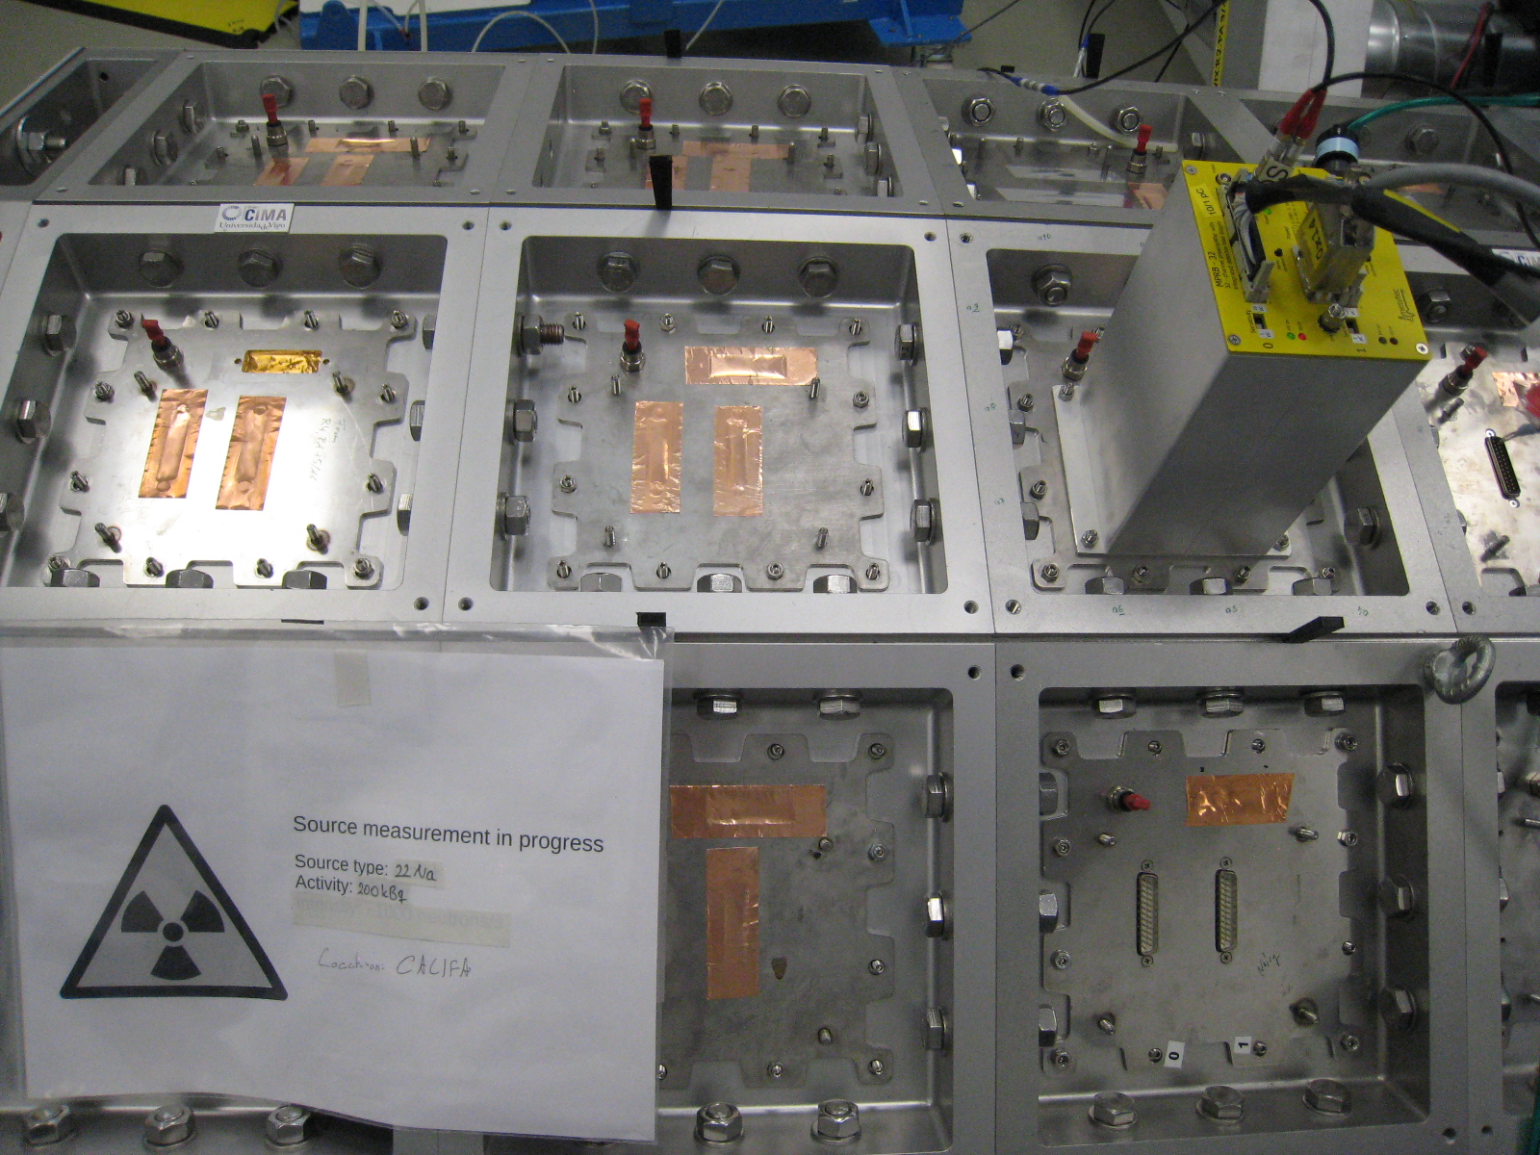
Meanwhile in R³B Preparation ROOM ….
Add new crystals
Improve noise figure
Check and replace some of internal cables

Slide 14
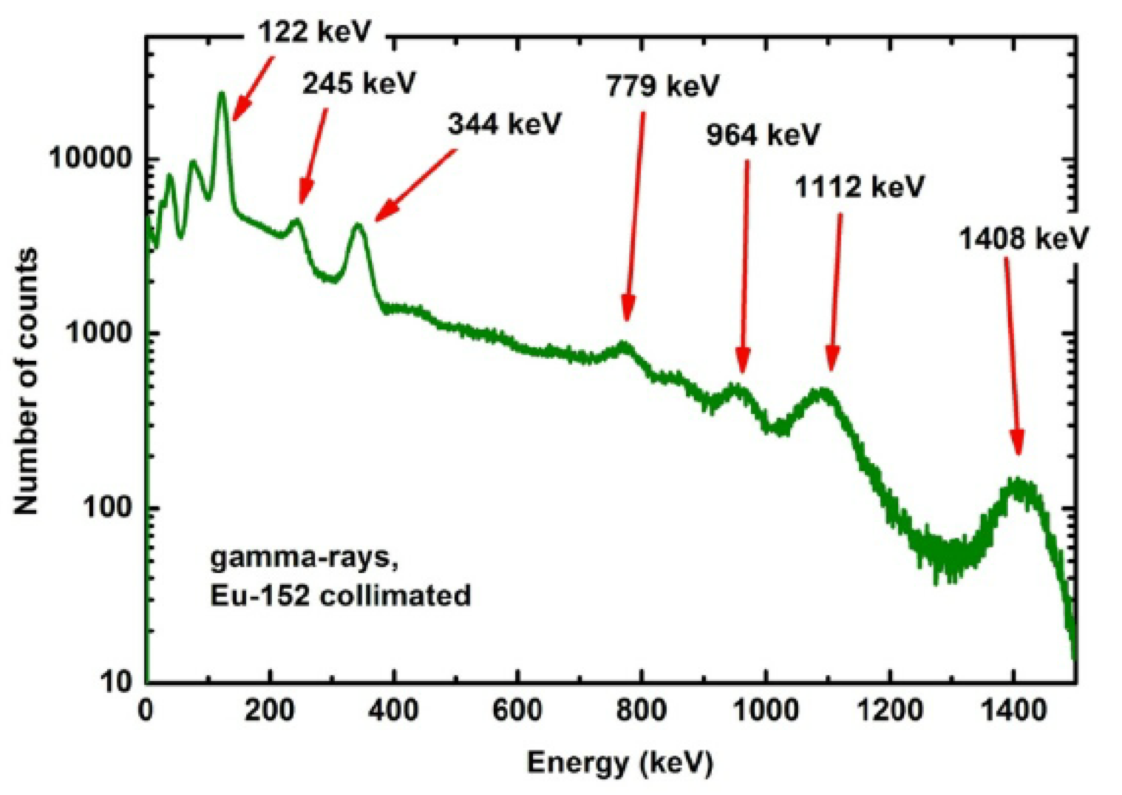
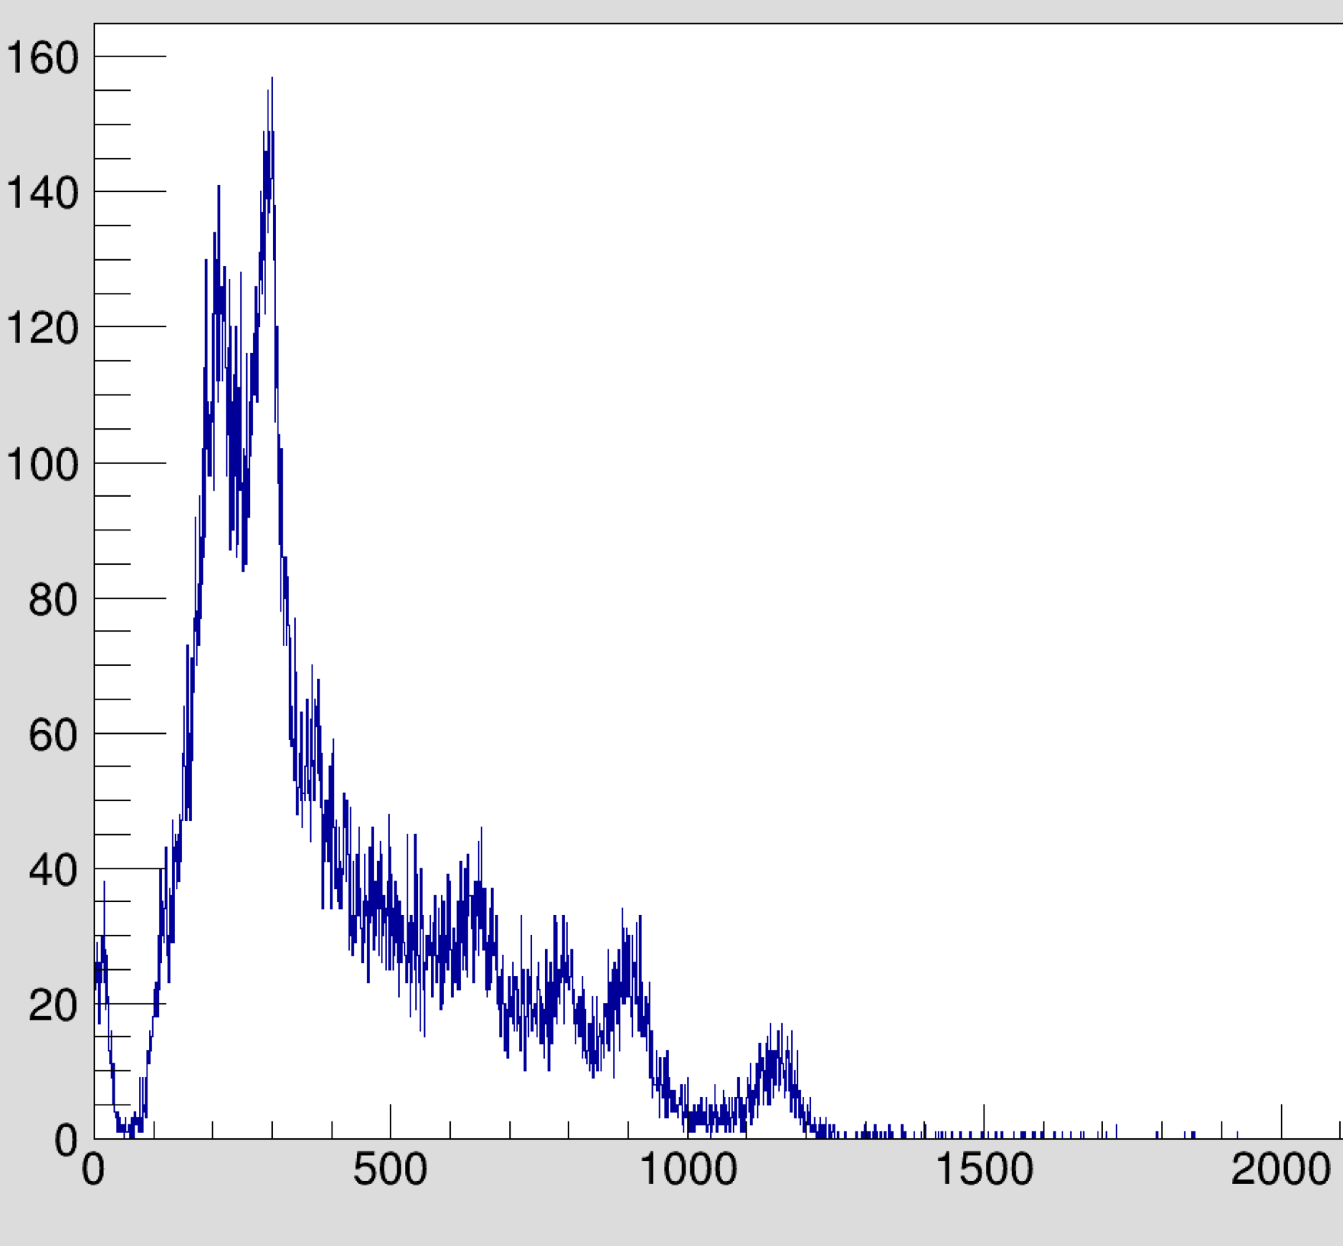
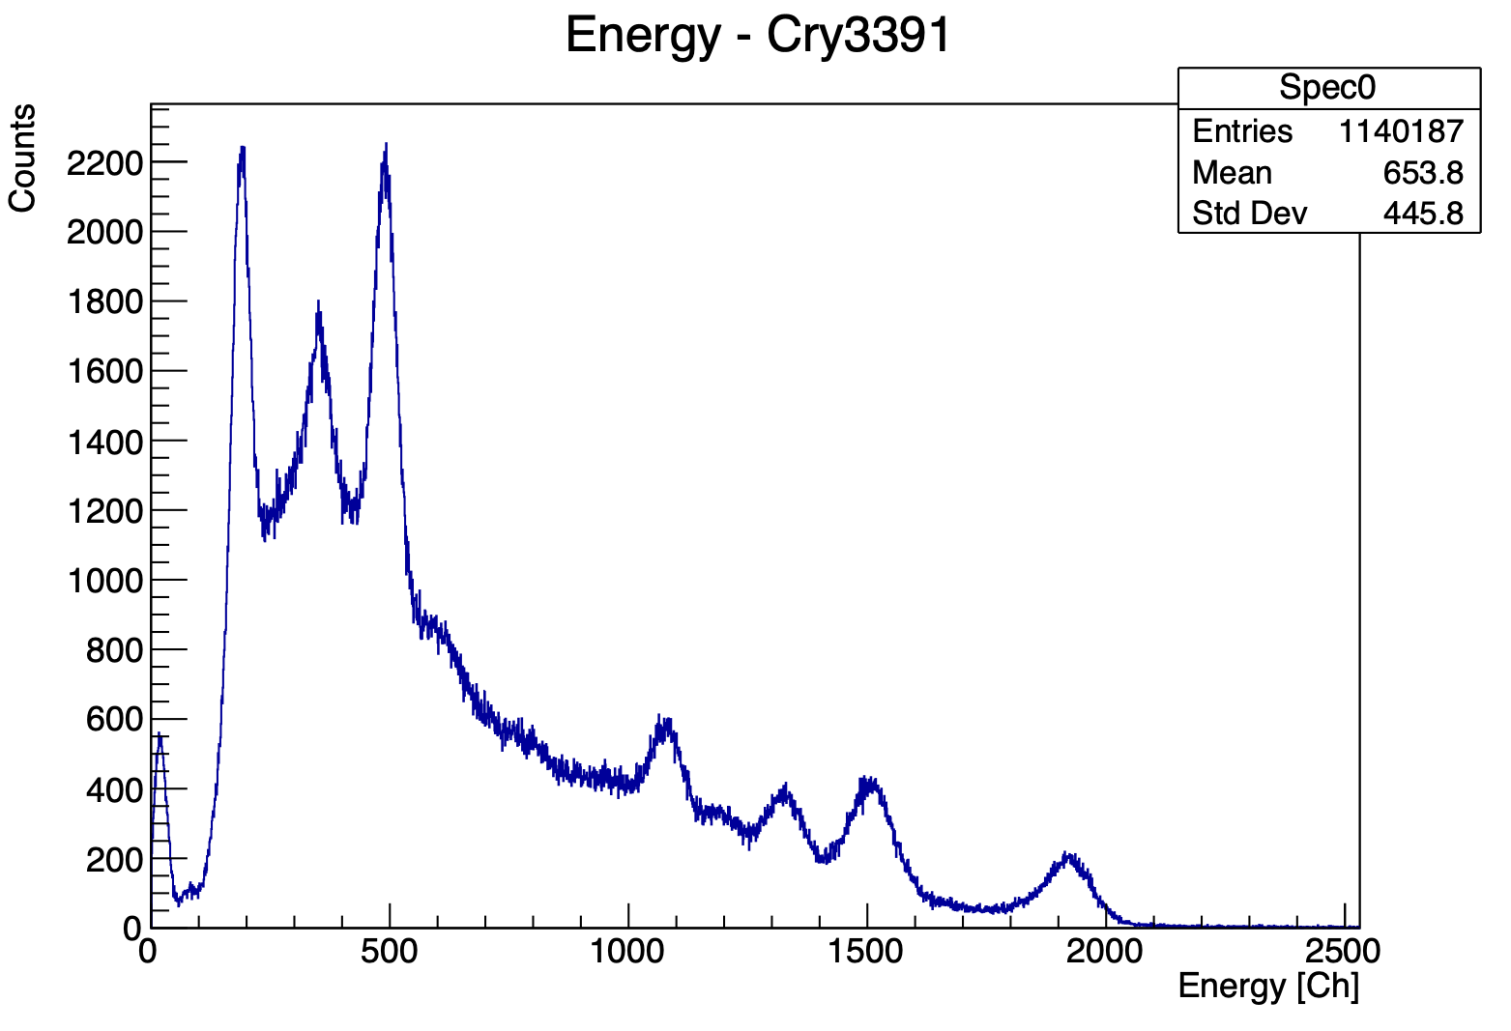


Testing Gain
344 keV
standard gain
enhanced gain
344 keV
1408 keV
1408 keV
Raising the gain allows to measure down to the 122 keV peak!
Higher gain leads to better resolution (but reducing the energy-range)
Lower threshold values are possible → crucial for add-back algorithm!

Slide 15
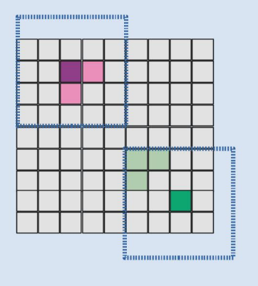

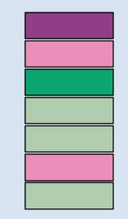
Add-Back Algorithm in CALIFA
User defines shape and size of cluster:
Sort the hit list according to their energy
5.34 MeV
1. create cluster centered around first hit
2. loop over all hits in list
0.51 MeV
1.01 MeV
0.74 MeV
→ if hit inside cluster add it and remove it from the list
0.51 MeV
0.15 MeV
3. Do this procedure until list is empty
0.21 MeV
Depending on how low we can get with the threshold we can addup or not !

Slide 16
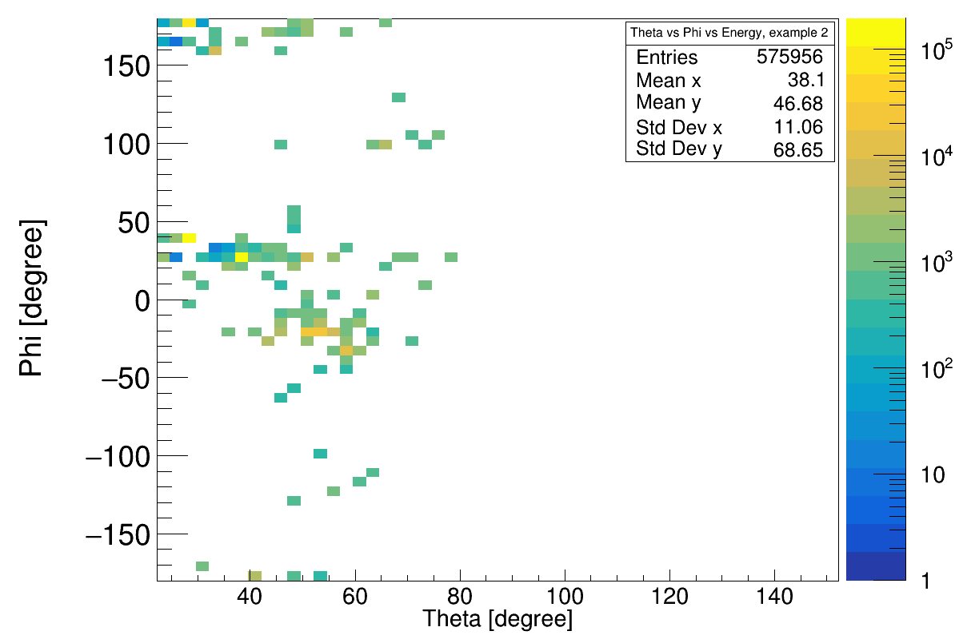
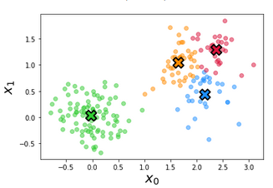
ODSL Collaboration - Optimize Add-Back Algorithm with AI
Use the power or Machine Learning:
→ recognize the physics cases
→ optimize the cluster shapes (event by event)
→ give probability for fully contained physics event
exp: high mult. event
Hit Time
Spatial Position
Energy
Correlation with neighboring crystals
Customized Cluster
Supervisor: Prof. Dr. Lukas Heinrich

Slide 17
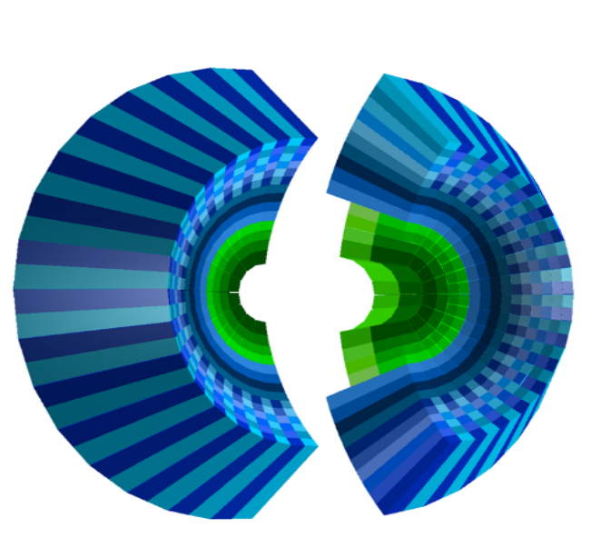
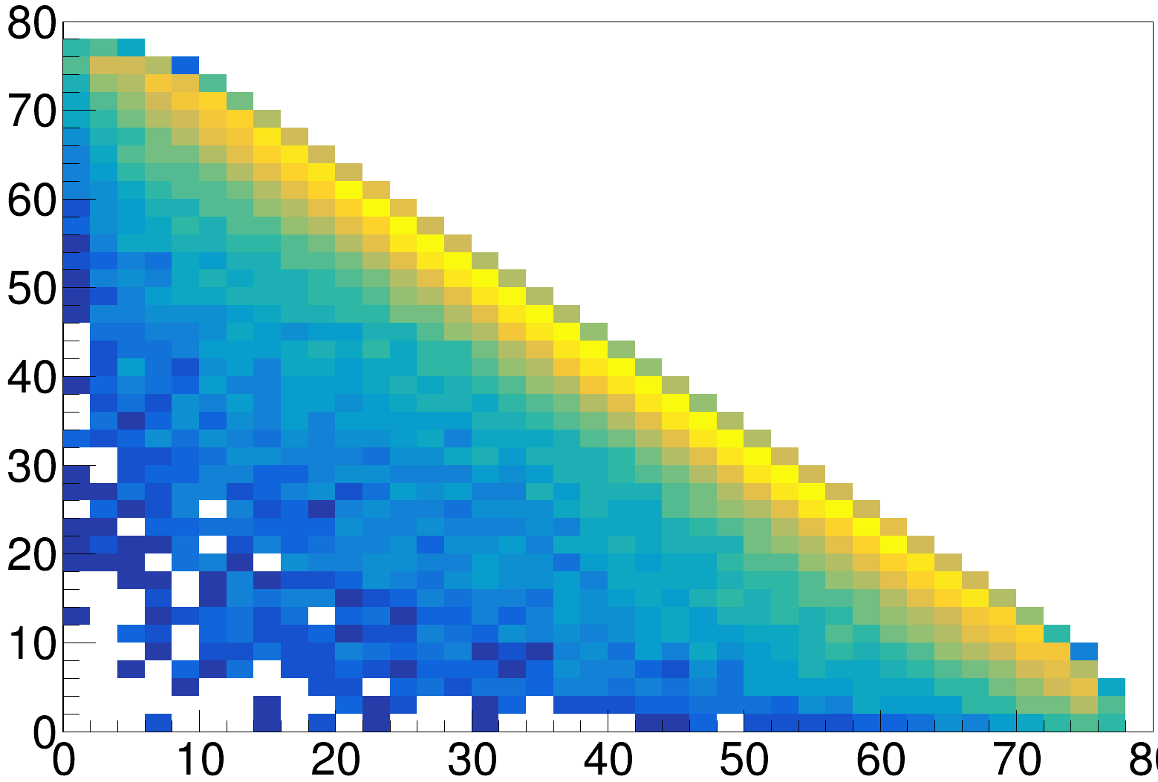
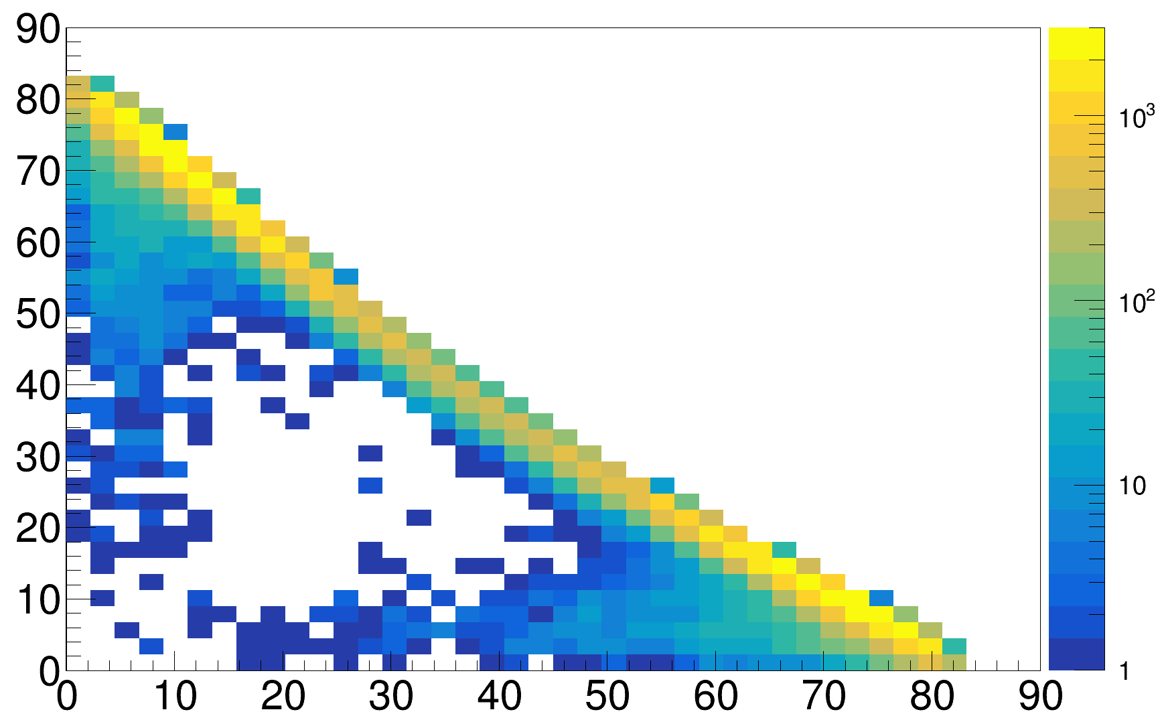
Filling CALIFA Endcap - CEPA
CALIFA Endcap Phoswich Array
Most forward section: 7° ≤ θ ≤ 19°
112 CsI crystals
Improves geometric acceptance for high beam energies drastically
p2p-reaction, 400 AMeV
p2p-reaction, 1200 AMeV
θ₂
θ₂
θ₁
θ₁

Slide 18
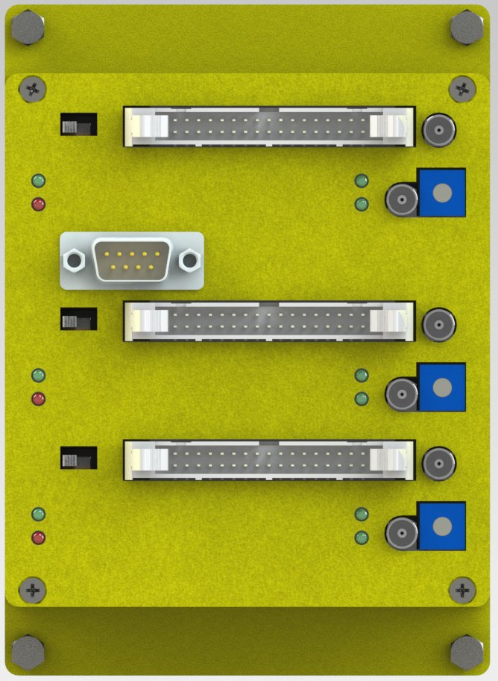
Filling CEPA
Mesytec MPRB-48 Dual Range Preamps
They get mounted on iPhos tiles
Connected to iPhos APDs
(32 channels)
Connected to CEPA APDs
(16 channels)
no space !

Slide 19
Final CALIFA Electronic Configuration
Workload:
DAQ
Slow Control
Analysis
LV - WIENER
Power Distributer
Exploder
extend to its full glory
Exploder
Exploder
TDK Lambda
Exploder
+
Dual Range Preamplifiers
TDK Lambda
NIM Crate
LV-Extension

Slide 20
Physics at R3B with CALIFA

Slide 21
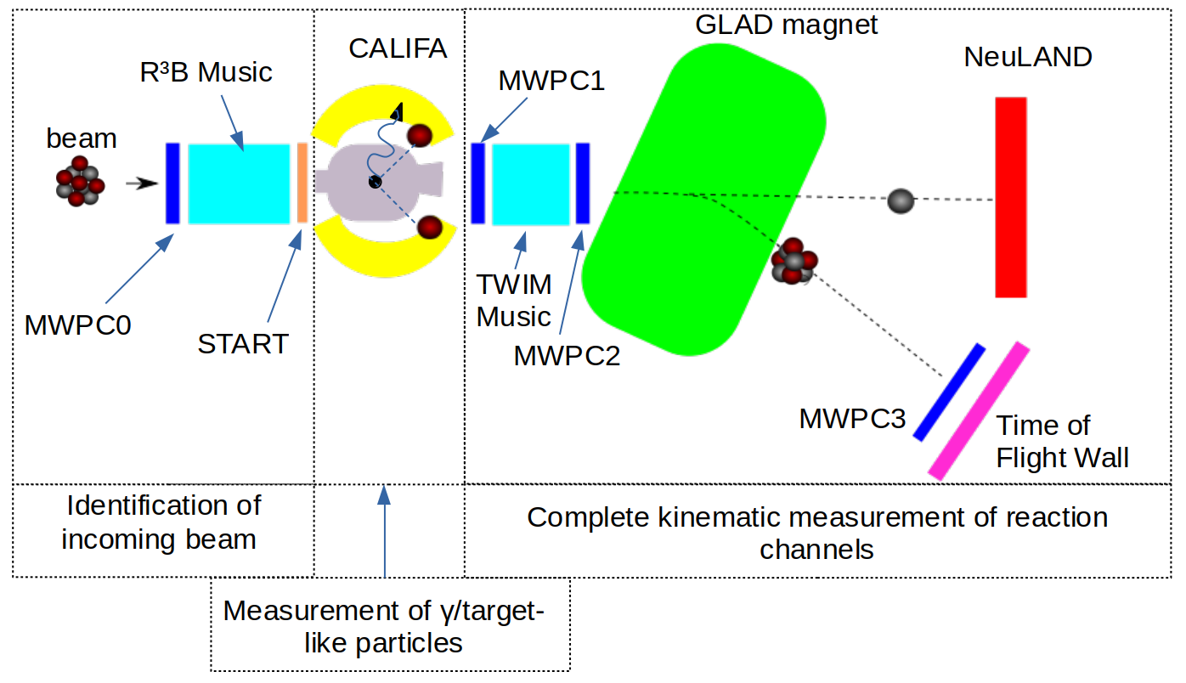
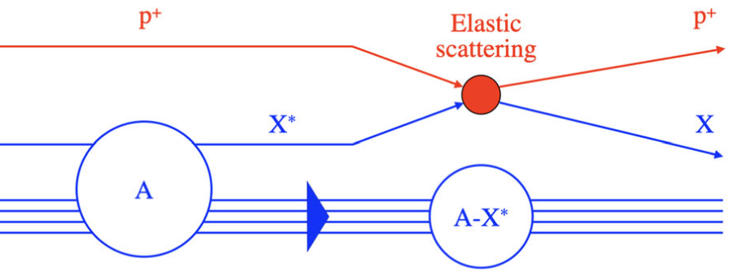
Physics Program @ R3B
Physics program on exotic nuclei in inverse kinematics:
kinematically complete measurements
Key physics Progam
→ Quasi-Free Scattering Reactions:
proton probe is used for sudden knockout of a nuclear constituent

Slide 22
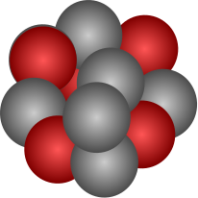


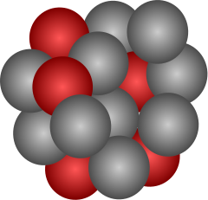
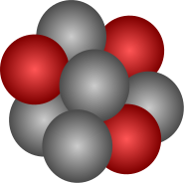

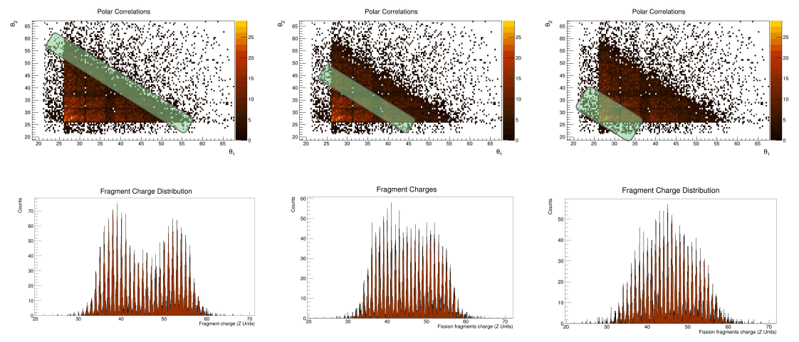
Quasi-Free Scattering Reactions @ R³B
Fission induced by QFS
proton
²³⁸U
*
target
Pilot experiment in 2021
proton
Gives direct access to single particle properties inside nuclei
Allows to study in detail the nuclear shell structure and its evolution far off stability

Slide 23
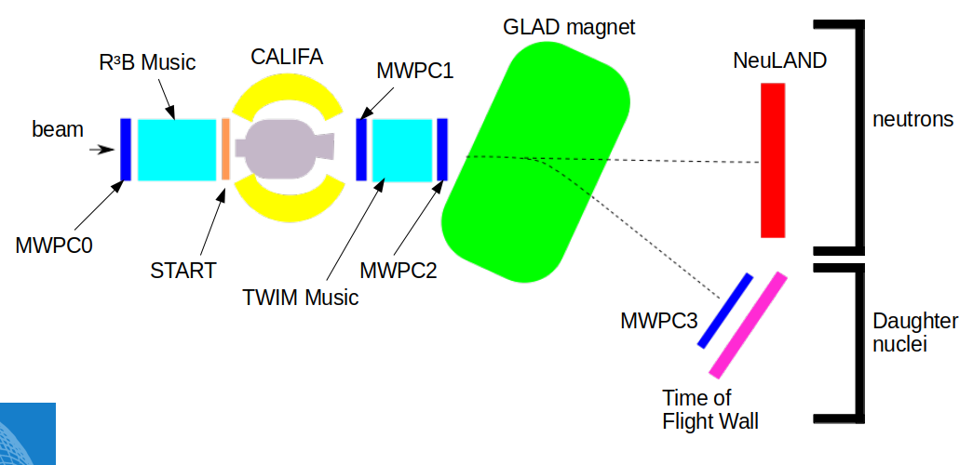
Quasi Free Scattering Analysis with Experiment S444/467 (2020)
12C(p,2p)11B reaction:
SETUP:
Beam energy: 400 AMeV
Beamtype: ¹²C
Beamtime: 3 hours
Target: CH₂ (12.29 mm)
¹²C beam
proton like target
2 protons
¹¹B fragment
(spectator)
¹²C
proton
¹¹B
proton

Slide 24
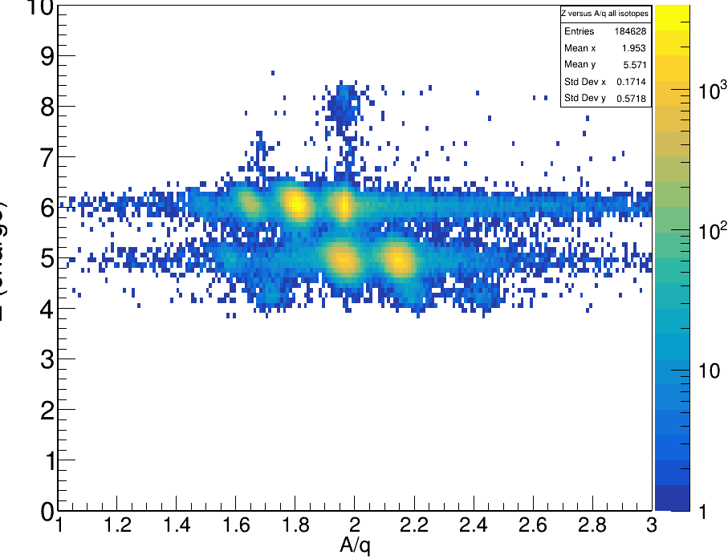
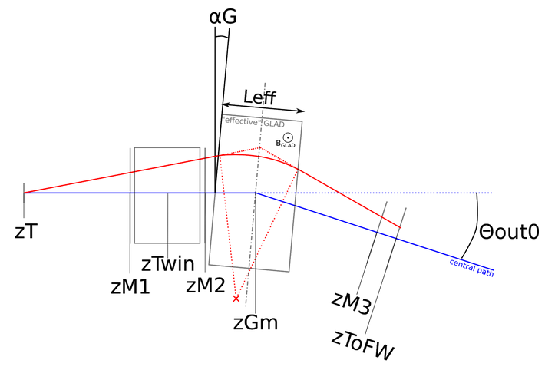
Fragment Particle Identification
Flightpath reconstruction:
¹²C
¹¹C
Z (TWIM)
Radius reconstruction:
¹⁰B
¹¹B

Slide 25
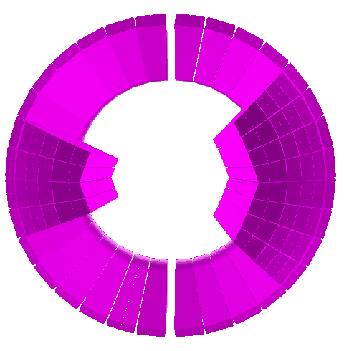
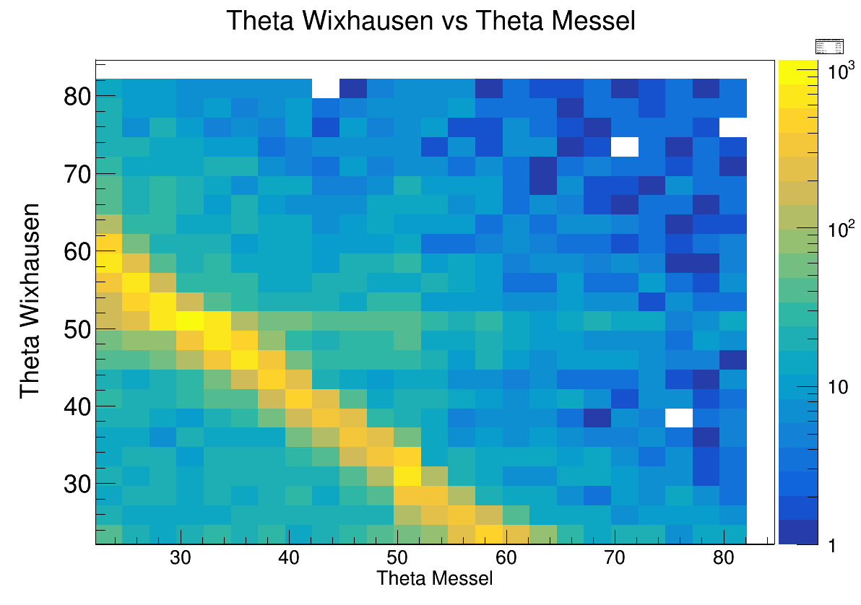
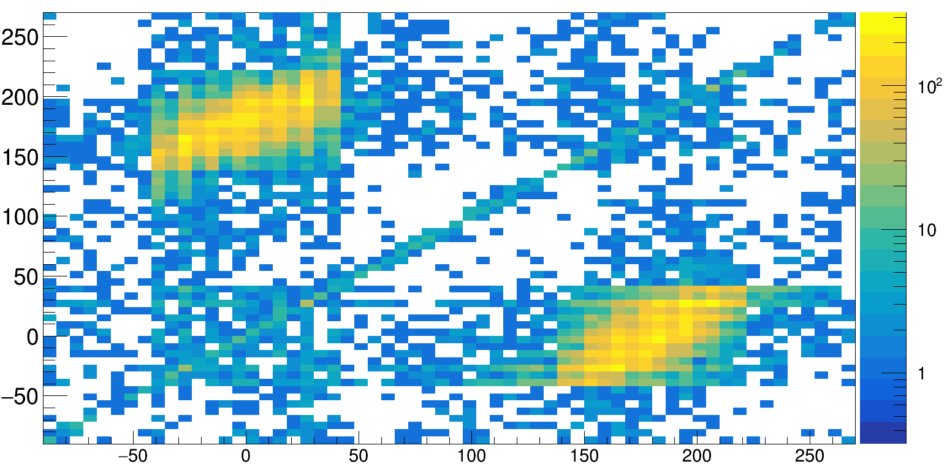
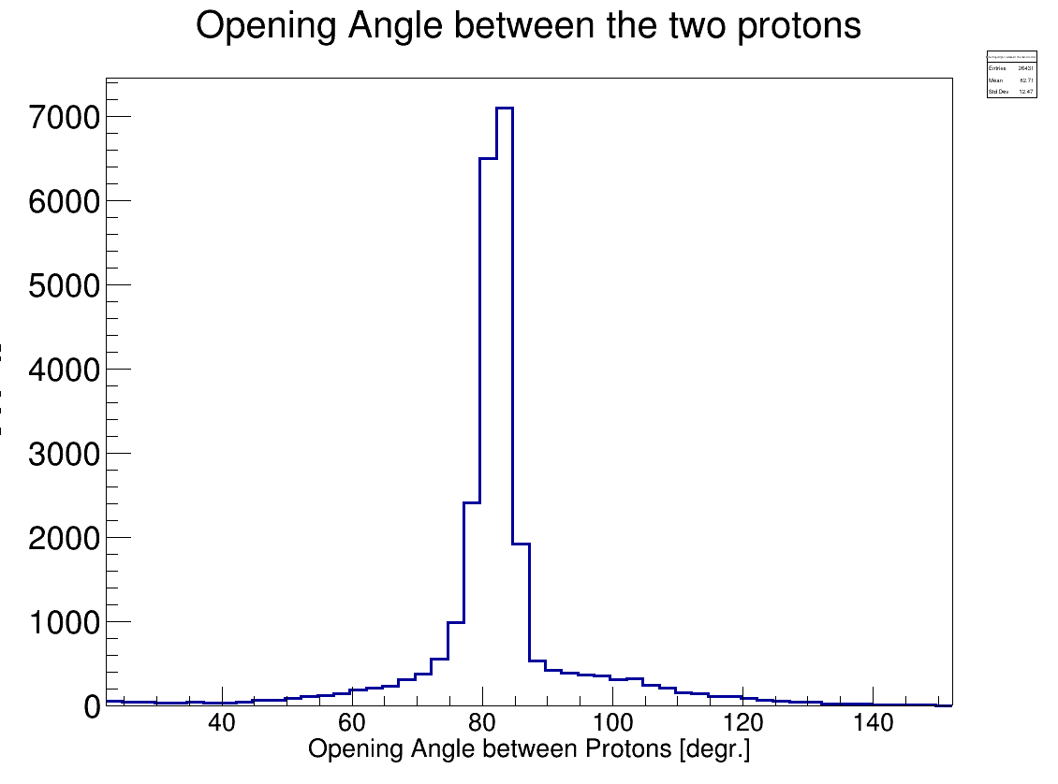
Identification of the two correlated Protons
CALIFA Front View
CALIFA Side View
Polar Angle of p₁ and p₂
Θ proton 2
beam
Azimuthal Angle Proton 1 vs Proton2
Θ proton 1
φ₂[degrees]
Tobias Jenegger
φ₁[degrees]
φ₁[degrees]

Slide 26
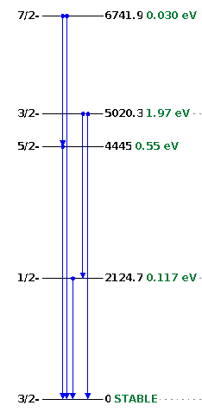
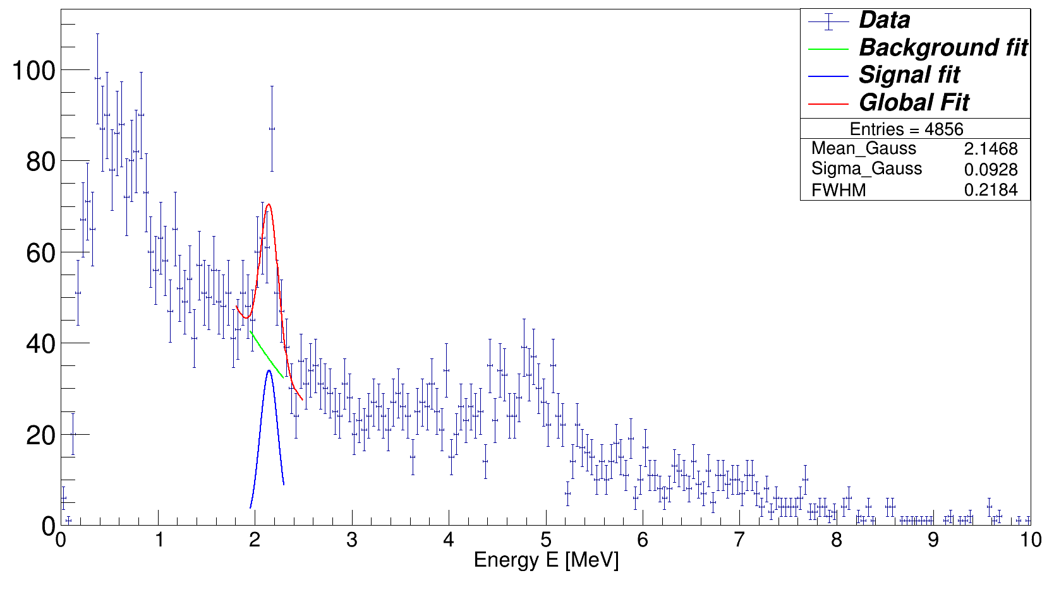
Gamma Spectrum of ¹¹B
Doppler Corrected Gamma Spectrum
2.1 MeV (1/2-) p-hole state
5.0 MeV (3/2-) p-hole state
7.3 MeV (5/2+) p-hole state
Event Selection Criteria:
¹¹B fragment identification
Two hits (protons) with E_{hit} > 30 MeV
θ1 + θ2 < 90°
Δφ = 180° +- 40°

Slide 27
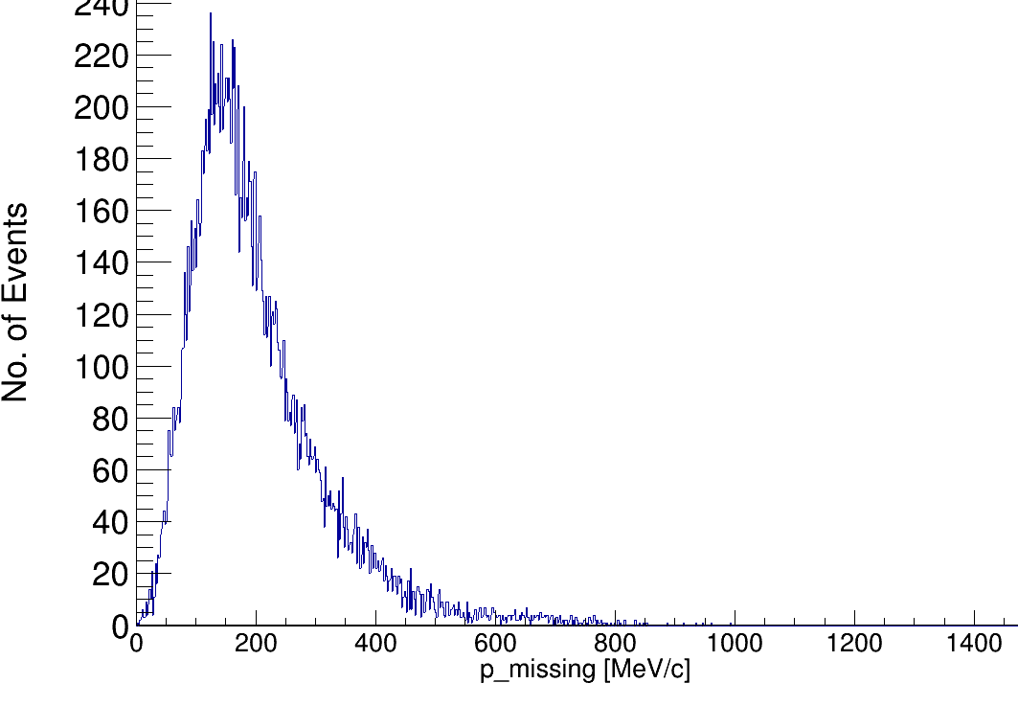
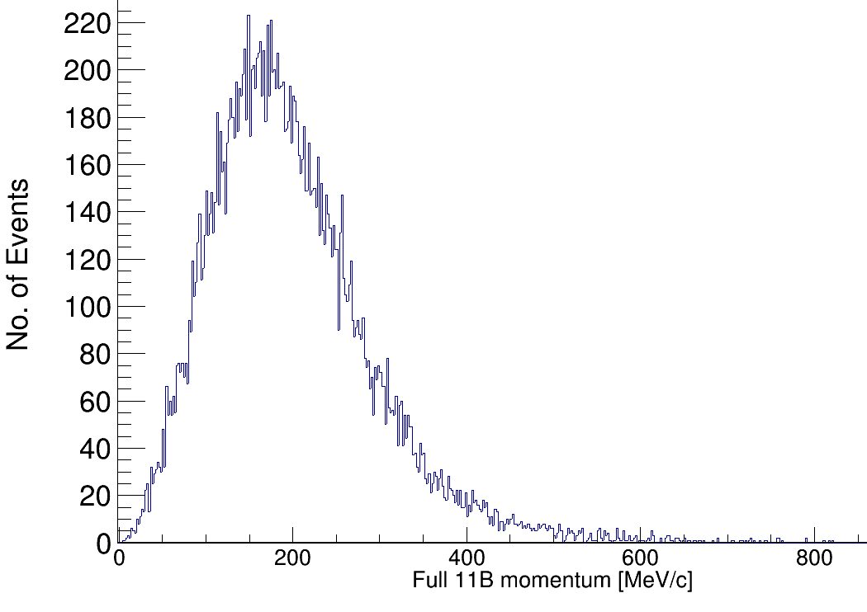
Reconstruction of Inner Momenta
Before Scattering:
After Scattering:
Before Scattering:
After Scattering:
p₁
p₁
p_{i}
p_{tg}
p_{i}
p_{tg}
Spectator!
p_{11B}
p₂
p₂
nucleon momentum inside ¹²C
¹¹B momentum inside ¹²C
(Four-)Momentum conservation relation:
assuming QE scattering in mean field potential:

Slide 28
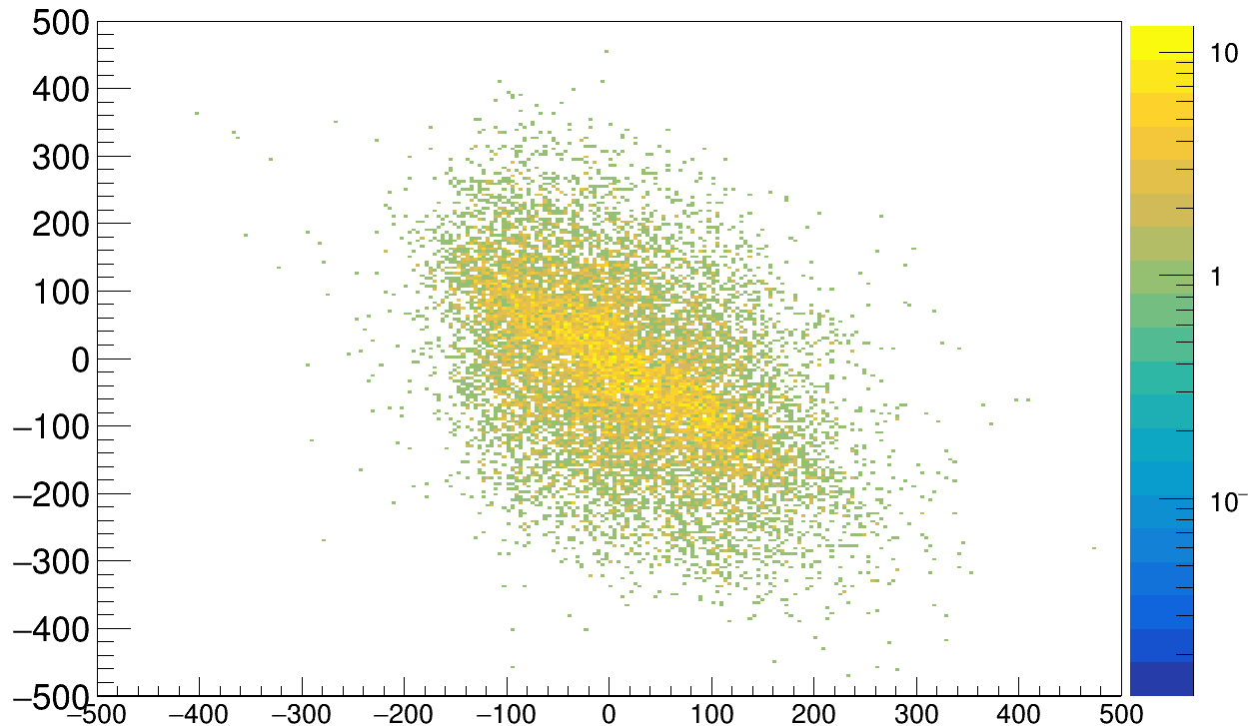



Correlations between Fragment and Proton Pair
x-component correlations
(p₁+p₂)_{x} in lab system
(p¹¹B)_{x} in lab system
y-component correlations
(p₁+p₂)_{y} in lab system
cos( γ )
Tobias Jenegger
(p¹¹B)_{y} in lab system

Slide 29

Proton Separation Energy of 12C
target
S_{p} = Energy needed to remove one proton from the nucleus
In direct kinematics it would be:
E₂
elastic pp - scattering
qfs scattering proton on ¹²C
qfs scattering ¹²C on ¹²C
16 MeV
16 MeV
E₁
no tracker in target region

Slide 30




12C(p,2p)¹¹B/¹⁰B Cross Section Measurements
Selection Cuts:
→ strict event selection in front of target
→ 2 hits in CALIFA with E_{1/2} > 30 MeV
→ Δφ = 180 +- 40°
→ Boron as Fragment (Z = 5)
Azimuthal Angle Proton 1 vs Proton2
uncalibrated charge
CALIFA only 35% filled in forward region → large correction factors
Cross sections im mbarn
VERY PRELIMINARY !!
Source: Valerii Panin, Thesis 2012

Slide 31
What else can we analyse with the S444 Experiment ?

Slide 32




Total Reaction cross section – Lukas Ponnath
Survival Probability:
Using the Transmission Method:
N₁
N₂

Slide 33


Comparing the two Setups
Setup - Lukas
S444 (2020) Setup → with carbon target
Acceptance issues due to the beam pipe confinement
High acceptance:
→ charge measured right after target by TWIM Music
→ no beam pipe ( = no vacuum) restrictions
more background
Fine tuned acceptance corrections needed
Convenient setup to compare with Lukas’ results

Slide 34





Starting with Charge Changing Cross Section
Why not starting directly with total reaction cross section measurement?
Z = 6
VERY PRELIMINARY !!
R3BMusic
N₁
TWIM Music
N₂
target
??

Slide 35


What more ?
12C-12C inelastic reaction
background
plastic target
carbon target
Gamma Spectrum in Lab. System
2+
4.4439 MeV
⁴⁰K (1460 MeV)
0+
²⁰⁸Pb (2.614 MeV)
Doppler corrected spectrum: reaction in incoming ¹²C

Slide 36

Summary and Outlook
Hopefully ChatGPT will know CALIFA soon !
STAY TUNED !

Slide 37



CALIFA @ Technical University of Munich (TUM)
Roman Gernhäuser, Lukas Ponnath, Philipp Klenze, Stefan Eder, Tobias Jenegger
Thank you!

