Slide 1



Optimizing -Detection in R3B
Bachelor’s student at TU Munich
Prof. Dr. Laura Fabbietti, Dr. Roman Gernhäuser
Advisors: Tobias Jenegger, Lukas Ponnath
GSI: Dr. Leyla Atar, Philipp Klenze
Stefan Eder

Slide 2
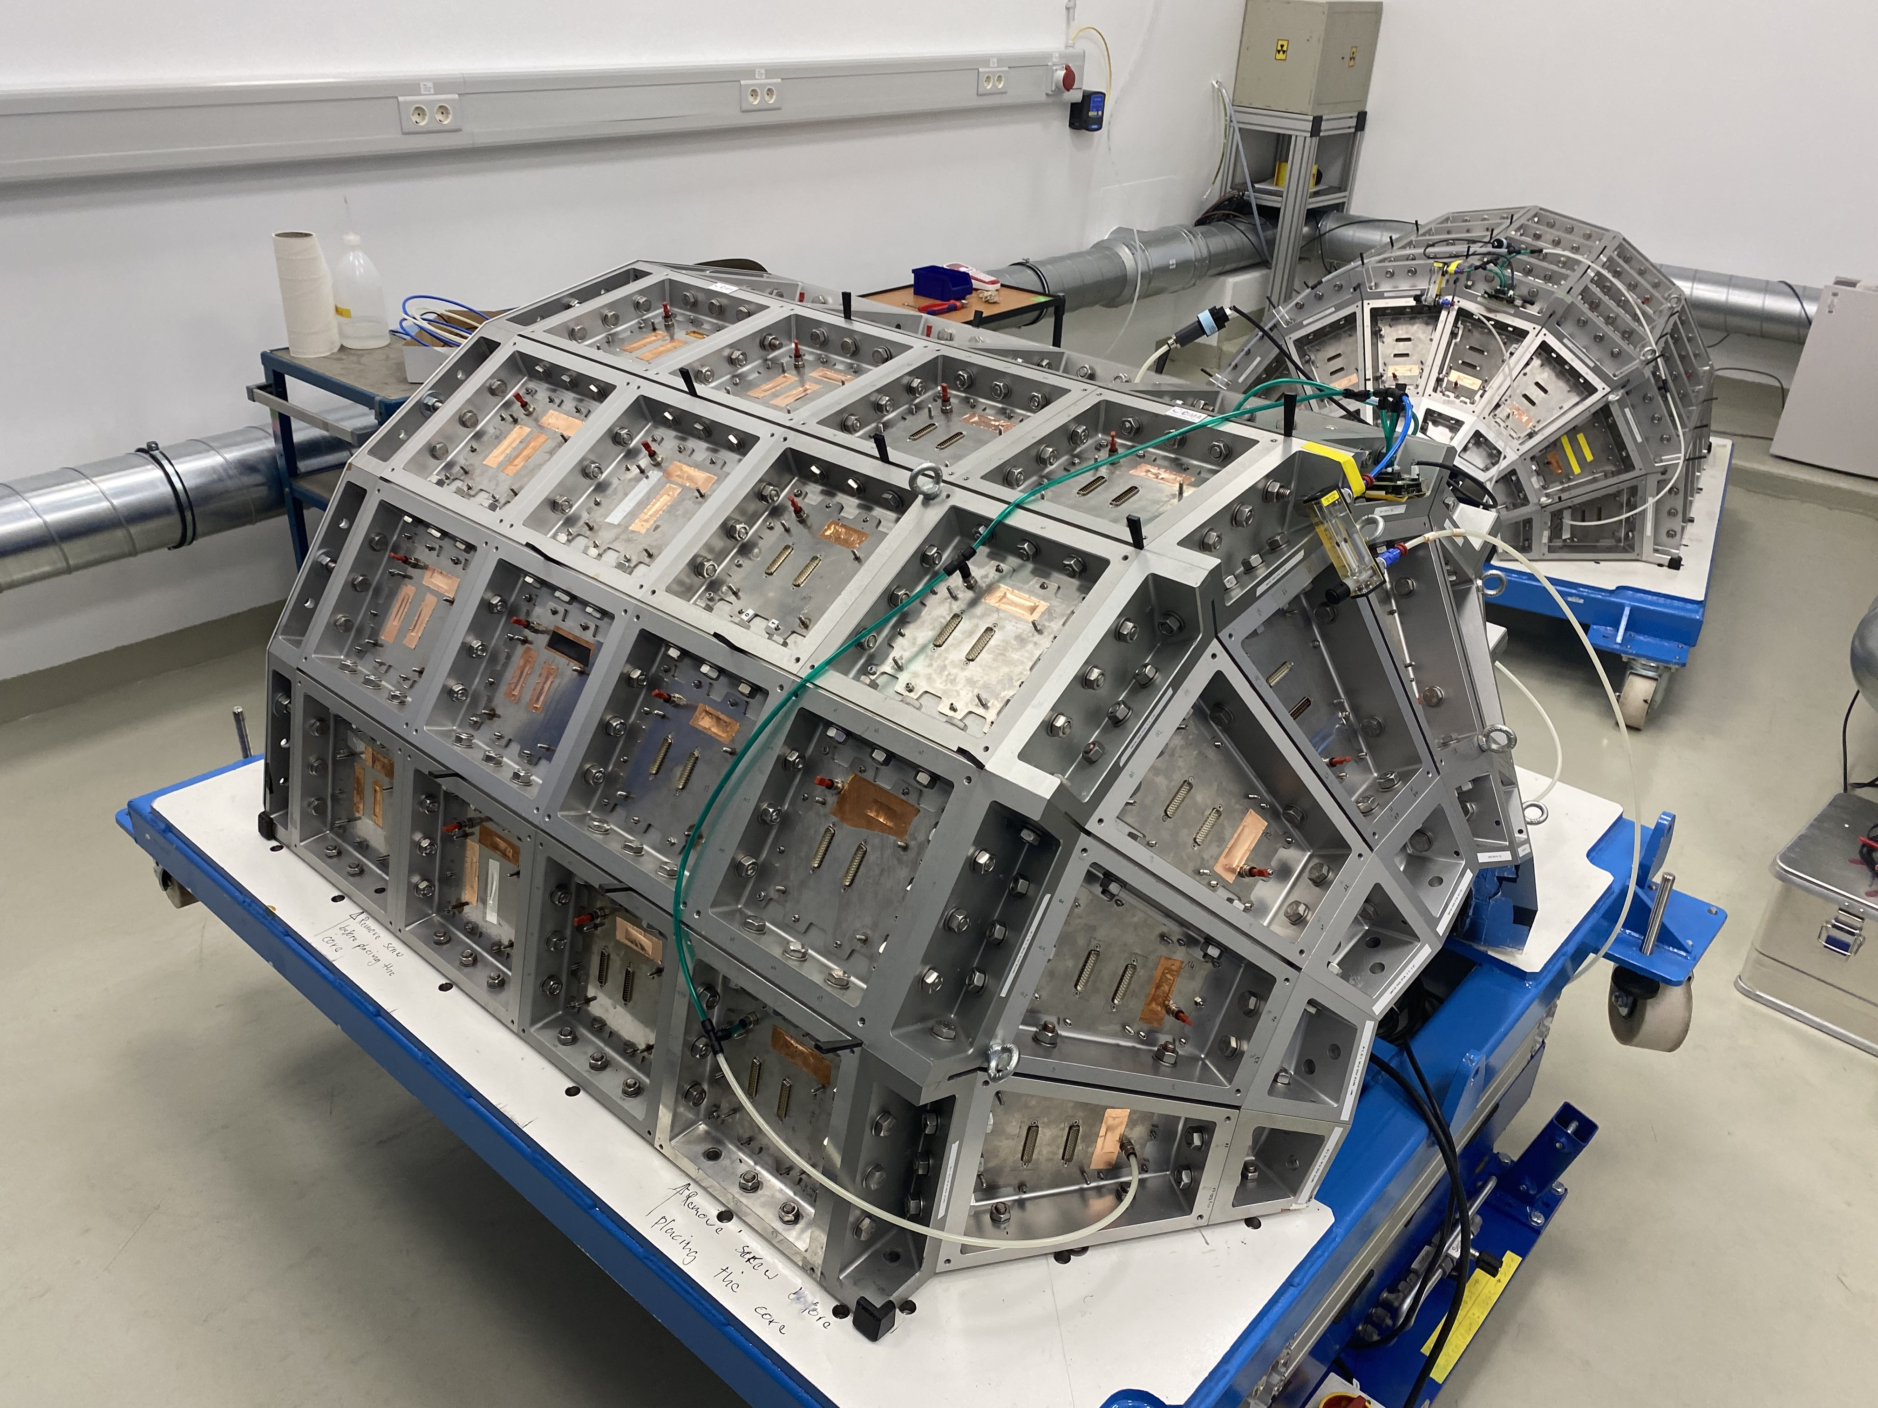
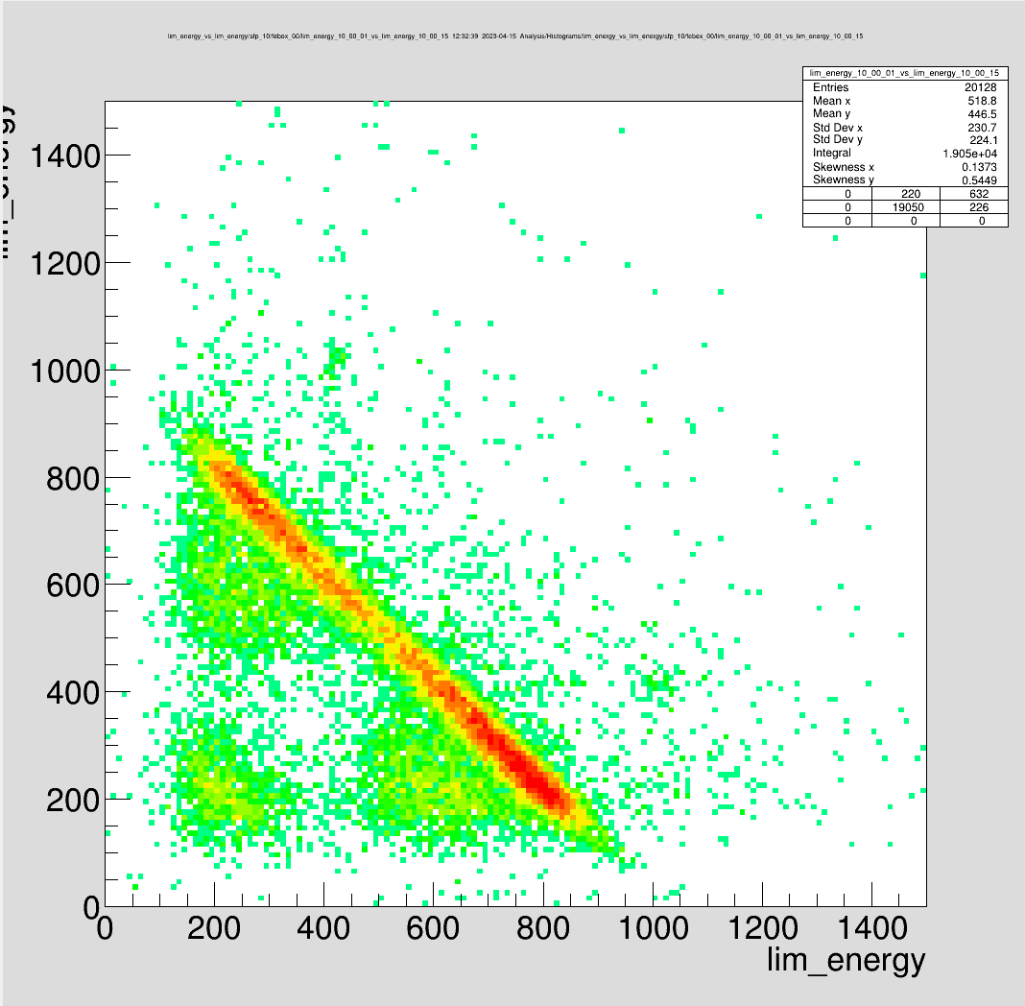
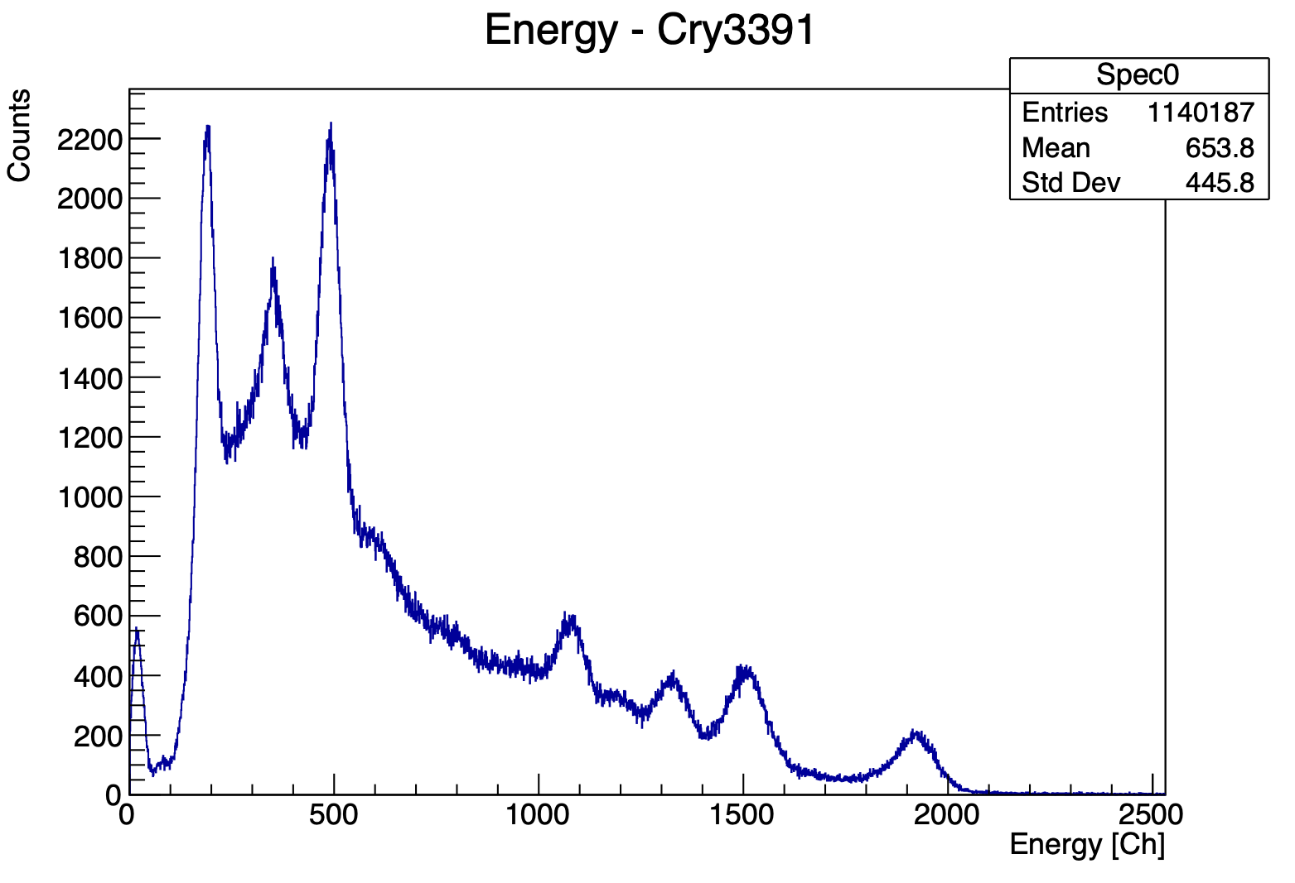
Outline
1
Situation
Importance of thresholds
Investigating Signal Improvements
What comes next?
APD
Pre-Amplifier
Febex
Crystal
Stefan Eder
Budapest Collaboration Meeting
May 2023

Slide 3
Situation
2
State of CALIFA
Current Noise Profile
Stefan Eder
Budapest Collaboration Meeting
May 2023

Slide 4
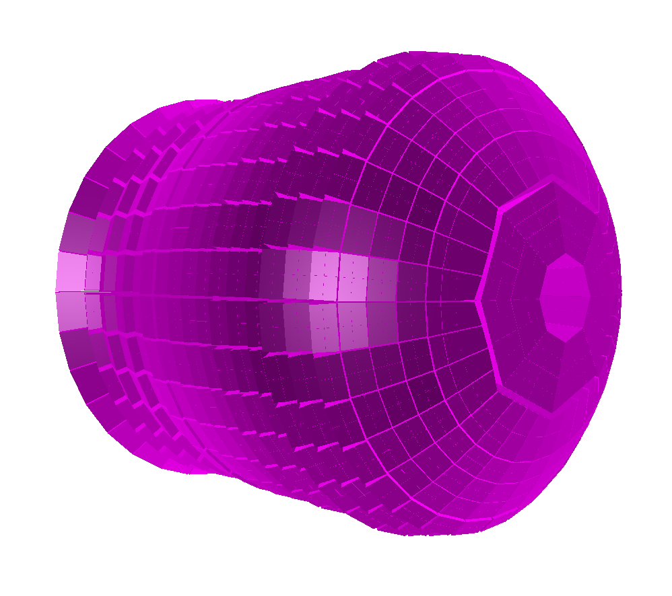
Situation
3
State of CALIFA
Dismounted Wixhausen and Messel halfs
Row 3 and 4 in the barrel-region
Full IPhos Row 5
=> Improvement analysis before next experiments
and the CEPA-upgrade

Slide 5
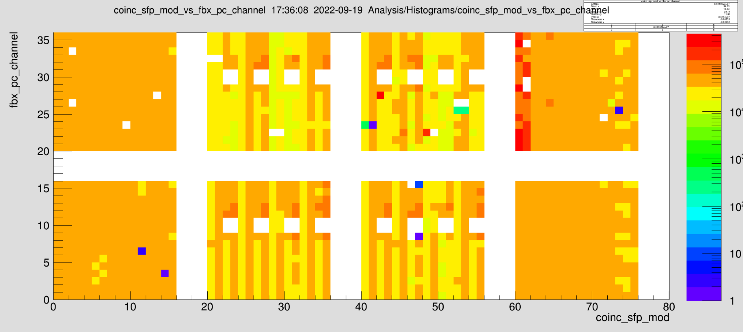
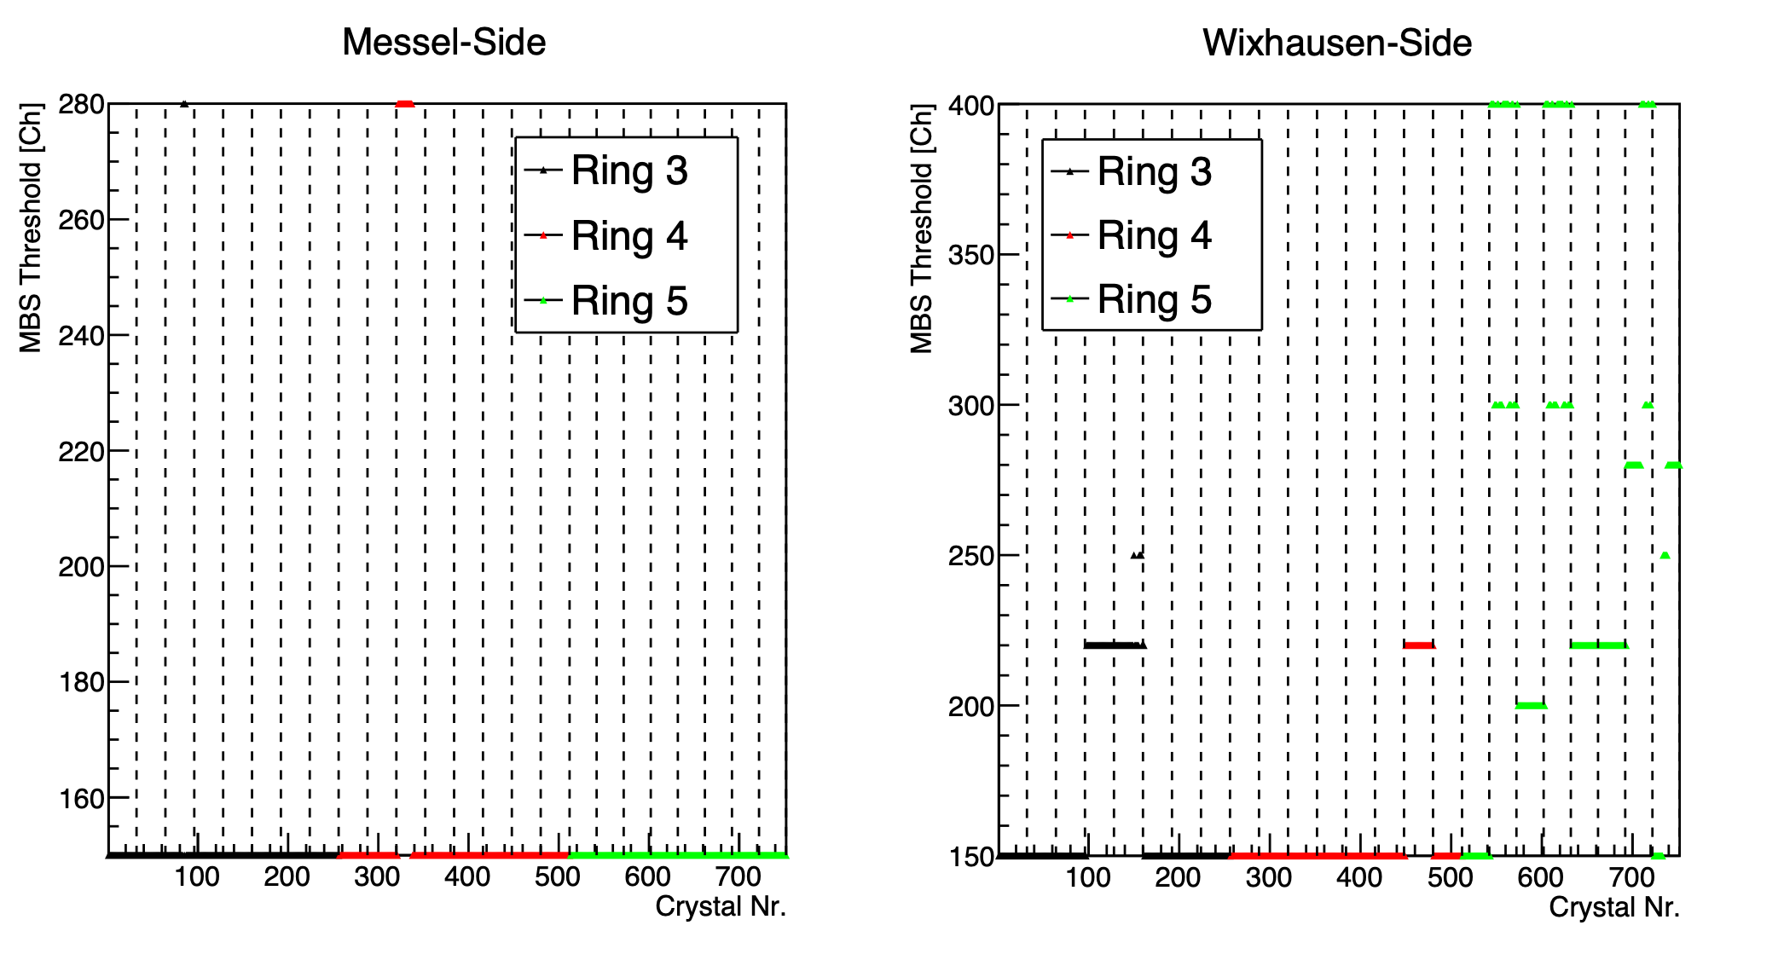
Situation
4
Current Noise Profile
=> Good and bad barrel Crystals
=>IPhos Crystals are rather noisy
=> Wixhausen-side is in general worse and therefore needs higher thresholds
Crystal-Channel
Crystal - Complex

Slide 6
Importance of Thresholds
5
Thresholds and Triggers
Add-back
- Spectroscopy
Stefan Eder
Budapest Collaboration Meeting
May 2023

Slide 7
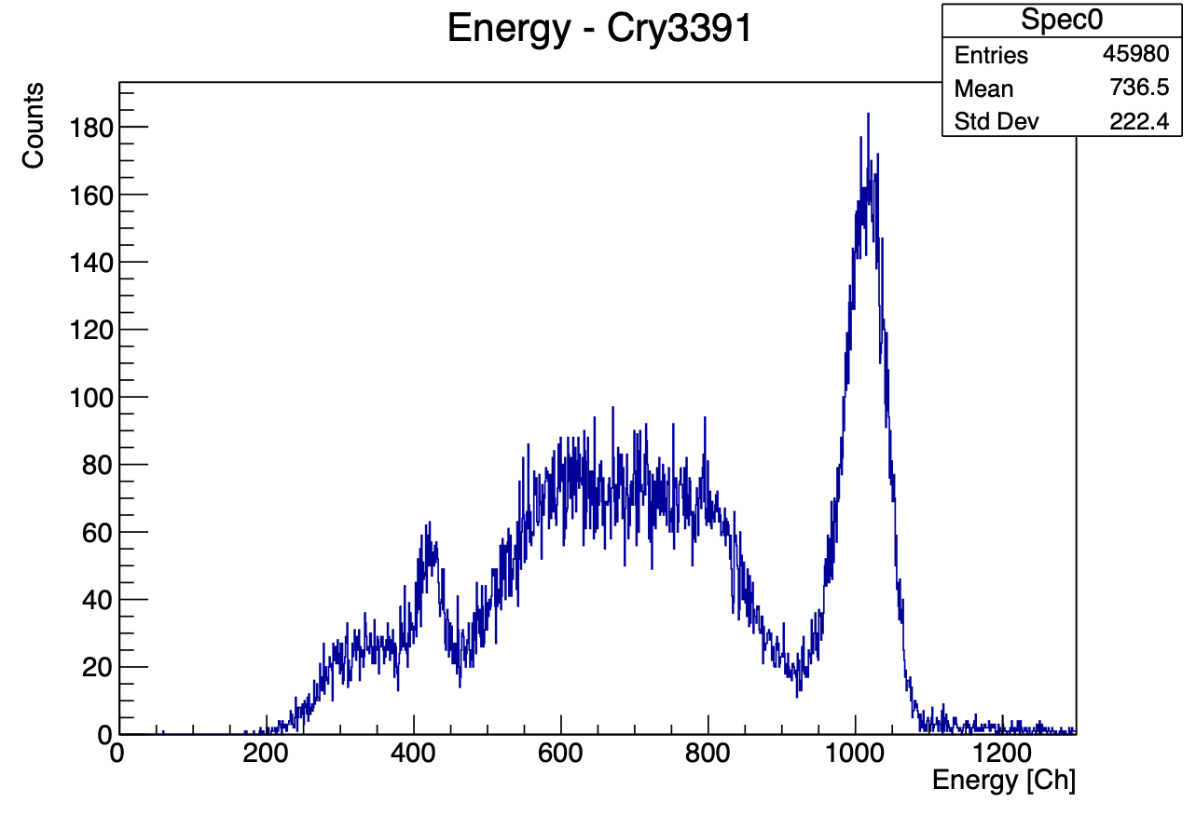
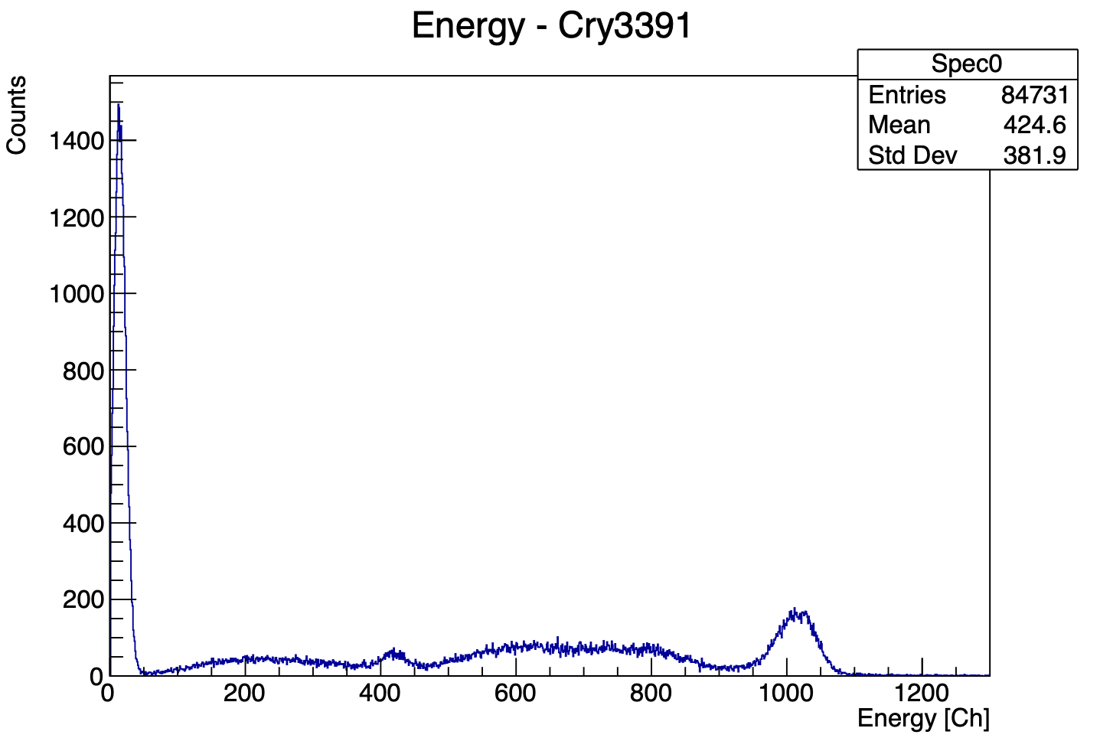
Importance of Thresholds
6
Na22
Thresholds and Triggers
Self-validation with the timing trigger if the energy surpasses the timing threshold
External validation with an external trigger if the energy of a neighboring crystal surpasses the proton threshold
=> Reduce data (signal disturbance)
=> Allows to analyze coincidences between different crystals
Timing Threshold
(Proton Threshold)
External validation
Na22
511keV
1275keV
Noise: Integral 0-50 Ch / Entries

Slide 8
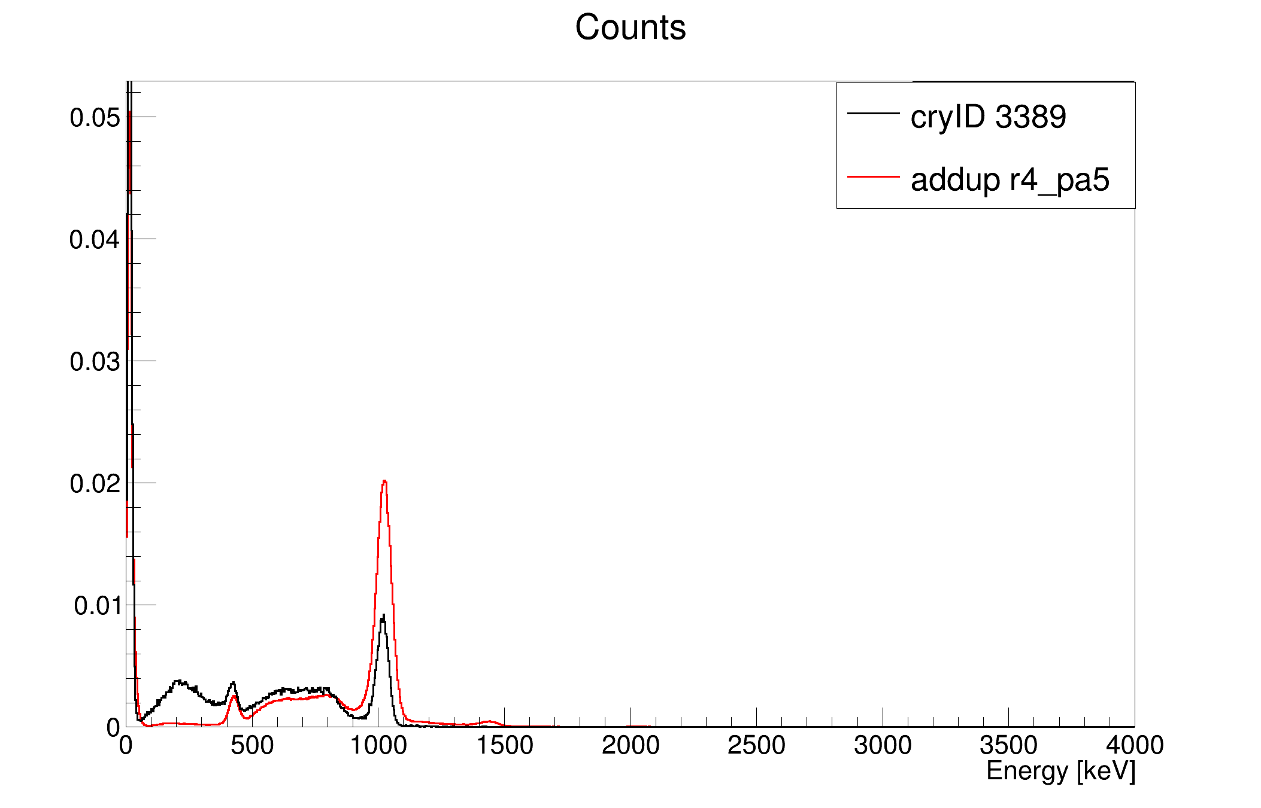
Importance of Thresholds
7
Add-back
Energy [Ch]
Photons are not placing all their energy in one crystal
Bremsstrahlung and Compton-Scattering leads to the energy-splitting
Add-back allows to recreate the full energy of the particle by adding over all the energies in crystals around a high-energy detection
Energy [Ch]
1275 keV

Slide 9
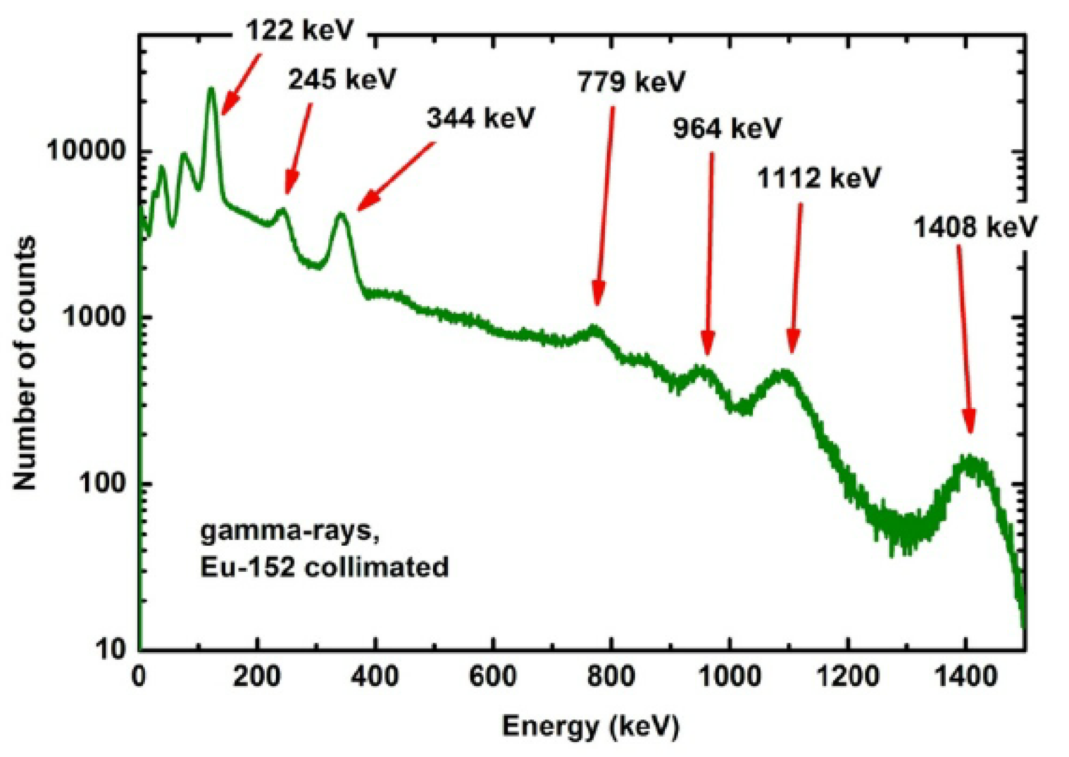
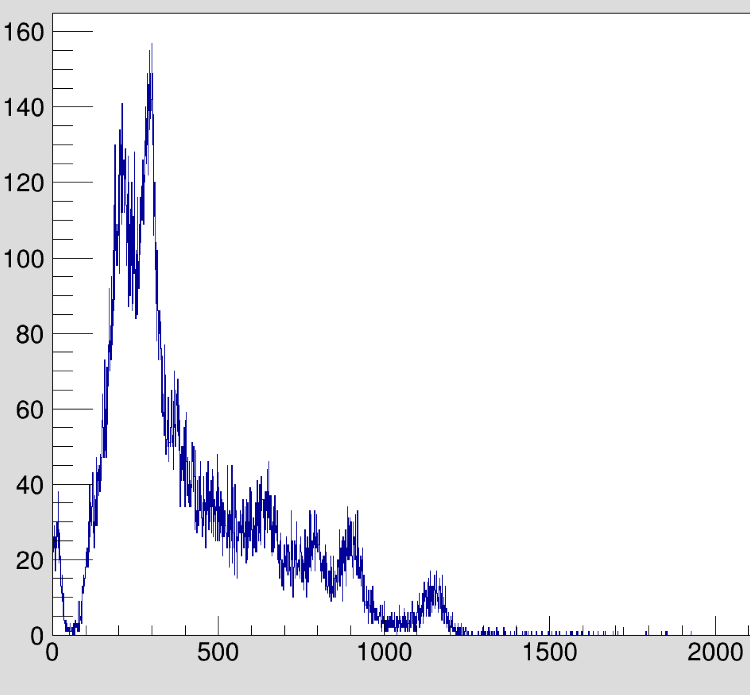
Importance of Thresholds
8
- Spectroscopy
Many spectra contain energies below the current thresholds
Managing data reduction and energy-limit with the timing threshold
=> Optimizing the signal by reducing disturbance allows measurements of low energies
Number of counts
Energy [Ch]

Slide 10
9
Investigating Signal Improvements
Gain
Cabling
Crystals
Pre-Amplifiers
APD
Pre-Amplifier
Febex
Crystal
Stefan Eder
Budapest Collaboration Meeting
May 2023

Slide 11
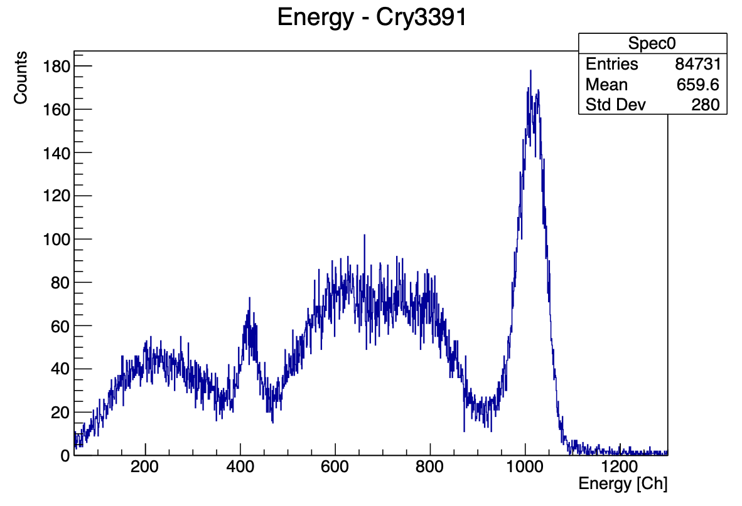
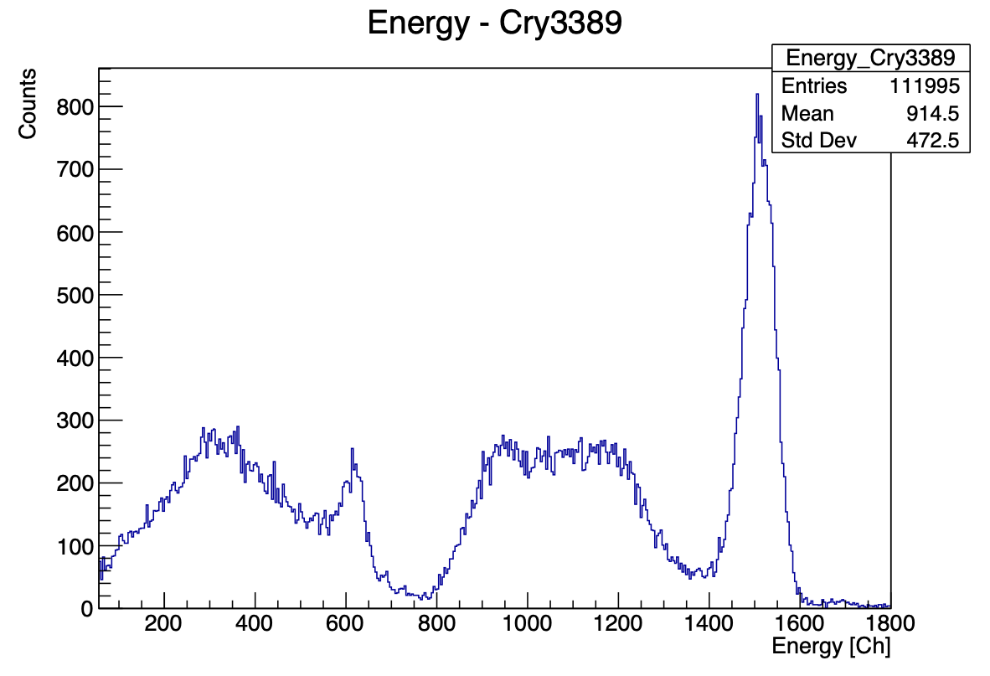
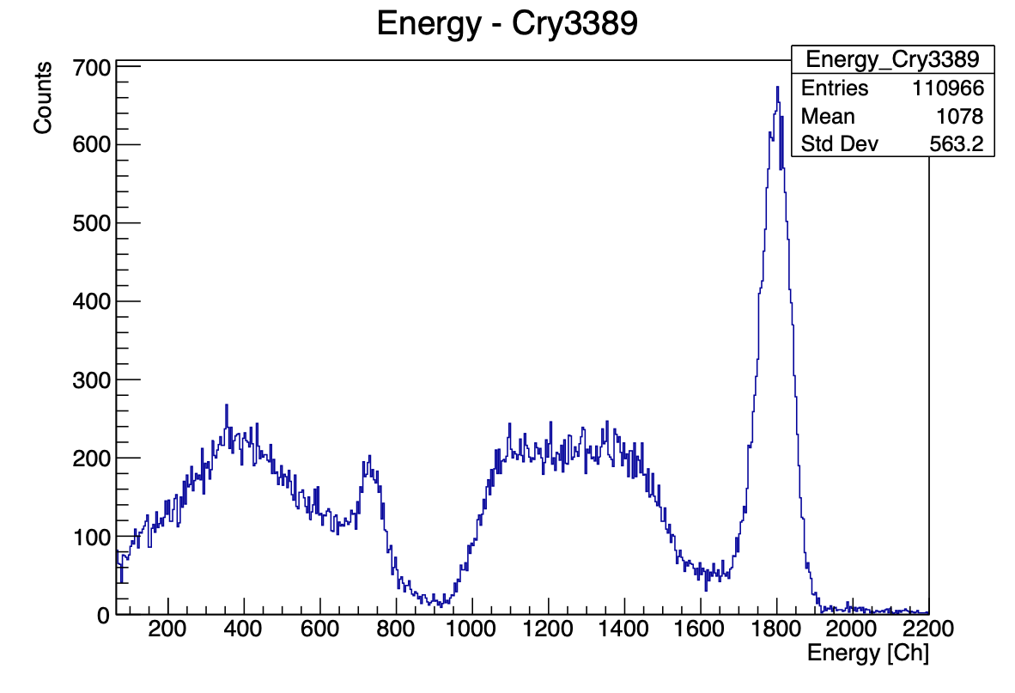
Investigating Signal Improvements
10
Gain
0.78
1.18
1.41
1000
1500
1800
(511keV) = 6.44 %
(1275keV) = 3.19 %
(511keV) = 5.63 %
(1275keV) = 2.82 %
(511keV) = 5.58 %
(1275keV) = 2.50 %
=> Heightening the gain leads to a better resolution while reducing the energy-range

Slide 12
11
Investigating Signal Improvements
Gain
Cabling
Crystals
Pre-Amplifiers
APD
Pre-Amplifier
Febex
Crystal
Data-Cables
Stefan Eder
Budapest Collaboration Meeting
May 2023

Slide 13
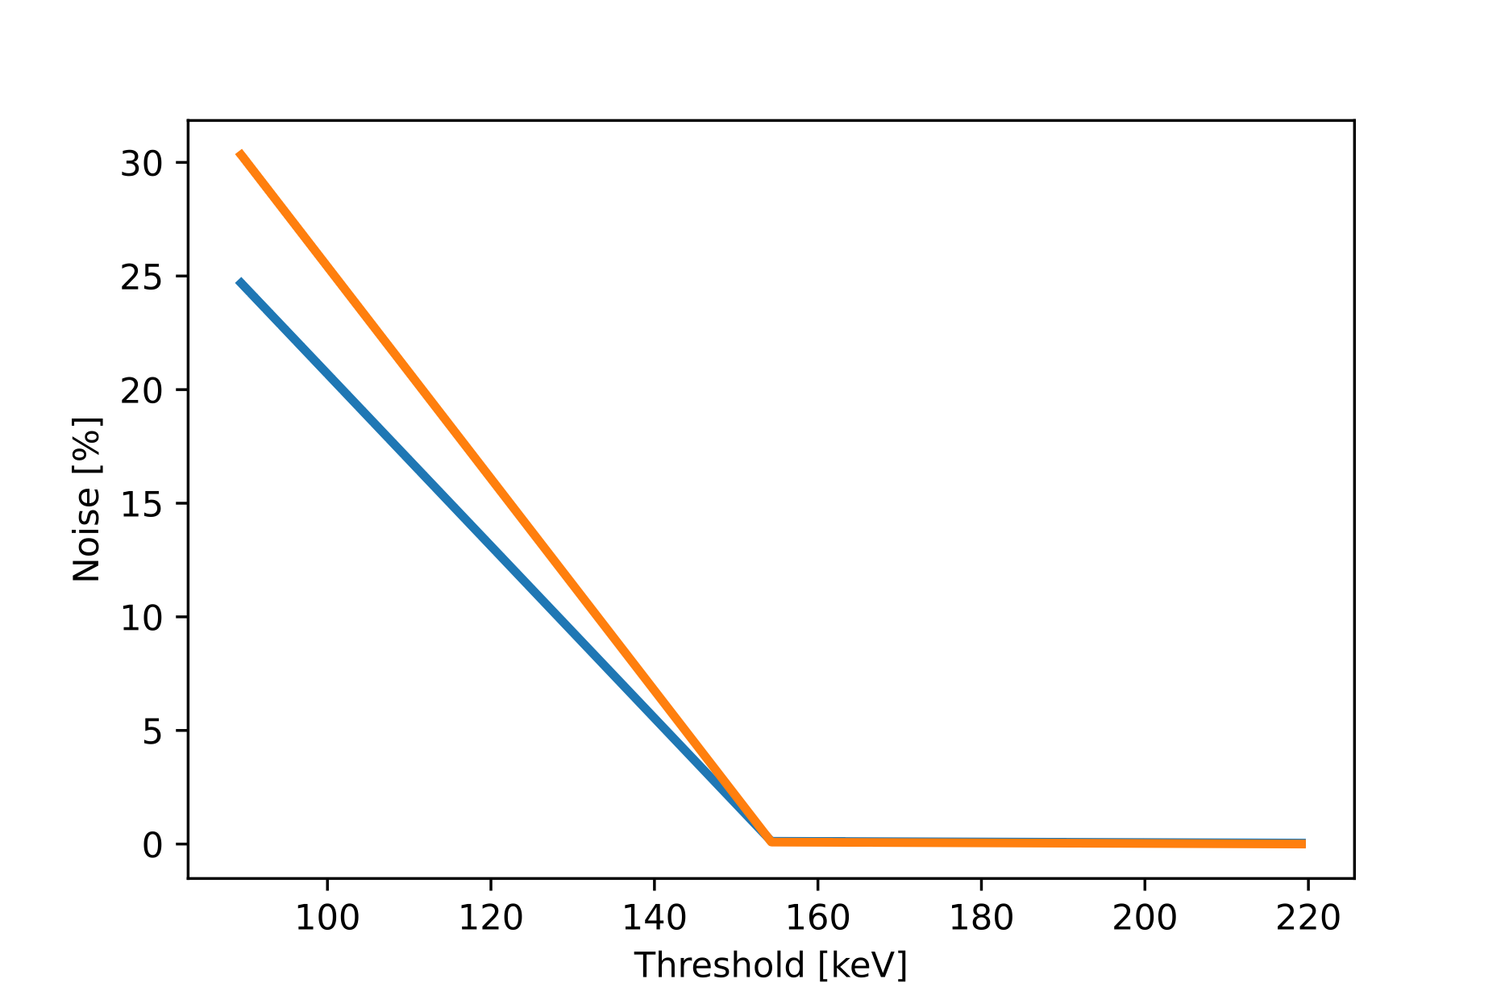
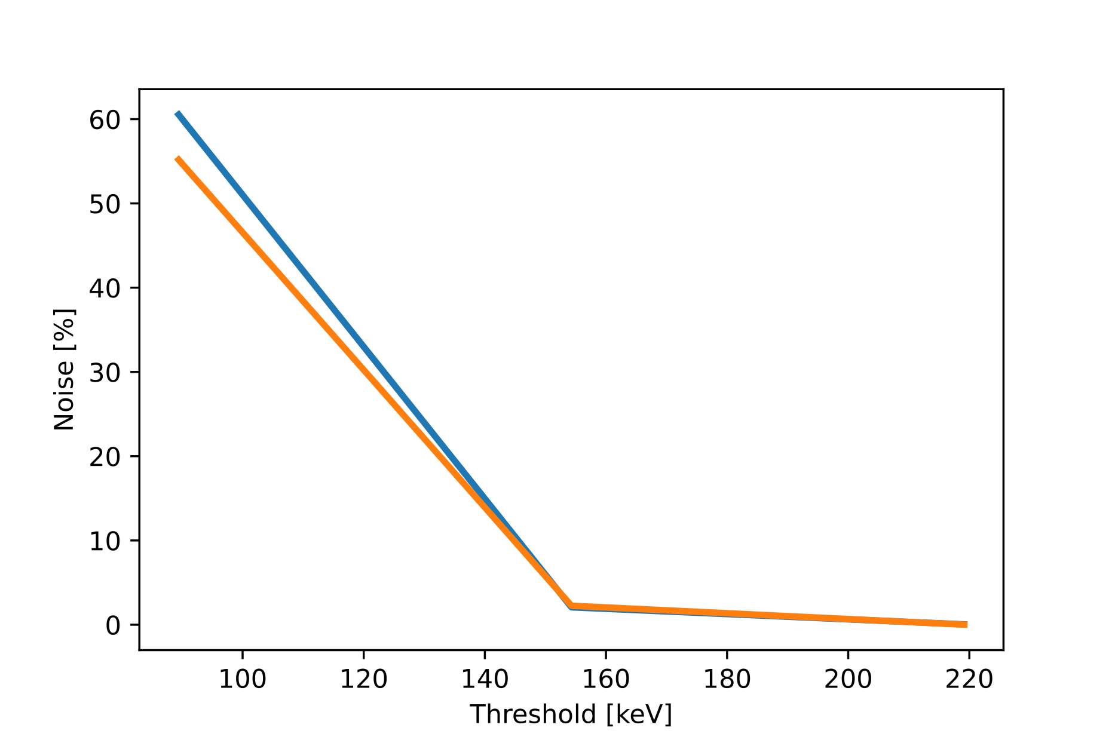
Investigating Signal Improvements
12
Cabling - Gain 0.78
DR R5PA1 @R3C9
DR R5PA5 @R4C5
64pin - Cables
64pin - Cables
32pin - Cables
32pin - Cables
=> No clear sign for signal improvement by changing the data - cables

Slide 14
13
Investigating Signal Improvements
Gain
Cabling
Crystals
Pre-Amplifiers
APD
Pre-Amplifier
Febex
Crystal
Stefan Eder
Budapest Collaboration Meeting
May 2023

Slide 15
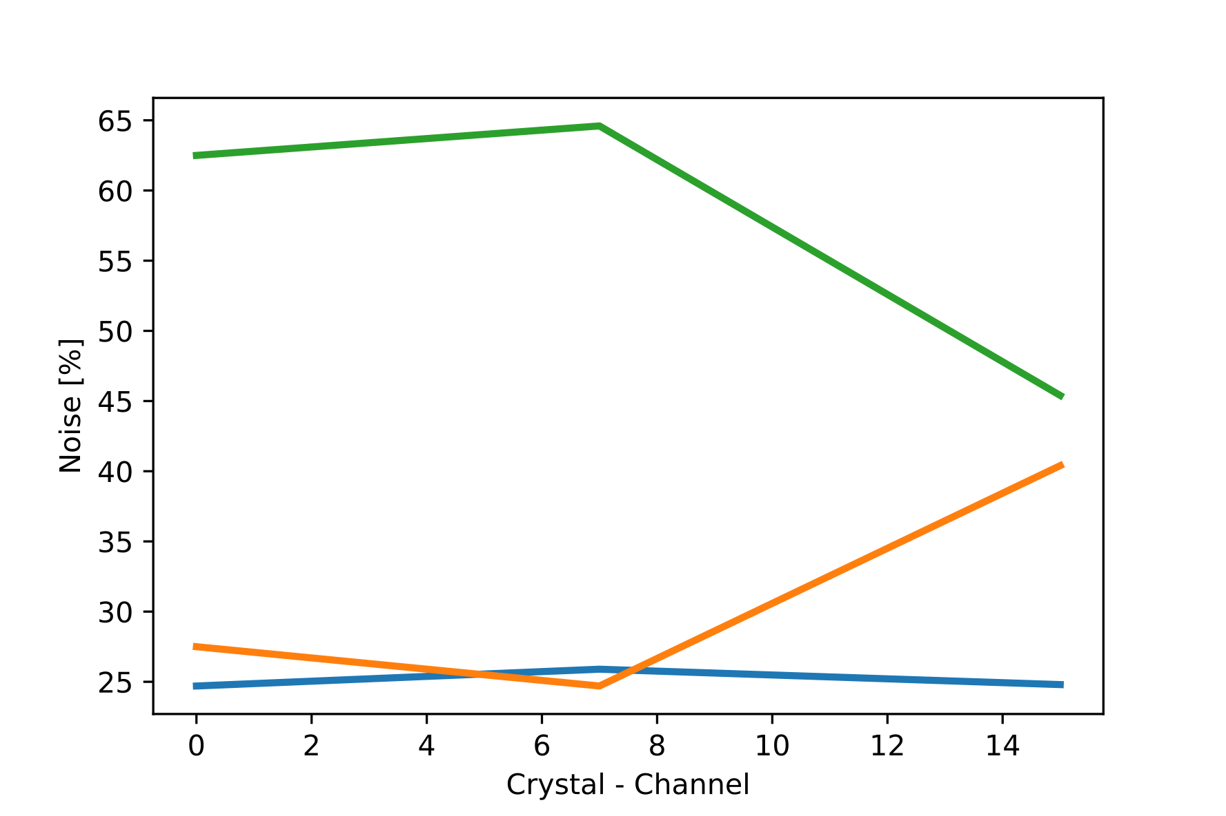
Investigating Signal Improvements
14
Crystals
=> Barrel crystals are with some channels as exception quite similar
=> Barrel crystals have less signal disturbance than IPhos
=> In general more difference between singular channels than between different Crystal-Complexes
IPhos
Bad Barrel
Good Barrel

Slide 16
15
Investigating Signal Improvements
Gain
Cabling
Crystals
Pre-Amplifiers
APD
Pre-Amplifier
Febex
Crystal
Stefan Eder
Budapest Collaboration Meeting
May 2023

Slide 17
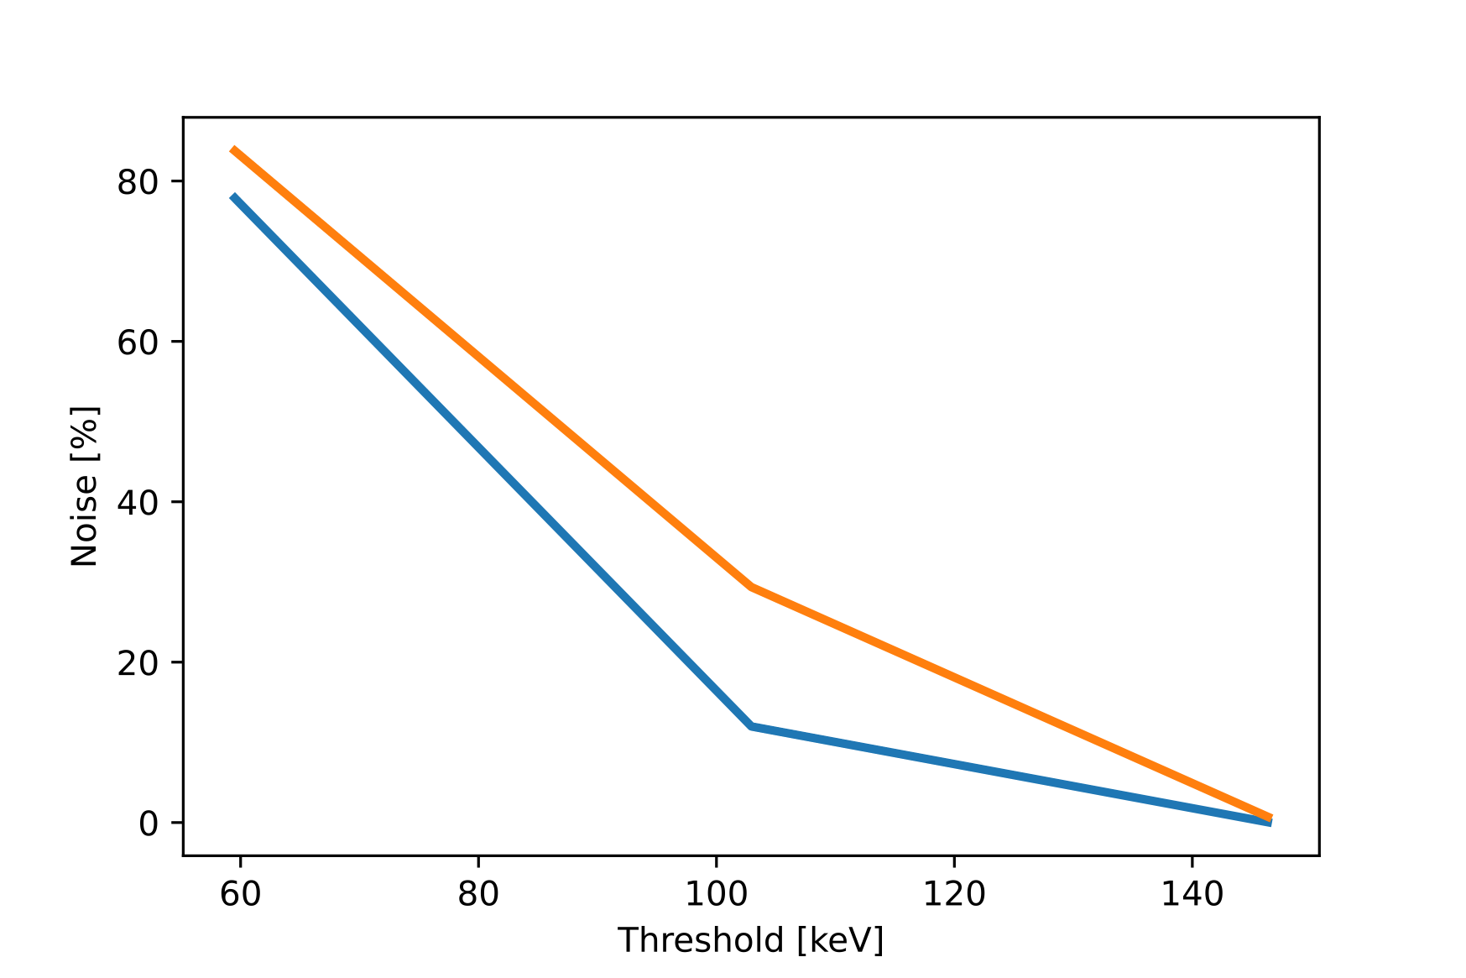
Investigating Signal Improvements
16
Pre-Amplifiers
Comparing SR and DR Pre-Amplifiers
IPhos: R5C16 @ Gain 1.18
DR
SR
=> DR Pre-Amplifiers
have more disturbance
than SR

Slide 18
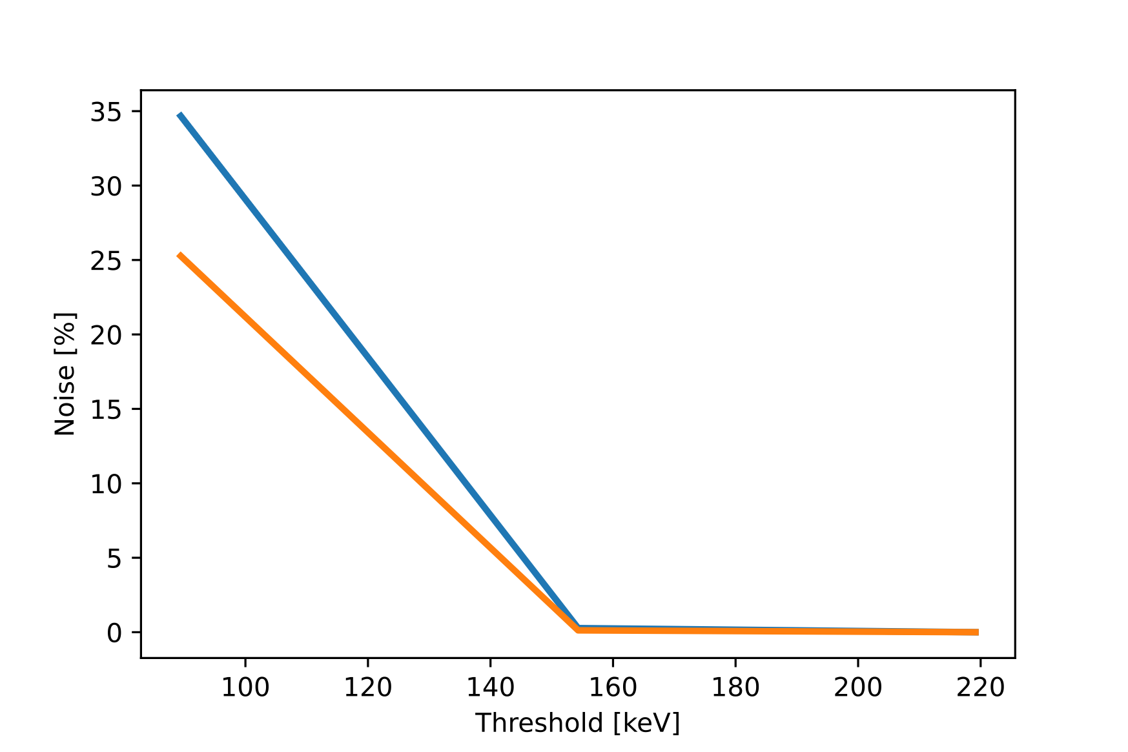
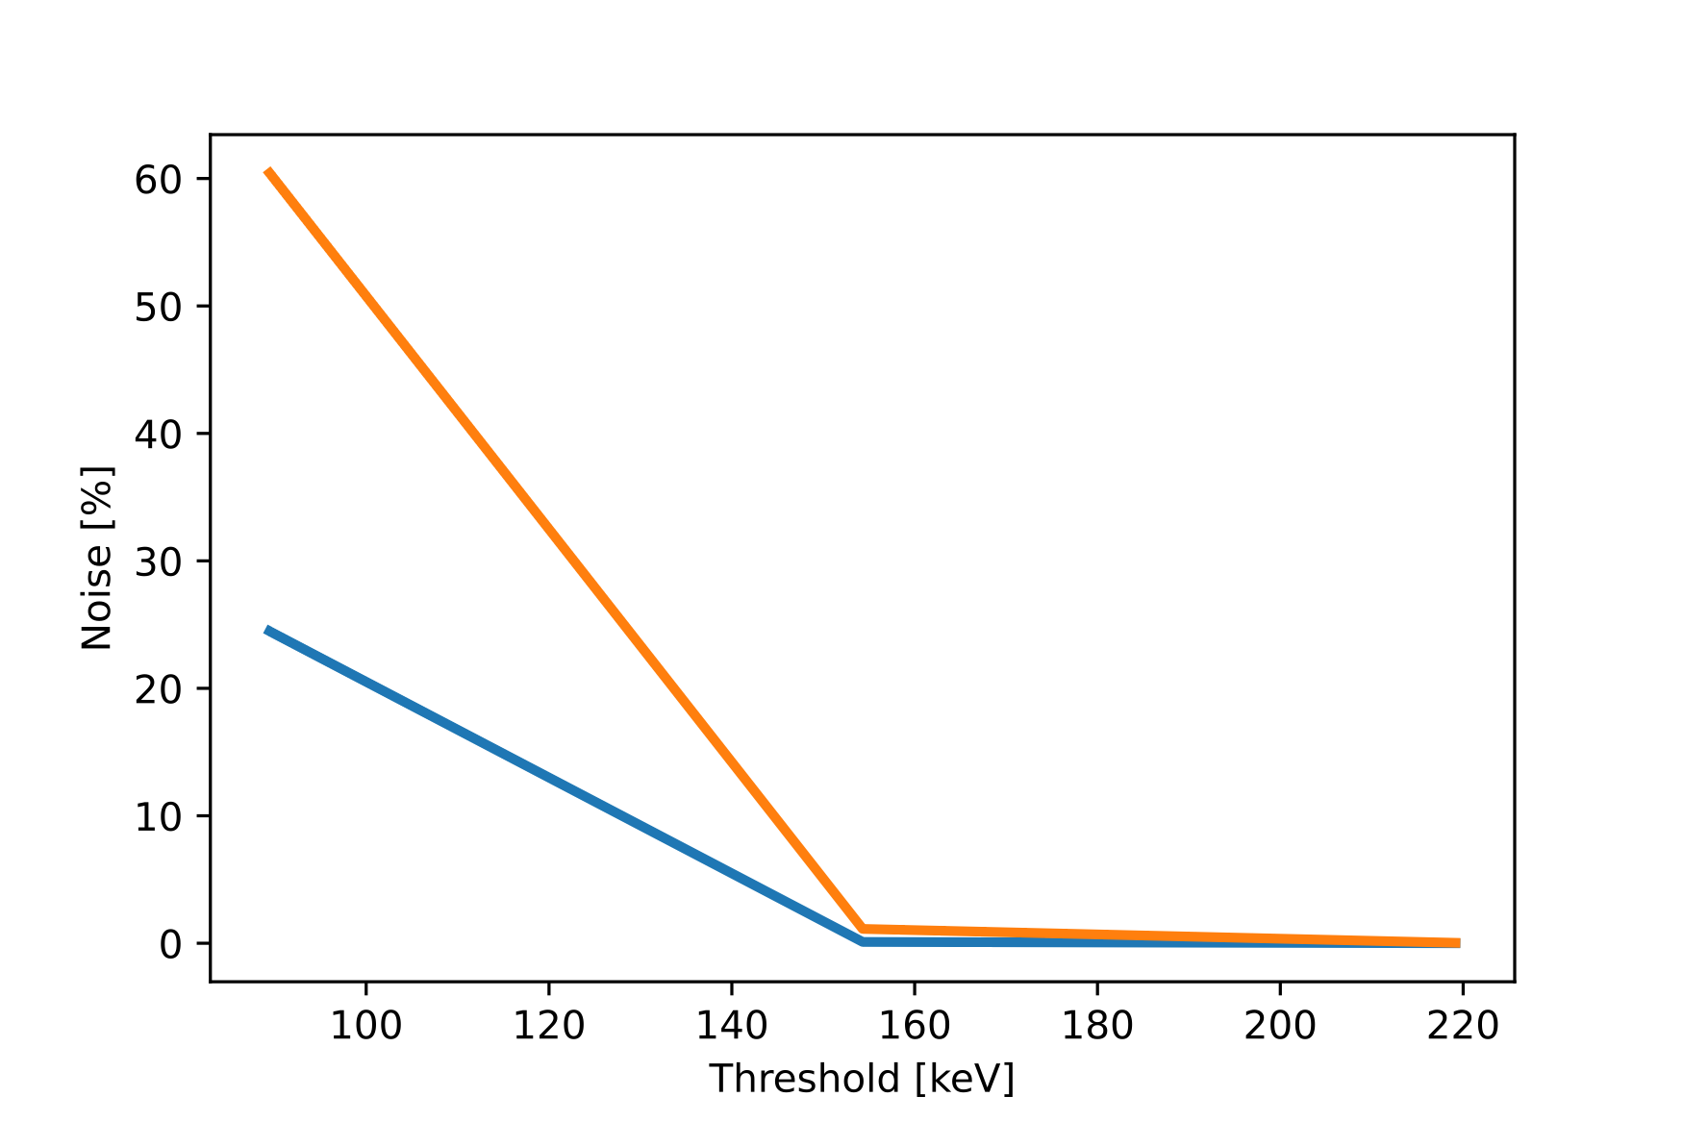
Investigating Signal Improvements
17
Pre-Amplifiers
Comparing SR and DR Pre-Amplifiers
Barrel: R3C9 & R4C5 @ Gain 0.78
R3C9
R4C5
SR
DR
(=> DR Pre-Amplifiers have more disturbance than SR?)

Slide 19
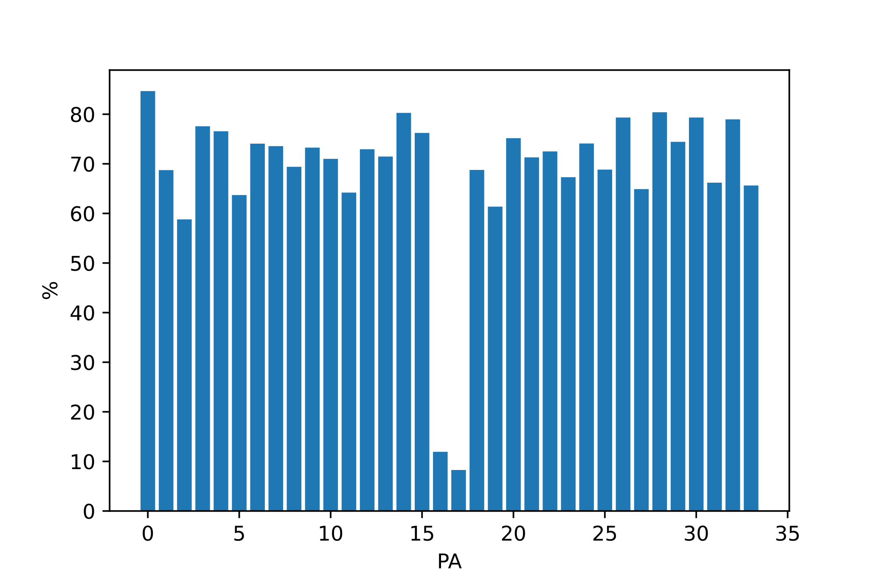
Investigating Signal Improvements
18
Pre-Amplifiers
Testing DR Pre-Amplifiers - Wixhausen @R4C5/6WIX
 | R5PA1 | R5PA2 | R5PA3 | R5PA4 | R5PA5 | R5PA6 | R5PA7 | R5PA8
Ch 0 | 12.17 % | 6.55 % | 62.86 % | 53.32 % | 74.27 % | 72.19 % | 70.24 % | 68.99 %
Ch 7 | 6.76 % | 10.47 % | 66.63 % | 64.22 % | 69.89 % | 71.36 % | 69.72 % | 63.23 %
Ch 15 | 16.84 % | 7.79 % | 76.79 % | 66.62 % | 66.62 % | 70.32 % | 77.57 % | 69.69 %
 | R5PA9 | R5PA10 | R5PA11 | R5PA12 | R5PA13 | R5PA14 | R5PA15 | R5PA16
Ch 0 | 73.30 % | 69.78 % | 76.22 % | 62.70 % | 80.33 % | 75.44 % | 78.69 % | 67.29 %
Ch 7 | 72.48 % | 64.02 % | 79.03 % | 61.24 % | 78.49 % | 70.97 % | 75.98 % | 61.02 %
Ch 15 | 76.53 % | 72.73 % | 82.80 % | 70.83 % | 82.37 % | 76.86 % | 83.35 % | 70.30 %

Slide 20
What comes next?
19
Further setup Analysis
Optimization for Measurements
Stefan Eder
Budapest Collaboration Meeting
May 2023

Slide 21
What comes next?
20
Further setup Analysis
Understanding the reason for reactions to microphonics
Systematic change of internal cables
What makes R5PA1/2 „magical“?
R3PA9 (SR) vs R5PA1 (DR) @R3C9
Timing threshold in Channel
Timing threshold in Channel
 | 100 | 150
Ch 0 | 36.05 % | 0.40 %
Ch 5 | 33.29 % | 0.15 %
Ch 10 | 25.13 % | 0.11 %
 | 100 | 150
Ch 0 | 24.689 % | 0.127 %
Ch 7 | 25.854 % | 0.117 %
Ch 15 | 24.835 % | 0.443 %

Slide 22
What comes next?
21
Optimization for Measurements
Gain 1.412 allowed at a timing threshold of
140 CH ~0.7% - 1.2% noise
Timing threshold 130 CH
~1.9% - 3.1% noise
=> At our goal of 1% noise we are at a threshold of ~95 keV
=> CALIFA can be operated differently for different desired measurements
=>Energy-range vs. resolution and thresholds

Slide 23
Thank you for your attention!
Stefan Eder
Bachelor’s student at TU Munich
Prof. Dr. Laura Fabbietti, Dr. Roman Gernhäuser
Advisors: Tobias Jenegger, Lukas Ponnath
GSI: Dr. Leyla Atar, Philipp Klenze

