Slide 1
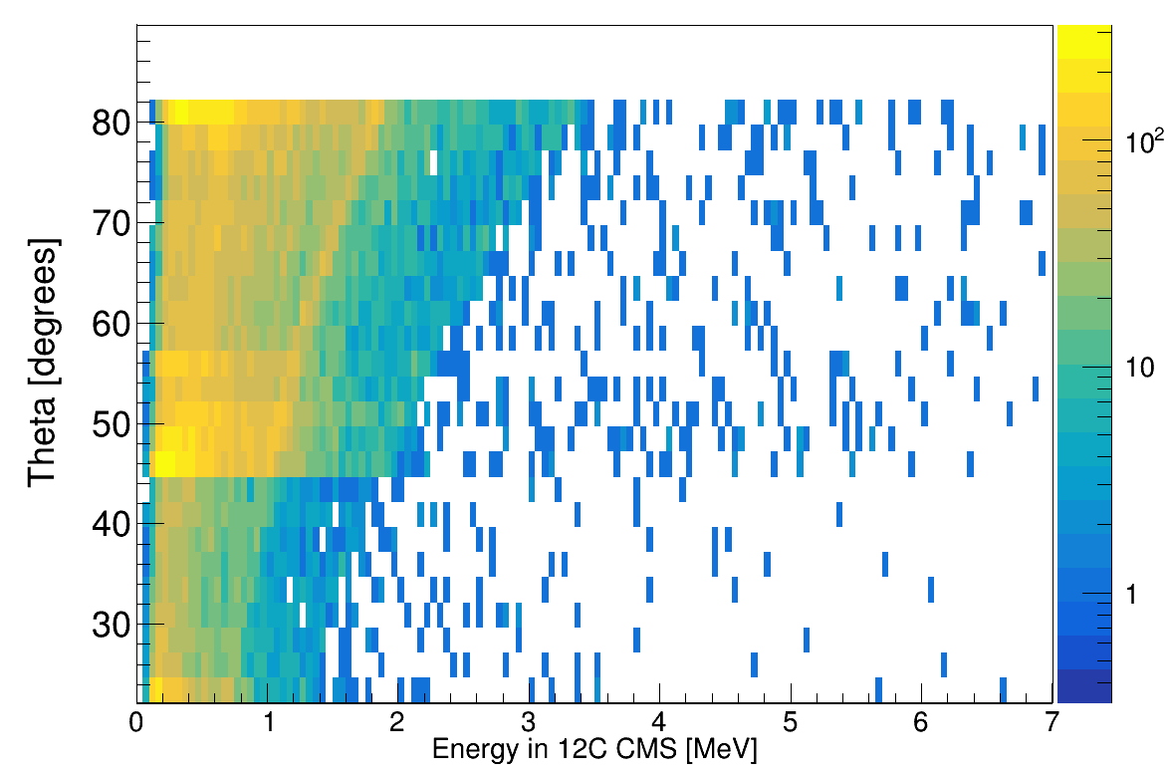
Doppler corrected Energy (400 AmeV) for 82° , Pb 2.614 MeV

