Slide 1






Particle Identification in R³B
R³B – Setup and Detectors
The CALIFA Calorimeter
Experiment Spring 2020
Fair at GSI
Tobias Jenegger
PSI Seminar
08.07.2020
Supported by BMBF 05P15WOFNA and 05P19WOFN1.
The results presented here are based on the experiment s444/s473, which was performed at the beam line/infrastructure Cave C at the GSI Helmholtzzentrum für Schwerionenforschung, Darmstadt (Germany) in the frame of FAIR Phase-0.
Physics with R³B
CALIFA – Design
TUM Members:
Roman Gernhäuser,Lukas Ponnath,Philipp Klenze,Tobias Jenegger

Slide 2
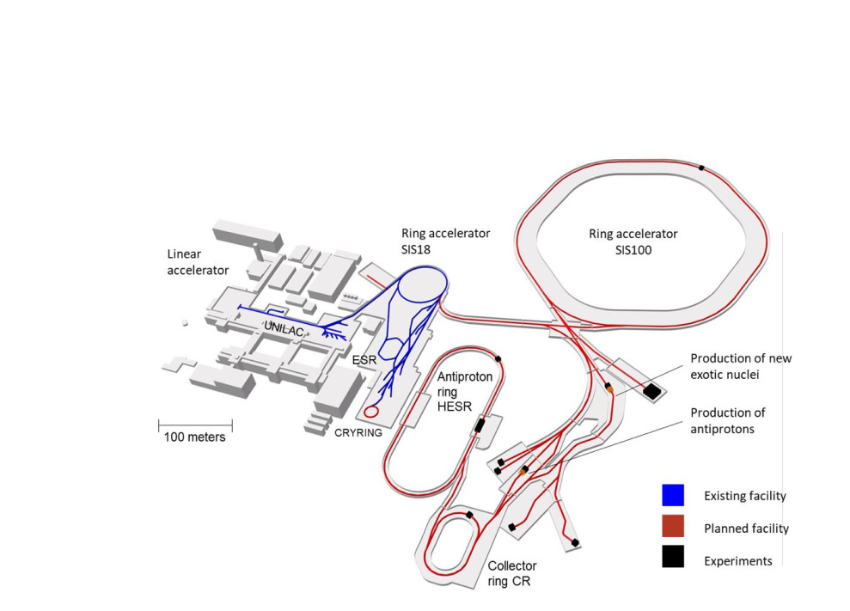
FAIR @ GSI
Facility for Antiproton and Ion Research
in Darmstadt
Four Experiment Pillars:
CBM (Compressed Baryonic Matter)
APPA (Atomic, Plasma Physics and Applications)
PANDA (anti-Proton ANnihilations at DArmstadt)
NUSTAR (NUclear STructure Astrophysics and Reactions)
→ R³B Experiment
Haik Simon – FAIR & Super-FRS – EPS 20190930
Particle Identification in R³B

Slide 3
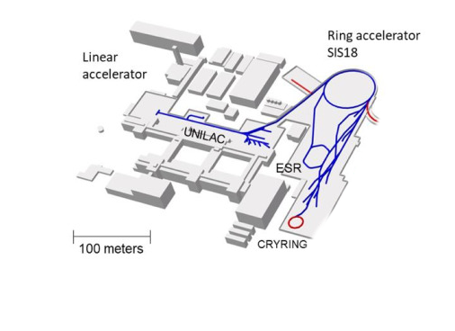
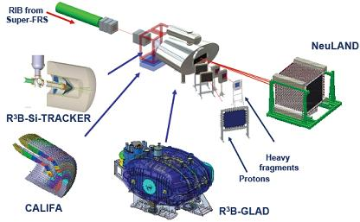
R³B @ FAIR
Reactions with Radioactive Relativistic Beams
Physics program on exotic nuclei in inverse kinematics
kinematically complete measurements
In flight production of exotic nuclei from
fragment separator Super-FRS
Flexible setup,
extensive physics schedule

Slide 4
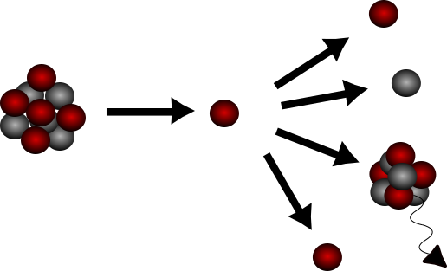
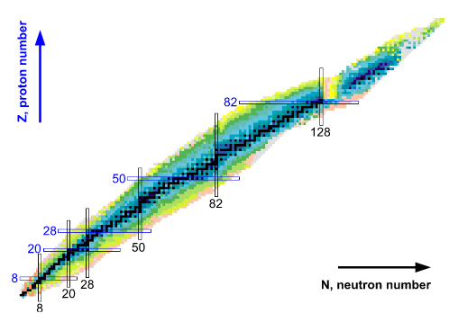
Physics program @ R³B
Right now two major physics fields:
Quasi Free Scattering (QFS)/Knockout reactions
→ study single particle properties inside nuclei
→ analyze shell evolution far off stability
Fission Studies (broad range of fissioning nuclei)
→ fission yields are important to understand e.g. the final r-process abundance
→measurement of the fission barriers far off stability
“doubly magic nuclei”

Slide 5
Requirements for R³B
We want to detect all reaction products and excited states:
→ complete kinematic reconstruction with high acceptance and high resolution
We have to identify all particles (PID):
→ heavy fragments:
superconducting dipole magnet (GLAD) for momentum resolutions Δp/p ~ 10⁻³
charge & tracking detectors
→ light charged fragments & gammas:
CALIFA
→ neutrons:
NeuLAND

Slide 6
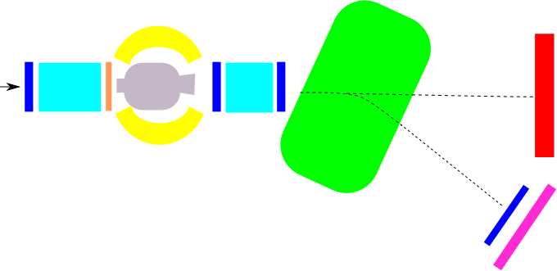
R³B Setup in 2020 Experiment S444/467
GLAD magnet
R³B Music
CALIFA
NeuLAND
MWPC1
beam
neutrons
MWPC0
START
MWPC2
TWIM Music
MWPC3
Daughter
nuclei
Beam energy: from 400 to 1000 AMeV
Intensities: 1kHz - 1MHz
Beamtype: C¹², Ca⁵⁰
Target: C, CH2
Time of Flight Wall

Slide 7
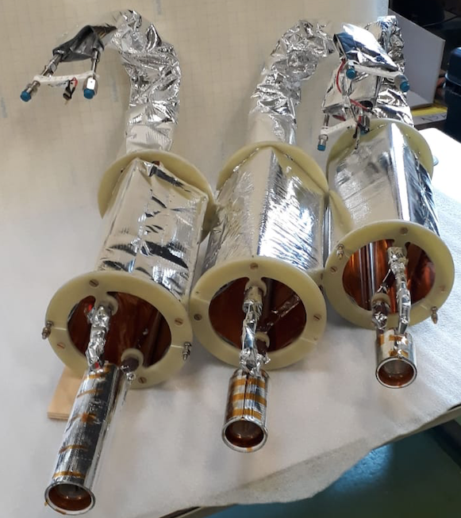
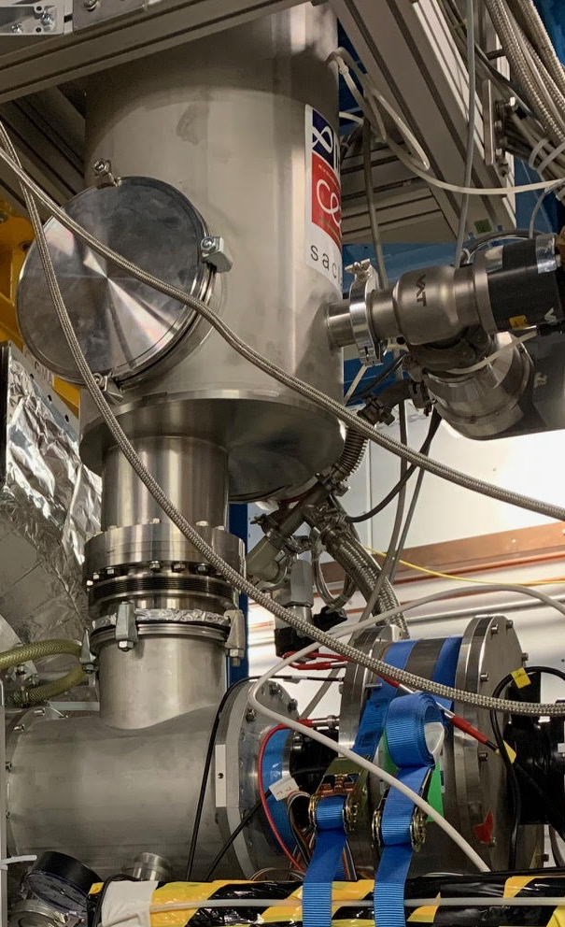
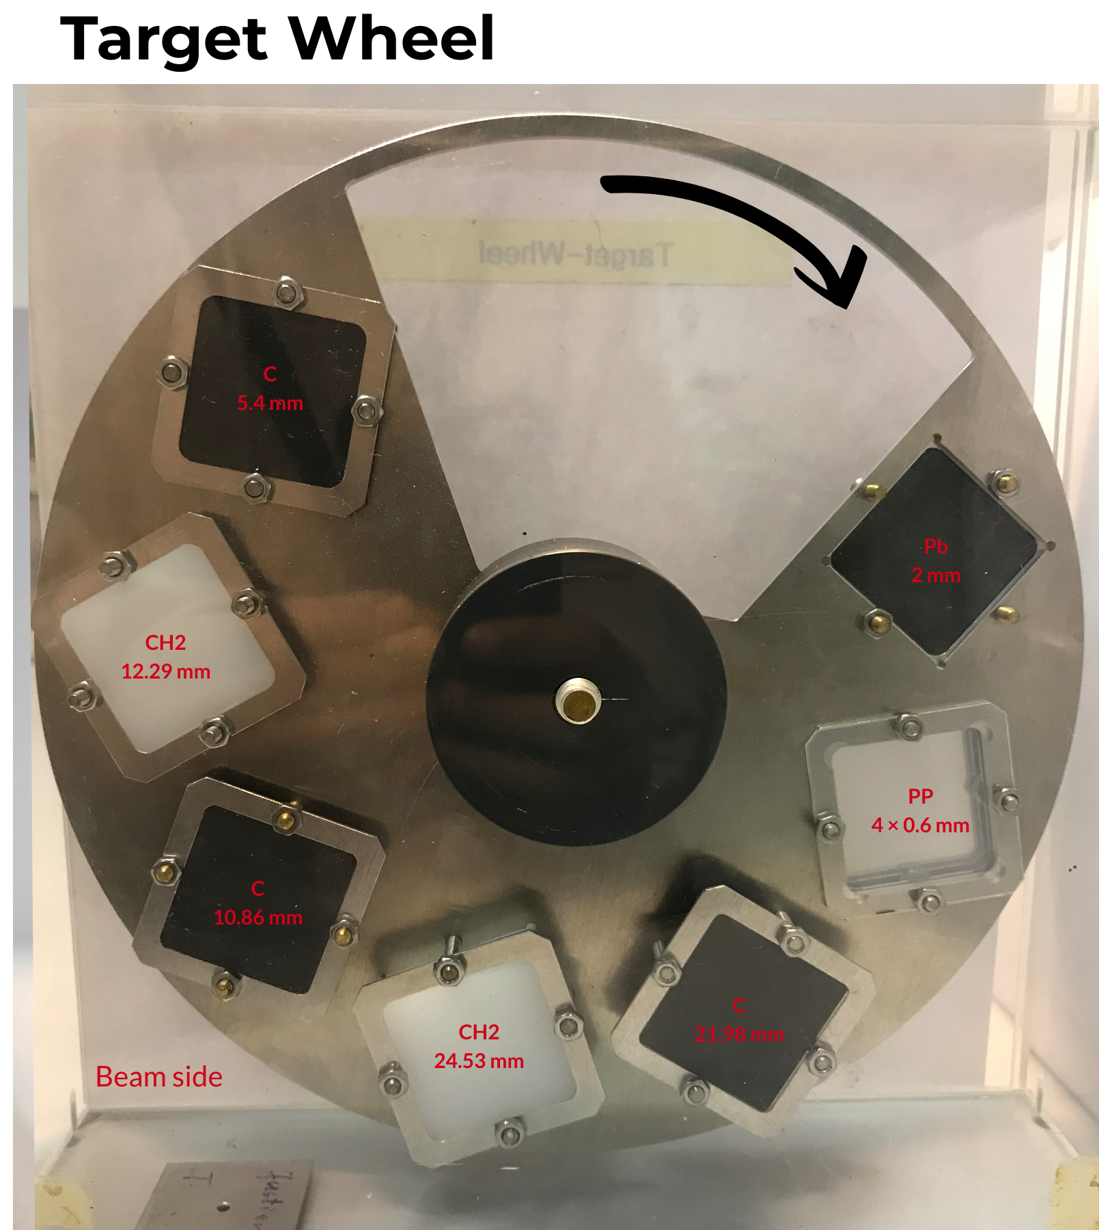
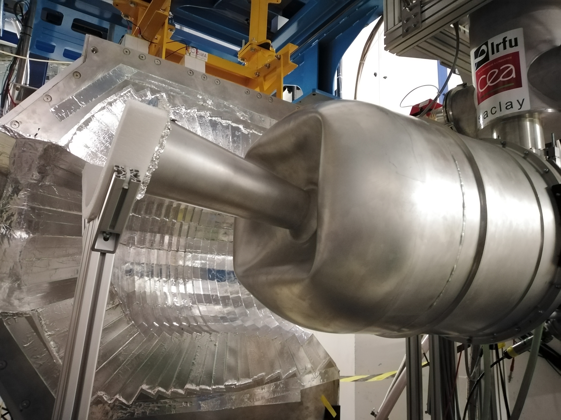
Comissioning of liquid hydrogen target failed...
Cryostat with target
(January 2020)
Due to implosion of the vacuum chamber
LH2 targets
With target lengths:
1.5 / 5 / 15 cm
Targets:
→ C with width:
5.4 / 10.86 / 21.98 mm
→ CH2 with width:
12.29 / 24.53 / 24 mm
→Pb with width:
2mm
Particle Identification in R³B

Slide 8
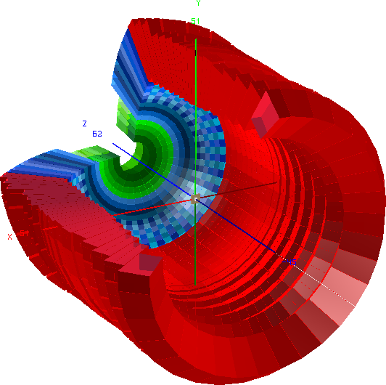
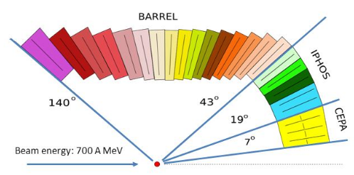
CALIFA Detector @ R³B
CALorimeter for the In Flight detection of γ-rays and light charged pArticles
Endcap:
iPhos:
512 CsI(Tl) crystals
CEPA:
96 LaBr3 &
LaCl3 crystals
Requirements:
-high dynamic range:
100 keV γ-rays – 700 AMeV charged particles
-high efficiency
-high granularity → Doppler correction
-particle identification
Barrel:
1952 CsI(Tl) scintillator crystals
BEAM
beam

Slide 9
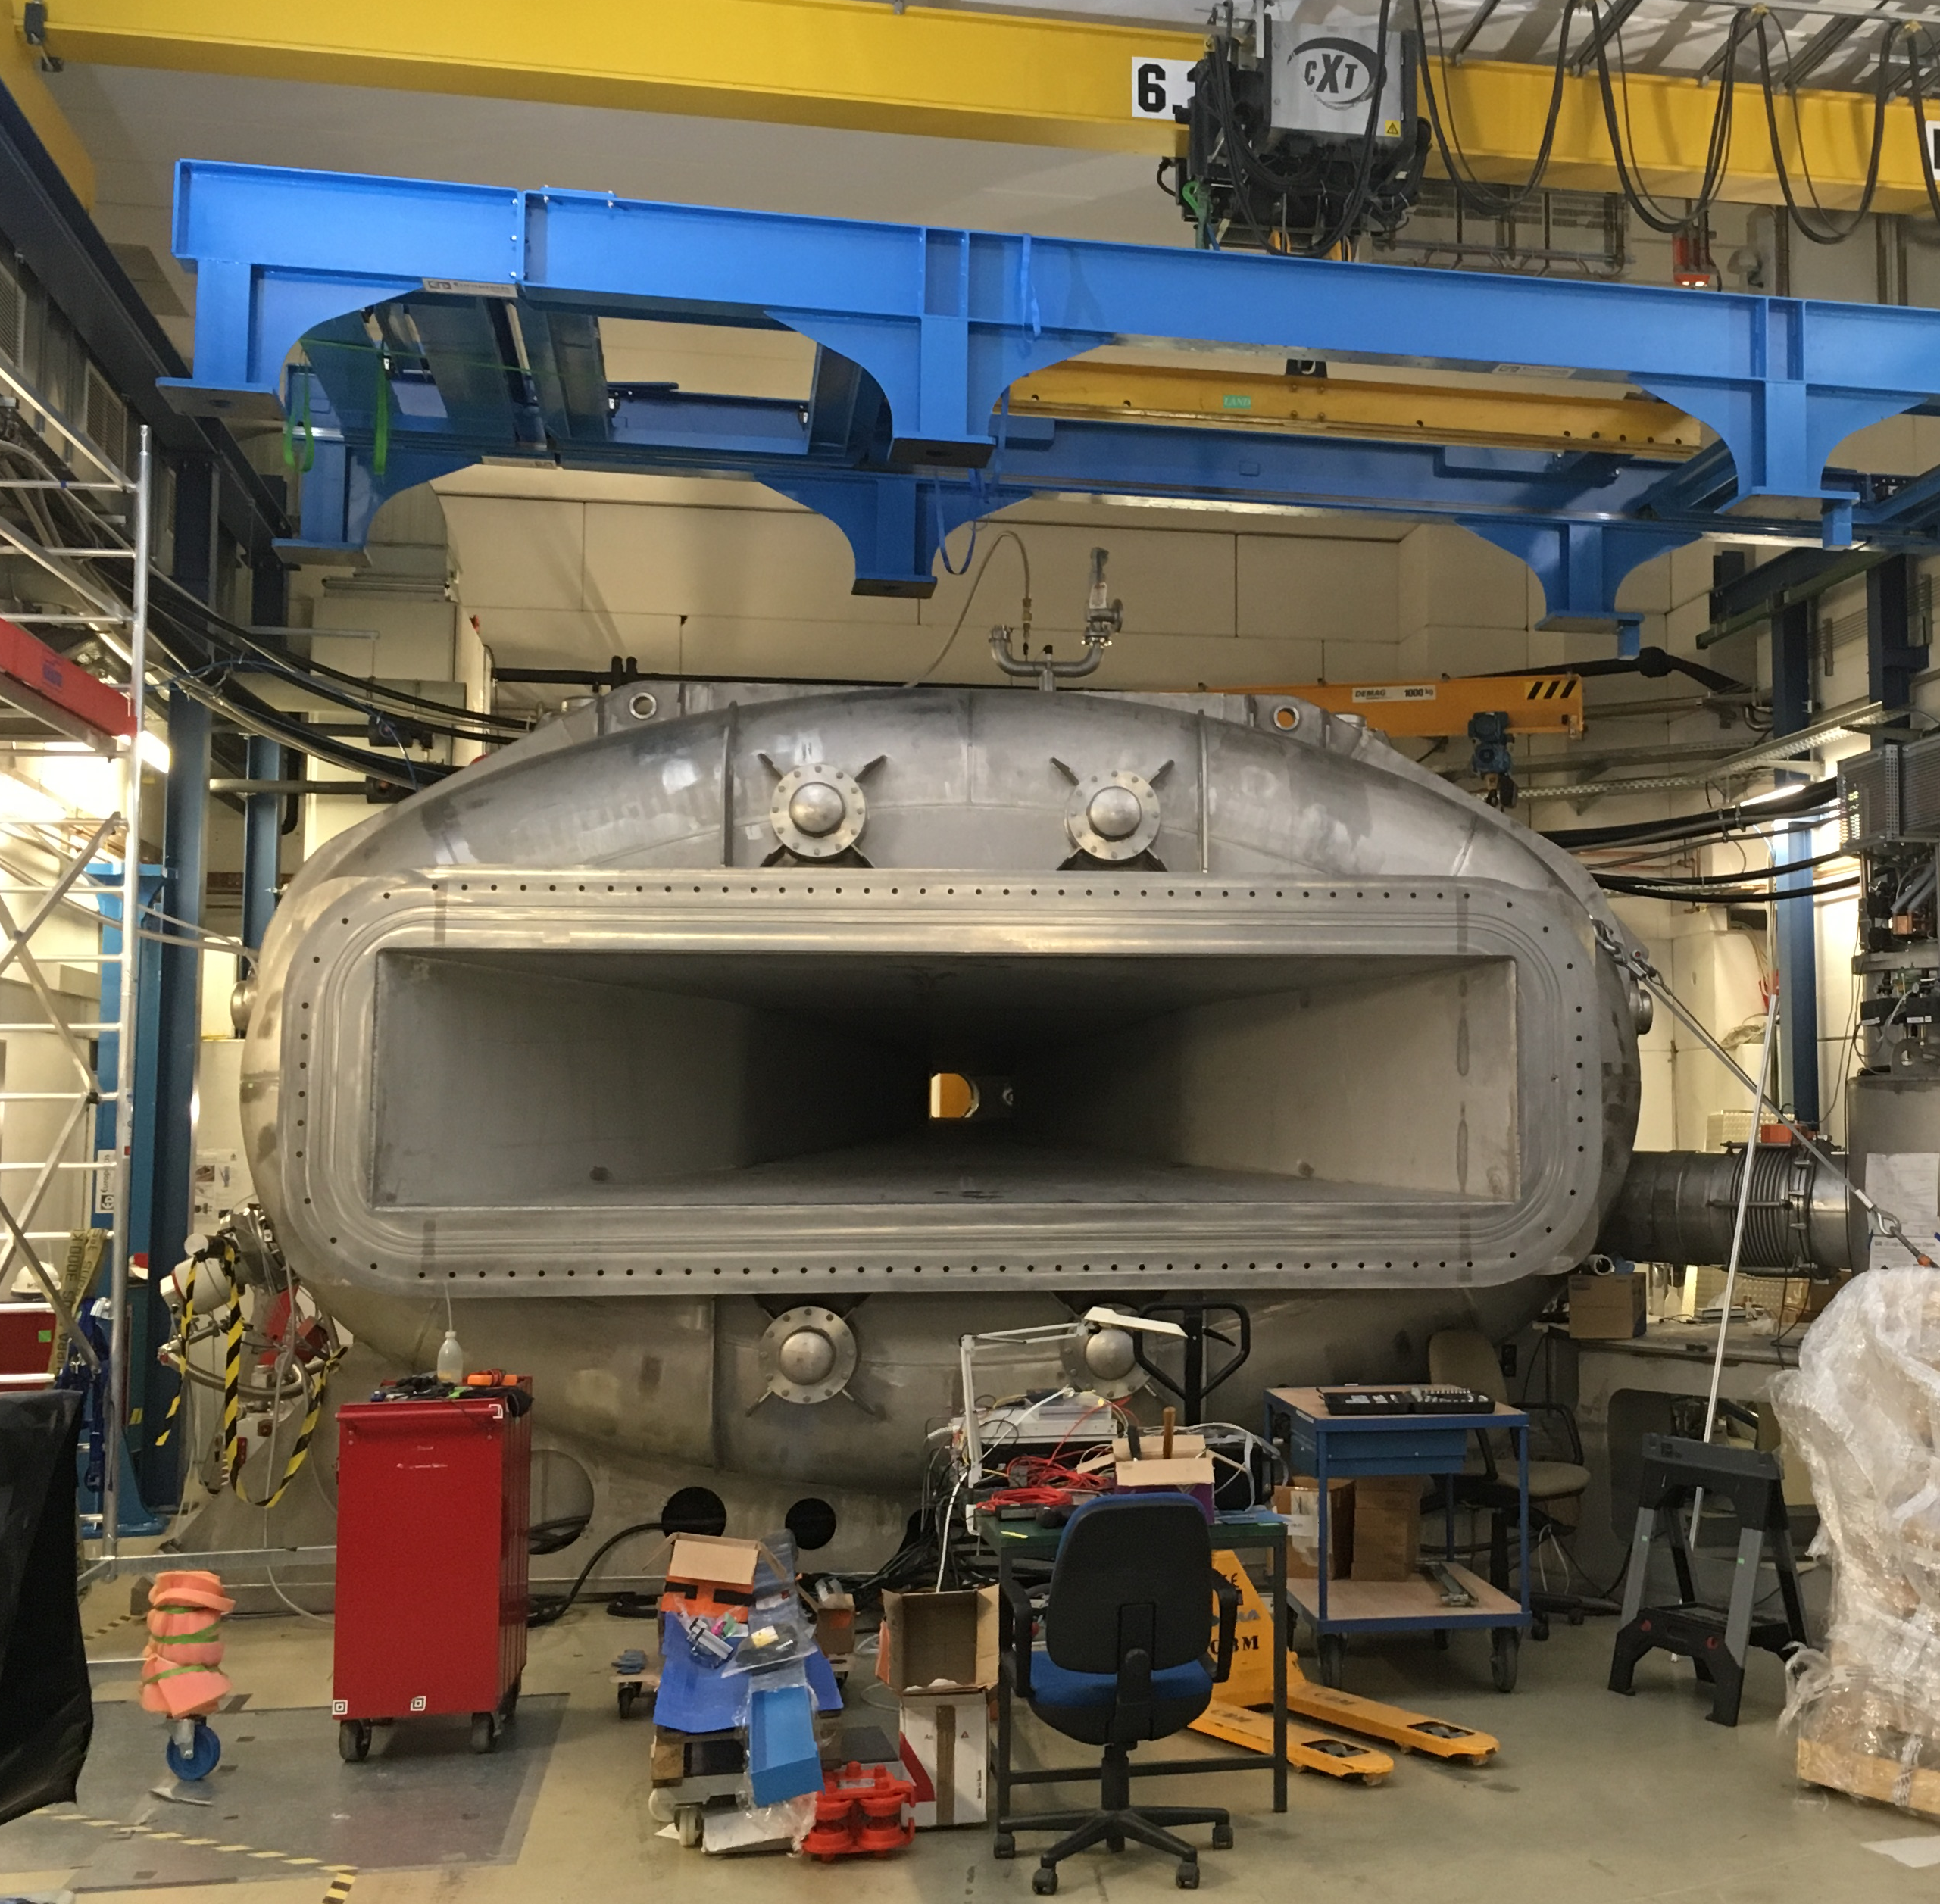
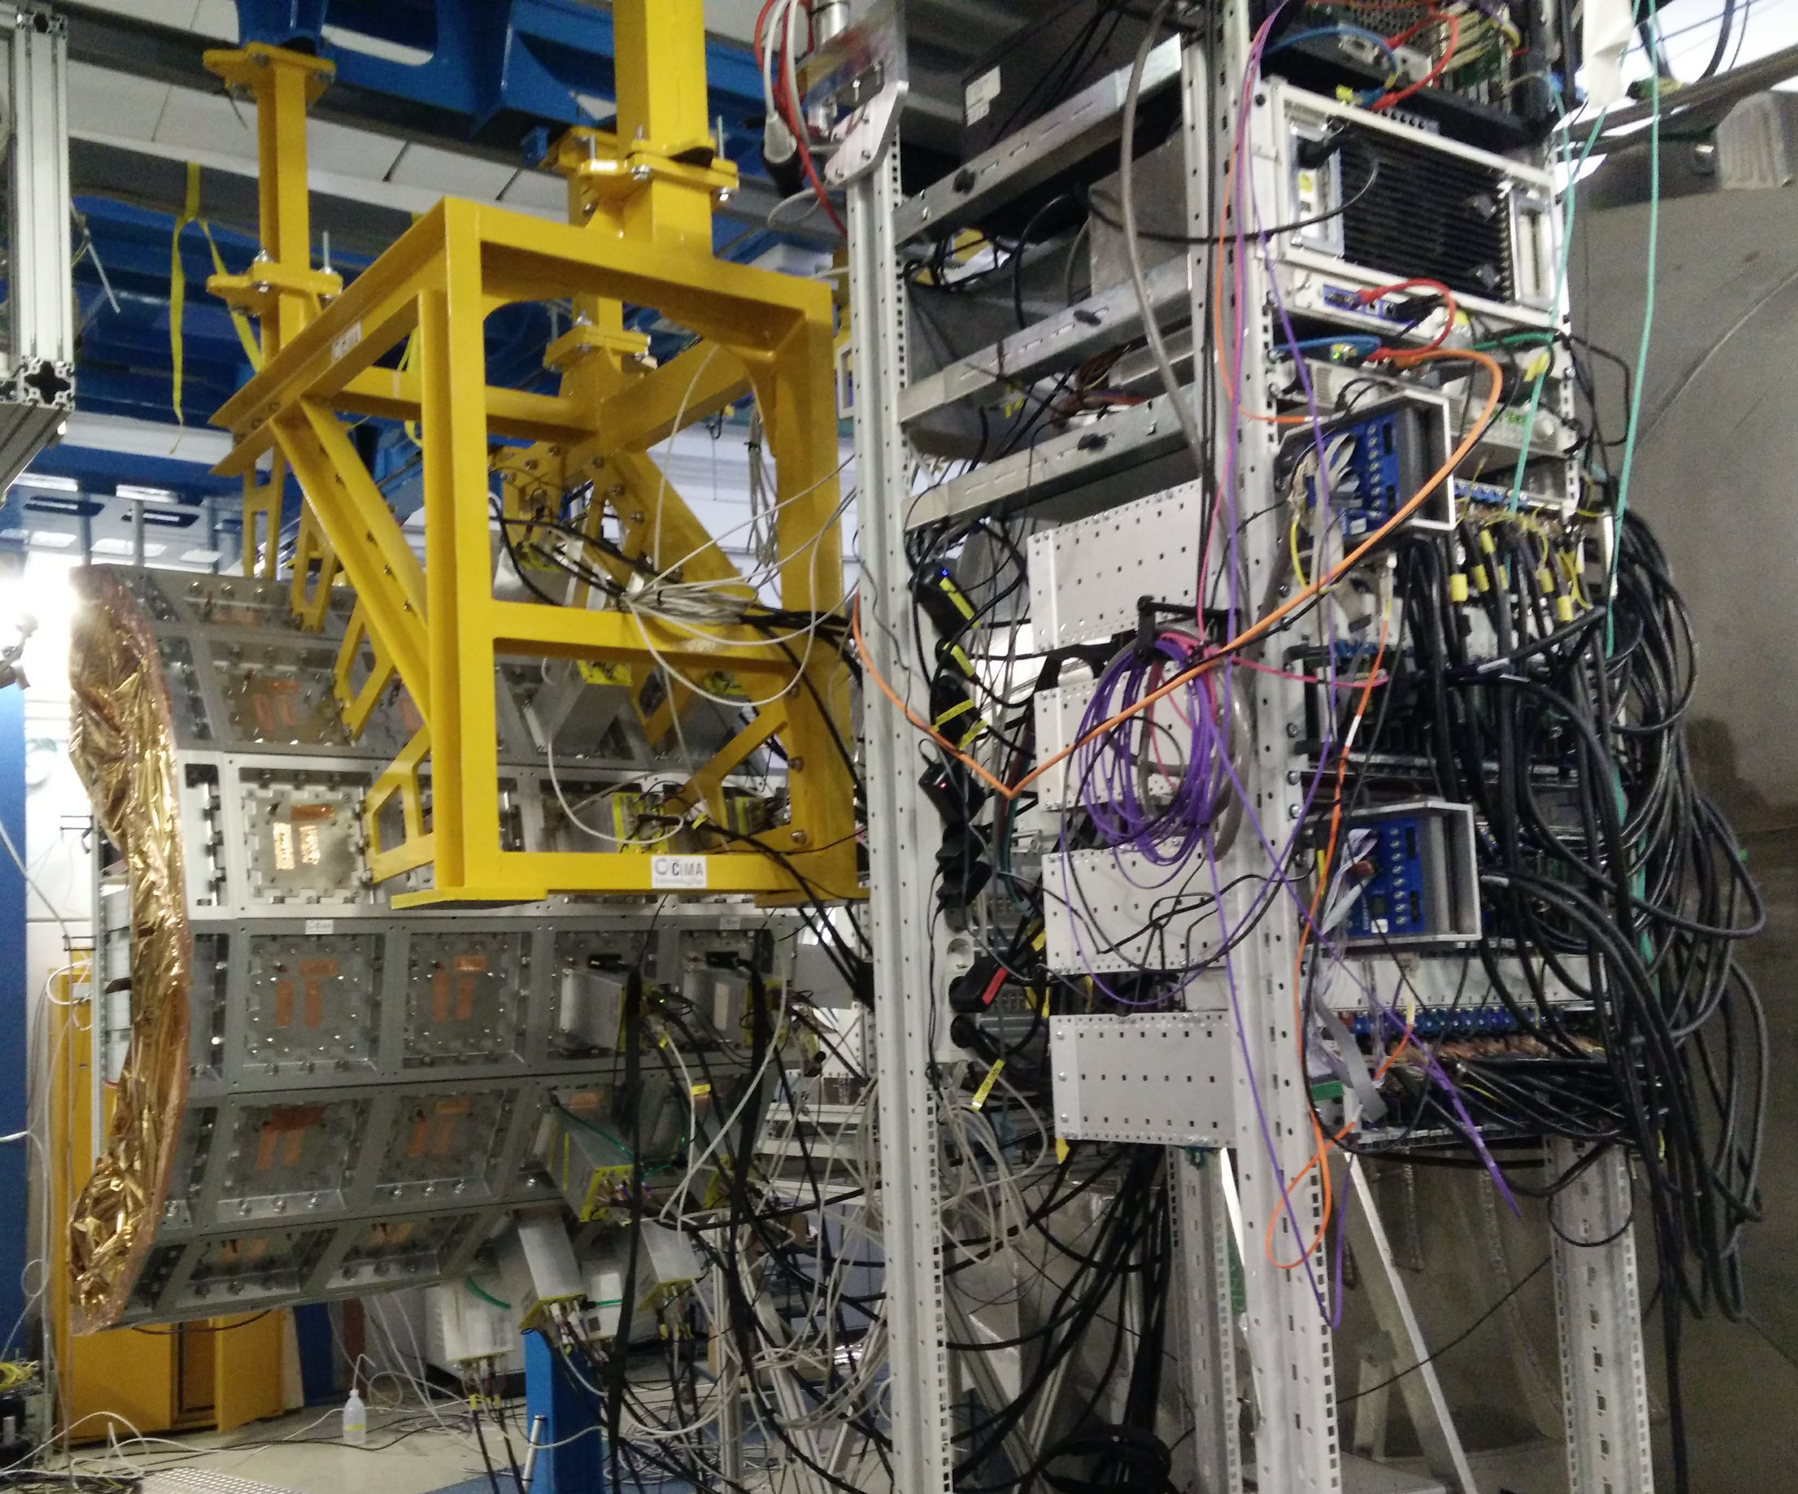
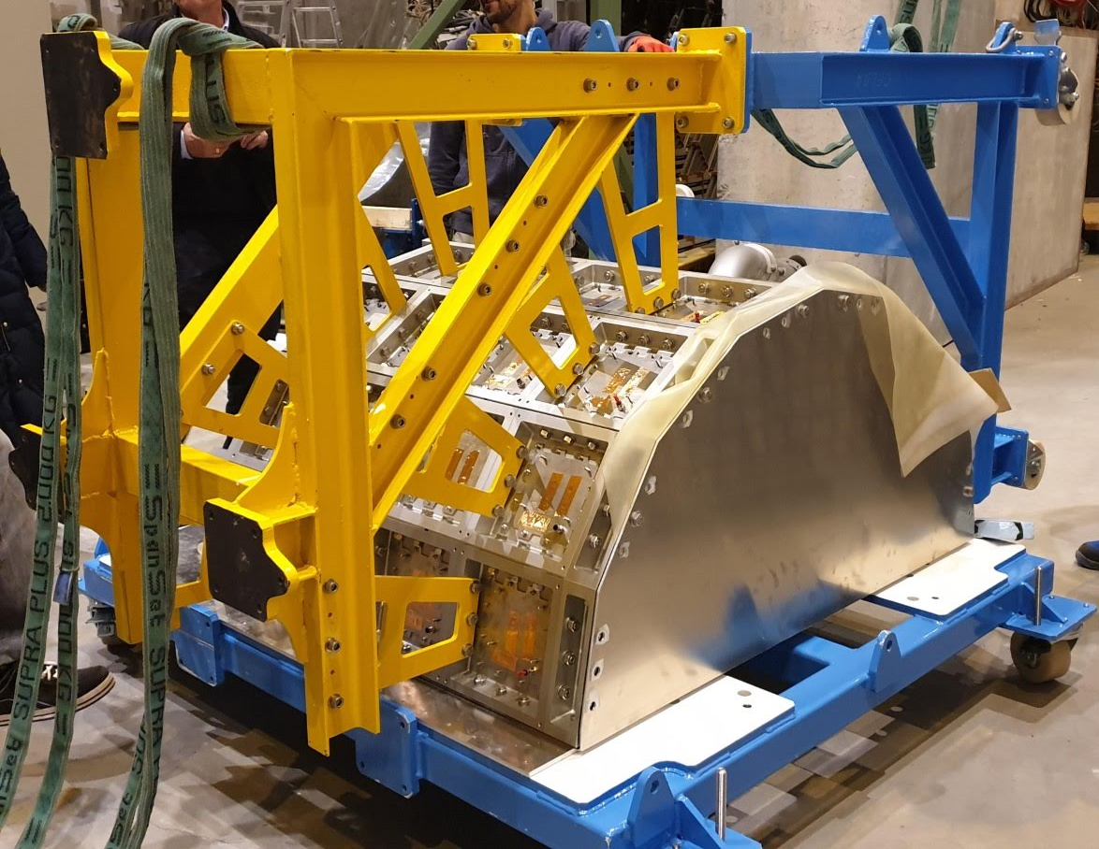
Commissioning of CALIFA Final Setup !
Tobias Jenegger
Particle Identification in R³B
Particle Identification in R³B
Particle Identification in R³B

Slide 10
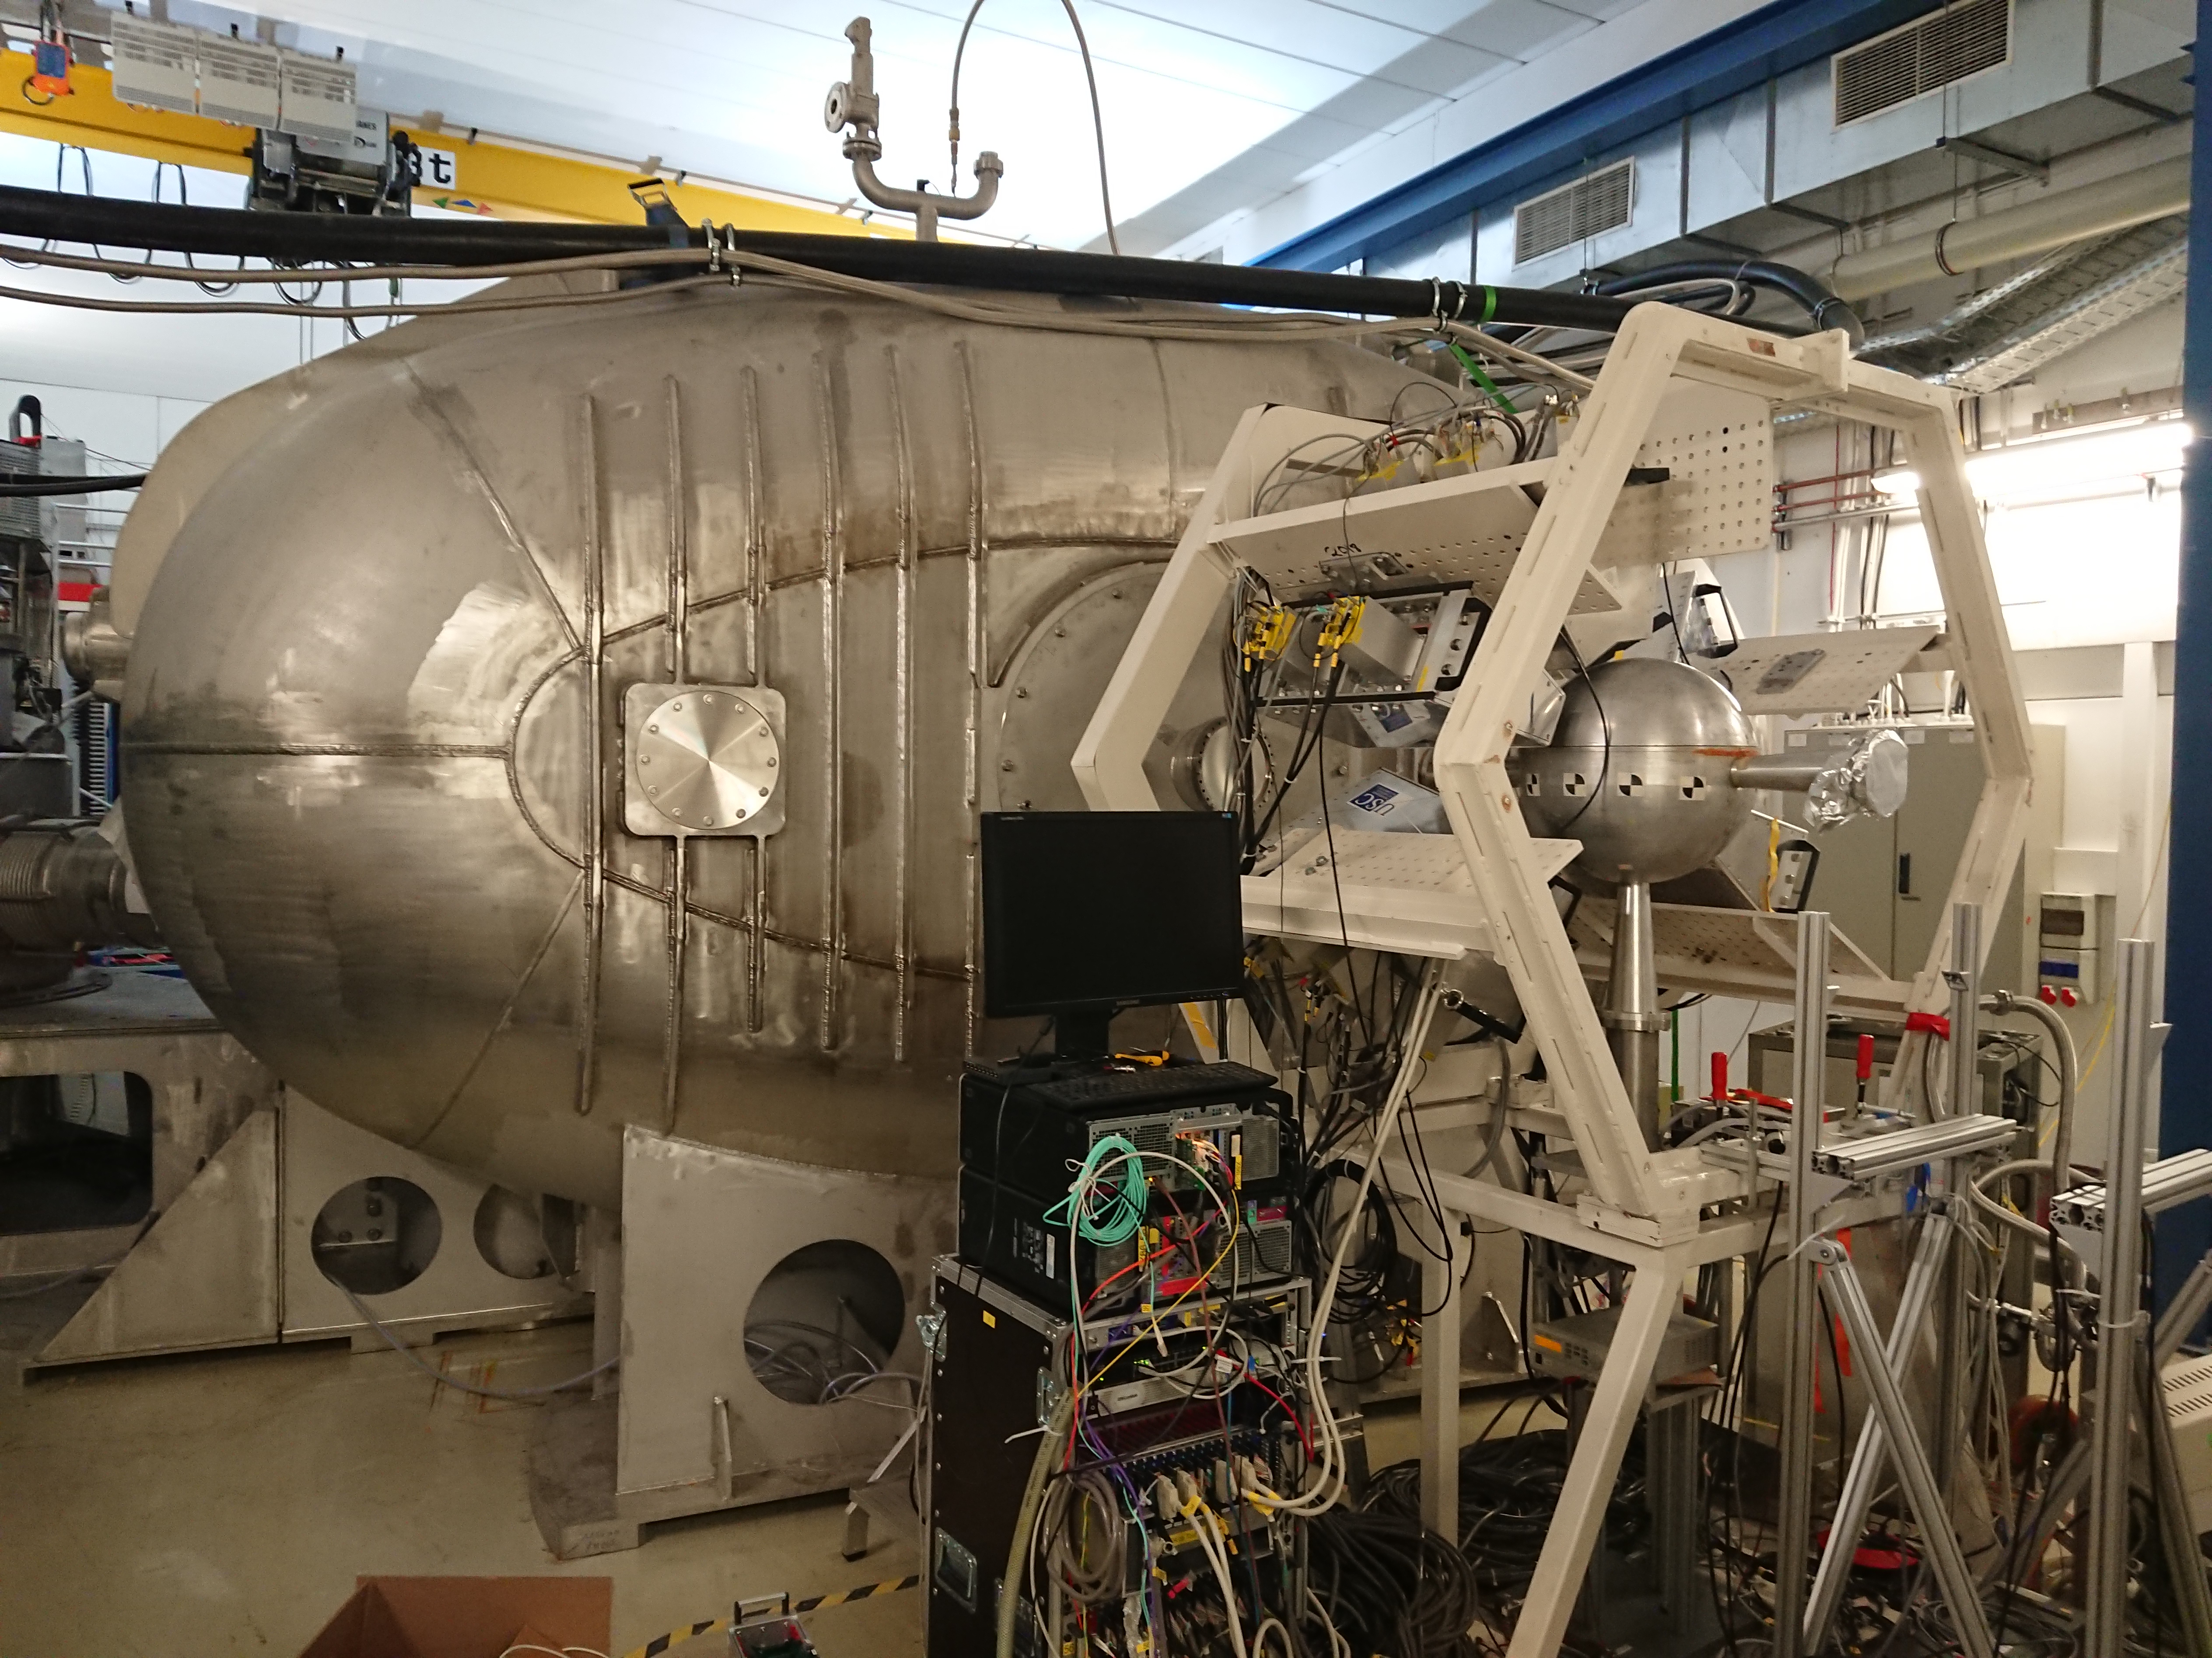
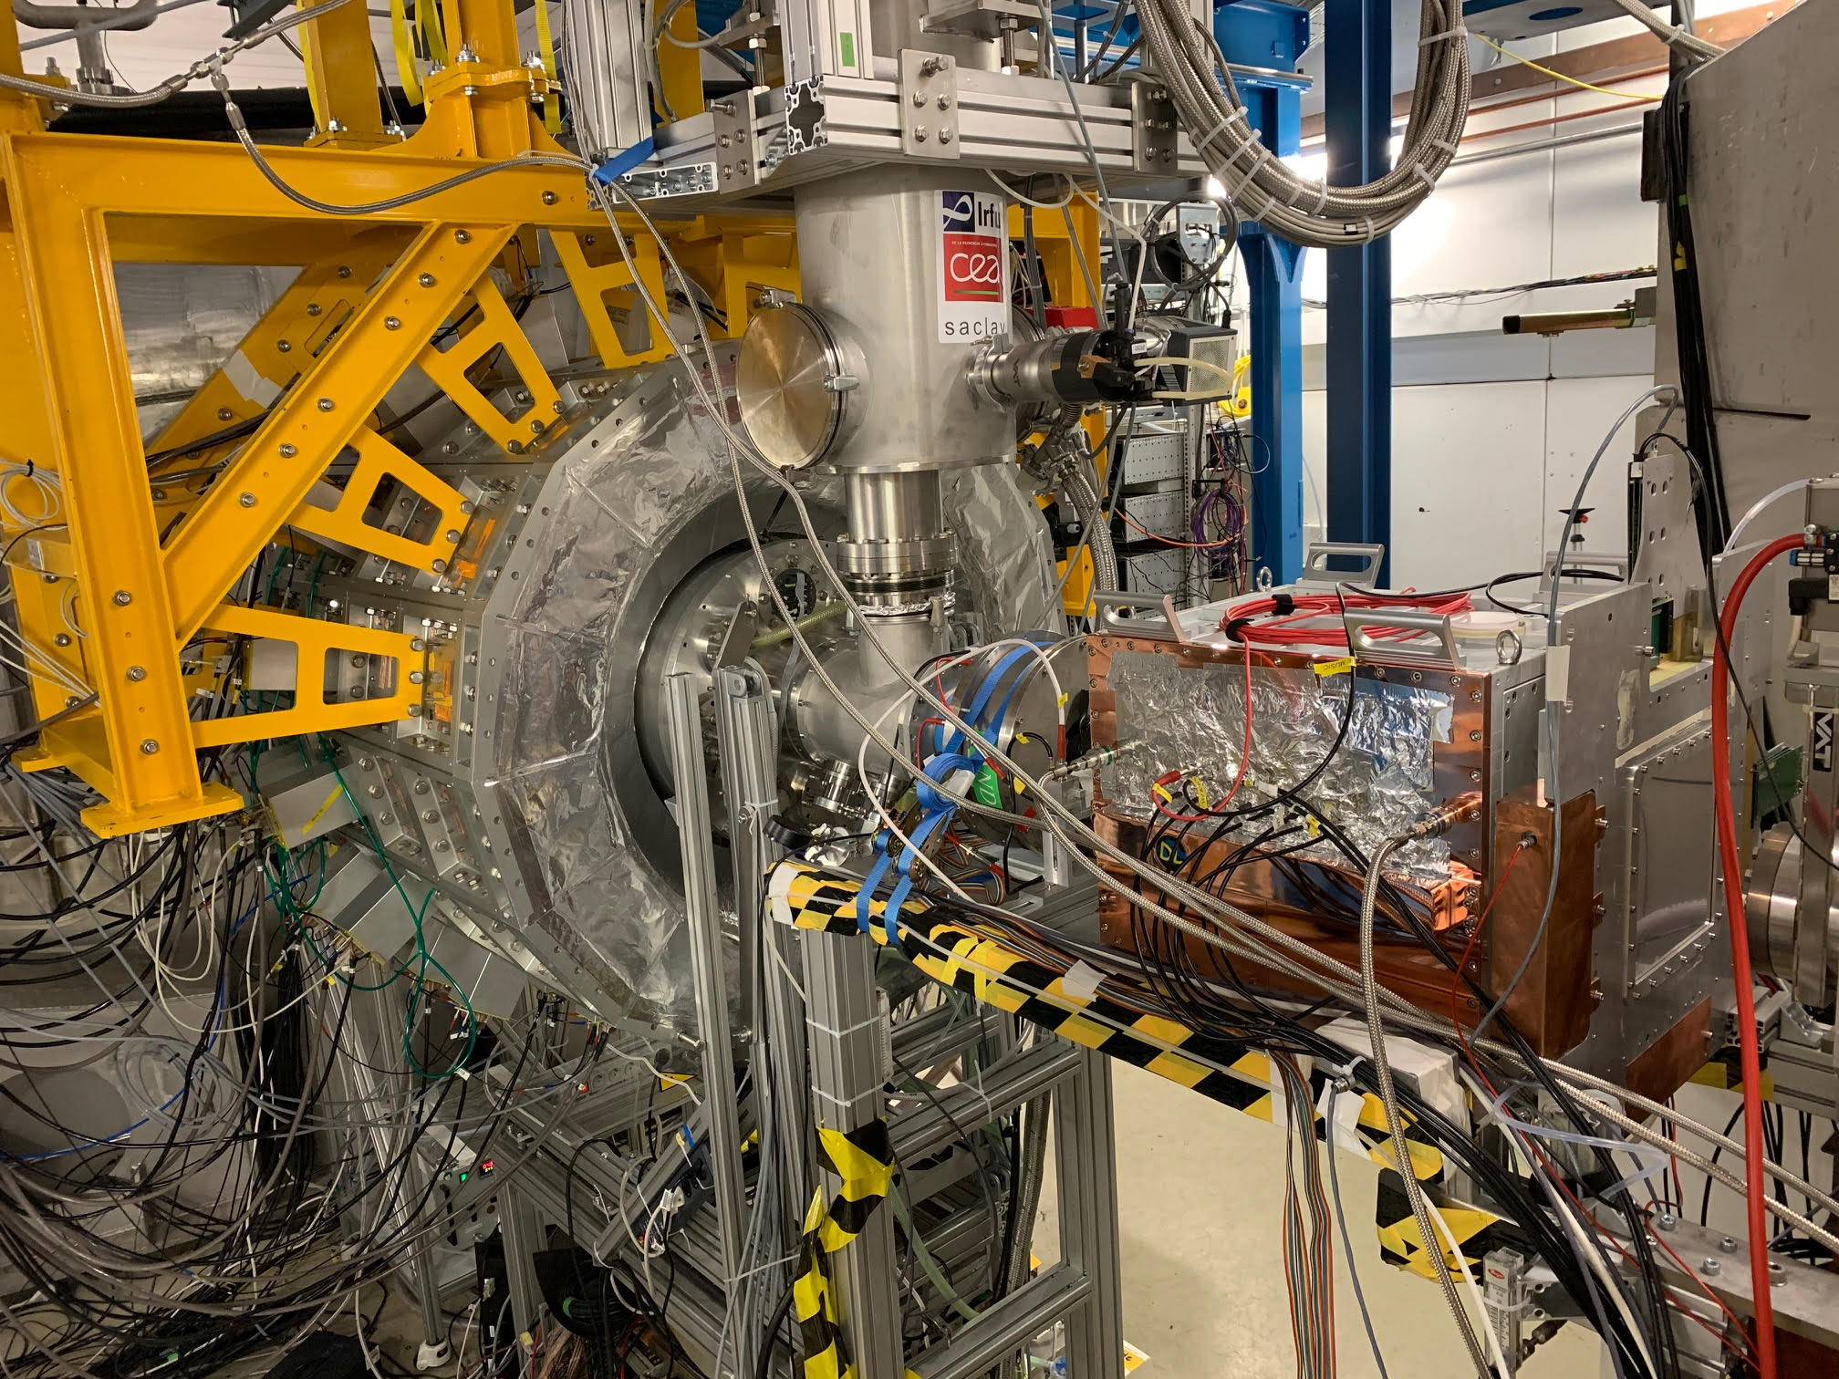
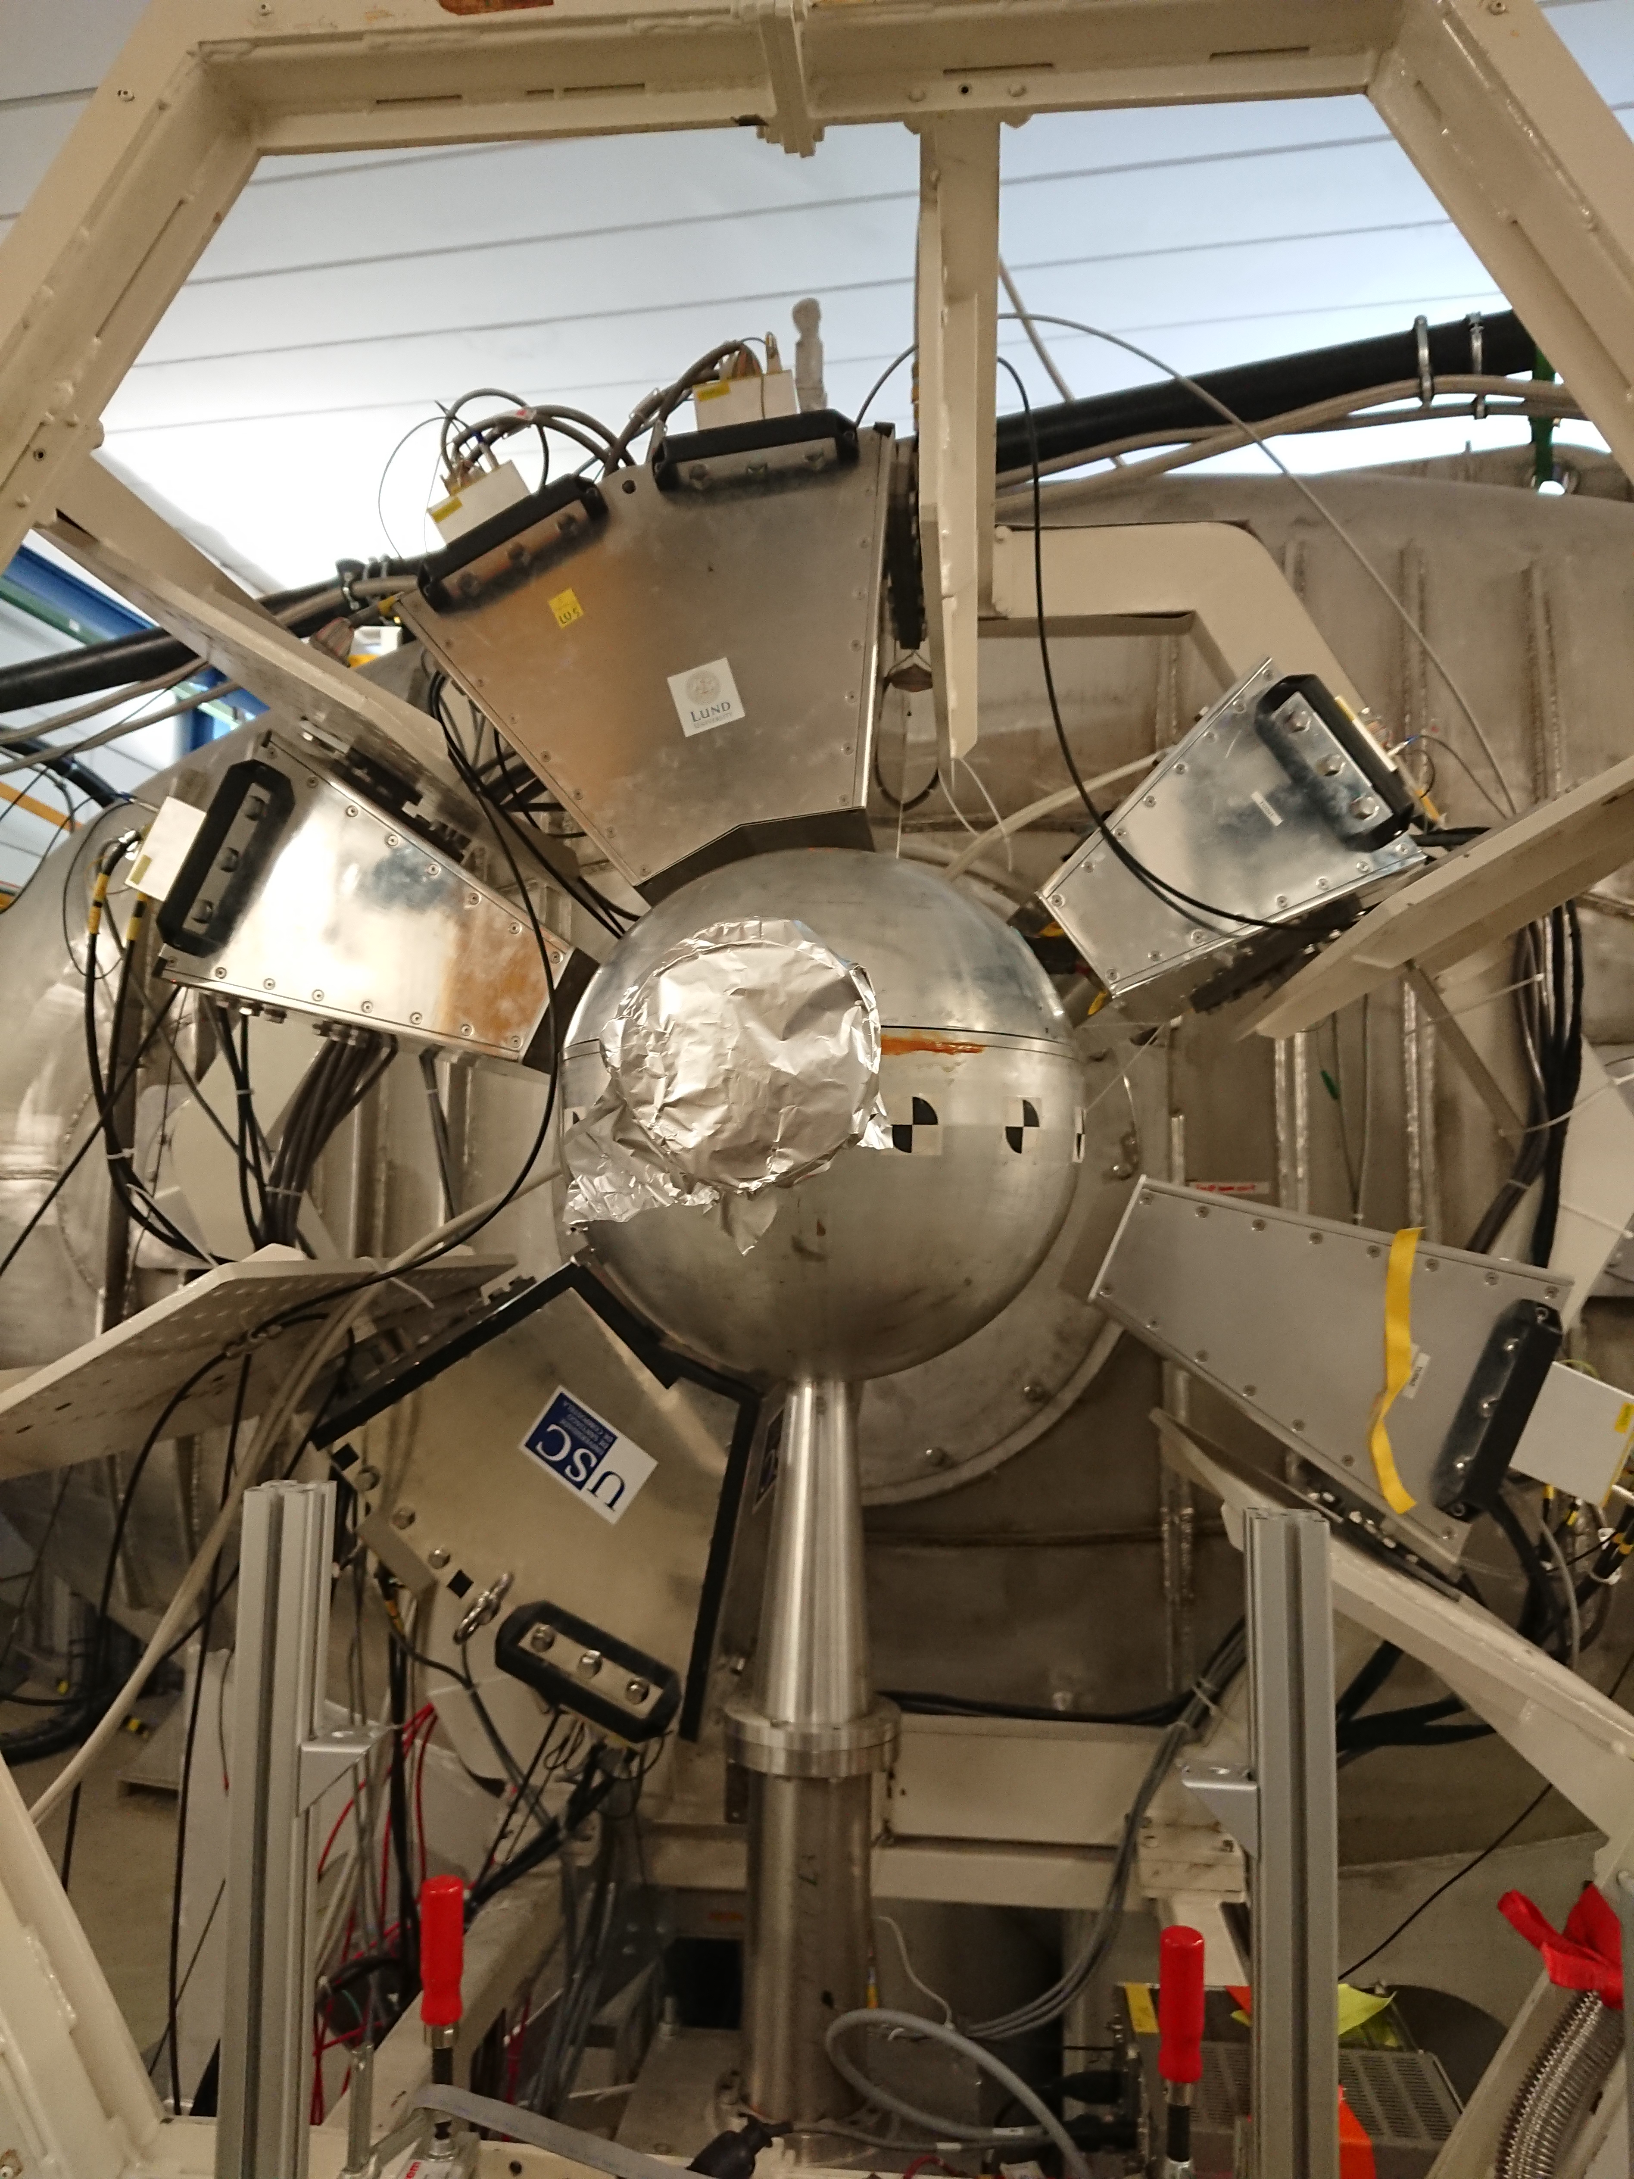
From Demonstrator to Final Setup
Total weight: 3 tons

Slide 11
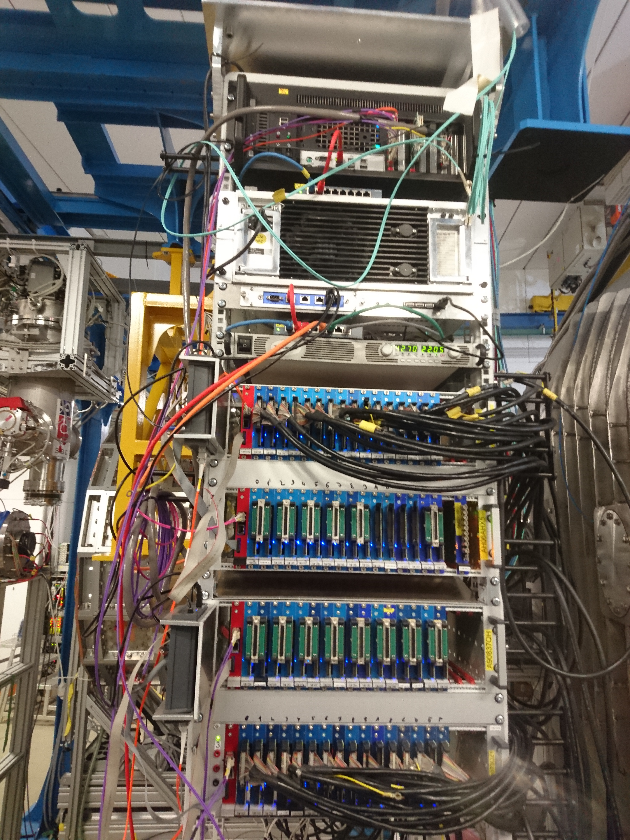
Setting up the Electronics
Pexor-Card
Trixor-Card
Main-DAQ
CALIFA DAQ-PC
Each rack:
→ 1024 channels
→ 50 MHz continuous sampling with
14 bit = 1.5Tbit/s
→ powerful FPGAs make full analysis in real time
data rate = 10Mb/s
34-Pin Twisted-Pair Cable
Pexaria-Card
Fiber
Flat ribbon cable + Erni Connector
LEMO cable
Master-Exploder
Slave-Exploder
CALIFA
Detector
Tobias Jenegger
Particle Identification in R³B

Slide 12
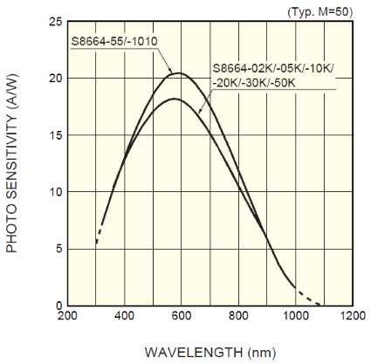
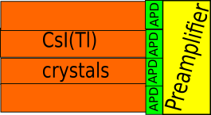
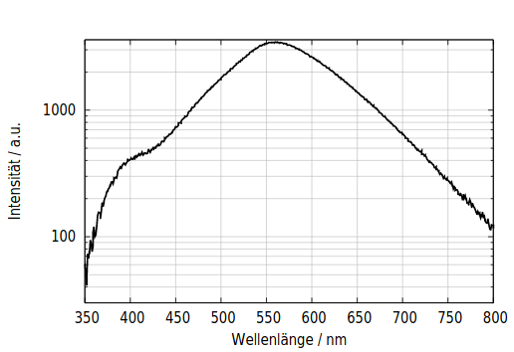
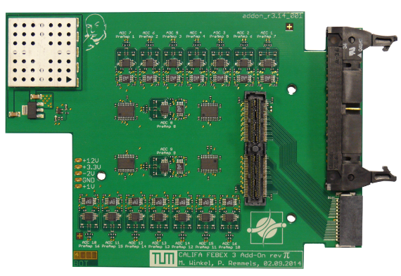
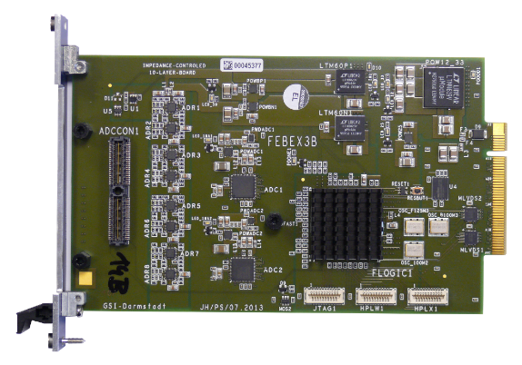
Signal Processing @ CALIFA
γ/particle interaction in crystal → scintillatorlight (550nm)
Every crystal connected to one APD → signal current
APDs connected to preamplifier:
→ generates HV for APD bias
→ amplifies (integrates) the signal
from the APDs
Add-on Board
connected to
FEBEX (Front End Board with optical link Extension) Add-on Board
→Nyquist Filtering (<25 MHz)
→DC offset:Signal from preamp is positive, ADC range of FEBEX ADC ±0.9V
Firmware developed by:
Michael Bendel,
Max Winkel,
Benjamin Heiss,
Philipp Klenze,
Patrick Remmels,
et al.
FEBEX
On FEBEX:
→ Energy and particle identification
Developed @ GSI

Slide 13
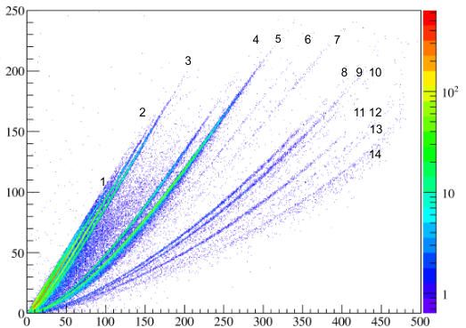

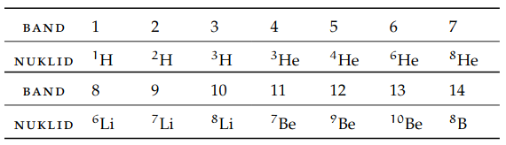
Quick Particle Identification (QPID)
Light emission of CsI(Tl):
Slow component N_{s} (γMeV)
fast component
slow component
Ratio of the components depend on Energy and particle type
exploit for particle Identification
Source:Max Oliver Winkel
Fast component N_{f} (γMeV)
Tobias Jenegger
Particle Identification in R³B

Slide 15
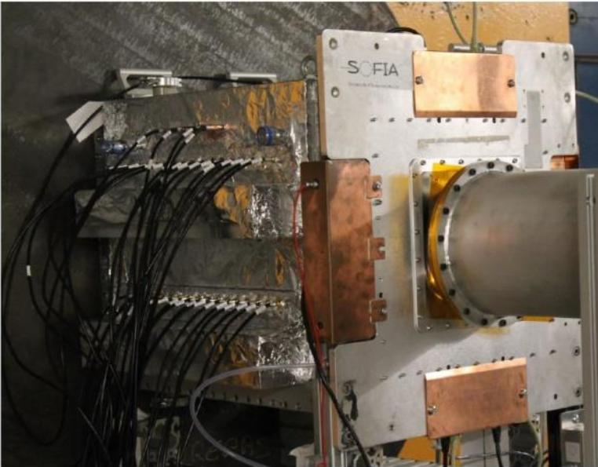
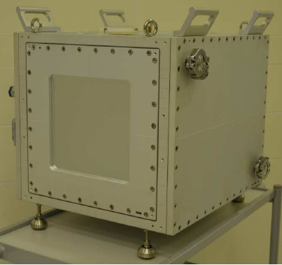
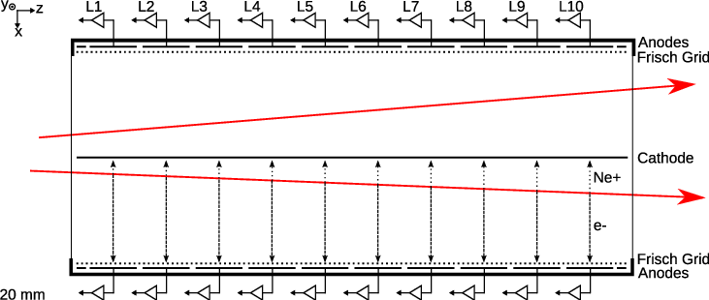
R³B-Music and TWIM MUSIC (Multi-Sampling Ionization Chambers)
TWIM MUSIC:
Double ionization chamber with central cathode and Frisch Grids
(3mm from anode)
and 16anodes
Gas: P75 (Ar 25%,CH4 75%)
cathode: -3000 V
anode: +600 V
Frisch Grid: 250V
Developed at: GSI and CEA
by Julien Taieb et al.

Slide 16
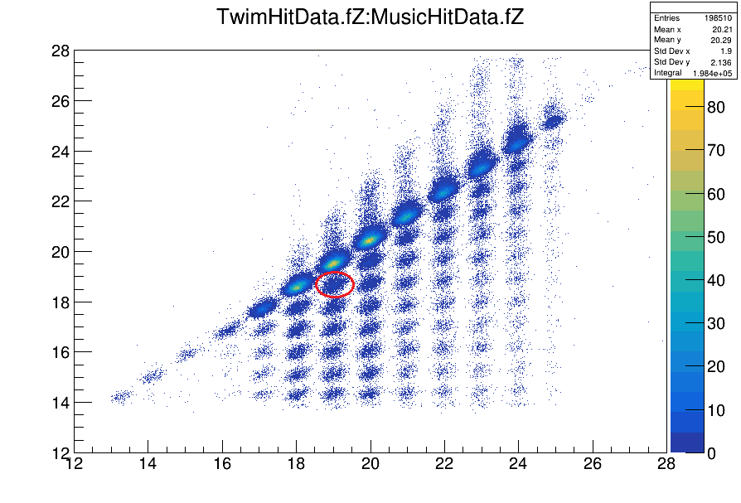
Ca⁵⁰ cocktail from Fragment Separator
with beam energy: 580 AMeV
Z -TWIM MUSIC (after target)
Z - R3B Music (before target)
What we can measure:
- deflection angle θ(Δθ≈ 0.3mrad)
-Atomic number Z (ΔZ≈ 0.33FWHM)
-(Section ID → Fission)
Tobias Jenegger
Particle Identification in R³B

Slide 17
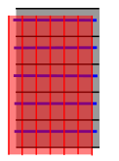
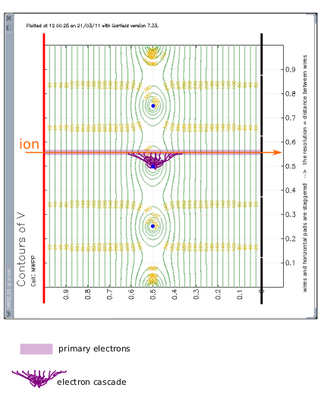
Particle Tracking @ MWPCs
y
x
MWPC0
MWPC1
z
Y pads (horizontal)
anodes: horizontal wires
X pads (vertical)
side view
MWPC2
MWPC3
Tobias Jenegger
Particle Identification in R³B

Slide 18
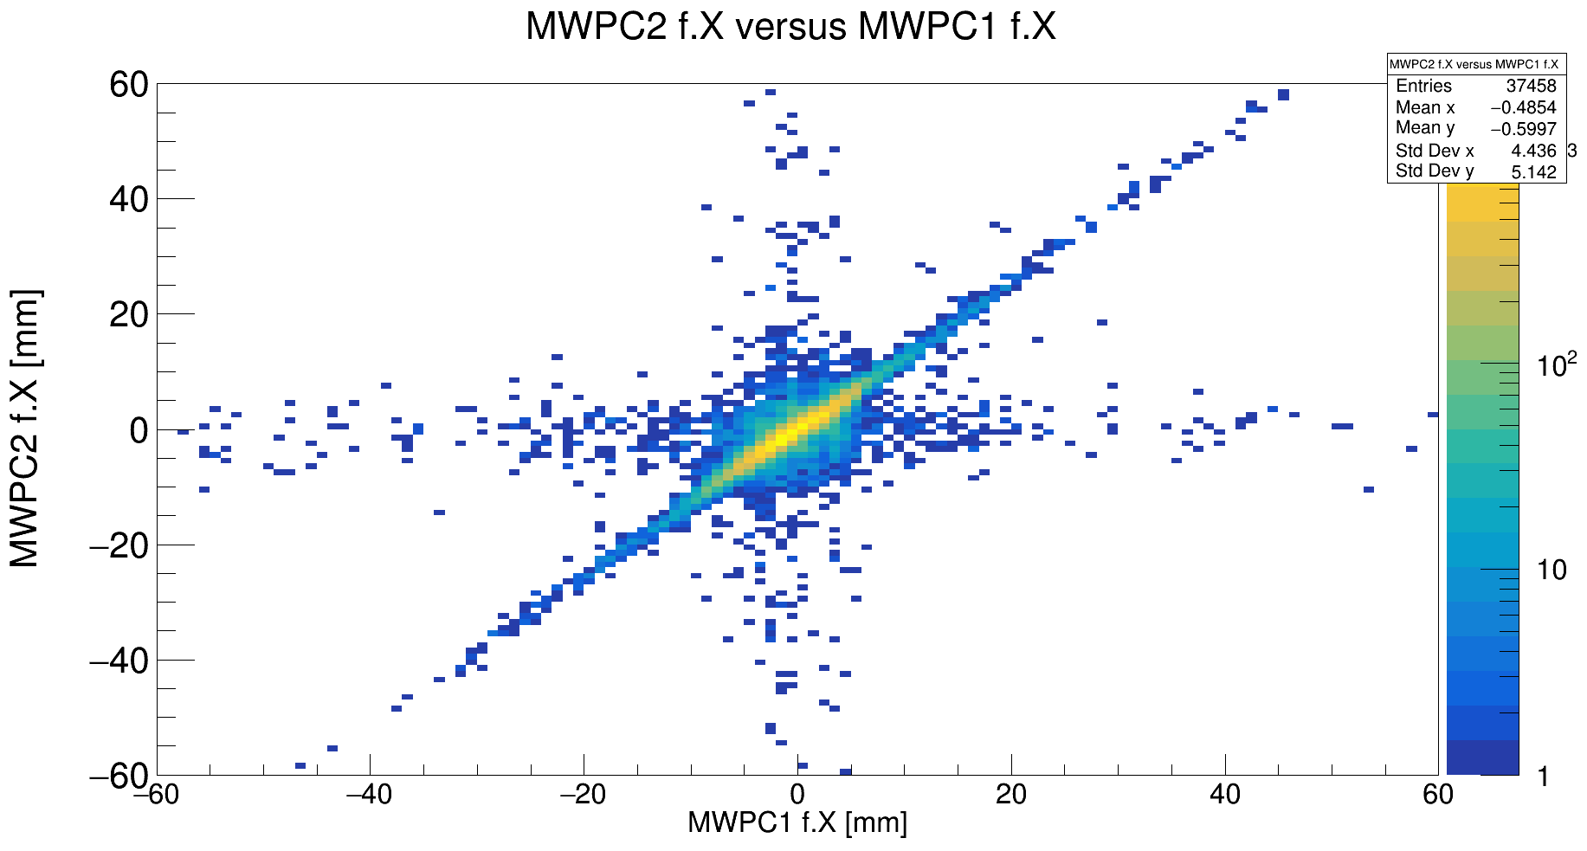
The MWPCs
y
x
MWPC0
MWPC1
z
MWPC0
-64 vertical pads (3.125mm)
-1plane horizontal/vertical wires (d=5μm)
-64 horizontal pads (3.125mm)
-pads grounded and wires at 1100V
-gas: 80%Ar + 20% CO2
MWPC2
resolution:
x&y: ~100 μm
MWPC3
MWPC1/2 (200x200x5mm)
-64 vertical pads(up/down) (3.125mm)
-1plane of horizontal wires
-40 horizontal pads (5mm)
-Aluminum/gold evaporated on Mylar foil
MWPC3 (900x600mm)
-1plane of 288 vertical pads
-1 plane of horizontal wires
-1 plane of 120 horizontal pads
resolution:
x: ~100μm
y: ~1-2mm

Slide 19
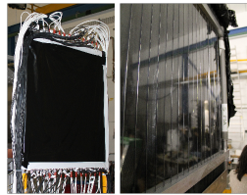
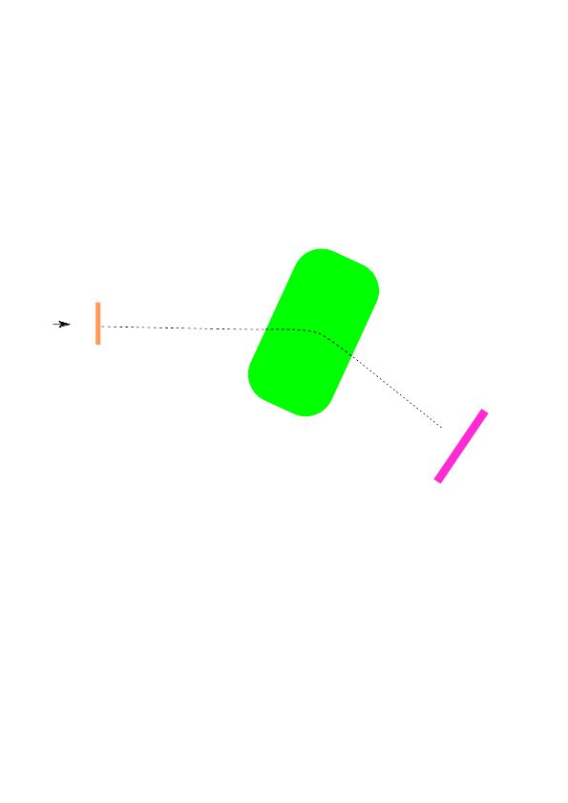
START detector and Time of Flight Wall
Plastic
Scintillator
Beam & reactions
START detector
for time measurement
Time of Flight Wall
27 vertical scintillators (54 PMTs, up&down)
(810x600x30mm)
relative time difference provides
total time of flight
We measure:
-Scintillatornr./PMTnr
-time

Slide 20
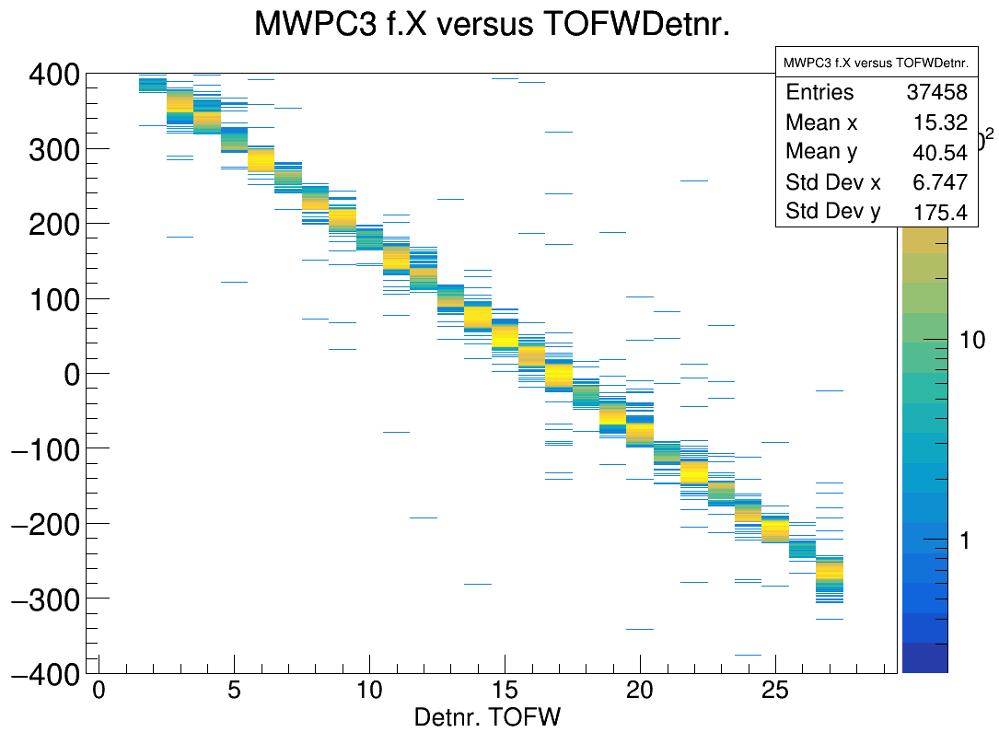
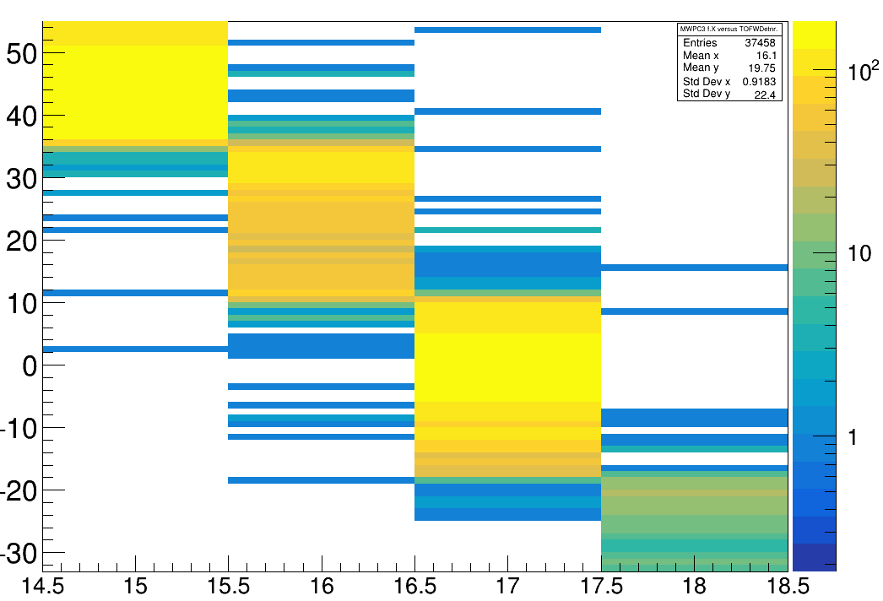
MWPC0
MWPC1
MWPC2
MWPC3
TOFW
30mm
(sweep runs without target)
Tobias Jenegger
Particle Identification in R³B

Slide 21
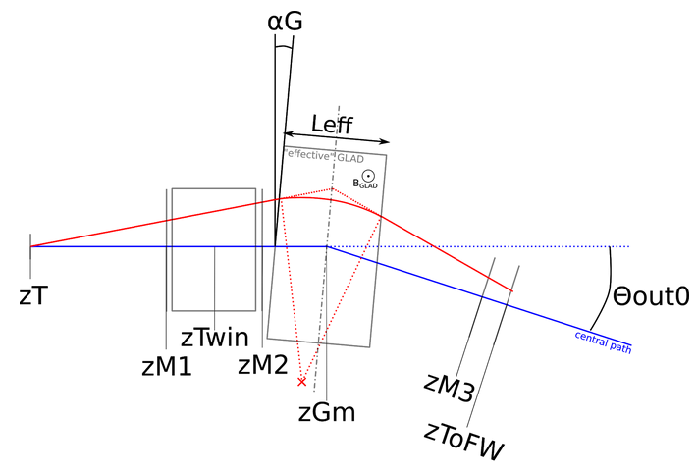
Time of Flight Calibration @ R³B
With sweep runs = without target, changing magnitude of B-Field
→exact Time of Flight measurement
gives us M,p of the daughter nuclei
→exact reconstruction of flightpath from
START detector to Time of Flight Wall
→make β-corrections due to
matter interaction
→get offsets for each TOFW scintillator
for calibration
Θin
/
START
sweeping
Tobias Jenegger
Particle Identification in R³B

Slide 22
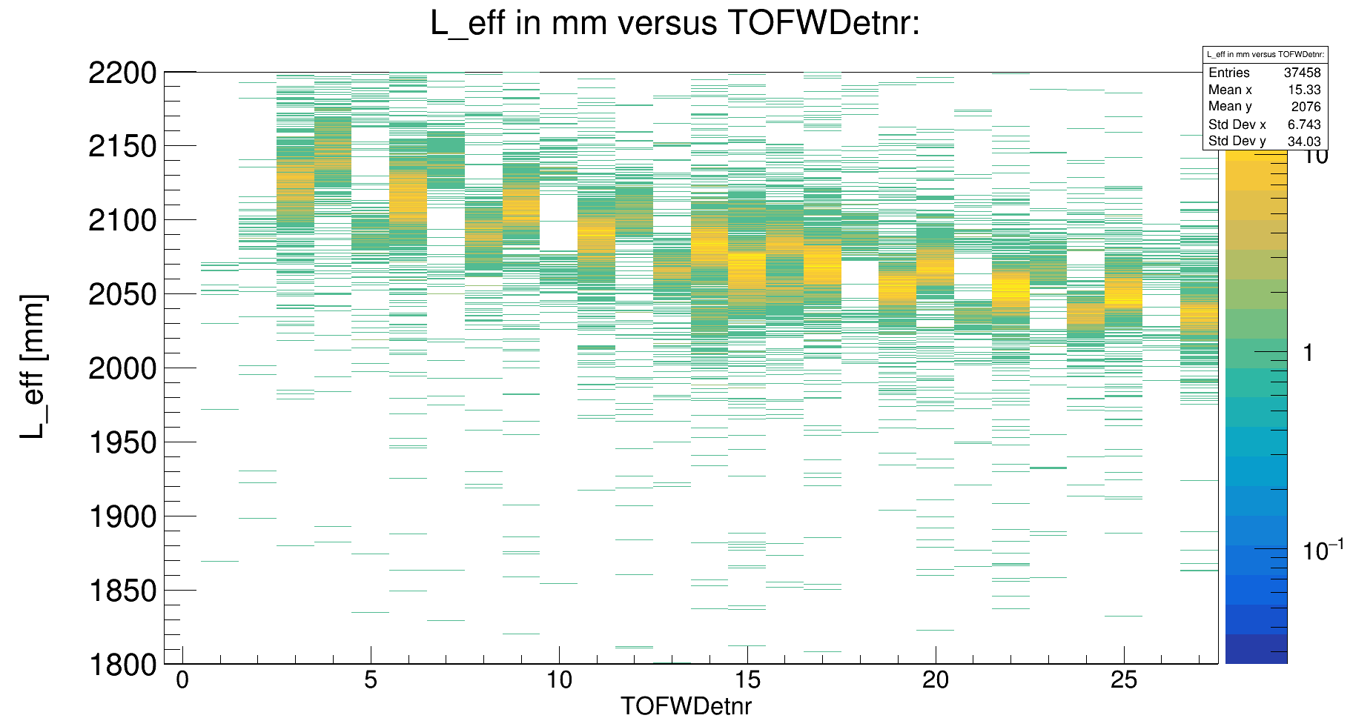
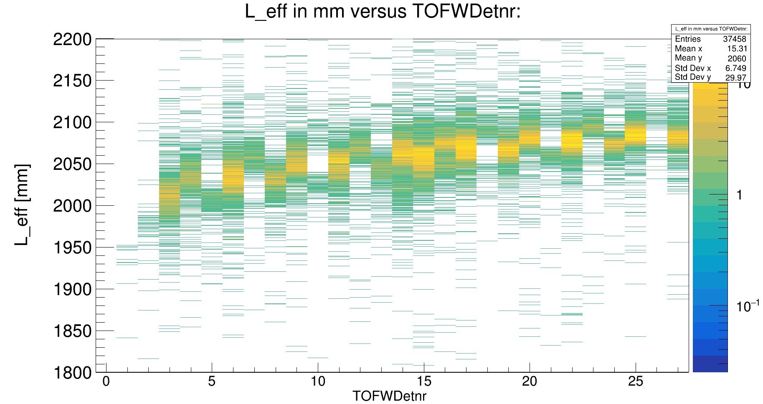
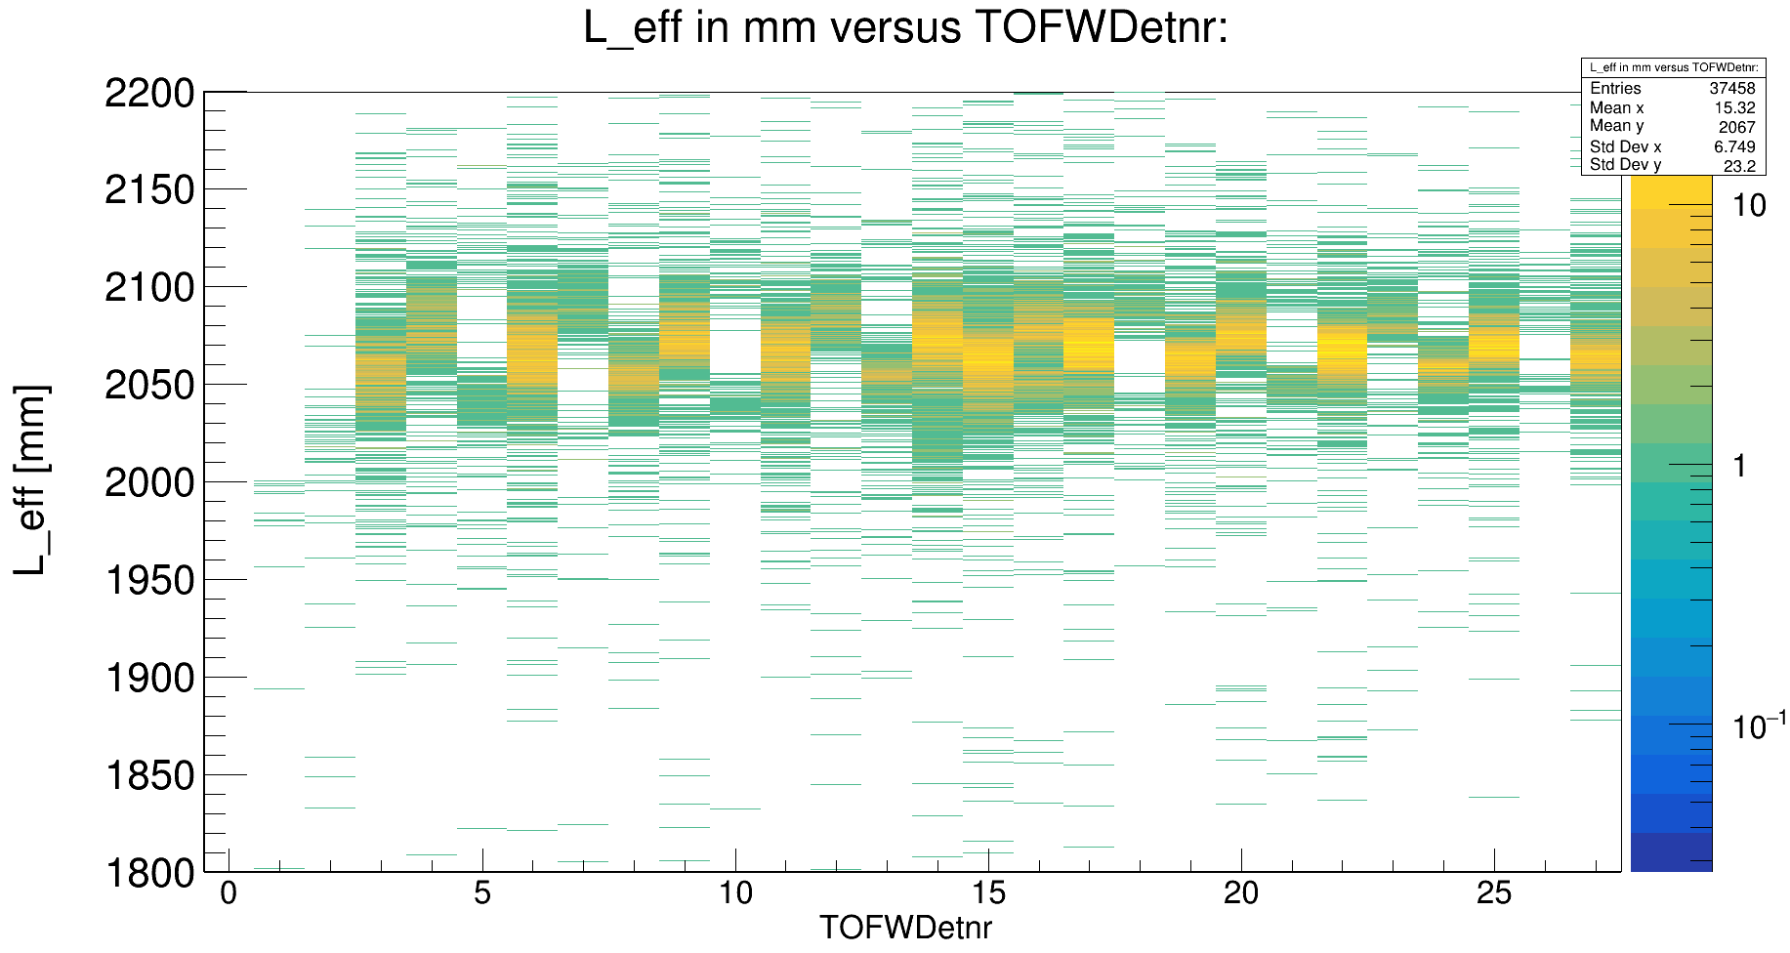
From ToF Calibration to Momentum Resolution Measurement...

Slide 23
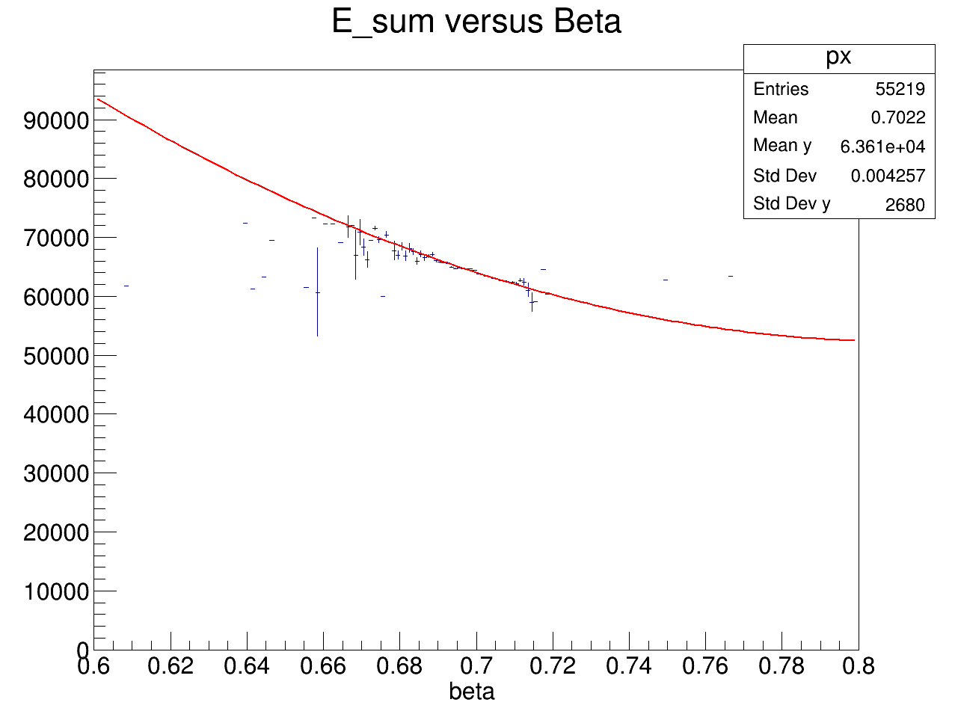
Further calibration steps
MUSICS
CALIFA
NeuLAND
- from raw time(START/TOFW) → flighttime
-from raw pos. in the detectorframes → full path trajectory
To Dos:
- ΔE corrections in TWIM from β
- ΔE corrections in TWIM from DT(drift time)
GLAD
START
MWPCs
TOFW
Energy versus velocity
(C¹² beam, engergy: 400AMeV)
Observables we measure:
-MWPCs = (x,y,z)
-MUSICS
→R3B MUSIC (Z,Θ)
→ Twim MUSIC (Z’,Θ’)
-START/TOFW (y, t)
energy channels (a.u.)

Slide 24

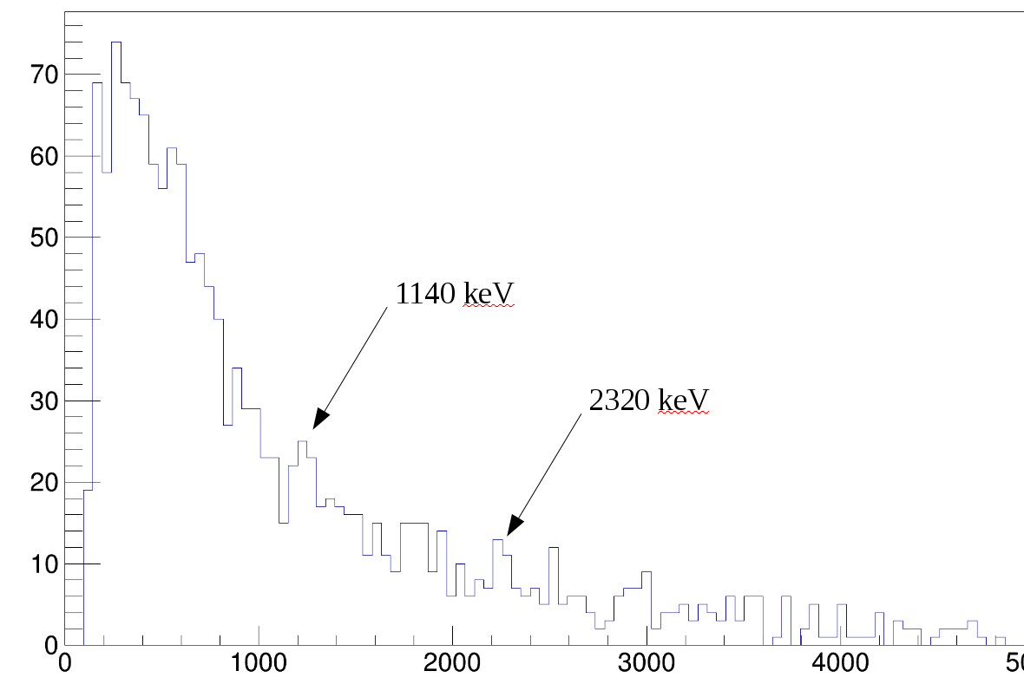
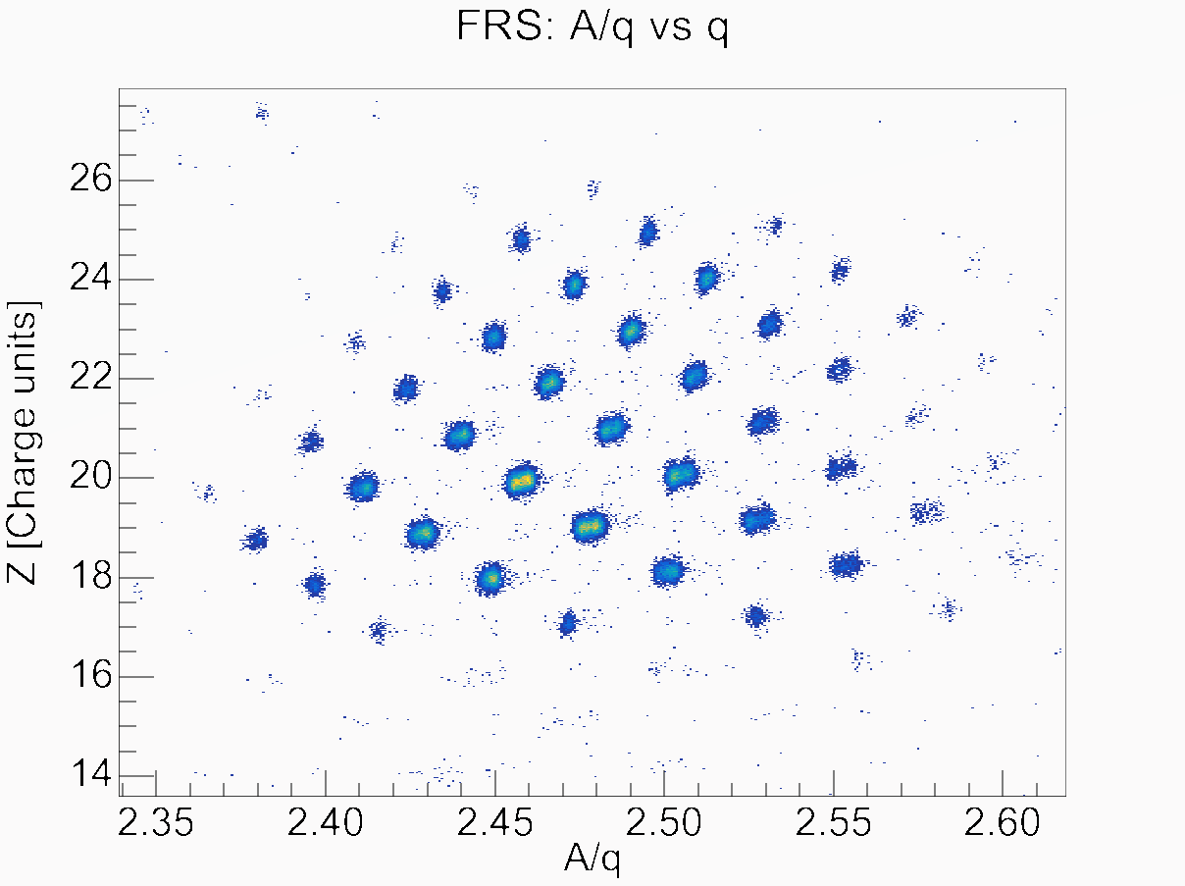
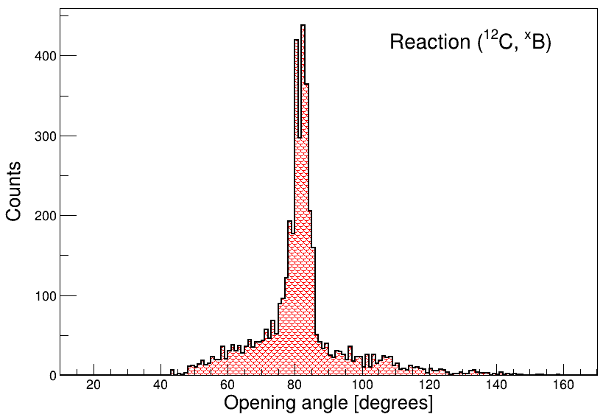
QFS – First Correlations in CALIFA
CALIFA
target chamber
Ca⁵⁰ cocktail from Fragment Separator

Slide 25
Summary & Outlook
→ CALIFA Doppler correction has to be done
→ Neutron detector NeuLAND is under calibration
→Calibration for incoming PID finished
→ Calibration for outgoing PID 50% finished
Tobias Jenegger
Particle Identification in R³B

Slide 26



CALIFA @ Technical University of Munich (TUM)
Roman Gernhäuser, Lukas Ponnath, Philipp Klenze, Tobias Jenegger
Thank you!

Slide 27
Backup

Slide 28
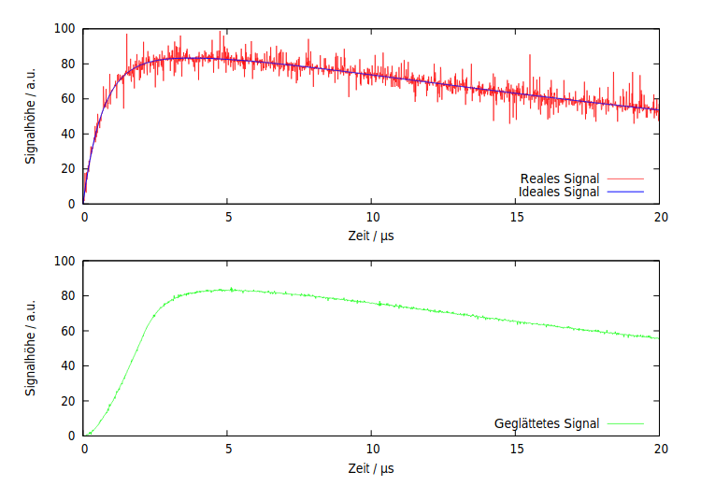
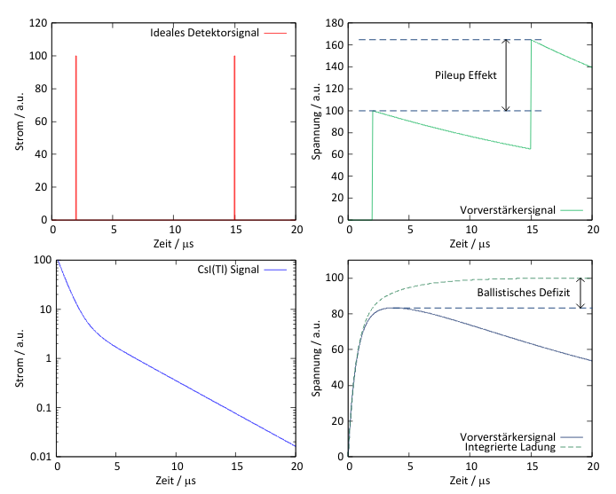
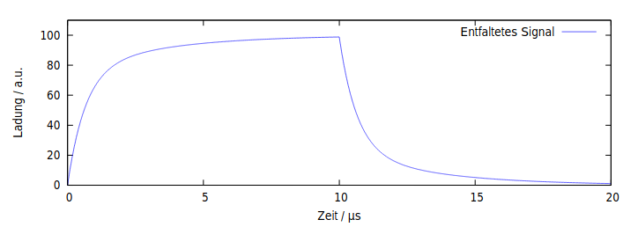
Pulse Shape Analysis and Particle Identification@FEBEX
Wanted: Energy & Particle Identification
→ convert to digital signal (ADC)
→ further filtering is needed:
discriminator, shaping,
baseline reconstruction,…
→ Energy ~ integrated charge
→ Appropriate Method: moving window deconvolution (MWD)
window size
Energy is measured from the max. pulse height
Tobias Jenegger
Particle Identification in R³B

Slide 29



