Slide 1






11B Analysis with S455 Setup
Setup and Detectors
Particle Identification
12C(p,2p)11B reaction
Summary & Outlook
Tobias Jenegger
R3B Collaboration Meeting
30. Nov. 2020
Supported by BMBF 05P15WOFNA and 05P19WOFN1.
The results presented here are based on the experiment s444/s473, which was performed at the beam line/infrastructure Cave C at the GSI Helmholtzzentrum für Schwerionenforschung, Darmstadt (Germany) in the frame of FAIR Phase-0.
Physics with R³B
CALIFA – Design
TUM Members:
Roman Gernhäuser,Lukas Ponnath,Philipp Klenze,Tobias Jenegger

Slide 2
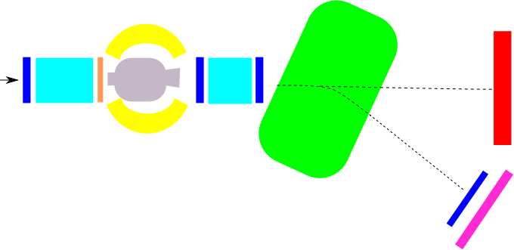
The S455 Setup (February 2020)
GLAD magnet
R³B Music
CALIFA
NeuLAND
MWPC1
beam
neutrons
MWPC0
START
MWPC2
TWIM Music
MWPC3
Daughter
nuclei
Beam energy: from 400 to 800 AMeV
Intensities: 1kHz - 1MHz
Beamtype: 12C,
Target: C, CH2
Time of Flight Wall

Slide 3
Particle Identification
START
TWIM Music
x
MWPC0
MWPC1
z
Time of Flight Measurement: Start to TOFW
Flight-path Reconstruction: Tracking Detectors (MWPC1, 2 and 3)
Charge Measurement : TWIM Music
CALIFA
MWPC2
MWPC3
Time of Flight Wall
11B Analysis with S455 Setup

Slide 4
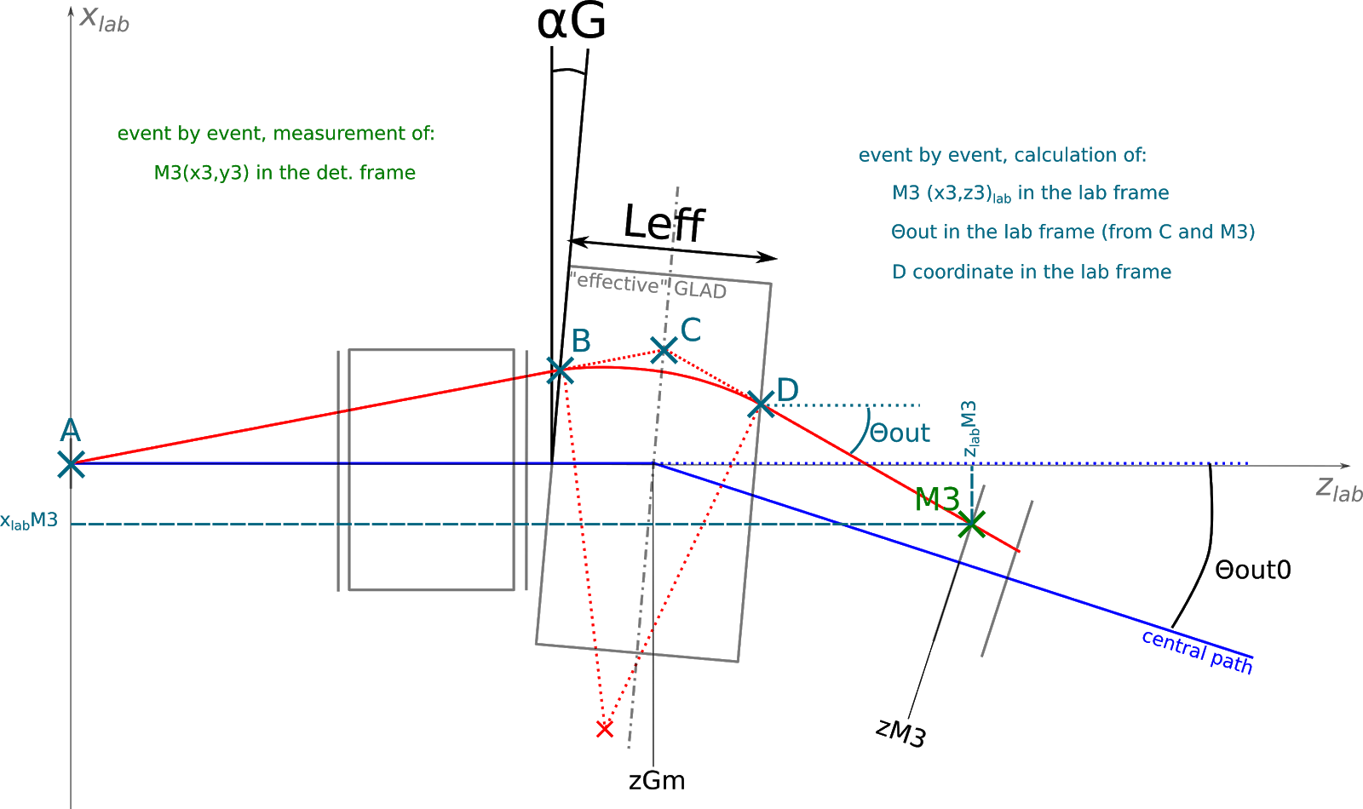
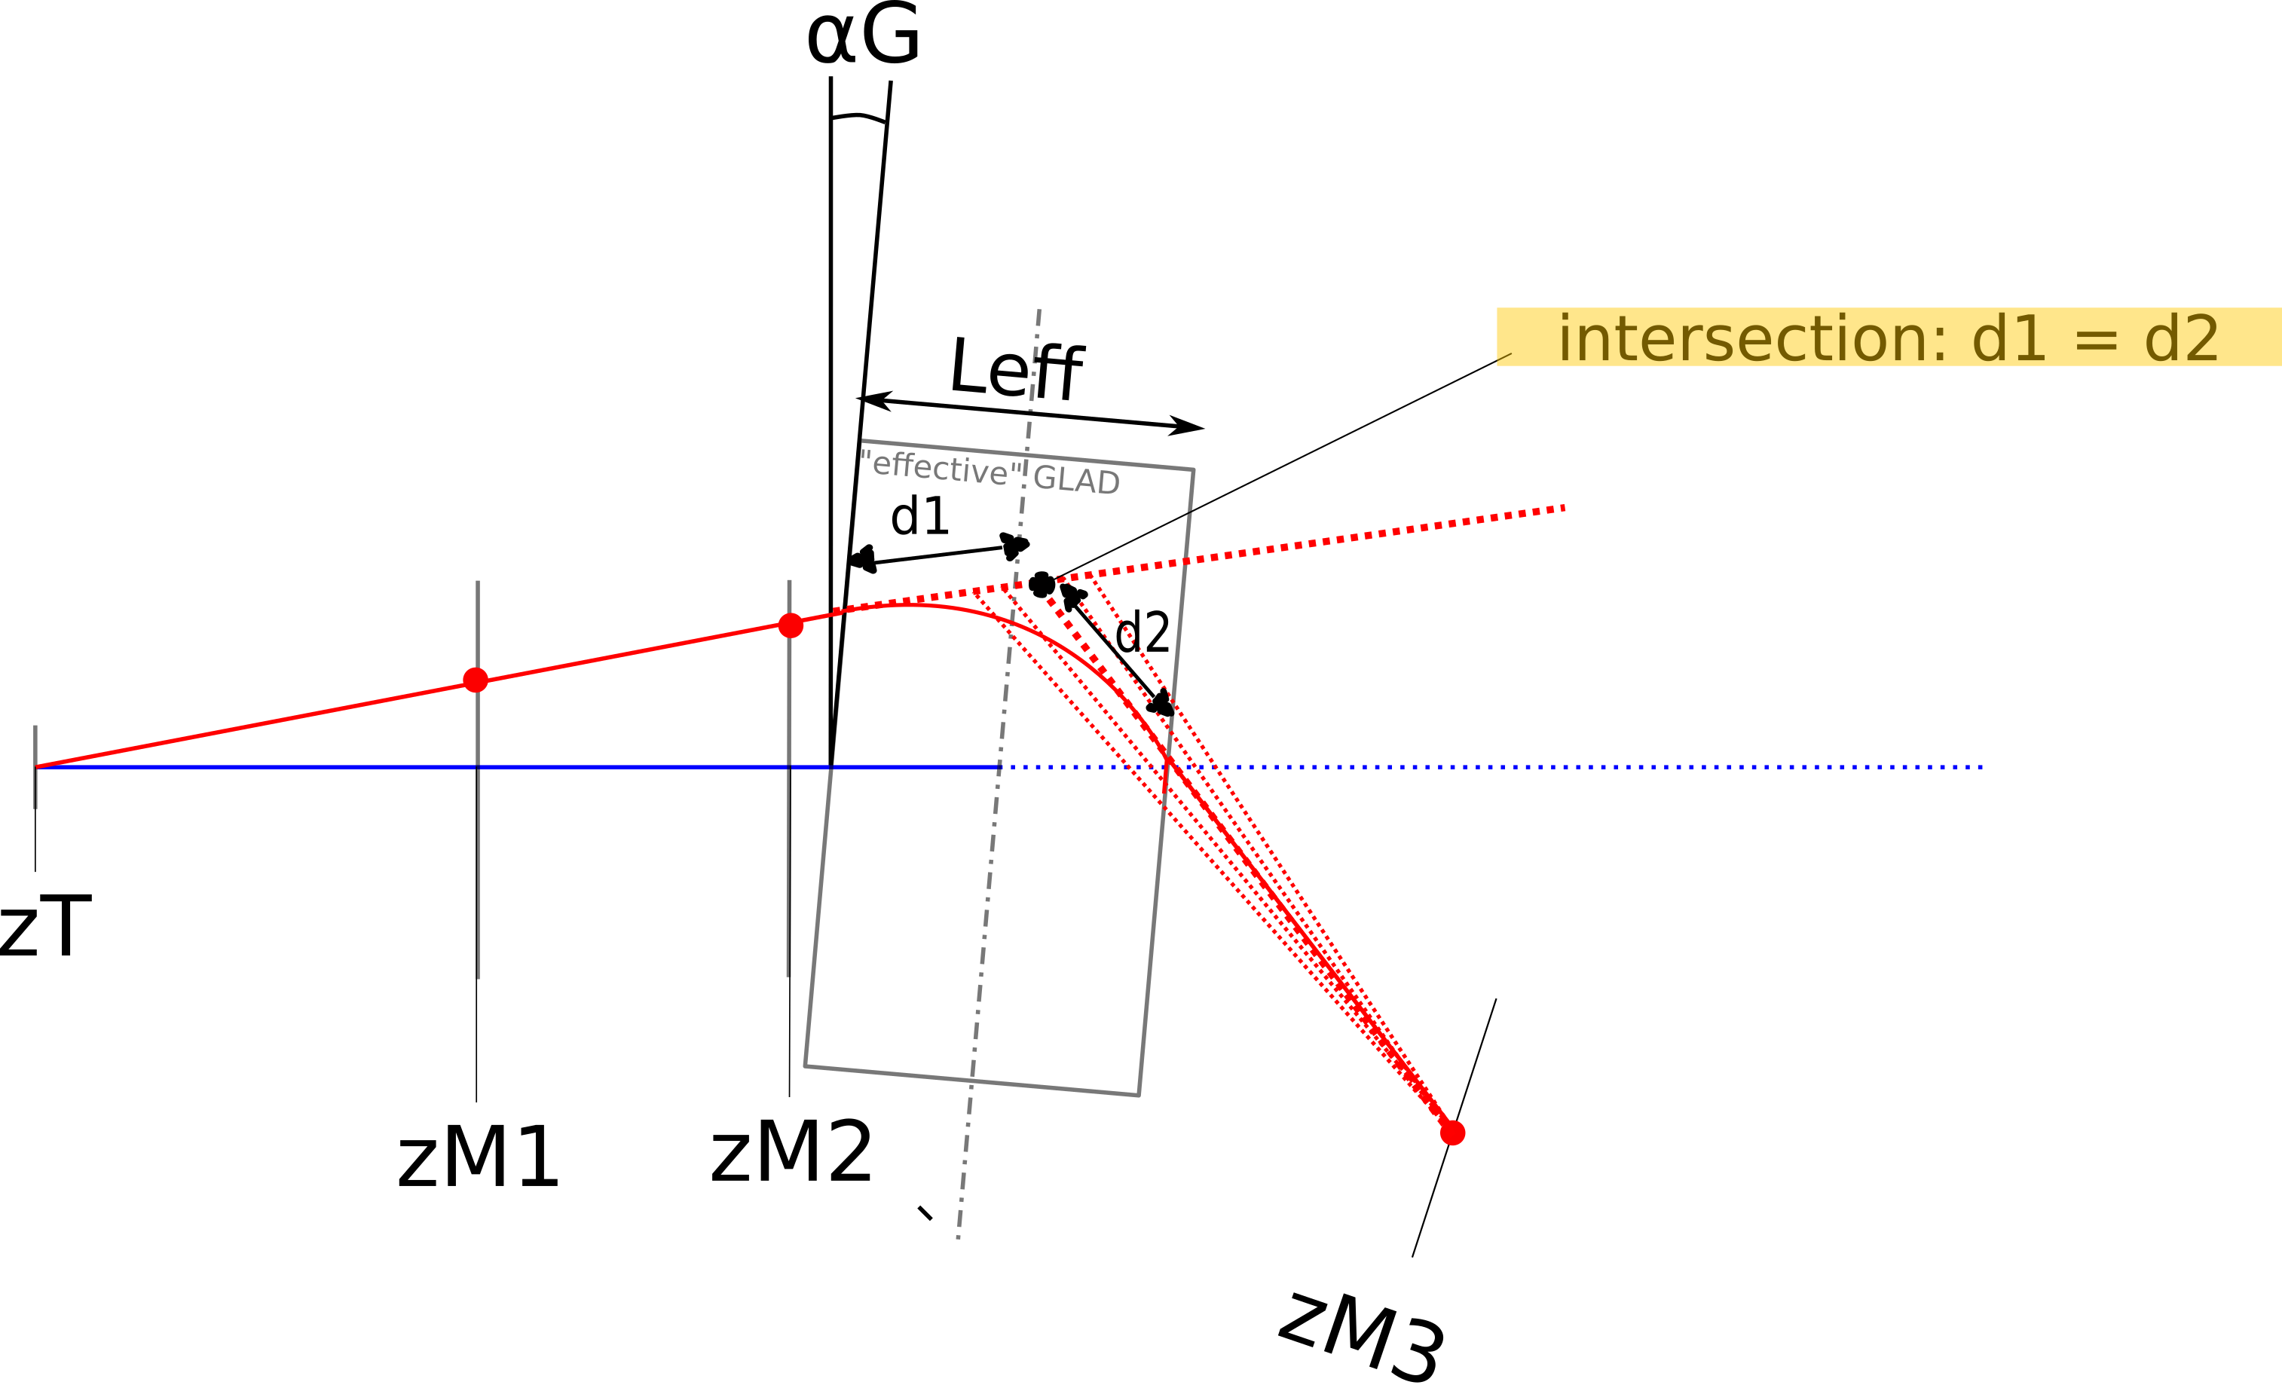
Flightpath Reconstruction
Radius Reconstruction:
Known:
position and inflight angle (θ_{in}) before GLAD
position after GLAD (MWPC3)
compute θ_{out} iteratively:
MWPC1
MWPC2
MWPC3

Slide 5

Charge versus A/q
12C
11C
10B
11B

Slide 6


12C(p,2p)11B reaction

Slide 7
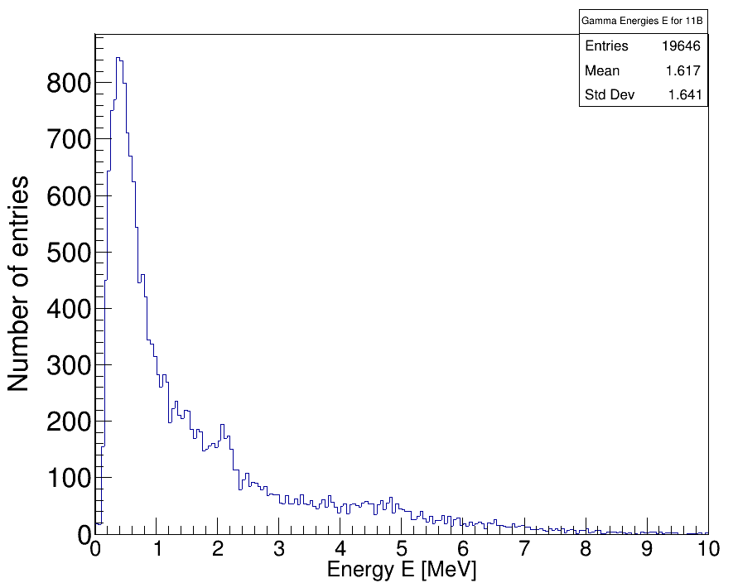
Gamma Spectrum of 11B
Doppler Correction
2.1 MeV (1/2-) p-hole state
5.0 MeV (5/2-) p-hole state

Slide 8
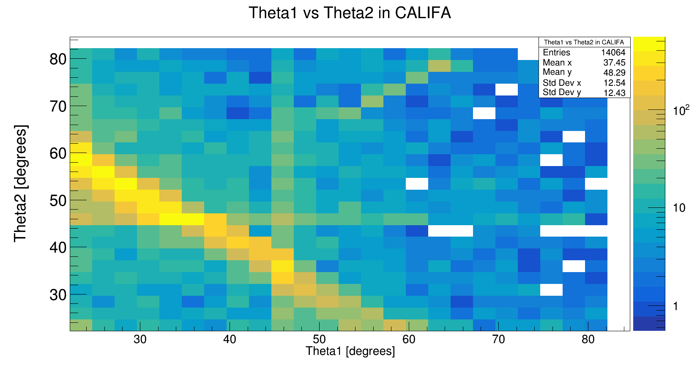

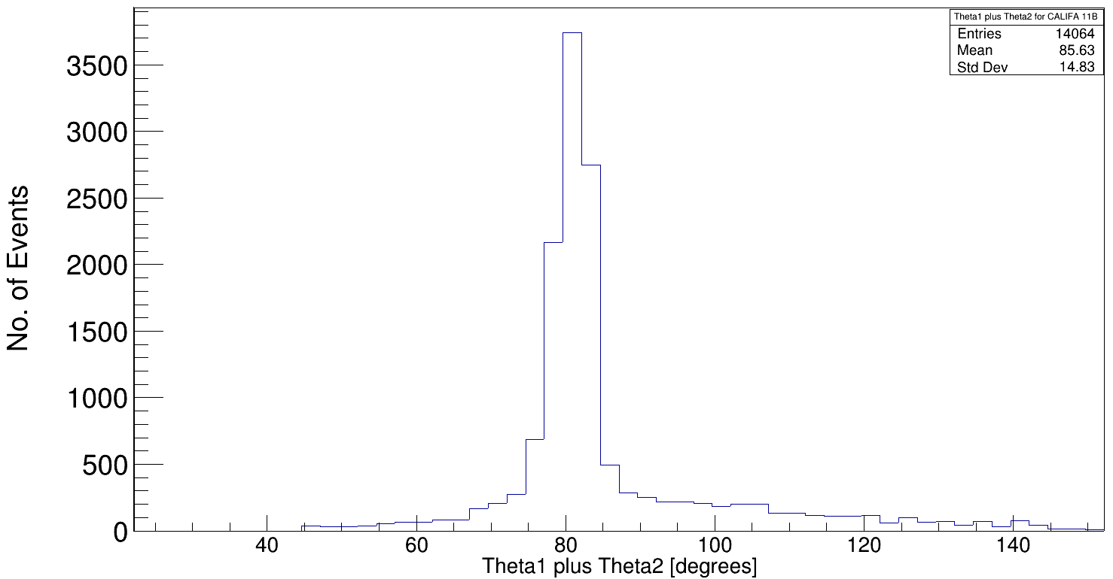
Polar Angular Distribution of protons for 12C(p,2p)11B
Barrel region with high acceptance
iPhos region
11B Analysis with S455 Setup

Slide 9

Arzimuthal Distribution of protons for 12C(p,2p)11B
z
Theta2 [degreees]
x
y
Theta1 [degreees]
CALIFA left half (90°) iPhos
Tobias Jenegger
11B Analysis with S455 Setup
CALIFA right half (45°) iPhos

Slide 10
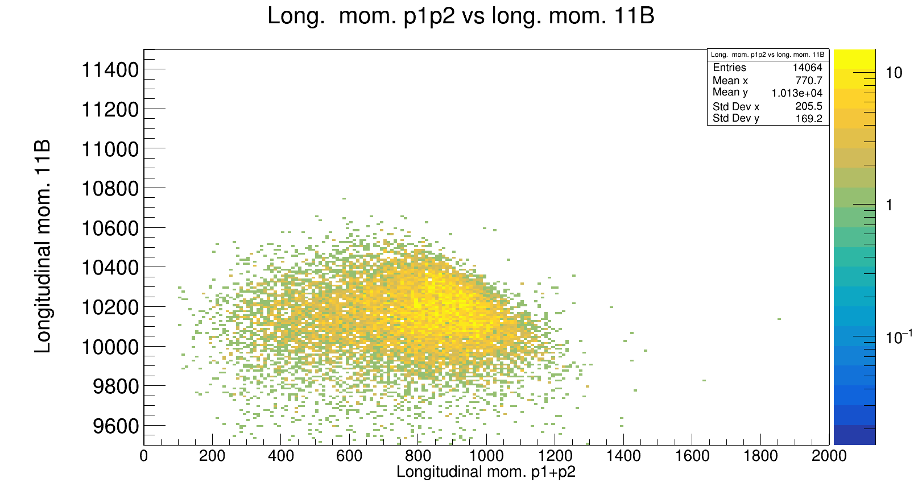
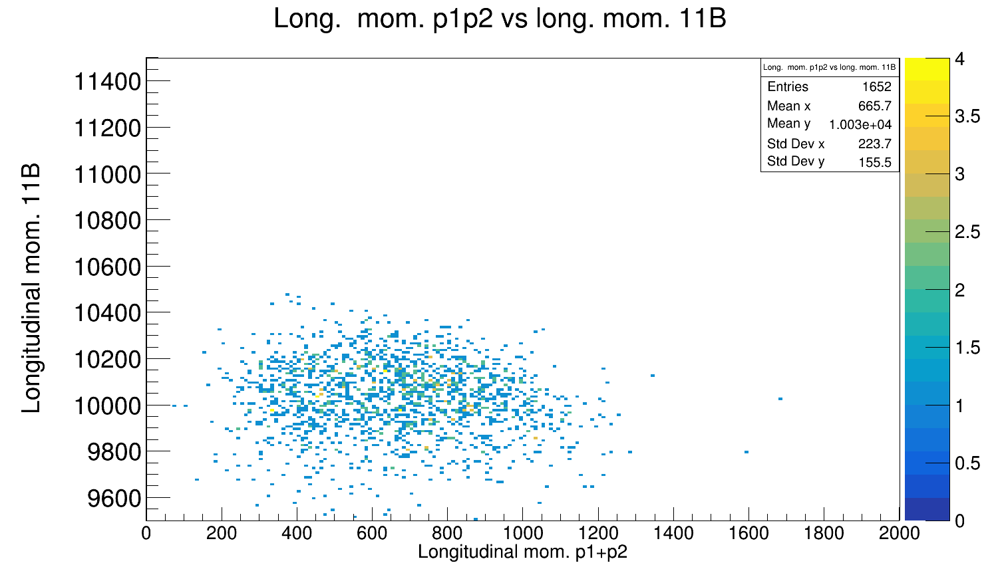
Momentum Distribution 2p & 11B
expected: barrier line
Explanation for smearing needed:
→ use simulation
→boosting to 12C frame:
p_{i}
11B
With 5.4 mm carbon target:

Slide 11
Summary & Outlook
→ Particle Identification works out
→ Gamma spectrum and angular distribution plots look reasonable
→ Further investigations for momenta distributions of the outgoing particles needed
→ Expand analysis towards 10B isotope
Tobias Jenegger
11B Analysis with S455 Setup

Slide 12



CALIFA @ Technical University of Munich (TUM)
Roman Gernhäuser, Lukas Ponnath, Philipp Klenze, Tobias Jenegger
Thank you!

Slide 13
Backup

