Slide 1







CALIFA DAQ
Readout and Electronics status update
Tobias Jenegger
R³B Week May 2023
Current Status
Filling CEPA
Final Electronics Configuration
Funded by the Deutsche Forschungsgemeinschaft (DFG, German Research Foundation)
under Germany’s Excellence Strategy – EXC-2094 – 390783311,
BMBF 05P19WOFN1, 05P21WOFN1
and the FAIR Phase-0 program
Physics with R³B
CALIFA – Design
TUM Members:
Roman Gernhäuser,Lukas Ponnath,Philipp Klenze,Tobias Jenegger

Slide 2
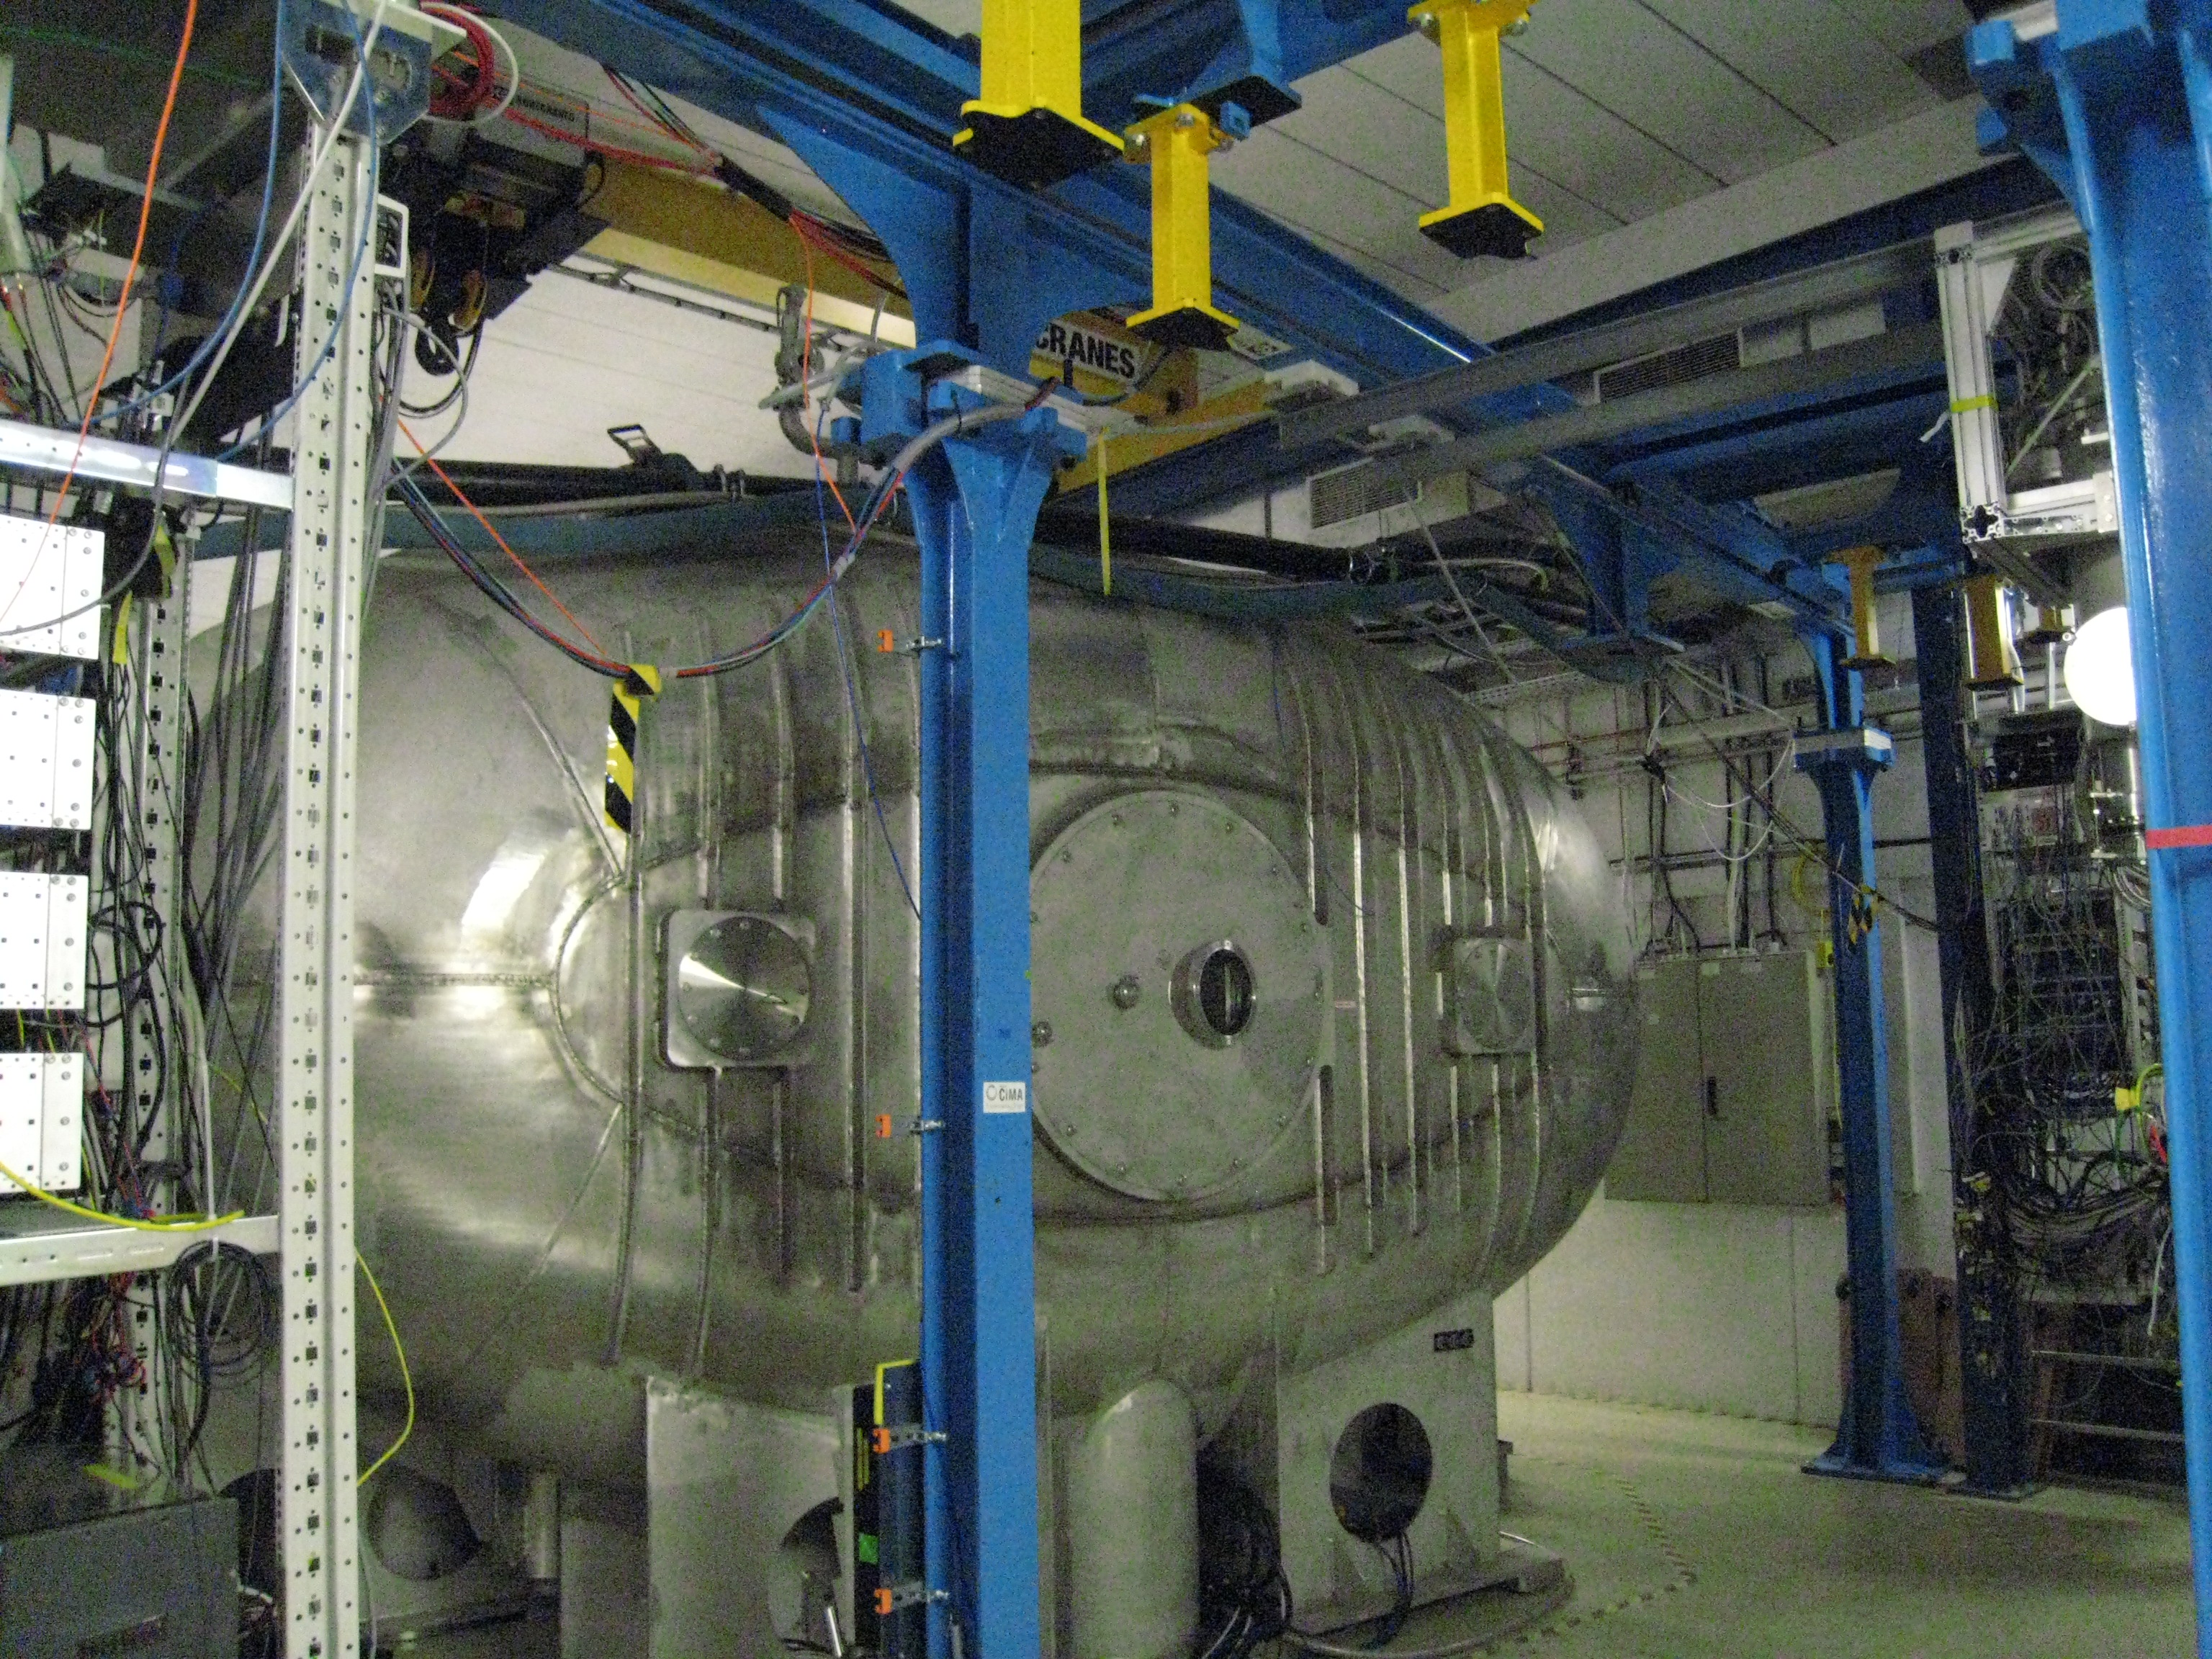
Where is CALIFA?

Slide 3
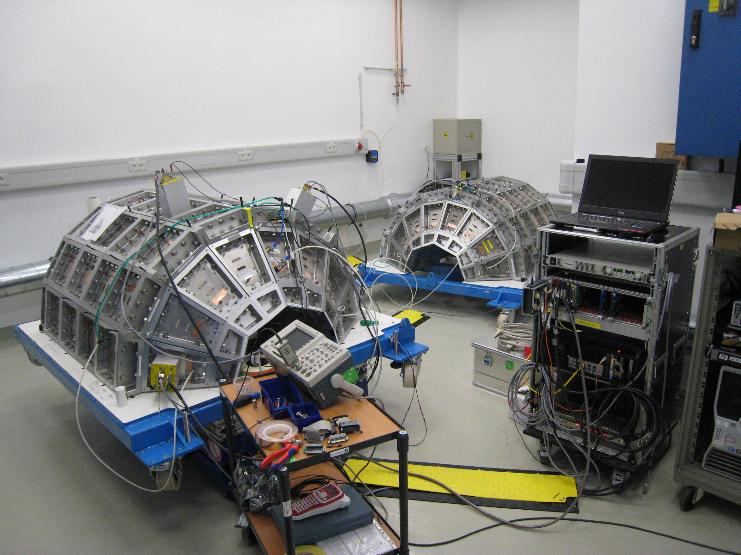
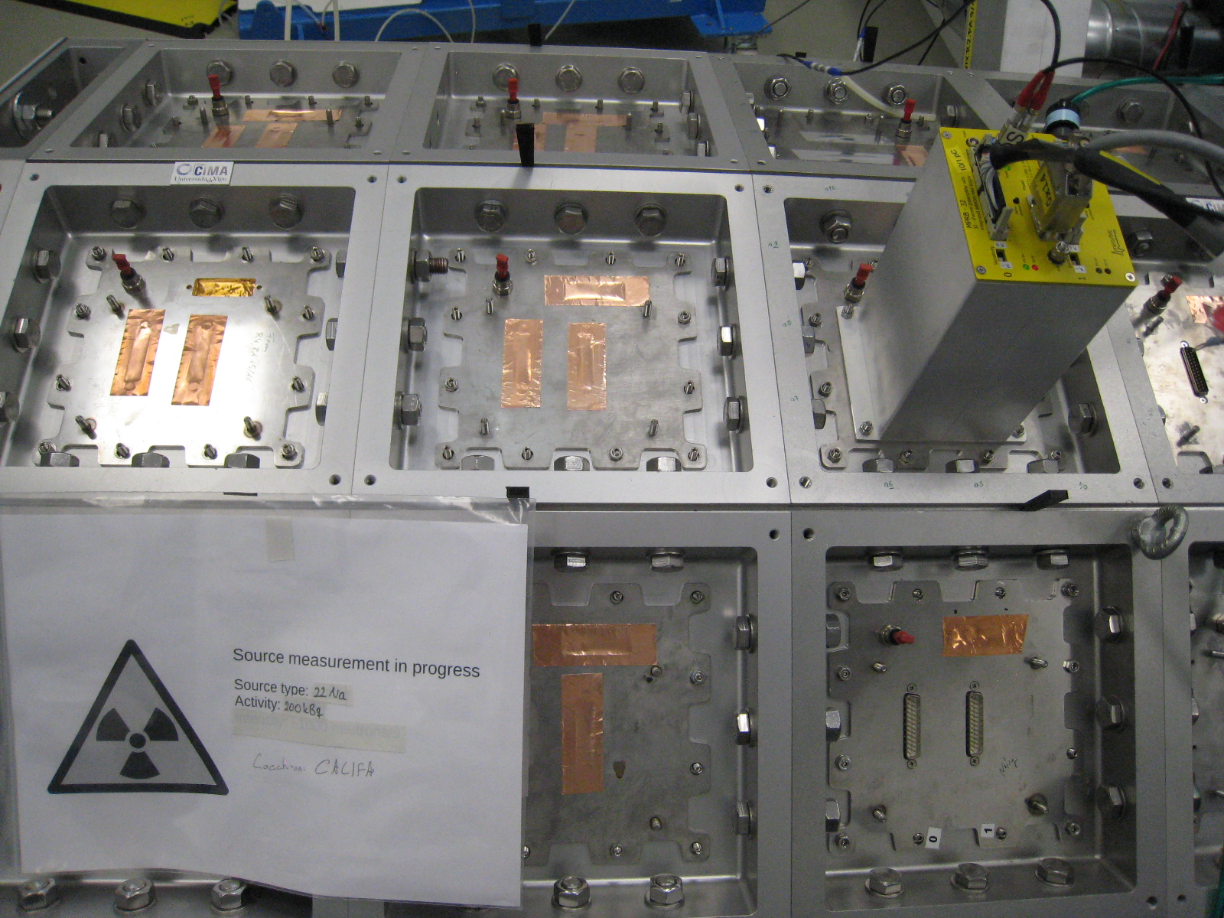
Meanwhile in R³B Preparation ROOM ….
Noise debugging
Cable/connectors checking
Etc.
More in Stefan Eder’s talk

Slide 4
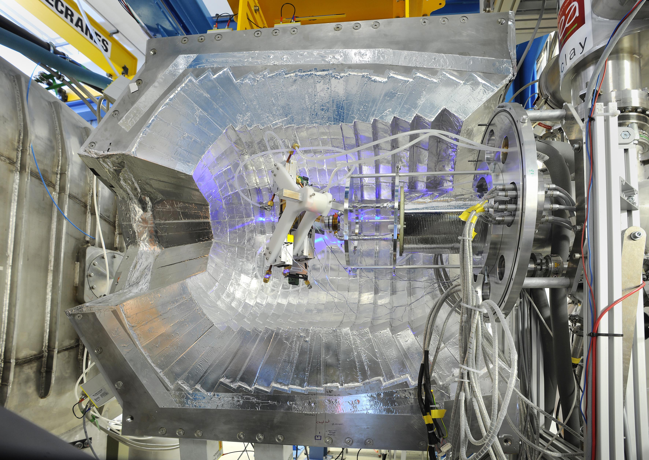
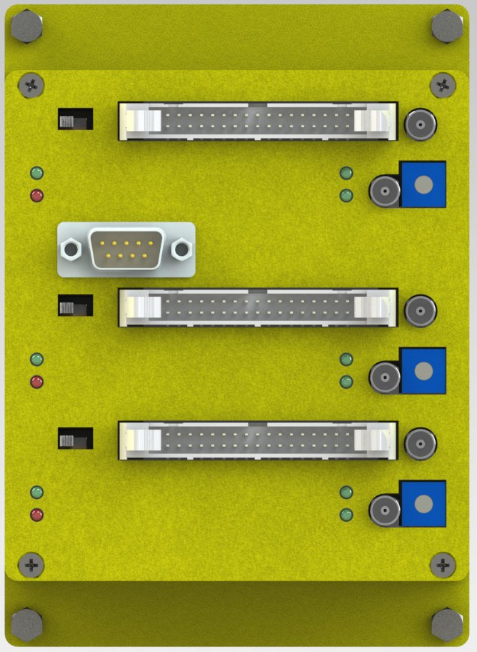
Filling CEPA
Most forward section: 7° ≤ θ ≤ 19°
96 CsI crystals
Mesytec MPRB-48 Dual Range Preamps
They get mounted on iPhos tiles
Connected to iPhos APDs
(32 channels)
Connected to CEPA APDs
(16 channels)

Slide 5
CALIFA Configuration (S522, 2022)
iPhos:
completely filled
readout with Dual Range Preamps
DR
100/10 MeV
Barrel:
Half filled (Ring 3&4)
Readout with Single Range (300/30 MeV) Preamps
300/30 MeV
100/10 MeV
Pulser:
2 SR 100/10 MeV Preamps
For deadtime/sync checking
DR

Slide 6
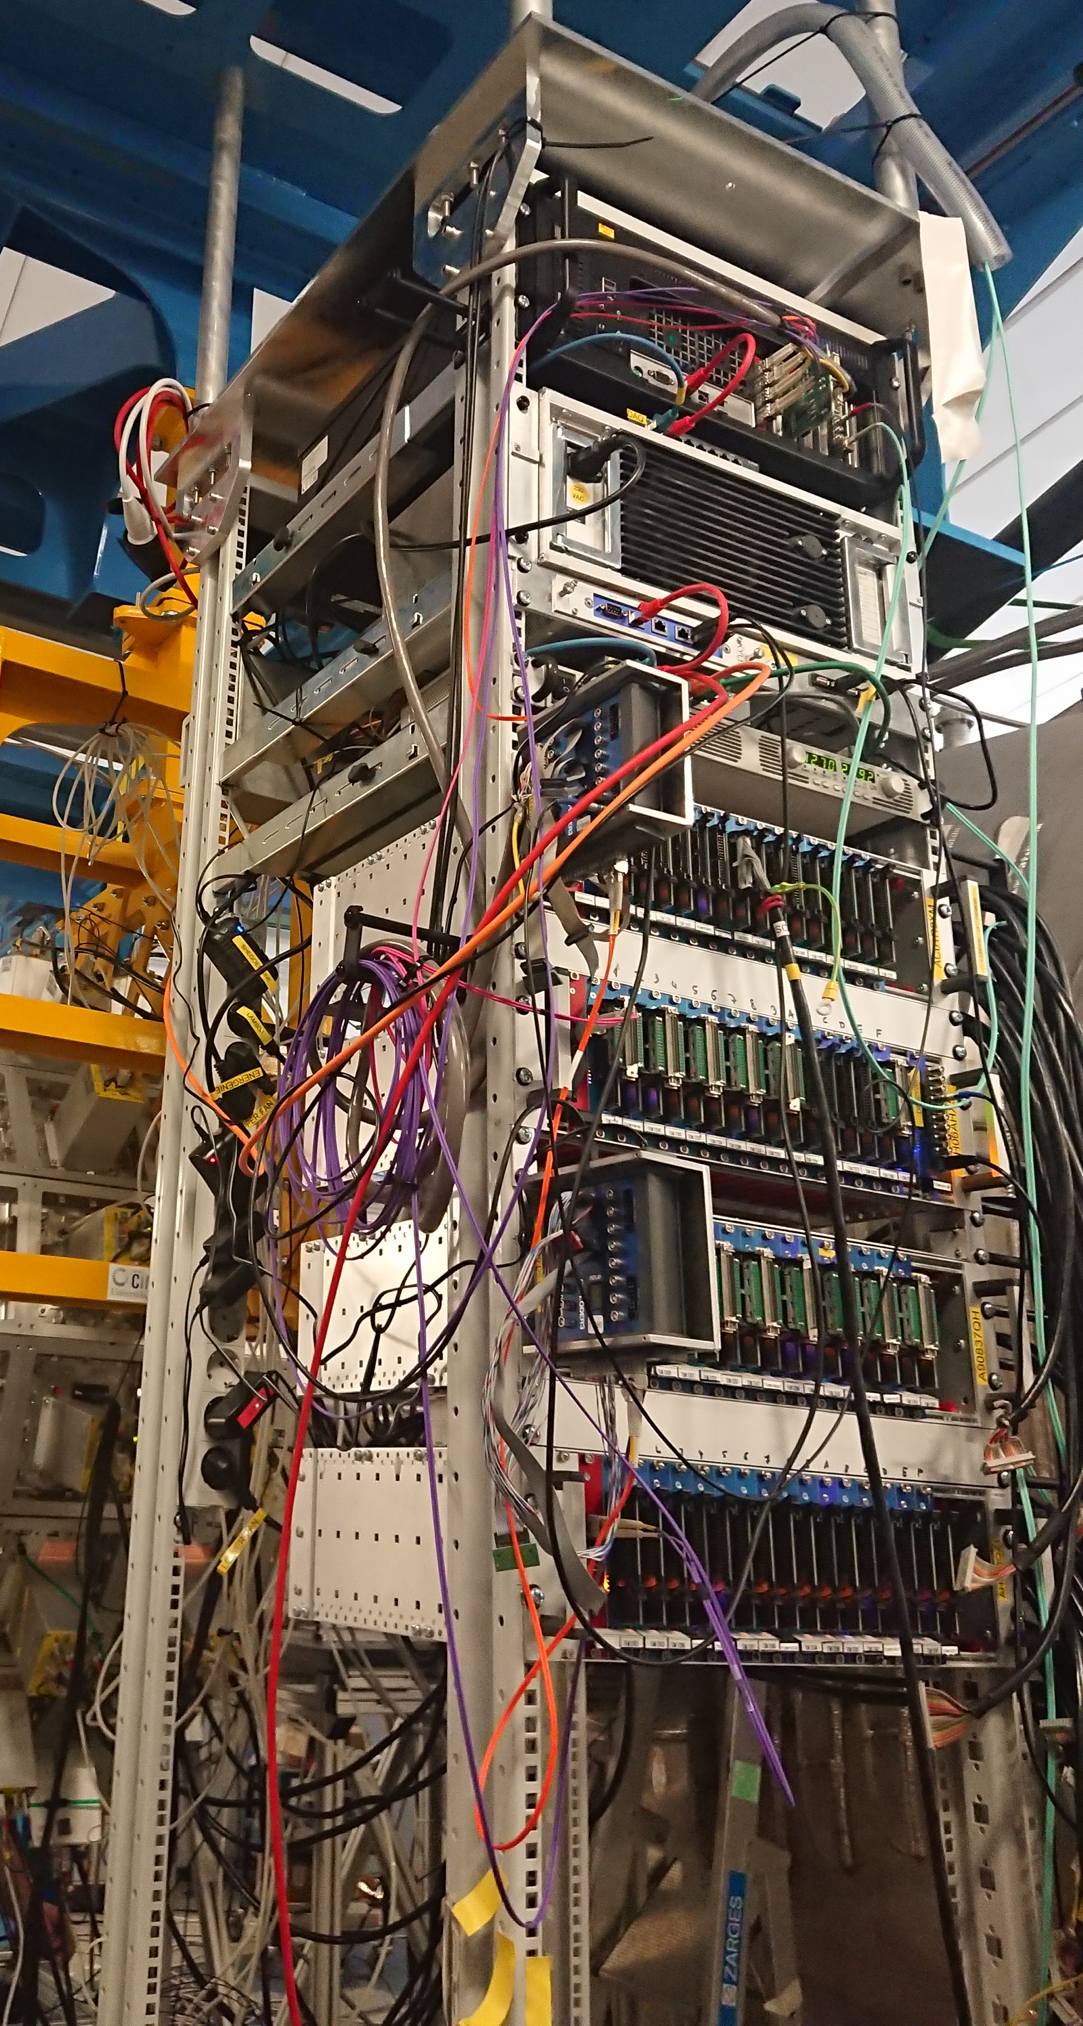
CALIFA DAQ Status (S522, 2022)
Pexor
Trixor
CALIFA DAQ-PC
Electronic Rack
Pexaria
8 Crates (each with 18 x FEBEX + Addon)
2 PCs (with Knipex+TRIXOR)
2 TDK Lambda
4 Exploder
1 “Overlord” Exploder
2 Slow Control PCs
LV - WIENER
Power Distributer
Exploder
Exploder
TDK Lambda
Cables
32 SCSI data cables (iPhos)
64+2 SR data cables (Barrel)
48 LV power cables
NIM Crate

Slide 7
What do we have still in Stock?

Slide 8
Stock
Missing compared to order status
3 x full crates
25 x FEBEX
BROKEN: 20 x FEBEX
1 x Crate + Addon
70 x Addon
2 x Exploder
8 x FEBEX (LUND)
8 x FEBEX (TUDa)
4 x FEBEX (Mobil)
4 x FEBEX (TUM)
24 x FEBEX
TDK Lambda
2 x TDK Lambdas
TDK Lambda
+
2 x
PC+Knipex+TRIXOR+EXPLODER
+

Slide 9
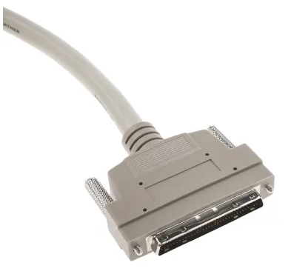
Stock
Missing compared to order status
DR 30/300
8 x 30/300 DR32
DR 30/300
1 x 30/300 DR32
SR 30/300
4 x 30/300 SR32
SR 30/300
6 x 30/300 SR32
SR 10/100
5 x 10/100 SR32
SR 10/100
5 x 10/100 SR32
8 x SCSI Cables
11 x Single Cables

Slide 10
Possible Electronics Configurations

Slide 11
Default Configuration
CEPA
iPhos
Ring 4
Ring 3
Ring 2
Ring 1
DR 30/300
SR 30/300
SR 30/300
SR 30/300
SR 10/100
LV - WIENER
Power Distributer
DR 30/300
SR 30/300
SR 10/100
DR 30/300
SR 30/300
SR 30/300
Exploder
DR 48 30/300
SR 30/300
SR 30/300
SR 30/300
SR 10/100
DR 48 30/300
SR 30/300
SR 30/300
SR 30/300
SR 10/100
Exploder
DR 48 30/300
SR 10/100
DR 48 30/300
SR 30/300
SR 30/300
SR 30/300
DR 48 30/300
SR 30/300
SR 30/300
SR 30/300
SR 10/100
Exploder
TDK Lambda
DR 30/300
SR 30/300
SR 30/300
SR 30/300
SR 10/100
DR 30/300
SR 30/300
SR 30/300
SR 30/300
SR 10/100
Exploder
TDK Lambda
NIM Crate

Slide 12
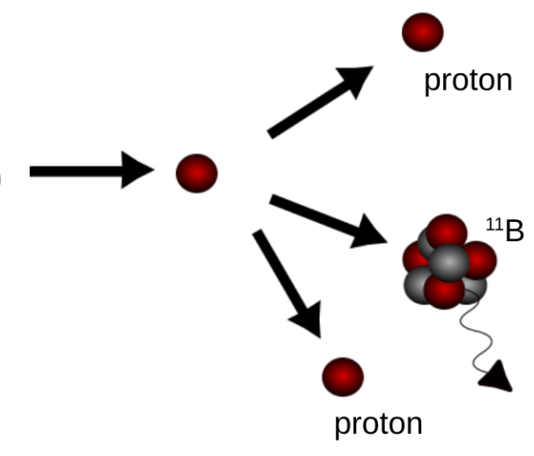
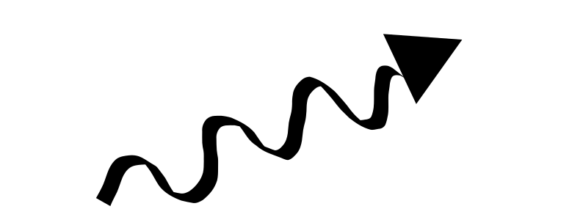
Default Configuration
SingleRange Preamplifier
Dual Range Preamplifier
low gain range
CEPA
iPhos
Ring 4
Ring 3
Ring 2
Ring 1
DR 30/300
SR 30/300
SR 30/300
SR 30/300
SR 10/100
LV - WIENER
Power Distributer
DR 30/300
SR 30/300
SR 10/100
DR 30/300
SR 30/300
SR 30/300
Exploder
DR 48 30/300
SR 30/300
SR 30/300
SR 30/300
SR 10/100
DR 48 30/300
SR 30/300
SR 30/300
SR 30/300
SR 10/100
Exploder
OR
DR 48 30/300
SR 10/100
DR 48 30/300
SR 30/300
SR 30/300
SR 30/300
high gain range
DR 48 30/300
SR 30/300
SR 30/300
SR 10/100
TDK Lambda
SIMULTANEOUS
high energetic paricle measurement
&
gamma spectroscopy
SR 30/300
Exploder
DR 30/300
SR 30/300
SR 30/300
SR 30/300
SR 10/100
DR 30/300
SR 30/300
SR 30/300
SR 30/300
SR 10/100
Exploder
TDK Lambda
experiment dependent decision has to be taken beforehand!
NIM Crate

Slide 13
4π Configuration
CEPA
iPhos
Ring 4
Ring 3
Ring 2
Ring 1
DR 30/300
DR 30/300
SR 30/300
SR 30/300
SR
10/100
LV - WIENER
Power Distributer
SR
30/300
DR 30/300
SR 30/300
Exploder
+
DR 30/300
DR 30/300
SR 30/300
SR
10/100
SR
30/300
DR 48 30/300
DR 30/300
SR 30/300
SR 30/300
SR
10/100
SR
30/300
LV-Extension
DR 48 30/300
DR 30/300
SR 30/300
SR 30/300
Exploder
SR
10/100
SR
30/300
DR 48 30/300
DR 48 30/300
DR 30/300
SR 30/300
SR 30/300
SR
10/100
SR
30/300
DR 48 30/300
DR 30/300
SR 30/300
SR 30/300
Exploder
TDK Lambda
Second Rack on each side needed!
SR
10/100
SR
30/300
DR 30/300
DR 30/300
SR 30/300
SR 30/300
SR
10/100
SR
30/300
Exploder
DR 30/300
SR 30/300
SR 30/300
DR 30/300
DR 30/300
DR 30/300
SR
10/100
SR
30/300
TDK Lambda
NIM Crate

Slide 14
Mixed Configuration
CEPA
iPhos
Ring 4
Ring 3
Ring 2
Ring 1
DR 30/300
DR
30/300
SR 30/300
SR 30/300
SR
30/300
SR
10/100
SR
30/300
LV - WIENER
Power Distributer
DR 30/300
DR
30/300
SR 30/300
DR 30/300
SR
30/300
SR 30/300
SR
10/100
Exploder
SR
30/300
DR 48 30/300
DR
30/300
SR 30/300
SR 30/300
SR
30/300
SR
10/100
SR
30/300
DR 48 30/300
DR
30/300
SR 30/300
SR 30/300
Exploder
SR
30/300
SR
10/100
SR
30/300
DR 48 30/300
DR 48 30/300
DR
30/300
SR 30/300
SR 30/300
SR
30/300
SR
10/100
SR
30/300
DR 48 30/300
DR
30/300
SR 30/300
SR 30/300
Exploder
TDK Lambda
SR
30/300
SR
10/100
SR
30/300
DR 30/300
DR
30/300
SR 30/300
SR 30/300
SR
30/300
SR
10/100
SR
30/300
Exploder
Load Balancing
DR 30/300
DR
30/300
SR 30/300
SR 30/300
DR 30/300
SR
30/300
SR
10/100
SR
30/300
TDK Lambda
NIM Crate

Slide 15

Comparison
Default Config.
4π Config.
Mixed Config.
Workload:
Minimum DAQ effort
Find missing 18 x FEBEX
Find 2 missing EXPLODERS
Modify 12DR32 into 8xDR48 (16k€)
Workload:
Minimum DAQ effort
Find missing 18 x FEBEX
Find 2 missing EXPLODERS
Workload:
Some DAQ effort
Find missing 18 x FEBEX
Find 2 missing EXPLODERS
Modify 16xSR-DR mixed (16k€)
Orders:
8 x DR 48 30/300 (60 k€)
8xSR32 30/300 10/100 (40 k€)
11 x SR32 10/100 (55 k€)
+ 3 spares (15 k€)
Modify 4 FEBEX CRATES(8 k€)
54 new FEBEX Cards (60 k€)
LV Extension (20k€)
Orders:
8 x DR 48 30/300 (60 k€)
8 x SR32 30/300 10/100 (40 k€)
+ 3 spares (15 k€)
Modify 2 FEBEX CRATES (4 k€)
36 new FEBEX Cards (40k€)
Orders:
12 x SR32 30/300 (60 k€)
11 x SR32 10/100 (55 k€)
+ 3 spares (15 k€)
Modify 2 FEBEX CRATES (4 k€)
18 new FEBEX Card (20 k€)
Sum: 180k€
Sum: 170k€
Sum: 248k€
As planned
All features in - 4π save
All features in - 4π save
Issues with punch through at 42-60°
More data, less spares
More modifications
@ Mesytec
Two more racks needed

Slide 16



CALIFA @ Technical University of Munich (TUM)
Roman Gernhäuser, Lukas Ponnath, Philipp Klenze, Tobias Jenegger
Thank you!

