Slide 1






11B Analysis with S455 Setup
Setup and Detectors
Particle Identification
12C(p,2p)11B reaction
Further Methods of Identification
Tobias Jenegger
R3B WG Meeting
11. Jan. 2021
Supported by BMBF 05P15WOFNA and 05P19WOFN1.
The results presented here are based on the experiment s444/s473, which was performed at the beam line/infrastructure Cave C at the GSI Helmholtzzentrum für Schwerionenforschung, Darmstadt (Germany) in the frame of FAIR Phase-0.
Physics with R³B
CALIFA – Design
TUM Members:
Roman Gernhäuser,Lukas Ponnath,Philipp Klenze,Tobias Jenegger

Slide 2
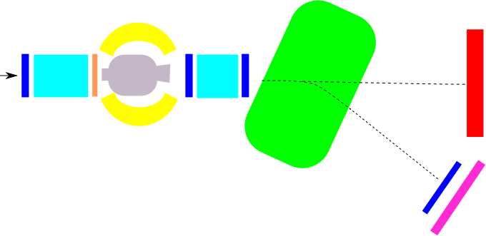
The S455 Setup (February 2020)
GLAD magnet
R³B Music
CALIFA
NeuLAND
MWPC1
beam
neutrons
MWPC0
START
MWPC2
TWIM Music
MWPC3
Daughter
nuclei
Beam energy: from 400 to 800 AMeV
Intensities: 1kHz - 1MHz
Beamtype: 12C,
Target: C, CH2
Time of Flight Wall

Slide 3
Particle Identification
START
TWIM Music
x
MWPC0
MWPC1
z
Time of Flight Measurement: Start to TOFW
Flight-path Reconstruction: Tracking Detectors (MWPC1, 2 and 3)
Charge Measurement : TWIM Music
CALIFA
MWPC2
MWPC3
Time of Flight Wall
11B Analysis with S455 Setup

Slide 4
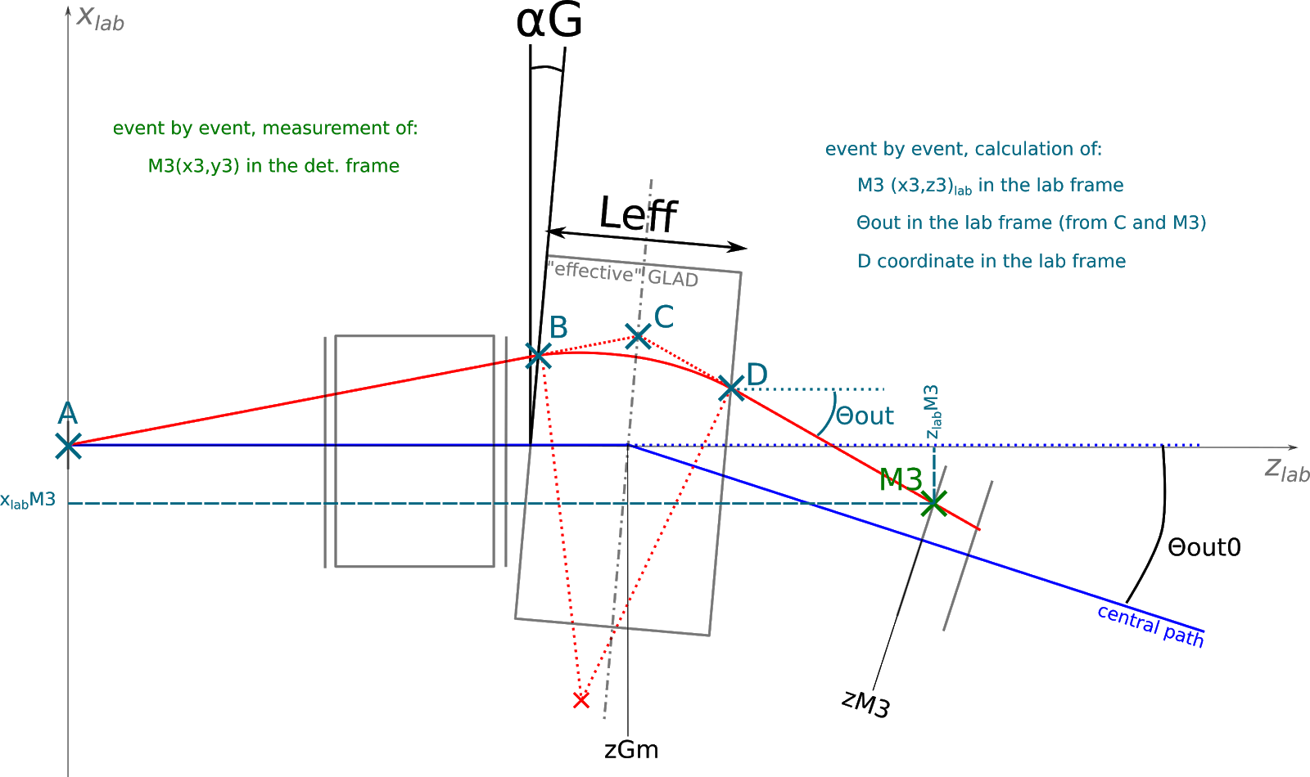
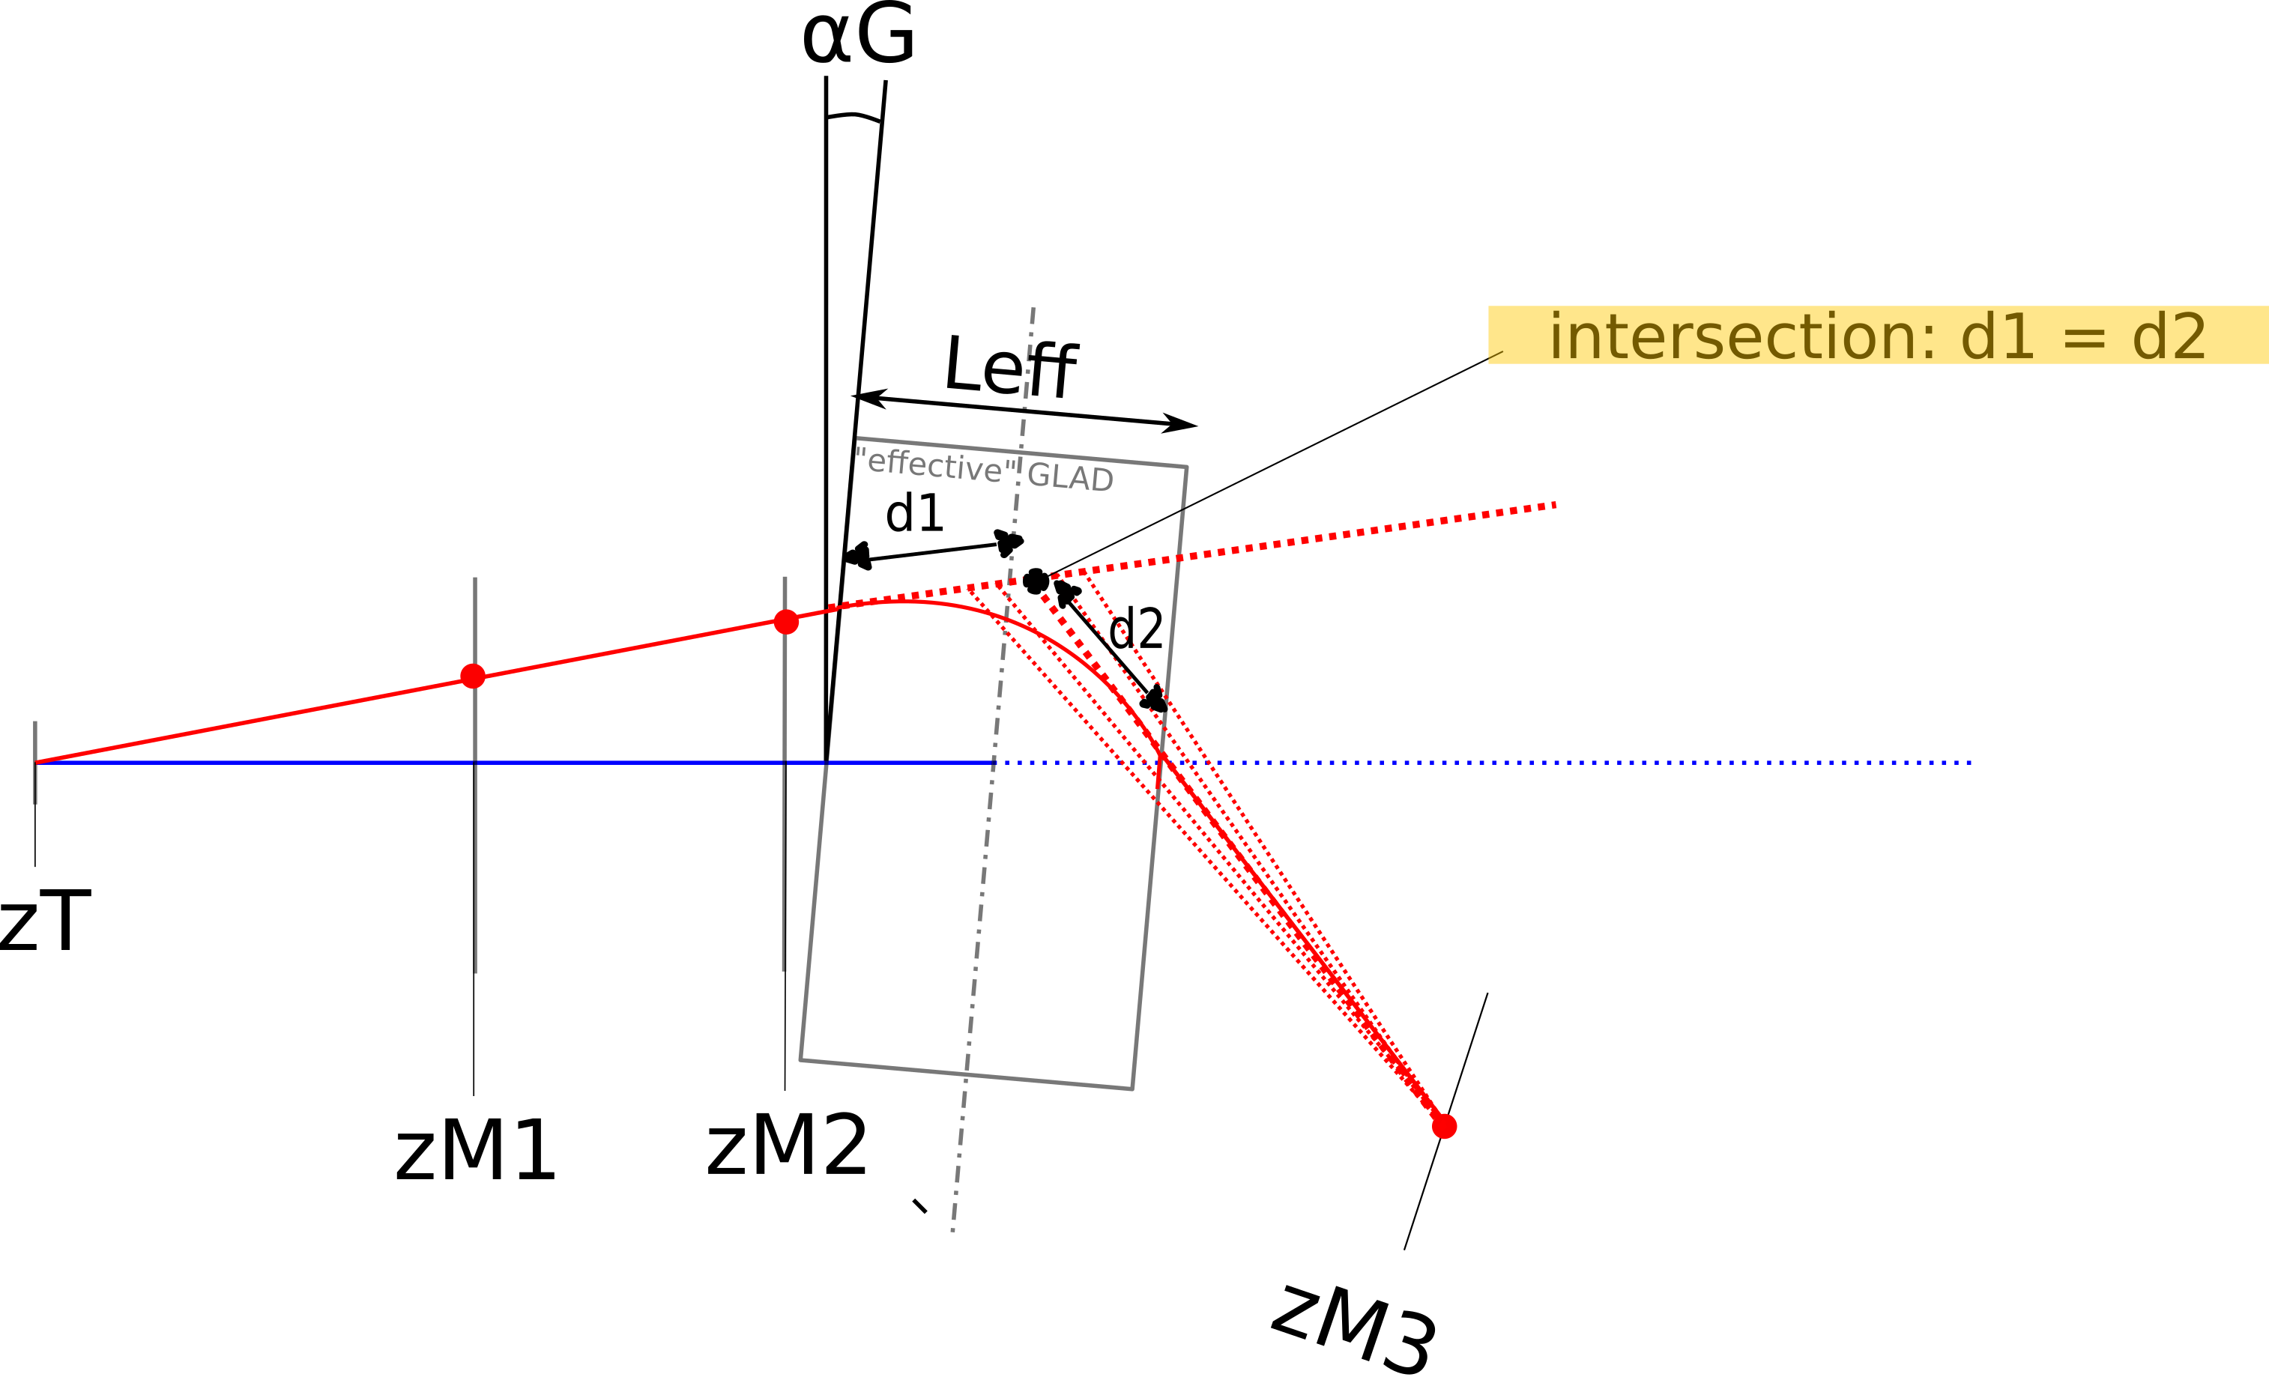
Flightpath Reconstruction
Radius Reconstruction:
Known:
position and inflight angle (θ_{in}) before GLAD
position after GLAD (MWPC3)
compute θ_{out} iteratively:
MWPC1
MWPC2
MWPC3

Slide 5

Charge versus A/q
12C
11C
10B
11B

Slide 6


12C(p,2p)11B reaction

Slide 7
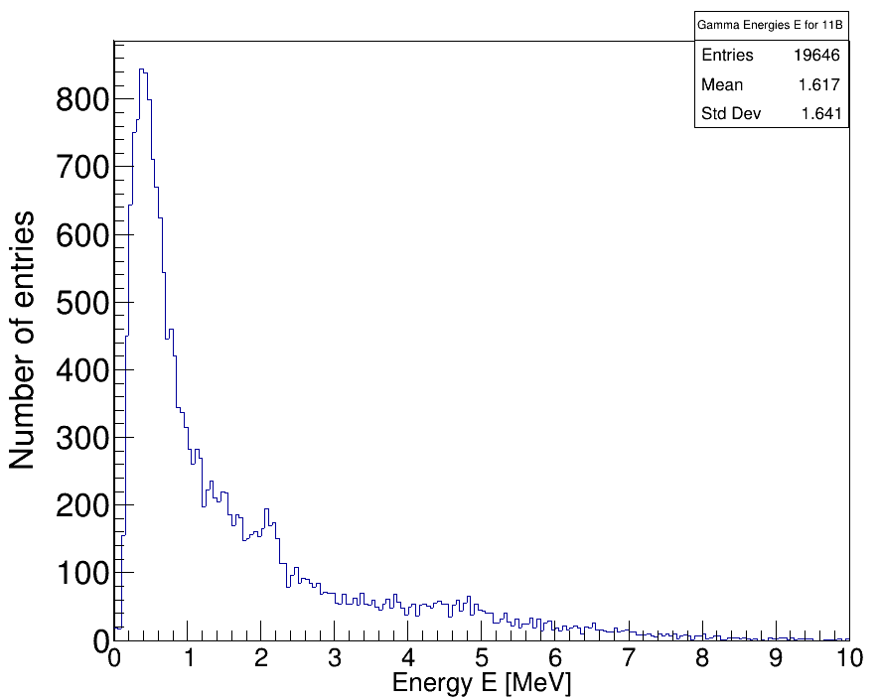
Gamma Spectrum of 11B
Doppler Correction
Single events can have multiple gamma hits
All gamma hits are filled into the histogramm (not just the hit with highest energy)
2.1 MeV (1/2-) p-hole state
5.0 MeV (5/2-) p-hole state

Slide 8
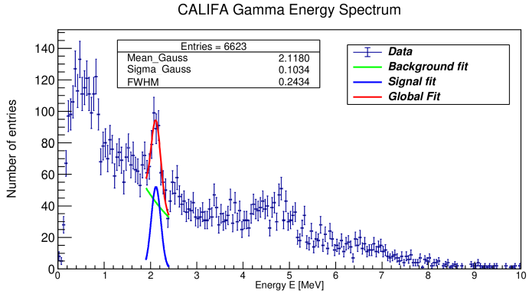
12C(p,2p)11B Analysis:
Beam energy: 400 AMeV
Beamtype: 12C
Beam Time: 3 hours
Target: CH2 (12.29mm)
Tracking Detectors: MWPC 1,2,3
ToF measurement: START to ToFW
Charge measurement: TWIM Music
Event selection criteria CALIFA:
→ two hits with E_{hit} > 30 MeV
¹¹B level scheme:
2.1 MeV (½ ⁻) p-hole state of ¹¹B
11B Analysis with S455 Setup, Feb. 2020
Tobias Jenegger

Slide 9
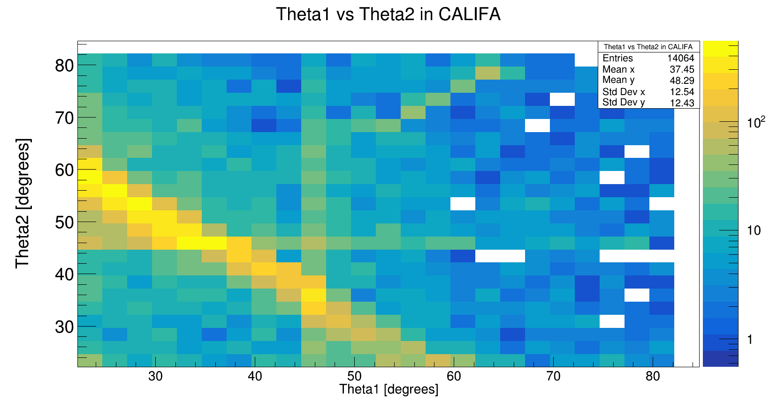

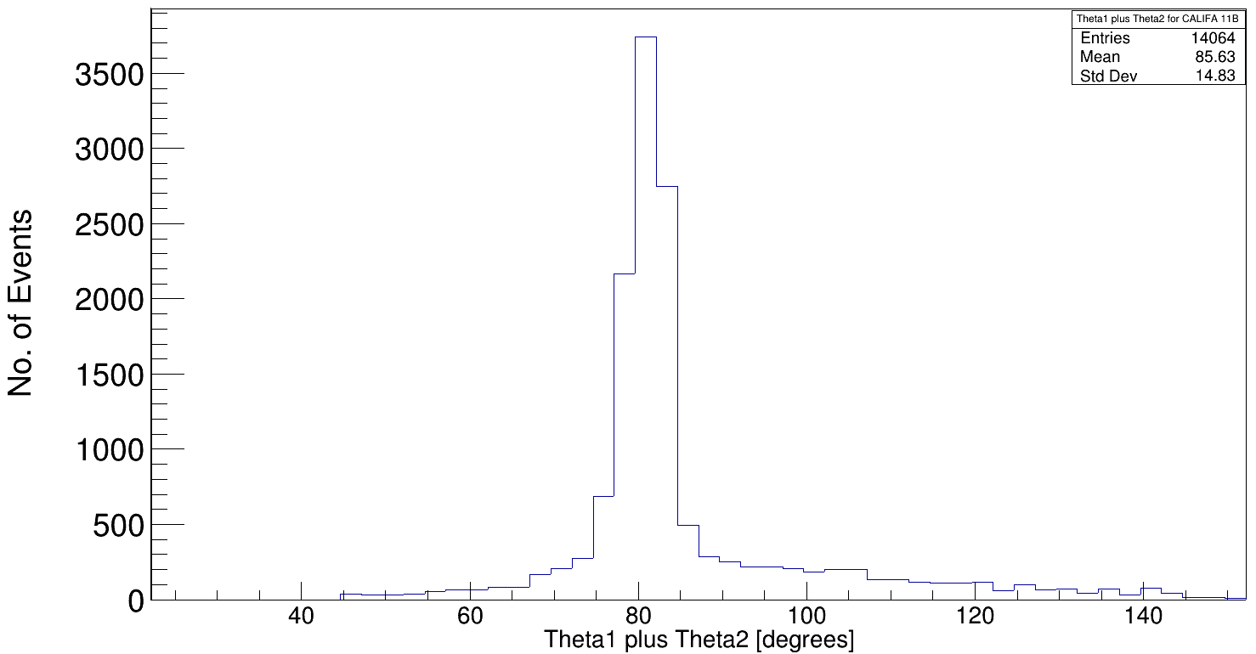
Polar Angular Distribution of protons for 12C(p,2p)11B
12C beam
Barrel region with high acceptance
iPhos region
11B Analysis with S455 Setup

Slide 10

Arzimuthal Distribution of protons for 12C(p,2p)11B
z
Psi2 [degreees]
x
y
Psi1 [degreees]
CALIFA left half (90°) iPhos
Tobias Jenegger
11B Analysis with S455 Setup
CALIFA right half (45°) iPhos

Slide 11
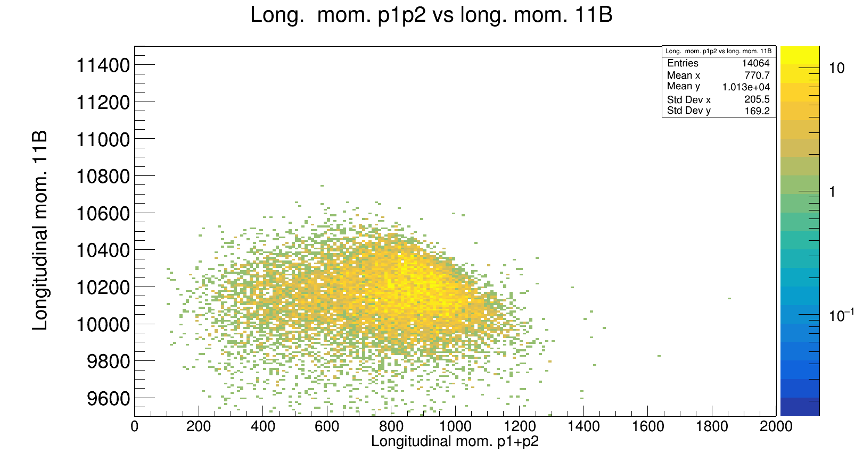
Momentum Distribution 2p & 11B
expected: barrier line
Smearing ??
Methods for Investigation:
→ Simulation
→ Boosting to the 12C frame
→ CALIFA shifting / geometric validation
→ Background analysis

Slide 12
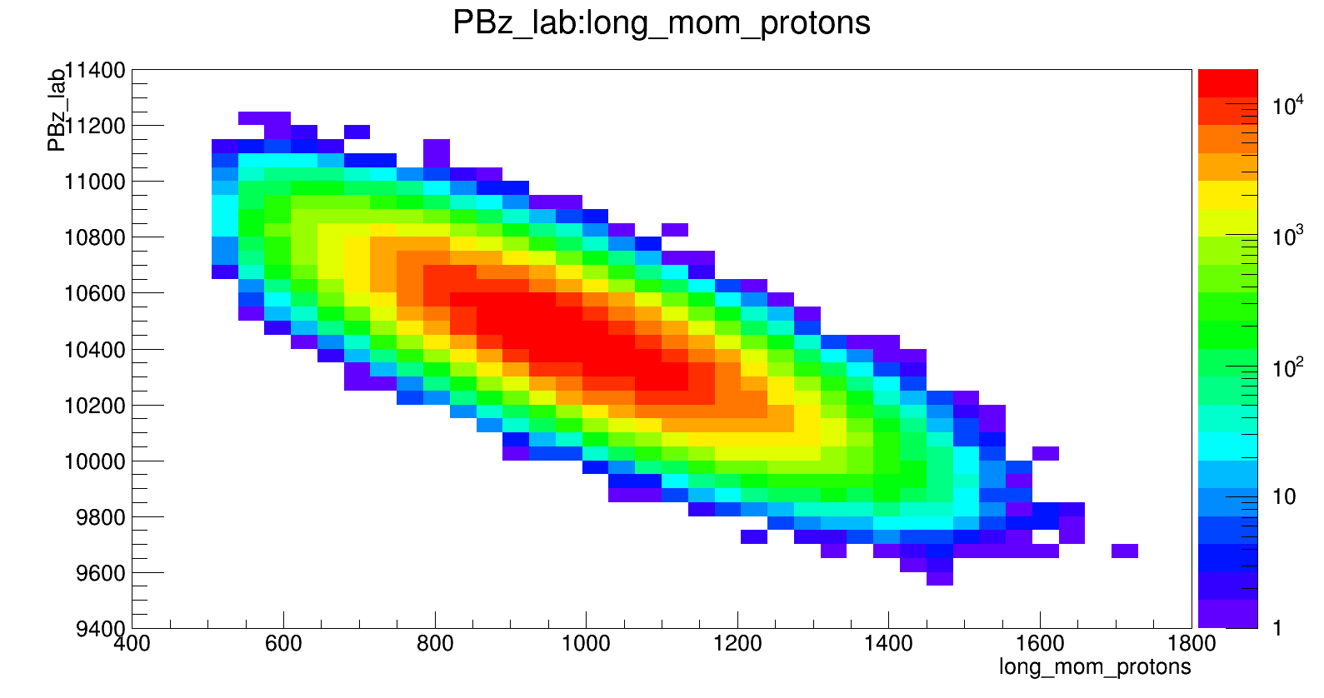
Simulation of the 12C(p,2p)11B reaction
Data:
Long. Mom p1p2 vs long. Mom. 11B

Slide 13
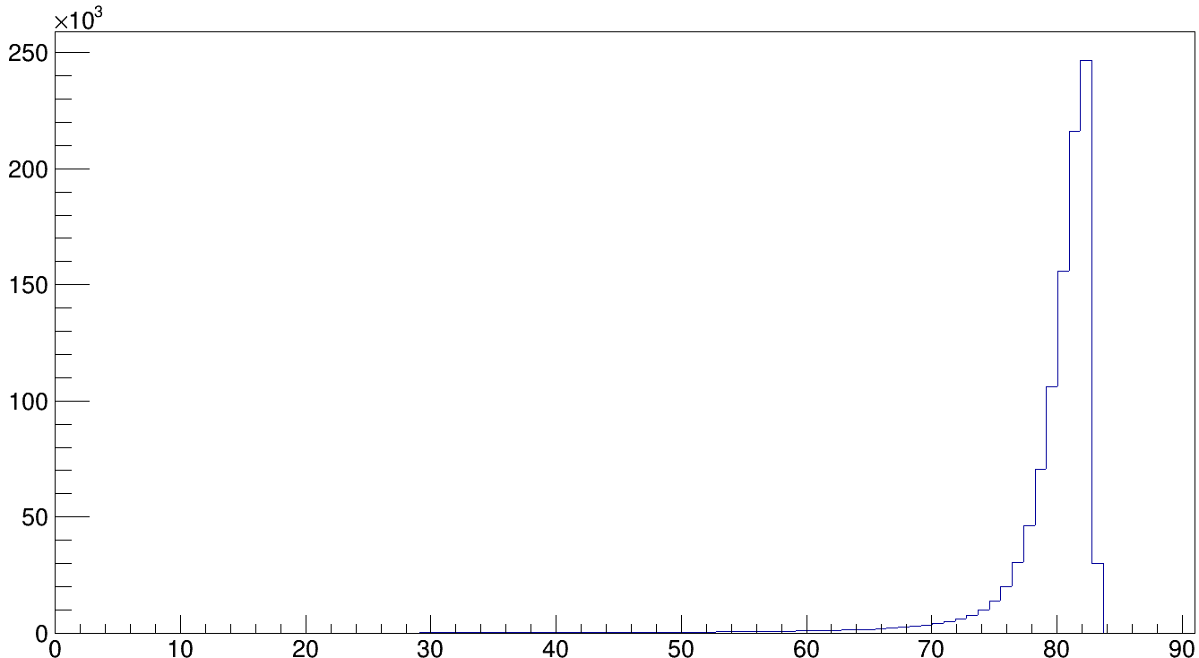
Simulation of Polar Angular Distribution
Simulation
Data
No. of Events
Theta1 plus Theta2 [degrees]
cut at ≈ 84 °

Slide 14
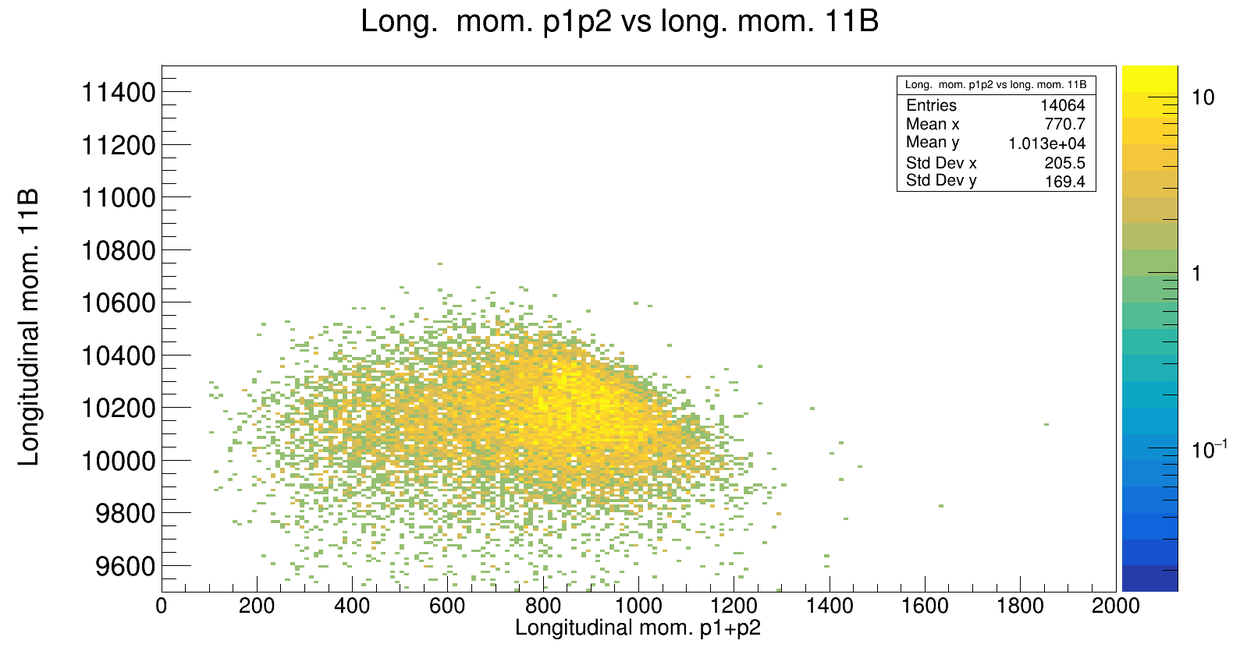
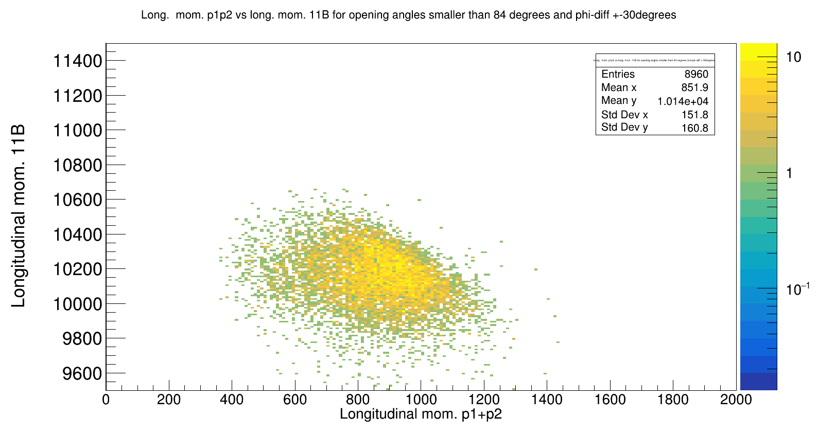
Polar and Arzimuthal Cuts
Polar cut: (p1+p2) < 84°
Arzimuthal cut: 180° +- 30° angular difference
with cut

Slide 15
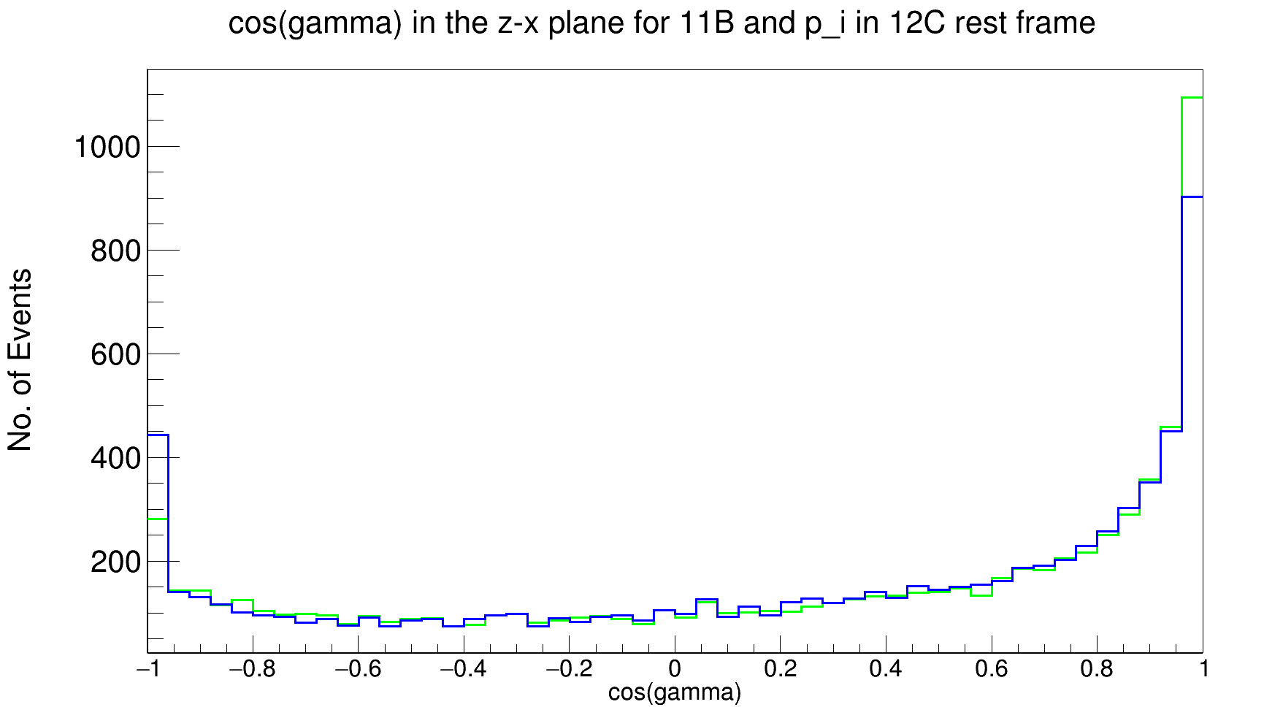
Boosting to 12C Frame
p_{i}
11B
y
green: using the arzimuthal angle of the crystal center
blue: sweeping +- 2.5° around the crystal center
→ sweep should also be done with polar angle
p1
x
p2

Slide 16
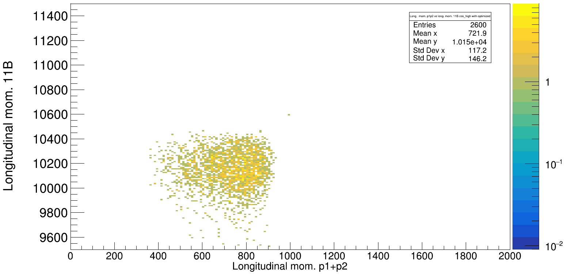
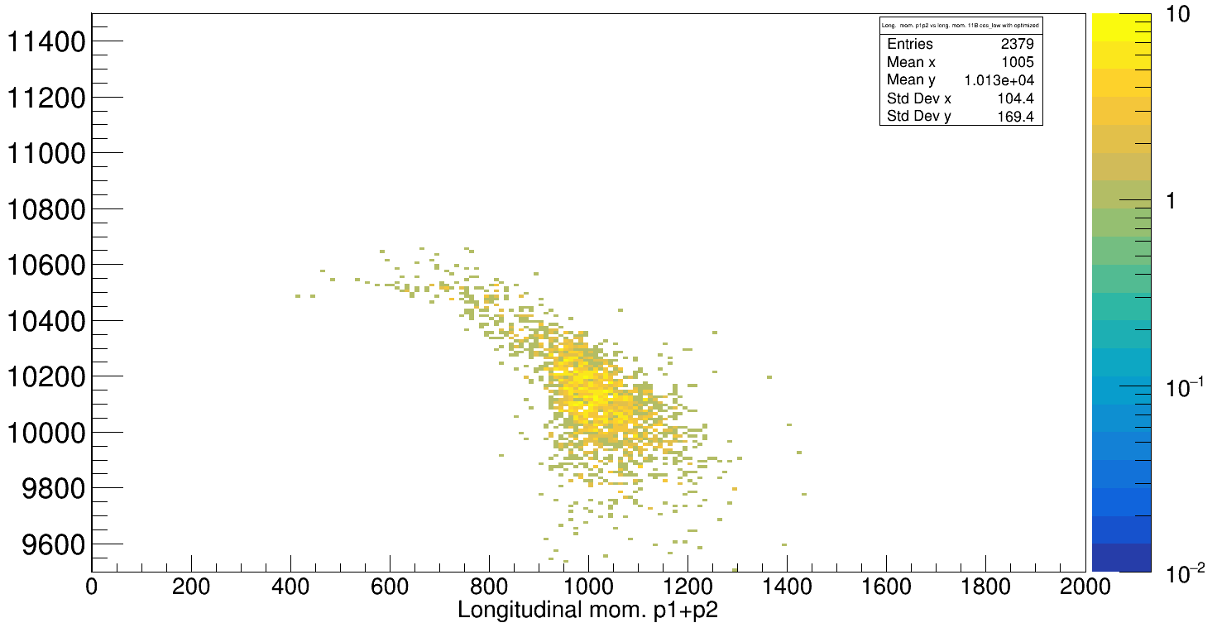
Using this info for momentum distribution plots...
cos(gamma) > -0.6 & polar/arzimuthal cuts:
cos(gamma) < -0.6 & polar/arzimuthal cuts:
Can this be improved??

Slide 17
CALIFA shifting
More some kind of consistency check
For this experiment CALIFA shift of 2.4 cm from nominal position toward SIS (see geometry files)

Slide 18
Does it change the pattern of the momentum distribution plots ?
Of course not!

Slide 19
Background analysis

Slide 20
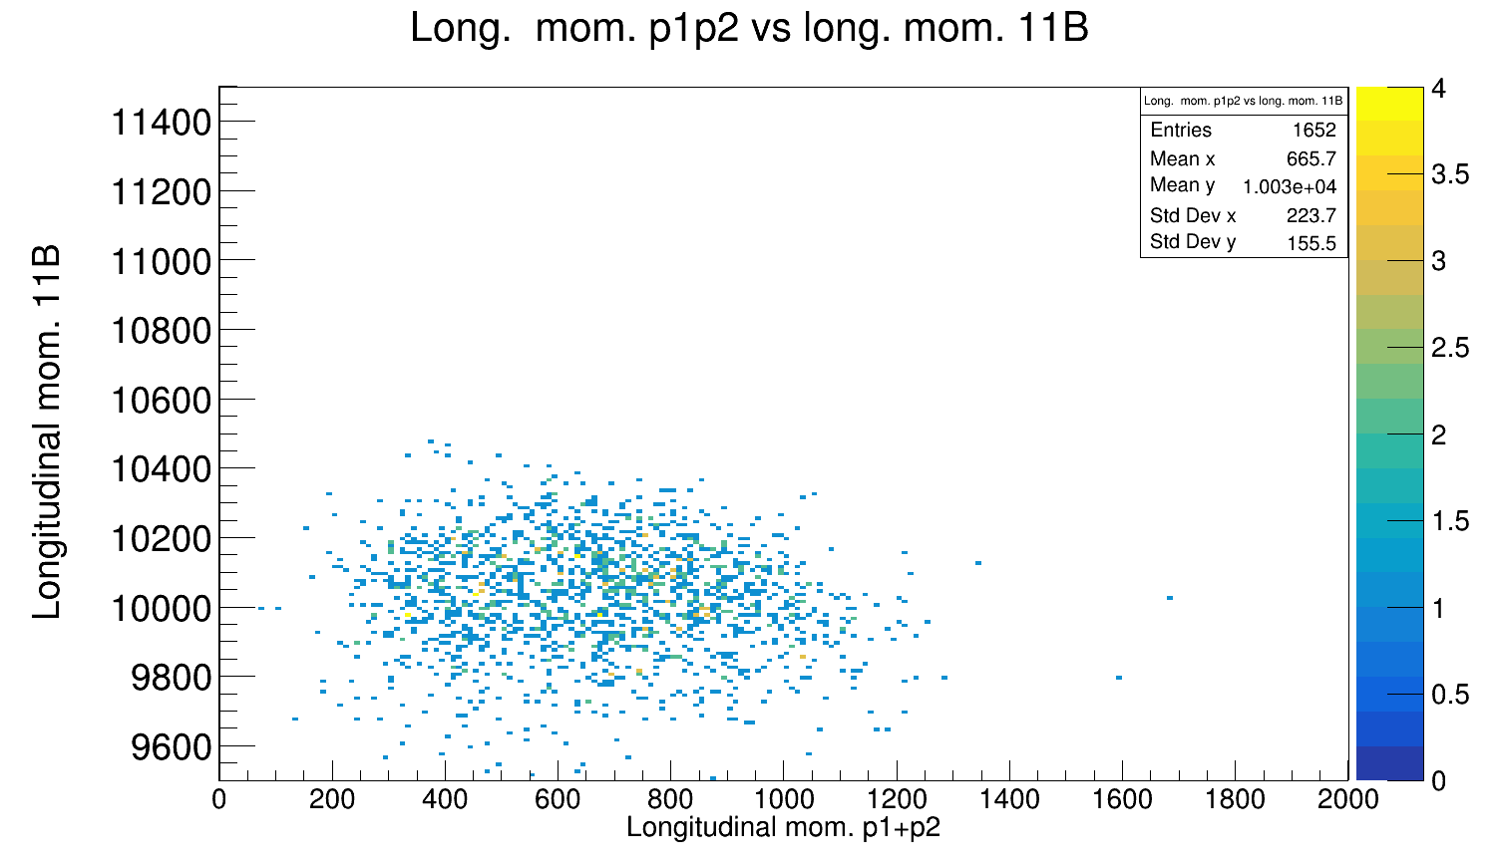
Background Analysis
With 5.4 mm carbon target:

Slide 21
Summary & Outlook
→ Particle Identification works out
→ Gamma spectrum and angular distribution plots look reasonable
→ Further investigations for momenta distributions of the outgoing particles needed
→ Expand analysis towards 10B isotope
Tobias Jenegger
11B Analysis with S455 Setup

Slide 22



CALIFA @ Technical University of Munich (TUM)
Roman Gernhäuser, Lukas Ponnath, Philipp Klenze, Tobias Jenegger
Thank you!

Slide 23
Backup

